Slide 1

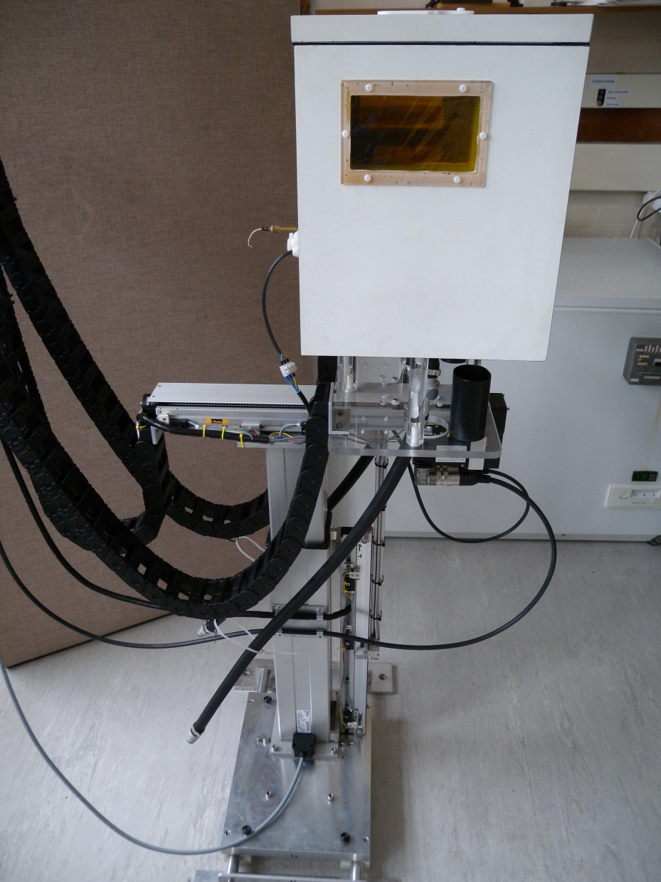


  The Birmingham Irradiation Facility
  Scanning System suitable for silicon & passive materials (with cooling)
H Marin-Reyes
R French
P Hodgson
P Dervan
J A Wilson

Slide 2
Index
  Irradiation using a MC40 Cyclotron
  Summary of the irradiation on the 14/06/12
  Offline dosimetry and Foils and Sensors
  Alibava setup and charge collection
  Chamber cooling performance
  Transfer line cooling tests
  Scanning Table and New Beam Area
  Irradiation Path Profiles

Slide 3
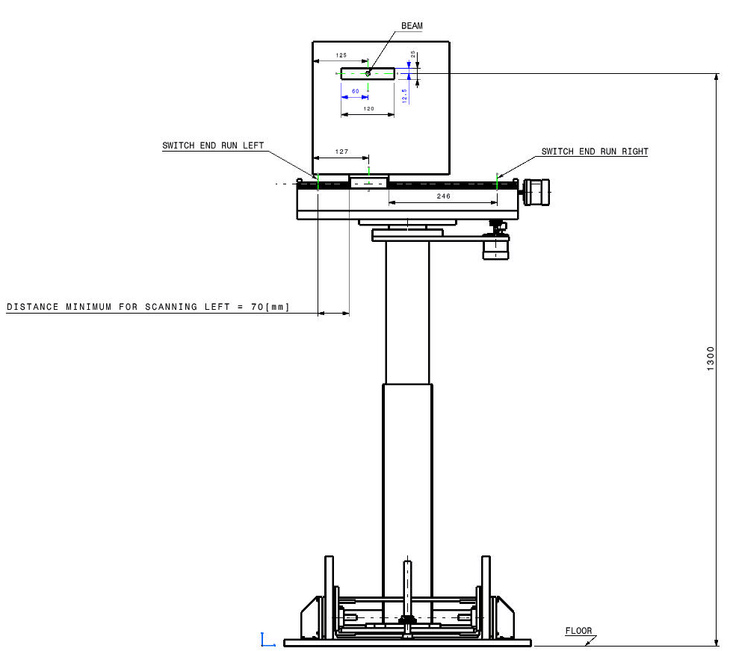
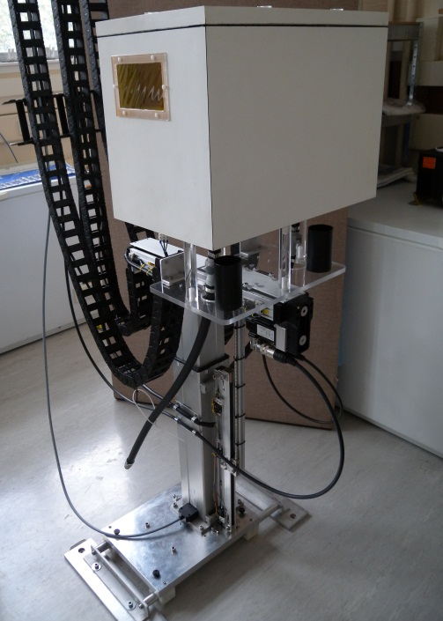
Irradiation using a MC40 Cyclotron
The University Birmingham, UK
History & Details
Scanning system + Thermal Chamber
  Fully portable plug & play scanning system
  Thermal chamber using similar principle to PS irradiation facility CERN (IRRAD 5)
    -22°C minimum operating temp
    ~ 480W heat load removal (@ -20°C).
    Recirculate cold air (forced convection)
  Readout and control system using COTS FPGA based technology
  Networked readout allowing remote access for data analysis and real-time sample performance
  Scanditronix MC40 variable energy cyclotron
  Maximum energies:
    40 MeV (protons or alphas)
    20 MeV (deuterons)
    53 MeV (3He)
  Produces tracers for the Positron Imaging Centre; related research projects; 81Rb production for sale to hospitals
Current status of facility
  2011 - Irradiations performed using 26MeV protons with a beam current of 0.4uA
  Dedicated beam line for higher beam currents of >0.8uA suited to detector activities ready in November 2012
  New shielding final installation Oct 2012 to allow for high energy running (custom high density concrete blocks)
  PIN Diode/ Titanium activation foil measurements made & calibrated ok
  Fibre optical ribbon jacket Irradiation carried out for ATLAS Upgrade 2012
  Possibility of linking to EU AIDA programme for user access to this facility 2013 onwards For more info: R French r.s.french@sheffield.ac.uk

Slide 4
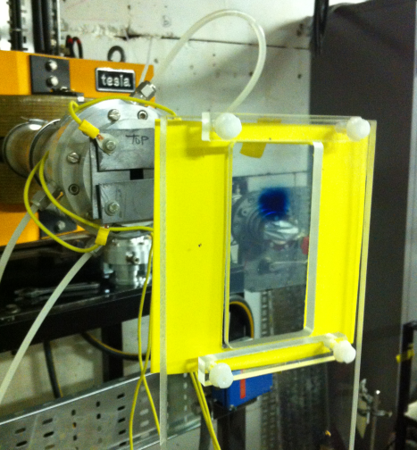
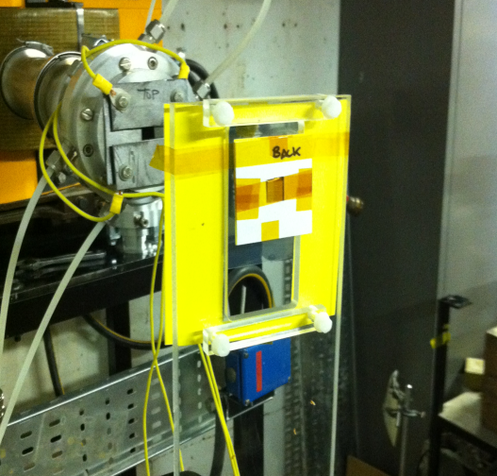
Summary of the irradiation on 14/06/12
Beam Line
  Run at a current of 0.5μA for 800 seconds to reach 2.5 × 10¹⁵ n_{eq}/cm²
  The faraday cup was also used to give an end time
  Both the time estimate and the faraday cup agreed with each other to within 1 second at the end of the run.
  Beam spot
  Sensors mounted in the beam line

Slide 5
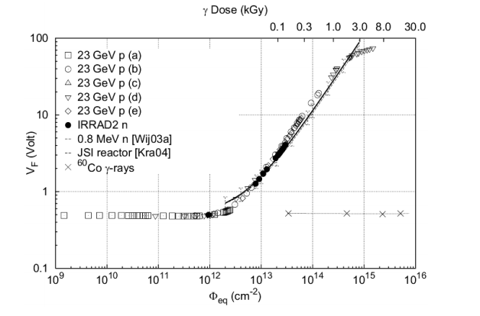
Offline dosimetry
  BPW32 measurements (F. Ravotti’s PhD Thesis)
  For more info: P Dervan Paul.dervan@cern.ch

Slide 6
Foils and Sensors
  Four 300μm thick ATLAS07 mini sensors (1 × 1cm2) were placed in the beam
  VPX73814-W148 BZ5-P11 (Back)
  VPX73814-W146 BZ6-P12
  VPX73814-W146 BZ5-P23
  VPX73814-W148 BZ6-P24 (Front)
  Example of an IV measurement, pre-irradiation)
  Example of a CV curve, pre-irradiation

Slide 7
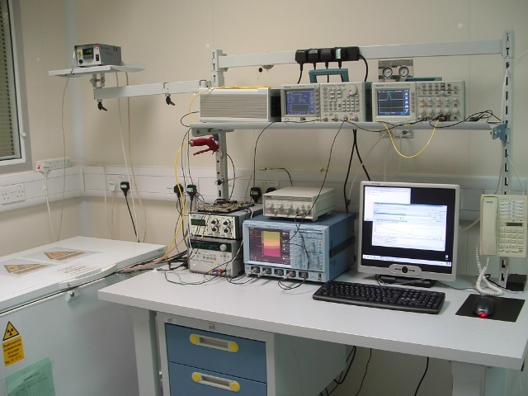
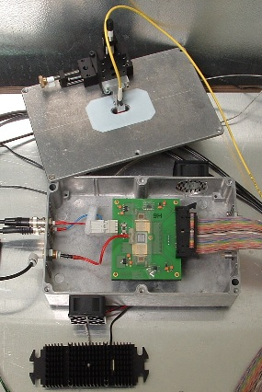
Alibava Setup
  Analogue readout based on the Beetle V1.5 chip(40 MHz readout speed)
  Signal generation with 370 Mbq 90Sr fast beta source for charge collection & sharing studies
  Detector attached to aluminium heat sink and cooled using fans to blow cold air over/under detector
  Scintilator/s placed under/ontop daughter board for single or coincidence trigger
  Cooling down to - 45 deg.C (ElCold EL11LT), 1deg.C hysteresis loop

Slide 8
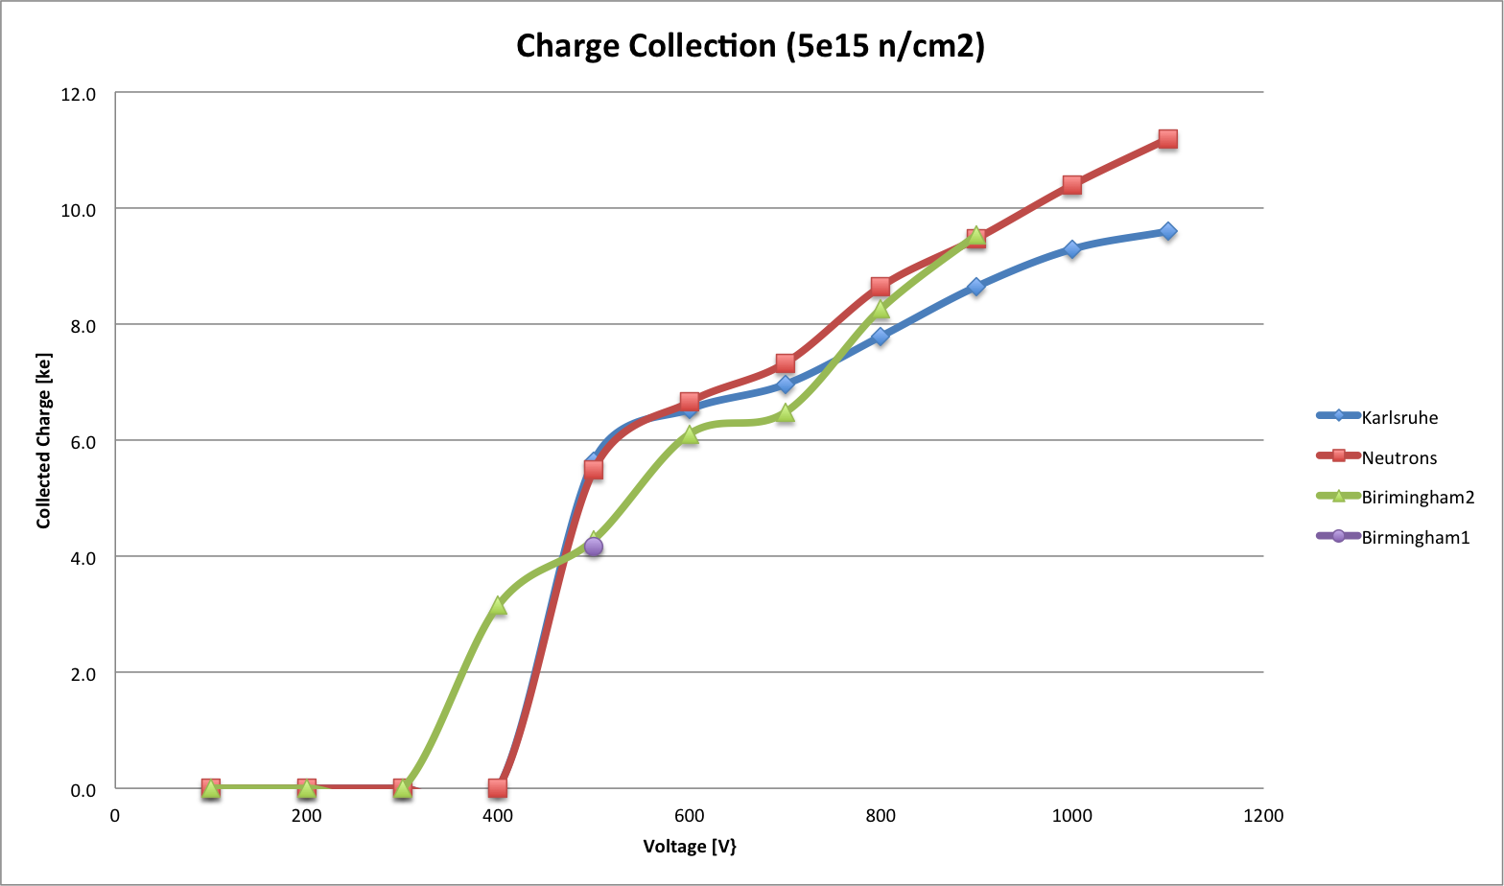
Charge Collection
  CCE measurements

Slide 9
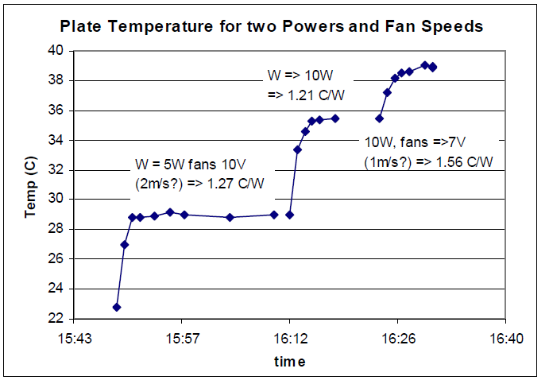
Chamber cooling performance
Dummy silicon heater tests using 100mm² Aluminium plates with Kapton film heaters
Chiller cooling the heated plate gives :
10W Sensor at -7C + Integrated hybrid => need to cool gas (N₂)to -22C
Chiller cooling heated plate gives DT ~ 1.5C/W => 1W sensor at -7C => cool the N₂ to -8.5 C
3x ATLAS Upgrade 250nm strip sensors 100mm² + hybrids, 2 fans at 10w, 12m of cooling circuit, 800w chiller power.
Sensors 3 x 1W + Hybrid: 10W
Fans: 10W
Ambient conduction (DT=35C): ~20W (estd.)
=> sub-total for HEX: ~30 – 40W (tested - ok! G.Beck et al 2009)
Conduction through insulation (2 x 6m) ~ 100W
=> total load for circulating chiller to remove ~ =< 150W or 50W per sensor
CONCLUSIONS
Thermal chamber and chiller have more than enough head room to cool multiple sensors (powered)
Temperature losses through transfer lines will be a problem if length exceeds 20m, loss per m is more dramatic the longer the length.

Slide 10
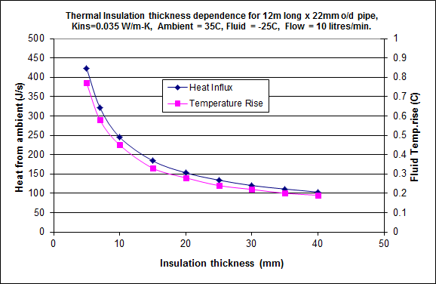
Transfer line cooling tests
Properties | Values
Material | Foamed nitrile rubber
Max. Surface Temperature | +105°C
Max. Temperature for Flat Surface | +85°C
Min. Surface Temperature | -200°C*
Thermal Conductivity at 0°C | 0.034 W/(m · K)
Thermal Conductivity at +20°C | 0.036 W/(m · K)
Thermal Conductivity at +40°C | 0.038 W/(m · K)
Thermal chamber to chiller system transfer line insulation performance
Based on Armacell data & samples
Chosen 30mm thick for optimal performance
Box insulation is a Styrofoam sourced from Dow - laminated with 0.8mm Aluminium (grounding & shielding) and 0.2mm white Formica (light tight rad hard, dust free
TESTED OK WITH THIS 800w SYSTEM UP TO 22.5m LONG

Slide 11
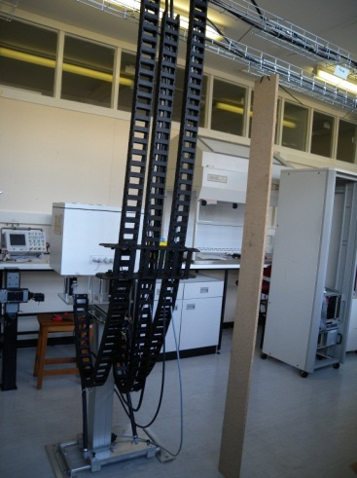
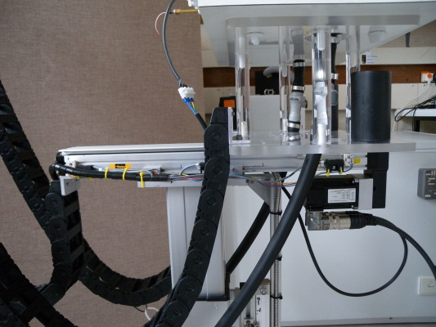
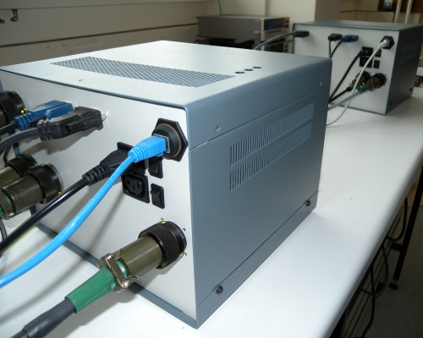
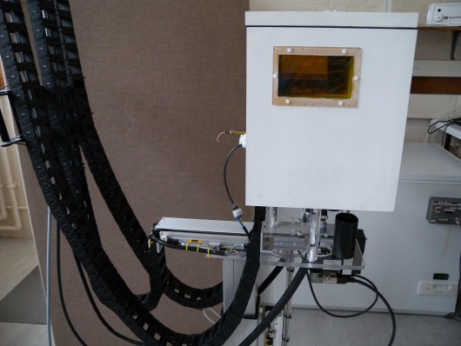
Scanning Table
Pre-configured XY-axis Cartesian Robot System
  It handles payloads up to 60 kg
  Speed: as low as 1 mm/s and as high as 360 mm/s (X-axis)
  Acceleration rates up to 20 m/s²
  Positional Accuracy ±50 μm (X-axis)
  This motion system can execute strokes up to 450 mm in X-axis, and 400 mm in Y-axis
  System driven by NI CompactRIO Real-Time controller and AKD Servo Drives with synchronized multi-axis motion using NI LabVIEW graphical programming.
  Overall unit length with a parallel mounted motor is 598mm long to reduce working space
  Motors and cables connect to the scanning table in a straightforward and simple manner.

Slide 12
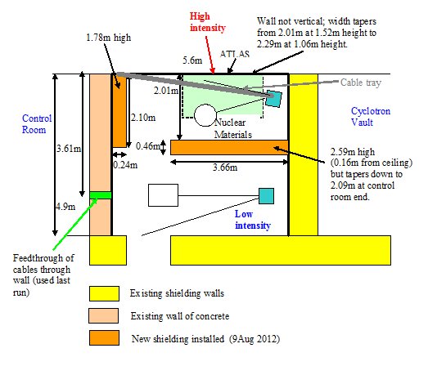
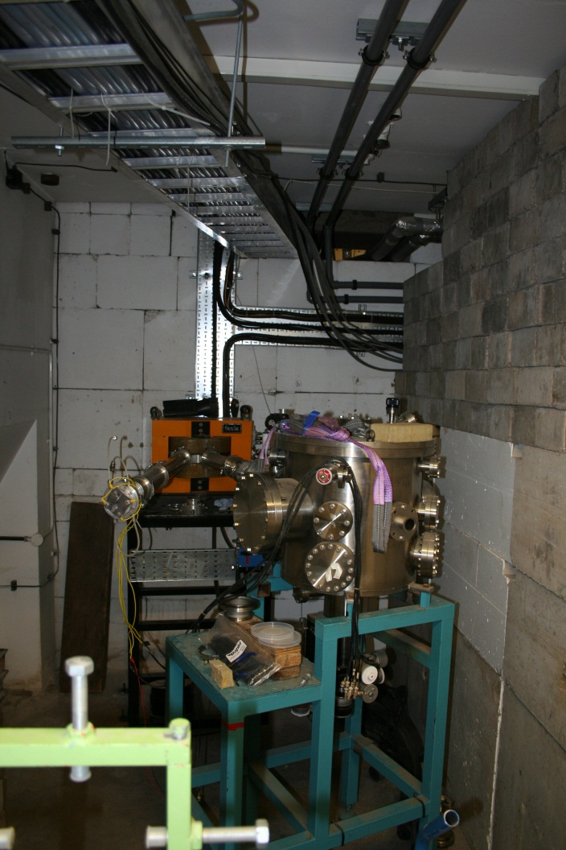
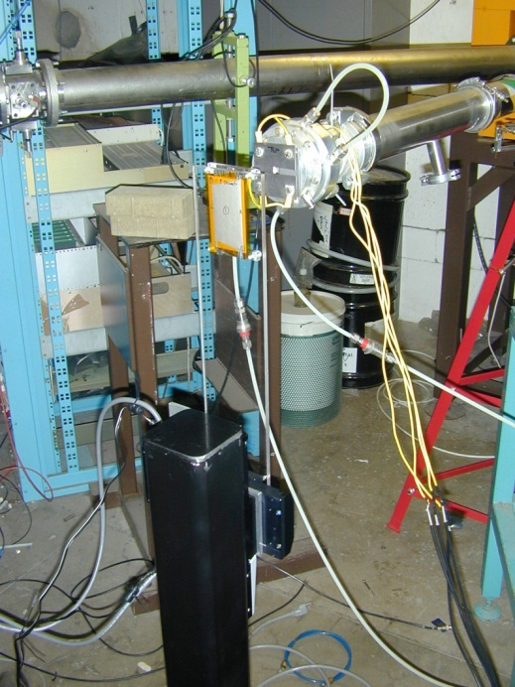
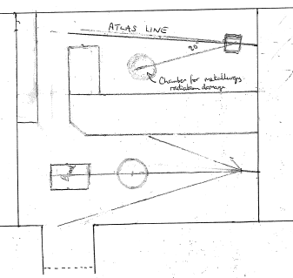
New Beam Area
Birmingham University, UK

Slide 13
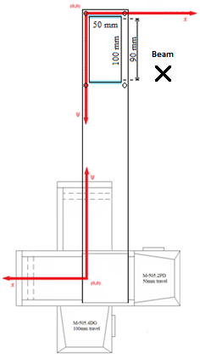
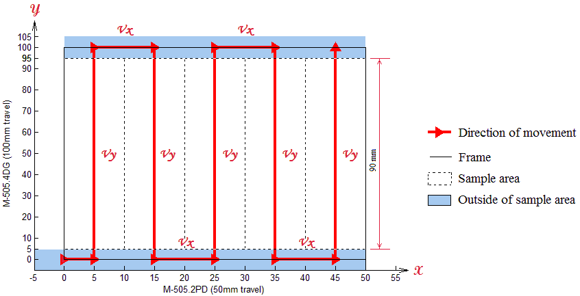
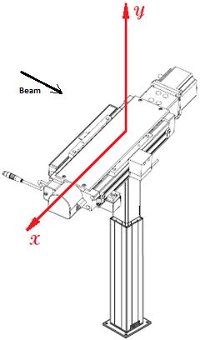
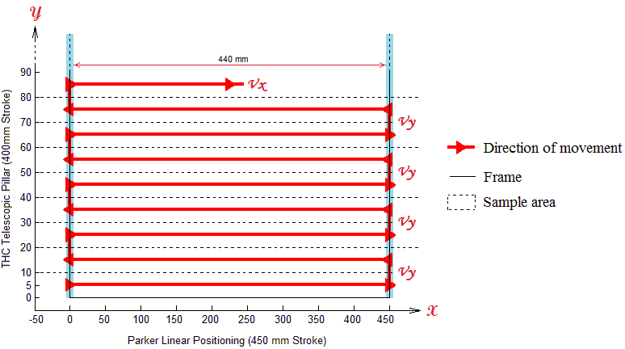
Irradiation Path Profiles
  Birmingham Irradiation (Nov 2011)
  New XY-axis Cartesian Robot System

Slide 14
Conclusions
  The Scanditronix MC40 located at Birmingham is easily capable of providing fluences for sLHC type applications
  Has provided successful irradiations of materials (e.g. Fibre optical ribbon jacket)
  New high energy beam area nearly ready for operation
  Plug and play portable irradiation system design that is easy to reproduce
  Dosimetry and activation measurements now fully tested and calibrated
  Detector test facilities proven and established
  Cooling system testing shows enough headroom to prevent annealing of sensors

Slide 15
THANK YOU

