Slide 1
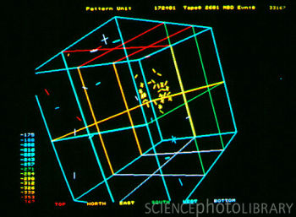
Neutrinos and the Universe
Susan Cartwright University of Sheffield

Slide 2
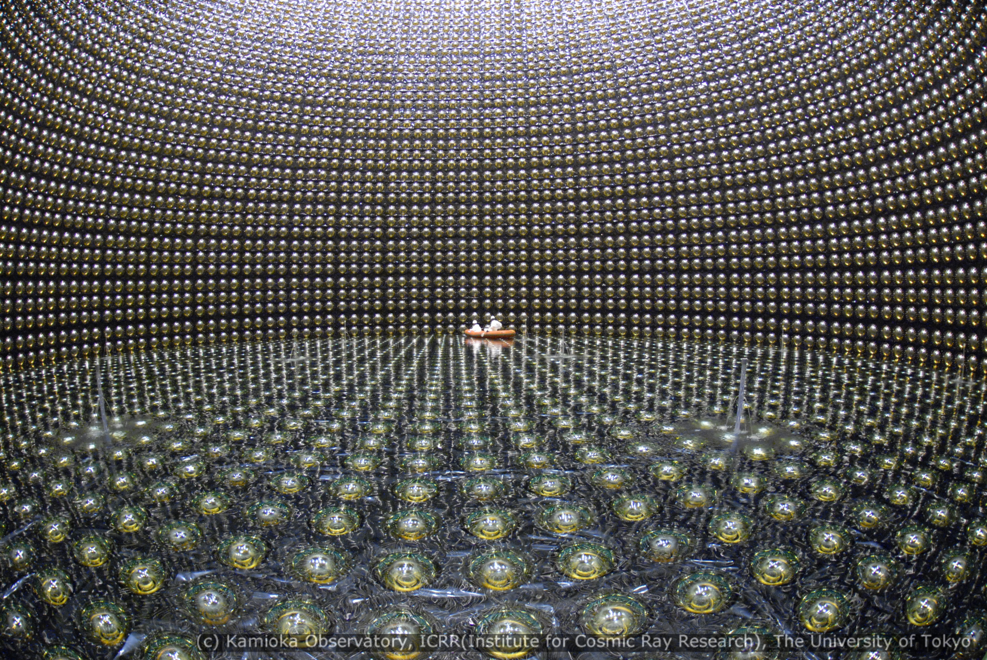
Neutrinos and the Universe
Discovering neutrinos
Detecting neutrinos
Neutrinos and the Sun
Neutrinos and Supernovae
Neutrinos and Dark Matter
Neutrinos and the Universe

Slide 3
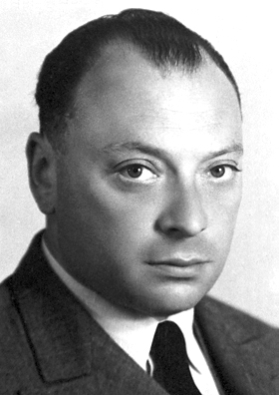
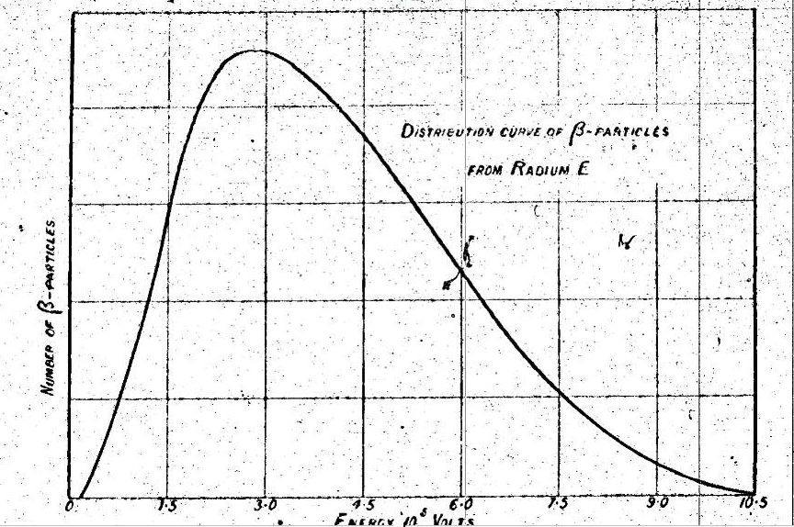
Discovering neutrinos
Neutrinos have
no charge
very little mass
very weak interactions with everything else
Why would anyone suspect their existence?
radioactive β decay X → X' + e⁻
Wolfgang Pauli suggested emission of an additional particle (1930)
+ ν̄_{e}
should have E = Δmc²
obviously doesn’t!
Ellis & Wooster, 1927

Slide 4
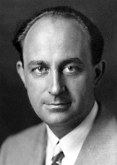
Discovering neutrinos
Fermi’s theory of weak force (1933) assumed the existence of the neutrino, but nobody had detected one directly
Pauli worried that he might have postulated a particle which was literally impossible to detect
Neutrinos interact so weakly that they are very hard to see
you need a very intense source to make up for the extremely small chance of any given neutrino interacting

Slide 5
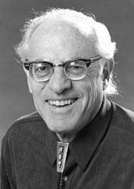
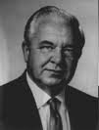
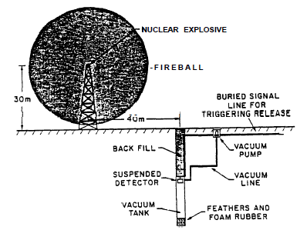
Discovering neutrinos
Enter Fred Reines and Clyde Cowan (1950s)
Plan A: use a bomb!
lots of neutrinos from fission fragments
detect via ν͞_{e} + p → e⁺ + n
problem—need your detector to survive the blast...
detect γ rays produced when it annihilates with e⁻
late γ rays emitted when it is captured by a nucleus

Slide 6
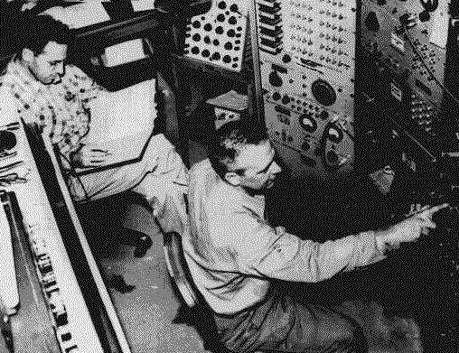
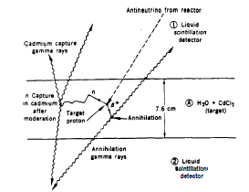
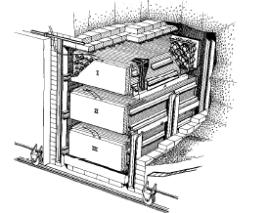
Discovering neutrinos
Enter Fred Reines and Clyde Cowan (1950s)
Plan B: use a nuclear reactor
lots of neutrinos from fission fragments
detect via ν͞_{e} + p → e⁺ + n
detector survives... can repeat experiment
detect γ rays produced when it annihilates with e⁻
late γ rays emitted when it is captured by a nucleus

Slide 7
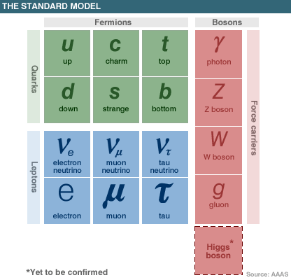
Neutrinos and their friends
Standard Model of particle physics has three different neutrinos
each associated with a charged lepton
All have similar properties
no charge and almost no mass
interact only via weak force and gravity
apparently completely stable
Recognise difference when they interact
each will produce only its own charged lepton

Slide 8
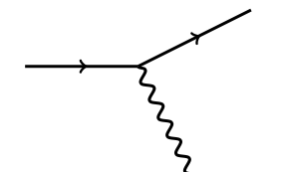
Detecting neutrinos
Neutrinos interact in two ways:
charged current
neutrino converts to charged lepton (electron, muon, [tau])
you detect the lepton
neutral current
neutrino just transfers energy and momentum to struck object
you detect the recoil, or the products when it breaks up
Either way you need a cheap method of detecting charged particles—usually leptons
ν_{ℓ}
ℓ
W
ν_{ℓ}
ν_{ℓ}
Z

Slide 9
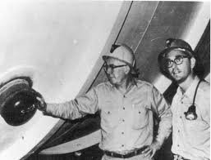
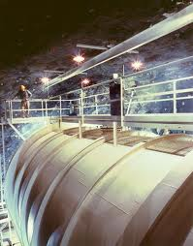
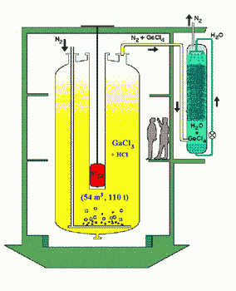
Detecting neutrinos
Radiochemical methods
neutrino absorbed by nucleus converting neutron to proton
new nucleus is unstable and decays
detect decay
no directional or timing information
but good performance at low energies
used for solar neutrinos
³⁷Cl, ⁷¹Ga

Slide 10
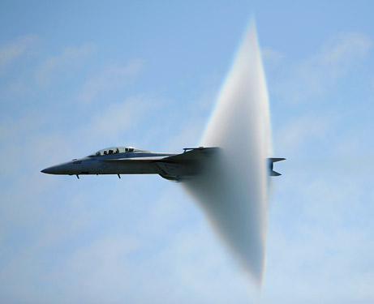
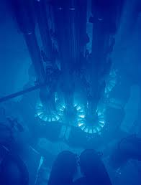
Detecting neutrinos
Cherenkov radiation
nothing travels faster than the speed of light in a vacuum
but in transparent medium light is slowed down by factor n
charged particles aren’t
result: particle “outruns” its own electric field, creating shock front similar to sonic boom
seen as cone of blue light
good directional and timing information, some energy measurement

Slide 11
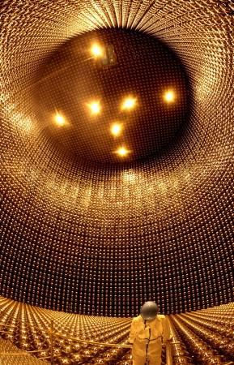
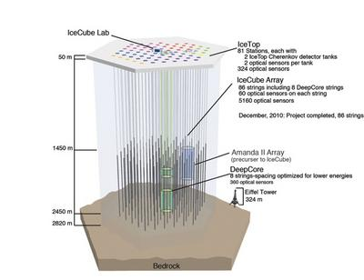
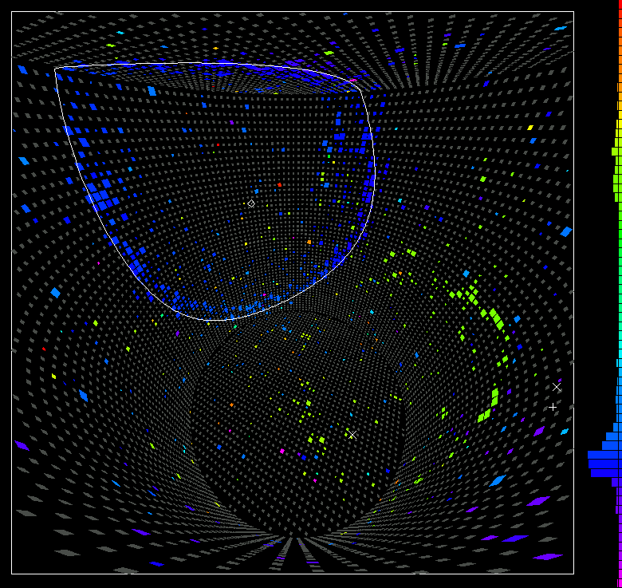
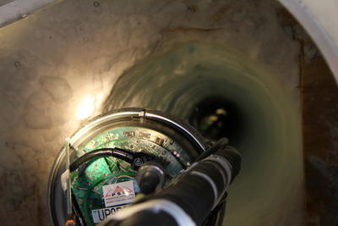
Detecting neutrinos

Slide 12
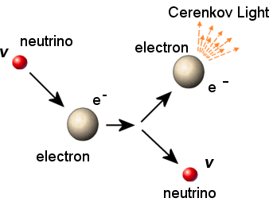
Neutrinos and the Sun
The Sun fuses hydrogen to helium
4 ¹He → ⁴He + 2e⁺ + 2ν_{e}
65 billion neutrinos per square centimetre per second at the Earth
unfortunately rather low energy, so difficult to detect even by neutrino standards
radiochemical experiments detected too few neutrinos
so did water Cherenkovs
Solar Neutrino Problem

Slide 13
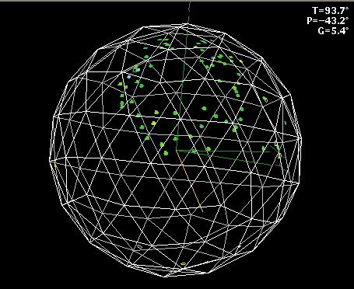
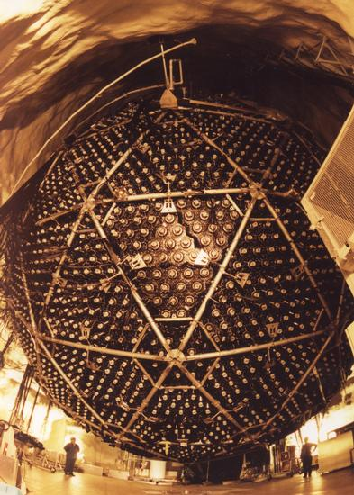
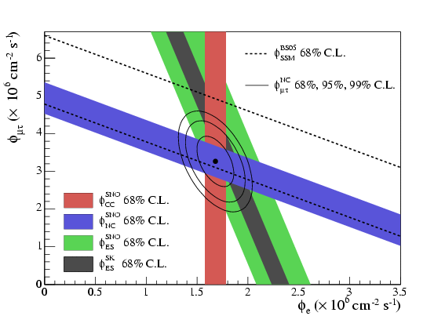
Neutrinos and the Sun
Solar problem or neutrino problem?
need to count all neutrinos—not just those associated with electrons
SNO experiment
heavy water
ν_{e} + d → p + p + e⁻
ν + d → p + n + ν
ν + e⁻ → ν + e⁻
total number fine—neutrinos change their flavour

Slide 14
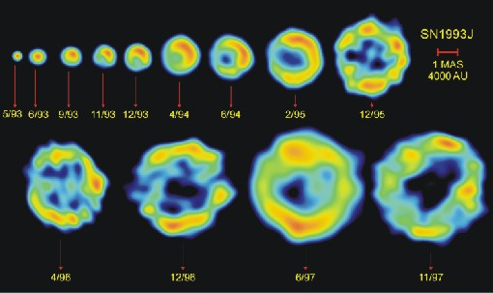
Neutrinos and supernovae
Massive stars explode as supernovae when they form an iron core which collapses under gravity
neutron star formed: p + e⁻ → n + ν_{e}
also thermal neutrino production, e.g. e⁺e⁻→νν̄
99% of the energy comes out as neutrinos
and neutrinos drive the shock that produces the explosion

Slide 15
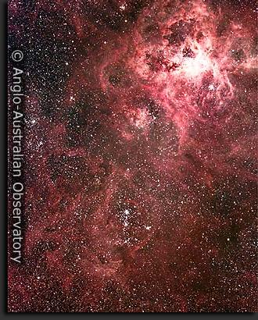
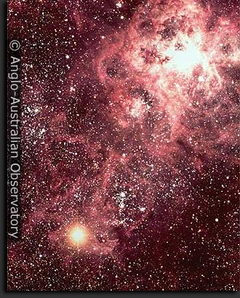
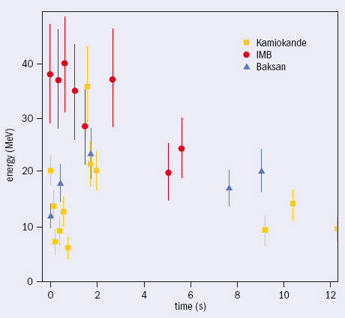
Supernova 1987A
In Large Magellanic Cloud, 160000 light years away
First naked-eye SN for nearly 400 years
20-25 neutrinos detected

Slide 16
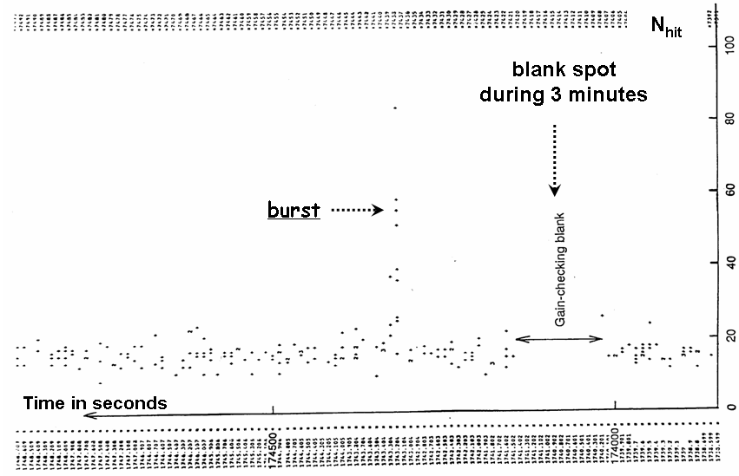
Kamiokande nearly missed the SN because of routine calibration, which took the detector offline for 3 minutes just before the burst...
...needless to say they changed their calibration strategy immediately aferwards so that only individual channels went offline!
...and IMB were missing ¼ of their PMTs as a result of a high-voltage trip—fortunately they were able to recover data from the working tubes

Slide 17
Neutrinos and Dark Matter
If neutrinos change type
which they do, as shown by solar neutrino results
then they must have (different) masses
essentially to provide an alternative labelling system
Neutrinos are very common in the cosmos
~400/cc
so could massive neutrinos solve the dark matter problem?
note that “massive” neutrinos have very small masses—travel close to speed of light in early universe (hot dark matter)

Slide 18
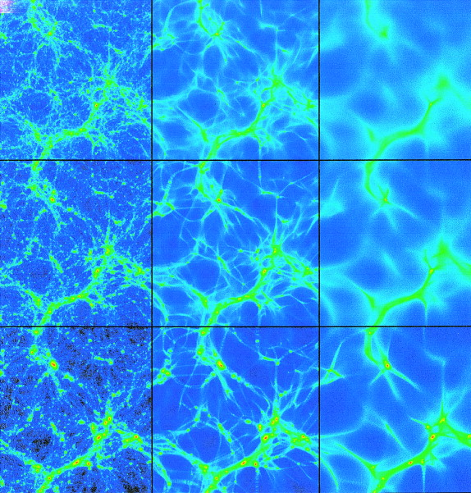
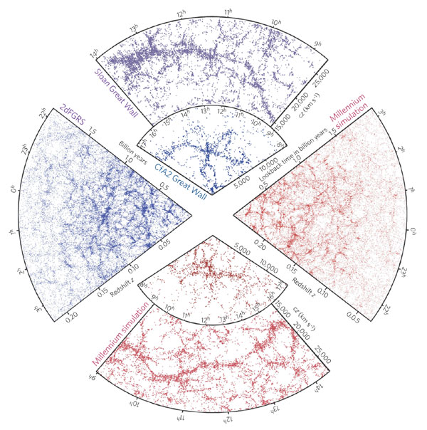
“Hot” and “cold” dark matter
Faster-moving (“hot”) dark matter smears out small-scale structure
Simulations with cold dark matter reproduce observed structures well
Dark matter is not massive neutrinos

Slide 19
Neutrinos and the Universe
Matter in the Universe is matter
not 50/50 matter/antimatter
why not?
masses of matter and antimatter particles are the same
interactions almost the same
should be produced in equal quantities in early universe
Sakharov conditions for matter-antimatter asymmetry
baryon number violation
to get B>0 from initial B=0
lack of thermodynamic equilibrium
to ensure forward reaction > back reaction
CP violation

Slide 20
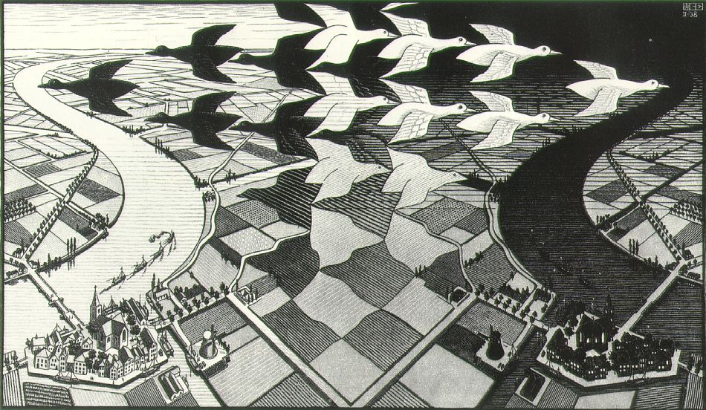
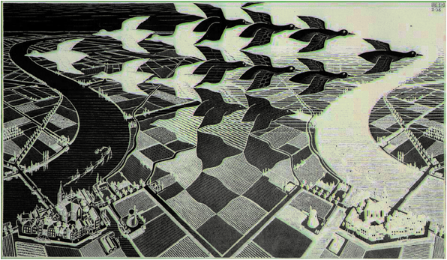
What is CP violation?
C = exchange particles and antiparticles
P = reflect in mirror (x,y,z) → (-x,-y,-z)
CP = do both

Slide 21
Neutrinos and CP violation
Standard Model nearly but not quite conserves CP
CP violation observed in decays of some mesons (qq̄ states)—K⁰, B⁰
however this is not enough to explain observed level of asymmetry
neutrino sector is the other place where CP violation expected
consequence of flavour changes
need all three types of neutrinos to be involved

Slide 22
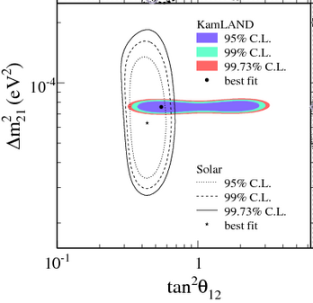
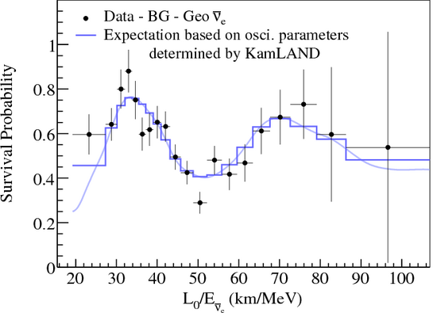
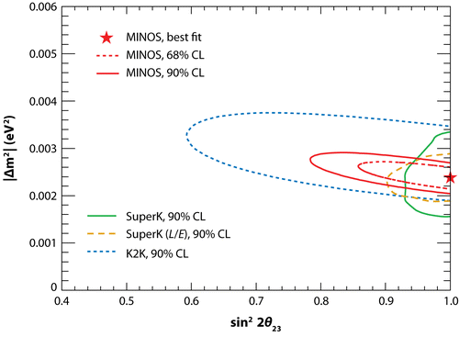
Neutrino Oscillations
Solar neutrinos
Atmospheric neutrinos
ν_{e} into either ν_{μ} or ν_{τ}
established by SNO
ν_{μ} into ν_{τ}
established by Super-Kamiokande

Slide 23
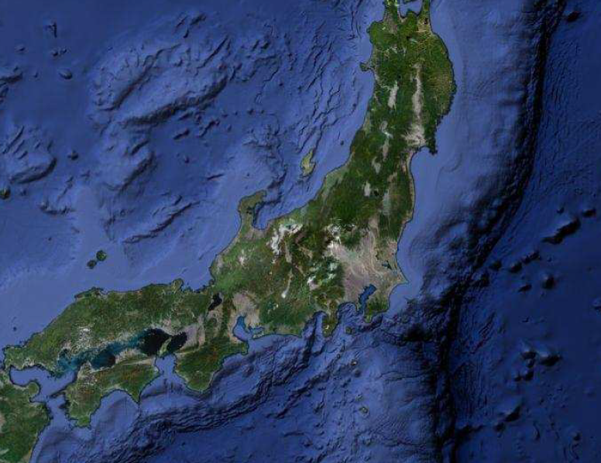
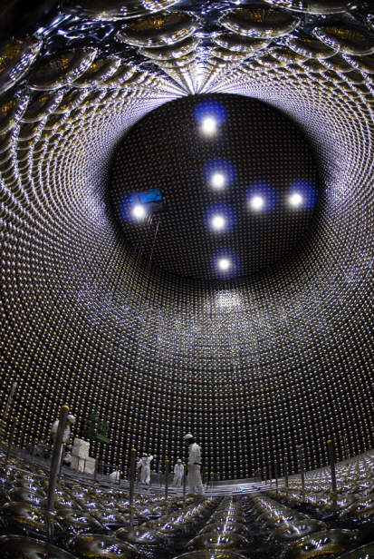
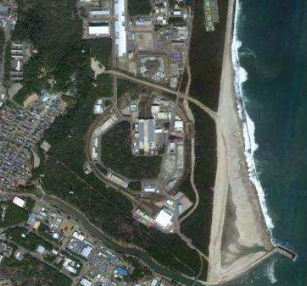
The third neutrino oscillation
Kamioka
Tokai
295 km

Slide 24
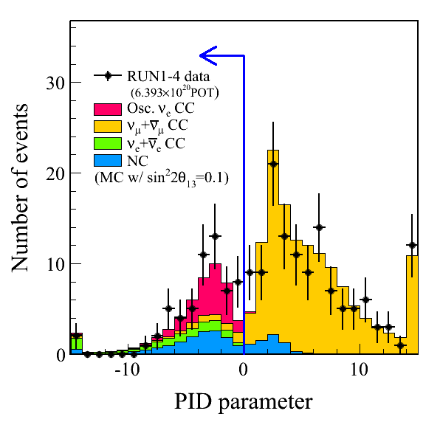
T2K measurement
Make ν_{μ} beam—search for ν_{e} appearance
Find 28 events
expect 4 or 5 background
for normal hierarchy

Slide 25
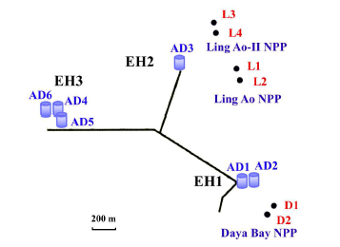
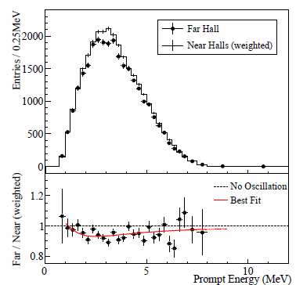
Reactor experiments
Observe disappearance of low-energy ν̄_{e} (energy too low to see expected ν̄_{μ})
Good signals from Daya Bay (China), RENO (Korea), Double Chooz (France)
sin² 2θ₁₃ = 0.093 ± 0.009

Slide 26
Conclusion
Neutrinos are fascinating but difficult to study
Present and future neutrino experiments can tell us much about the Universe we live in
Watch this space!

