Slide 1
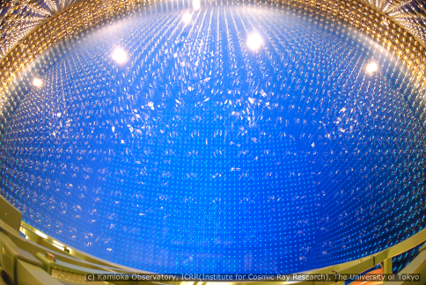
Neutrino Oscillations and T2K
Susan Cartwright
Neutrinos
Neutrino Oscillations
T2K

Slide 2
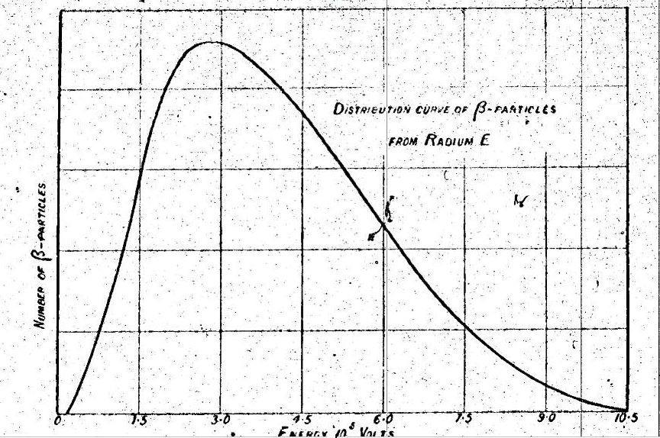
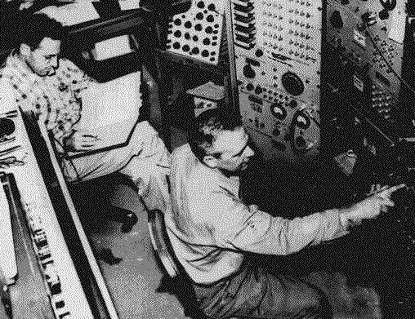
Neutrinos
Originally introduced to explain the properties of β-decay
energy released in decay is shared between e and ν
Experimentally discovered by Reines and Cowan
using inverse β-decay reaction ν̄ + p → e⁺ + n
Feel only the weak interaction (and gravity)—therefore very difficult to detect and study

Slide 3
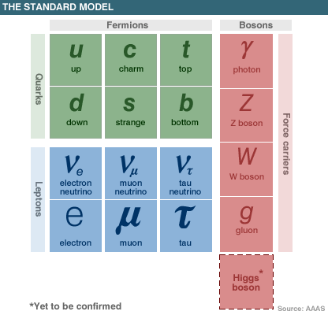
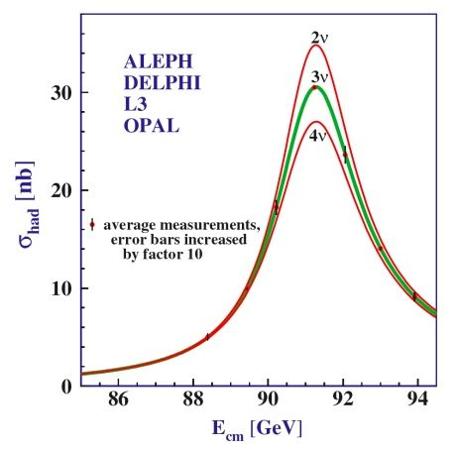
Neutrinos in the Standard Model
Three distinct types (flavours), one for each charged lepton
Lepton flavour number is a conserved quantity
Neutrinos are massless and left-handed
Neutrino physicists have spent most of the intervening period proving this wrong!

Slide 4
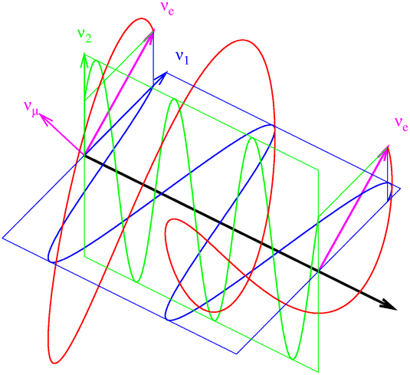
Neutrino Oscillations
Neutrino oscillations
Solar neutrinos
Atmospheric neutrinos
The third mixing angle

Slide 5
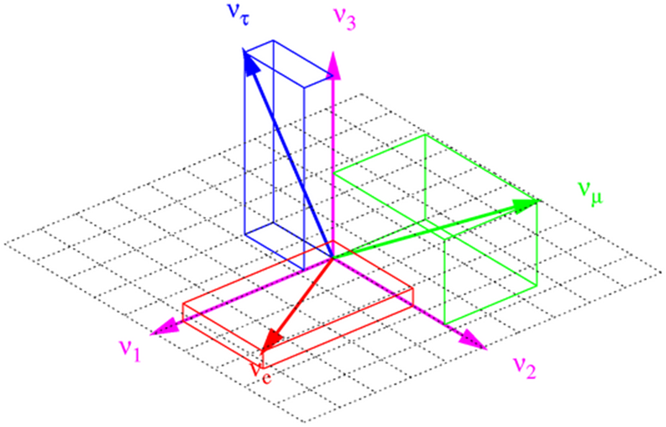
Neutrino Oscillations
There are three different types of neutrino
three different flavours, e, μ, τ
three different masses, m₁, m₂, m₃
These categories do not match—a pure flavour state is a mixed mass state and vice versa
the mathematics is the same as rotation of coordinates
can be expressed in terms of three mixing angles θ₁₂, θ₂₃, θ₁₃
exactly the same as the quark mixing matrix

Slide 6
Neutrino mixing matrix
Flavour and mass eigenstates are related by where
solar neutrinos
T2K, reactors
atmospheric neutrinos

Slide 7
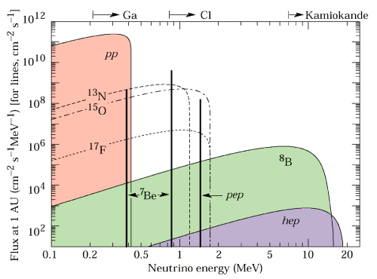
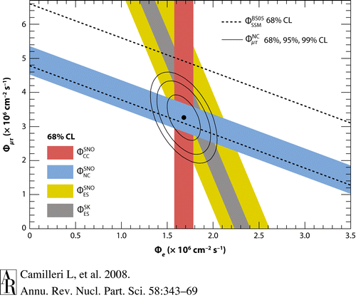
Solar neutrinos
Neutrinos are produced as a by-product of fusion
4 ¹H → ⁴He + 2e⁺ + 2ν_{e}
necessarily ν_{e} as there’s not enough energy to make muons
We know neutrino flux from Sun’s power output
we see too few ν_{e}
but experiments sensitive to all neutrino types see no deficit
ν_{e} transform to some other type

Slide 8
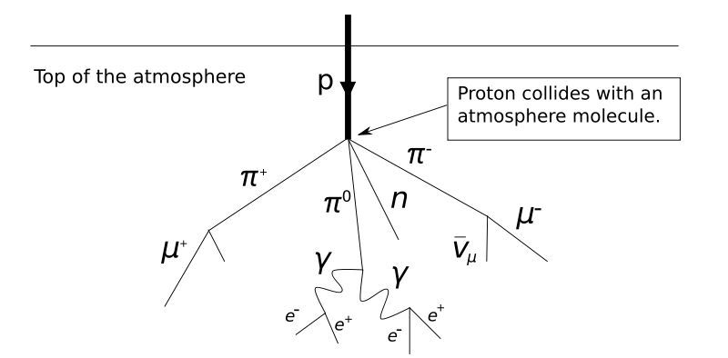
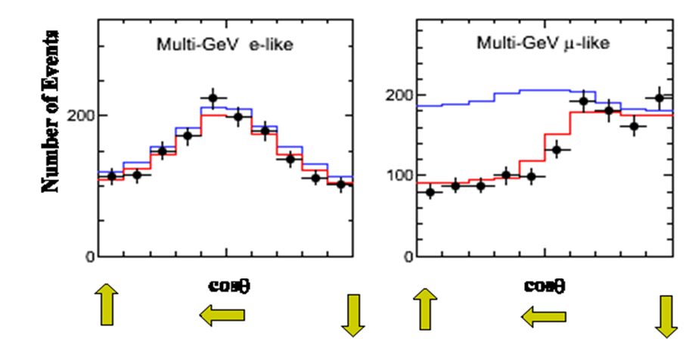
Atmospheric Neutrinos
ν_{μ}
Produced by cosmic rays interacting in the upper atmosphere
mixture of ν_{μ} and ν_{e} produced, roughly 2:1 ratio
Observe too few upward-going ν_{μ}
Conclusion: ν_{μ} convert to ν_{τ}
not ν_{e} because no excess of up- going ν_{e}
e⁺
ν̄_{μ}
ν_{e}
Number of Events
cos θ
cos θ

Slide 9
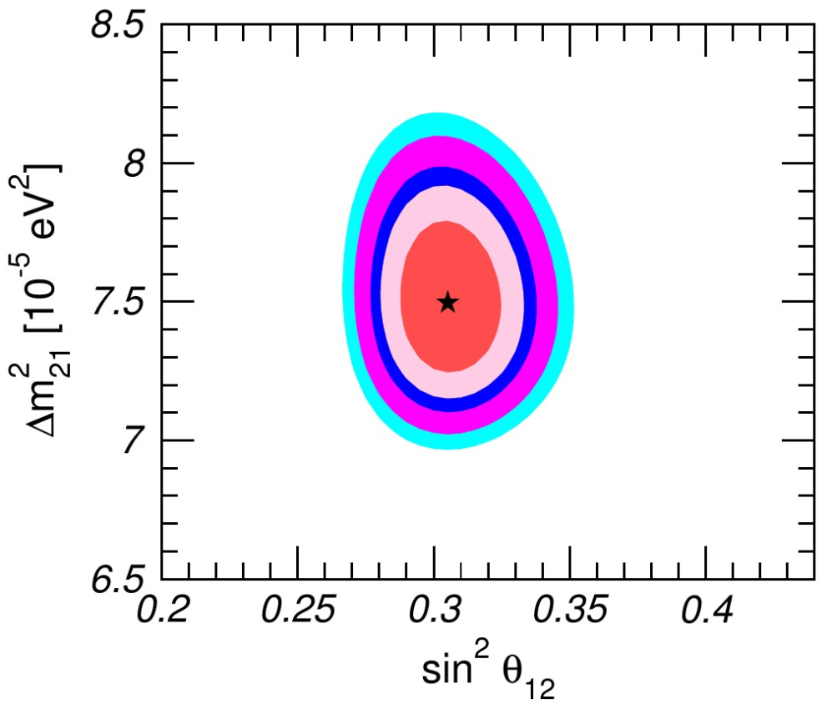
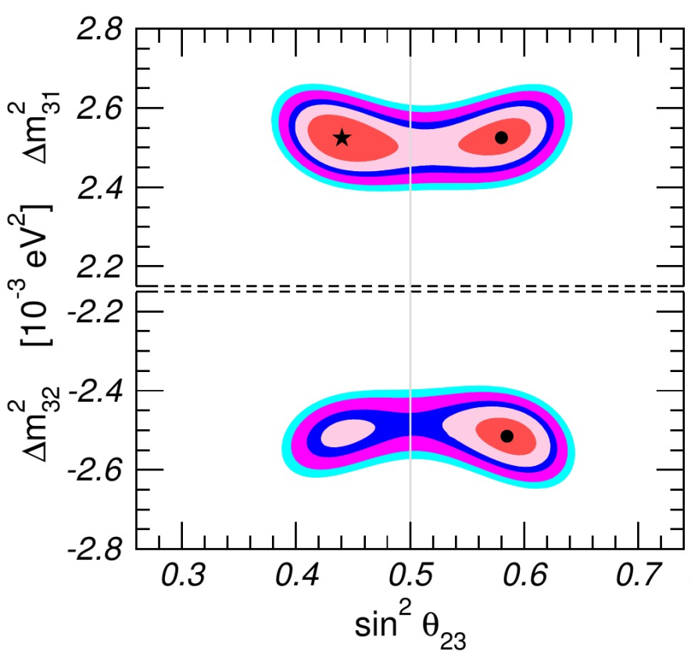
Neutrino Oscillation data
Both solar and atmospheric neutrino oscillations imply large mixing angles (33.6° and 38−53° respectively)
What about θ₁₃? It is not large—but is it zero?
NuFIT 3.0 (2016)

Slide 10
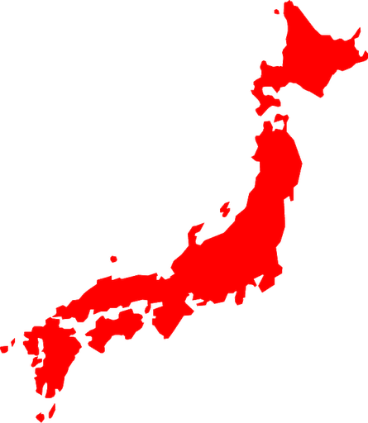
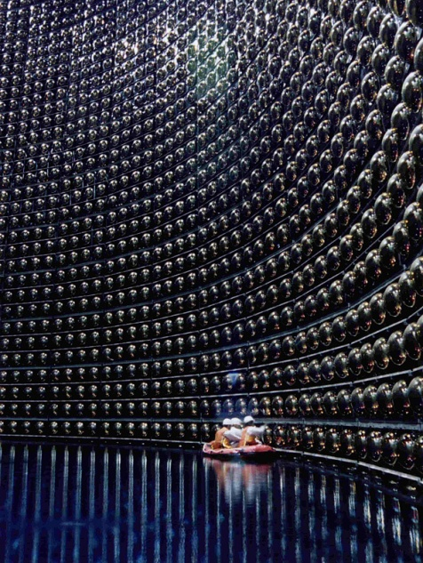
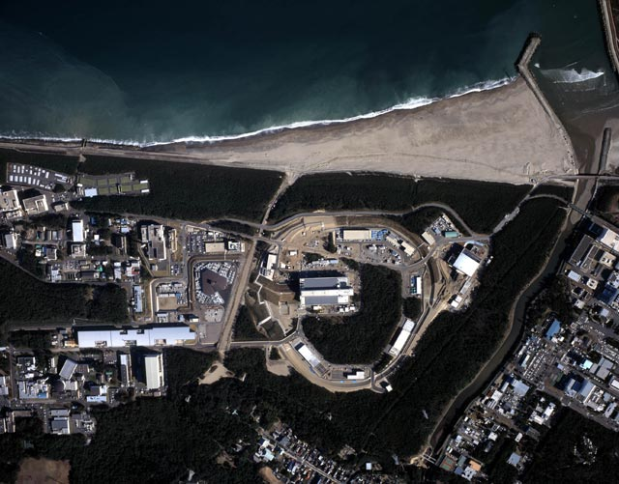
T2K and θ₁₃
The importance of θ₁₃
T2K
Results

Slide 11
The importance of θ₁₃
3-flavour mixing introduces the parameter δ
this distinguishes between matter and antimatter
this is important since we do not currently understand the fact that the universe is made of matter (only)
Neutrinos could possibly hold the key to our existence!

Slide 12
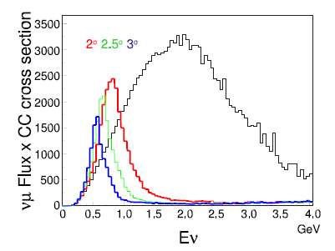
ν_{μ} beam made by allowing π⁺ to decay in flight
beam is not aimed directly at Super-K because energy distribution is narrower when beam is slightly misaligned (by 2.5°)
Signal for θ₁₃ is appearance of ν_{e}
disappearance of ν_{μ} mostly θ₂₃
Near detector characterises beam and measures intrinsic ν_{e} content
there is a bit, from K decays

Slide 13
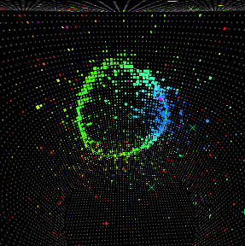
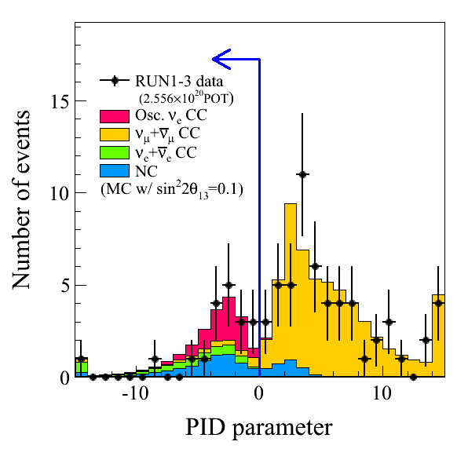
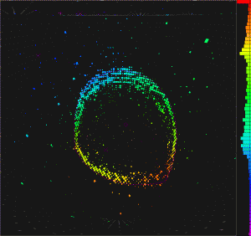
T2K analysis
28 events observed
4.92±0.55 expected
7.3σ effect
Super-Kamiokande measures Cherenkov radiation from e/μ produced in interaction
can distinguish the two based on ring morphology
fuzzy electron ring
sharp muon ring

Slide 14
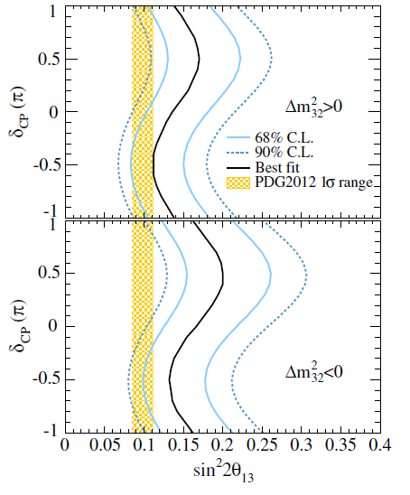
θ₁₃
disagreement points to δ_{CP} ≠ 0
T2K finds
assuming “normal hierarchy”
Reactor ν̄ experiments find similar results
Daya Bay sin² 2θ₁₃ = 0.089±0.008
RENO sin² 2θ₁₃ = 0.101±0.013
Note that reactor experiments measure ν̄_{e} disappearance not ν_{e} appearance

Slide 15
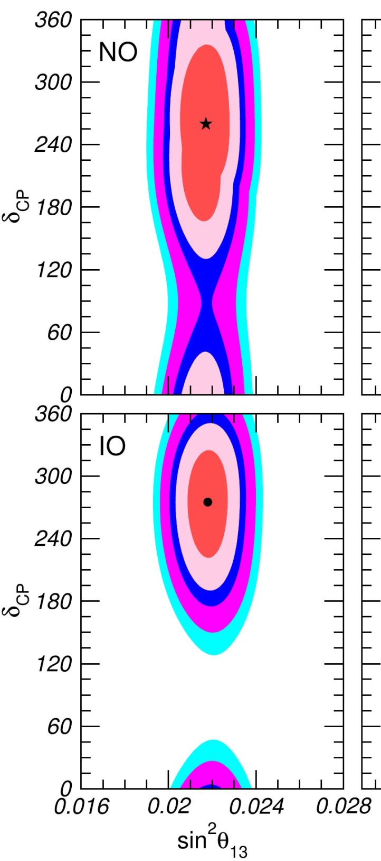
CP violation
Combining results from reactor and accelerator experiments favours a value of δ ~ 270°
However, the error bars are still very large (and any value of δ is allowed at 3σ)
We are very far from the 5σ that particle physics requires for a “discovery”
Await more data (and new experiments)
NuFIT 3.0 (2016)

Slide 16
Conclusions and Prospects
θ₁₃ is definitely not zero!
and there is a hint of matter-antimatter asymmetry
But we do not know
the ordering of the states in mass
how large the matter-antimatter asymmetry is
whether the neutrino sector has more surprises in store
there is some rather contradictory evidence for “sterile”, non-interacting, neutrinos in addition to the Standard Model flavours
At least they don’t travel faster than light!
Normal Hierarchy Inverted Hierarchy
3
2
1
Δm²(atm)
Δm²(sol)
2
1
3

