Slide 1
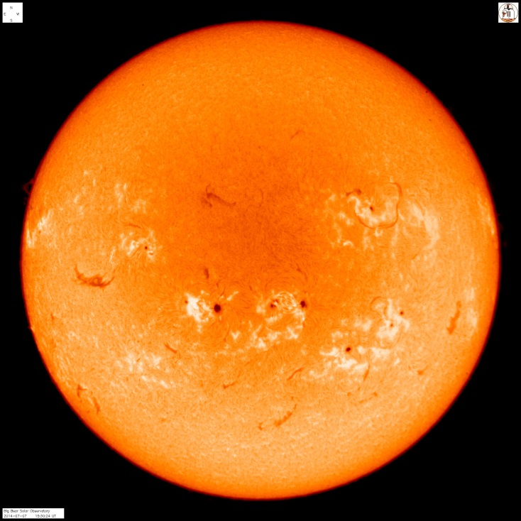
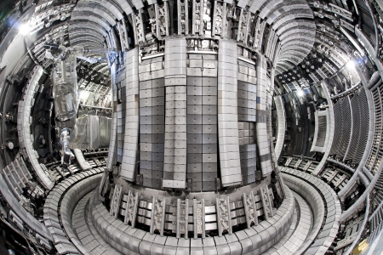
Fusion
Susan Cartwright

Slide 2
Nuclear Physics
Atoms consist of a nucleus surrounded by electrons
Chemistry is produced by interactions involving the electrons around the atom
this involves small energy changes (~0.01 eV) and can happen at room temperatures
our lives are dominated by chemical reactions
Nuclear physics is concerned with reactions of the atomic nuclei
these involve much larger energies (~MeV) and therefore normally happen at high temperatures
we are not so aware of nuclear reactions in our everyday lives, but they are critical to our existence

Slide 3
Why is nuclear physics important?
Naturally occurring nuclear reactions are crucial to our very existence
They power the Sun
They created most of the elements in your body (the exception being hydrogen)
Engineered nuclear reactions can also be useful
Medical applications
radiotherapy, PET scanners
Nuclear fission as a power source
much safer than most people think it is, and contributes less to global warming
Nuclear fusion as a power source?
“always 50 years away”?

Slide 4
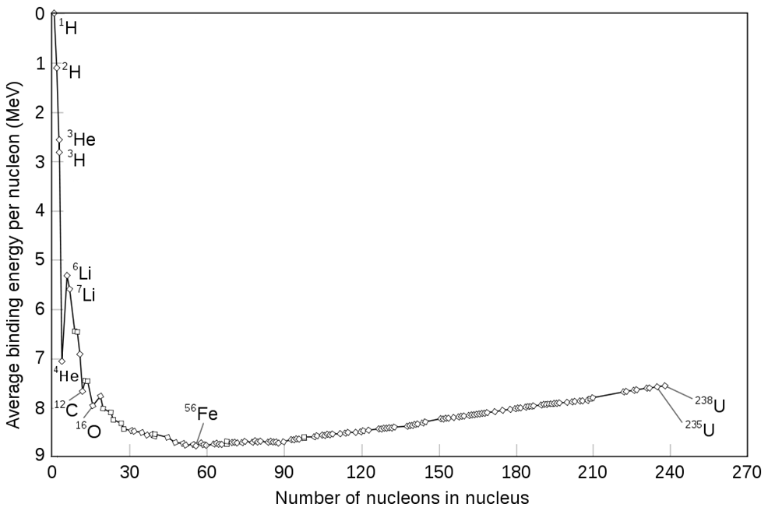
Why do nuclear reactions happen?
E = mc²
fusion
Fusion is a much more efficient energy source than fission
fission

Slide 5
Natural fusion: the Sun
Fuses hydrogen (¹H) to helium (⁴He)
4 ¹H → ⁴He + 2e⁺ + 2ν_{e}
converts about 0.7% of the initial mass to energy
~10% of the Sun’s initial hydrogen content will power it for 10 billion (10¹⁰) years

Slide 6
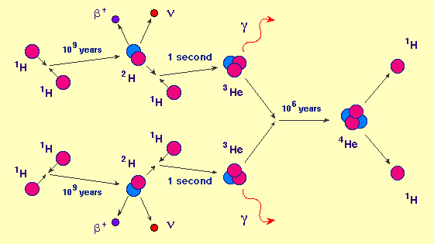
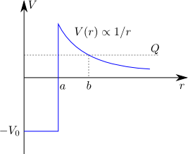
Natural fusion: the Sun
Fusing two protons together is difficult
they repel each other by the electrostatic force
classically you need temperatures of ~10¹⁰ K to overcome this
remember temperature = mean kinetic energy of particles
the Sun manages to do it at ~10⁷ K because of quantum tunnelling
still a very improbable reaction—the reason the pp chain is slow

Slide 7
Fusion in fusion reactors
Fuses deuterium (²H) with tritium (³H) to make helium (⁴He)
²H + ³H → ⁴He + n
about half as efficient as fusing ¹H (0.4% of initial mass converted to energy)
but much easier (do not need to convert any protons to neutrons—no weak interactions)

Slide 8
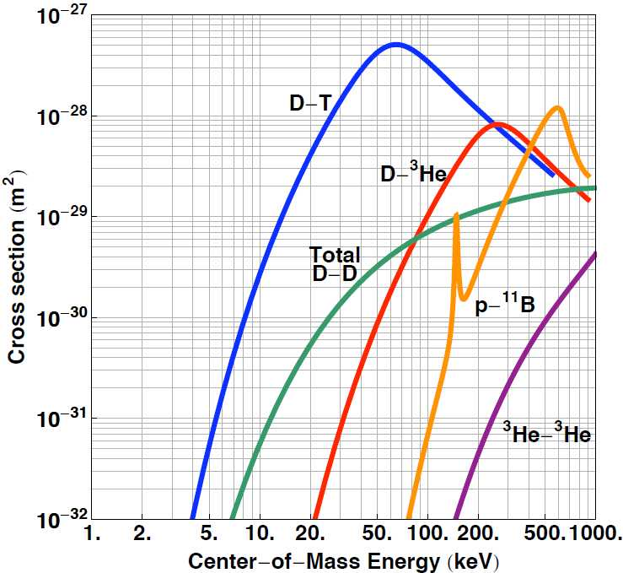
Why is this hard?
Still need temperatures of ~10⁹ K or so
can’t afford to wait for quantum tunnelling
Tritium is unstable
decays to ³He with a half- life of 12 years
so it does not occur naturally—you have to make it
The free neutron is potentially dangerous
can produce radioactive nuclei

Slide 9
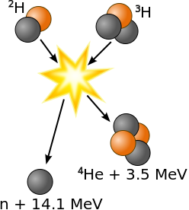
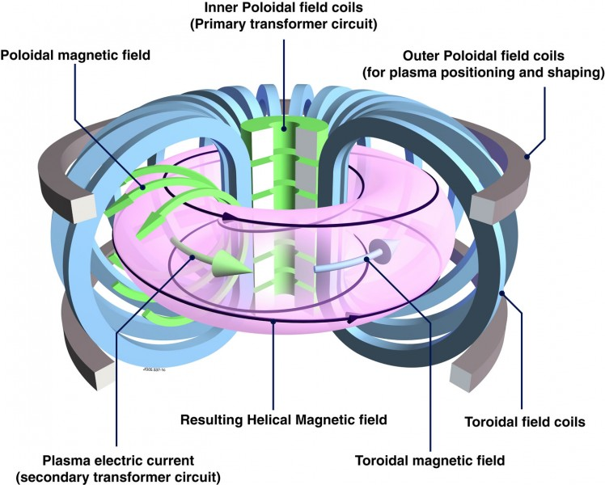
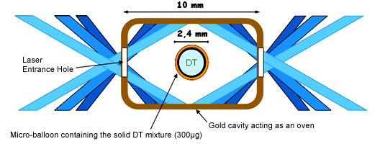
Fusion techniques
Tokamak
create extremely hot d-t plasma and confine with a magnetic field (it will vaporise anything it touches)
Inertial confinement
take small pellet of fuel and blast it with powerful lasers

Slide 10
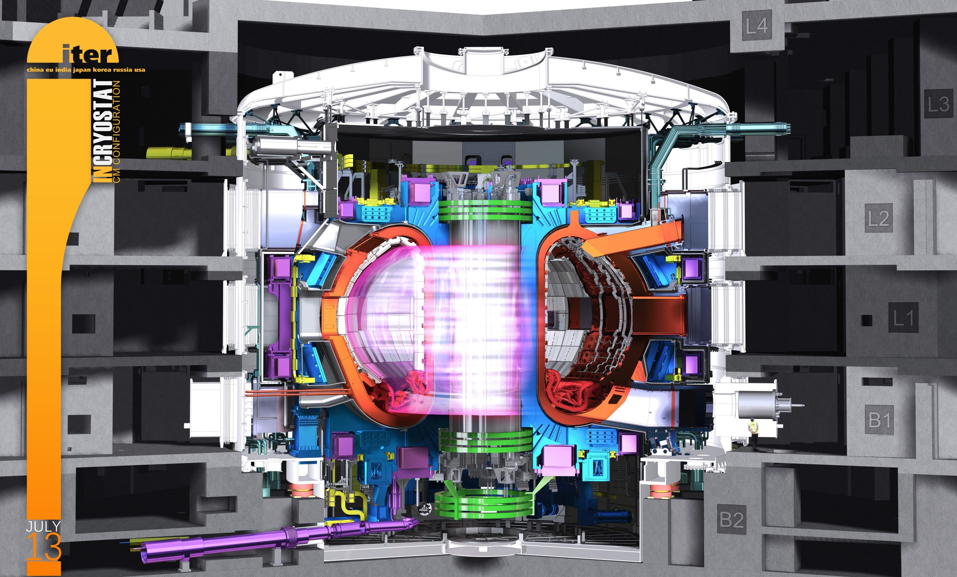
The ITER fusion reactor

Slide 11
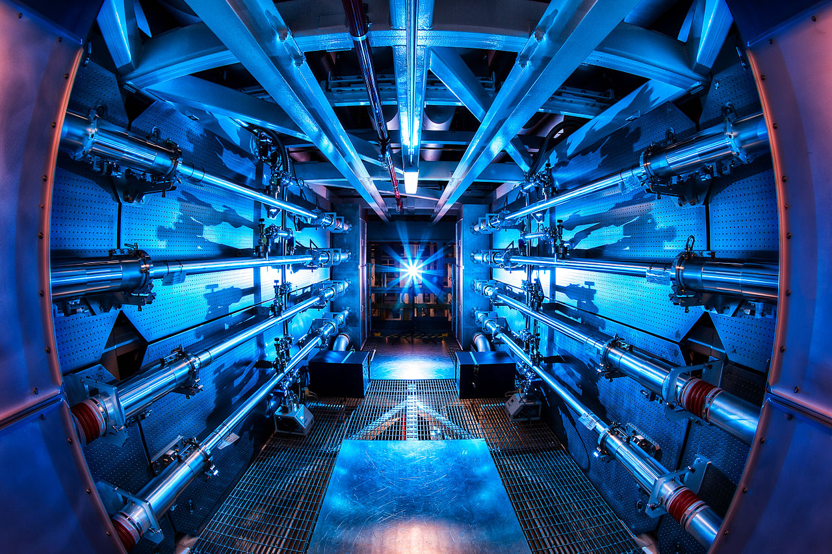
National Ignition Facility

Slide 12
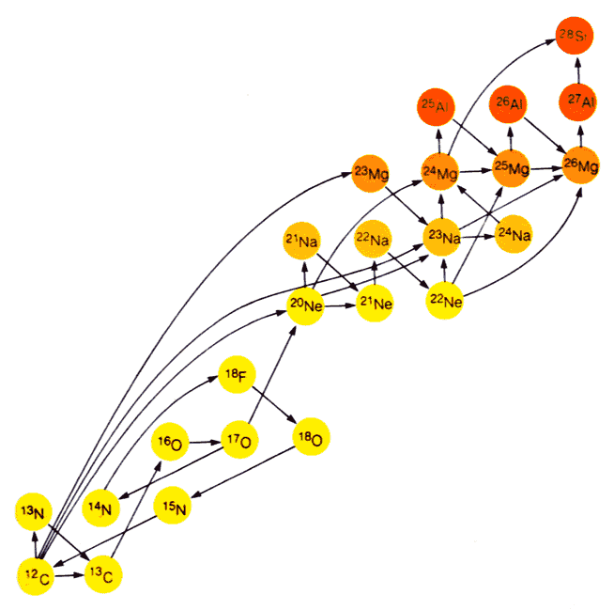
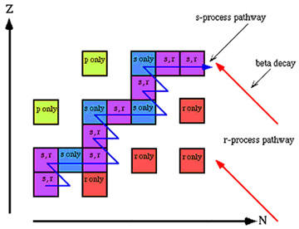
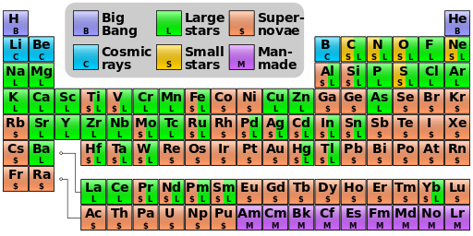
Fusion and the elements
Heavier elements are made by neutron capture processes
Elements from carbon to iron can be made by fusion processes in massive stars
You really are “stardust”!

Slide 13
Conclusions
Fusion is a promising future energy source
next generation fusion reactors are coming close to “break-even”
But there are issues
tritium supply is an issue
need to contain the free neutrons
Clever idea: line tokamak with lithium
neutron capture on ⁶Li makes tritium: ⁶Li + n → ⁴He + ³H
remove neutrons and regenerate tritium!
such “lithium blankets” are a current focus of research
Meanwhile, small-scale d-t fusion is used as a convenient source of neutrons for research
as is the case here in Sheffield…

