Slide 1

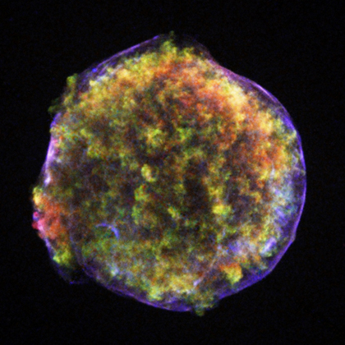
ASTROPARTICLE PHYSICS LECTURE 1
Susan Cartwright
University of Sheffield

Slide 2
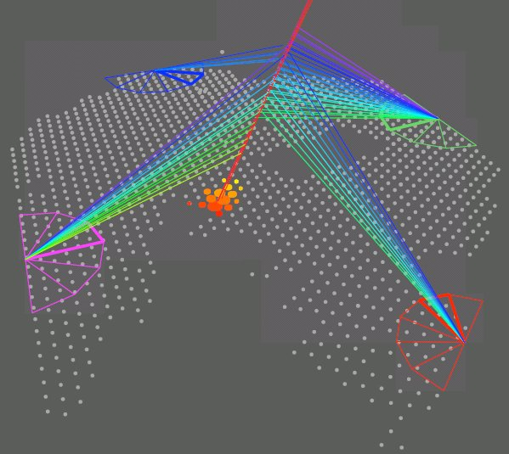
Overview
What is Astroparticle Physics?

Slide 3
What is Astroparticle Physics?
Various definitions! Mine is the use of particle physics technology to study astrophysical phenomena
Included:
neutrino astrophysics
gamma-ray astronomy
cosmic rays
dark matter
early-universe cosmology
Sometimes also included:
cosmic microwave background
gravitational waves
neutrino masses (especially 0νββ)
coherent field with a lot of common factors
High Energy Astroparticle Physics
someone else’s problem!
not very particulate
not very astrophysical

Slide 4
Common Issues
Low rates
fluxes of high-energy particles are small
neutrinos and dark matter have weak interactions
Need for large detectors
No control over “beam”
harder to control backgrounds
harder to calibrate, e.g., energy resolution
Signals can be difficult to establish and/or characterise
cf. solar and atmospheric neutrino oscillation

Slide 5
Related Fields
Neutrino physics
atmospheric neutrinos are “astroparticle physics” but have contributed more to understanding of neutrinos than to astrophysics
similar situation for solar neutrinos
long-baseline neutrino experiments can do low-energy neutrino astrophysics “for free” (and vice versa)
Nucleon decay
many detector technologies useful for both
original purpose of Kamiokande (NDE = Nucleon Decay Experiment not Neutrino Detection Experiment!)
planned noble-liquid detectors may be able to do both nucleon decay experiments and dark matter searches

Slide 6
Topics to be Covered
High energy astroparticle physics (cosmic rays, gammas, high-energy neutrinos)
sources
detection
results
prospects
Dark matter
evidence
candidates
search techniques
Not Covering:
solar neutrinos (SB)
neutrino masses (SB)
supernova neutrinos (no time)

Slide 7
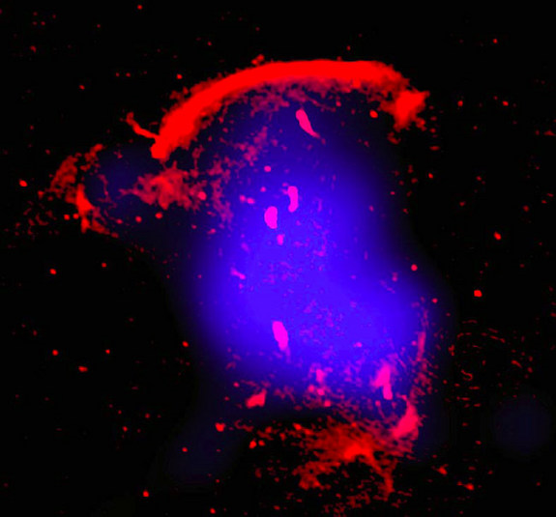
High Energy Astroparticle Physics
Acceleration Mechanisms
Sources
Detection

Slide 8
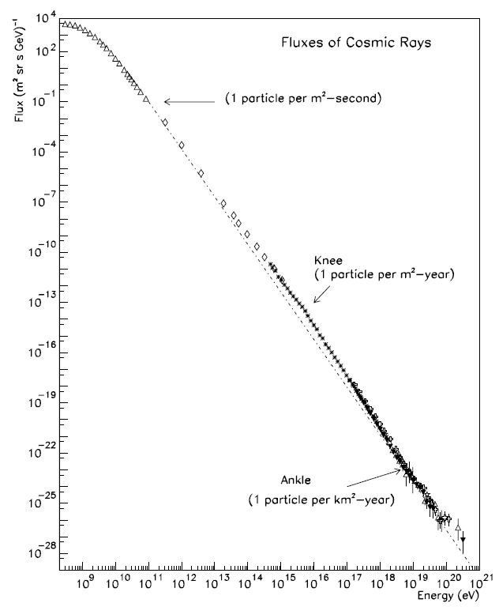
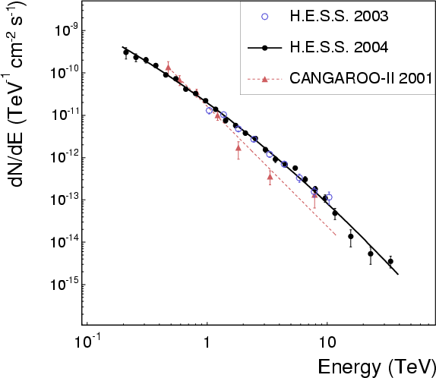
Cosmic Accelerators
Cosmic rays and gamma rays are observed up to extremely high energies
something must therefore accelerate them
10⁹ eV 10²¹
Note the power-law spectrum

Slide 9
Acceleration Mechanisms
Fermi Mechanism
energetic charged particles can gain energy by scattering off local magnetic turbulence (Fermi 1949)
Assume particle scatters off much more massive object moving with speed u. Then in the com frame (= frame of massive object) its energy and momentum before the scatter are
The particle scatters elastically: its energy is conserved and its x-momentum reversed. In original (lab) frame

Slide 10
Acceleration Mechanisms
Fermi Mechanism
energetic charged particles can gain energy by scattering off local magnetic turbulence (Fermi 1949)
We need to average over angle. Head-on collisions are slightly more likely than overtaking collisions, so middle term doesn’t just go away. In relativistic limit we find
Hence this process is known as second-order Fermi acceleration.
The good news
this produces a power law energy spectrum: N(E) ∝ E^{−x} where x = 1 + 1/ατ, α is the rate of energy increase and τ is the residence time of the particle
The bad news
since u << c, it’s slow and inefficient

Slide 11
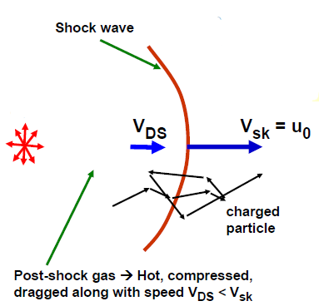
Acceleration Mechanisms
Don Ellison, NCSU
First-order Fermi Mechanism (Diffusive Shock Acceleration)
O(u/c) term gets lost in integral over angles—we could retrieve this if we could arrange to have only head-on scatters
Consider shock wave as sketched above
high-energy particles will scatter so that their distribution is isotropic in the rest frame of the gas
crossing shock in either direction produces head-on collision on average
Rest frame of upstream gas
Rest frame of downstream gas
Rest frame of shock
V_{DS}
V_{DS}
u₀
u₀ − V_{DS}

Slide 12
Acceleration Mechanisms
Rest frame of shock
DSA, continued
shock compresses gas, so density behind shock ρ₂ > ρ₁
in rest frame of shock, ρ₁u₀ = ρ₂u₂ where u₂ = u₀ − V_{DS}
for strong shock ρ₂/ρ₁ = (γ + 1)/(γ − 1) where γ is ratio of specific heats (= ⁵/₃ for hydrogen plasma)
therefore expect u₂/u₀ ≈ ¼
gas approaches shock-crossing particle at speed V = ¾ u₀
if high-energy particles move randomly, probability of particle crossing shock at angle θ is P(θ) = 2 sin θ cos θ dθ, and its energy after crossing shock is E’ ≈ E(1 + pV cos θ) (if V << c)
therefore average energy gain per crossing is
u₀ − V_{DS}
u₀

Slide 13
Acceleration Mechanisms
DSA spectrum
if average energy of particle after one collision is E₁ = fE₀, and if P is probability that particle remains in acceleration region, then after k collisions there are N_{k} = N₀P^{k} particles with average energy E_{k} = f^{k}E₀.
Hence , or
This is the number of particles with E ≥ E_{k} (since some of these particles will go on to further collisions), so differential spectrum is
for DSA this comes to N(E) dE ∝ E^{−(r + 2)/(r − 1)} dE, where r = ρ₂/ρ₁.
“universal” power law, independent of details of shock

Slide 14
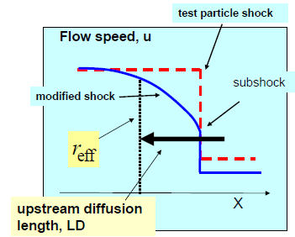
Additional Complications
Above was a “test particle” approach, in which we assume most of the gas is unaffected
If acceleration is efficient, high momentum particles will modify the shock
Need a consistent treatment which takes proper account of this
mathematically challenging
but valid across very large range of particle energies
Also need to allow for possibility of relativistic shocks
_{D}
Don Ellison, NCSU

Slide 15
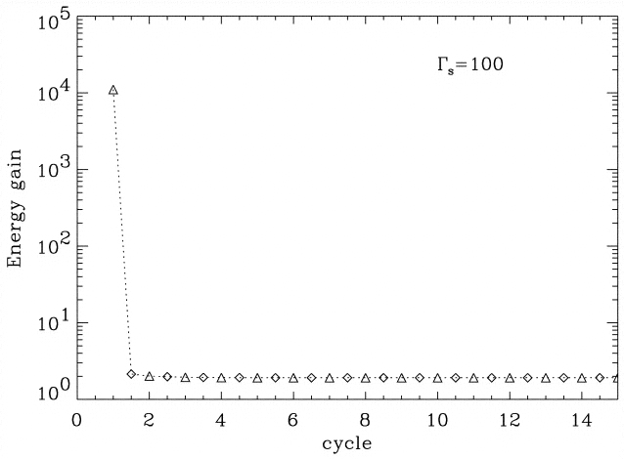
Relativistic Shocks
Lemoine & Pelletier 2003
DSA assumes non-relativistic shock
Many astrophysical objects (γ-ray bursts, AGN) are known to host relativistic shocks (Γ ~ 10 for AGN, up to 1000 for GRBs)
these can produce much larger accelerations
first return crossing causes energy gain of order Γ²
second and subsequent crossings “only” factor 2, because particle does not have time to scatter to random orientation before shock overtakes it
produces a somewhat steeper spectrum, spectral index ~2.4

Slide 16
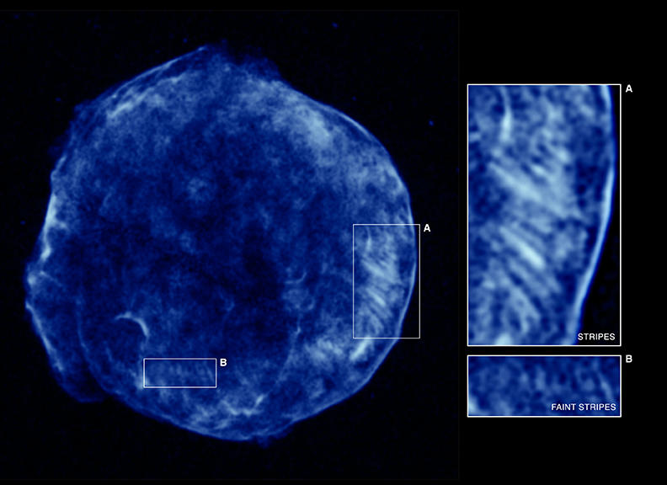
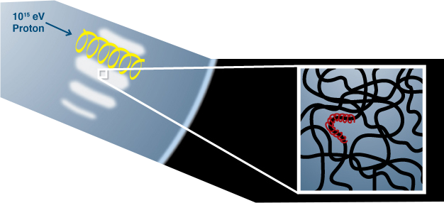
Tycho’s Supernova (SN 1572)
Shock front seen in high-energy electrons
“Stripes” may signal presence of high-energy protons
Chandra

Slide 17
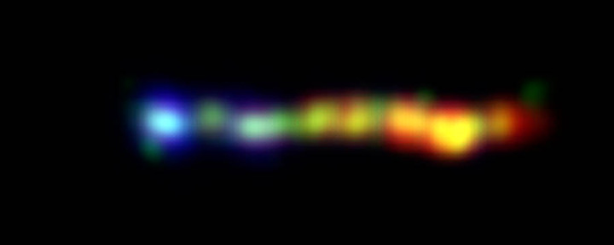
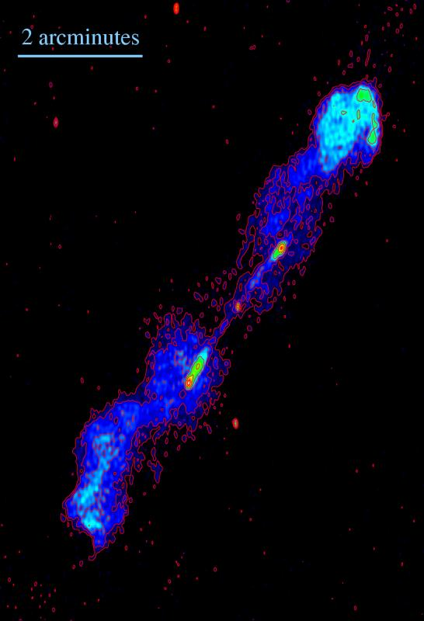
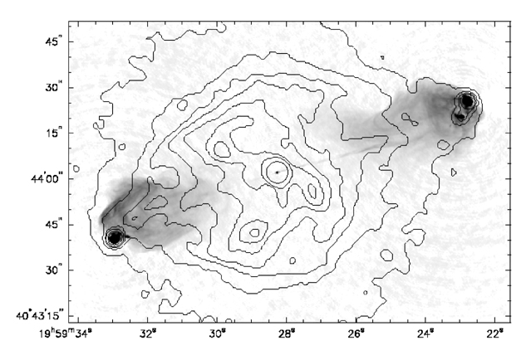
Radio Galaxies
3C 273 jet
Chandra, HST, Spitzer
B1545-321
13 cm wavelength ATCA image by L. Saripalli, R. Subrahmanyan and Udaya Shankar
Cygnus A in X-ray (Chandra) and radio (VLA)

Slide 18
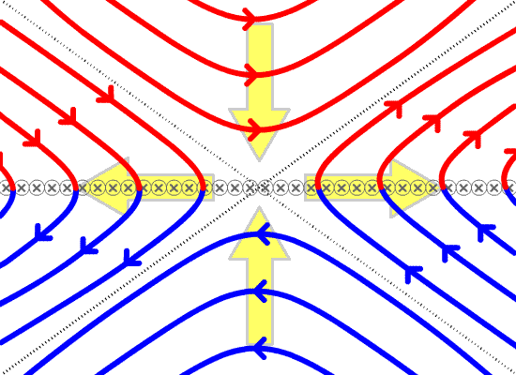
Alternative Acceleration Mechanisms
Magnetic reconnection
occurs when two magnetic flows of opposite polarity are forced close together
it is then energetically favourable for field lines to break and reconnect
resulting release of energy could drive acceleration
Well known to occur in solar flares and coronal mass ejections
Good candidate for acceleration near pulsars

Slide 19
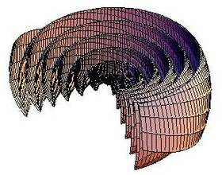
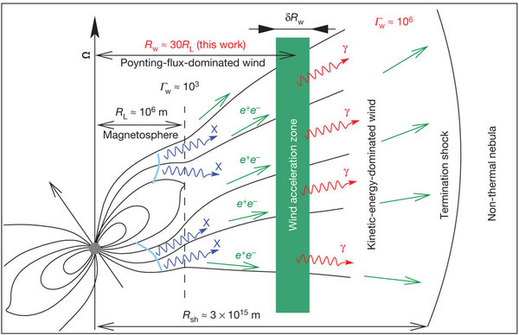
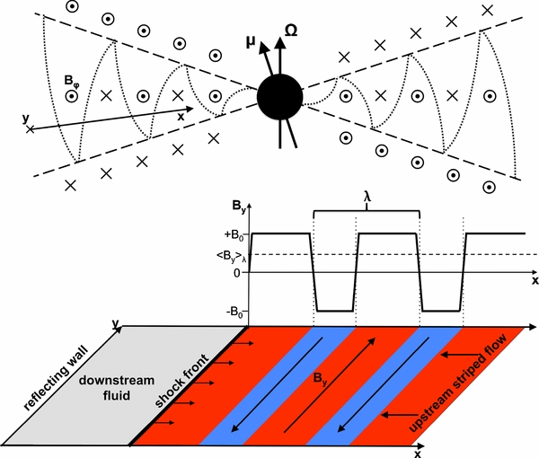
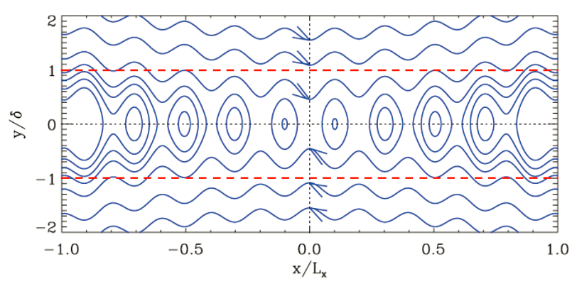
Pulsar Magnetic Fields
“striped wind”
Magnetic reconnection has been proposed as an explanation for fast γ-ray flares in Crab Nebula

Slide 20
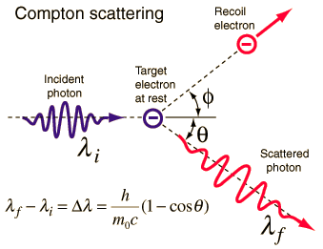
Photons and Neutrinos
High-energy photons and neutrinos are secondary particles produced by interactions of high-energy primaries.
production mechanisms:
inverse Compton scattering (photons only)
Low-energy photon backscatters off high-energy electron. In electron rest frame we have Δλ = h(1−cos θ)/mc². In lab frame, maximum energy gain occurs in head-on collision: ν ≈ 4γ²ν₀ Because of relativistic aberration, spectrum is sharply peaked near maximum

Slide 21
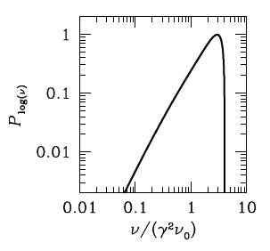
Photons and Neutrinos
inverse Compton scattering (continued)
Plot shows calculated spectrum for monoenergetic photons and electrons.
Plenty of potential sources of low-energy photons to be upscattered:
synchrotron radiation produced by the same population of fast electrons (synchrotron-self-Compton, SSC)
cosmic microwave background
optical photons from source
For real objects, need to integrate over power-law spectrum of electrons and spectrum of photon source

Slide 22
Photons and Neutrinos
High-energy photons and neutrinos are secondary particles produced by interactions of high-energy primaries.
production mechanisms:
pion decay (photons and neutrinos)
pions produced by high-energy proton colliding with either matter or photons (pion photoproduction)
neutral pions decay to γγ, charged to μν_{μ}
mechanism produces both high-energy γ-rays and neutrinos
Both mechanisms need population of relativistic charged particles
electrons for IC, protons for pion decay
Unclear which dominates for observed TeV γ-ray sources

Slide 23
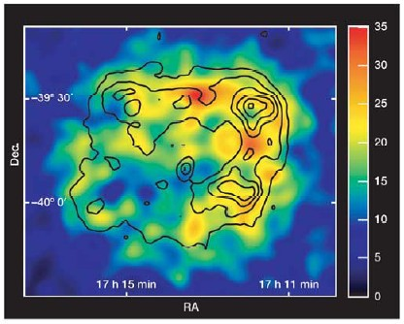
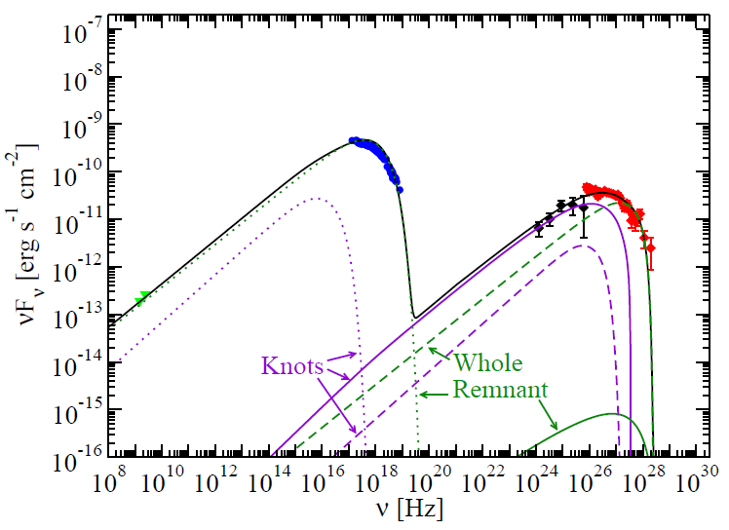
Spectrum of Supernova Remnant RXJ 1713.7−3946
Suzaku
Fermi LAT
HESS
ATCA
Spectrum is consistent with high-energy electrons only: synchrotron radiation (radio → x-ray) plus inverse Compton effect (γ-rays)
Expect this SNR not to produce high-energy neutrinos

Slide 24
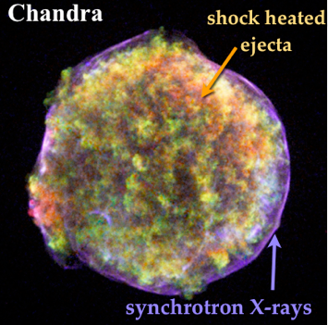
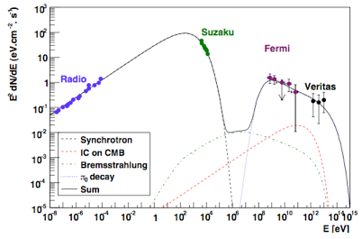
Spectrum of SN1572 (Tycho’s SN)
Spectrum seems to prefer π⁰ decay—shape wrong for IC
This SNR should produce high-energy neutrinos

Slide 25
Acceleration: Summary
Observations made in high-energy astroparticle physics require that charged particles be accelerated to very high energies (~10²⁰ eV)
Likely candidate is diffusive shock acceleration
requirement of shocks associated with magnetic fields found in many astrophysical objects, especially supernova remnants and AGN
synchrotron radiation from these objects direct evidence for population of fast electrons
much less evidence for presence of relativistic hadrons, but there must be some somewhere since we observe them in cosmic rays!
TeV γ-rays can be produced by fast electrons using inverse Compton scattering, or by fast protons from π⁰ decay
latter will also make TeV neutrinos, not yet observed

Slide 26
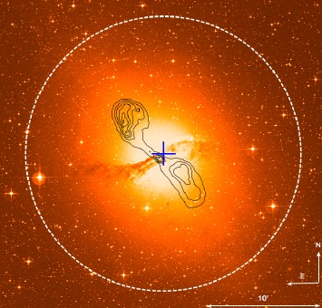
High Energy Astroparticle Physics
Acceleration Mechanisms
Sources
Detection

Slide 27
Gamma-Ray Astronomy
Well-established branch of high-energy astrophysics
most work done at modest energies (few 10s of MeV)
some, e.g. EGRET, out to few 10s of GeV
this is not usually regarded as astroparticle physics
though EGRET catalogue sometimes used as list of candidates for, e.g., neutrino point source searches
Atmosphere is not transparent to gamma rays
low and medium energy γ-ray astronomy is space-based
CGRO, SWIFT, GLAST, INTEGRAL, etc.
space platforms not suitable for TeV γ-ray astronomy
too small!
therefore very high energy γ-ray astronomy is a ground-based activity
detect shower produced as γ-ray enters atmosphere

Slide 28
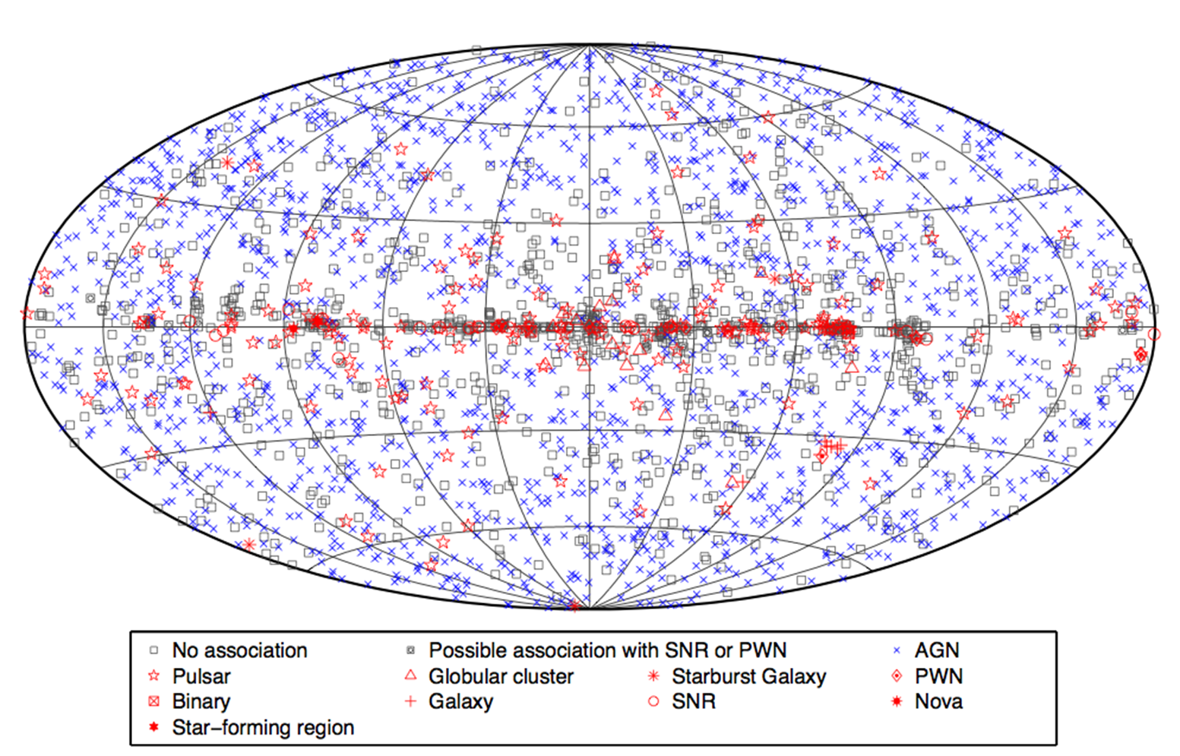
Fermi-LAT 3rd Point Source Catalogue

Slide 29
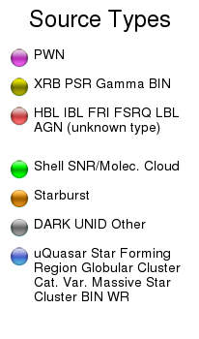
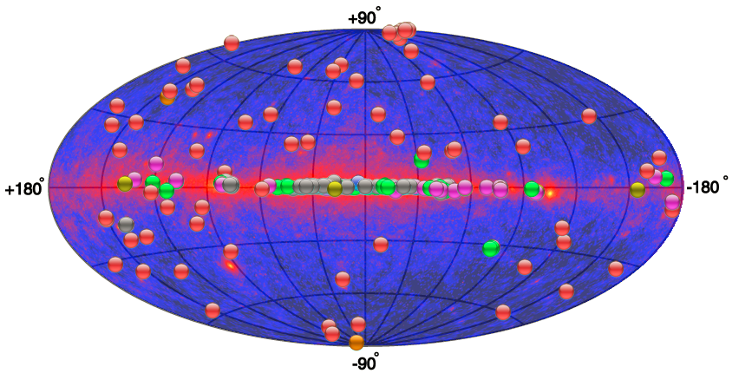
TeV Gamma-Ray Sky
from TeVCat, http://tevcat.uchicago.edu/

Slide 30
Gamma-Ray Sources
From maps, clearly mixed Galactic and extragalactic
extragalactic sources of TeV γs are mostly blazars (a class of AGN where we are looking down the jet)
identified Galactic sources are SN-related (supernova remnants and pulsar wind nebulae), plus a few binary compact objects
dark/unidentified objects associated with Galactic plane, therefore presumably Galactic
SNRs and AGN are suitable environments for particle acceleration
shocks, magnetic fields, synchrotron emission

Slide 31
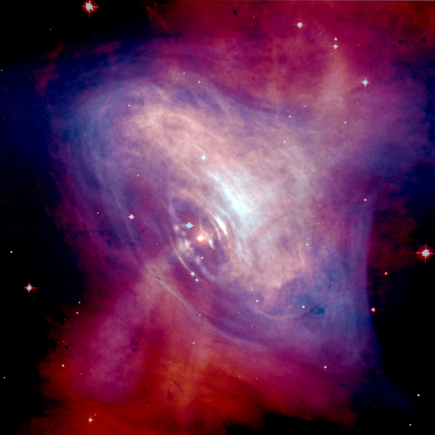
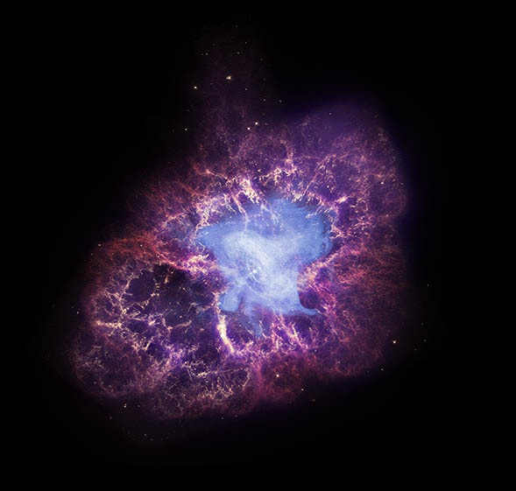
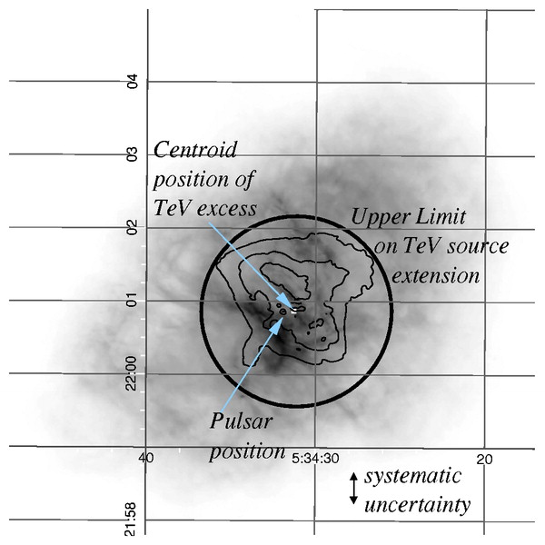
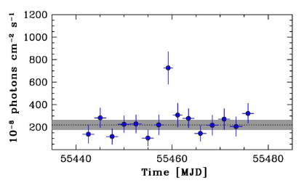
Pulsar Wind Nebula: The Crab
TeV gamma-ray signal as observed by HEGRA (Aharonian et al. 2004)
Medium-energy γ-ray flare observed by AGILE (Tavani et al. 2011)

Slide 32
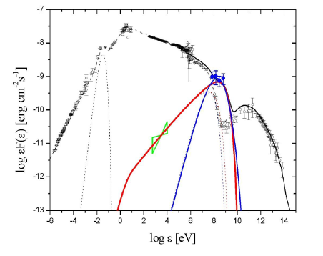
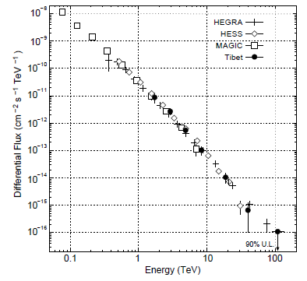
Pulsar Wind Nebula: The Crab
Crab spectral energy distribution showing September 2010 flare
TeV energy spectrum

Slide 33
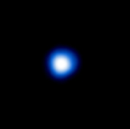
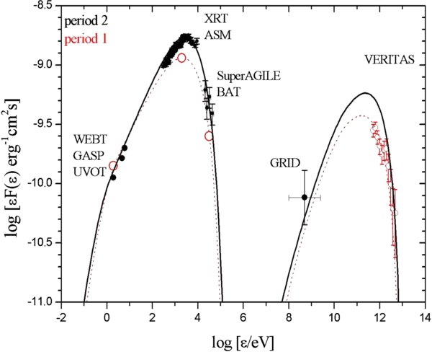
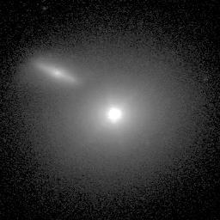
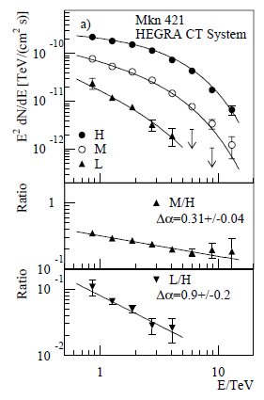
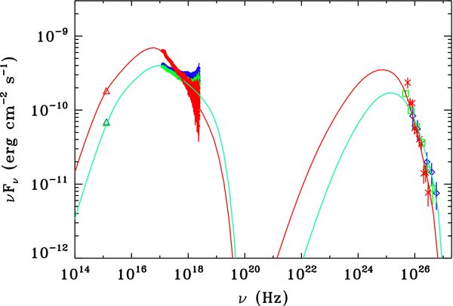
Blazar: Mkn 421
Mkn 421 and companion galaxy.
Aimo Sillanpaa, Nordic Optical Telescope. (Above: very boring X-ray image by Chandra)
Highly variable (typical of blazars)
Spectrum varies according to state

Slide 34
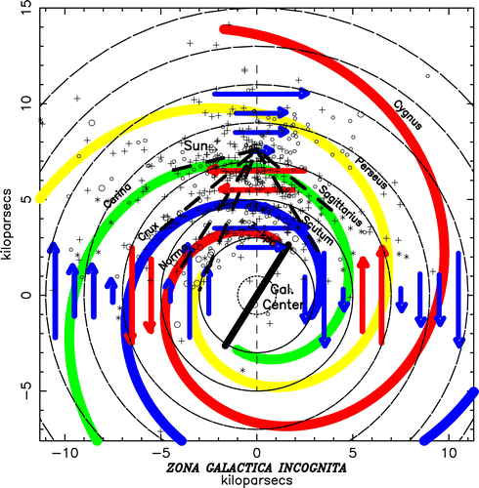
Cosmic Ray Sources
Observations of cosmic rays now span about 100 years
However, sources are not definitively established
Galaxy has a complex magnetic field which effectively scrambles direction of charged particles
Gamma ray luminosity requires fast particles, but maybe only electrons
therefore, observation of γ-rays does not definitively establish source as a cosmic ray factory
Neutrino luminosity does require fast hadrons
but no neutrino point sources yet
Vallée, ApJ 681 (2008) 303

Slide 35
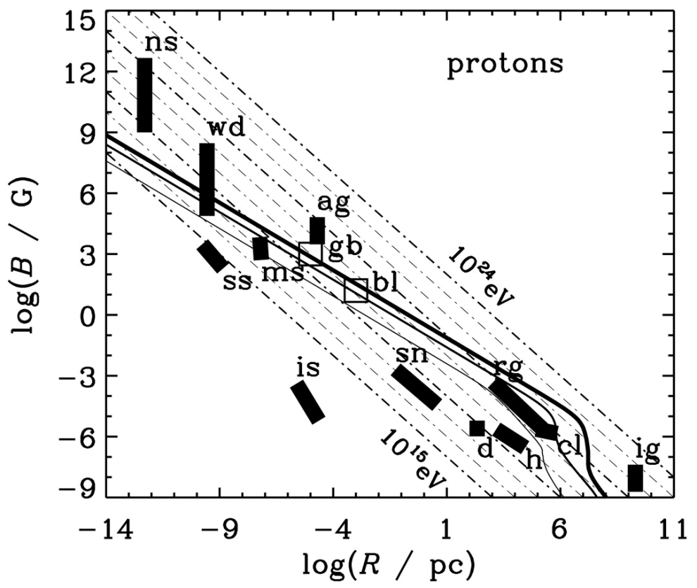
Cosmic Ray Sources
General dimensional analysis suggests E_{max} [GeV] ≈ 0.03 η Z R[km] B[G] (Hillas condition)
basically requires particles to remain confined in accelerating region
quite difficult to satisfy for highest-energy CRs
plot shows neutron stars white dwarfs sunspots magnetic stars active galactic nuclei interstellar space supernova remnants radio galaxy lobes disc and halo of Galaxy galaxy clusters intergalactic medium gamma-ray bursts blazars shock-wave velocities
Torres & Anchordoqui, astro-ph/0402371

Slide 36
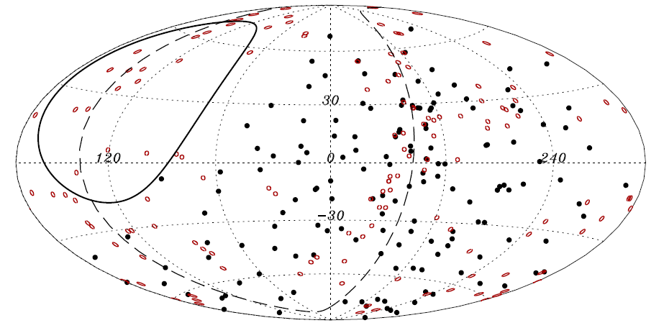
Cosmic Ray Sources
Amount of magnetic deflection decreases with increasing energy
highest energy events might remember where they came from...
Pierre Auger Observatory initially observed correlation between arrival directions of CRs above 55 EeV and a catalogue of AGN
however, with more data significance went down (not up!)
currently (2014), no statistically significant correlation with galaxy surveys, nearby AGN/radio galaxies, or Centaurus A

Slide 37
Cosmic Ray Sources: Summary
CRs up to about 10¹⁵ eV or so assumed to come from SNRs
but they don’t provide good directional information, so this remains to be confirmed
neutrino observations, or definitive proof that some SNR γ-rays originate from π⁰ decay
Ultra-high energy CRs may come from local AGN
however, arrival directions do not show significant correlation
this is not unexpected if UHEC CRs are heavy nuclei, as higher charge implies more deflection by magnetic fields
composition of UHE CRs is currently unclear, as experiments disagree
note that intergalactic space is not completely transparent to UHECRs—see later—so distant AGN (beyond ~100 Mpc) are assumed not to contribute

Slide 38
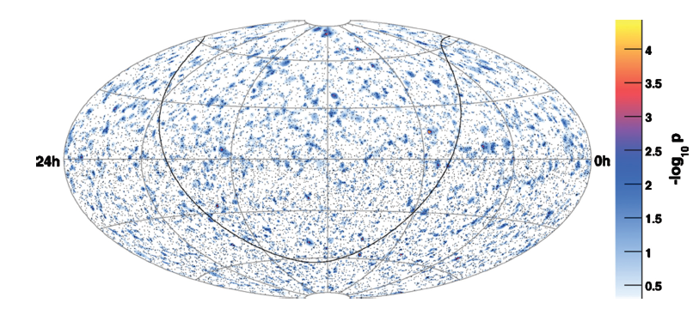
Neutrino Sources
Known sources of low-energy (0.1−100 MeV) neutrinos:
Sun
SN 1987A
Known point sources of high-energy neutrinos:
None (some events, but no significant clusters)
to be fair, this is as expected for current exposure times
IceCube search for point sources.
No significant excess found.
(Halzen & Klein 2010)

Slide 39
Sources: Summary
TeV gamma rays are observed from a variety of sources, primarily SNRs within the Galaxy and blazars outside
clear evidence of charged particles accelerated to very high energies, but whether electrons or hadrons is unclear
Cosmic ray sources are difficult to pinpoint because CRs are strongly deflected by the Galactic magnetic field
SNRs suspected to be source of CRs at <10¹⁵ eV
local AGN may be responsible for highest energy CRs
Observations of high energy neutrinos would solve the mystery, but no clear point sources yet
situation should improve after a few more years of IceCube running

