Slide 1
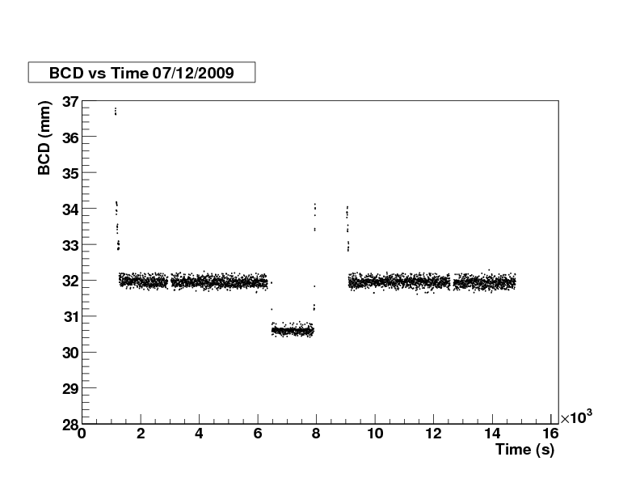
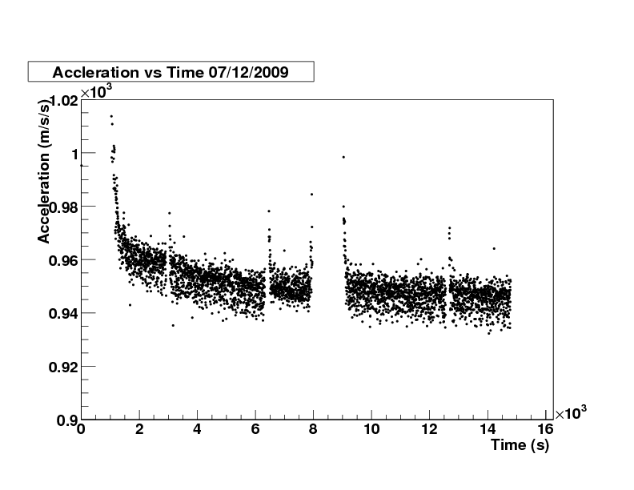
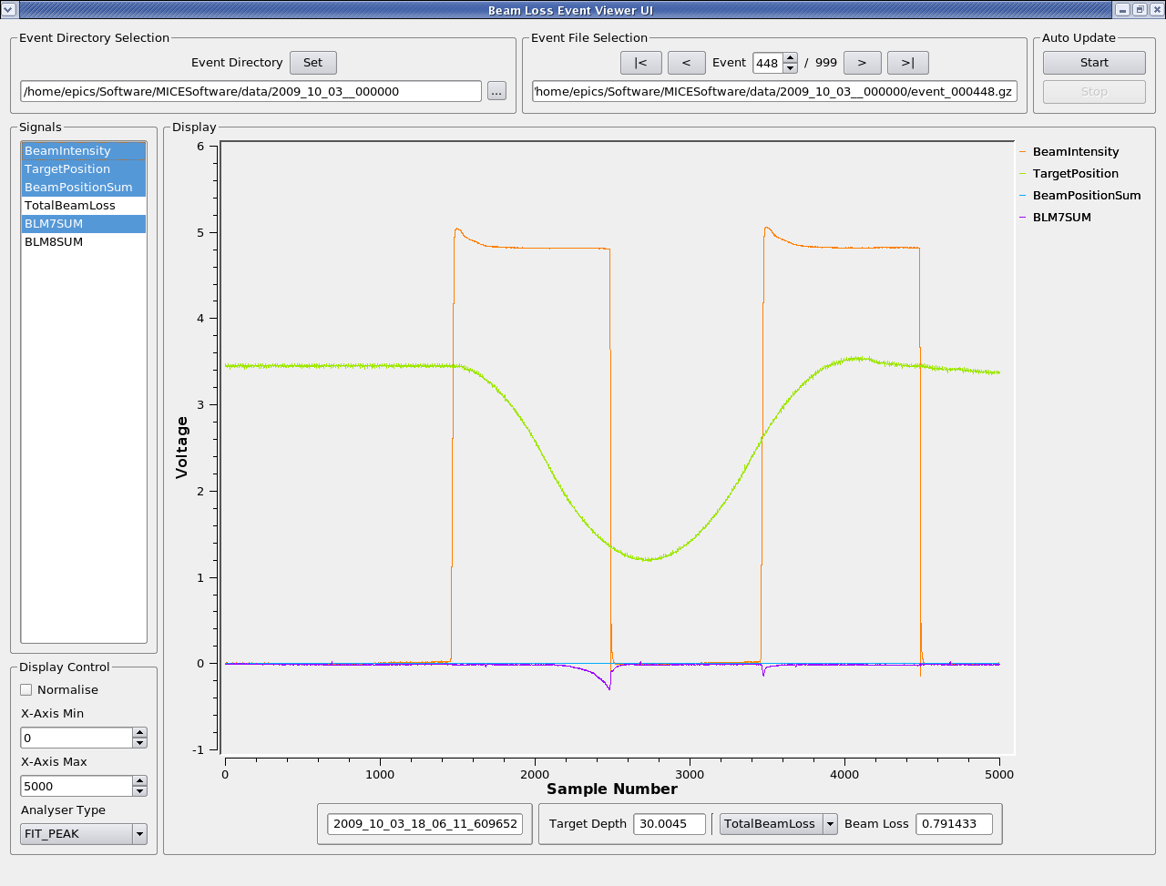
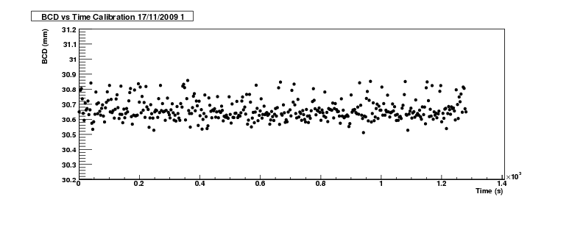
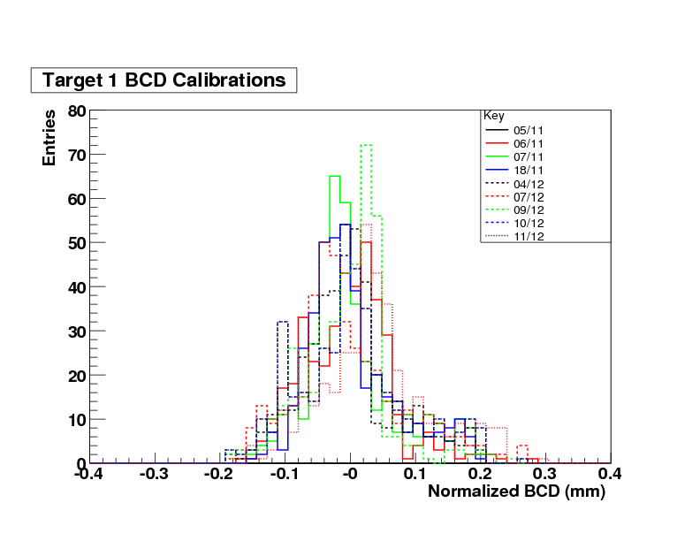
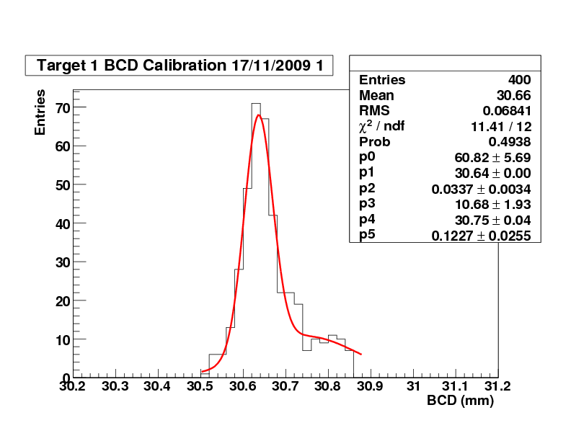
MICE TARGET OPERATION
AND MONITORING
C. Booth, P. Hodgson, P. J. Smith, Dept. of Physics & Astronomy
University of Sheffield, England.
1 – The MICE Experiment
2 - The Target Mechanism
The aim of MICE is to construct a section of cooling channel that is long enough to demonstrate a measurable cooling effect by reducing the transverse emittance of a muon beam by the order of 10%. The MICE detectors and instrumentation will be able to achieve an absolute accuracy on the measurement of the emittance to 0.1% or better. Fast emittance reduction will be an important step towards a future neutrino factory.
The MICE target has been designed to operate parasitically on the ISIS accelerator at the Rutherford Appleton Laboratory, by inserting a small titanium shaft into the proton beam during the last couple of ms before beam extraction. The first operational target was installed on ISIS in January 2008 and remained operational for a period of approximately one year. A second upgraded design is currently installed in ISIS and remains in use. Further details of the MICE target hardware can be found on a separate poster.
3 –Target Operation in 2009
5 –Target Offline Monitoring
During 2009 the target was run for approximately 185,000 actuations. The operational run time for the target was limited, so the majority of this time was used to commission the MICE beam-line and to further understand the interaction of the MICE target with the ISIS beam. The actuation depth and exact insertion time of the target were set so that the amount of beam-loss produced by the target could be controlled to within the limits set by the normal variation in the position of the ISIS beam from pulse to pulse.
Steering target into/out of beam
Rapid change – Ohmic heating of coils
Normal operation
Slower decrease over 2+ hours
Decreased BCD to increase particle rate
Takes about 2 hours to warm up
Using parameterised target data allows close examination of interesting target properties and can be used to monitor changes in the physical state of the mechanism without direct inspection. The above plots show some of these data giving information about target performance over a particular MICE shift.
4 –Target Online Monitoring
Beam Intensity
6 –Calibration Plots
In order to attempt to identify potential wear on the bearing/shaft interface periodic calibration pulses are taken. The target is pulsed at a fixed BCD for a set period of time and the resulting data is compared with previous runs. A shift in the width of these distributions can be correlated with increased wear within the target mechanism.
Target position
Beamloss
The above diagram illustrates some of the raw signals that are recorded by the EPICS based DAQ during target operation. It can be seen that target intercepts the ISIS spill during the last 2 ms, catching the protons when they are at their highest energy. This interaction produces a corresponding beamloss which can be tuned to some desired value by varying the target dip depth. As each pulse is recorded it is parameterised to produce a set of useful variables such as acceleration, Beam Centre Distance (BCD) and beamloss. These quantities can then be plotted over time to allow close monitoring of performance.
7 – Correlation to MICE muon rate
The current levels of beam-loss are consistent with a rate of a few muons per spill into the MICE cooling channel. As MICE needs several hundred muons per spill the permitted beam-loss caused by the target will need to be increased significantly to obtain the required muon rate for MICE.
p.hodgson@sheffield.ac.uk for IPAC 10

