Slide 1
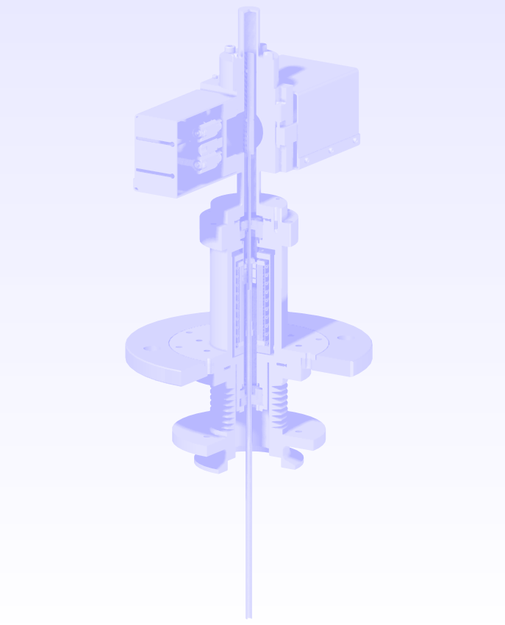


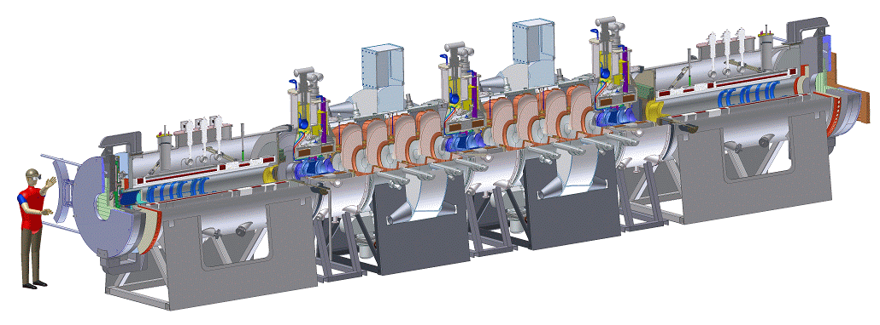
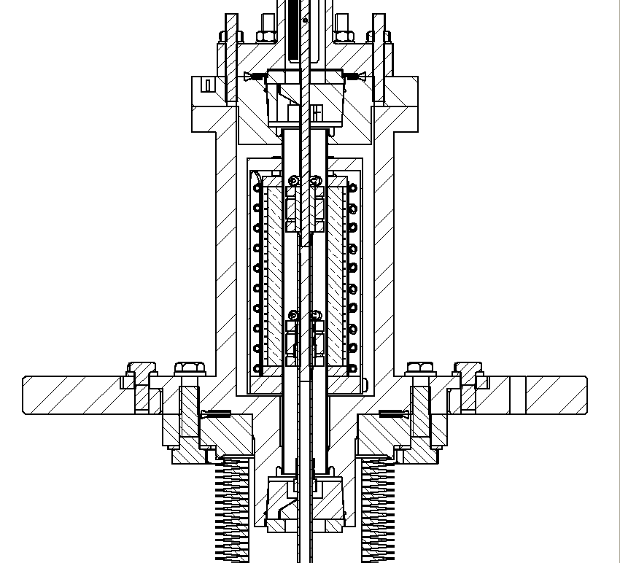
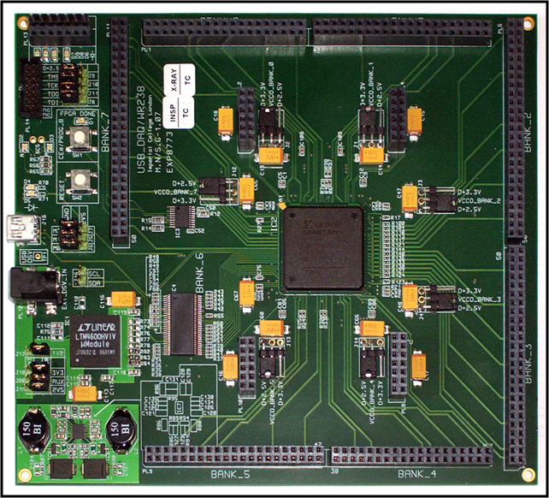
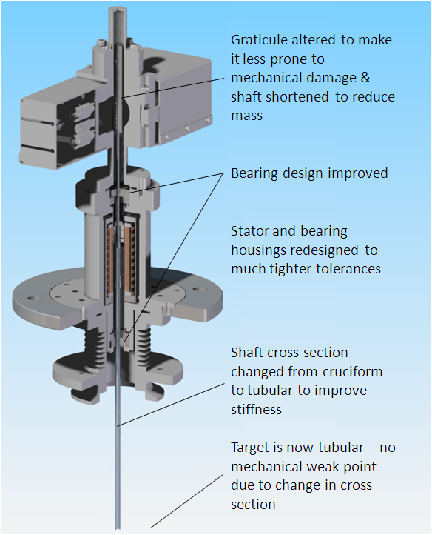
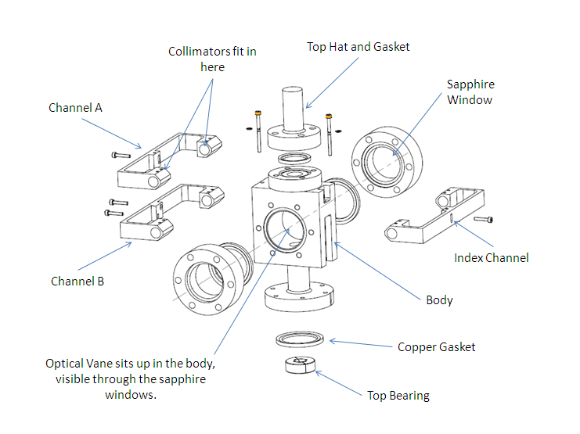
MICE TARGET HARDWARE
C. Booth, P. Hodgson, R. Nicholson, P. J. Smith, J. Tarrant
University of Sheffield, England.
1 - The MICE Experiment
The aim of MICE is to construct a section of cooling channel that is long enough to demonstrate a measurable cooling effect by reducing the transverse emittance of a muon beam by the order of 10%. The MICE detectors and instrumentation will be able to achieve an absolute accuracy on the measurement of the emittance to 0.1% or better.
5 - Control
Knowledge of the position of the target is required for both control and monitoring purposes. The stator coils are driven from a 3-phase pulse width modulated (PWM) power supply, to achieve maximum shuttle acceleration the phase of the current through the coils must be switched to track the exact position of the magnets. It is also necessary to monitor the depth of insertion of the target into the beam, so that this can be correlated with particle production. Future cycles of target insertion can then be adapted accordingly.
2 - ISIS & the MICE Target as the Muon Source
The MICE target has been designed to operate parasitically on the ISIS accelerator at the Rutherford Appleton Laboratory, by inserting a small titanium paddle into the proton beam during the last couple of ms before beam extraction. Pions created by the interaction are collected, their subsequent decay providing the source of muons for the MICE experiment.
6 - Running
The first operational linear electromagnetic drive was installed onto ISIS in January 2008; this particular drive was used for a period of approximately one year and allowed the MICE beam line to be commissioned. During that time it had been operated for approximately 185,000 actuations. Data obtained from this running period is presented in a second poster.
3 - The Target Mechanism
7 - Upgrades
The target system operated reliably for approximately one year on ISIS. However there are some known issues with the longevity of the DLC coated bearings and further analysis of the target shaft indicated that its design needed to be improved. The target is currently undergoing a significant redesign to eliminate these known problems. By improving the target’s mechanical design and its electronic interface the long term reliability of the target will be enhanced. This will be necessary as MICE progresses to the point where the target will be required to operate for many millions of actuations per year.
The target drive is a high acceleration (~850 ms⁻²) brushless DC permanent magnet linear motor. This motor consists of a moving magnetic assembly on a long shaft that is suspended within a bank of 24 flat coils. The shaft is magnetically propelled by the interaction of the permanent magnets with the coils that are contained within the stator body. The target shaft is supported by two diamond like carbon (DLC) coated dry bearings.
4 - Position Sensing
Knowledge of the position of the target is required for both control and monitoring purposes. The position of the shuttle is measured with an optical quadrature system. The teeth on a comb attached to the top of the target shaft interrupt three laser beams; the quadrature modulation of two of these beams is used to determine the change in the shuttle’s position whereas the third beam fixes the absolute position.
p.hodgson@sheffield.ac.uk for IPAC 10

