Slide 1
MICE Beam-line and Detectors Status Report
16th October 2009
Chris Booth
The University of Sheffield

Slide 2
Outline
Overview of MICE beam-line
Target
Operation
Stability
Beam-line optimisation
Quadrupoles
Decay Solenoid
Time of Flight counters
π, p and μ beams
Other detectors
Cherenkov
e/μ identifier
Sci Fi trackers

Slide 3
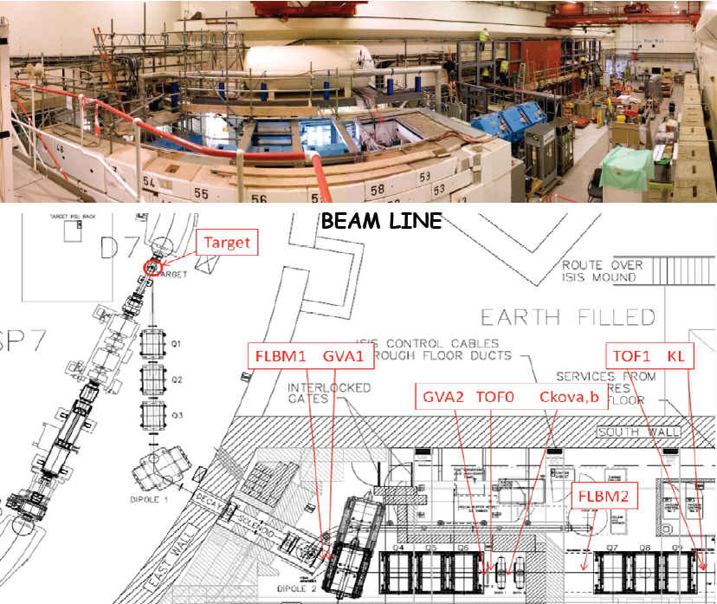

Slide 4
Target
Target drive installed in August shutdown
Timing & depth scans during ISIS start-up to explore edge of beam
Operation in ISIS MD (50 Hz/32) and User Run modes
Studies of different accelerations (drive voltages)
Runs at increasing target depth, producing ISIS beam-loss 0.1, 0.2, 0.3, 0.4, 0.5, 1 and 2 V
(Last year’s maximum for prolonged running was 50 mV)
Target stability checked over long runs and between runs
62,250 pulses to date (inspections after 12, 22 & 42 k pulses)
Routinely providing particles for beam-line and detector studies

Slide 5
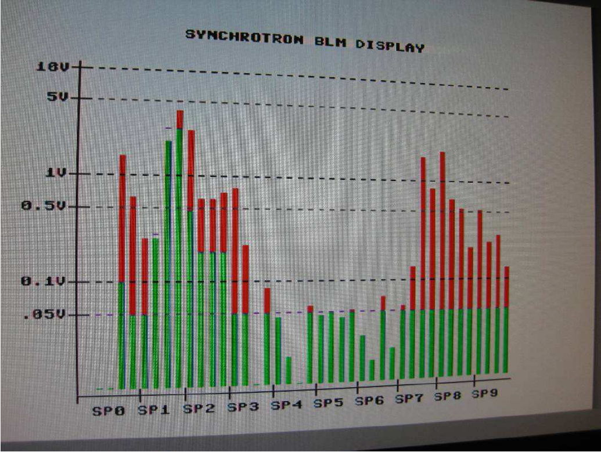
Normal beam loss monitor (BLM) display with MICE target inactive
Target is in sector 7
Target operating at 2 V beam-loss
Note losses in sectors 7 to 9 (and elsewhere)

Slide 6
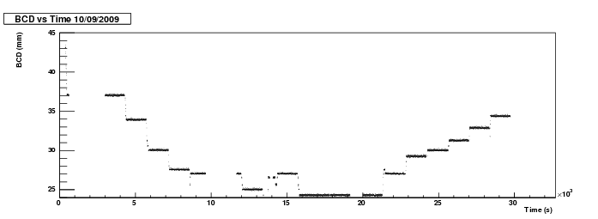
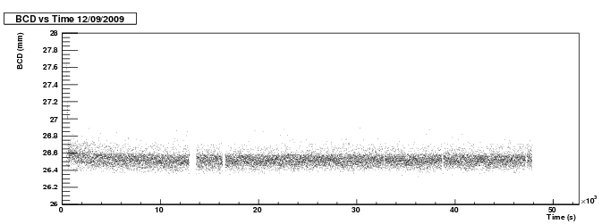
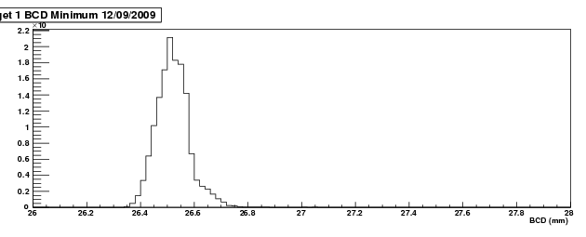
“BCD” = Beam Centre Distance
Exploring the beam edge
Increased depth = increased beam-loss
Stable operation
> 13 hours
0.2 mm (c.f. strike of 38 mm)

Slide 7
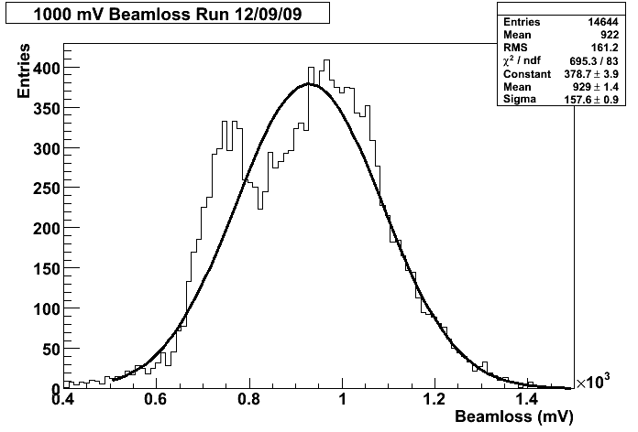
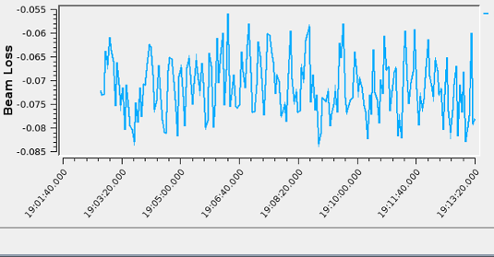
Beam-loss variation
Beam-loss (in Sector 7) for the 13 hour run at 1V
Apparently two distinct peaks (although only fitted a single Gaussian).
Double structure due to ISIS beam wandering in cyclic pattern
Not due to variation in target depth!
Activation Study
Survey of target area after long 1V run
Slight activation (max. 500 µSieverts/hour) in 1 or 2 spots near target
ISIS suggests repeat at 5V beam-loss

Slide 8
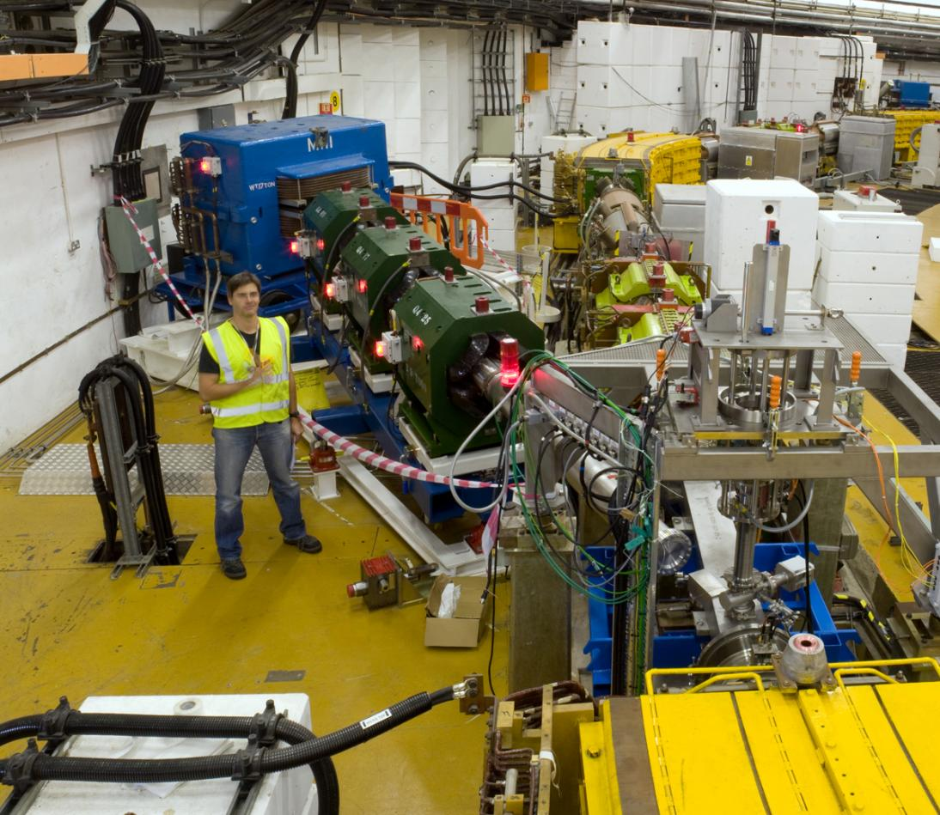
Upstream Beam-line
ISIS
synchrotron
Dipole
D1
Quads
Q1 - 3
Target

Slide 9
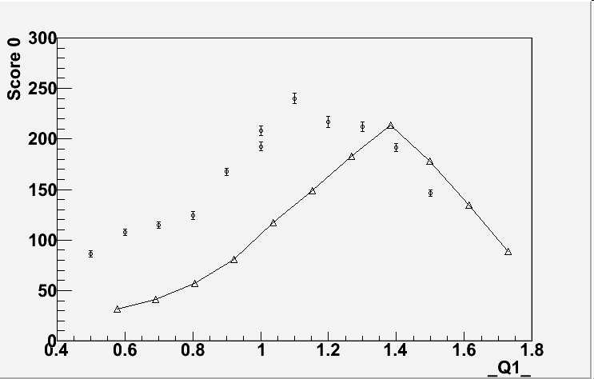
Optimisation of Upstream Beam-line
Scan of upstream quadrupoles
Simulation – triangles
Data – circles
Behaviour qualitatively as expected; more work needed to understand details
Counts in GVA1
Preliminary!

Slide 10
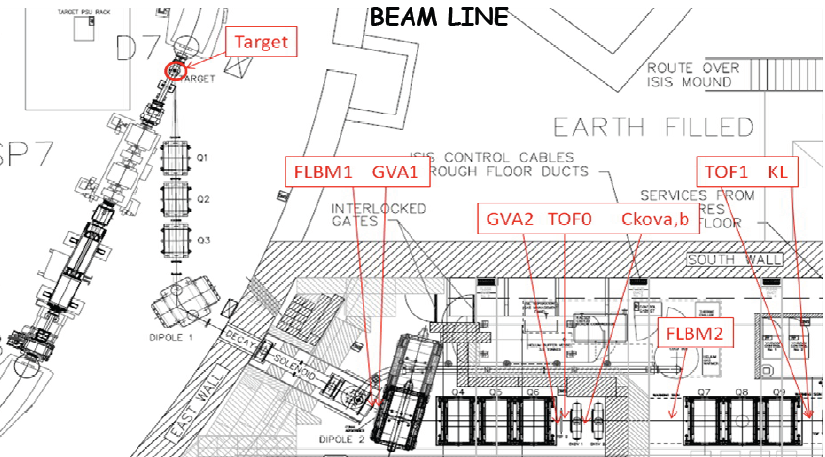
Beam-line and detectors

Slide 11
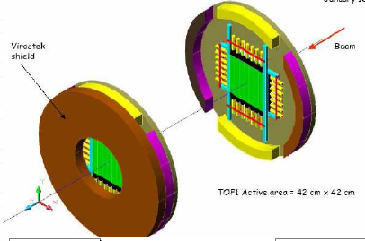
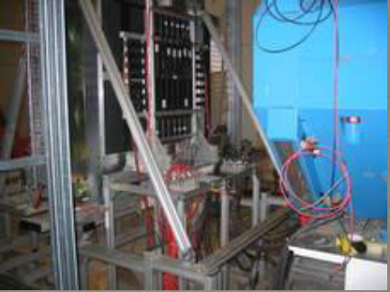
Time of Flight Counters
TOF0 and TOF1 installed
Horizontal and vertical bars – hodoscope as well as timing
Have proved invaluable in beam-line commissioning

Slide 12
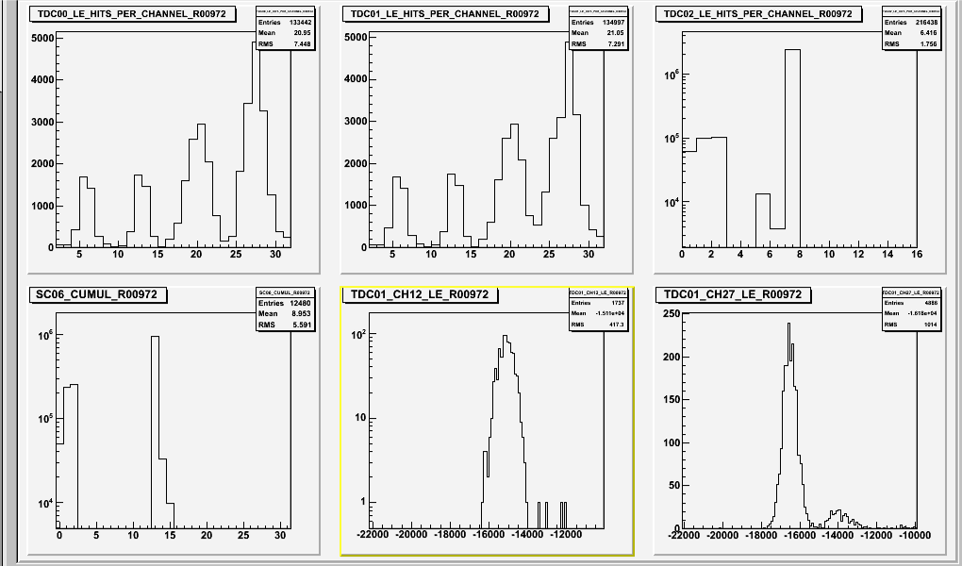
333 MeV/c pion beam
TOF1 TOF0
Single-channel ToF spectra
π p

Slide 13
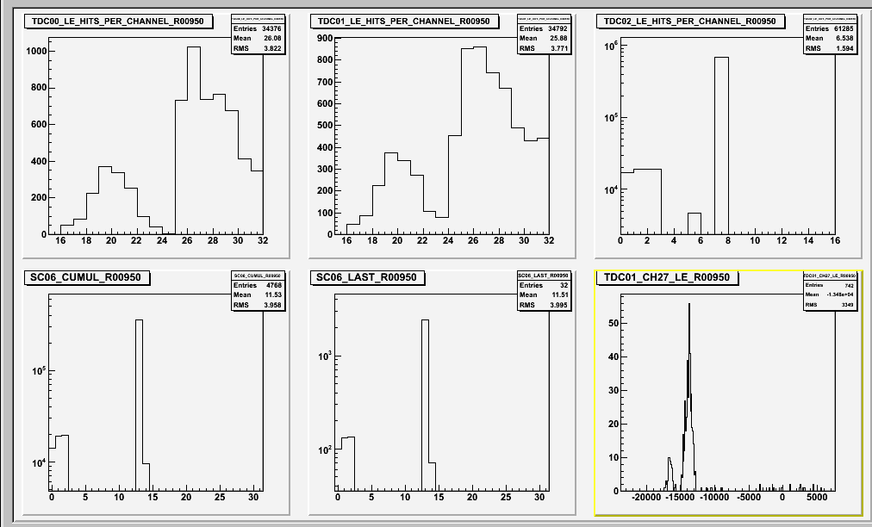
333 MeV/c proton beam
TOF0 TOF0
back front
Protons range out
π p

Slide 14
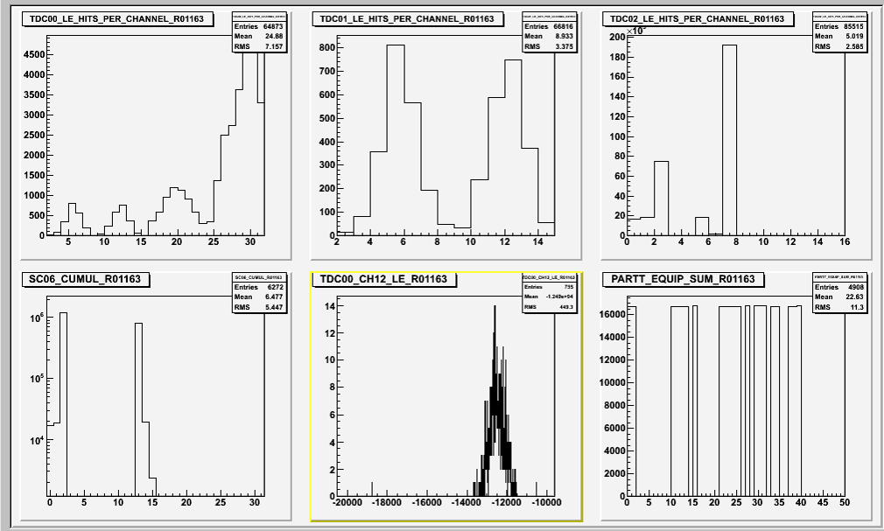
444 Mev/c pi⁺ to mu⁺
Proton contamination ranges out
muons!

Slide 15
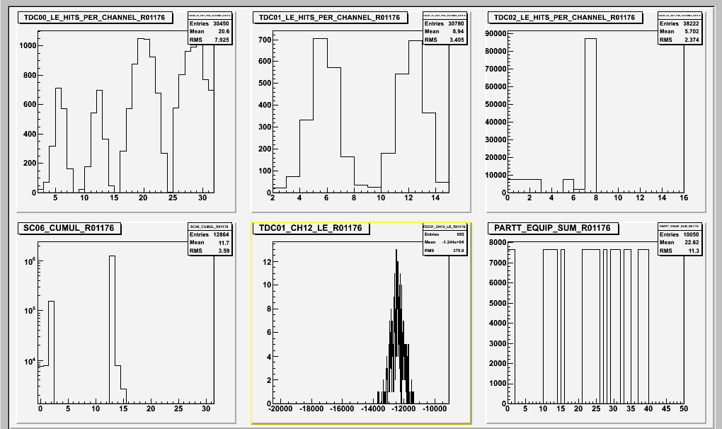
444 Mev/c pi– to mu–
Excess in TOF0 largely eliminated!
muons!

Slide 16
Preliminary muon rate survey
330 MeV/c π– to μ– beam
Varied target depth to study muon rate as function of beam loss
VERY preliminary!
Very
preliminary!

Slide 17
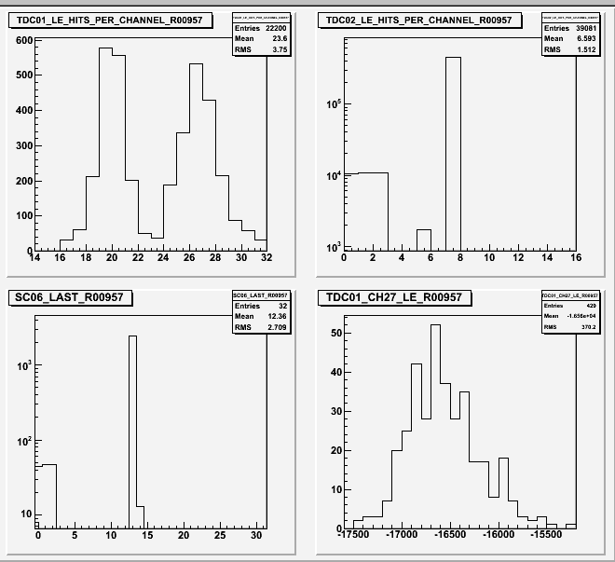
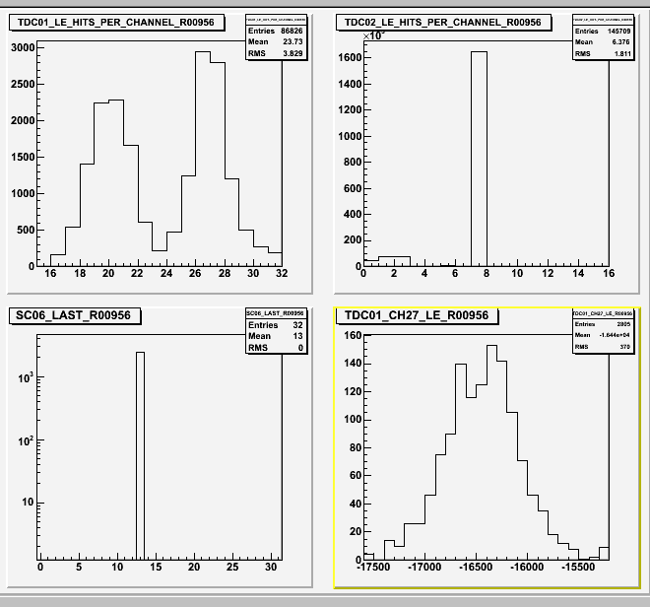
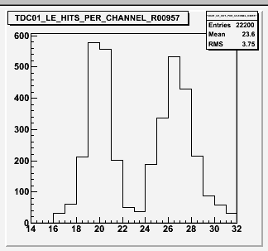
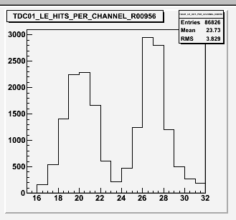
Decay Solenoid
Operation of Decay Solenoid is now routine
Provides gain of ~5 in pion flux – much more for muons
Without DS With DS

Slide 18
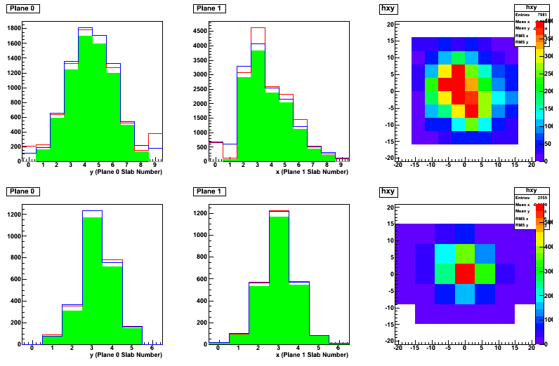
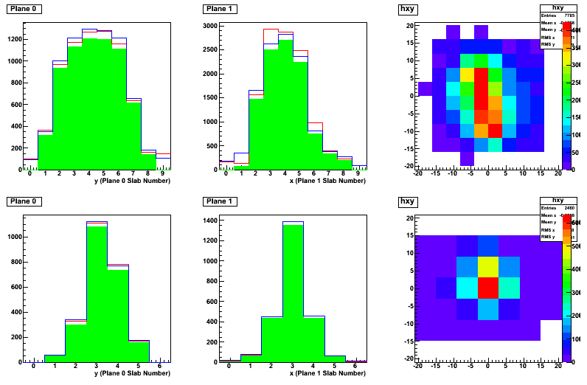
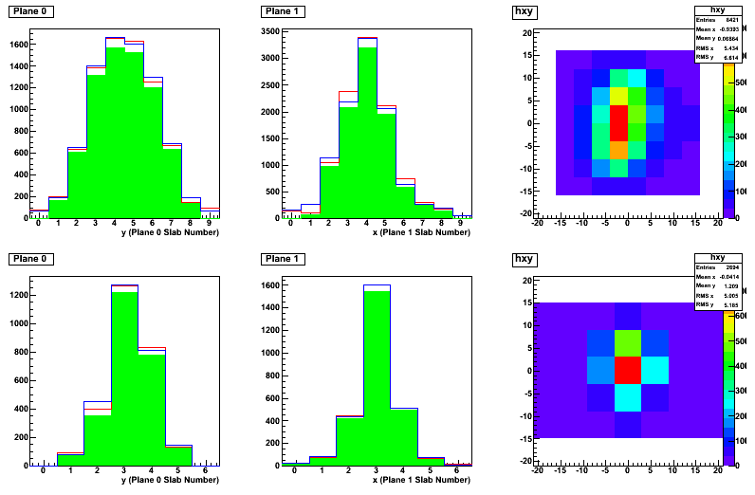
Decay Solenoid Optimisation
330 MeV/c pion beam
DS nominal setting 550 A (3.1 T)
Vary ± 10%, study profile in TOF0
TOF0 →
TOF 1 →
Run 1123 Nominal DS
Run 1125 DS up 0.30T
Run 1121 DS lower 0.30T
Preliminary!

Slide 19
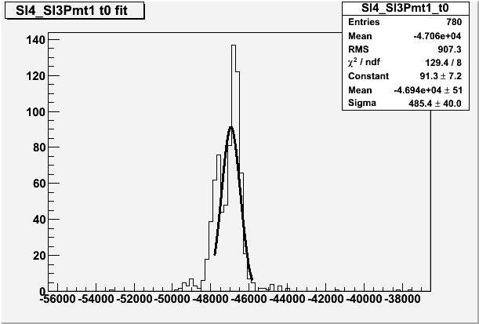
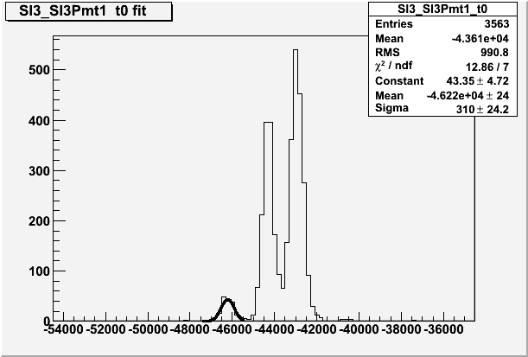
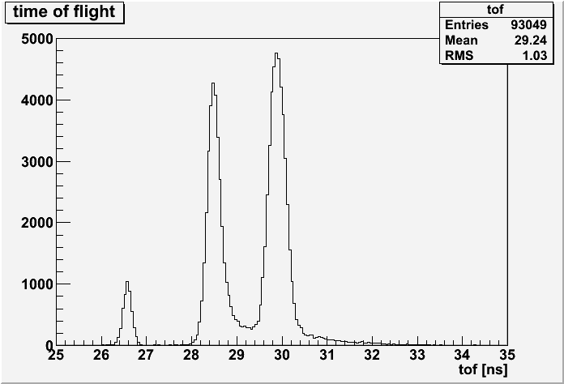
TOF Calibration
Many TOF bars to cross-calibrate
Needs lots of data!
2009
330 MeV/c
(peaks overlap)
2008
π
μ
TOF2 under construction (Milan)
to be delivered at end of this year.
2009
300 MeV/c
increased statistics
e

Slide 20
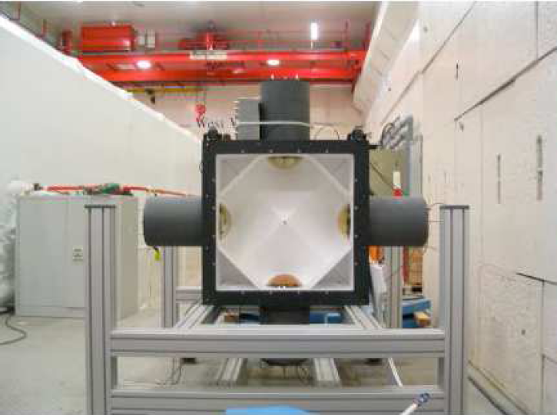
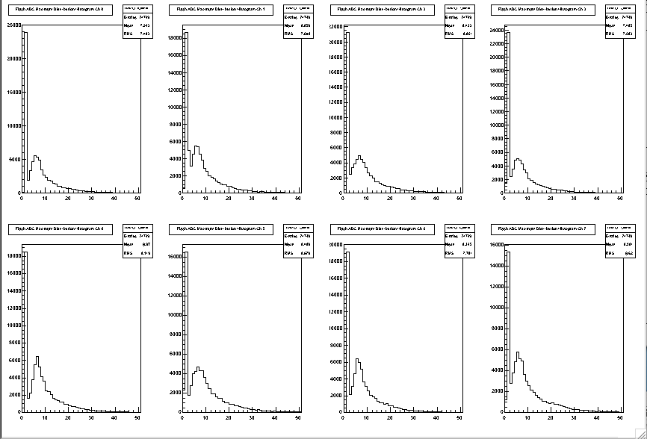
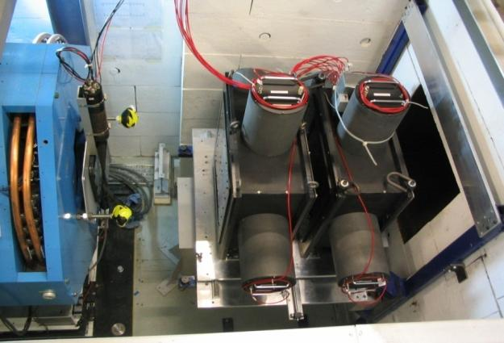
Cherenkovs
Two aerogel Cherenkov counters
Installed after Q6 and TOF1
To separate e/μ/π 220-350 MeV/c
e/μ/π calibration data taken
Sample electron data below

Slide 21
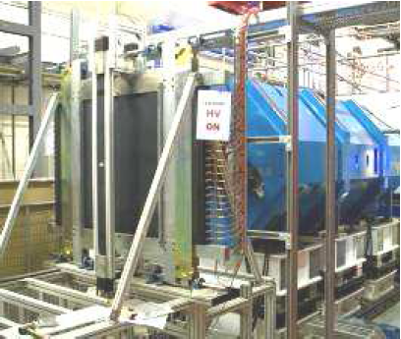
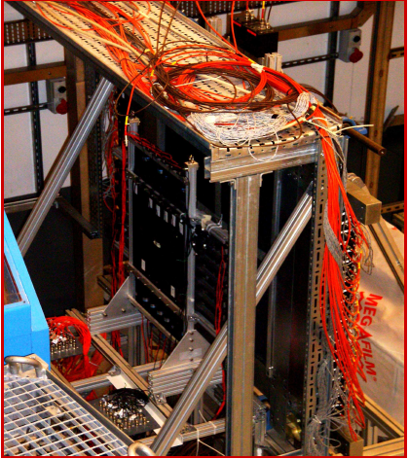
e/μ Identifier
KL
KL lead/scintillating fibre calorimeter module
Installed on temporary support in September
Calibration in progress
Will be followed by
Electron Muon Ranger (EMR)
See next slide
KL behind TOF1

Slide 22
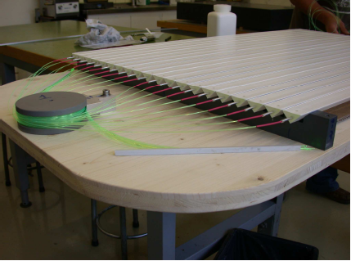
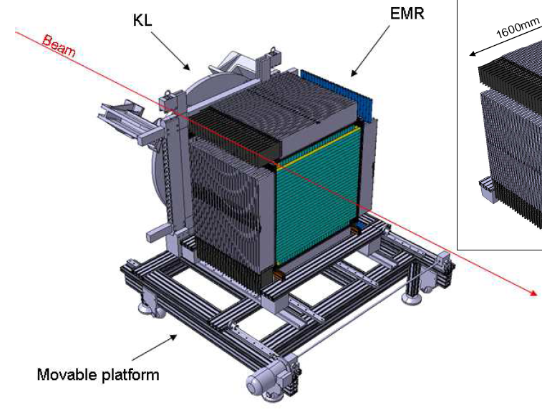
Electron-Muon Ranger (EMR)
50 1m² planes, 1.7 cm thick. Triangular scintillator bars + wavelength-shifter fibre readout.
to be installed July next year.

Slide 23
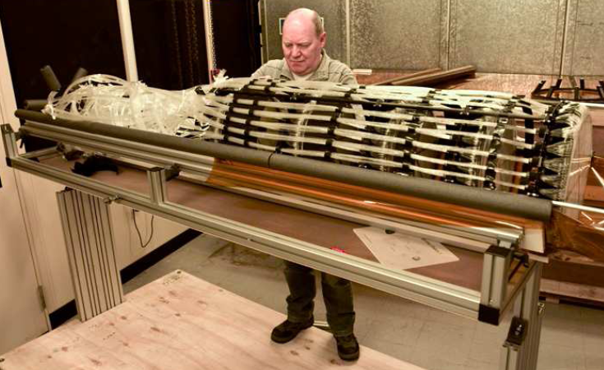
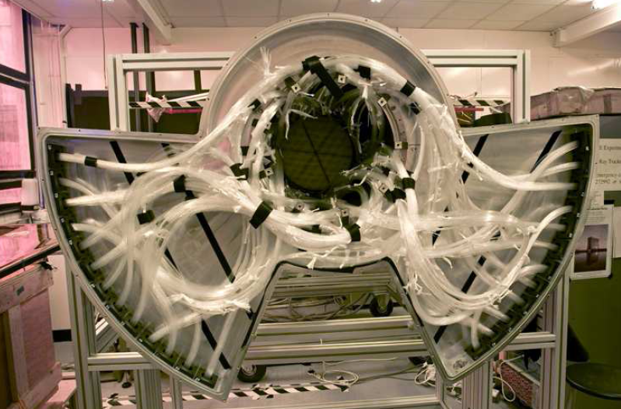
Scintillating Fibre Tracker
2nd tracker completed Feb.
Exposed to cosmics Mar-Aug.
Performs according to spec.
Final calibration in progress
Both trackers ready for installation

Slide 24
Summary
A huge amount of effort and progress during September!
Target reliably producing beam losses up to 2 V.
TOF providing valuable beam diagnostics.
Decay solenoid operating without problems.
Beam-line optimisations (DS, Qn, ...) performed.
Proton, pion, muon & electron beams, of various momenta, used for detector calibrations.
Data acquisition synchronisation problems fixed, limit on particles/spill raised from 40 to 250.
Data in use for off-line calibrations of TOF, Cherenkovs, KL.
We look forward to more data in November!!

