Slide 1
Halbach arrays for MICE PMs
Ben Shepherd
February 2012

Slide 2
Previously
Coil inner radius reduced to 8.1mm
PM outer radius kept at 7.5mm (i.e. 0.6mm gap)
Calculated force (from 2D model): 75N

Slide 3
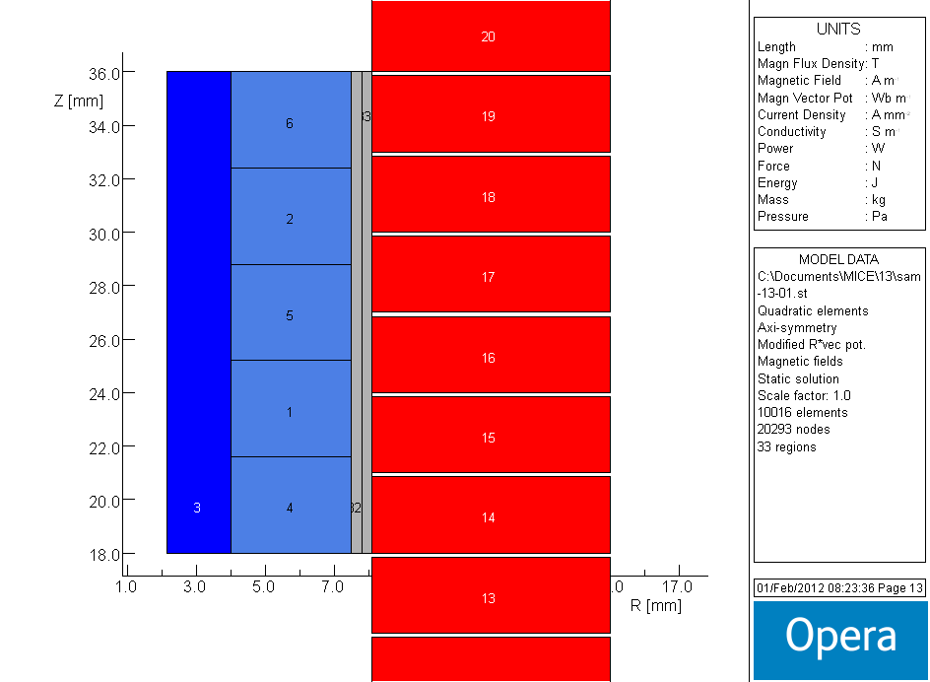
Add axially-magnetised blocks
Keep overall length at 18mm
Five equal blocks, 3.6mm long
Force increased to 95N

Slide 4
Optimisation of block sizes
initial
Overall length constant at 18mm
Block lengths:
a = 2.5mm
b = 4.0mm
c = 5.0mm
Force: 107.2N
final
a
b
c
b
a

