Slide 1
The MICE Target
Hitting the ISIS Beam to a Hair's Breadth
Paul J Smith
University of Sheffield

Slide 2
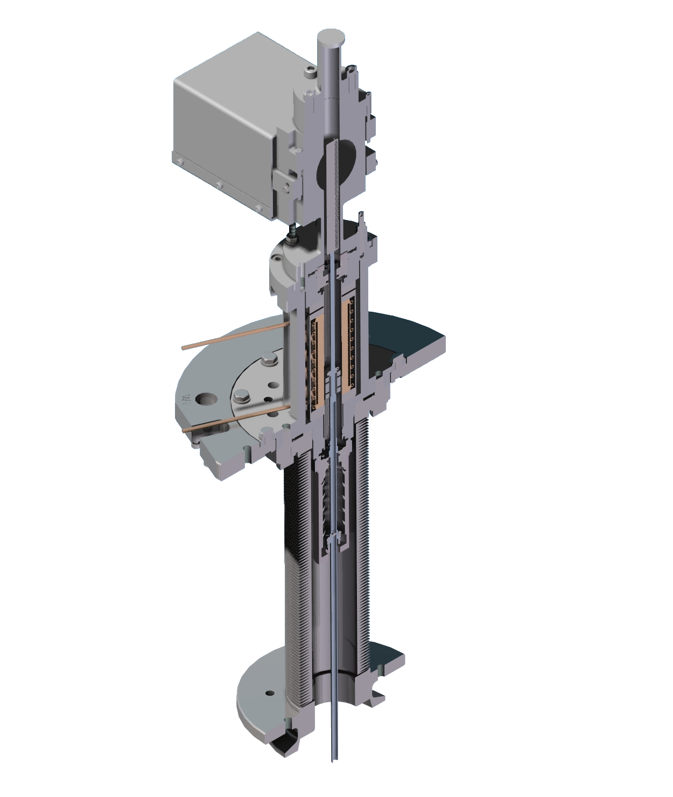
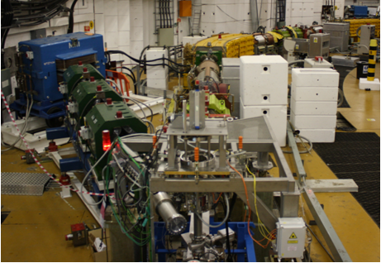
What is the Target Mechanism?
Optics Block
The target mechanism is an electromechanical device that rapidly inserts a small titanium target into the circulating proton beam of ISIS immediately prior to extraction without unduly disturbing the primary proton beam.
Top Bearing
Stator
Pions created from the interaction with the target are collected by the MICE beamline where they undergo decay to muons for use in the MICE experiment.
Permanent Magnets
Bottom Bearing
Dust Trap
Target

Slide 3
Timeline of Developments
2003
Initial Specification Determined.
In preparing for this talk I reviewed a lot of the material that has been produced for the collaboration over the last 7 years.
The following slides are mostly a photo album tour showing the highlights of the development of the MICE Target.

Slide 4
Original Specification - 2003
A lot of the figures for the original specification were ‘best estimates’ based upon what was known at the time and from operation of the old HEP target on ISIS.
Enter last 1-2 ms of beam.
Not disturb next injection.
Resonant system disfavoured. On demand actuation preferred.
Baseline frequency of 1 Hz.
Travel estimated 25 mm but variable
Required entry into beam estimated 5 mm.
Reproducibility 0.2 mm.
Accurately synchronised to ISIS, drift/jitter 0.2 ms.
Slit across beam pipe 2 mm wide max.
Target titanium 1 mm across beam, 10 mm along.
Radiation hard, UHV materials.
It was estimated that it would require 1.4 E12 protons out of 2.5 E13 protons per pulse to interact with the 10 mm length of the target in order to generate 600 good muons per intercepted spill.

Slide 5
Original Specification - 2003
A lot of the figures for the original specification were ‘best estimates’ based upon what was known at the time and from operation of the old HEP target on ISIS.
Enter last 1-2 ms of beam.
Not disturb next injection.
Resonant system disfavoured. On demand actuation preferred.
Baseline frequency of 1 Hz.
Particles are of right energy for MICE
Reduces losses for ISIS which nominally operates at 50 Hz.
Travel estimated 25 mm but variable
Required entry into beam estimated 5 mm.
Reproducibility 0.2 mm.
Accurately synchronised to ISIS, drift/jitter 0.2 ms.
Slit across beam pipe 2 mm wide max.
Target titanium 1 mm across beam, 10 mm along.
Radiation hard, UHV materials.
It was estimated that it would require 1.4 E12 protons out of 2.5 E13 protons per pulse to interact with the 10 mm length of the target in order to generate 600 good muons per intercepted spill.

Slide 6
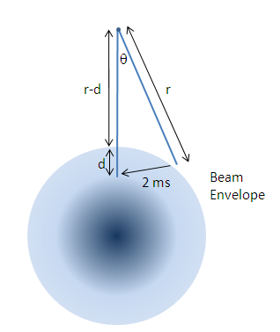
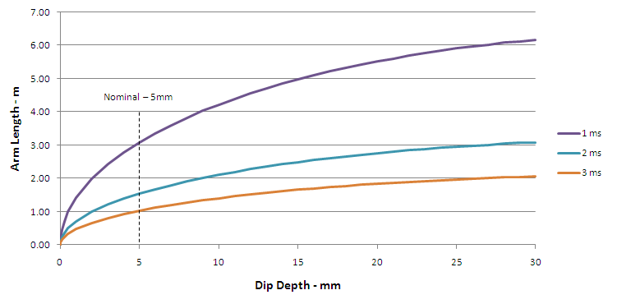
Original Specification - 2003
A lot of the figures for the original specification were ‘best estimates’ based upon what was known at the time and from operation of the old HEP target on ISIS.
Enter last 1-2 ms of beam.
Not disturb next injection.
Resonant system disfavoured. On demand actuation preferred.
Baseline frequency of 1 Hz.
Travel estimated 25 mm but variable
Required entry into beam estimated 5 mm.
Reproducibility 0.2 mm.
Accurately synchronised to ISIS, drift/jitter 0.2 ms.
Slit across beam pipe 2 mm wide max.
Target titanium 1 mm across beam, 10 mm along.
Radiation hard, UHV materials.
Initial studies indicated that an electromagnetic linear motor was the best way of achieving these objectives
It was estimated that it would require 1.4 E12 protons out of 2.5 E13 protons per pulse to interact with the 10 mm length of the target in order to generate 600 good muons per intercepted spill.

Slide 7
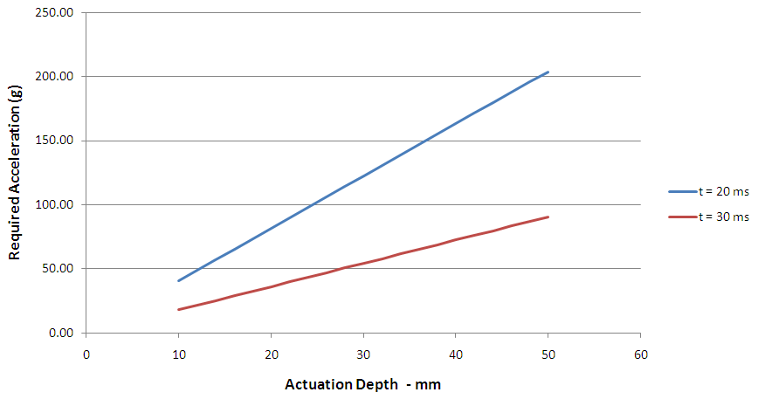
Original Specification - 2003
A lot of the figures for the original specification were ‘best estimates’ based upon what was known at the time and from operation of the old HEP target on ISIS.
Enter last 1-2 ms of beam.
Not disturb next injection.
Resonant system disfavoured. On demand actuation preferred.
Baseline frequency of 1 Hz.
Travel estimated 25 mm but variable.
Required entry into beam estimated 5 mm.
Reproducibility 0.2 mm.
Accurately synchronised to ISIS, drift/jitter 0.2 ms.
Slit across beam pipe 2 mm wide max.
Target titanium 1 mm across beam, 10 mm along.
Radiation hard, UHV materials.
Hair’s Breadth!
It was estimated that it would require 1.4 E12 protons out of 2.5 E13 protons per pulse to interact with the 10 mm length of the target in order to generate 600 good muons per intercepted spill.

Slide 8
Original Specification - 2003
A lot of the figures for the original specification were ‘best estimates’ based upon what was known at the time and from operation of the old HEP target on ISIS.
Enter last 1-2 ms of beam.
Not disturb next injection.
Resonant system disfavoured. On demand actuation preferred.
Baseline frequency of 1 Hz.
Travel estimated 25 mm but variable
Required entry into beam estimated 5 mm.
Reproducibility 0.2 mm.
Accurately synchronised to ISIS, drift/jitter 0.2 ms.
Slit across beam pipe 2 mm wide max.
Target titanium 1 mm across beam, 10 mm along.
Radiation hard, UHV materials.
The requirement for a 2mm wide slot was later not necessary as the target was given a port, but this requirement drove the initial design of using a blade.
Also another reason to preclude the use of a rotary target system.
It was estimated that it would require 1.4 E12 protons out of 2.5 E13 protons per pulse to interact with the 10 mm length of the target in order to generate 600 good muons per intercepted spill.

Slide 9
Original Specification - 2003
A lot of the figures for the original specification were ‘best estimates’ based upon what was known at the time and from operation of the old HEP target on ISIS.
Enter last 1-2 ms of beam.
Not disturb next injection.
Resonant system disfavoured. On demand actuation preferred.
Baseline frequency of 1 Hz.
Travel estimated 25 mm but variable
Required entry into beam estimated 5 mm.
Reproducibility 0.2 mm.
Accurately synchronised to ISIS, drift/jitter 0.2 ms.
Slit across beam pipe 2 mm wide max.
Target titanium 1 mm across beam, 10 mm along.
Radiation hard, UHV materials.
Solving this problem has been the hardest!
It was estimated that it would require 1.4 E12 protons out of 2.5 E13 protons per pulse to interact with the 10 mm length of the target in order to generate 600 good muons per intercepted spill.

Slide 10
Timeline of Developments
2003
Initial specification determined.
2004
First stator built - 6 coils – Heavy magnets ~100g.
Initial development of some basic control & power circuits.
2005
Diaphragm springs developed.
Electronic quadrature encoder trialled.
Magnetic Hall encoder trialled.

Slide 11
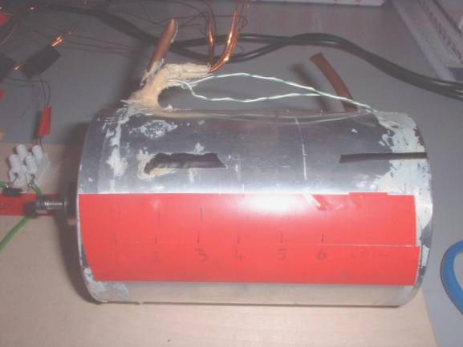
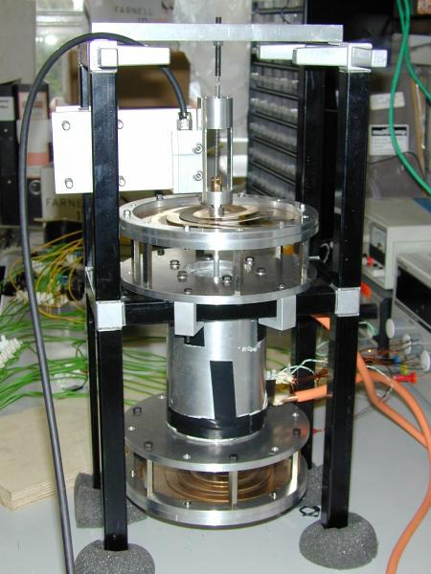
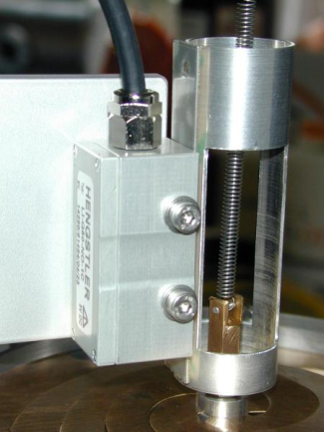
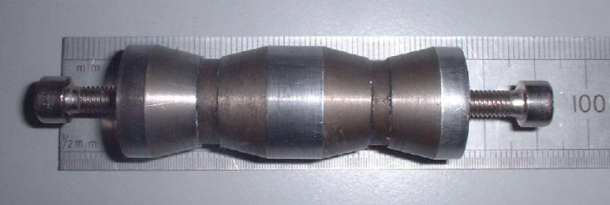
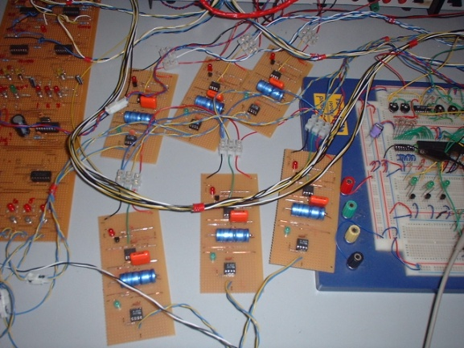
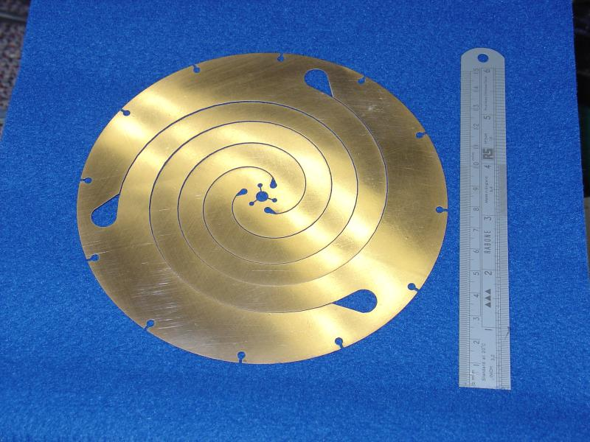
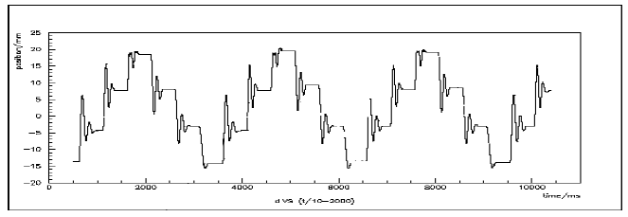
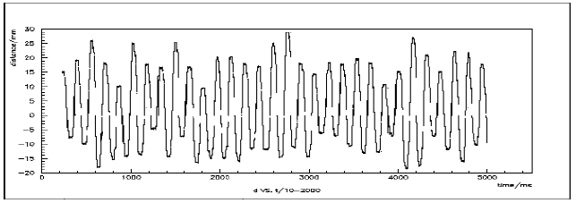
Timeline of Developments
This stator was known to be inadequate.
The diaphragm springs were not stiff enough and added too much mass.
Quadrature Encoder was good but we needed an optical, non-contact version.
A Basic DAQ was built.
2003
Initial specification determined.
2004
First stator built - 6 coils – Heavy magnets ~100g.
Initial development of some basic control & power circuits.
2005
Diaphragm springs developed.
Electronic quadrature encoder trialled.
Magnetic Hall encoder trialled.

Slide 12
Timeline of Developments
2003
Initial specification determined.
2004
First stator built - 6 Coils – Heavy magnets.
Initial development of some basic control & power circuits.
2005
Diaphragm springs developed.
Electronic quadrature encoder trialled.
Magnetic Hall encoder trialled.
New stator (24 coil design).
10A power supply.
2006
Quadrature encoder turned into an optical system – 150µm resolution
Control electronics developed – PIC based.
Cruciform shaft & full optics block
RAL R78 assembly tests & first target tests on ISIS

Slide 13
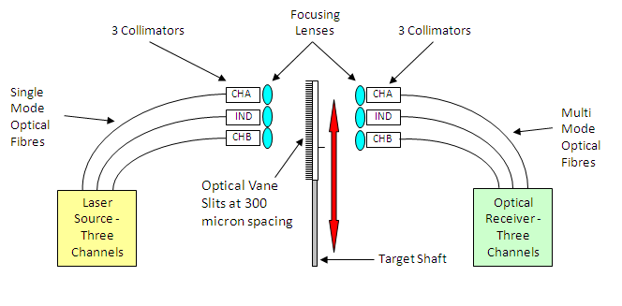
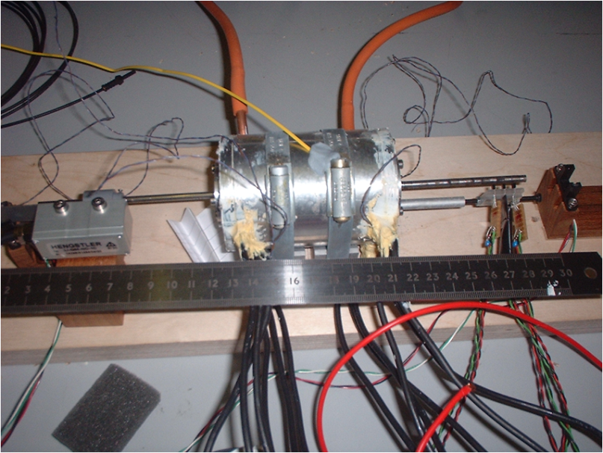
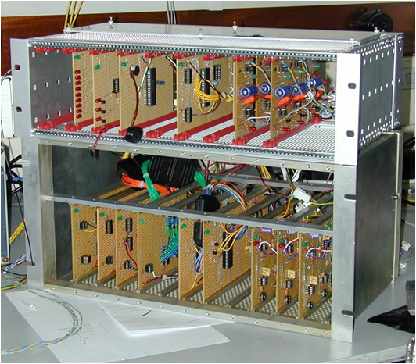
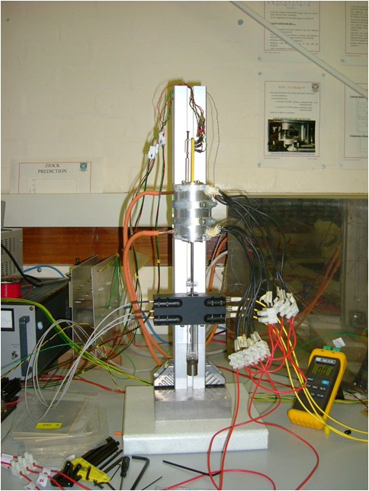
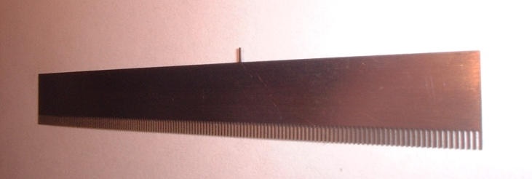
Timeline of Developments
2003
Initial specification determined.
2004
First stator built - 6 Coils – Heavy magnets.
Initial development of some basic control & power circuits.
2005
Diaphragm springs developed.
Electronic quadrature encoder trialled.
Magnetic Hall encoder trialled.
New stator (24 coil design).
10A power supply.
2006
Quadrature encoder turned into an optical system – 150µm resolution
Control electronics developed – PIC based.
Cruciform shaft & full optics block
RAL R78 assembly tests & first target tests on ISIS

Slide 14
Timeline of Developments
2003
Initial Specification Determined.
2004
First Stator Built - 6 Coils – Heavy magnets.
Initial development of some basic control & power circuits.
2005
Diaphragm springs Developed.
Electronic Quadrature encoder trialled.
Magnetic Hall encoder trialled.
New stator (24 coil design).
10A power supply.
2006
Quadrature encoder turned into an optical system.
Control Electronics Developed
Cruciform shaft & full optics block
RAL R78 assembly tests & first target tests on ISIS

Slide 15
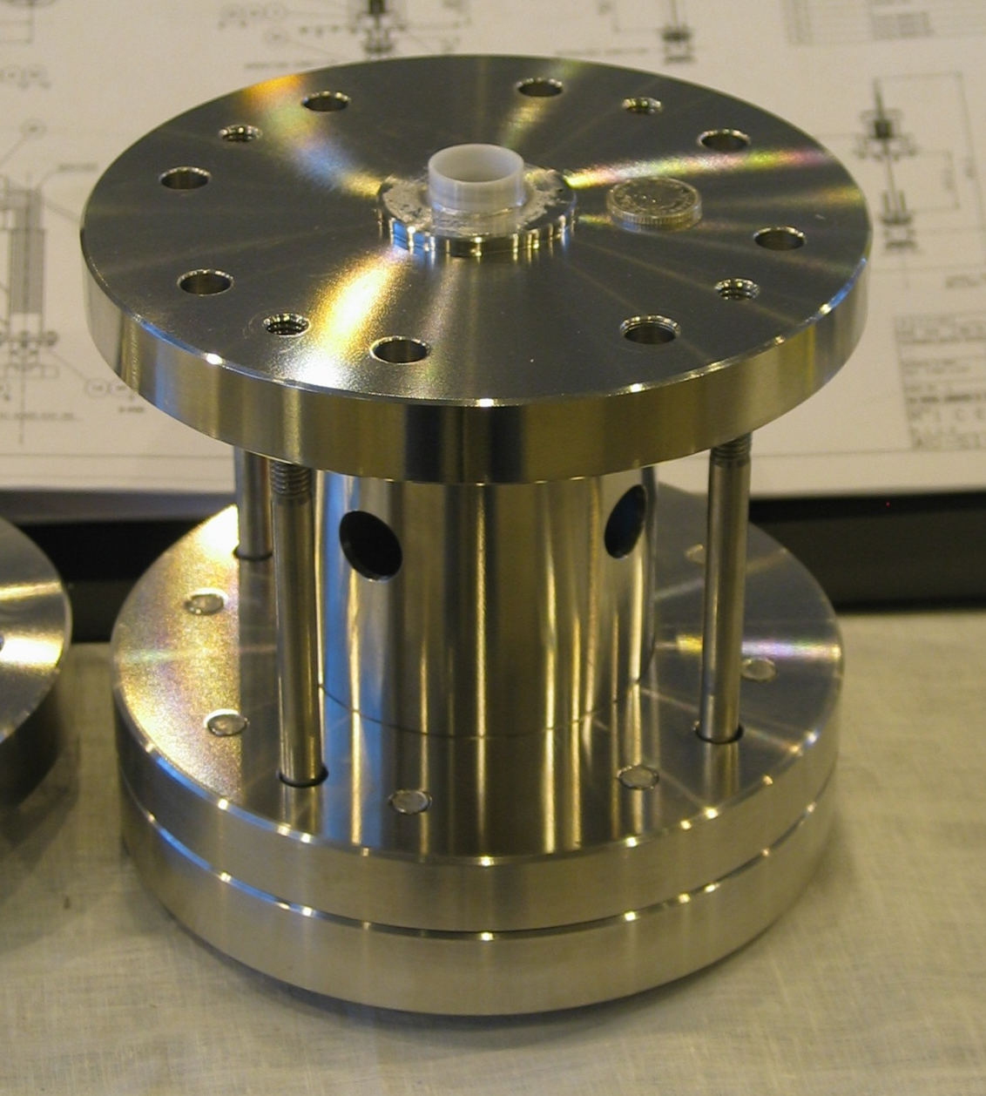
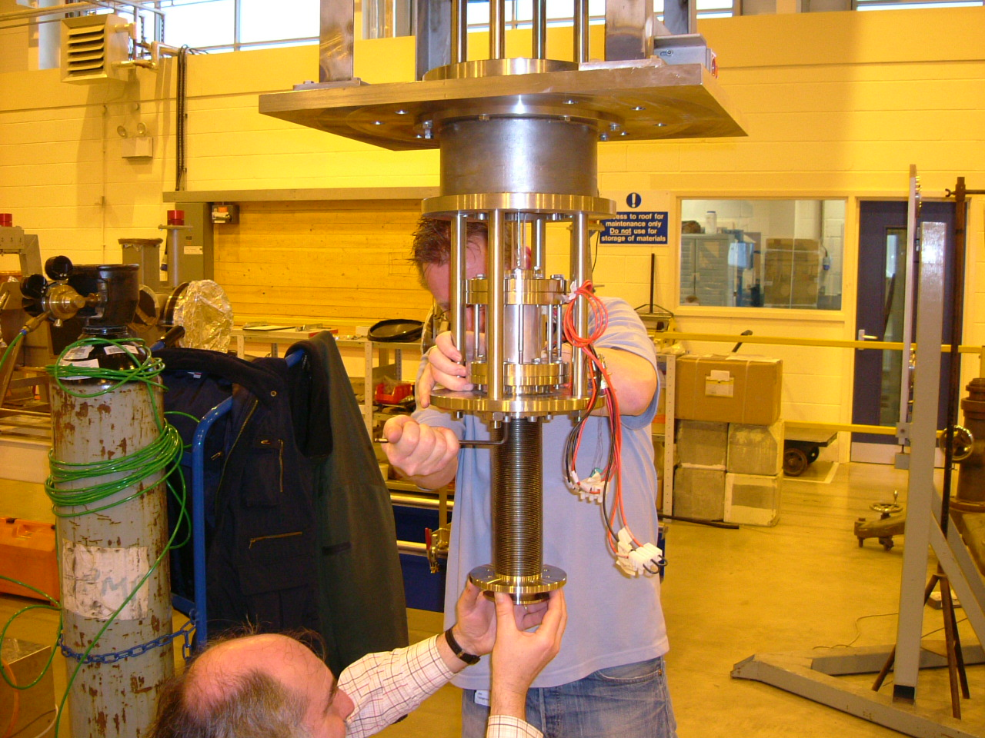
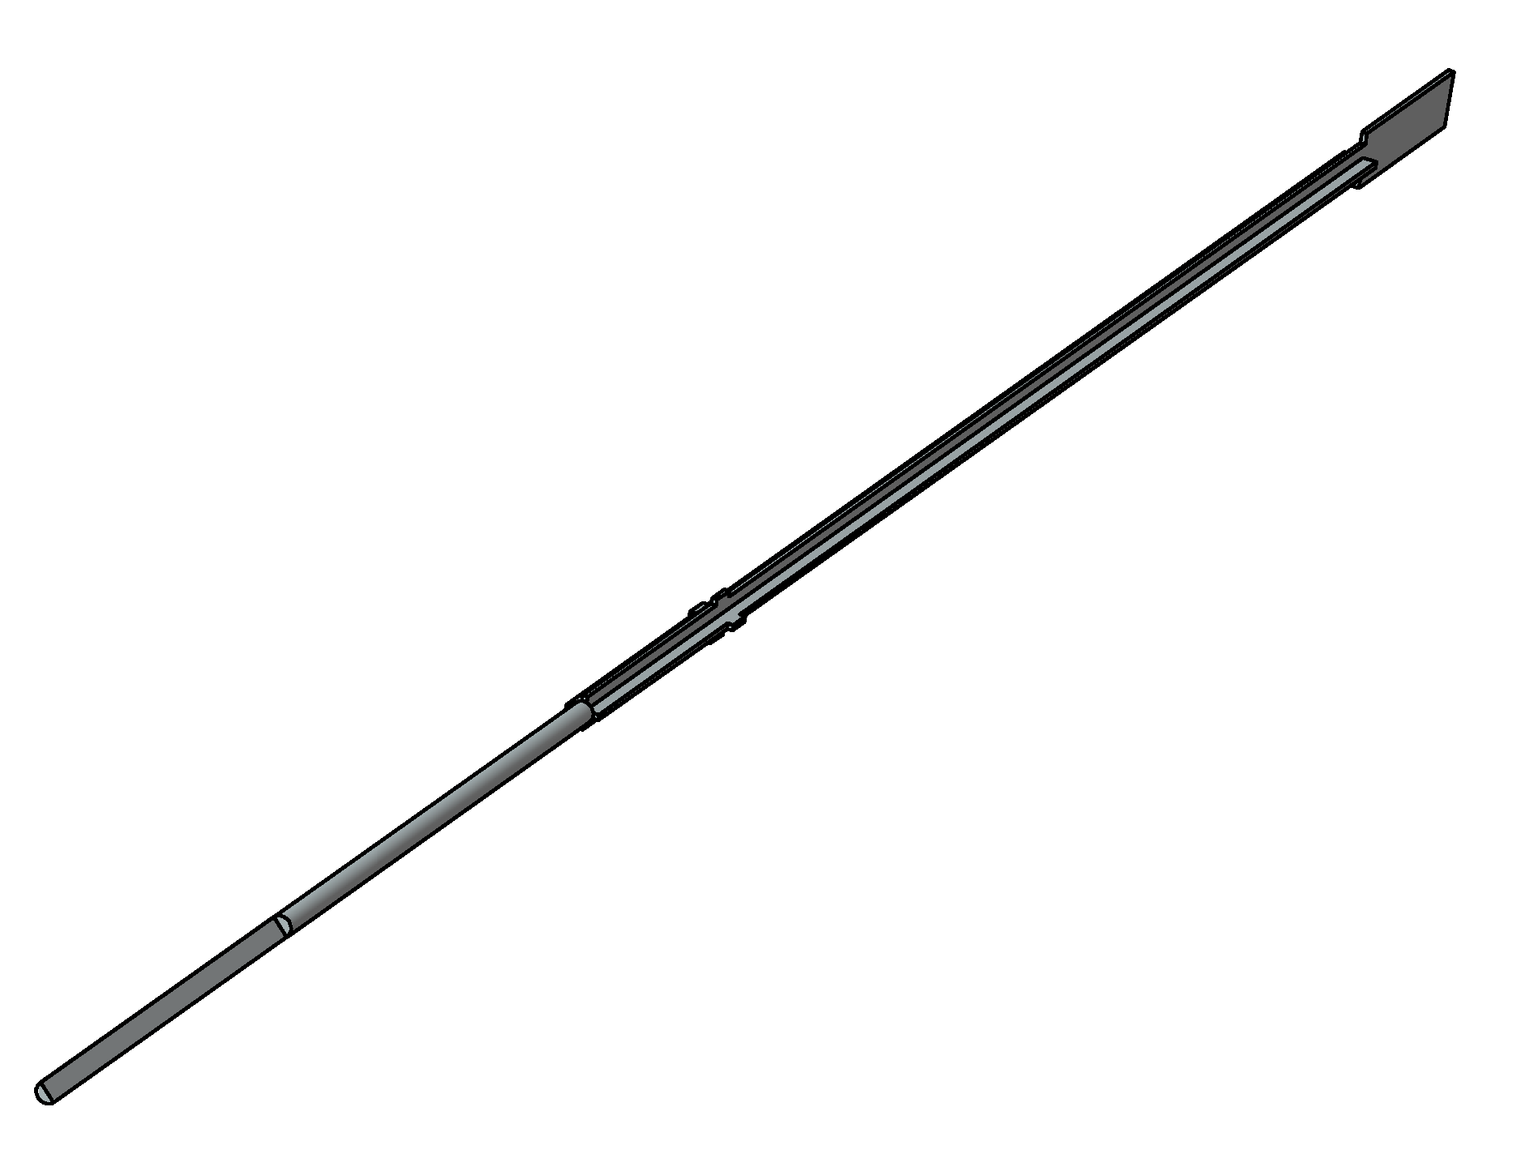
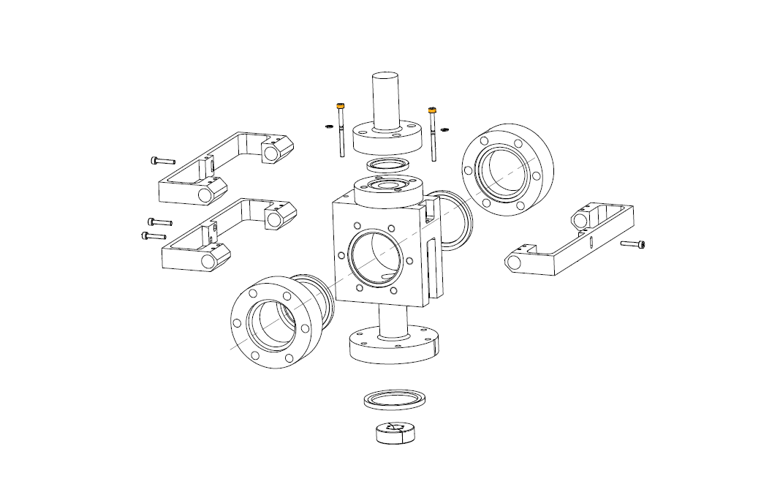
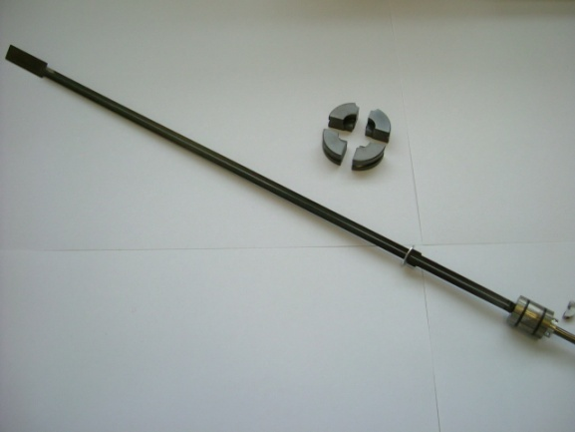
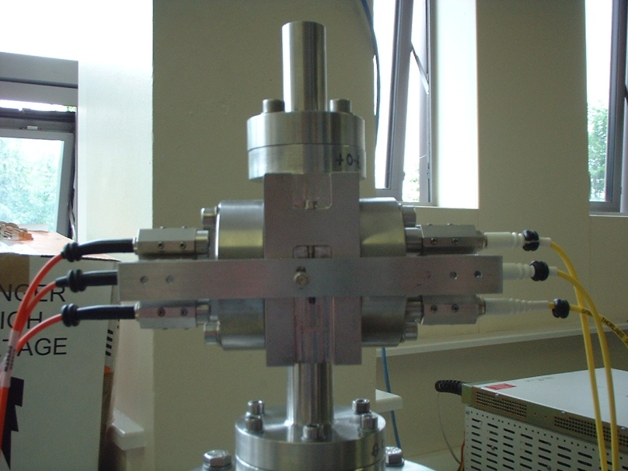
Timeline of Developments
2003
Initial Specification Determined.
2004
First Stator Built - 6 Coils – Heavy magnets.
Initial development of some basic control & power circuits.
2005
Diaphragm springs Developed.
Electronic Quadrature encoder trialled.
Magnetic Hall encoder trialled.
New stator (24 coil design).
10A power supply.
2006
Quadrature encoder turned into an optical system.
Control Electronics Developed
Cruciform shaft & full optics block
RAL R78 assembly tests & first target tests on ISIS

Slide 16
Timeline of Developments
2006 Target Tests performed in the MICE Hall.
Aimed to Understand
– ISIS beam profile (r,t)
– Beam loss caused by the new target
What we were not trying to do:
– It was not the aim to test the final target (as this didn’t exist!) but to learn how well the current prototype matched the assumed ISIS parameters.

Slide 17
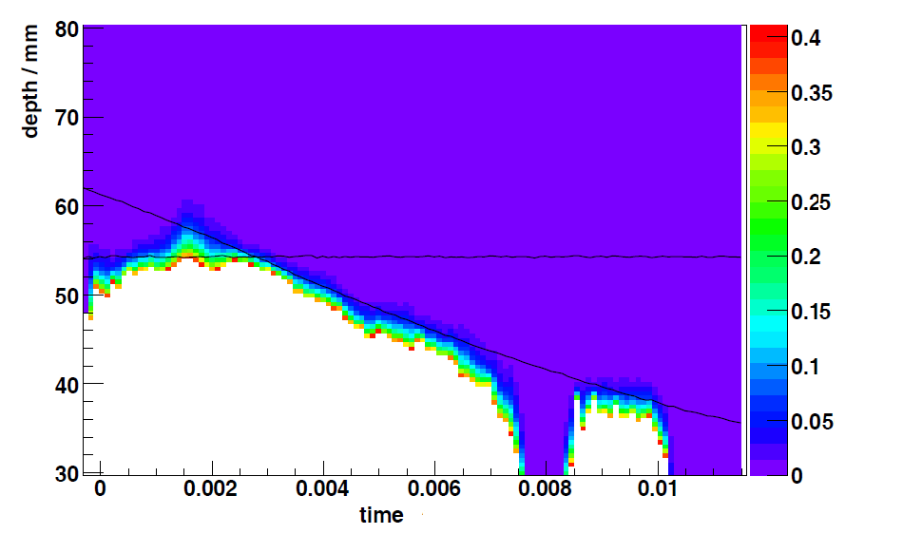
2006 Target Tests
Beamloss (Vms)
(s)
MICE Note 165:
Analysis of Target Beam Test Data
http://mice.iit.edu/micenotes/public/pdf/MICE0165/MICE0165.pdf

Slide 18
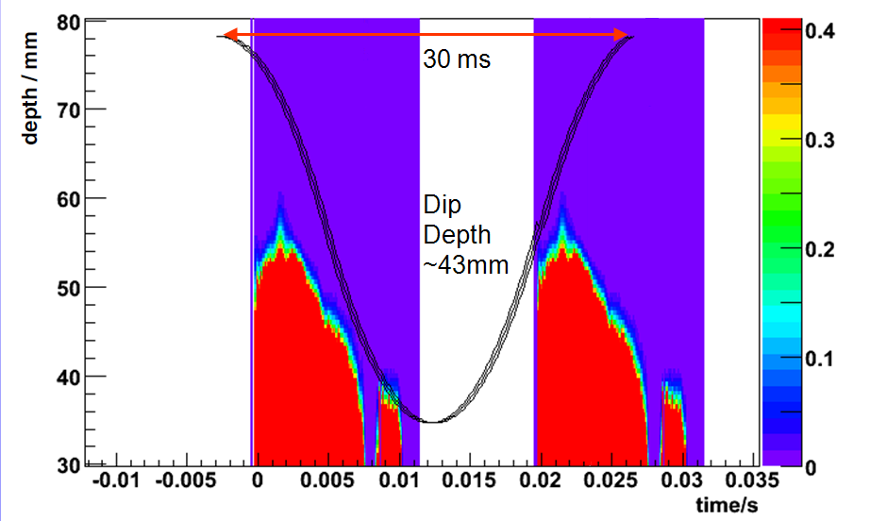
2006 Target Tests
Beamloss (Vms)
(s)
Beamloss (Vms)
MICE Note 165:
Analysis of Target Beam Test Data
http://mice.iit.edu/micenotes/public/pdf/MICE0165/MICE0165.pdf

Slide 19
2006 Target Tests
Beamloss (Vms)
(s)
Beamloss (Vms)
MICE Note 165:
Analysis of Target Beam Test Data
http://mice.iit.edu/micenotes/public/pdf/MICE0165/MICE0165.pdf

Slide 20
Timeline of Developments
2007
New Power supply designed to supply currents of 60A to stator via capacitor banks.
Control algorithms adopted to deal with higher accelerations.
Bearing tests performed at Sheffield Revealed Ceramic bearings to be inadequate
Bearing Trials – Found Diamond Like Carbon (DLC) on DLC gave the best results.
First ‘Installation Ready’ target control system completed.

Slide 21
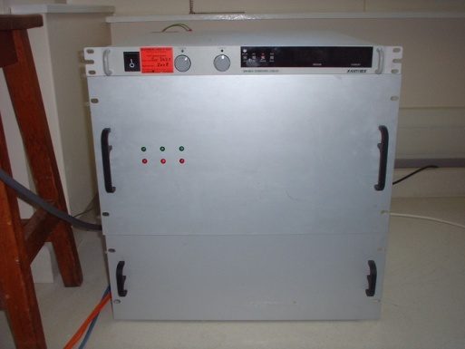
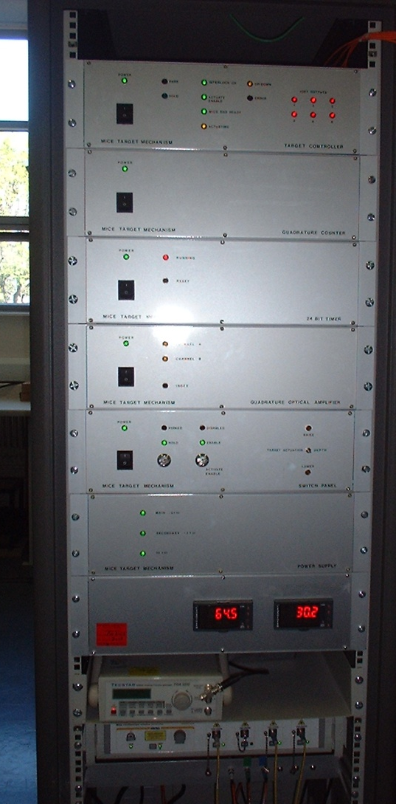
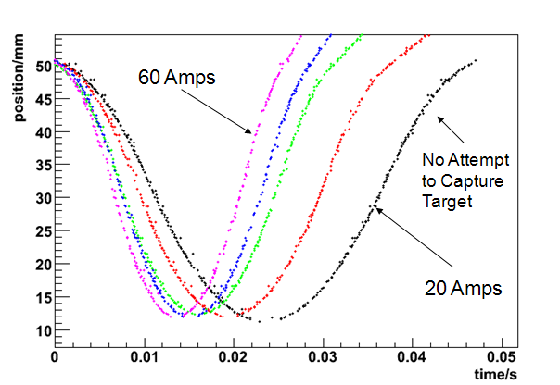
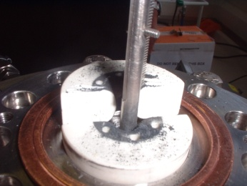
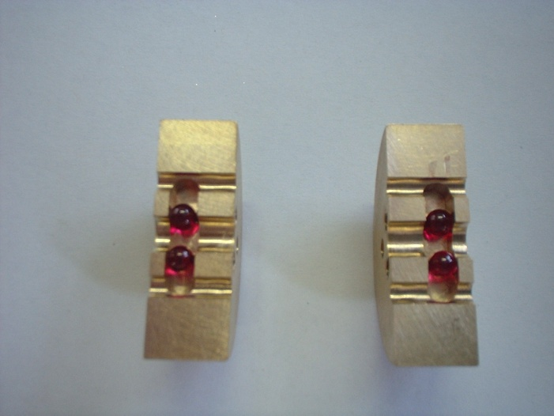
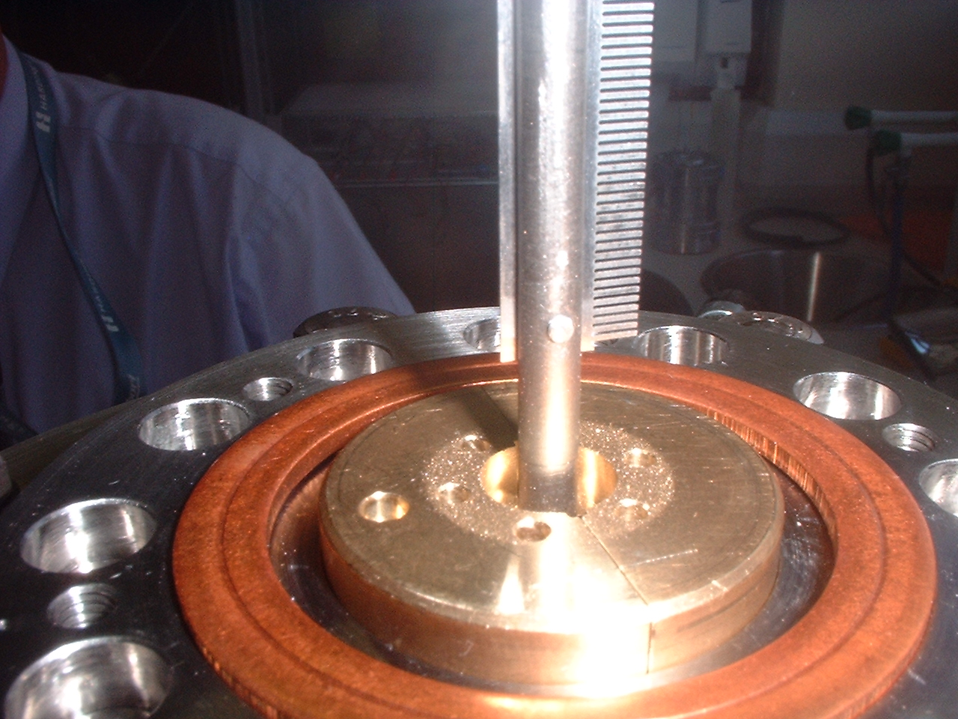
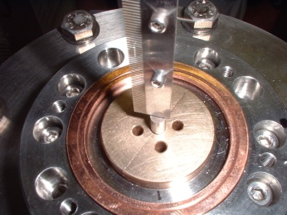
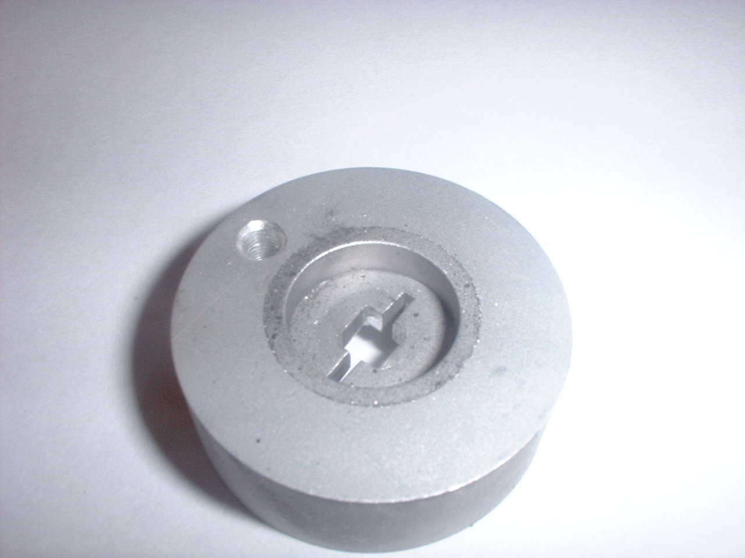
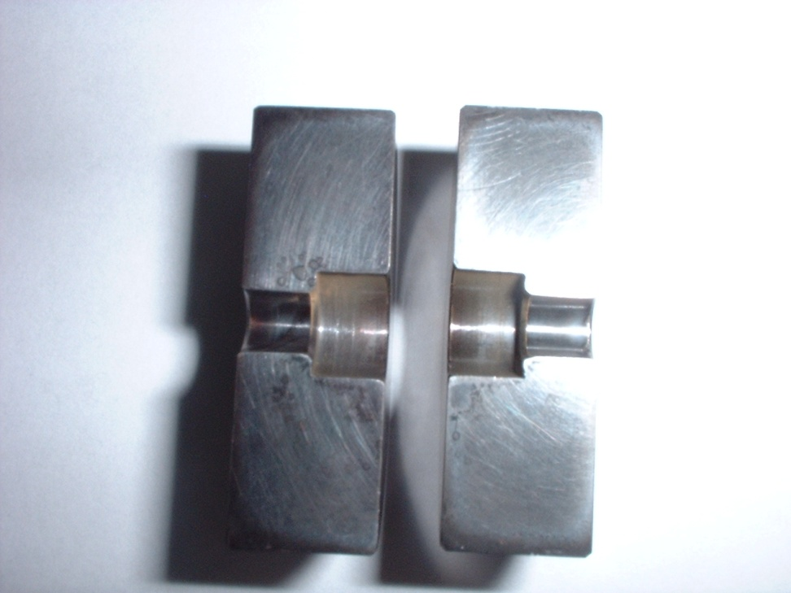
Timeline of Developments
2007
New Power supply designed to supply currents of 60A to stator via capacitor banks.
Control algorithms adopted to deal with higher accelerations.
Bearing tests performed at Sheffield Revealed Ceramic bearings to be inadequate
Bearing Trials – Found Diamond Like Carbon (DLC) on DLC gave the best results.
First ‘Installation Ready’ target control system completed.

Slide 22
Timeline of Developments
2007
New Power supply designed to supply currents of 60A to stator via capacitor banks.
Control algorithms adopted to deal with higher accelerations.
Bearing tests performed at Sheffield, Revealed Ceramic bearings to be inadequate?
Bearing Trials – Found DLC on DLC to give best results.
First Installation ready target control system completed.
2008
First Target (T0) Installed on ISIS in January – Target ran until Dec 2008 (190K pulses).
Running Tests with Demonstrator Targets R78 revealed electrical problems with design.
Split Power Supplies Designed to reduce voltage stress – Improved QA on coil testing.
New Target produced and Run in R78 – performs 340K actuations before bearing failure.
Jason Tarrant Joined the Target team to improve the mechanical design.

Slide 23
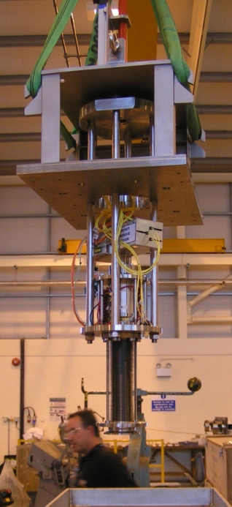
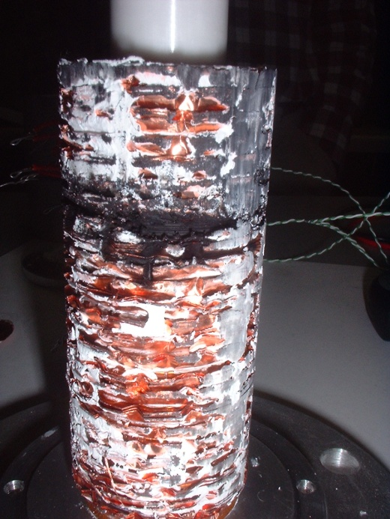
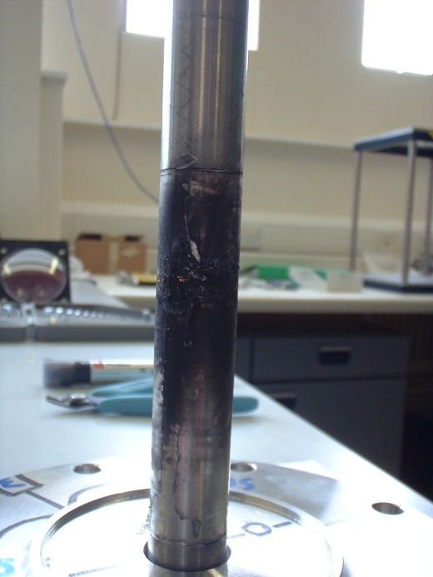
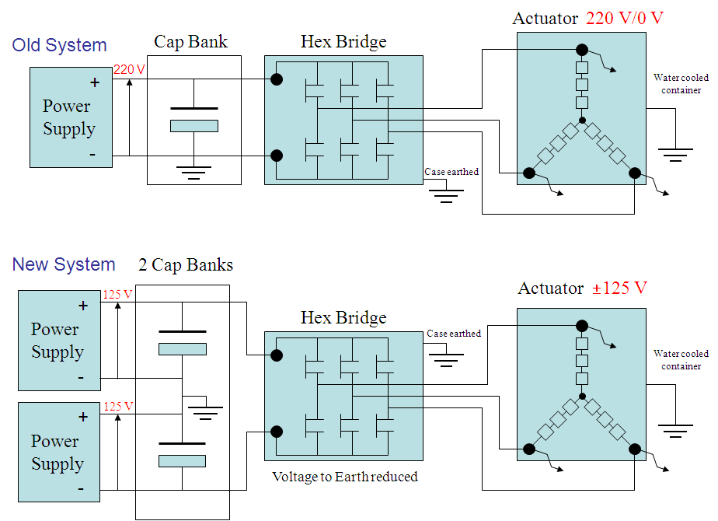
Timeline of Developments
2007
New Power supply designed to supply currents of 60A to stator via capacitor banks.
Control algorithms adopted to deal with higher accelerations.
Bearing tests performed at Sheffield, Revealed Ceramic bearings to be inadequate?
Bearing Trials – Found DLC on DLC to give best results.
First Installation Ready target control system completed.
2008
First Target (T0) Installed on ISIS in January – Target ran until Dec 2008 (190K pulses).
Running Tests with Demonstrator Targets R78 revealed electrical problems with design.
Split Power Supplies Designed to reduce voltage stress – Improved QA on coil testing.
New Target produced and Run in R78 – performs 340K actuations before bearing failure.
Jason Tarrant Joined the Target team to improve the mechanical design.

Slide 24
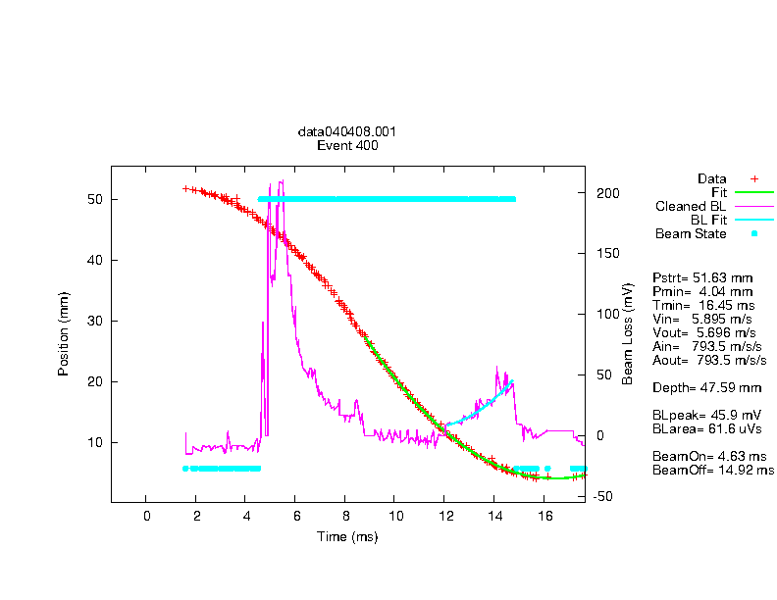
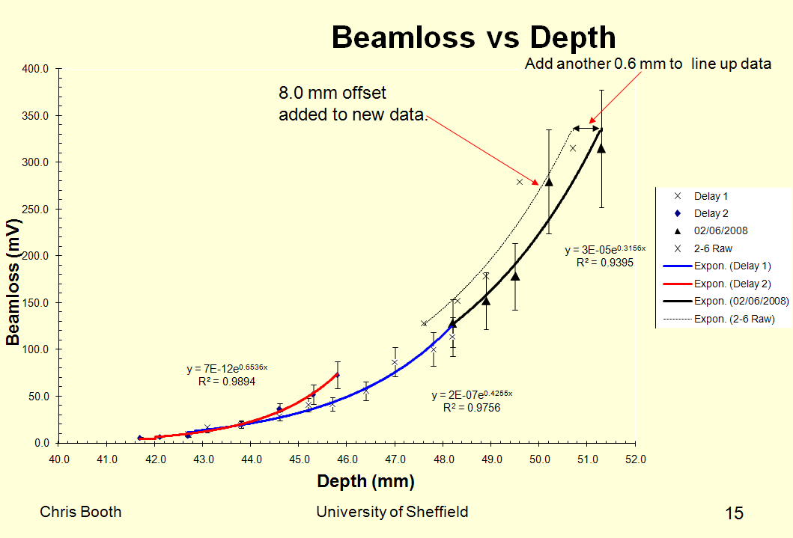
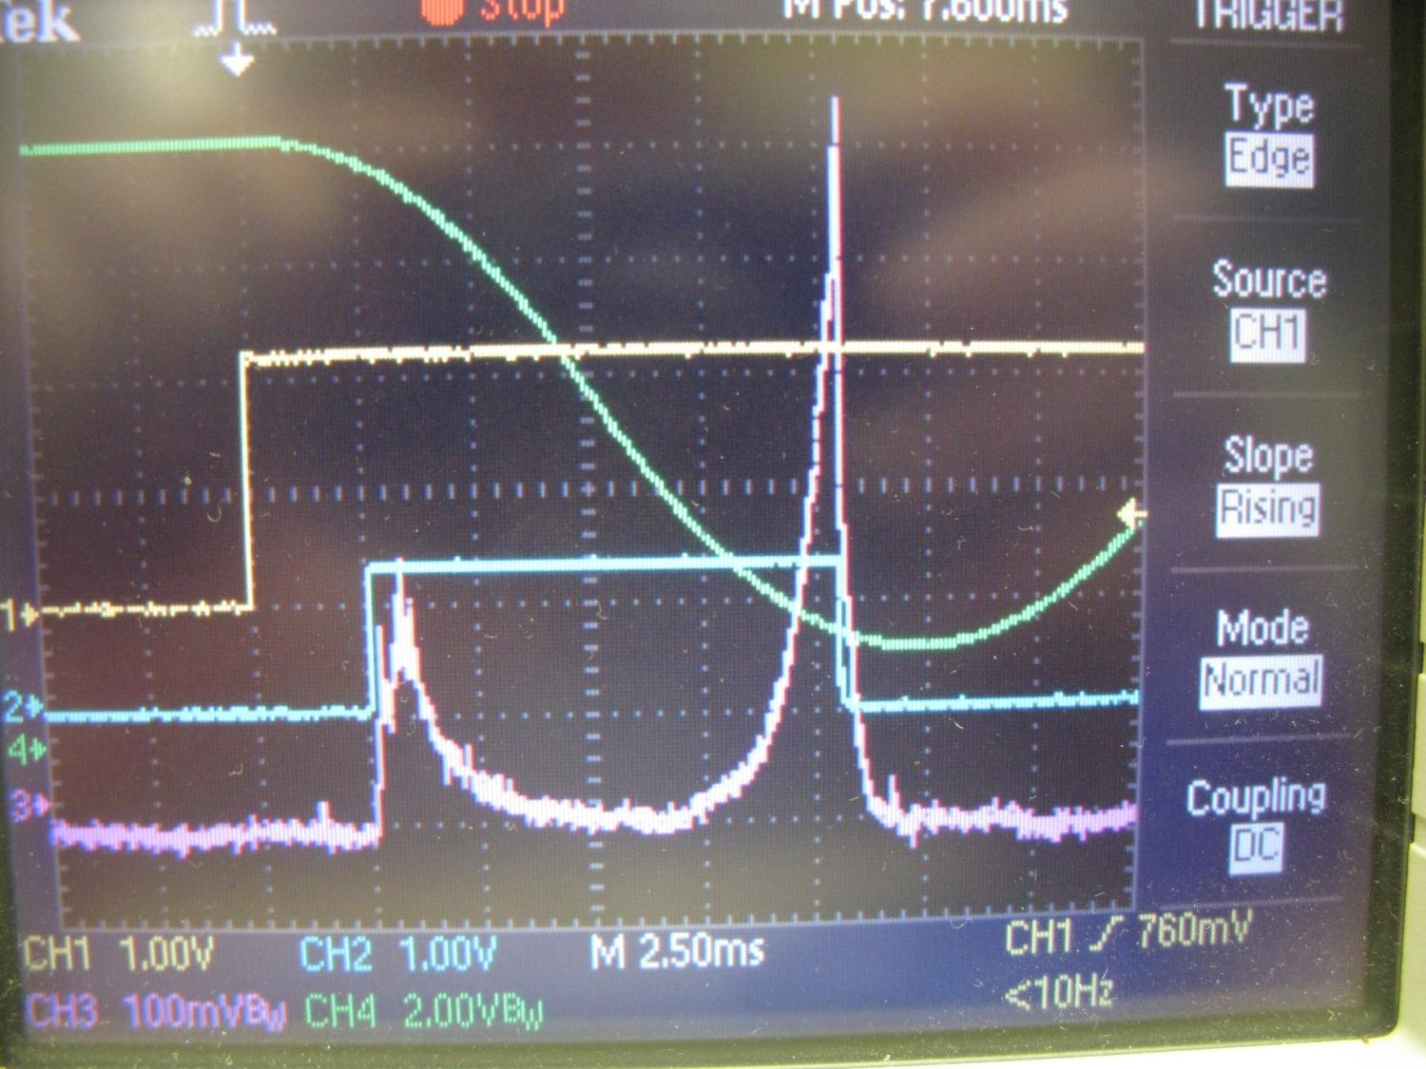
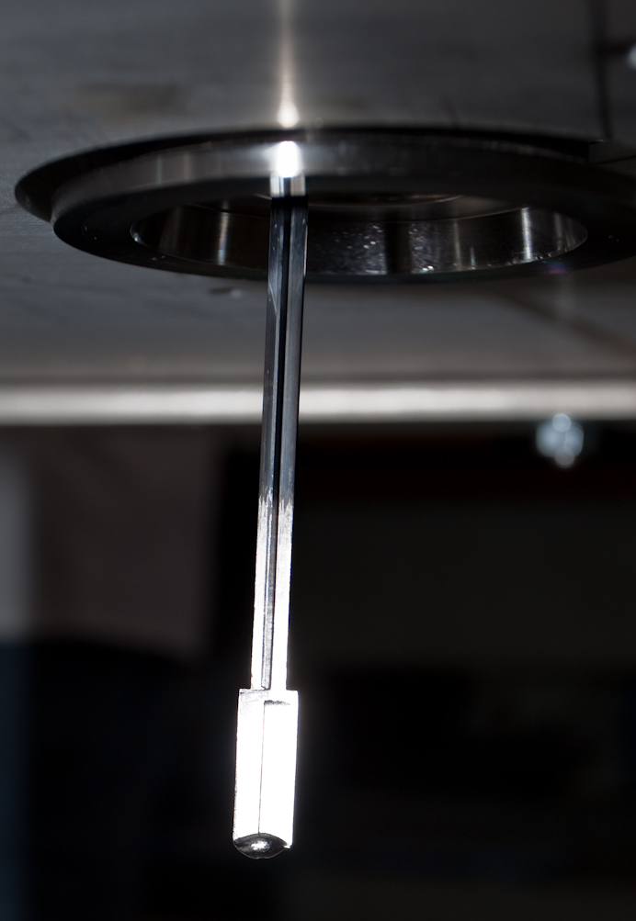
T(0) Operations
T(0) Mapped Beamloss vs Target Operation.
Permitted commissioning of the MICE beamline (190K Actuations).
More in the next presentation on what MICE has done with the targets!
Target was broken in Dec 2008

Slide 25
Timeline of Developments
2009
Cruciform shaft design changed to a cylindrical design.
Bearing design changed.
Second stator (T1) tested and installed on ISIS (August 2009)– DLC on DLC .
Controller upgrade - Phase 1 started.
Stator tests T2.1 and T2.2 in R78.

Slide 26
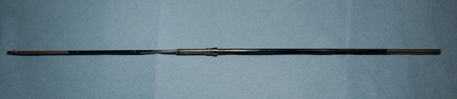
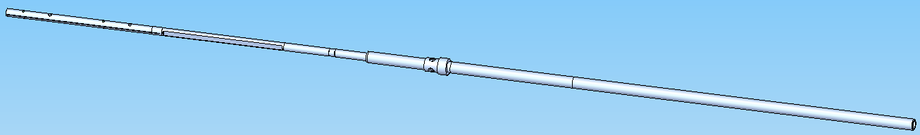
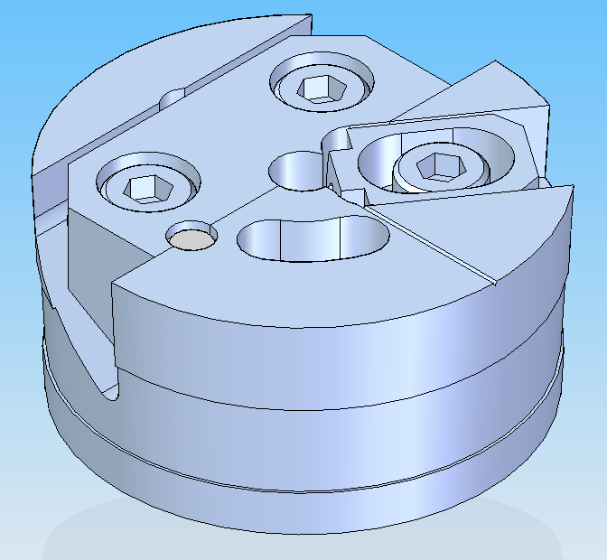
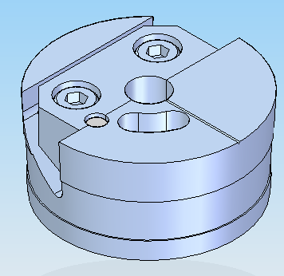
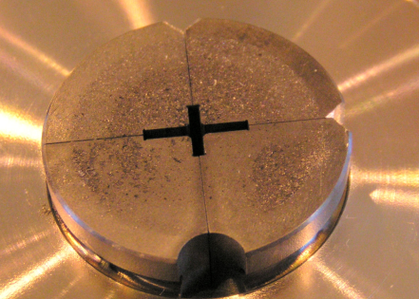
Timeline of Developments
2009
Cruciform shaft design changed to a cylindrical design.
Bearing design changed.
Second stator (T1) tested and installed on ISIS (August 2009)– DLC on DLC .
Controller upgrade - Phase 1 started.
Stator tests T2.1 and T2.2 in R78.
Dowel & angle faces for location
Removable wedge
Bearing hole
Rotation stop

Slide 27
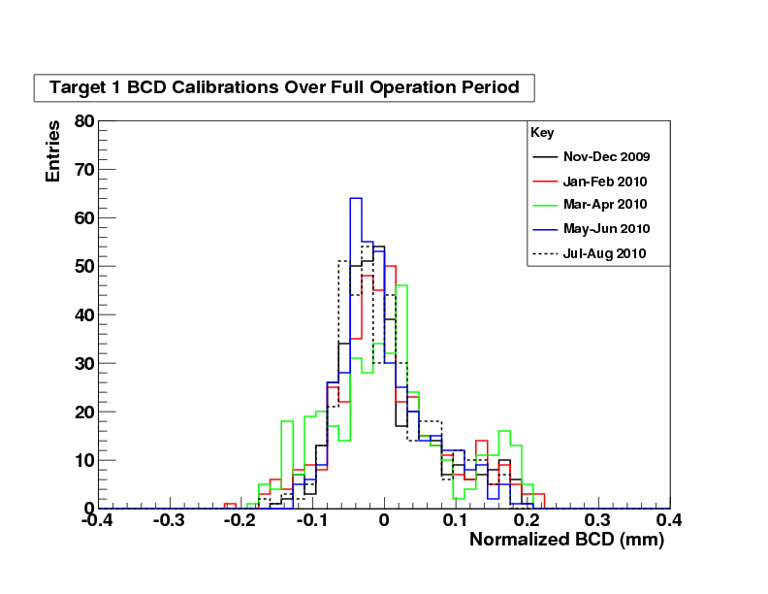
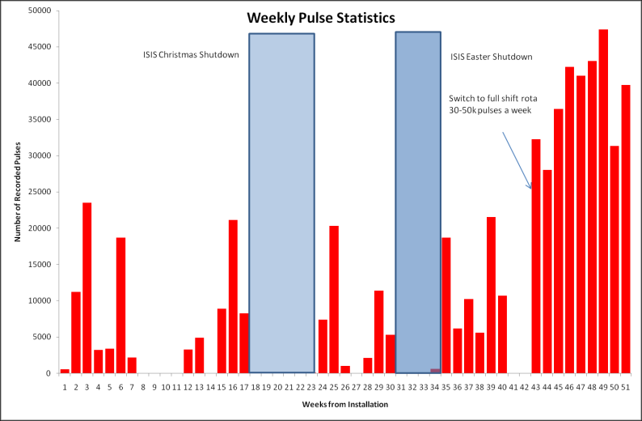



T(1) Operations
Pulse Statistics
Calibration Plots
Hair’s Breadth!
571k pulses in ISIS (620k total)
Visual inspections
7th Sept 2009
Continuing to use
T1 during 2011
27th Aug 2010

Slide 28
Timeline of Developments
2009
Cruciform shaft design changed to a cylindrical design.
Bearing design changed
Second stator (T1) tested and installed on ISIS – DLC on DLC
Controller upgrade - Phase 1 started
Stator tests T2.1 and T2.2
2010
Magnetic mapping of stator showed deviation in T2 of magnetic axis
Started testing Vespel bearings with DLC shaft
Controller upgrade Phase 1 completed and commissioned in R78
Controller upgrade Phase 2 started
Addition of a ‘Dust Catcher’

Slide 29







Timeline of Developments
2009
Cruciform design changed to cylindrical
Bearing Design Changed
Second stator (T1) tested and installed on ISIS – DLC on DLC
Controller Upgrade Phase 1 started
Stator Tests T2.1 and T2.2
2010
Magnetic mapping of stator showed deviation in T2 of magnetic axis
Started testing Vespel bearings with DLC shaft
Controller upgrade Phase 1 completed and commissioned in R78
Controller upgrade Phase 2 started
Addition of a ‘Dust Catcher’
29

Slide 30
Timeline of Developments
2011
Controller Phase 2 Commissioned.
Significant testing of Vespel Bearings.
Redesign of the stator core and the coils is underway.
We’ll take look at these individually...

Slide 31


Target Controller
DAQ &
Target Control PC and DAQ electronics
Target
Controller
Target (Older design)
Target PSU
And Temp Monitoring
Target User Interface!
Target Setup at Sheffield

Slide 32



R78 Tests (T2)
T2.5 before/after 2.3 million actuations

Slide 33

Example Plots

Slide 34


Example Plots
The Vespel bearings are showing broader distributions that the DLC/DLC.
This is currently being investigated. Techniques are being tried to mitigate the effects of this.
Example of Plots from DAQ

Slide 35




Stator Core Redesign
Evidence of off axis forces leading to a redesign of stator core –
  Improving tolerances/QA. -> Reducing Off Axis Forces
  Improving the heat sinking capacity -> running the target cooler has major benefits.
Coil Wound using Square Wire. Design changed to improve the coils magnetic symmetry/reproducibility.

Slide 36
Future Work
New Stator Design to be built and tested and commissioned.
New bearing materials, can we improve on Vespel?
Improve the longevity of targets through both incremental improvements in design and
control
1 million Actuations = 6 weeks of running 8 hours a day 7 days a week @ 1Hz
It would be great to get this to 4M+ consistently
Working with ISIS to improve particle production/reduce losses eg a beam bump
Making the target work harder:
Changing the actuation profile.
Halbach Arrays - > Improve the magnetic coupling of the stator to the magnets.
Improve the current Target DAQ (interface to ISIS)

Slide 37
Addendum
Target T1 on ISIS became non-operational on Wed of this week.
First indications are that a control issue has caused the target to malfunction in such a way that the target was able to get stuck.
Theory at the moment: (TBC)
  Target positioning system has malfunctioned.
    This failure mode has not been observed before (In tens of millions of actuations!)
    Depending on the exact failure mode there are several new features in the Phase 2 controller that should prevent this from recurring.
We have a live spare target in R78 – T2 - The one that is currently running the tests. ISIS have previously agreed that this target can be used as a live spare.
However because we are in the middle of running some tests in R78 and because ISIS is in the middle of the user run we will need to wait until the ISIS shutdown before we can swap the T2 target in.
We will also take the opportunity to upgrade to the Phase 2 control electronics that is currently under test in R78.

Slide 38
END

