Slide 1
Steel Procurement

Slide 2
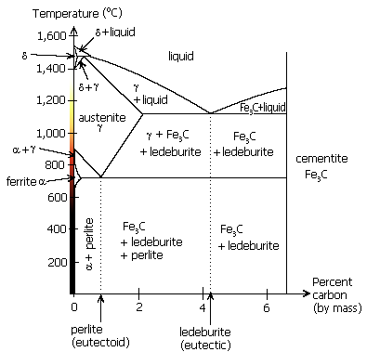
Steel Procurement
Steel: flame cut
Issue: magnetic properties?
  Thermal process
  FeO
Oxy-fuel cutting
  Acetylene + oxygen
  Bring iron to flame temperature
  Add. Oxygen to oxidize Fe
  O₂ blows FeO away from cut
How much of material is affected by heat?

Slide 3
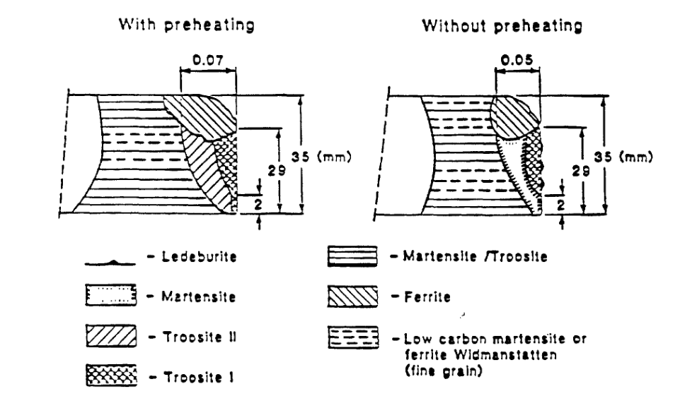
Flame Cutting
Wood, W.E. Heat-affected Zone Studies of Thermally Cut Structural Steels.
Federal Highway Administration and Oregon Graduate Institute of Science and Technology, 1994.

Slide 4
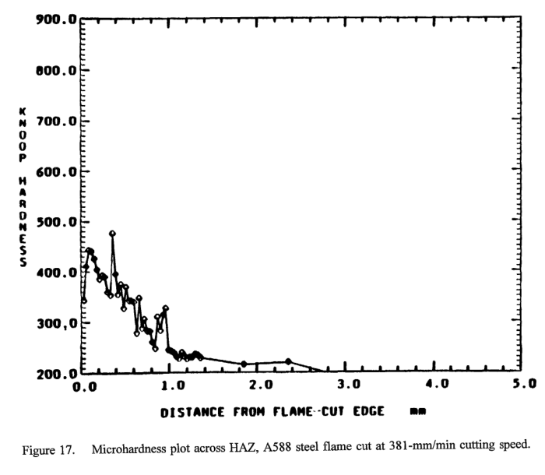
Hardness

Slide 5
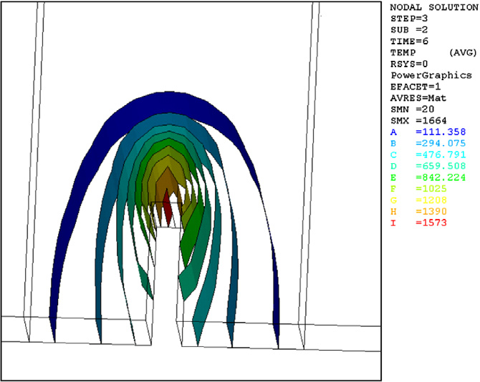
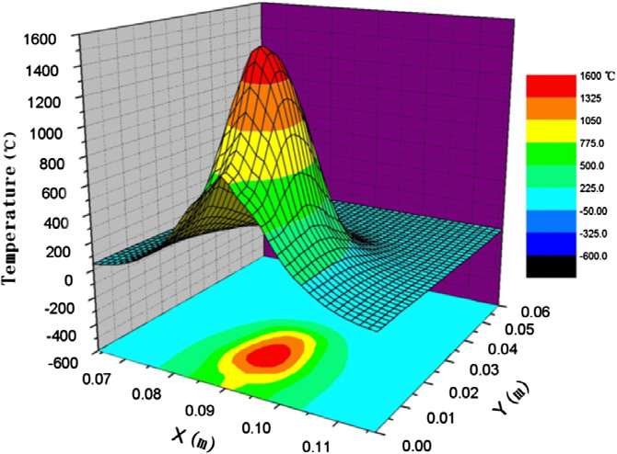
FEA Simulation
Efficient simulation of oxygen cutting using a composite heat source model.
http://dx.doi.org/10.1016/j.ijheatmasstransfer.2012.10.011

Slide 6
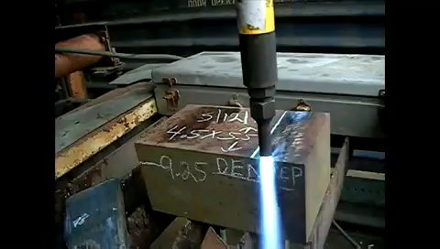
Flame cutting

Slide 7
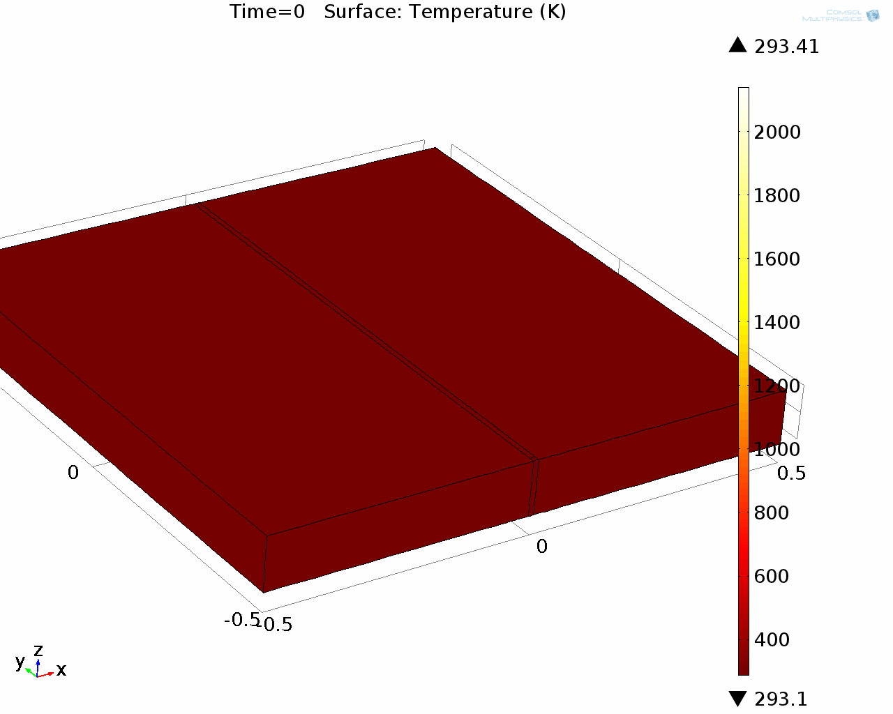
Finite Element Simulation
k, c_{p}: constant
Q: 6.44 x 10⁹ W/m³
v: 3 mm/s
Worst case?

Slide 8
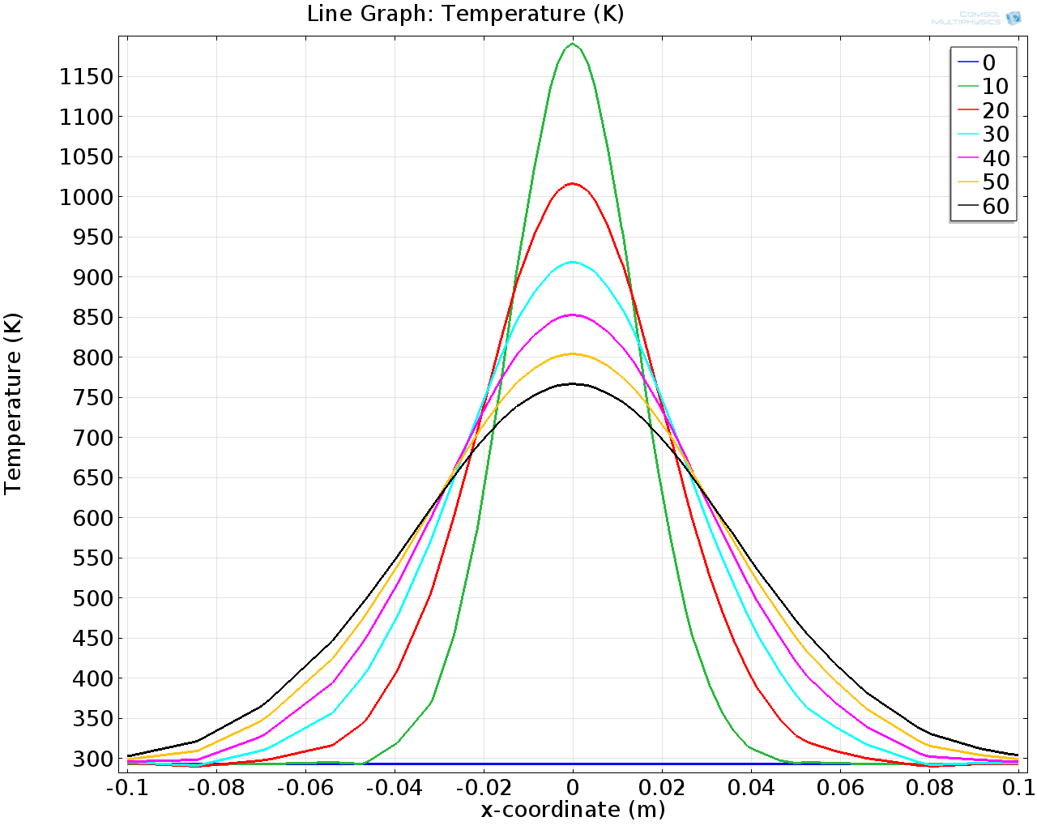
Temperature Profile

Slide 9
Summary
Flame-cutting
  Can affect magnetic properties
  If carried out correctly: limited effect?
  Annealing?
Monitoring PRY
  fiducial markers?

