Slide 1
Current full model can only deal with large-scale objects, where cabinet dimension, for example, have to be at least 6mm
  This is not sufficiently representative of the actual compressors, transformers, sub-station, etc.
  However it does at least provide the correct field table for Sub-Models
The sub-models require one of the following:
  Cabinet with a homogeneous mass that fills the whole volume
  Thick-walled cabinet with air inside
  Thin-walled cabinet with central mass inside
  Thin-walled cabinet with say 5 masses inside
  From the above
    Options 1 & 2 rely completely on sub-models for internal cabinet field
    Options 3 & 4 give some useful information re internal cabinet field
    Option 4 gives the most useful internal field details, but makes the model the most complex to mesh, solve and view
The full model must include ALL ferrous objects, not just representative ones, as he degree of field perturbation varies according to how many objects are present
  This results from the fact that magnetic flux is conserved
The following two images use option 2

Slide 2
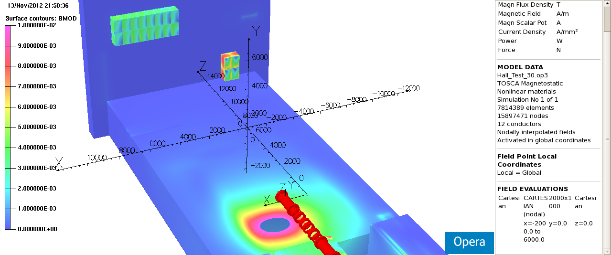

Slide 3
