Slide 1
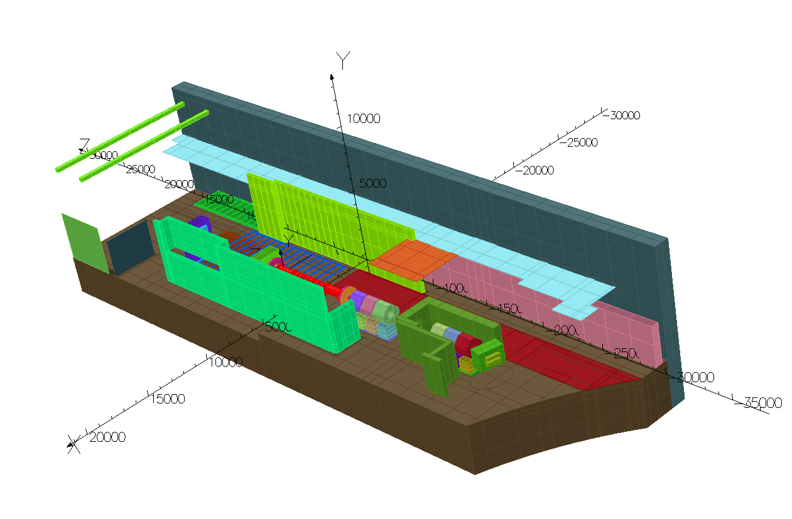
Modelling Update – 31/10/12

Slide 2
Items in the model
Ferrous Components
Beam Dump
Floor Web
D2
DSA Steel
North Shield Wall
Q4-Q9 (Solid Blocks)
South Shield Wall
Virostek Plates
EMR (Inaccurate)
Quad Bases in Cellar
Linac Wall
SW Distribution Board
Steel Door to MICE Hall
North Mezzanine (No Structural Steel)
Flooring above the trench
False Floor Behind NSW
Quad Bases and Floor plate
Equivalent Iron Representation of Crane
Non - Ferrous Components
Hall Floor
Hall Roof
Hall Walls
Solenoids Step IV (S-mode)
Solenoids Step VI (S-mode)
Cellar
Trench

Slide 3
Items to add to the main model?
Ferrous Components
South Mezz Stairs
PPS Cages (may not be possible)
West Wall Stairs
Additional Steel Framework?
Other Items of interest?
Substation
Power Supplies
etc
Non - Ferrous Components
Outline of MLCR
Outline of ISIS CR
Plant Room
(Basically South End structures)
Solenoids Step IV (F-mode)
Solenoids Step VI (F-mode)

Slide 4
New Computer…
It was taking ~52 hours to solve the model on the old machine…
The first time I solved using the new machine (and the model had additional structures - Trench Floor plates - compared with the last solve on the old machine…)
21 hours
Added more structures (Quad Bases & Crane Iron)
24 hours
Added more structures… (First Attempt at Racks behind NSW)
28 hours
So we are at a turnaround of just over a day which I think is quite good.

Slide 5
Additional Structures
Over the last couple of days I’ve tried adding a couple of other objects just to see how the model will cope.
The seven racks behind the NSW – Assumed Steel
I initially had to guess the dimensions of the racks (wasn’t too far out) and I’ve managed to get the sides of the rack down to 1.5mm!!.
This model is currently solving but I will re-run with correct dimensions shortly. This could be useful as a cross check against the sub-model process if it works ok
Holger’s Step IV Shield
It is now possible to place the Step IV shield into the model, this could be useful to compare with Holger’s results. I had to shorten the shield 0.5m at one end as it interfered with the EMR block. For symmetry I also shortened it by 0.5m at the other end. A model with the Step IV shield in-situ is in the system and ready for solving
Plan is now to get plant room and MLCR into the model.

Slide 6
Additional Comments
I would like to visit Mike in the next week or so to discuss where we are with the model and the way forward from here. The main goals would be to:
Validate the model so we can start to produce ‘official’ results. By official I mean a system will be in place so that all the solutions are available and that it will be possible to track what was in the model for that given solution. All the results produced so far have been ‘test models’ and I think we are ready to move over to ‘production models’ which we should initially treat as a baseline.
  Note that this does not imply that the model is ‘complete’ as we expect further refinements to be made
To understand how we can start to generate sub-models now that Mike seems to have a better understanding of how this works.
I currently can’t upload to the repository as the new machine is not set up correctly. I’ll ask Matt Robinson to resolve this when he is back off A/L.

Slide 7
Additional Comments
I’m not really getting the opportunity to take a proper look at the solutions that the model is generating. I was hoping that Craig would take a poke around but he’s on A/L this week.
I’ve been posting the solutions that I’m happy with on the Web (i.e. those that I know don’t have errors) so if you have OPERA you can take a look yourself.
http://www.hep.shef.ac.uk/tmp/
Directories are /Hall_Test_XX
I will ask if Craig if he will continue his good work when he gets back.

Slide 8
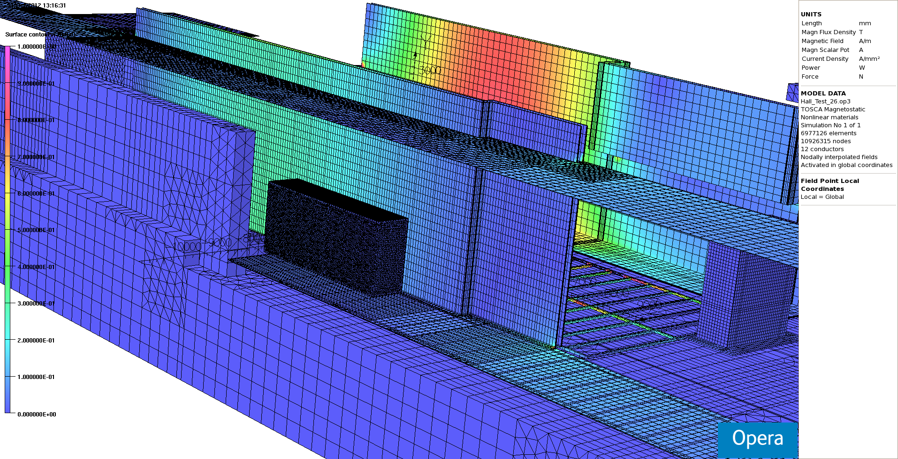
First attempt at placing the racks behind the NSW. Wrong location, Wrong dimensions, no blister pack and wall thickness too thick so I’m not showing any solutions – but it looks promising…

Slide 9
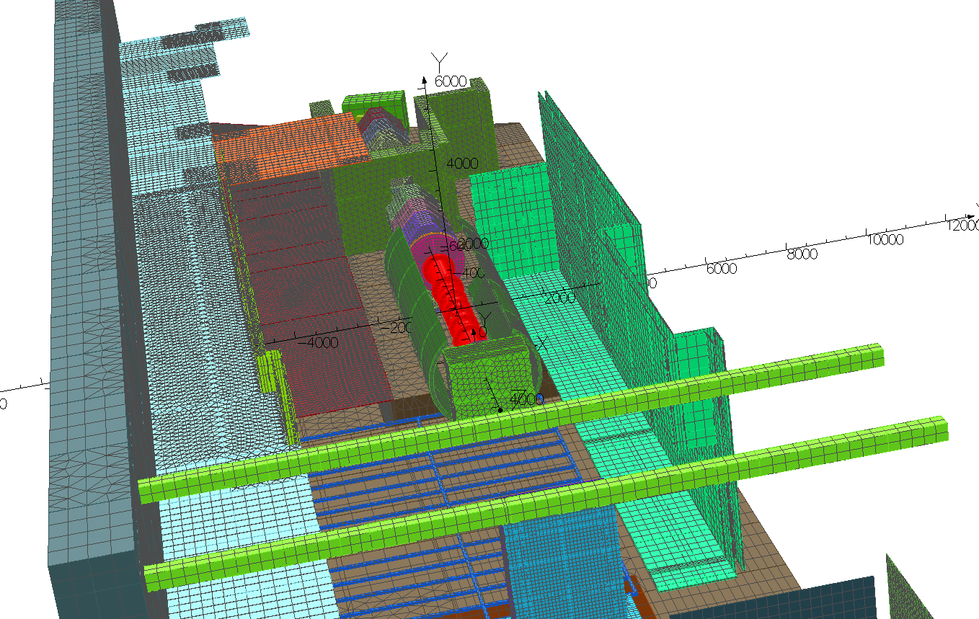
Step IV shield – shortened by 0.5m at either end. Model has yet to be solved

