Slide 1
Option 1
Racks relocated behind North Wall

Slide 2
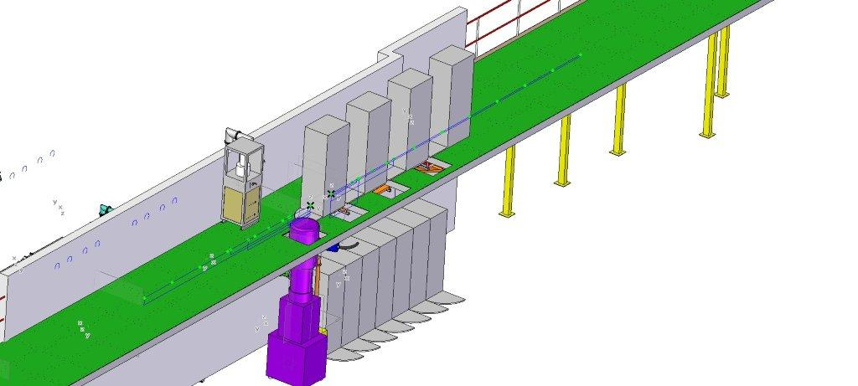

Slide 3
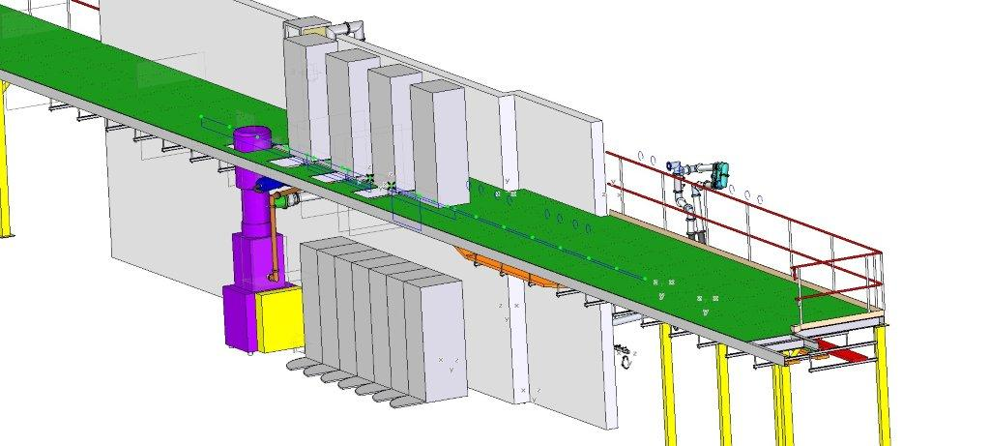

Slide 4
