Slide 1
MICE Magnet Modelling -
Presentation to the Daresbury Magnetics Group
Daresbury Laboratory
31st January 2013
P J Smith
University of Sheffield

Slide 2
Overview of MICE

Slide 3
Overview of MICE
The MICE experiment uses a beam of low energy muons to test the feasibility of ionization cooling.
The goal of the MICE experiment is to construct a section of cooling channel long enough to demonstrate a measurable cooling effect.
This is achieved by reducing the transverse emittance of a muon beam by the order of 10%. Several different particle detectors will be used to measure the cooling effect particle by particle with high precision, the aim being to achieve an absolute accuracy on the measurement of emittance of 0.1% or better.
The emittance measurements will be performed with muon beams of different momenta within the range of 140 to 240 MeV/c and a variety of beam optics and absorber materials will be tried.
Much of the primary beamline for the experiment has been constructed and commissioned and work is now focusing on installing the major components of the cooling channel.

Slide 4
Overview of MICE
We have a beamline to ‘feed’ the experiment:
Target
3 Quad Triplets
2 Dipoles
1 Superconducting ‘Decay Solenoid’
MICE itself:
Step VI contains 16 superconducting solenoids
Plus additional detectors, and considerable infrastructure to support the experiment.

Slide 5
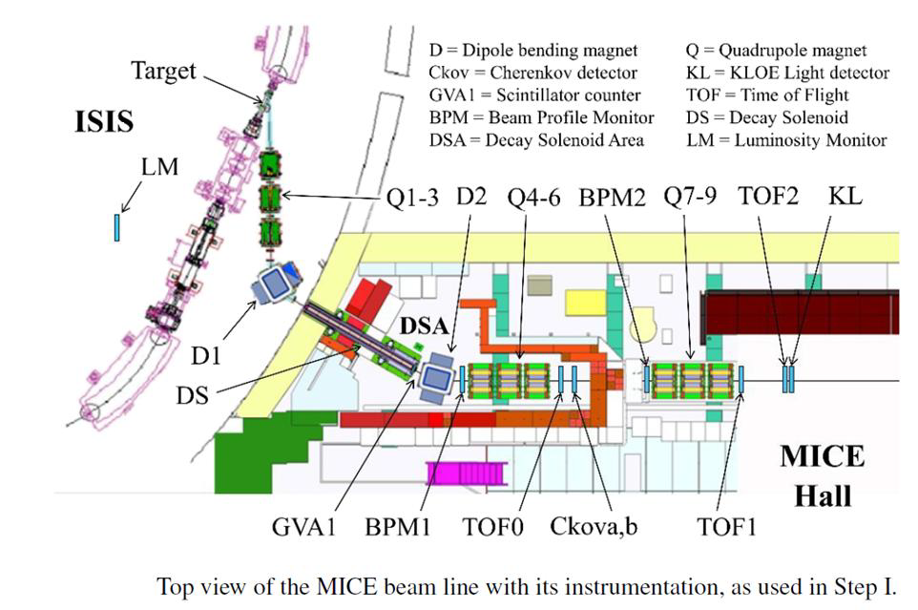

Slide 6
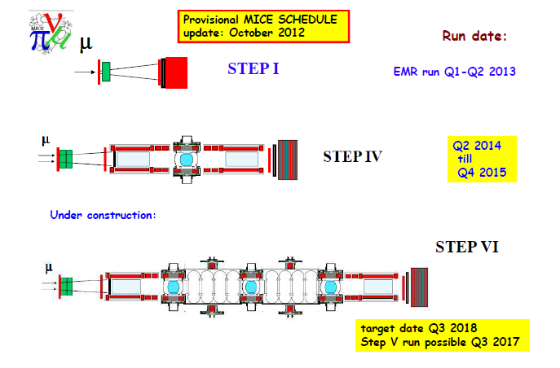

Slide 7
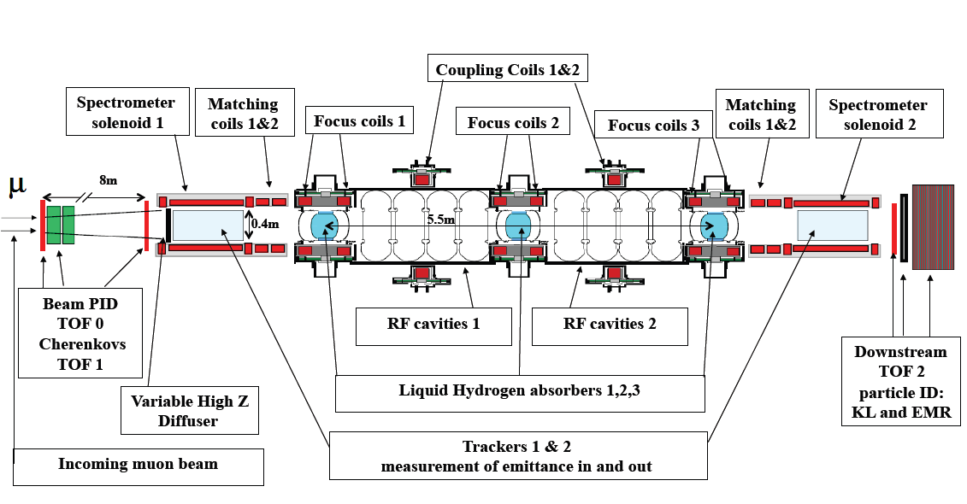
Overview of MICE- Step VI

Slide 8
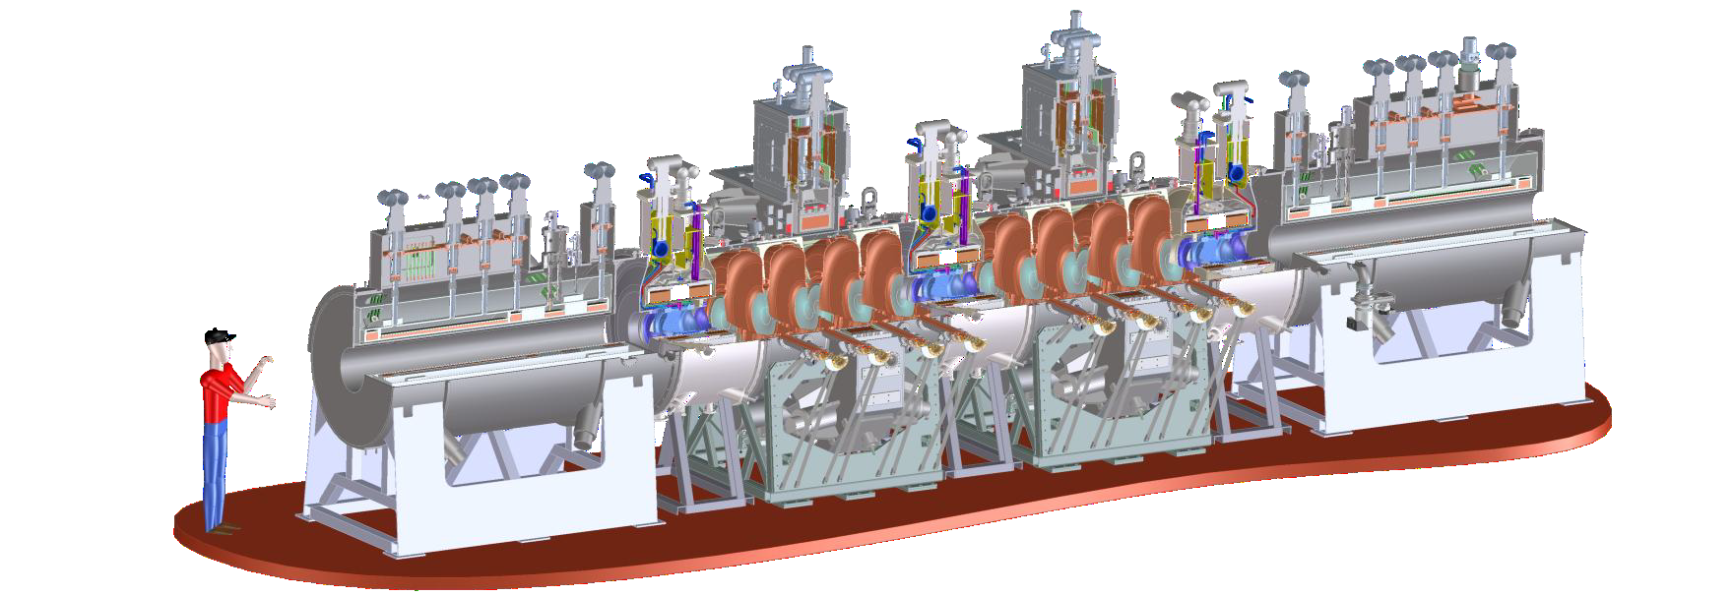
Overview of MICE
Illustration showing a completed step IV cooling channel. None of the external detectors and surrounding infrastructure are shown

Slide 9
Magnets

Slide 10
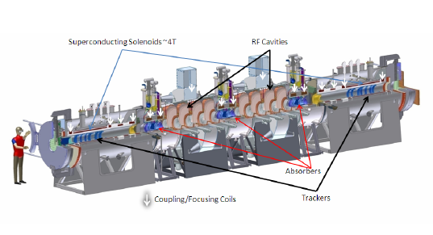
The MICE Magnets

Slide 11
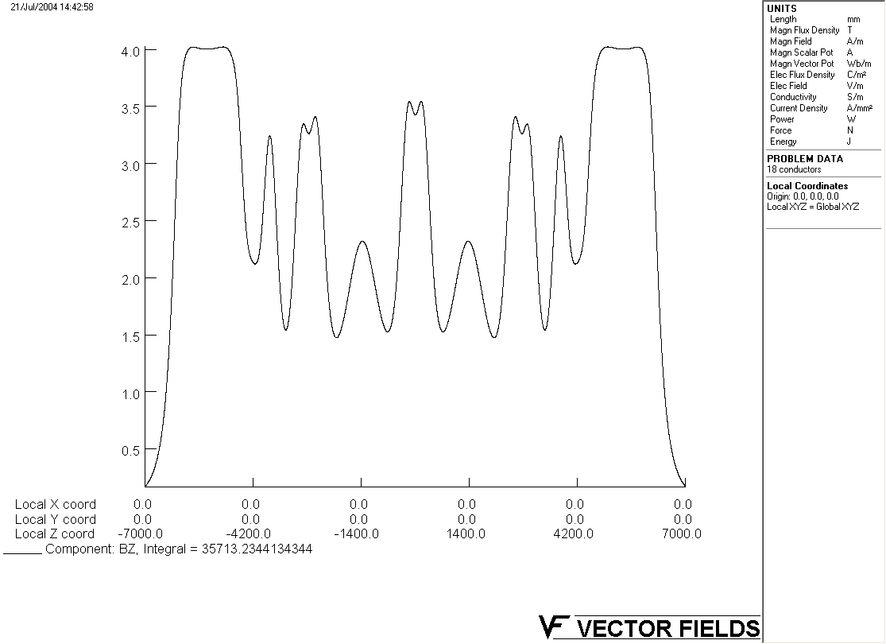
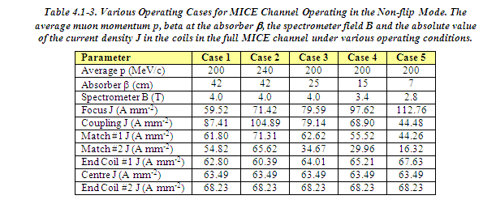
The MICE Magnets
Solenoid Mode
Values taken from Technical Reference Document which is slightly out of date

Slide 12
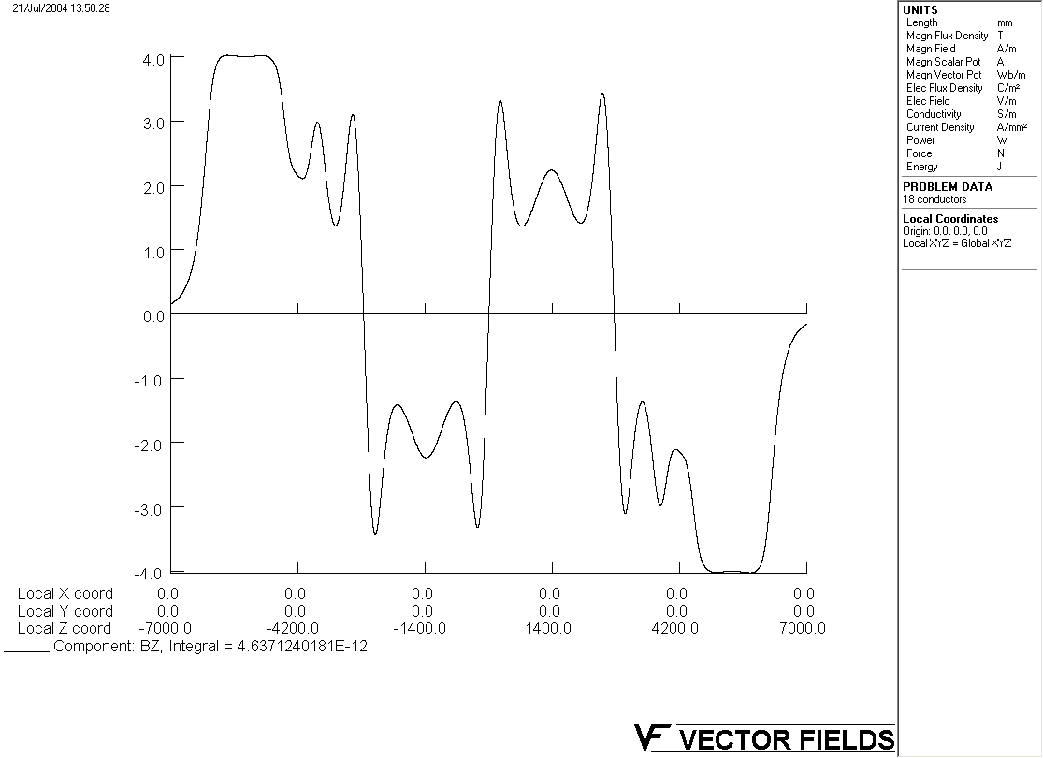
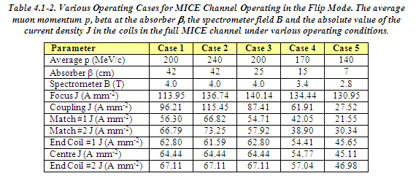
The MICE Magnets
Flip Mode
Values taken from Technical Reference Document which is slightly out of date

Slide 13
The MICE Magnets
The MICE superconducting magnets were designed without return yokes. (circa 2000~2004?)
Reasons for these not having return yokes...
(some speculation here as no-one is really holding their hand up)
  - Cost
  - Non distortion of magnetic field within MICE?
  - Simulation results at the time showed that external field generated from these magnets was not going to be a problem.
  - Others?
At this stage the reason is irrelevant. It’s a problem that we have whatever the reason and it’s a problem that we urgently need to solve...

Slide 14
Initial Simulation Work
About a year ago Mike Courthold and Vicky Bayliss (RAL) started to run some simulations that challenged the next-to-last assertation that I made on the previous slide.
INSERT LINK TO CM talks? etc
It appears that the air fields produced by the MICE magnets were of sufficient magnitude to be of concern. There is a clear risk to the reliable functioning of a significant amount of equipment within the MICE hall and beyond the experimental hall’s walls.

Slide 15
Defining the Problem
Since then much of the work done has to been to try and ascertain:
Do we really have a problem and if so how big is it?
What areas of the experimental hall are particularly affected?
What items are particularly affected?
Are there areas of the experimental hall that are not so badly affected by stray field and is it ok to put equipment in those areas?
Where equipment can’t be moved, what is the effect of the field on that equipment and if necessary can it be mitigated?
Can the field be mitigated with a retrofitted return yoke?

Slide 16
Defining the Problem
Our starting assumption was that everything in the Hall, and some way beyond the Hall walls will be affected by the MICE magnetic fields.
A catalogue of potentially affected systems was then made – it’s a huge list and I won’t show it here – but is available on-line.
This was only starting assumption, and I think we are already someway towards showing that some areas of the Hall are now safe for Step IV of the project.

Slide 17
Magnetic Modelling
I shall take a look at all of these in more detail over the forthcoming slides:
1) I’ve built a magnetic FEA model of the whole experimental Hall – This provides a guide as a to a first feel of the what the field level is likely to be like in particular areas.
2) There has been a lot of effort put into designing a retro-fitted return yoke for step IV (and step VI) - Holger Witte – BNL
If it can be implemented this looks like the obvious solution but in parallel we have to consider the possibility of running the experiment and the ramifications of not having a return yoke.
Even with a return yoke there are certain systems that will still be in high field and so the return yoke does not mitigate the need for some analysis work.

Slide 18
Magnetic Modelling
3) Sub Modelling. Areas of the hall that need particular attention and cannot be modelled in a ‘Hall Model’. As this will be the thrust of our discussion I will return to this later.

Slide 19
Model Verification
There is a clear desire to have some form of independent validation of these models!
R9 Testing
We’re currently having an AFC magnet tested in R9 at RAL. The setup in R9 is being modelled by Vicky Baylliss (RAL) and extensive field measurements of equipment in situ (racks/compressors) will be taken .
The aim here is to tally the field measurements to the model and then to link this back to other models/sub-models. I’m lead to understand that this is no easy task.

Slide 20
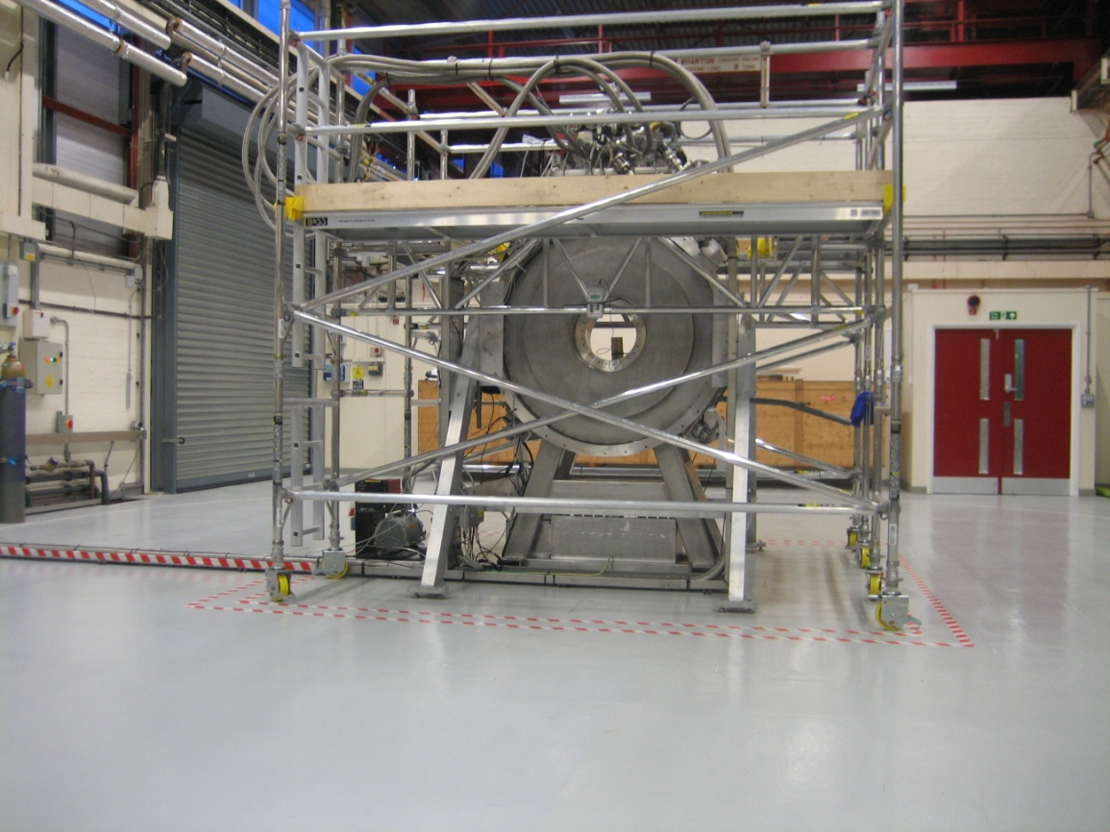
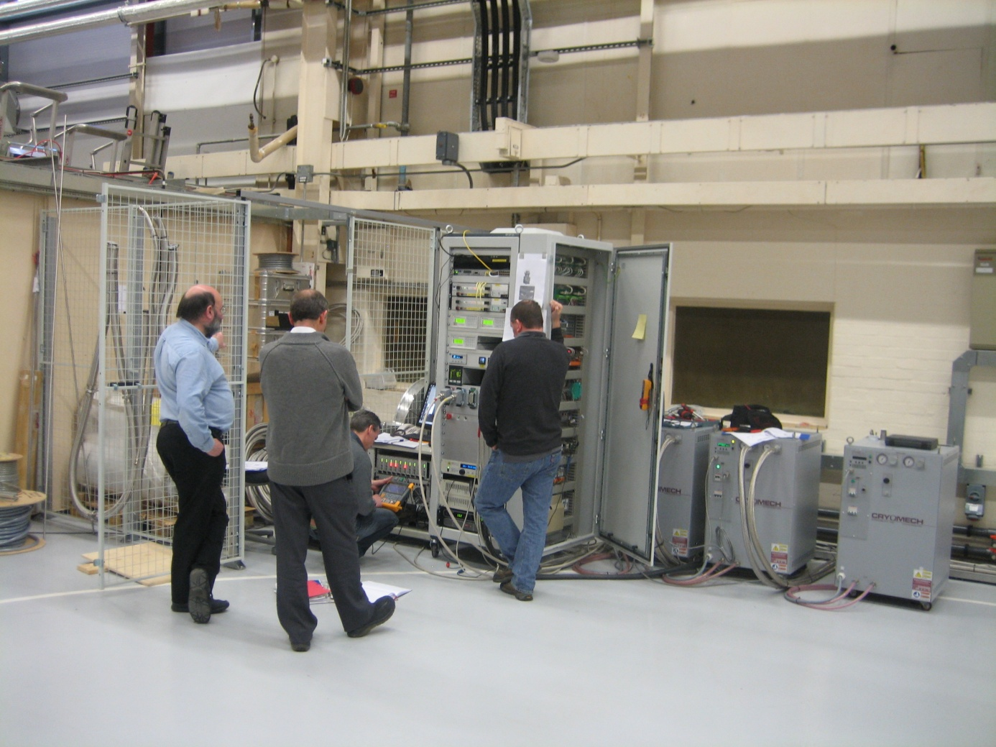
AFC Magnet in R9
Cryomech Compressors and Controls in R9

Slide 21
Model Verification
Holger’s Models
Holger Witte has built some independent models (OPERA FEA, OPERA Biot-Savart, COMSOL) that have demonstrated that the fields predicted at the West End of the MICE Hall by the Hall Model seem to be reasonable.
Holger has indicated that the meshing resolution in the Hall model is probably not good enough to give accurate results if we were to include finer levels of detail in the model.
I won’t cover the details of his findings here as this would be another presentation in itself but I can provide you with copies of these presentations later if desired.

Slide 22
Model Verification
Discussion @ DL:
How do you verify your magnetic models?

Slide 23
(1) Hall Model
There is a clear need understand what is happening in various locations of the MICE hall in good detail (accuracy) but without knowing the local field it is difficult to generate localised models.
The primary aim of the Hall model was to:
Give an indication of what the field is in a particular area of the MICE Hall.
Tell us whether the field is uniform in that area.
If the field is not uniform then the Hall model can provide us with a data set of boundary fields that can be plugged into various local sub-models.
The last point has been shown in principle but not yet put into practice.

Slide 24
(1) Hall Model
The MICE Hall model contains a reasonably realistic representation of the structural iron contained within the MICE Hall itself. Other structures that are not made of iron but provide useful reference structures (i.e. walls and floors etc have also been added)
The structural iron in the MICE Hall has no symmetry and so a full 3D model is required.
In terms of the code itself it was fairly clear from the outset that a Hall model was going to be a big task and writing one long piece of .comi script was going to end in tears...
The Hall model is component based, so components can be turned on and off at will in the .comi code and in principle it should still mesh and run. This significantly speeds up coding/debugging.
At the moment no studies on what the effect of turning individual components off has on the field , so I tend to only run models with all of the components turned on. In light of recent findings it’s not clear that such a study would be productive.

Slide 25
(1) Hall Model
After the iron was added to the hall there was a great temptation on my behalf to push the model to see what meshing resolution I could achieve whilst keeping the solve time tractable. (Call this inexperience and no data yet on the model’s validity.)
Our first ‘study’ with the Hall model involved placing some racks in the Hall model and increased the meshing resolution in those areas to see how those racks affected the fields. Interesting results but...
Later, independent studies by Holger indicated that the meshing resolution in the Hall model is not high enough to give accurate results at the level of detail that was being modelled.
At this point it is probably fair to say that the Hall model is now serving its purpose – subject to model validation - it is providing us with first estimates of background fields given realistic estimates of iron content within the Hall.
We need sub-models of areas of interest to continue developing the modelling work.

Slide 26
(1) Hall Model - Website
The development of the Hall model has been reasonably well documented (at least by my standards) and a lot of information can be found at
http://www.hep.shef.ac.uk/research/mice/opera_models/
Notes
Drawings
comi Script
(Results)
This might be a useful source of information to those involved in the modelling.

Slide 27
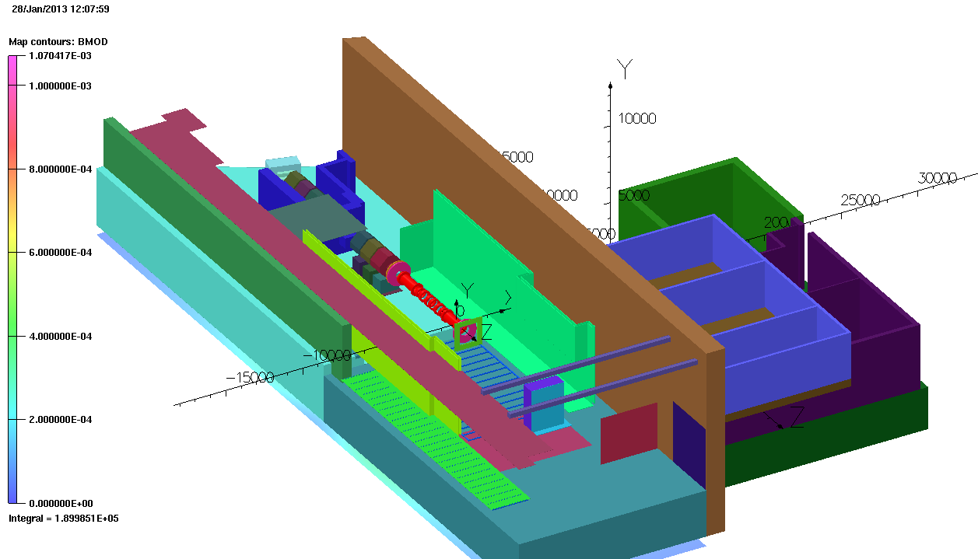
(1) Hall Model – Model 52
This is one of the latest models – if we can view this model in OPERA then I can zoom in and give you a virtual tour...
Also a good point to visit the modelling website

Slide 28
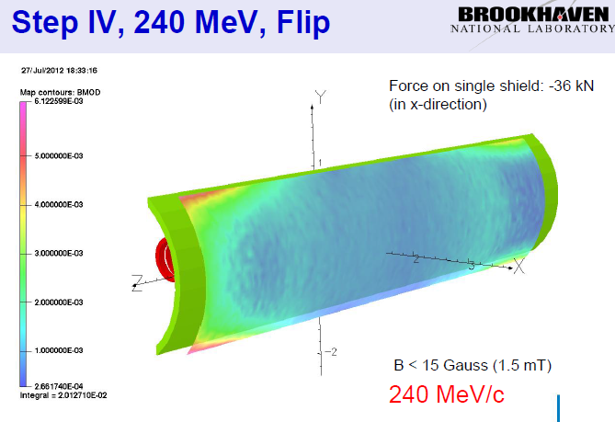
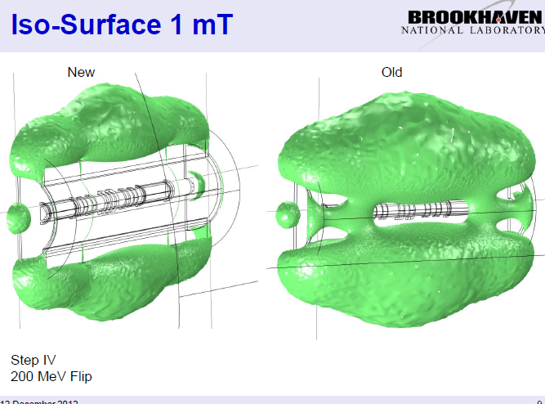
(2) Return Yoke
Holger Witte (BNL) has been working on the design of a retro-fitted return yoke to the cooling channel for step IV.
We now have an outline magnetic solution for step IV – the devil is in the engineering detail which is now being worked upon . These example slides have been taken from Holger’s presentations to illustrate the principle – details may change.
Early development of idea
Return yoke connected to end plates and with addition of vertical ‘flanges’

Slide 29
(3) Sub Modelling
The areas of particular interest include:
Tracker
Sub station
Quads
Better Rack model
Transformer in Trench
Racks behind North Shield Wall.
From our point of view one great aspect about the sub-modelling is that (in addition to drawing upon the experience of the people who have done modelling work before!) the sub-modelling will allow us to parallelise our progress.

Slide 30
(3) Sub Modelling - Tracker
The tracker is a major component of the MICE cooling channel.
The external infrastructure for the tracker contains many magnetically sensitive components and many of these components cannot be moved. Managing this, with or without a return yoke, is going to be a challenge.
Craig will now give his presentation on the tracker as he his much more knowledgeable than I am about this.
It is our hope that this problem will pique your interest as it is in this area that we urgently require some assistance with the sub-modelling.

