Slide 1
PHY418 Particle Astrophysics
Sources

Slide 2
Sources of high-energy particles
We now have clear observational diagnostics for particle acceleration
  synchrotron radiation (radio, sometimes X-ray)
  inverse Compton scattering (X-ray, γ-ray)
  π⁰ decay (γ-ray, neutrinos)
We have acceleration mechanisms
  Fermi 2nd order, DSA, SDA, relativistic shocks, magnetic reconnection
How do these come together in astrophysical environments?

Slide 3
Sources
The solar system

Slide 4
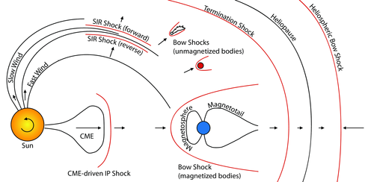
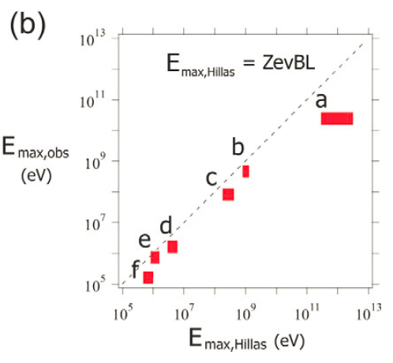
Shocks in the solar system
notes section 4.2
Various different types of collisionless shocks are seen in the solar system
  they do accelerate particles
  (to fairly modest energies)
  they have the advantage
  that we can study them
  directly with spacecraft
a: CME shocks
b: Van Allen belts
c: heliospheric shocks
d: Earth’s bow shock
e: Earth’s magnetotail
f: Earth’s foreshock
Hillas relation seems to be a good guide to maximum energies (except for CME shocks)

Slide 5
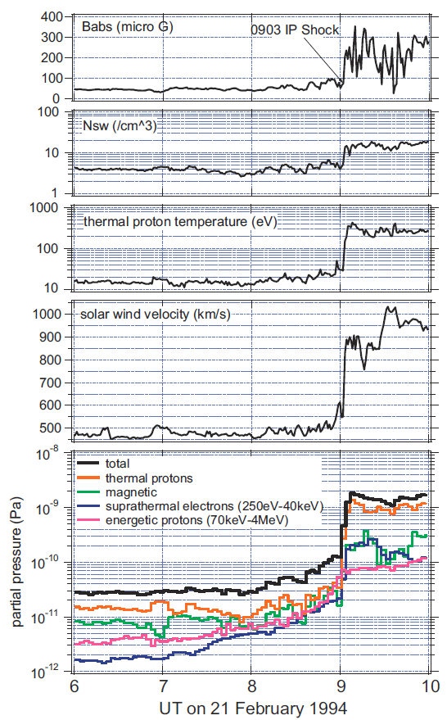
Solar flares and CMEs
“Solar energetic particles” (SEPs) are associated with solar flares
  not emitted by Sun itself but accelerated by magnetohydrodynamic shocks accompanying flare event
At least two acceleration mechanisms believed to operate
  DSA in CME-driven interplanetary shocks (“gradual” SEP events)
  magnetic reconnection in flare itself (“impulsive” events)
Evidence for modification of shock front by accelerated particles

Slide 6
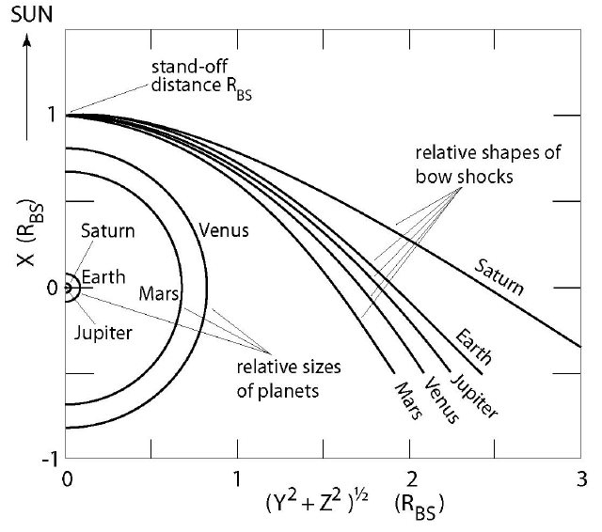
Planetary bow shocks
Occur when the supersonic solar wind encounters an obstacle
  this needs to be something
  conductive
    the magnetosphere for planets
    with magnetic fields (Mercury,
    Earth, the giants)
    ionosphere for non-magnetic
    planets with atmospheres
    (Venus, Mars, also comets)
  rocky bodies without
  atmosphere have no bow
  shock (Moon, asteroids)

Slide 7
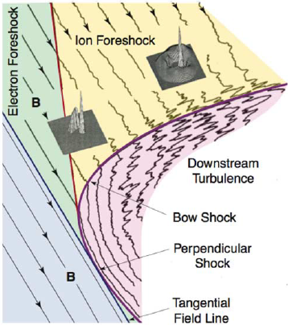
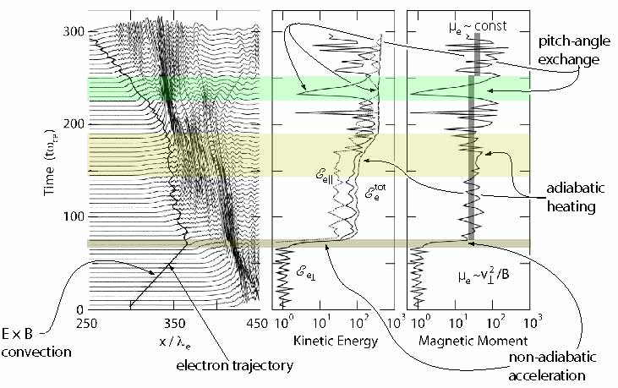
Planetary bow shocks
Bow shock geometry varies across
shock
  expect DSA to operate in quasi-parallel
  geometry region, SDA in quasi-perp.
  observe field-aligned beams of ions
  probably originating from SDA
Simulation of electron acceleration by “shock surfing” in quasi-perpendicular shock

Slide 8
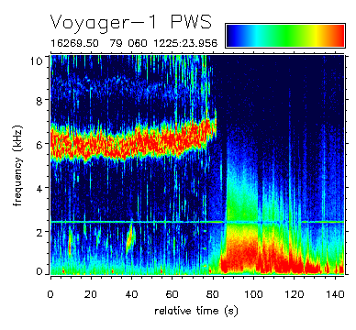
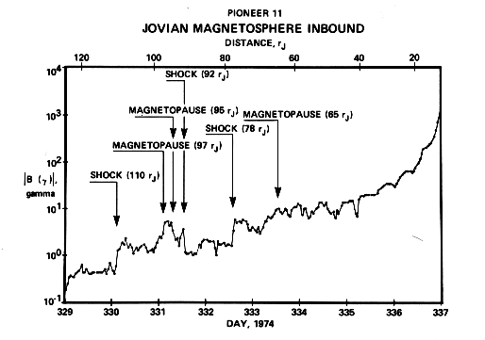
Planetary bow shocks
Jupiter and Saturn have
extensive magnetospheres
strongly influenced by fast
rotation (~10 hr)
  studied originally by Pioneer 10/11 and
  Voyager 1/2 flybys, then by Galileo and
  Cassini probes
Small (ionosphere-generated) bow shocks of Mars and Venus also studied
  interaction of solar wind with Martian atmosphere may contribute to early loss of atmosphere—though clearly this did not happen to Venus!

Slide 9
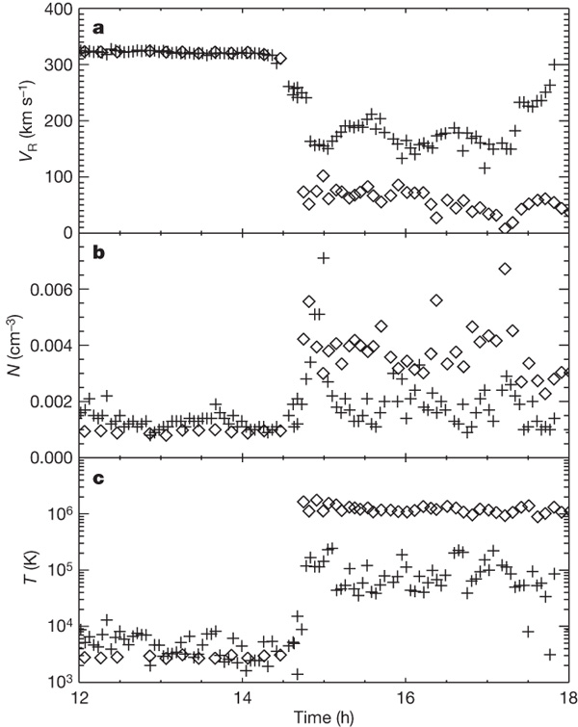
Termination shock
“Edge of solar system” (in some
senses)
  occurs when solar wind slows to
  subsonic speed
  observed by Voyagers 1 and 2
    interestingly at quite different
    heliocentric distances, 94 and 84 AU
  not as strong as planetary bow
  shocks
Believed to be source of
“anomalous cosmic rays”, but
apparently not where the Voyagers crossed it
  this may be a result of magnetic field geometry

Slide 10
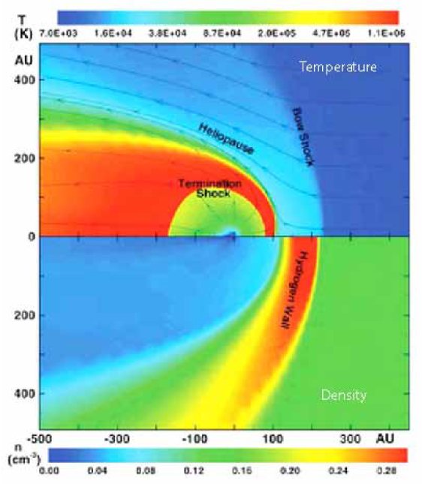
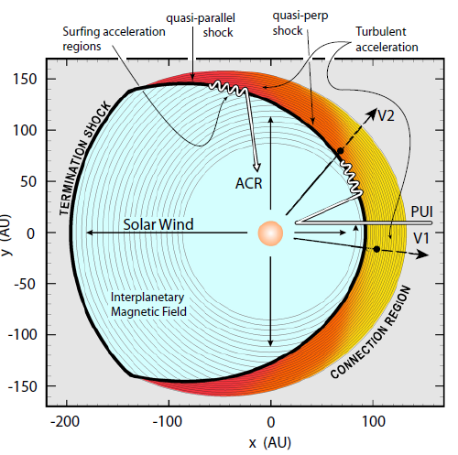
Termination shock

Slide 11
Galactic Sources
Supernova remnants

Slide 12
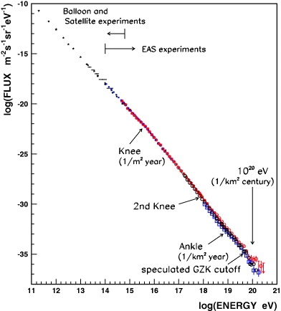
Supernovae and supernova remnants
notes section 4.3.1
Galactic SNRs are believed to be the source of cosmic rays up to the “knee” at
~10¹⁶ eV
Rate of supernovae in
Galaxy adequate to supply
required energy if they are
~10% efficient in converting
explosion energy to CRs
  this is quite high but consistent
  with simulations of diffusive
  shock acceleration

Slide 13
Classification of supernovae
No hydrogen |  |  | Early hydrogen | Hydrogen always present
Si II | No Si II |  |  | Light curve |  | Narrow lines
 | He | No He |  | Plateau | Linear
Ia | Ib | Ic | IIb | II-P | II-L | IIn
thermo-nuclear
massive star core collapse
All types of supernovae form supernova remnants (expanding shells of gas), but only CCSNe form compact objects (neutron stars/black holes)

Slide 14
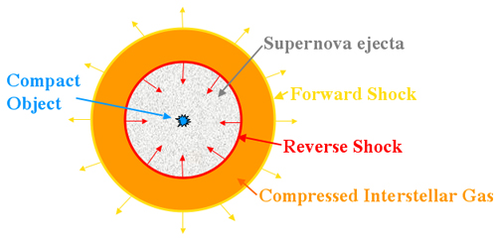
Evolution of supernova remnants
notes section 4.3.2
Supernova blast wave is
highly supersonic
  forward shock develops at
  its leading edge
Three main evolutionary phases:
  free expansion (ejecta-dominated)
    forward shock has swept up relatively little ambient gas, expansion velocity nearly constant (does decelerate slightly)
  Sedov or Sedov-Taylor phase
    mass of swept-up material becomes comparable to ejecta mass
    forward shock decelerates, reverse shock generated
  radiative phase
    shock slows to ~200 km/s, significant energy loss through emission lines
Particle acceleration probably only in first two phases

Slide 15
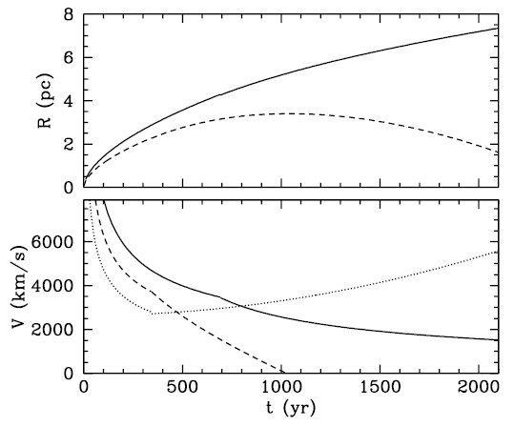
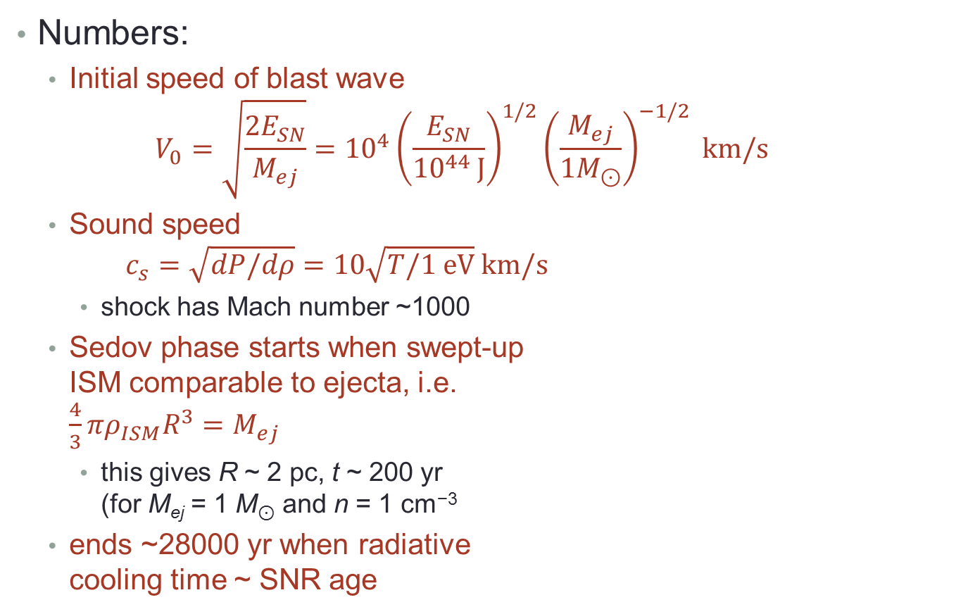
Evolution of supernova remnants
Numbers:
  Initial speed of blast wave
  $V_{0}=\sqrt{\frac{2E_{SN}}{M_{ej}}}={10}^{4}{\left(\frac{E_{SN}}{{10}^{44 }J}\right)}^{1/2}{\left(\frac{M_{ej}}{1M_{⊙}}\right)}^{−1/2} km/s$
  Sound speed
  $c_{s}=\sqrt{dP/dρ}=10\sqrt{T/1 eV} km/s$
    shock has Mach number ~1000
  Sedov phase starts when swept-up
  ISM comparable to ejecta, i.e.
  $\frac{4}{3}πρ_{ISM}R^{3}=M_{ej}$
    this gives R ~ 2 pc, t ~ 200 yr
    (for M_{ej} = 1 M⊙ and n = 1 cm⁻³
  ends ~28000 yr when radiative
  cooling time ~ SNR age

Slide 16
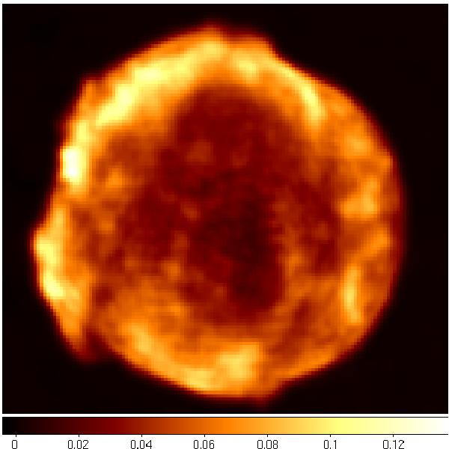
Observational evidence
notes section 4.3.3
Tycho at 1.5 GHz
Historical supernovae
  naked-eye observations for SNe 1604
  (Kepler’s), 1572 (Tycho’s), 1181, 1054,
  1006 (also 393, 386, 185?)
    two young remnants not seen as SNe
    (Cas A, ~1680, G1.9+0.3, ~1870)
Radio
  most SNRs are observed at radio
  wavelengths
  294 in standard catalogue (Green),
  only 20 have insufficient data for radio flux
    80% shell-type, 12% composite, 3% filled-centre (remainder unclassified)
  ~40% also observed in X-rays, ~30% in optical
    lack of detectable optical emission is partly due to location of massive stars close to Galactic plane, where there is a lot of dust absorption

Slide 17
Observational evidence
Radio emission is synchrotron
  spectral index ~0.5 (electron index ~2)
    younger objects have steeper spectra
    filled-centre/composite objects flatter spectra
  polarised, though less than would be expected
    indicates disorder in magnetic field
    this would be expected in diffusive
    shock acceleration since turbulent
    magnetic fields are key to this
    mechanism
  steeper spectrum in younger objects
  may be a consequence of CR-modified
  shock
    electrons “see” only the subshock with
    reduced r; their index is (r + 2)/(r – 1)

Slide 18
X-ray emission
Thermal X-ray emission from shock-heated ejecta quite common in shell-type SNRs, but not relevant to particle acceleration as such
However, some shell SNRs also have a featureless power-law X-ray spectrum
  this is synchrotron radiation—wrong spectral index for IC, not accompanied by line emission as bremsstrahlung would be
  implies a local population of very high energy electrons
X-rays come from a thin outer rim
  electrons accelerated locally
  may imply amplification of magnetic field up to ~200 μG
    if mechanism is synchrotron energy loss depleting electron population
    but thin rims also seen in radio, so this mechanism may be wrong

Slide 19
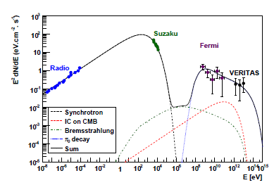
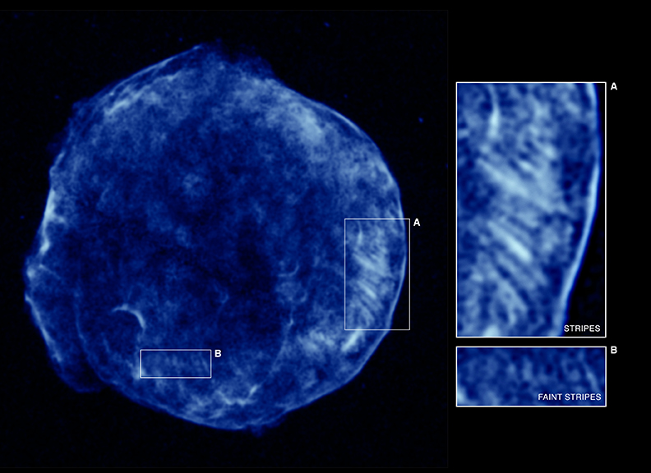
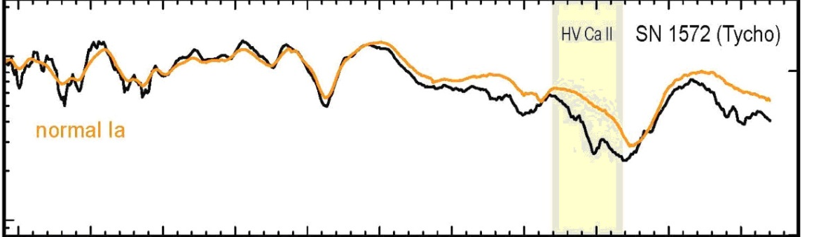
X-ray emission
Tycho’s SNR (1572)
  SN Ia (spectrum observed as “light echo”)
  γ-ray emission suggests π⁰ decay
  “stripes” in X-ray image spaced by ~8"
    if these features are caused by proton gyroradius, then for B-field of 30 μG E_{p} = 2×10¹⁵ eV (knee)
    some fits to radio/X-ray spectrum suggest B ~ 300 μG
light echo spectrum compared with SN Ia

Slide 20
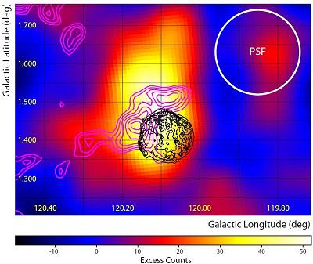
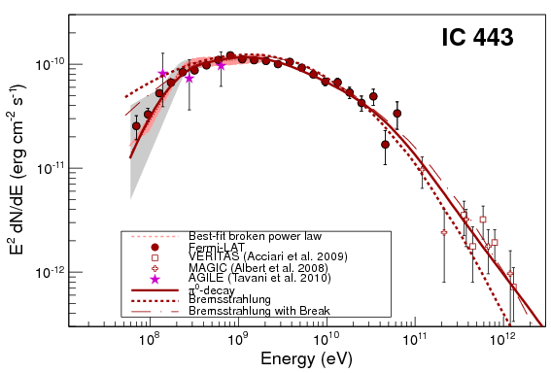
GeV and TeV emission
Most shell SNRs do not emit high-energy photons
Exceptions:
  young objects such as Tycho
    hard spectra, bright in TeV range
  SNRs interacting with molecular
  clouds
    softer spectra, more luminous in GeV
Both Tycho and IC 443 have high-energy spectra best fitted by π⁰ decay. However, other young SNRs such as RXJ1713−3946 have IC spectra

Slide 21
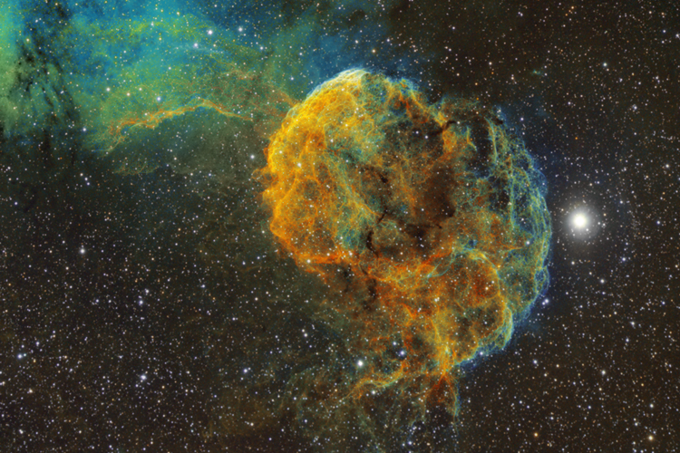
IC443
Bob Franke, http://bf-astro.com/ic443sho.htm

Slide 22
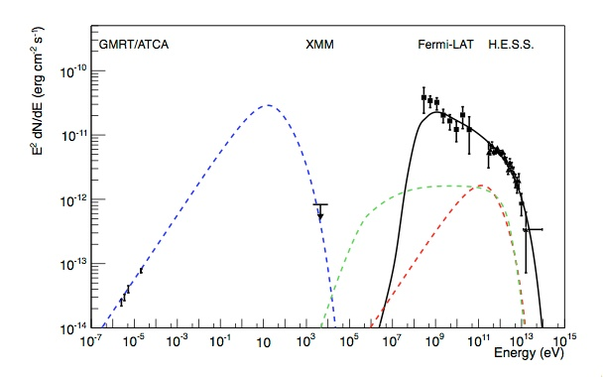
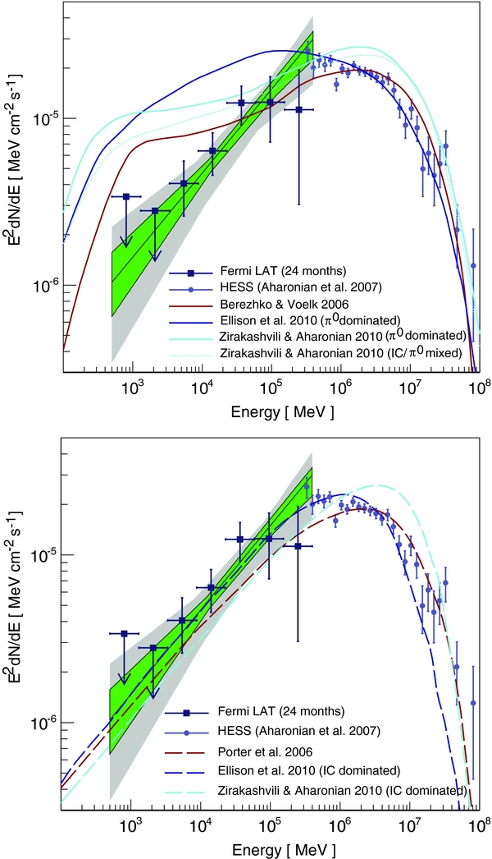
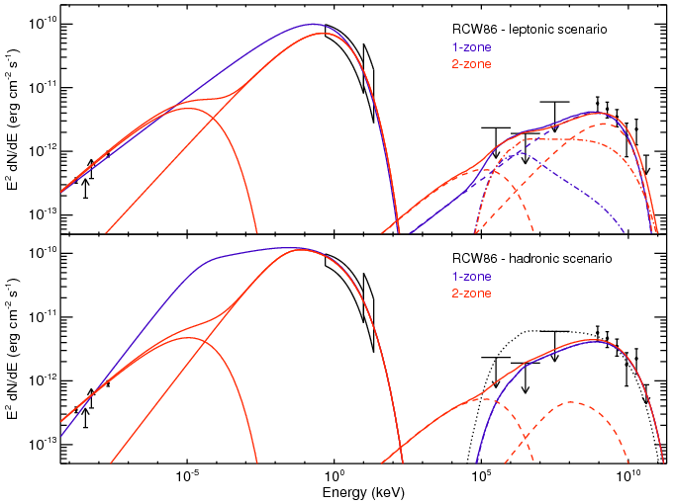
GeV and TeV emission
Observations at GeV energies are essential to distinguish
IC and π⁰ hypotheses.
Note that IC-dominated spectra don’t necessarily mean that remnants do not accelerate cosmic rays!
HESS J1640−465

Slide 23
Conclusion: SNRs
Supernovae occur about once every 40 years on average (±50%) and release about 10⁴⁴ J of energy each
  this is sufficient to account for cosmic rays up to the knee if SNRs are about 10% efficient in converting this energy into cosmic rays
The supernova blast wave is highly supersonic and will produce a forward shock
  subsequently also a reverse shock as the forward shock is decelerated by the ambient interstellar medium
  the shock is seen in young SNRs as a sharp edge in synchrotron emission
SNRs do accelerate particles
  synchrotron emission seen in radio, and in young SNRs also in X-rays
  GeV and TeV γ-rays emitted by young and interacting SNRs
Properties are broadly consistent with diffusive shock acceleration
  right synchrotron spectral index and combination of shock and B-field

Slide 24
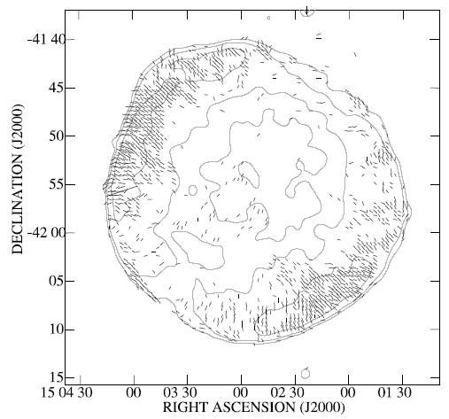
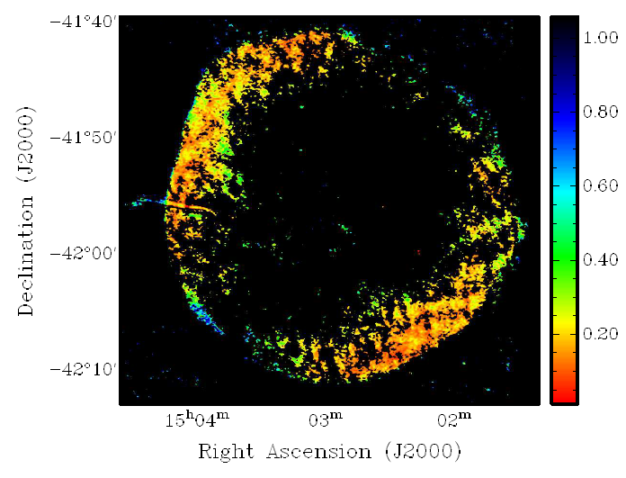
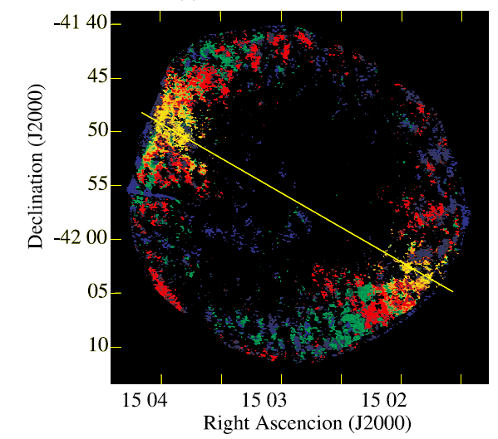
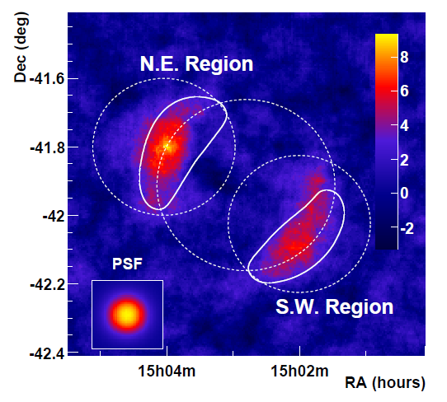
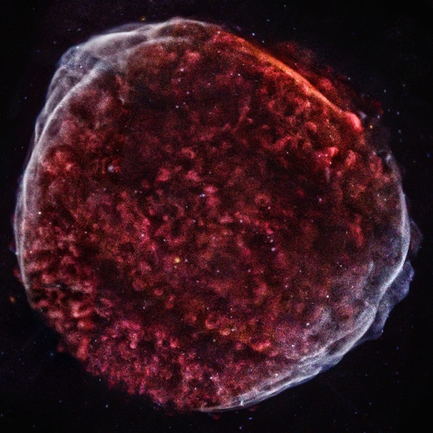
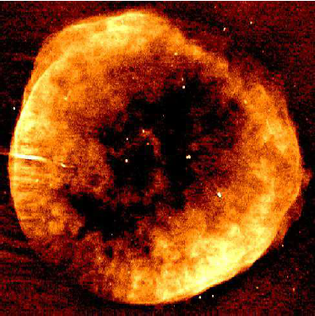
Example: SN 1006
Also seen in TeV
γ-rays by HESS
Remnant of the brightest supernova ever observed
Polarisation lower in regions where particles are being accelerated
These appear to be regions of quasi-parallel geometry
Note “thin rim” in both X-ray and radio
Chandra, X-ray VLA+ATCA, radio

Slide 25
Galactic Sources
Pulsar wind nebulae

Slide 26
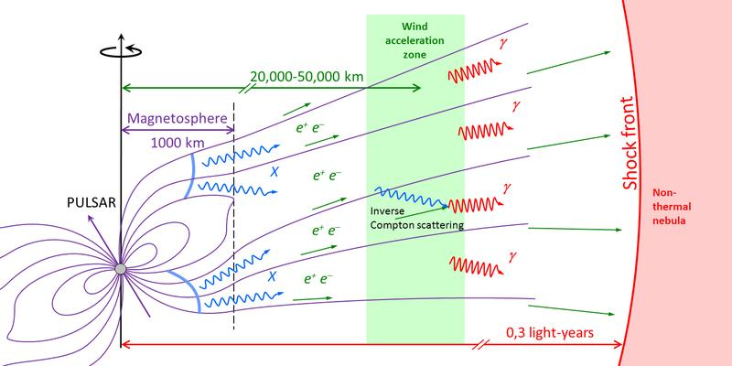
Pulsar wind nebulae
Pulsars are rapidly spinning neutron stars with strong magnetic fields
  they have enough energy to produce an e⁺e⁻ “pair plasma” and a relativistic wind, which generates a shock when it hits either supernova ejecta or ambient interstellar medium
  this produces a pulsar wind nebula (PWN)
    sometimes referred to as a plerion
PWNe are powered
by pulsar spin-down
  not by the energy of
  the original SN as
  in shell-type SNRs

Slide 27
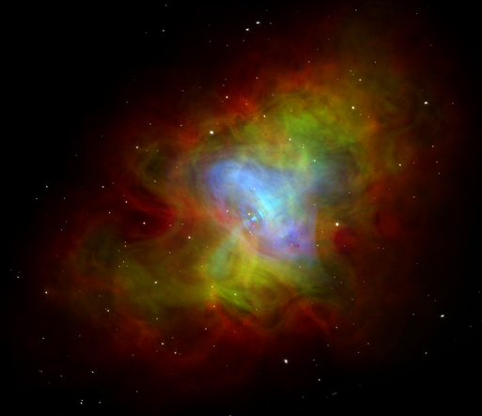
Pulsar wind nebulae
The classic PWN is the Crab Nebula (SN 1054)
  The Crab is seen at all wavelengths from TeV to radio—it was one
  of the first radio sources
  identified with a known
  object
  It is powered by a pulsar
  with 33 ms period
  Despite extensive searches
  no shell SNR is found
    extremely unexpected, as
    would expect a young
    SN II remnant to have a
    shell
    maybe this was an atypical
    SN II
X-ray
Optical
Radio

Slide 28
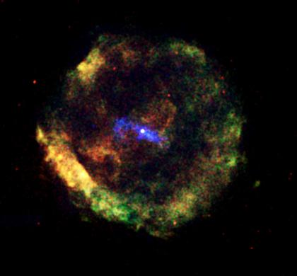
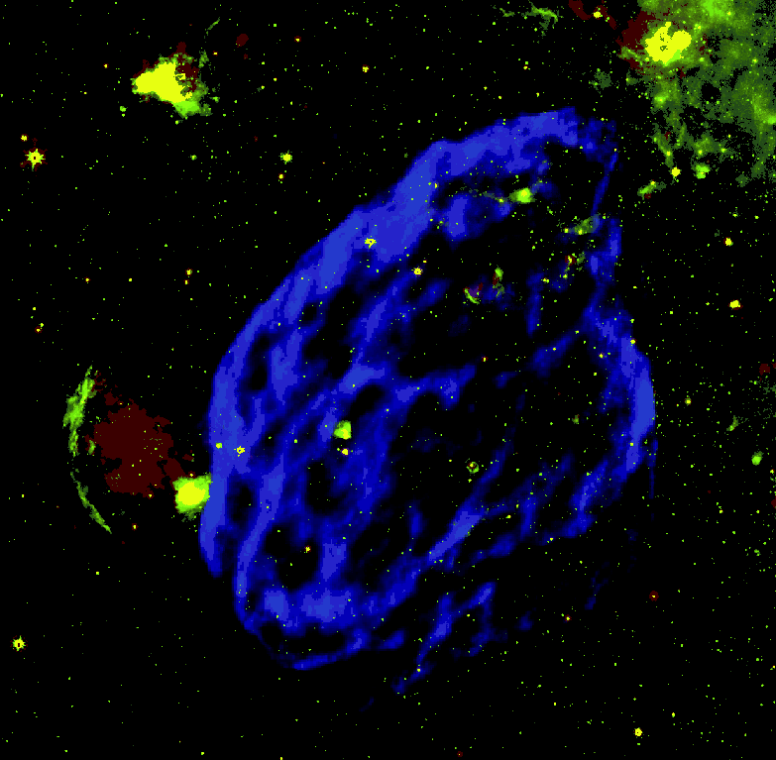
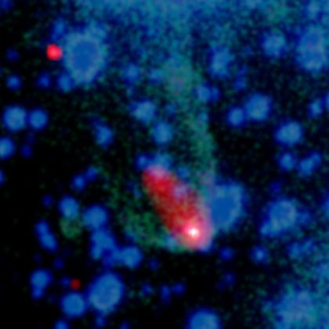
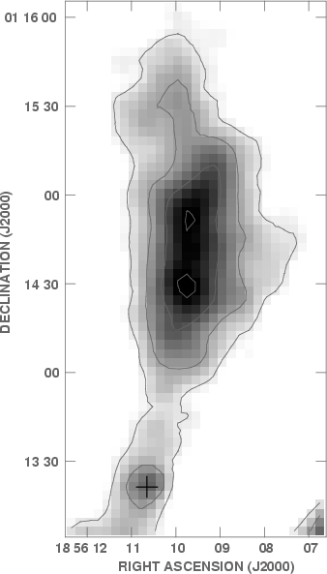
Pulsar wind nebulae
G11.2−0.3 by Chandra
“Composite” SNRs contain a
PWN surrounded by a shell SNR
  PWN will be central in young SNRs,
  but not in older examples because
  asymmetric SNR explosion imparts a
  “kick” to the pulsar
  older pulsars may have a “bow shock”
  PWN with no SNR
W44 in radio, VLA

Slide 29
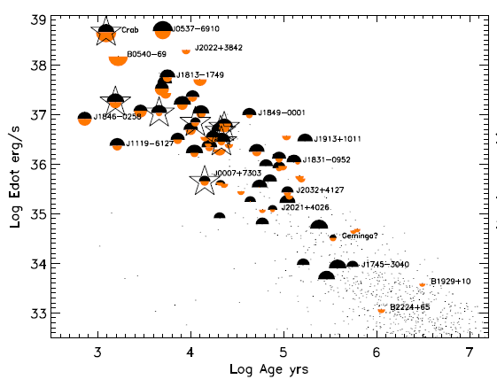

High energy photon emission
TeV
X-ray
GeV
Energy source is
pulsar spin-down
$\frac{dE}{dt}=4π^{2}I\frac{dP/dt}{P^{3}}$
  I is pulsar moment of inertia
  (10³⁸ kg m² for mass 1.4M⊙
  and radius 10 km)
  typically only pulsars with
  fairly high dE/dt generate
  obvious PWNe
Surprisingly little correlation between L_{X} and L_{TeV}
  L_{X} shows some correlation with dE/dt, L_{TeV} really doesn’t

Slide 30
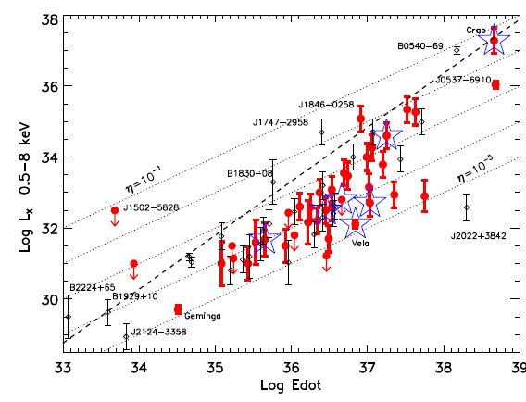
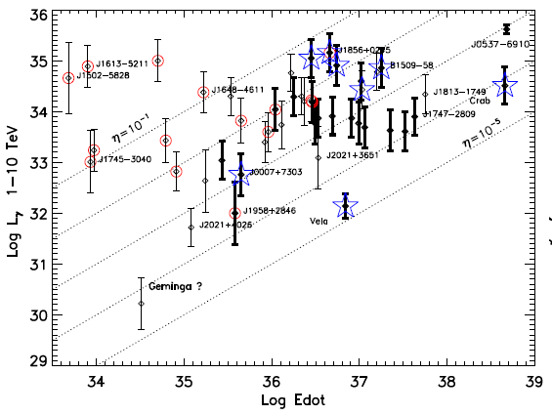
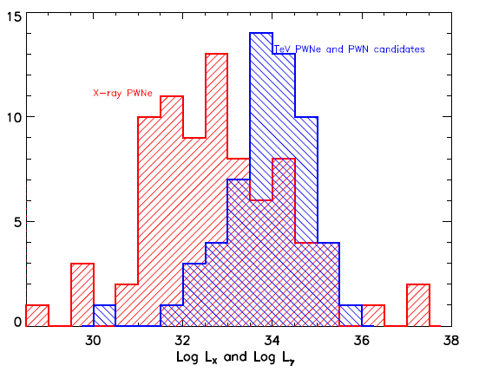
High energy photon emission
⧳ detected at TeV energies
○ not detected in X-rays
Luminosity at TeV energies is on average somewhat higher than in X-rays
Both TeV and X-ray emission are basically power laws, with photon index (dN_{γ}/dE ∝ E^{−Γ}) typically 2-2.7 for TeV, 1-2 for X-rays
X-ray
TeV

Slide 31
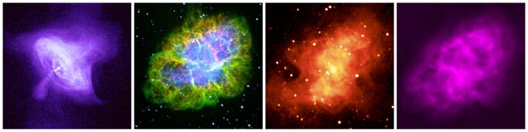
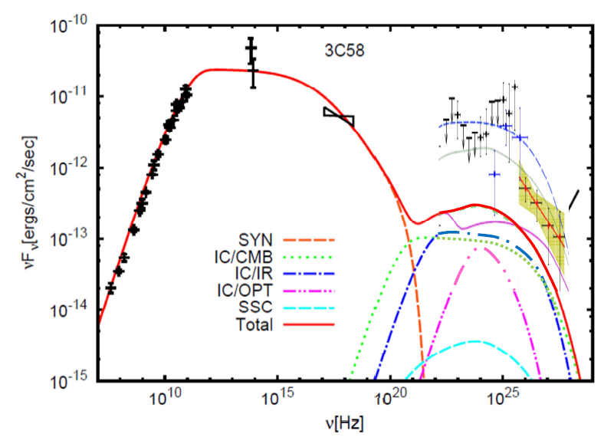
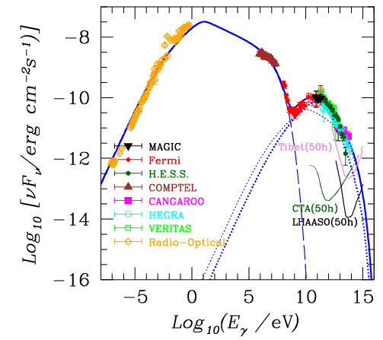
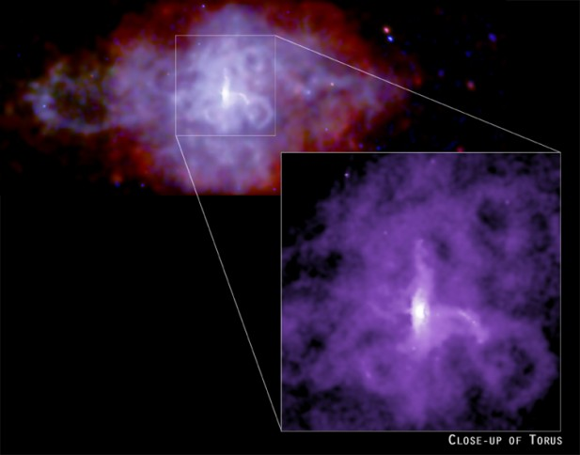
High energy photon emission
X-ray optical infra-red radio
Crab
Complex spectra with multiple slope breaks.
Jet-torus morphology in X-rays
3C 58

Slide 32
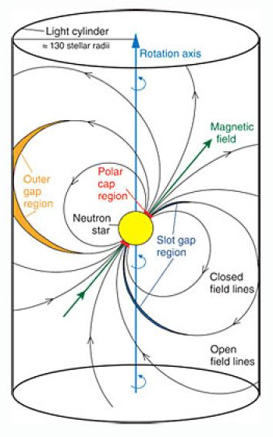
Particle acceleration in pulsar wind nebulae
Basic principles:
  pulsars have a very large magnetic field and rotate extremely rapidly
  this induces an extremely large electric field which rips particles off the surface of the pulsar and accelerates them to high energies
  in the high-density pulsar wind these accelerated primary particles induce an electromagnetic shower, producing a “pair plasma” dominated by e⁺ and e⁻ (rather than p and e⁻ as in a normal plasma)
  plasma escapes along open field lines, producing a relativistic pulsar wind

Slide 33
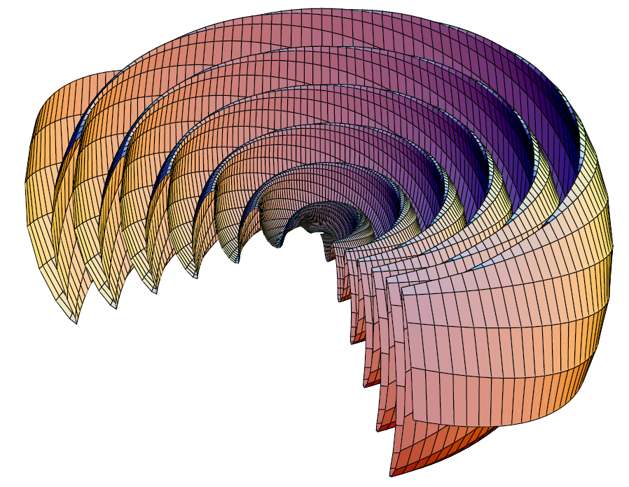

Particle acceleration in pulsar wind nebulae
Pulsars are oblique
rotators—magnetic and
rotation axes not parallel
  this produces a time-varying
  electromagnetic field which
  propagates outward as an EM
  wave with wavelength ≤ 2πr_{L}
    r_{L} = cP/(2π) is the radius of the light cylinder (distance
    from rotation axis at which constant angular velocity
    would require v = c)
  net result of this is a striped wind consisting of two spirals of opposite magnetic polarity
  this propagates outward to a termination shock where it hits either supernova ejecta or ISM:
  $r_{TS}=\dot{E}/(4πηcp)$
η = fraction of solid angle
covered by wind
p = pressure outside shock

Slide 34
Particle acceleration in pulsar wind nebulae
PWNe unquestionably accelerate particles
  radio and X-ray synchrotron emission, TeV photons
But it’s quite hard to work out how they do it
  magnetic geometry at the termination shock must be quasi-perpendicular, which disfavours diffusive shock acceleration
    but maybe enough small-scale turbulence is generated at the shock
    the expected electron power law of E^{−2.2} is right for the Crab’s X-ray spectral index (though not for its much flatter radio index)
  opposed magnetic fields in the striped wind suggest reconnection
    acceleration by magnetic reconnection in relativistic plasma is not yet well understood—not clear if it can generate required spectrum
  resonant cyclotron absorption
    ion-dominated “cold” (i.e. very ordered) winds produce cyclotron waves that are resonantly absorbed by e⁺e⁻ (doesn’t accelerate ions)
    hard to justify required injection rate of ions

Slide 35
Conclusion: PWNe
Pulsar wind nebulae are important sources of high energy photon emission in the Galaxy
  this emission is powered by the pulsar spin-down
They can be associated with SNRs, but some are isolated pulsars with “bow shocks”
  there are various ways in which a pulsar can be “kicked” out of its SNR (asymmetric explosion, asymmetric reverse shock)
  also, the most famous PWN of all—the Crab—has no associated shell SNR despite not having moved much from observed SN
The exact acceleration mechanism is disputed
  hence it is not obvious if PWNe accelerate ions, or just e⁺e⁻
Note that e⁺ escaping from PWNe might account for the “positron excess” in cosmic rays

Slide 36
Extragalactic Sources
Gamma ray bursts

Slide 37
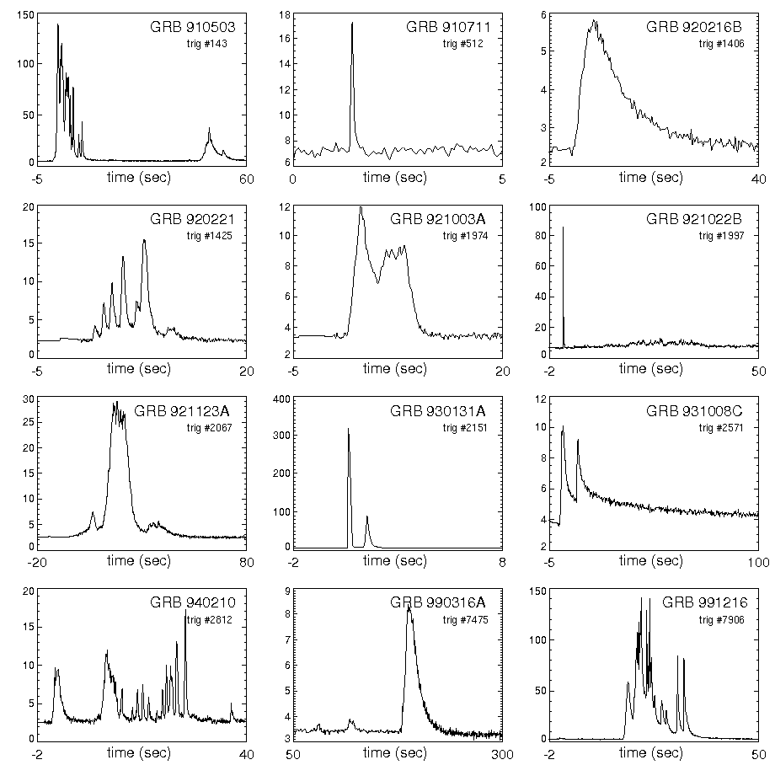
Gamma-ray bursts
Bursts are very variable in duration and shape
Discovered in 1973 following several years of observations by Vela defence satellites
  these were designed to look for γ rays from clandestine nuclear tests
  relative timing of detections from different satellites made it clear that source was extra-terrestrial
Diagnostic feature: burst of soft (MeV)
γ-rays

Slide 38


Distribution
BATSE instrument on CGRO (1991-2000) catalogued over 2700 GRBs
  isotropic in space
    either very local or extragalactic
  bimodal time distribution
    “short” bursts, 90% of the energy within < 2 s; “long” bursts, > 2 s
BeppoSAX (1996-2003) detected X-ray afterglows with higher positional accuracy
  identified sources; confirmed GRBs are extragalactic

Slide 39


Gamma-ray emission
The GRB proper is in soft γ-rays
(0.1−10 MeV)
  the spectrum peaks at ~1 MeV
  a minority of bursts also emit GeV
  γ-rays, but these are later than the
  main burst
  no GRBs have been seen to emit
  TeV photons
    this is not a very stringent limit:
      high redshift GRBs lie beyond the
      range limit for VHE photons
      only a fraction of bursts can be
      observed owing to low duty cycle of
      air Cherenkov telescopes

Slide 40

Long and short GRBs
The 2 s boundary is a bit
artificial
  it is different in different
  energy ranges
  high z GRBs are affected
  by time dilation and may
  move from “long” as observed
  to “short” in their rest frames
But the two classes are real
  “short” GRBs have harder spectra and differ in many other respects (distance, luminosity, host galaxy properties) from “long” GRBs
Evidence indicates different progenitors for the two classes
BATSE
Fermi-GBM

Slide 41




Long and short GRBs
Long GRBs have higher redshift, are more luminous, and live in galaxies with higher star formation rates
dependence of duration on energy
Short GRBs have lower X-ray luminosity for a given
γ-ray energy

Slide 42


GRB afterglows
Initial prompt emission from GRB is followed by an afterglow
  afterglow occurs at all wavelengths from X-rays to radio
  can be observed for several months after burst
Only a small number of afterglows have been observed for short GRBs
  they are less luminous, even allowing for GRB luminosity
    see plot on previous slide
GRB 080319B

Slide 43


GRB progenitors
A number of long GRBs have
been clearly associated with
supernovae
  light curves and spectra of SNe show
  them to be Type Ibc, but they appear to be brighter than typical SNe Ibc
Short GRBs are definitely not associated with SNe
  and there are a few long GRBs that don’t seem to have associated SNe either
Diversity of host galaxies shows short GRBs are not linked to massive stars
  currently favoured model is NS-NS mergers

Slide 44
GRB models
GRB emission must be beamed
  rapid variability implies small source size (< 300 km)
  photon energies extend beyond 2m_{e}c² (~1 MeV) with no cut-off
    this means that pair conversion is possible
    with photon density as implied by luminosity, photons above 1 MeV or so should be heavily depleted by γγ → e⁺e⁻
      this clearly is not happening
  conclusion: source region must be expanding relativistically
    for Lorentz factor Γ, this increases size scale by Γ², decreases opacity by Γ⁴, and increases pair production threshold by Γ
    estimated value of Γ is 10² – 10³
  a forward shock will certainly occur when this relativistic outflow hits the surrounding medium, and there may be multiple shocks
    multiple peaks in some GRB light curves suggest this

Slide 45
Particle acceleration in GRBs
The central engines of long and short GRBs are similar (formation of a black hole)
  the different properties are probably caused by the difference in environment, plus perhaps difference in mass of BH
The emission is probably all synchrotron
  not sure about the GeV range—might be inverse Compton
A beamed relativistic outflow seems essential to explain the observations
  relativistic shocks generate turbulence through plasma instabilities
  this provides a suitable environment for particle acceleration
    acceleration at relativistic shocks can be very fast, because of ~Γ² gain at first return crossing
  prompt γ-ray emission may be generated at internal shock, afterglow at external shock

Slide 46


GRB models
Slope breaks in GRB afterglows suggest jet opening angles of a few degrees (break occurs when jet opening angle comparable to 1/Γ)

Slide 47


Hadron acceleration in GRBs?
Synchrotron (+SSC?) spectrum requires only electrons
  no π⁰ decay signature
IceCube sees no neutrinos associated with GRBs
  the constraints are starting to be interesting, though other authors argue their predicted neutrino fluxes are too high (and hence limit too low)
IceCube

Slide 48
Conclusions: GRBs
GRBs are among the most extreme phenomena in the universe
  they appear to be generated when the formation of a BH by massive star core collapse or NS-NS merger produces an ultrarelativistic shock
    conditions for this to happen are not fully understood: statistics show that only a minority of SNe Ibc produce long GRBs (and a minority of long GRBs are not associated with supernovae)
Particle acceleration is probably associated with relativistic shocks
  EM spectrum either synchrotron or synchrotron+SSC
  no evidence for hadron acceleration (but not much against)
    neutrino limits from IceCube are beginning to look interesting
  GRBs could be source of UHE CRs, but starting to look less likely

Slide 49
Extragalactic Sources
Active galactic nuclei

Slide 50

Active galactic nuclei
Only a minority of AGN are radio loud, for reasons not yet understood
Active galaxies are those whose luminosities are not dominated by starlight
  The power source is believed to be accretion on to a super-massive black hole
Different types of active galaxy correspond to different orientations

Slide 51


Radio-loud AGN
FR I FR II
Radio galaxies are divided into FR I and FR II
  FR I: low radio luminosity, edge-darkened, bright jets
  FR II: high radio luminosity, edge-brightened, faint or invisible jets with bright hotspots
  some galaxies have >1 jet system (episodic)
Blazars and FSRQs are similar objects, but viewed down the jet
  in FSRQs see emission lines as well
hotspot
core
jet
lobe
plume

Slide 52

High and low excitation radio AGN
Most radio quiet and some
radio loud AGN have strong
emission lines from ionised
atoms
  “high excitation radio galaxies”
  mostly (but not all) FR II
Most radio loud AGN do not
have these emission lines
  “low excitation radio galaxies”
  mostly (but not all) FR I
This appears to be related to accretion rate
  HERGs are accreting at a high rate from an accretion disc
  LERGs are accreting at a low rate from optically thin hot gas
Laing et al. 1994

Slide 53

Radio and X-ray emission
Radio emission is
synchrotron
  diagnostic of lepton
  acceleration
X-ray emission is more
complicated
  there is a power law (synchrotron? inverse Compton?) but also thermal contributions, e.g. iron Kα emission
  X-ray and radio emission closely related
    “fundamental plane” relating radio luminosity, X-ray luminosity and black hole mass
    this holds (with different coefficients) whether X-ray emission is synchrotron emission from the jet or inverse Compton from the corona surrounding the black hole

Slide 54


High energy photon emission
Extragalactic sources reported by Fermi-LAT and IACTs are almost all blazars or flat spectrum radio quasars
Radio quiet AGN are not seen; more surprisingly, nor are higher-luminosity FR II radio galaxies

Slide 55


Relativistic bulk motion
Many AGN jets display apparent superluminal motion
  this is an optical illusion
  if speed of jet is βc, then
  if hotspot travels distance
  AB in time Δt, observed
  time interval between A
  and B is
  $Δt\left(1−β\cos{θ}\right)$
  so observed speed is
  $\frac{βc\sin{θ}}{1−β\cos{θ}}$
  for $γ≫1$ this comes out to 2γ/3
Jets aren’t superluminal, but they are relativistic
A
θ
C
B

Slide 56


Shocks
FR II radio galaxies clearly have
a jet termination shock at the outer hotspots
  “Knotty” jets like M87 suggest possible internal shocks too
These would be relativistic with bulk Lorentz factors ~10
  not as relativistic as GRBs
Presence of shocks is consistent with relativistic shock acceleration
  but X-ray synchrotron emission, especially in FR I galaxies, is diffuse and distributed—not concentrated at shocks

Slide 57



Particle acceleration in FR I jets
X-ray emission in FR I jets includes both diffuse emission and small bright knots
  two different acceleration processes?
  DSA at shocks, something else
  for diffuse emission?
FR I jets appear to decelerate
as they propagate outwards
  model: initially very light (lepton
  dominated) jet entrains
  material from hot IGM
Distributed acceleration
may be Fermi 2nd order
in turbulent fields
  magnetic reconnection
  also possible
Cen A

Slide 58

Particle acceleration in FR II jets
FR II galaxies have a well-defined termination shock
  though it is not obvious that it has favourable magnetic geometry
The “hotspot” behind the shock is bright at radio and X-ray wavelengths
  X-ray emission is usually synchrotron-self-Compton
  sometimes also a synchrotron component (needs higher energy e±)
  this is consistent with
  acceleration at or near
  the TS
Sometimes X-rays are
not coincident with radio
  this may indicate a more
  complex process than simple
  shock acceleration
3C 227

Slide 59




Spectral energy distributions
Blazars and FSRQs are very variable
Fits to leptonic (IC) and hadronic (π⁰) models sometimes favour one over the other
  either way round!
  usually, both work
Leptonic model
Hadronic model

Slide 60
Conclusions: AGN
Radio-loud AGN definitely accelerate particles
  they produce radio and sometimes X-ray synchrotron emission, and blazars are the dominant source of high-energy γ-ray emission
AGN jets show evidence of bulk relativistic motion
  with termination shock in FR II
  with deceleration along jet in FR I
Several different acceleration mechanisms may be involved
  X-ray emission is not all concentrated at shocks, so shock acceleration is not the whole story
    but is still likely to play a role
  stochastic (Fermi 2nd order) acceleration in turbulent fields may be implicated—would yield required diffuse X-ray emission
  magnetic reconnection may also occur
AGN are not ruled out as the source of UHE CRs, but neither are they definitely ruled in

Slide 61



Nearby AGN
Cen A and M87 likely to dominate UHE CR flux because of GZK cutoff
M87
17 Mpc
Centaurus A (NGC 5128): 3.7 Mpc
FR II galaxies much less common in local universe
Cygnus A: 240 Mpc
(closest FR II)

Slide 62




Our Galaxy as an AGN
“Bubbles” seen in γ-rays, micro-wave and radio
Relic of Sgr A* activity ~10⁷ yr ago?

Slide 63
Summary
Explaining the observed cosmic ray spectrum requires both Galactic and extragalactic sources
  Galactic sources explain spectrum up to the “knee”, extragalactic beyond this
Supernova remnants strongly believed responsible for Galactic emission
  energetics OK, some observed spectra show evidence for π⁰ decay
  properties are consistent with diffusive shock acceleration
Pulsar wind nebulae dominate high-energy photon emission—unclear whether these accelerate hadrons
  probably not DSA in this case: magnetic reconnection or (if only leptons) resonant cyclotron absorption
Main extragalactic sources are GRBs and radio-loud AGN
  GRBs contain highly relativistic shocks
  Lack of detected neutrino emission not definitive yet but interesting
  Radio-loud AGN have relativistic bulk motion with shocks
    distributed X-ray emission suggests acceleration not all localised to shocks—Fermi 2nd order and/or magnetic reconnection may be relevant
You should read chapter 4 of the notes (in progress)
You should know about
  supernova remnants
  pulsar wind nebulae
  gamma-ray bursts
  active galactic nuclei

