Slide 1
PHY418 Particle Astrophysics
Acceleration Mechanisms

Slide 2
Acceleration Mechanisms
There is clear observational evidence that hadrons and electrons are accelerated to extreme energies by astrophysical objects
direct evidence: charged cosmic rays
indirect evidence: synchrotron emission, inverse Compton emission, TeV photons, evidence of pion production and decay
Charged particles are accelerated by electric fields, but large-scale permanent electric fields do not exist in nature
there are too many charged particles about—space is surprisingly conductive!
Therefore our source must be magnetic fields
stable magnetic fields cannot induce acceleration, but varying magnetic fields can

Slide 3
Acceleration Mechanisms
Suggested mechanisms for acceleration in astrophysical sources:
Fermi second-order acceleration
diffusive shock acceleration (DSA)
shock drift acceleration (SDA)
acceleration by relativistic shocks
magnetic reconnection
Most favoured candidates are DSA and acceleration by relativistic shocks, but probably all of these mechanisms contribute to some degree

Slide 4
Acceleration Mechanisms
Fermi second-order acceleration

Slide 5
Fermi second-order acceleration
notes section 3.3
Original mechanism (Fermi 1949)
Particle travelling at speed v scatters off magnetic field irregularity travelling at speed V
In COM frame (= frame of field irregularity) energy of particle is $E_{i}^{′}=γ_{V}\left(E_{i}+β_{V}cp\cos{θ}\right)$ and x-momentum is $cp_{x}^{′}=γ_{V}(cp_{x}+β_{V}E_{i})$
After elastic collision, energy unchanged, but p_{x} reversed
Transform back into lab frame: $E_{f}=γ_{V}\left(E_{f}^{′}+β_{V}cp_{x}^{′}\right)$ $=γ_{V}^{2}\left(E_{i}+2β_{V}cp\cos{θ}+E_{i}β_{V}^{2}\right)$
Assume V ≪ c so $γ_{V}^{2}={\left(1−β_{V}^{2}\right)}^{−1}≃1+β_{V}^{2}$ and v ~ c so $E≃cp$
Then $\frac{ΔE}{E_{i}}=2β_{V}\left(β_{V}+\cos{θ}\right)$ neglecting terms higher than $β_{V}^{2}$
V
v
θ
x

Slide 6
Fermi second-order acceleration
Need to average over cos θ
Cannot neglect relativistic beaming as we are working to order $β_{V}^{2}$, so number density of photons as seen by magnetic field is $∝γ_{V}(1+β_{V}\cos{θ})$
Therefore $\left\langle \cos{θ}\right\rangle =\frac{\int_{−1}^{+1}{\cos{θ}}\left(1+β_{V}\cos{θ}\right) d\left(\cos{θ}\right)}{\int_{−1}^{+1}{\left(1+β_{V}\cos{θ}\right) d\left(\cos{θ}\right) }}=\frac{{\left[\frac{1}{2}\cos^{2}{θ}+\frac{1}{3}β_{V}\cos^{3}{θ}\right]}_{−1}^{+1}}{{\left[\cos{θ}+\frac{1}{2}{β_{V}cos}^{2}{θ}\right]}_{−1}^{+1}}$ i.e. $\left\langle \cos{θ}\right\rangle =\frac{1}{3}β_{V}$
Substituting this into the equation gives $\frac{ΔE}{E_{i}}=\frac{8}{3}β_{V}^{2}$

Slide 7
Energy spectrum
If the time between collisions is τ_{coll} and the time to escape is τ_{esc}, we have
${dE}/{dt}=αE$ where $α=\frac{8}{3}β_{V}^{2}/τ_{coll}$ and $\frac{dN\left(E\right)}{dt}=\frac{d}{dE}\left(−αEN\left(E\right)\right)−\frac{N\left(E\right)}{τ_{esc}}=−αN\left(E\right)−αE\frac{dN}{dE}−\frac{N(E)}{τ_{esc}}$
This will eventually settle down into a steady state in which dN/dt = 0: $E\frac{dN}{dE}=−N\left(1+\frac{1}{ατ_{esc}}\right)$
Separating variables gives $\frac{dN}{N}=−\left(1+\frac{1}{ατ_{esc}}\right)\frac{dE}{E}$
power law spectrum
$$N\left(E\right)∝E^{−k} \\ k=1+{\left(ατ_{esc}\right)}^{−1}$$

Slide 8
Issues with Fermi 2nd order
It’s too slow
relative velocities of objects in Galactic disc are only 10s of km/s, so fractional energy gain per reflection is only ~10⁻⁸
There is no obvious reason why different sources should yield same spectral index
but the fact that the CR spectrum is close to E^{−2.7} over many orders of magnitude suggests that they do
It is very difficult to get started (“injection problem”)
at low energies, ionisation losses exceed predicted energy gain
need seed population to have energies of ~200 MeV or more
worse for particles heavier than protons as ionisation loss ∝ z²
this is far higher than thermal energies
Solution to these problems is acceleration near shocks

Slide 9
Acceleration Mechanisms
Astrophysical shocks

Slide 10
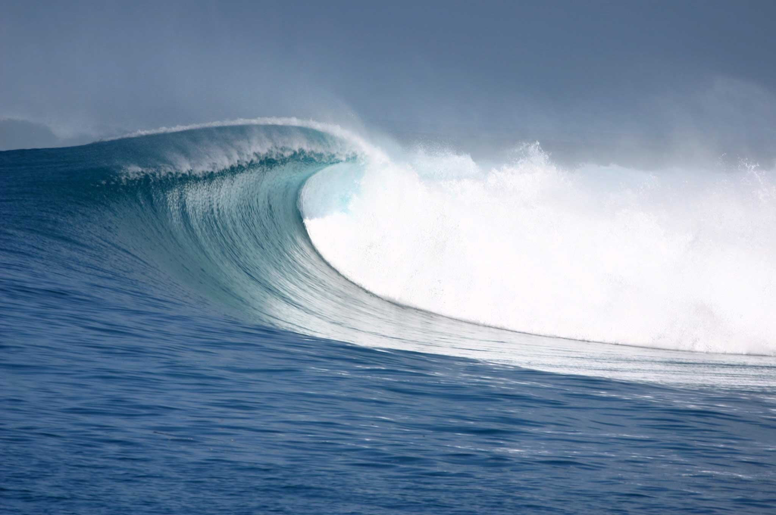
Astrophysical shocks
notes section 3.4
Shocks occur when a supersonic flow encounters an obstacle or decelerates to subsonic speed
In a situation where a transverse wave would “break”, a longitudinal wave forms a shock front
velocity, density and pressure change discontinuously across the shock
Astrophysical shocks are usually collisionless shocks
shock front is much thinner than particle mean free path

Slide 11
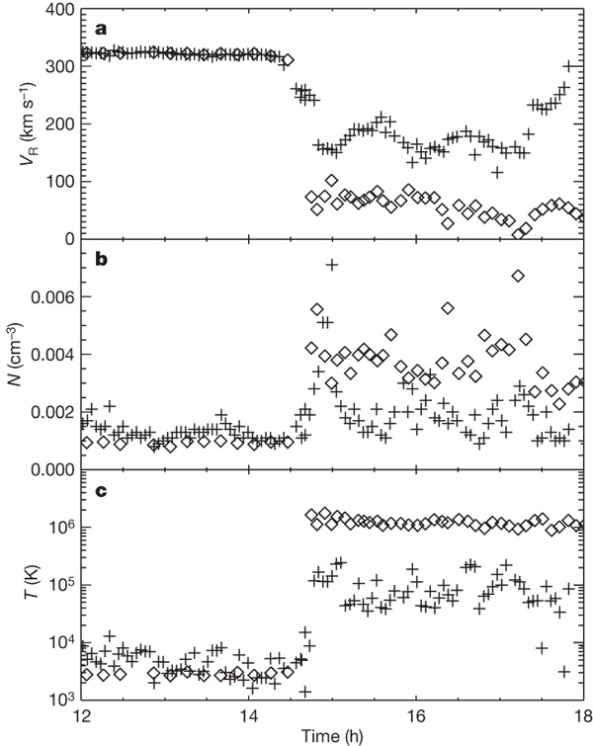
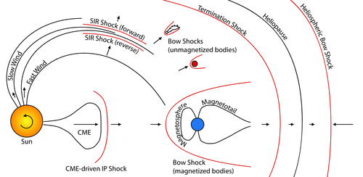
Astrophysical shocks
Neptune bow shock ◊ and solar termination shock + observed by Voyager 2
Many astrophysical objects exhibit shocks
several types exist in the solar system and have been studied by spacecraft
discontinuities in physical quantities clearly seen
http://sprg.ssl.berkeley.edu/~pulupa/illustrations/

Slide 12
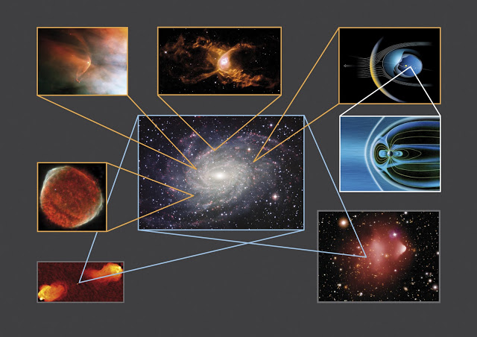
Astrophysical shocks
Outside the solar system, shocks are observed as sharp edges in emission, with characteristic shape
They occur on all scales from planets to clusters of galaxies
Many are clearly associated with acceleration, e.g. seen in synchrotron radiation
http://minsex.blogspot.co.uk/2011/11/astrophysical-shock-waves.html

Slide 13
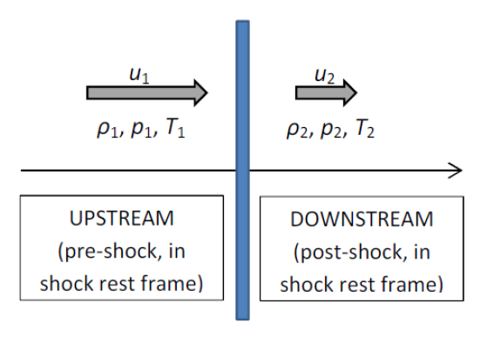
Shock jump conditions
plane parallel shock:
gas velocity along shock normal
Consider situation in shock rest frame
gas flows into shock with high velocity, low density, low T
flows out with low velocity, high density, high T
Shock jump conditions relate pre- and post-shock quantities using conservation laws
conservation of mass: $ρ_{1}u_{1}=ρ_{2}u_{2}$
conservation of momentum: $ρ_{1}u_{1}^{2}+p_{1}=ρ_{2}u_{2}^{2}+p_{2}$
mass of gas crossing shock in time Δt is ρ_{i}u_{i} Δt (per unit area)
change in momentum balanced by change in pressure

Slide 14
Shock jump conditions
Shock jump conditions (cont.)
conservation of energy:
energy of gas = internal thermal energy + bulk kinetic energy
$ℰ_{i}=c_{V}T_{i}+\frac{1}{2}u_{i}^{2}$ [per unit mass] where c_{V} is specific heat at constant volume
Ideal gas law gives $p=ρ\left(γ_{g}−1\right)c_{V}T$ ($γ_{g}=c_{p}/c_{V}$)
Conservation of energy gives $ρ_{1}u_{1}ℰ_{1}+p_{1}u_{1}=ρ_{2}u_{2}ℰ_{2}+p_{2}u_{2}$, i.e. $p_{1}u_{1}\left(\frac{γ_{g}}{γ_{g}−1}\right)+\frac{1}{2}ρ_{1}u_{1}^{3}=p_{2}u_{2}\left(\frac{γ_{g}}{γ_{g}−1}\right)+\frac{1}{2}ρ_{2}u_{2}^{3}$ $\frac{p_{1}γ_{g}}{ρ_{1}\left(γ_{g}−1\right)}+\frac{1}{2}u_{1}^{2}=\frac{p_{2}γ_{g}}{ρ_{2}\left(γ_{g}−1\right)}+\frac{1}{2}u_{2}^{2}$
this term is the work done, p dV

Slide 15
Shock jump conditions
Putting these three equations together, we have the Rankine-Hugoniot conditions for a plane-parallel shock:
$$ρ_{1}u_{1}=ρ_{2}u_{2}$$
$$ρ_{1}u_{1}^{2}+p_{1}=ρ_{2}u_{2}^{2}+p_{2}$$
$$\frac{p_{1}γ_{g}}{ρ_{1}\left(γ_{g}−1\right)}+\frac{1}{2}u_{1}^{2}=\frac{p_{2}γ_{g}}{ρ_{2}\left(γ_{g}−1\right)}+\frac{1}{2}u_{2}^{2}$$
Three equations in three unknowns, therefore soluble

Slide 16
Solution of Rankine-Hugoniot conditions
Solving these simultaneous equations gives $\frac{ρ_{2}}{ρ_{1}}=\frac{\left(γ_{g}+1\right)M_{1}^{2}}{\left(γ_{g}−1\right)M_{1}^{2}+2};$ $\frac{p_{2}}{p_{1}}=\frac{2γ_{g}M_{1}^{2}−\left(γ_{g}−1\right)}{γ_{g}+1}$
where the Mach number $M_{1}=\sqrt{ρ_{1}u_{1}^{2}/\left(γ_{g}p_{1}\right)}$
For strong shocks, M₁ >> 1, and a nonrelativistic monatomic gas, γ_{g} = 5/3, this gives ρ₂/ρ₁ = 4 = u₁/u₂
reverting to the rest frame of the upstream gas, this means that the downstream gas is accelerated to ¾ of the speed of the shock

Slide 17
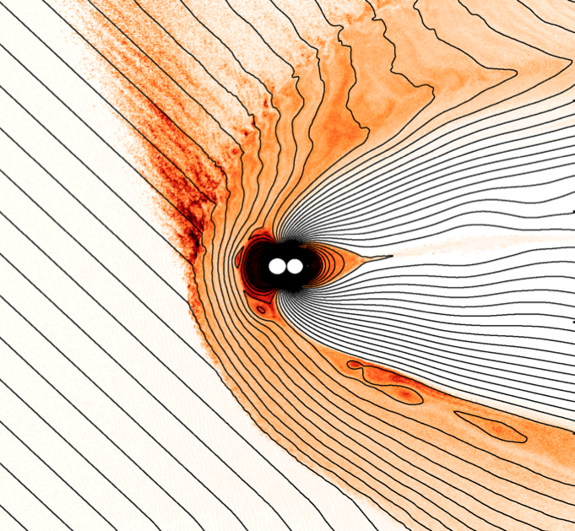
Effect of magnetic fields
Shocks must be associated with magnetic fields to accelerate particles
magnetic fields directed close to shock normal have little effect on shock jump conditions—these are quasi-parallel shocks
magnetic fields strongly inclined to shock normal contribute an additional “pressure” term—oblique shocks
shocks in which magnetic field is nearly perpendicular to shock normal are called quasi-perpendicular shocks
some shock fronts, e.g. planetary bow shocks, are curved and can have all three geometries at different points

Slide 18
Collisionless shocks and acceleration
Because astrophysical shocks are collisionless, population of fast particles can remain out of thermal equilibrium with bulk gas
therefore shocks can accelerate particles to high energies, even though they do not accelerate bulk gas that much
Key parameter is criticality of shock
subcritical shock can satisfy shock jump conditions while particles remain within (thin) shock front
supercritical shock cannot do this as it is moving too fast
therefore it must dissipate energy (generate entropy) some other way
it turns out that the natural way to do this is to reflect some of the incoming gas back upstream
this is exactly what we want for acceleration
boundary between subcritical and supercritical is ℳ ≃ 2.76

Slide 19
Acceleration Mechanisms
Diffusive Shock Acceleration

Slide 20
Diffusive shock acceleration
notes section 3.5
Plane-parallel shock travelling with speed V
in shock rest frame, upstream gas has speed −V, downstream gas has speed −¼V
in upstream rest frame, downstream gas has speed ¾V
in downstream rest frame, upstream gas has speed −¾V
If gas contains a population of fast particles
they will scatter elastically until isotropic in the gas rest frame (⟨v⟩ = 0)
any particle crossing shock will see gas approaching with speed ¾V: collision geometry guaranteed to be favourable

Slide 21
Test particle approach
Assume fast-particle population does not affect shock
Particle with momentum p in upstream rest frame has energy $E^{′}=γ_{U}(E+p_{x}U)$, where U = ¾V, in downstream rest frame
Assume fast particles are ultra-relativistic, E ≈ cp
probability of given particle crossing shock in given time interval is $P\left(θ\right)dθ=2\sin{θ}\cos{θ}dθ$
if shock is non-relativistic can take γ_{U} ≈ 1
therefore average energy gain is $\left\langle \frac{ΔE}{E}\right\rangle =\frac{U}{c}\int_{0}^{π/2}{2\cos^{2}{θ}\sin{θ}dθ}=\frac{2}{3}\frac{U}{c}=\frac{1}{2}\frac{V}{c}$
The same is true for a crossing from downstream to upstream
Therefore average energy gain in one return crossing is V/c
This is diffusive shock acceleration, or Fermi first-order acceleration

Slide 22
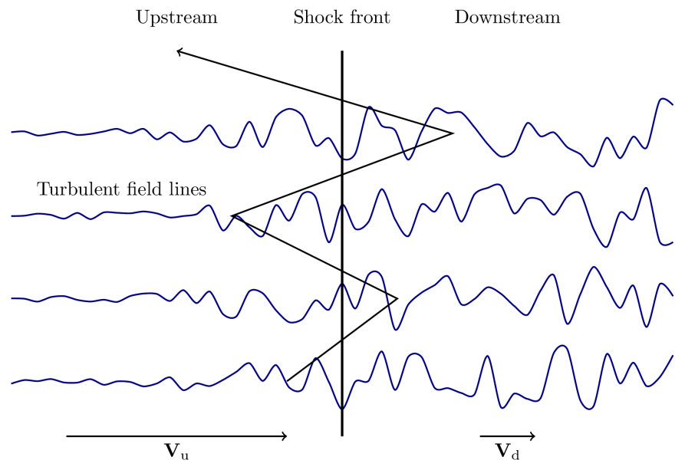
DSA energy spectrum
After each shock crossing, $E_{k}=fE_{k−1}$where $f=1+\frac{V}{c}$
If fast particles have v ≈ c
number crossing shock front per unit area per unit time = ¼Nc (N number density)
number advected downstream = ¼NV
therefore fraction lost per unit time is V/c
Hence after k shock crossings, $E_{k}=f^{k}E_{0}$ and $N_{k}=P^{k}N_{0}$ where $P=1−\frac{V}{c}$
therefore $N\left(E>E_{k}\right)=N_{0}{\left(E_{k}/E_{0}\right)}^{\ln{P}/\ln{f}}≃N_{0}{\left(E_{k}/E_{0}\right)}^{−1}$
since ln P ≈ −V/c and ln f ≈ +V/c
hence N(E) dE ∝ E⁻² dE, independent of details of shock
http://sprg.ssl.berkeley.edu/~pulupa/illustrations/

Slide 23
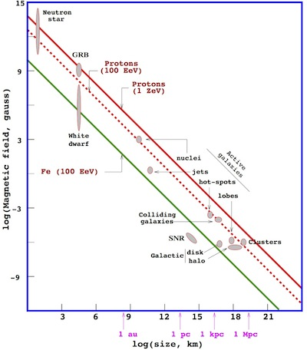
Maximum energy from DSA
Expect a high-energy cut-off because at high energies the magnetic field of the source will not confine the particles
For order of magnitude estimate, take Maxwell’s equation $∇×E=−\frac{∂B}{∂t}$
replace derivatives by divisions $\frac{E}{L}∼\frac{B}{L/V}$
then for particle of charge ze, E_{max} ~ zeEL ~ zeBVL
This is the basis of the Hillas plot of magnetic field against size, used to evaluate potential CR sources
V speed of shock L size of source

Slide 24
Realistic DSA
Test particle approach assumes fast particles are negligible as regards their effect on the shock
but for supercritical shocks this cannot be right as we know that such shocks need a significant reflected flux to conserve energy and momentum across the shock front
also, measurements in solar system shocks indicate that acceleration is quite efficient—as much as 20% of the kinetic energy of the bulk gas is used in accelerating high-energy particles
Therefore the test-particle approach is inadequate and we need a more realistic treatment
this is highly non-linear and cannot be done analytically
detailed 3D computer simulations are needed
3D because particle distributions are highly anisotropic and turbulence is involved

Slide 25
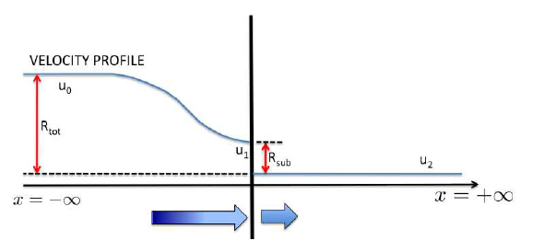
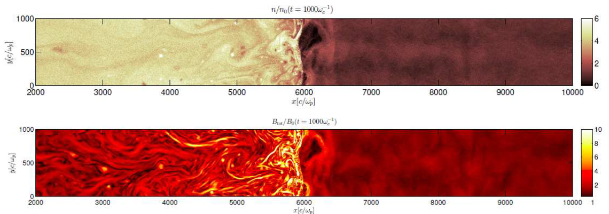
Realistic DSA
Fast particles scattered back across shock front affect velocity profile of gas
Resulting compression ratio can be >4
Particles can also generate turbulence via streaming instabilities
subshock
shock precursor

Slide 26
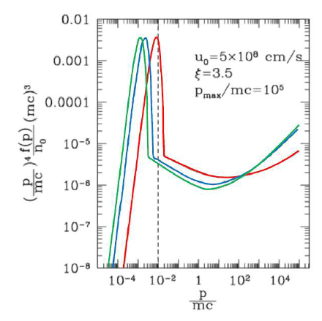
Realistic DSA
Energy spectrum for realistic DSA simulations tends to be concave rather than flat
this plot from Blasi is the phase space density f(p) scaled by p⁴
a 1/E² spectrum would be horizontal on this plot (since d³p = 2πp² dp)
the conclusion from this would be that the energy spectrum at high energies should be somewhat less steep than 1/E²
this is a little unfortunate, since such evidence as there is suggests that if anything the energy spectra in astrophysical sources tend to be a little steeper than 1/E²

Slide 27
DSA: Conclusions
Diffusive shock acceleration across non-relativistic shocks can accelerate particles to high energy with high efficiency
It produces a power-law spectrum ~E⁻² with little dependence on details of shock
The maximum energy is of order zeBVL for a shock of speed V in magnetic field B in a source of size L
Required magnetic field strengths and level of turbulence can be generated by non-linear effects in realistic simulations
There do appear to be unsolved issues in getting the energy spectrum exactly right, but these calculations require extremely sophisticated simulations with high CPU requirements, so future work may resolve this

Slide 28
Acceleration Mechanisms
Shock Drift Acceleration (SDA)

Slide 29
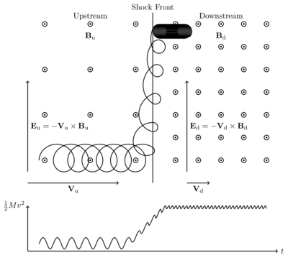
SDA vs DSA
DSA takes place at quasi-parallel shocks
it does not happen at perpendicular shocks because the magnetic fields tend to prevent repeated shock crossings
In quasi-perpendicular shocks, particles—especially electrons— can be trapped in the vicinity of the shock front
the particle is accelerated by the effective electric field in the shock front; the energy gain is proportional to the distance travelled along the front
SDA usually only increases particle energy by ~factor 10
not an effective mechanism for CR acceleration, but may solve injection problem
http://sprg.ssl.berkeley.edu/~pulupa/illustrations/

Slide 30
Acceleration Mechanisms
Acceleration at Relativistic Shocks

Slide 31
Relativistic shocks
notes section 3.6
In many astrophysical sources, e.g. GRBs and AGN jets, there is good evidence for relativistic shocks (V ~ c)
acceleration in these shocks differs from DSA, because on return to the upstream rest frame there isn’t time for the fast particles to become isotropic before the shock catches them
also, must consider beaming effects: cos θ will look very different to upstream and downstream observers
relativistic shock jump conditions (for a plane parallel shock) $γ_{1}ρ_{1}β_{1}=γ_{2}ρ_{2}β_{2};$ $γ_{1}^{2}w_{1}β_{1}^{2}+p_{1}=γ_{2}^{2}w_{2}β_{2}^{2}+p_{2};$ ${ γ}_{1}^{2}w_{1}β_{1}=γ_{2}^{2}w_{2}β_{2}$
where enthalpy $w=ℰ+p$
equation of state $p=\left(\hat{γ}−1\right)\left(ℰ−ρc^{2}\right)$
$\hat{γ}$ is the effective ratio of specific heats

Slide 32
Highly relativistic case
Take case where p₁ is negligible and $ℰ_{2}≫ρ_{2}c^{2}$
then we have $p_{2}≃\left(\hat{γ}−1\right)ℰ_{2}$ and $γ_{1}^{2}w_{1}β_{1}^{2}=γ_{2}^{2}w_{2}β_{2}β_{1}≃γ_{2}^{2}w_{2}β_{2}^{2}+\left(\hat{γ}−1\right)ℰ_{2}$
Substituting $w_{2}=ℰ_{2}+p_{2}≃\hat{γ}ℰ_{2}$ and taking $β_{1}≃1$ (in the shock rest frame, the unshocked gas is moving at essentially c), we get $\frac{β_{2}}{1+β_{2}}≃\frac{\hat{γ}−1}{\hat{γ}}$ and therefore $β_{2}=\hat{γ}−1$ (= ⅓ for a fully relativistic gas)
Also, write $β_{1}=1−ε$ where $ε≪1$
then as $β_{rel}=\frac{β_{1}−β_{2}}{1−β_{1}β_{2}}≃1−2ε$
we conclude that $γ_{rel}≃1/2\sqrt{ε}=γ_{1}/\sqrt{2}$

Slide 33
Highly relativistic shocks
Consider highly relativistic particle which crosses from upstream to downstream and back
in upstream rest frame its energy gain is given by $\frac{E_{f}}{E_{i}}=\frac{1−β_{rel}μ_{1}}{1−β_{rel}μ_{2}}=\frac{1}{2}γ_{s}^{2}\left(1−β_{rel}μ_{1}\right)\left(1+β_{rel}{\overline{μ}}_{2}\right)$
where $μ_{i}≡\cos{θ_{i}}$, and the bar indicates measurement in the downstream rest frame (other quantities measured in upstream rest frame) $μ_{2}=\frac{{\overline{μ}}_{2}+β_{rel}}{1+β_{rel}{\overline{μ}}_{2}}$
upstream particles will be overtaken by the shock if $−1≤β_{1}μ_{1}<β_{s}$
if upstream particle is a particle of the upstream bulk gas, $β_{1}≪1$ and $E_{i}≃mc^{2}$, giving $E_{f}=\frac{1}{2}γ_{s}^{2}\left(1+β_{rel}{\overline{μ}}_{2}\right)mc^{2}$ and $\frac{2}{3}γ_{s}^{2}<\frac{E_{f}}{E_{i}}≤γ_{s}^{2}$
if upstream particle was already relativistic, particle flux for given μ₁ is $∝\left(β_{s}−μ_{1}\right)≃(1−μ_{1})$, giving $\frac{E_{f}}{E_{i}}=\frac{2}{3}γ_{s}^{2}\left(1+β_{rel}{\overline{μ}}_{2}\right)$and $\frac{8}{9}γ_{s}^{2}<\frac{E_{f}}{E_{i}}≤{\frac{4}{3}γ}_{s}^{2}$

Slide 34
Highly relativistic shocks
From previous, first return crossing leads to energy gain of factor ~$γ_{s}^{2}$
this can be very large, as bulk γ factors for GRBs can be 10² or 10³
For subsequent shock crossing, must have ${\overline{μ}}_{2}>\frac{1}{3}$
this transforms to $μ_{2}>β_{s}=1−{\left(1/γ_{s}\right)}^{2}$, corresponding to $\sin{θ}=\frac{1}{γ_{s}}$
to recross shock must scatter out of this cone, but relativistic scattering can only change angle by another $1/γ_{s}$, giving $θ_{2}<\frac{1}{γ_{s}}<θ_{1}$
this gives a large escape probability, P ~ ⅓, and small energy gain $\frac{E_{f}}{E_{i}}≃\frac{1+\frac{1}{2}γ_{s}^{2}θ_{1}^{2}}{1+\frac{1}{2}γ_{s}^{2}θ_{2}^{2}}≃2$
(assuming $θ_{2}\sim 2/γ_{s}$ and $θ_{1}\sim 1/γ_{s}$)
this turns out to imply a somewhat steeper power law, 2.3–2.4

Slide 35
Acceleration Mechanisms
Magnetic Reconnection

Slide 36
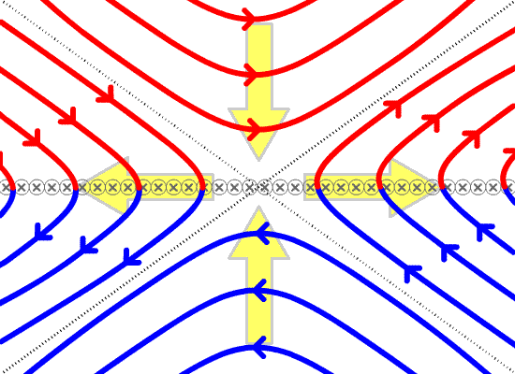
Magnetic reconnection
notes section 3.7
Magnetic reconnection occurs when magnetic field lines of opposed polarities are forced close together
resulting field configuration has lower energy, so energy is released in this process and can drive acceleration (and/or bulk flow of plasma)
This is probably not appropriate for most astrophysical accelerators, but is implicated in solar flares and may be important near pulsars
in particular, it is fast and so can drive sudden γ-ray flares as observed, e.g., in Crab Nebula

Slide 37
Acceleration Mechanisms
Propagation through the Galaxy

Slide 38
Propagation of CRs in Galaxy
notes section 3.7
DSA predicts energy spectrum E⁻², maybe even less for realistic approach; relativistic shocks give E^{−2.3} or so
observed spectrum is ~E^{−2.7}
is this a problem?
Perhaps not: as CRs propagate through Galaxy, more energetic particles will have larger gyroradii and so are more likely to escape
can model this by a cylindrical “leaky box” with radius R ~ 15 kpc and height H ~ 3 kpc (height of Galactic magnetic field as estimated from synchrotron radiation)
escape time is then $τ_{esc}≃H^{2}/D(E)$ where D(E) is diffusion coefficient for CRs of energy E
assume $D\left(E\right)=D_{0}E^{−δ}$, and take original spectrum $N_{s}\left(E\right)∝E^{−α}$

Slide 39
Propagation of CRs in Galaxy
If rate of production by sources is ℛ_{s}, we have $N\left(E\right)≃\frac{N_{s}\left(E\right)ℛ_{s}}{2πR_{d}^{2}H}τ_{esc}∝E^{−\left(α+δ\right)}$ for primary cosmic rays
For secondary (spallation-produced) CRs, rate is $N_{sec}\left(E\right)≃N\left(E\right)ℛ_{spall}τ_{esc}∝E^{−\left(α+2δ\right)}$
the extra factor of δ comes from the fact that spallation reactions occur throughout the lifetime of the CR in the galaxy
Therefore comparison of secondary and primary cosmic rays should allow us to separate α and δ
results suggest 0.3 < δ < 0.7 and thus 2.0 < α < 2.4
models of CR anisotropy (lack of) prefer α at high end of range

Slide 40
Summary
Particle acceleration in astrophysical sources must involve magnetic fields
but scattering off magnetic fields in interstellar space is too inefficient
Most popular mechanisms are diffusive shock acceleration and acceleration by relativistic shocks
both of these rely on favourable kinematics created by presence of shock
observational evidence does link shocks to acceleration (e.g. X-ray synchrotron emission from edges of supernova remnants)
Magnetic reconnection may well be important in some sources
especially those associated with pulsars
Propagation through Galaxy produces steeper energy spectrum
You should read chapter 3 of the notes
You should know about
Fermi 2nd order mechanism
shocks and shock jump conditions
diffusive shock acceleration
relativistic shocks
magnetic reconnection
propagation effects

Slide 41
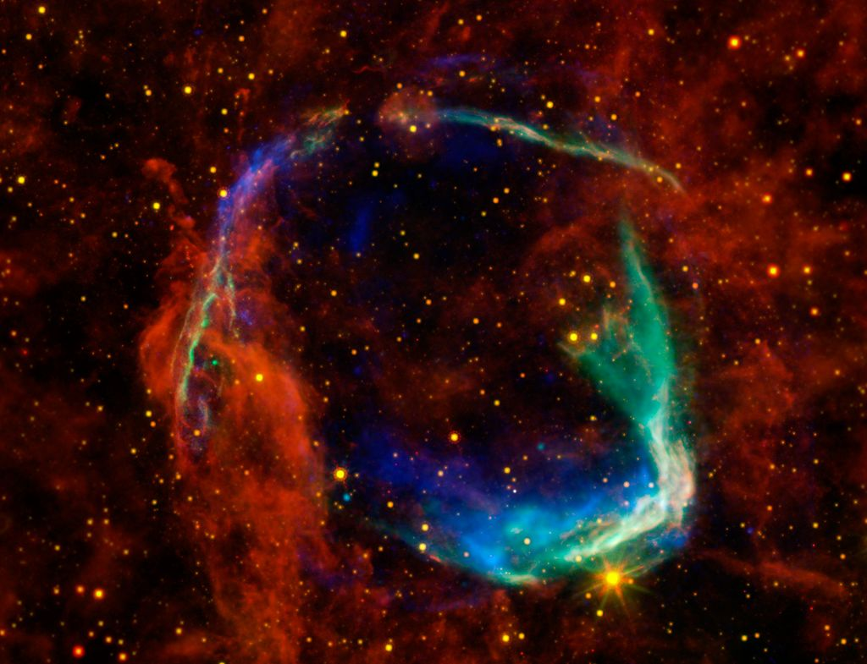
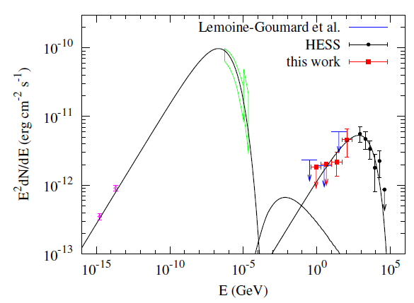
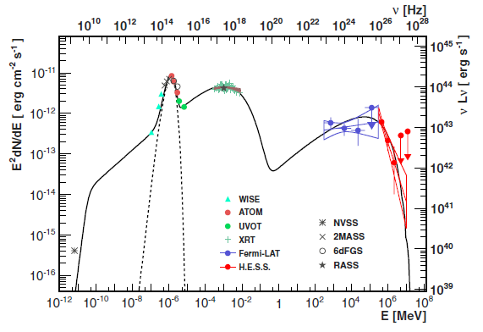
Next: some case studies
solar system
Galactic sources
extragalactic sources
Notes chapter 4

