Slide 1
PHY418 Particle Astrophysics
High Energy Neutrinos

Slide 2
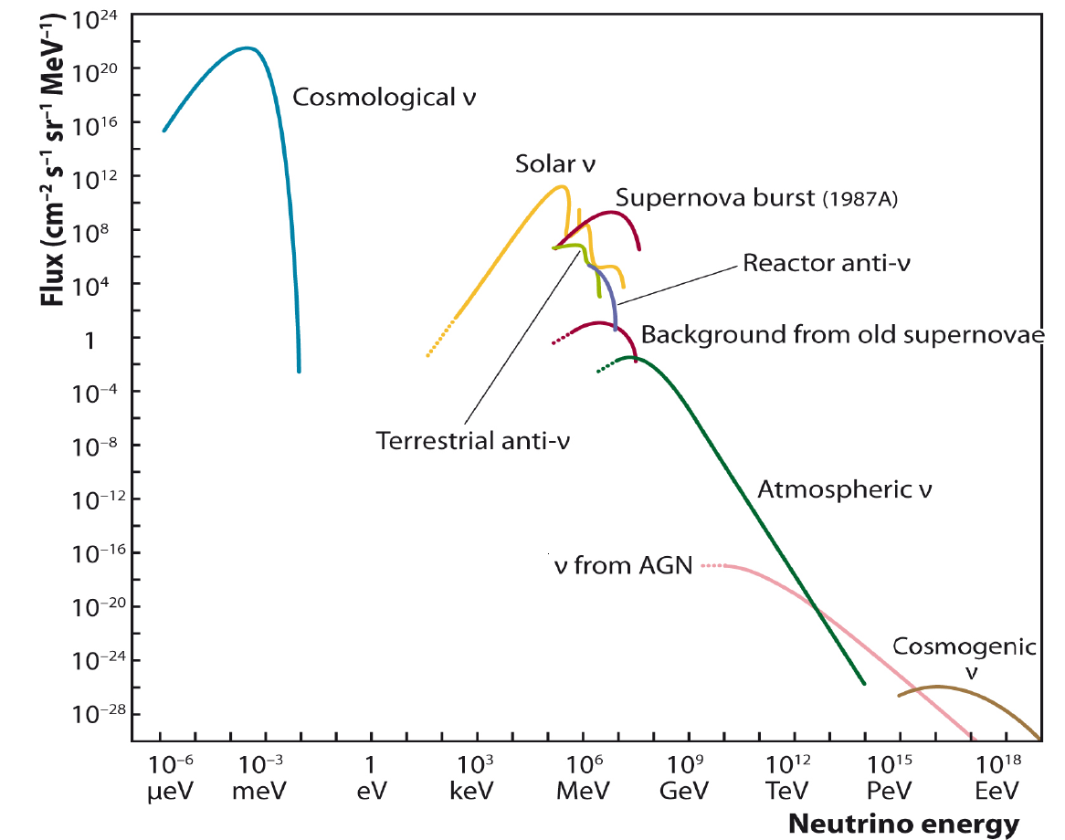
Neutrino astrophysics
notes section 1.5
essentially undetectable
IceCube website
Relevant to high energy particle astrophysics

Slide 3
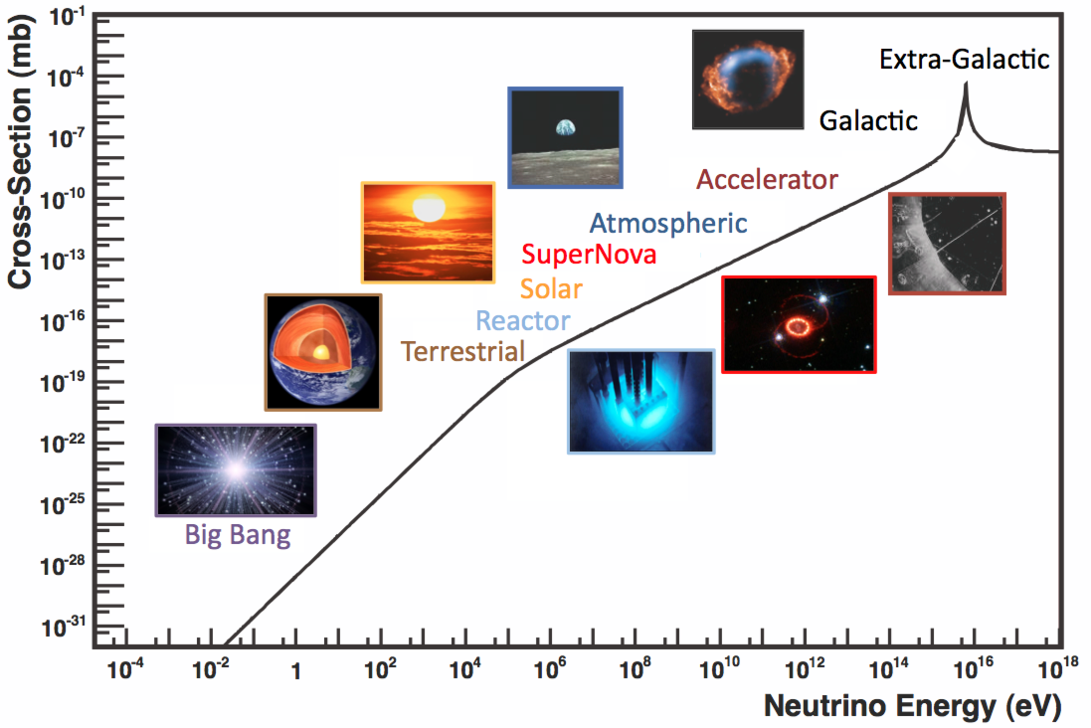
Neutrino astrophysics
Formaggio & Zeller
ν̅_{e}e⁻ cross-section

Slide 4
High Energy Neutrinos
Emission Mechanisms

Slide 5
Charged pion decay
notes section 2.5.1
If an object accelerates protons to high energies, we should get charged pion production via p + p → p + n + π⁺
(i.e. energetic proton hits ambient gas; as protons are more common than neutrons this reaction will be more common than p + n → p + p + π⁻)
π⁺ then decays to μ⁺ν_{μ} (π⁻ to μ⁻ν̅_{μ})
other flavours of neutrino will be produced in flight by neutrino oscillation
This is essentially the same mechanism that produces high-energy γ-rays from π⁰ decay
any source that is known (from its spectrum) to produce π⁰ decay photons is guaranteed to be a neutrino source (but possibly not a detectable neutrino source, because of the low cross-section)

Slide 6
Waxman-Bahcall bound
We know the spectrum of high-energy cosmic rays, and pγ interactions with ambient radiation—e.g. CMB photons—must occur and also produce pions, mainly via the Δ resonance
therefore we can calculate the expected neutrino flux from this source
this is the Waxman-Bahcall bound
Assume an energy spectrum ∝E⁻²
then energy production rate in CRs between E_{p} and E_{p} + dE_{p} is $\dot{ℰ}\left(E_{p}\right)dE_{p}={\dot{N}}_{p}\left(E_{p}\right)×E_{p}dE_{p}=\frac{{\dot{N}}_{0}}{E_{p}}dE_{p}$
Integrate this between 10¹⁹ and 10²¹ eV, substitute in measured CR energy flux of 5×10³⁷ J Mpc⁻³ yr⁻¹
solve for ${\dot{N}}_{0}$ to get ~10³⁷ J Mpc⁻³ yr⁻¹

Slide 7
Waxman-Bahcall bound
Now suppose that each proton loses some fraction η of its energy in pion production before it escapes from the source
roughly ¼ of that goes into neutrinos
resulting neutrino energy density is $E_{ν}^{2}\frac{dN_{ν}}{dE_{ν}}≃\frac{1}{4}ξ_{z}ηt_{H}E_{p}^{2}\frac{d{\dot{N}}_{p}}{dE_{p}}$
t_{H} is the Hubble time, ξ_{z} is an evolution factor which is probably of order 3 or so (to allow for more cosmic ray production in earlier epochs because of more massive stars and AGN)
convert from energy density to flux by multiplying by c/4π (volume of neutrinos crossing unit area in unit time is c; divide by 4π to get flux per unit solid angle)
putting in numbers we get $E_{ν}^{2}Φ_{ν_{μ}}≃ξ_{z}η×{10}^{4}$ GeV m⁻² s⁻¹ sr⁻¹

Slide 8
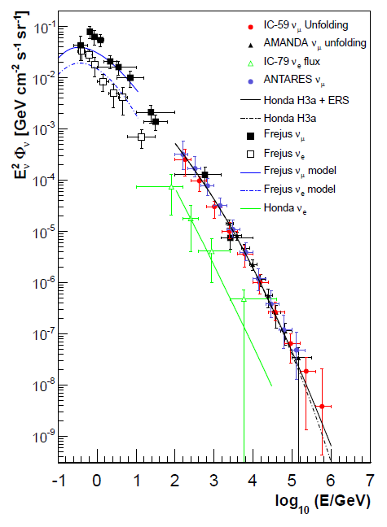
High-energy neutrino astrophysics
Neutrino telescopes are capable of reaching Waxman-Bahcall bound
problem is that there is an irreducible background of neutrinos from CR interactions in our atmosphere— “atmospheric neutrinos”
Neutrinos from astrophysical sources are identifiable only at extremely high energies, above about 100 TeV
therefore the expected fluxes are extremely low

Slide 9
High Energy Neutrinos
Neutrino interactions with matter

Slide 10
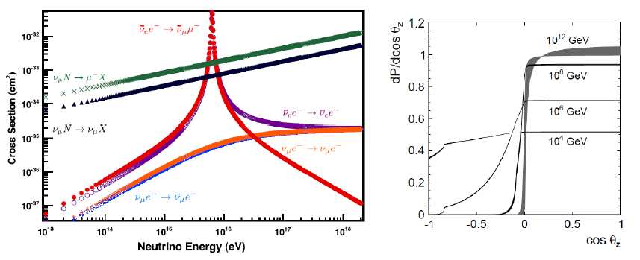
Neutrino interactions with matter
notes section 2.5.2
Neutrinos are weakly interacting
this makes them difficult to detect
mean free path of 10¹⁵ eV neutrino in water is ℓ = 1/nσ ≈ 17000 km
Generally σ ∝ E for scattering off nuclei
scattering of ν̅_{e} off e⁻ can excite W resonance
Earth opaque to neutrinos above ~1000 TeV

Slide 11
High Energy Neutrinos
Detection

Slide 12
Detection of high-energy neutrinos
notes section 2.5.3
Neutrino interacts by either W exchange or Z exchange
W exchange produces charged lepton, which you detect
Z exchange at sufficiently high momentum transfer may cause hadronic shower (break-up of struck nucleon) which you also detect
Detection is normally by Cherenkov radiation in water (liquid water or ice)
for ultra-high-energy neutrinos use natural bodies of water/ice to get large effective volumes
Lake Baikal, Mediterranean Sea (ANTARES), South Pole (IceCube)
Muons will leave track, electrons will shower
fairly good direction resolution (tenths of a degree) for ν_{μ}, but poor for ν_{e}; ν_{τ} OK if τ decay is seen (“double bang” event)

Slide 13
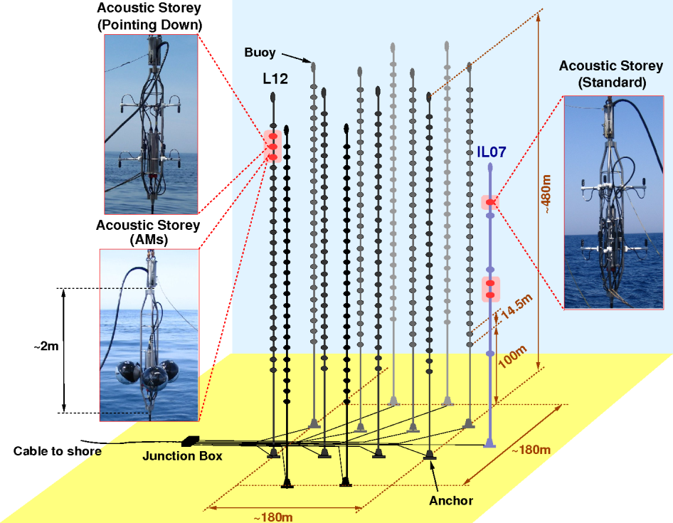
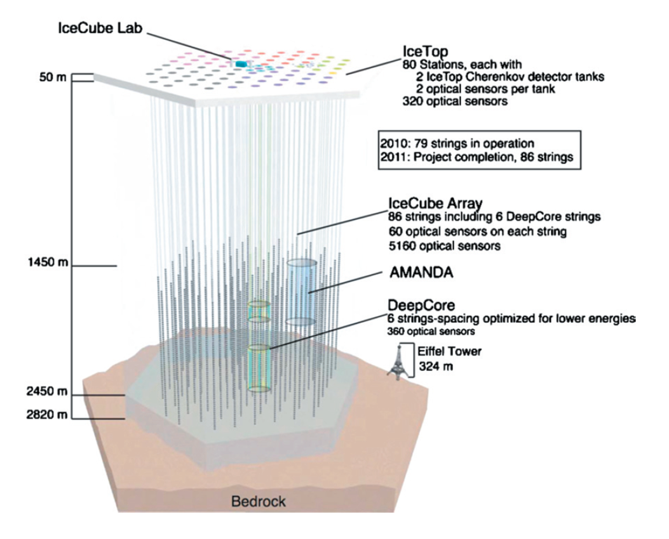
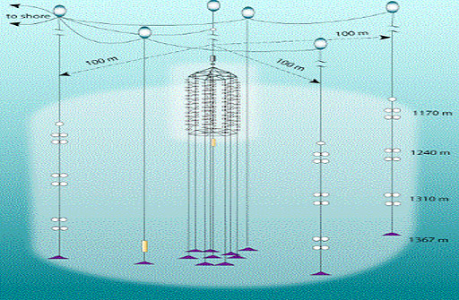
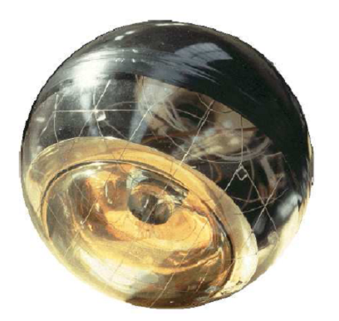
Neutrino telescopes
ANTARES Lake Baikal
IceCube

Slide 14
High Energy Neutrinos
Observations

Slide 15
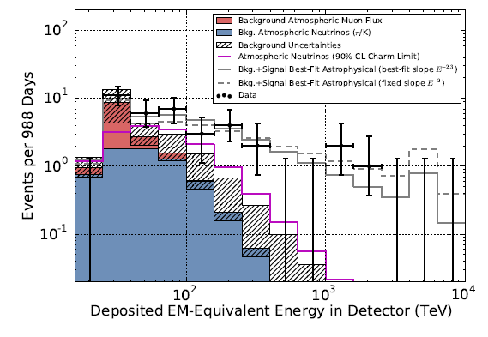
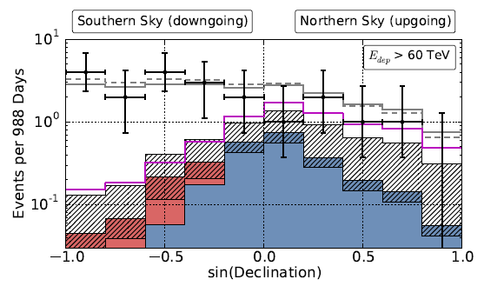
Observation of astrophysical neutrinos
In 3 years of data taking IceCube has detected 37 events above 30 TeV deposited energy
background estimates are 8.4±4.2 CR muons and ${\text{6.6}}_{−1.6}^{+5.9}$ atmospheric neutrinos
the excess events are at higher energy than the background and are downgoing
high-energy neutrinos have high enough cross-section to be absorbed by the Earth
signal significance >5σ owing to difference in distribution

Slide 16
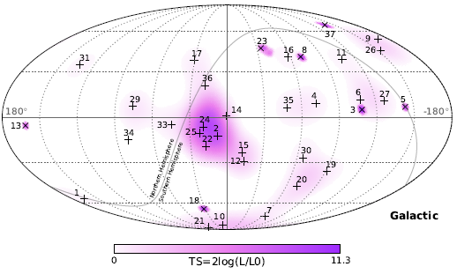
Observation of astrophysical neutrinos
Derived flux is consistent with Waxman-Bahcall bound
spectral index somewhat larger than naïve expectation of 2
but this is true of CR spectra too
No clear point sources
most significant cluster is near Galactic centre, but it is not statistically significant and is not confirmed by ANTARES
no correlation with Galactic plane
Need more data!
IceCube arXiv:1410.1749 (astro-ph.HE)

Slide 17
Summary
High-energy astrophysical neutrinos are produced by π± decay
the pions come from CR proton interactions
As neutrinos interact extremely weakly, very large detectors are required
natural bodies of water/ice instrumented with PMTs to detect Cherenkov radiation from produced leptons or hadronic showers
The main background is atmospheric neutrinos also produced by CR interactions
penetrating CR muons also contribute
There is a signal (from IceCube) but as yet no identified point sources
You should read section 2.5 of the notes.
You should know about
π⁺ decay
the Waxman-Bahcall bound
neutrino telescopes
IceCube results

Slide 18
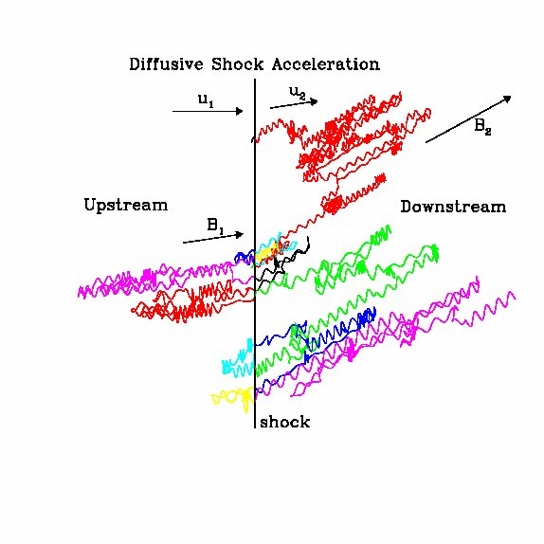
Next: acceleration mechanisms
Fermi second-order
diffusive shock acceleration
acceleration by relativistic shocks
acceleration by magnetic reconnection
propagation through Galaxy
Notes chapter 3

