Slide 1
PHY418 Particle Astrophysics
Emission of High Energy Photons

Slide 2
X-ray and γ-ray astrophysics
The atmosphere is opaque to wavelengths shorter than the near UV
  therefore most high-energy photon detection is space-based
For detection purposes, there are essentially four energy or wavelength ranges:
  X-rays (~0.1 – 15 keV)
    can be detected with focusing optics
  hard X-rays – soft γ-rays (~15 keV – 20 MeV)
    require coded mask apertures
  intermediate-energy γ-rays (~20 MeV – 300 GeV)
    space-based pair-production spectrometers
  high-energy γ-rays (30 GeV – many TeV)
    ground-based detection of air showers, cf. cosmic rays

Slide 3
High Energy Photon Emission
Emission Mechanisms

Slide 4
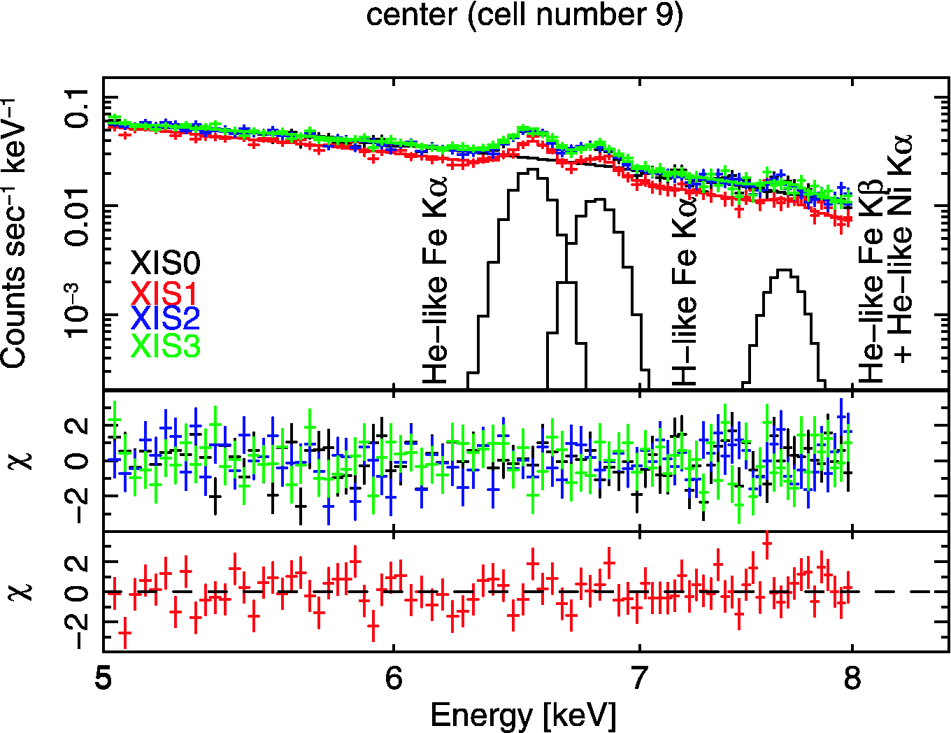
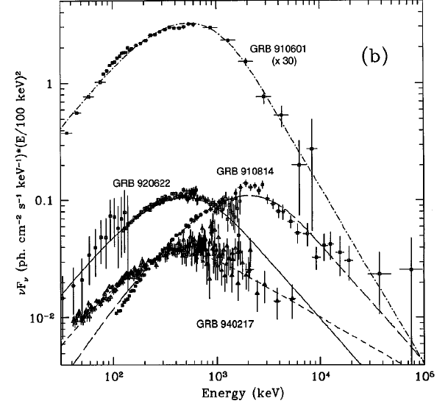
Emission Mechanisms
notes section 2.4.2
Bremsstrahlung and synchrotron radiation extend from the radio up into the X-ray and even soft γ-ray regions
Tavani, 1996
X-ray spectrum of Coma IGM showing bremsstrahlung plus iron K-lines (Suzaku)
Some GRB spectra fitted with a synchrotron radiation model

Slide 5
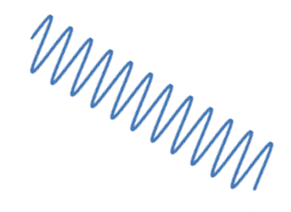

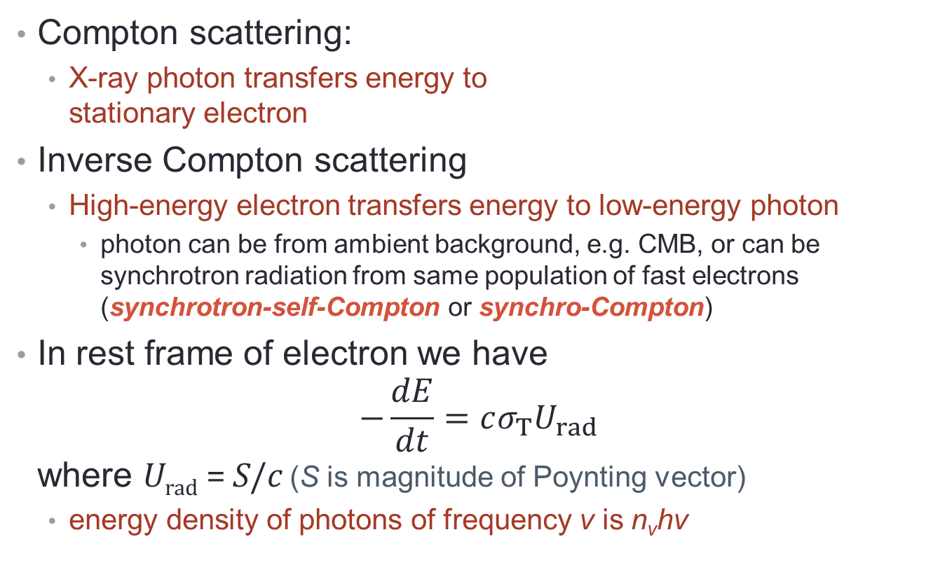
Inverse Compton scattering
Compton scattering:
  X-ray photon transfers energy to
  stationary electron
Inverse Compton scattering
  High-energy electron transfers energy to low-energy photon
    photon can be from ambient background, e.g. CMB, or can be synchrotron radiation from same population of fast electrons (synchrotron-self-Compton or synchro-Compton)
In rest frame of electron we have
$−\frac{dE}{dt}=cσ_{T}U_{rad}$
where U_{rad} = S/c (S is magnitude of Poynting vector)
  energy density of photons of frequency ν is n_{ν}hν

Slide 6
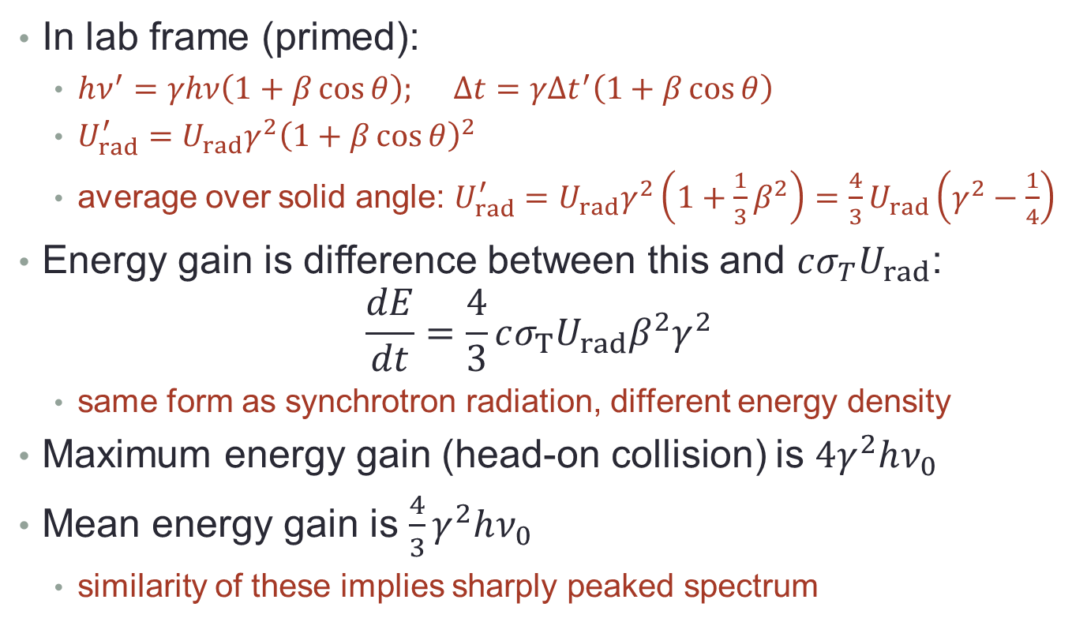
Inverse Compton scattering
In lab frame (primed):
  $hν^{′}=γhν\left(1+β\cos{θ}\right); Δt=γΔt^{′}\left(1+β\cos{θ}\right)$
  $U_{rad}^{′}=U_{rad}γ^{2}{\left(1+β\cos{θ}\right)}^{2}$
  average over solid angle: $U_{rad}^{′}=U_{rad}γ^{2}\left(1+\frac{1}{3}β^{2}\right)=\frac{4}{3}U_{rad}\left(γ^{2}−\frac{1}{4}\right)$
Energy gain is difference between this and $cσ_{T}U_{rad}$:
$\frac{dE}{dt}=\frac{4}{3}cσ_{T}U_{rad}β^{2}γ^{2}$
  same form as synchrotron radiation, different energy density
Maximum energy gain (head-on collision) is $4γ^{2}hν_{0}$
Mean energy gain is $\frac{4}{3}γ^{2}hν_{0}$
  similarity of these implies sharply peaked spectrum

Slide 7
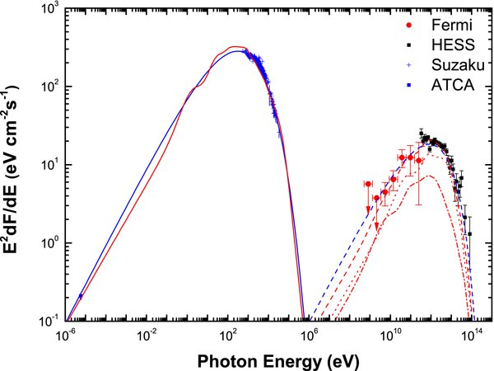
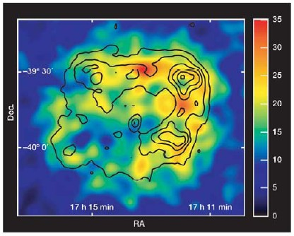
Synchrotron and inverse Compton
Spectral energy distribution of young SNR RX J1713.7−3946
Note the similar shapes of the synchrotron radiation spectrum (radio to X-rays) and the inverse Compton emission (γ-rays)

Slide 8
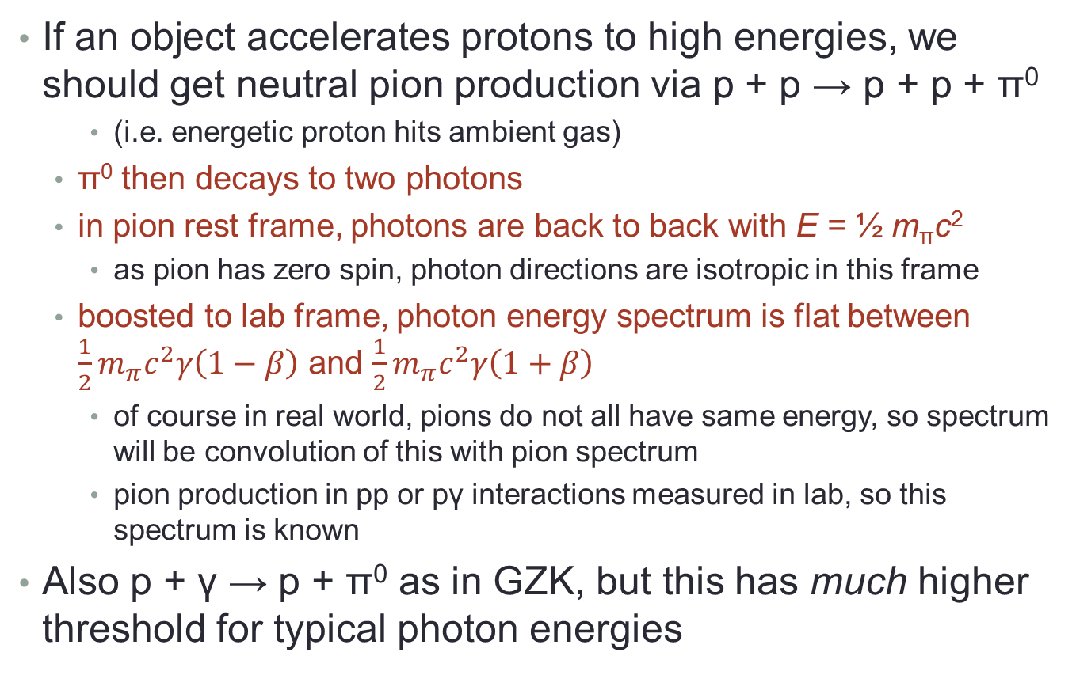
Neutral pion decay
If an object accelerates protons to high energies, we should get neutral pion production via p + p → p + p + π⁰
    (i.e. energetic proton hits ambient gas)
  π⁰ then decays to two photons
  in pion rest frame, photons are back to back with E = ½ m_{π}c²
    as pion has zero spin, photon directions are isotropic in this frame
  boosted to lab frame, photon energy spectrum is flat between $\frac{1}{2}m_{π}c^{2}γ\left(1−β\right)$ and $\frac{1}{2}m_{π}c^{2}γ\left(1+β\right)$
    of course in real world, pions do not all have same energy, so spectrum will be convolution of this with pion spectrum
    pion production in pp or pγ interactions measured in lab, so this spectrum is known
Also p + γ → p + π⁰ as in GZK, but this has much higher threshold for typical photon energies

Slide 9
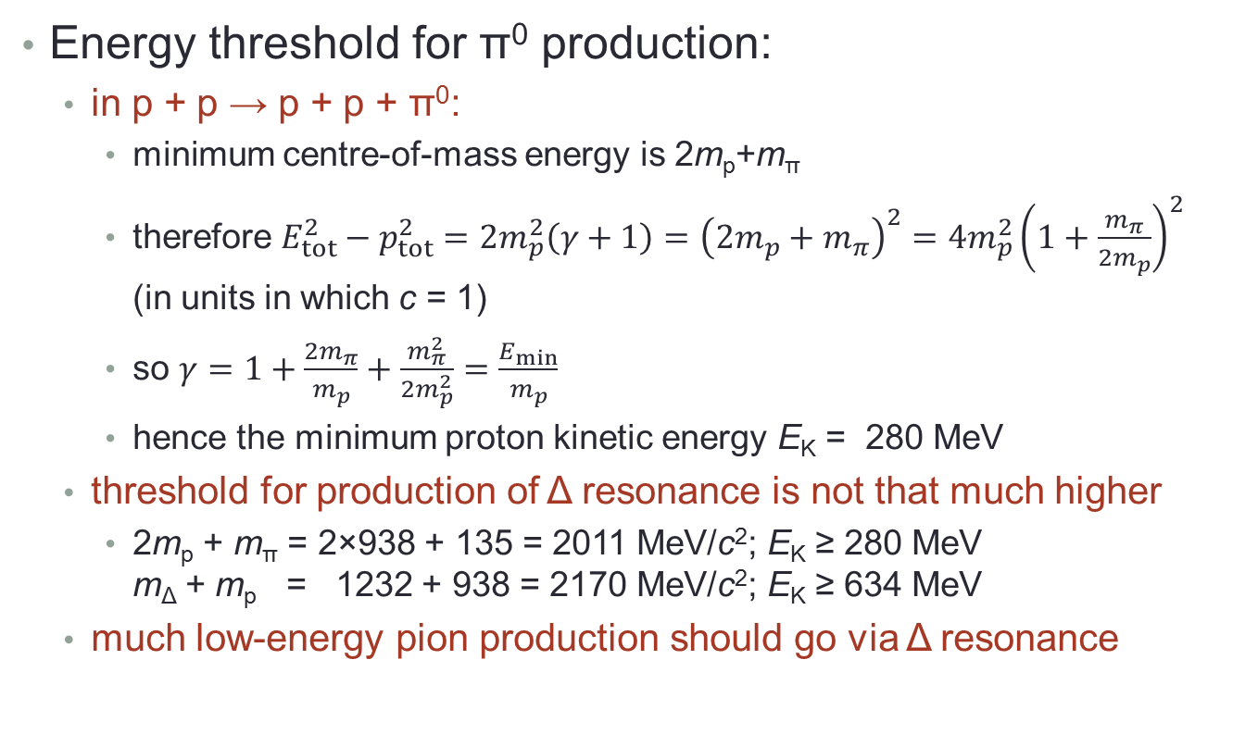
Decay energetics
Energy threshold for π⁰ production:
  in p + p → p + p + π⁰:
    minimum centre-of-mass energy is 2m_{p}+m_{π}
    therefore $E_{tot}^{2}−p_{tot}^{2}=2m_{p}^{2}\left(γ+1\right)={\left(2m_{p}+m_{π}\right)}^{2}=4m_{p}^{2}{\left(1+\frac{m_{π}}{2m_{p}}\right)}^{2}$
    (in units in which c = 1)
    so $γ=1+\frac{{2m}_{π}}{m_{p}}+\frac{m_{π}^{2}}{2m_{p}^{2}}=\frac{E_{min}}{m_{p}}$
    hence the minimum proton kinetic energy E_{K} = 280 MeV
  threshold for production of Δ resonance is not that much higher
    2m_{p} + m_{π} = 2×938 + 135 = 2011 MeV/c²; E_{K} ≥ 280 MeV
    m_{Δ} + m_{p} = 1232 + 938 = 2170 MeV/c²; E_{K} ≥ 634 MeV
  much low-energy pion production should go via Δ resonance

Slide 10
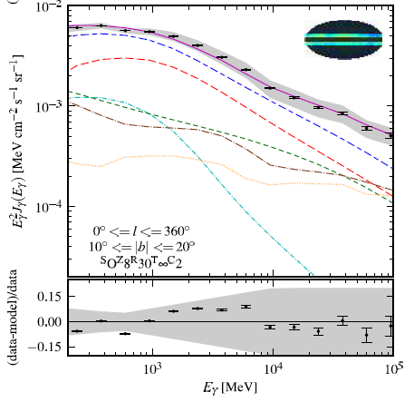
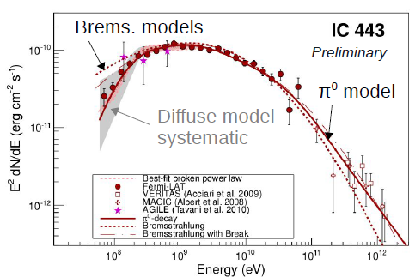
Diffuse γ-ray emission in Galaxy
Dominated by π⁰ decay at energies below ~50 GeV
  this is caused by cosmic rays scattering in Galactic gas
Some SNR spectra also show “pion bump”
Fermi-LAT, 2012
pion decay; inverse Compton; bremsstrahlung; isotropic background; sources; total diffuse Galactic; total with isotropic BG and sources

Slide 11
High Energy Photon Emission
X-Rays

Slide 12
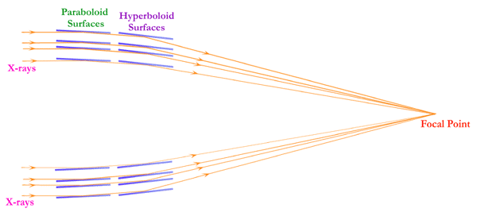
X-rays: detection and sources
notes section 2.4.3
Modern X-ray telescopes use focusing optics
  however, X-rays do not reflect at normal incidence
  hence use grazing incidence optics
    any part of a parabola focuses light to a point
    use the high part of the curve instead of the bowl at the bottom
    multiple nested mirrors to increase effective area
  Detector at focus
  is usually silicon-
  based: typically
  CCDs (as with
  optical astronomy)
    Chandra HRC uses
    microchannel
    plates

Slide 13
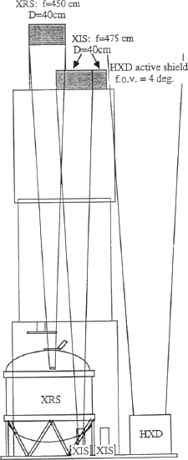
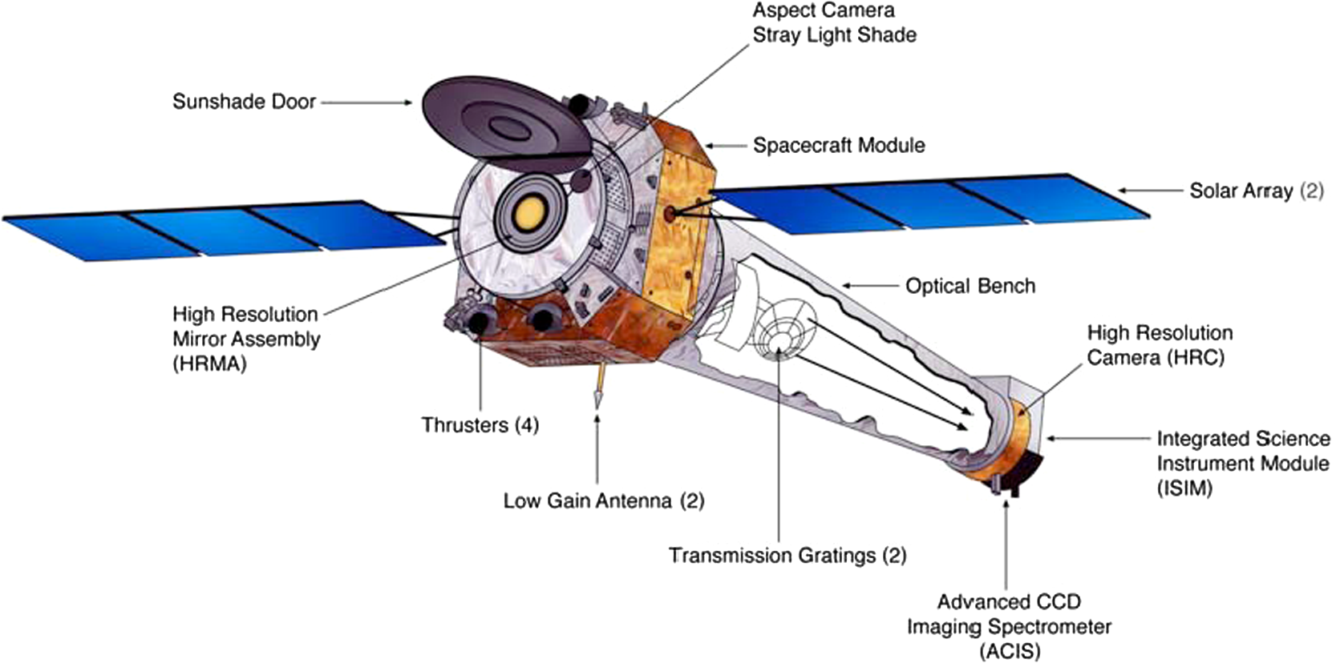
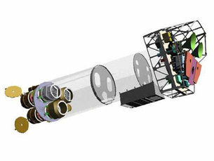
Modern X-ray telescopes
Suzaku
Chandra
XMM-Newton

Slide 14
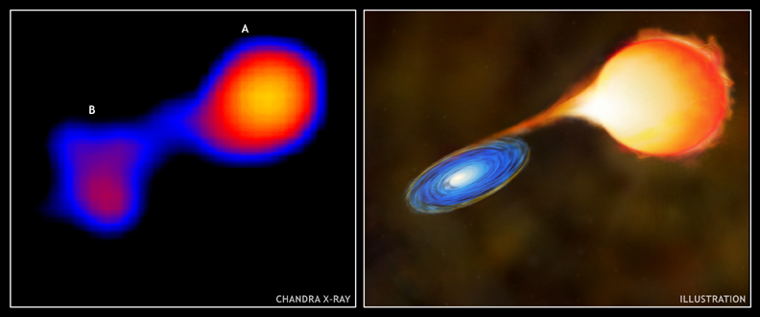
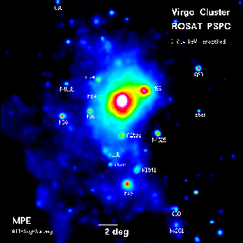
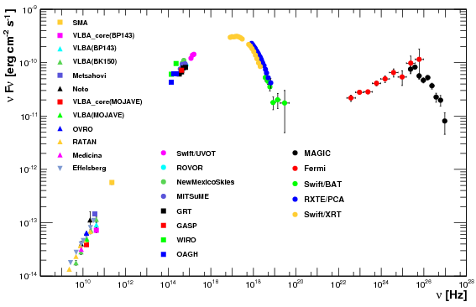
X-ray sources
Thermal bremsstrahlung
  from accretion discs, e.g. in
  close binaries containing a compact object
  from the intracluster medium of rich clusters
  of galaxies
Non-thermal emission (usually
synchrotron)
  from
  populations
  of fast
  electrons
  SNR, GRBs,
  AGN
Mira
Spectral energy distribution of active galaxy Mkn 421

Slide 15
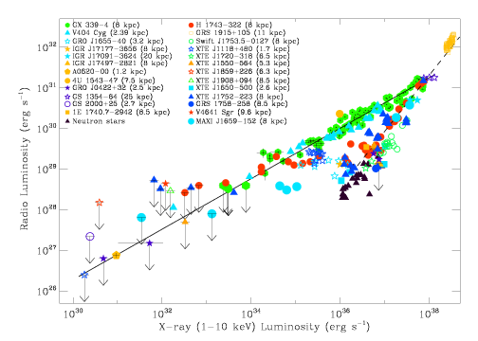
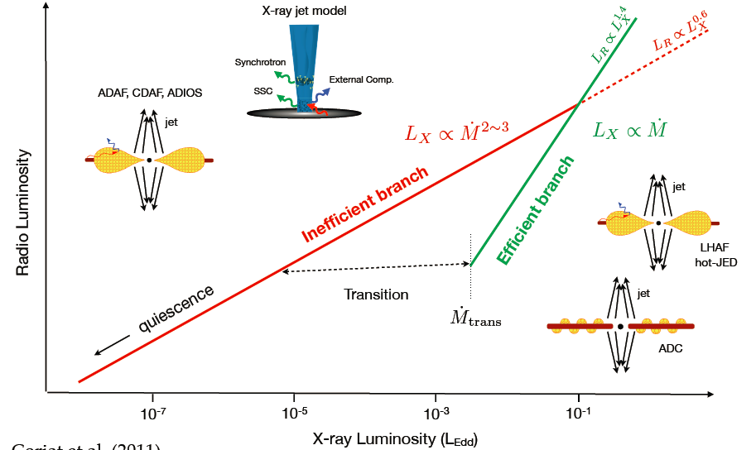
Radio and X-ray luminosity
Sample of X-ray binaries
radio-loud AGN live here
interpretation (Panessa 2013)

Slide 16
High Energy Photon Emission
Low-energy γ-rays

Slide 17
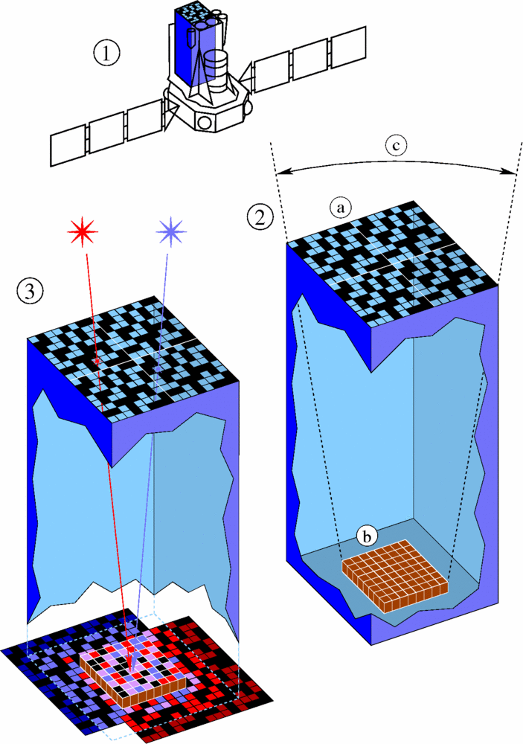
Coded mask apertures
notes section 2.4.4
Above a few 10s of keV even grazing-incidence reflection doesn’t work
  and below 20 MeV or so the photon is unlikely
  to initiate an electromagnetic shower
This makes direction-sensitive
detection difficult
  Some instruments use collimators
    restrict angle of incoming radiation
    necessarily poor field of view
  Preferred option is coded masks
    Principle: each direction results in a
    distinctive shadow pattern, so image
    can be recovered by deconvolution
INTEGRAL/ IBIS

Slide 18
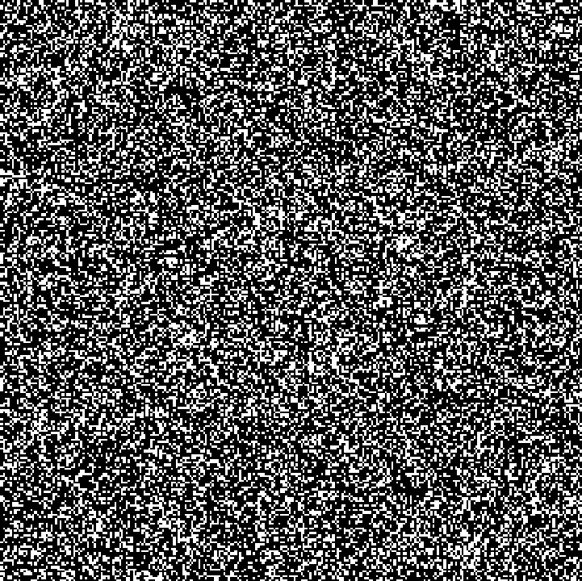
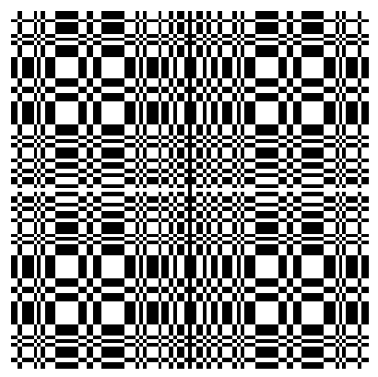
Coded mask apertures
Beppo-SAX
WFC
INTEGRAL
IBIS
Coded mask patterns vary from apparently random to highly structured, but are in fact designed according to established principles
Better angular resolution than collimators (WFC: 5' (source location <1')) coupled with wide field of view (WFC: 20° × 20°)

Slide 19
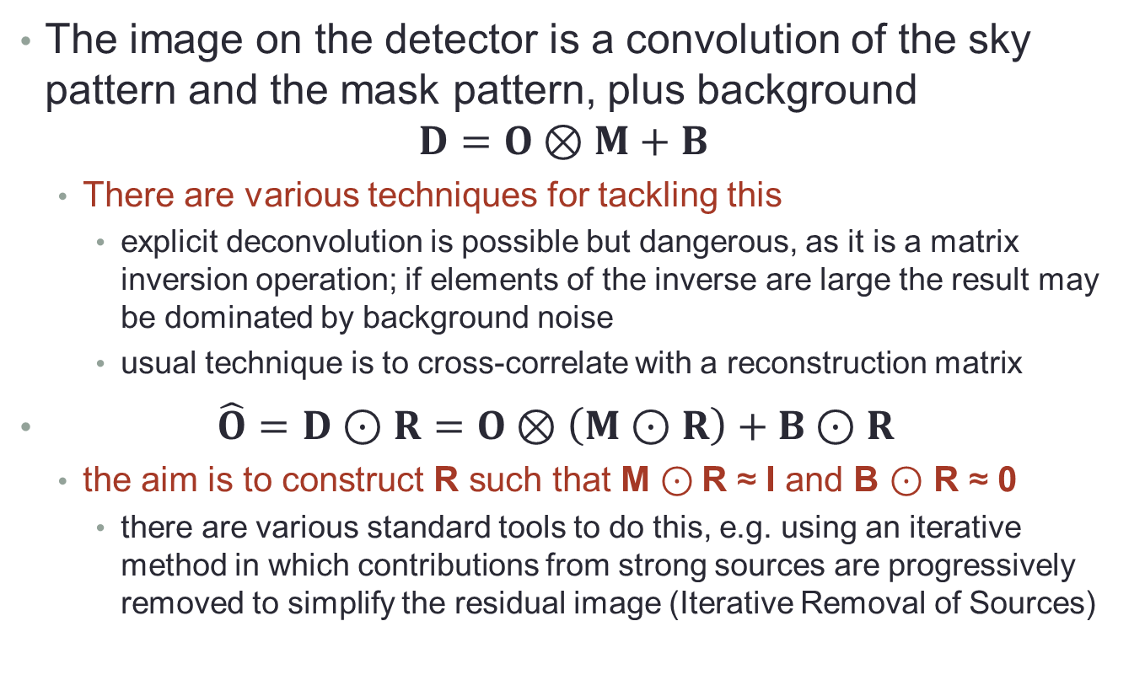
Decoding coded mask images
The image on the detector is a convolution of the sky pattern and the mask pattern, plus background
$D=O⊗M+B$
  There are various techniques for tackling this
    explicit deconvolution is possible but dangerous, as it is a matrix inversion operation; if elements of the inverse are large the result may be dominated by background noise
    usual technique is to cross-correlate with a reconstruction matrix
$\hat{O}=D⊙R=O⊗\left(M⊙R\right)+B⊙R$
  the aim is to construct R such that M ⊙ R ≈ I and B ⊙ R ≈ 0
    there are various standard tools to do this, e.g. using an iterative method in which contributions from strong sources are progressively removed to simplify the residual image (Iterative Removal of Sources)

Slide 20
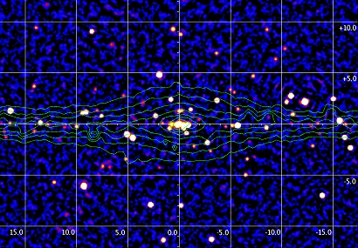
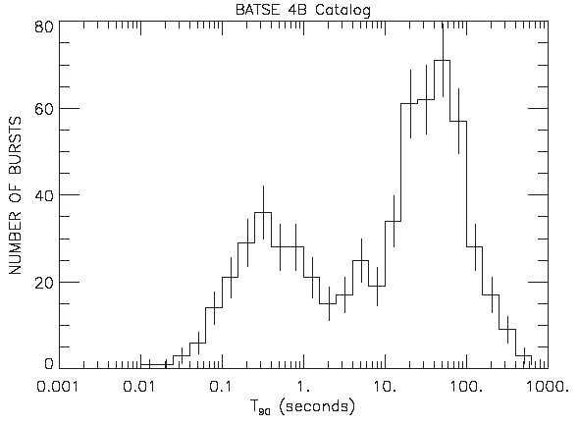
Soft γ-ray sources
Coded mask arrays are
inferior to imaging X-ray
telescopes and pair-creation
spectrometers
  however, this energy range is
  very important for some source types
Most important source class: gamma-ray bursts (GRBs)
  transient bursts of γ-rays from
  extragalactic sources
  two classes: long (or long-soft) and
  short (or short-hard); boundary around
  2 s (for 90% of emission)
    the two classes are real but the 2 s
    boundary may not be optimal
IBIS map of Galactic bulge region

Slide 21
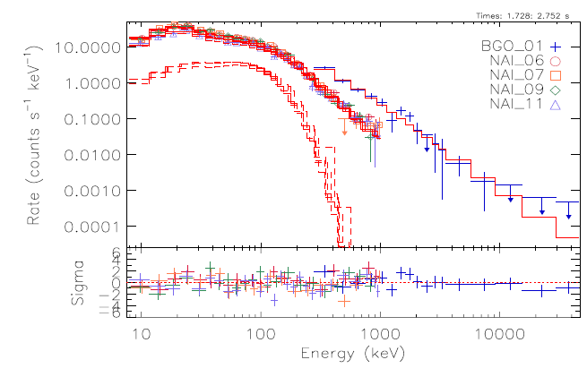
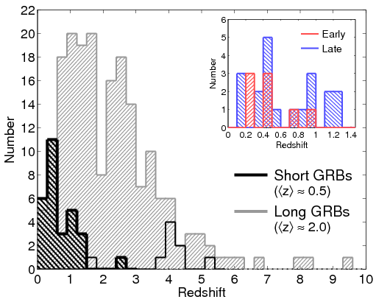
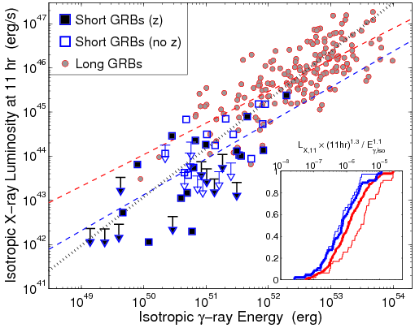
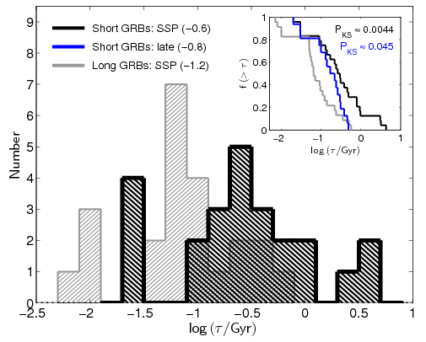
Gamma-ray bursts
Spectrum of a long GRB, fitted with blackbody + synchrotron
Long GRBs are brighter, more distant and located in galaxies with higher star formation rates

Slide 22
High Energy Photon Emission
Intermediate-energy γ-rays

Slide 23
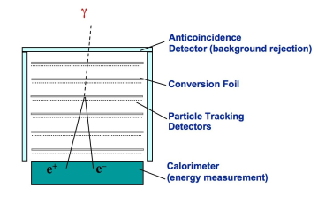
Pair-conversion spectrometers
notes section 2.4.5
Above a few 10s of MeV, photons
will readily convert into e⁺e⁻ pairs
  these are charged particles and can
  be tracked using ionisation detectors
  their energies can subsequently be
  measured using calorimetry
All intermediate-energy detectors are conceptually identical
  anticoincidence shield (scintillator)
    vetoes charged particles coming in from outside
  converter-tracker (metal foils plus spark chambers or silicon strips)
    provide material for pair conversion (requires external field) plus position-sensitive detectors to track converted pair
  calorimeter (inorganic crystal scintillator—NaI or CsI)
    induce electromagnetic shower and measure energy

Slide 24
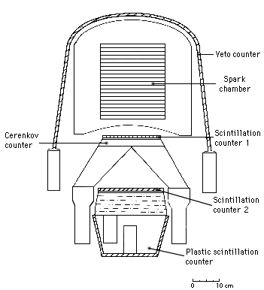
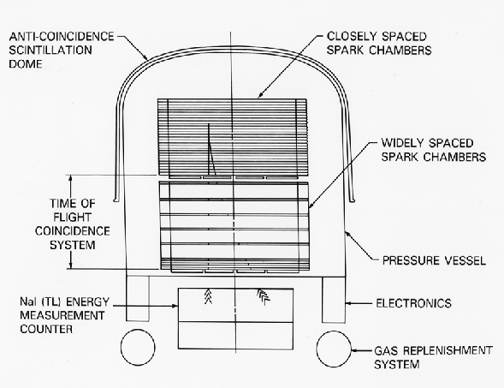
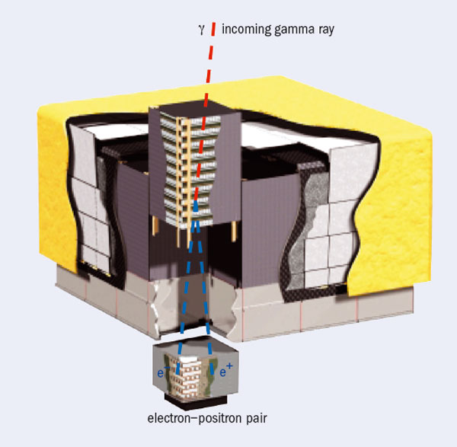
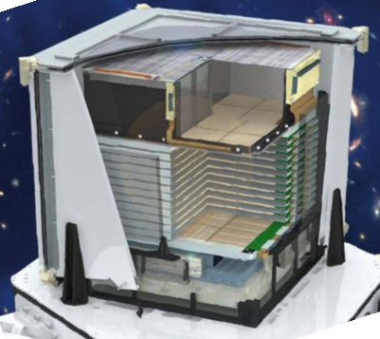
COS-B
(1975-1982)
EGRET
(1991-2000)
AGILE
(2007-)
Fermi-LAT
(2008-)
HXD

Slide 25
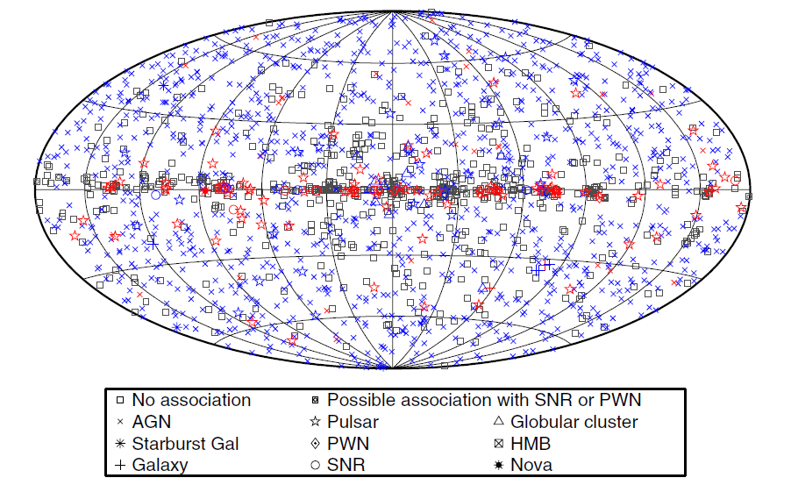
Sources of GeV-energy γ-rays
Fermi-LAT catalogue of sources above 100 MeV
(1873)
mostly
radio-loud AGN
(63%)

Slide 26
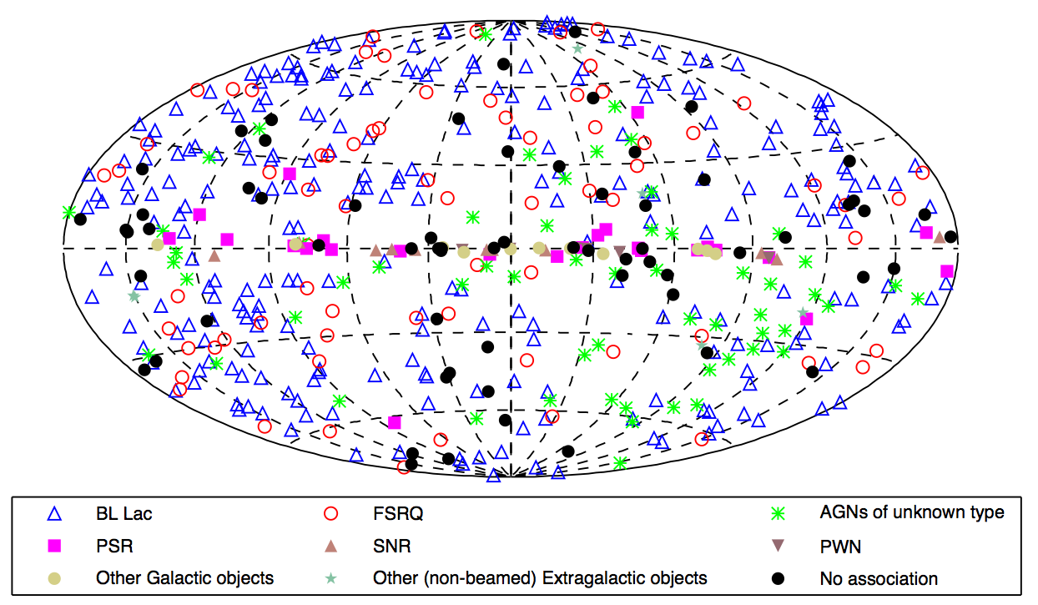
Sources of GeV-energy γ-rays
Fermi-LAT catalogue of sources above 10 GeV
(514)
mostly
radio-loud AGN
(76%)

Slide 27
High Energy Photon Emission
High-energy γ-rays

Slide 28
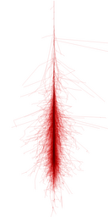
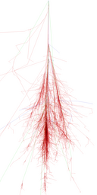
Photon-induced air showers
notes section 2.4.6
γ p
Very-high-energy γ-rays are uncommon
  space-based detectors are too small to get a
  decent rate
  also, measurement quality degrades because
  larger showers leak out of back of calorimeter
Therefore, as with charged cosmic rays,
go for ground-based detectors and detect the shower produced in the atmosphere
  very little of a photon shower reaches ground, so applicable techniques are nitrogen fluorescence and Cherenkov radiation
    high-energy photon detectors tend to choose Cherenkov emission because of its high directionality (as photons point back to their source, direction reconstruction is important to identify optical counterparts of γ-ray sources)

Slide 29
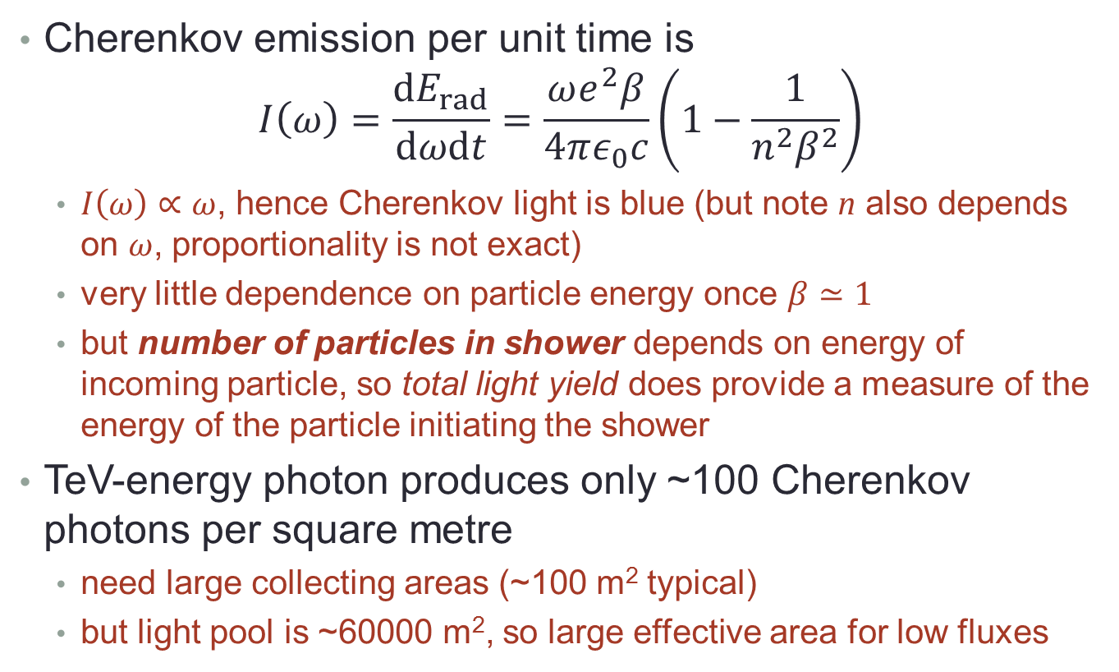
Cherenkov radiation
Cherenkov emission per unit time is
$I\left(ω\right)=\frac{dE_{rad}}{dωdt}=\frac{ωe^{2}β}{4πε_{0}c}\left(1−\frac{1}{n^{2}β^{2}}\right)$
  $I\left(ω\right)∝ω$, hence Cherenkov light is blue (but note n also depends on ω, proportionality is not exact)
  very little dependence on particle energy once $β≃1$
  but number of particles in shower depends on energy of incoming particle, so total light yield does provide a measure of the energy of the particle initiating the shower
TeV-energy photon produces only ~100 Cherenkov photons per square metre
  need large collecting areas (~100 m² typical)
  but light pool is ~60000 m², so large effective area for low fluxes

Slide 30
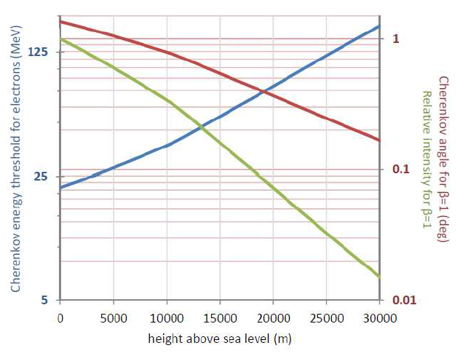
Cherenkov radiation from air showers

Slide 31
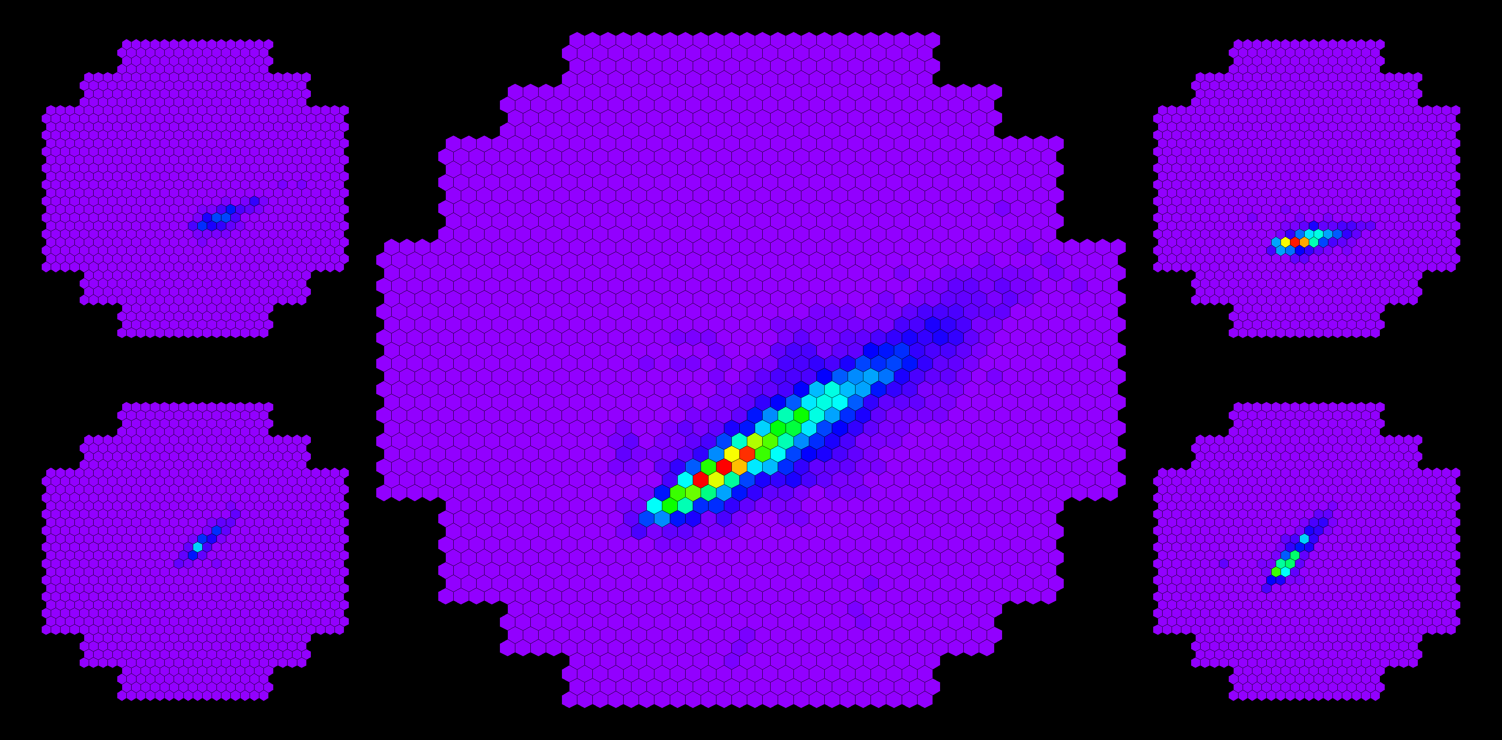
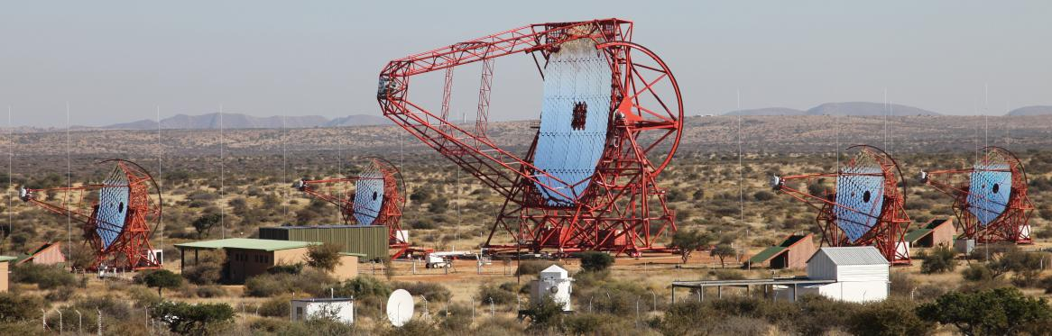
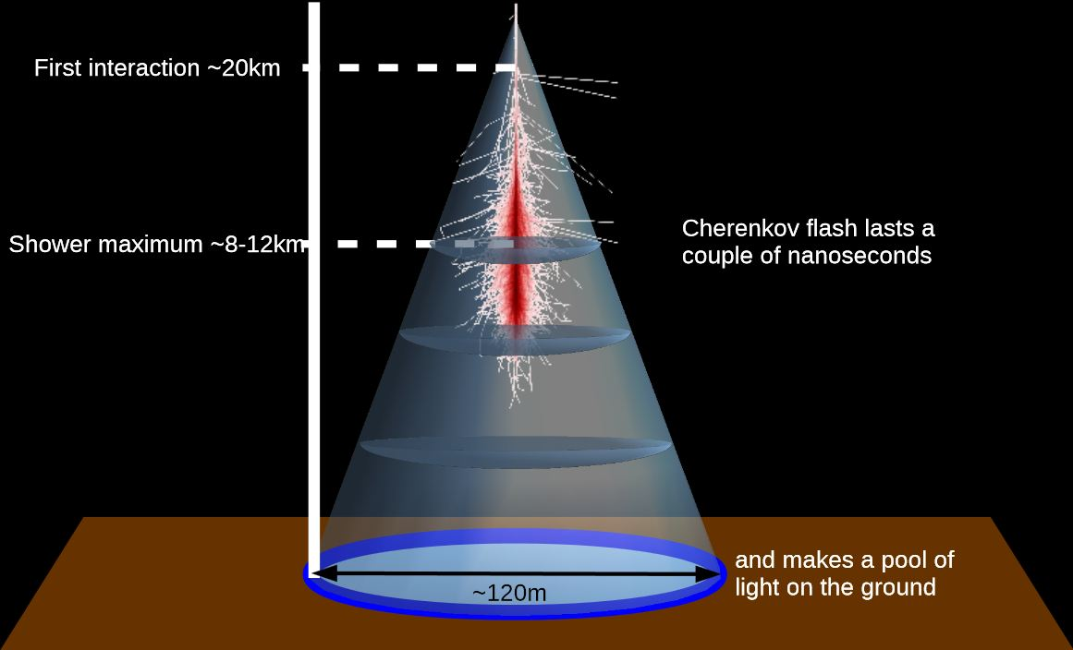
Imaging air Cherenkov telescopes
Stereo imaging with multiple telescopes improves shower reconstruction.
Photon showers are identified by shower shape.
Sources can be located to within a few arcsec (for H.E.S.S.); γ energy measurement ~15%
H.E.S.S. array in Namibia

Slide 32
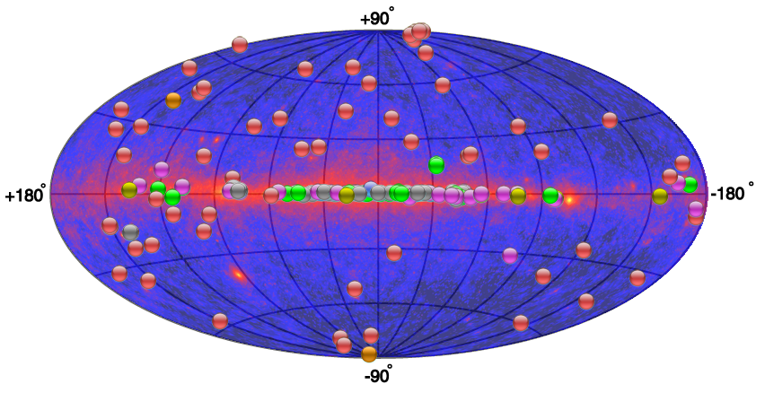
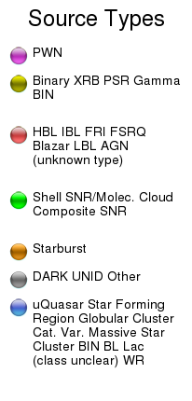
TeV photon sources
Mixture of Galactic sources (mainly SNR/PWN) and extragalactic (mainly radio-loud AGN).
Note that at these energies high-redshift sources are not visible

Slide 33
Summary
The atmosphere is not transparent to high-energy photons
Detection techniques depend on energy
  grazing-incidence optics for X-rays
  coded masks or collimators for hard X-rays/soft γ-rays
  pair conversion spectrometers for intermediate-energy γ-rays
  air-shower detection by Cherenkov emission for TeV photons
Emission mechanisms include brems-strahlung and synchrotron radiation plus inverse Compton scattering and π⁰ decay
  former dominate for lower energies (X-rays), latter two for high energies
Sources include supernova remnants and pulsars (Galactic) and radio-loud AGN
  most important transient sources are GRBs
You should read section 2.4 of the notes.
You should know about
  inverse Compton effect
  π⁰ decay
  grazing incidence optics
  coded masks
  pair-conversion spectrometers
  air Cherenkov telescopes
  source types

Slide 34
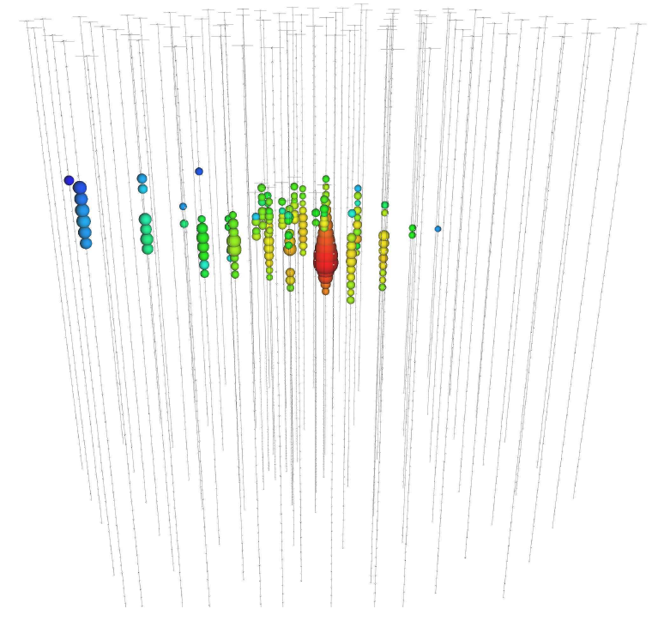
Next: high-energy neutrinos
production
Waxman-Bahcall bound
interactions with matter
detection
Notes section 2.5

