Slide 1
PHY418 Particle Astrophysics
Radio Emission

Slide 2
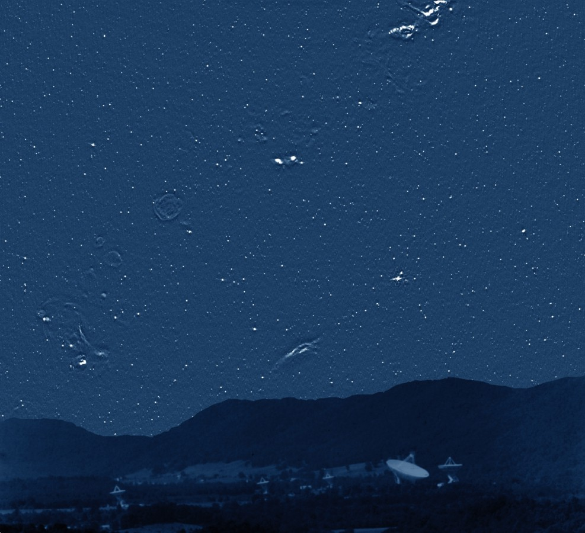
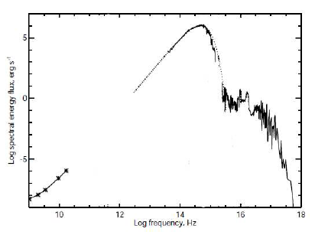
Radio emission and particle astrophysics
Why are the lowest-energy photons relevant to high-energy particle astrophysics?
Because thermal radiation from stars is not significant in the radio waveband—bright radio emission is mostly non-thermal and diagnostic of high-energy particles.
http://www.cv.nrao.edu/course/astr534/Tour.html

Slide 3
Radio Emission
Emission Mechanisms

Slide 4
Radio emission mechanisms
notes section 2.3.2
thermal emission from Galactic dust at 10-30 K
  mostly far infra-red and submillimetre
thermal emission from the CMB
  submillimetre and microwave
“spinning dust”
  5-30 mm, from very small, rapidly-spinning dust grains
  (important as foreground to CMB emission)
line emission from gas
  21 cm (H I) plus many molecular lines
bremsstrahlung
  “braking radiation” from electron-ion interactions
synchrotron radiation
  from relativistic electrons in magnetic fields
these are of interest to us

Slide 5
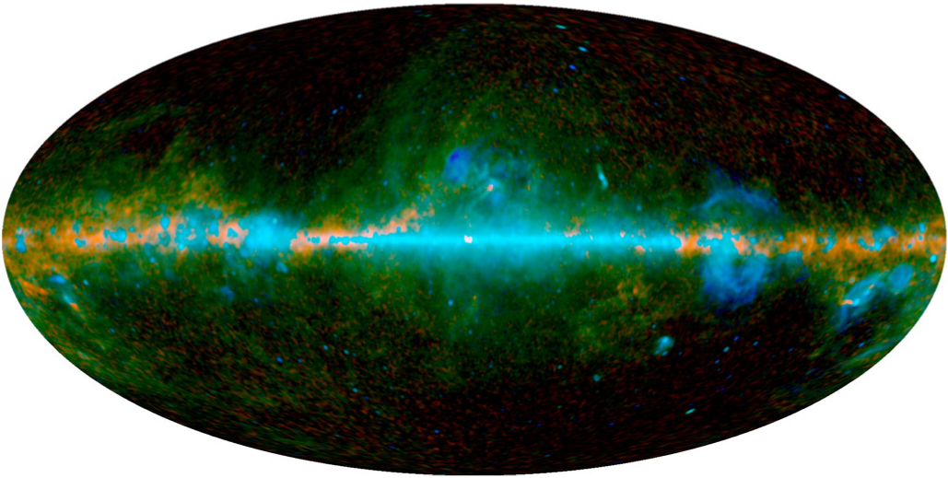
Radio emission from Galaxy
CMB
foregrounds
from 9-year WMAP analysis
thermal dust
bremsstrahlung
synchrotron & spinning dust

Slide 6
Radio Emission
Emission from an accelerated charge

Slide 7
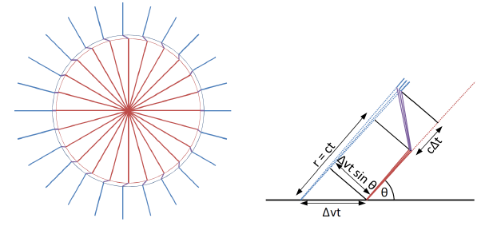
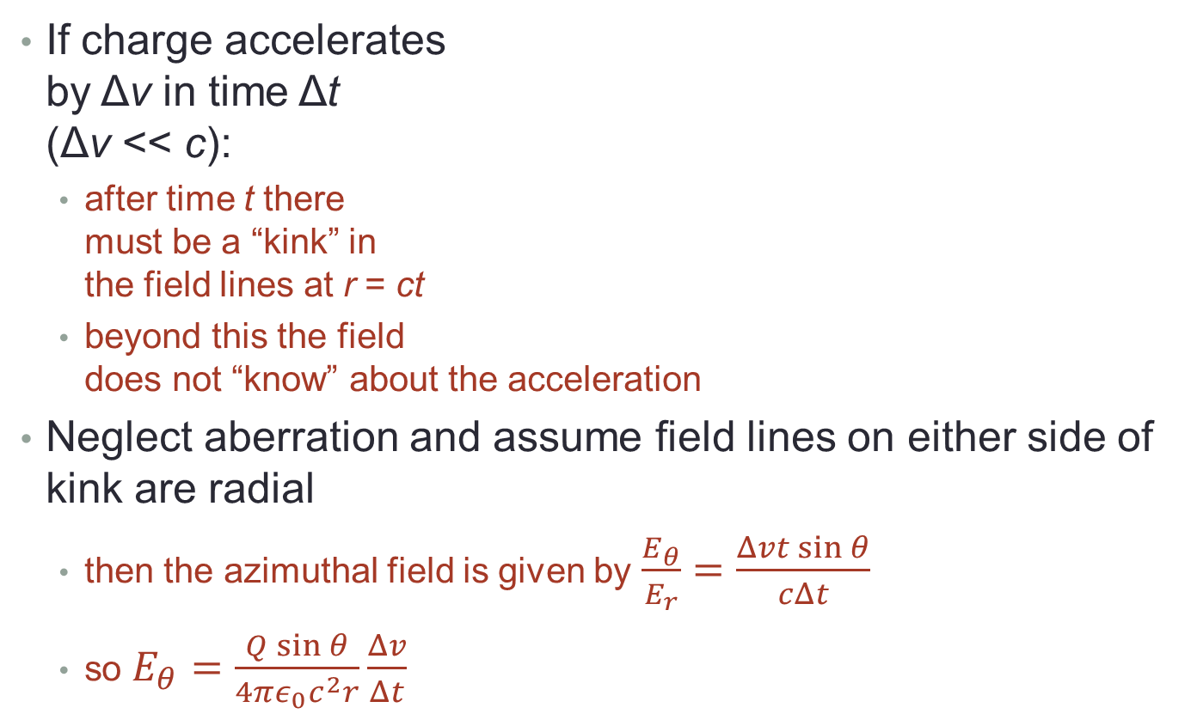
Radiation from an accelerated charge
notes section 2.3.3
If charge accelerates
by Δv in time Δt
(Δv << c):
  after time t there
  must be a “kink” in
  the field lines at r = ct
  beyond this the field
  does not “know” about the acceleration
Neglect aberration and assume field lines on either side of kink are radial
  then the azimuthal field is given by $\frac{E_{θ}}{E_{r}}=\frac{Δvt\sin{θ}}{cΔt}$
  so $E_{θ}=\frac{Q\sin{θ}}{4πε_{0}c^{2}r}\frac{Δv}{Δt}$

Slide 8
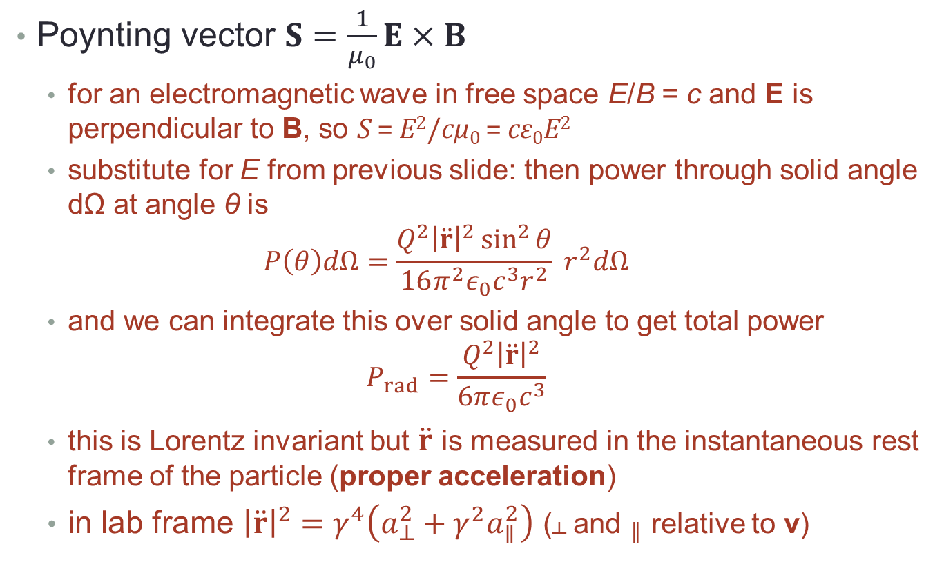
Power emitted
Poynting vector $S=\frac{1}{μ_{0}}E×B$
  for an electromagnetic wave in free space E/B = c and E is perpendicular to B, so S = E²/cμ₀ = cε₀E²
  substitute for E from previous slide: then power through solid angle dΩ at angle θ is
  $P\left(θ\right)dΩ=\frac{Q^{2}{\left|\ddot{r}\right|}^{2}\sin^{2}{θ}}{16π^{2}ε_{0}c^{3}r^{2}} r^{2}dΩ$
  and we can integrate this over solid angle to get total power
  $P_{rad}=\frac{Q^{2}{\left|\ddot{r}\right|}^{2}}{6πε_{0}c^{3}}$
  this is Lorentz invariant but $\ddot{r}$ is measured in the instantaneous rest frame of the particle (proper acceleration)
  in lab frame ${\left|\ddot{r}\right|}^{2}=γ^{4}\left(a_{⊥}^{2}+γ^{2}a_{∥}^{2}\right)$ (┴ and ║ relative to v)

Slide 9
Radio Emission
Bremsstrahlung

Slide 10
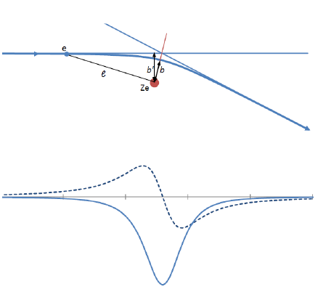
Bremsstrahlung
notes section 2.3.4, 2.3.6
Radiation emitted when an electron is
deflected by the electric field of an ion
  also known as free-free emission
  since the electron is not bound
  to the ion either before or after
  the scattering
For radio frequencies ωτ << 1 where
τ = 2b/γv
  can neglect parallel acceleration since positive and negative cancel
  can treat perpendicular acceleration as delta function with area Δv┴
Fourier transform of a delta function is a constant
  therefore Fourier transform of a┴ is A┴(ω) ≈ Δv┴/(2π)^{1/2}
geometry
acceleration

Slide 11
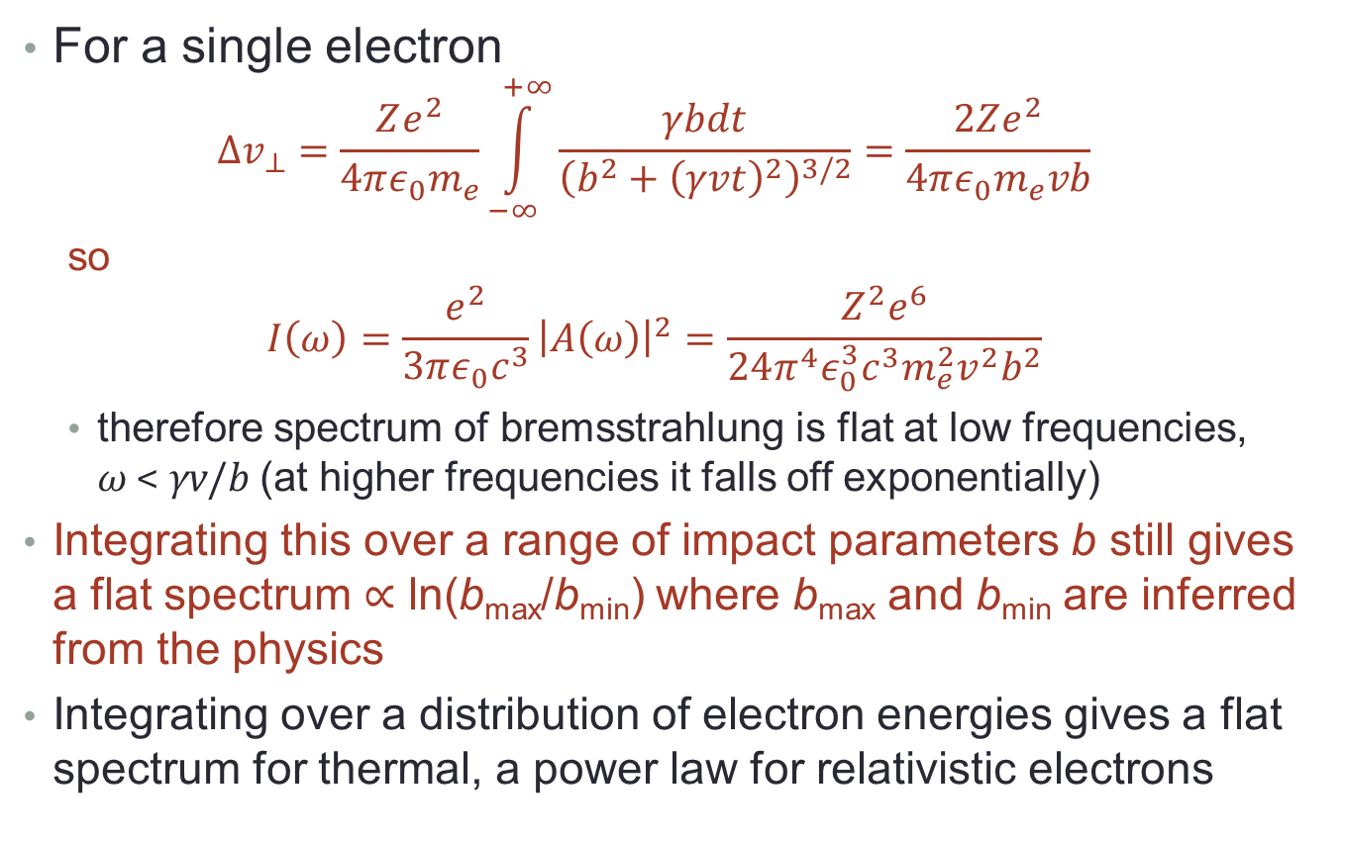
Bremsstrahlung
For a single electron
  $$Δv_{⊥}=\frac{Ze^{2}}{4πε_{0}m_{e}}\int_{−∞}^{+∞}{\frac{γbdt}{{\left(b^{2}+{\left(γvt\right)}^{2}\right)}^{3/2}}}=\frac{2Ze^{2}}{4πε_{0}m_{e}vb}$$
  so
  $$I\left(ω\right)=\frac{e^{2}}{3πε_{0}c^{3}}{\left|A\left(ω\right)\right|}^{2}=\frac{Z^{2}e^{6}}{24π^{4}ε_{0}^{3}c^{3}m_{e}^{2}v^{2}b^{2}}$$
    therefore spectrum of bremsstrahlung is flat at low frequencies,
    ω < γv/b (at higher frequencies it falls off exponentially)
  Integrating this over a range of impact parameters b still gives a flat spectrum ∝ ln(b_{max}/b_{min}) where b_{max} and b_{min} are inferred from the physics
  Integrating over a distribution of electron energies gives a flat spectrum for thermal, a power law for relativistic electrons

Slide 12
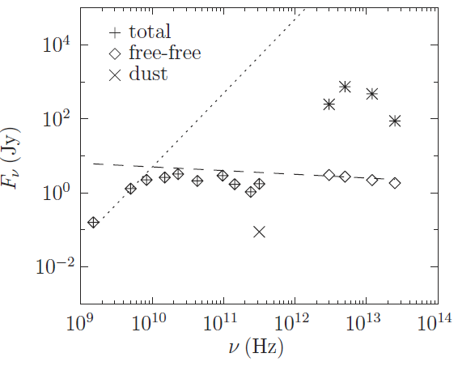
Typical bremsstrahlung spectrum
optically thick (∝ ν², Rayleigh-Jeans)
blackbody (dust)
optically thin (nearly flat)
Spectral energy distribution of a compact HII region

Slide 13
Radio Emission
Synchrotron radiation

Slide 14
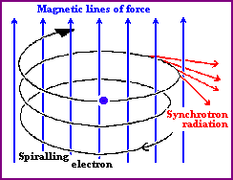
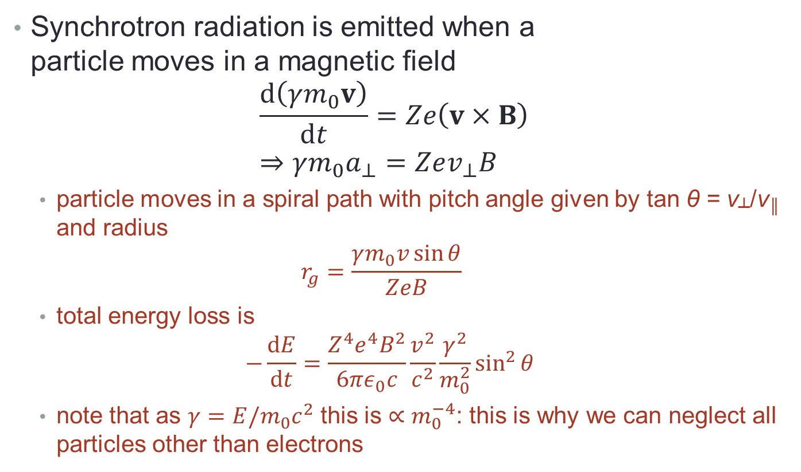
Synchrotron radiation
notes section 2.3.5, 2.3.6
Synchrotron radiation is emitted when a
particle moves in a magnetic field
$\frac{d\left(γm_{0}v\right)}{dt}=Ze\left(v×B\right)$
$⇒γm_{0}a_{⊥}=Zev_{⊥}B$
  particle moves in a spiral path with pitch angle given by tan θ = v┴/v║ and radius
  $r_{g}=\frac{γm_{0}v\sin{θ}}{ZeB}$
  total energy loss is
  $−\frac{dE}{dt}=\frac{Z^{4}e^{4}B^{2}}{6πε_{0}c}\frac{v^{2}}{c^{2}}\frac{γ^{2}}{m_{0}^{2}}\sin^{2}{θ}$
  note that as $γ=E/m_{0}c^{2}$ this is $∝m_{0}^{−4}$: this is why we can neglect all particles other than electrons

Slide 15
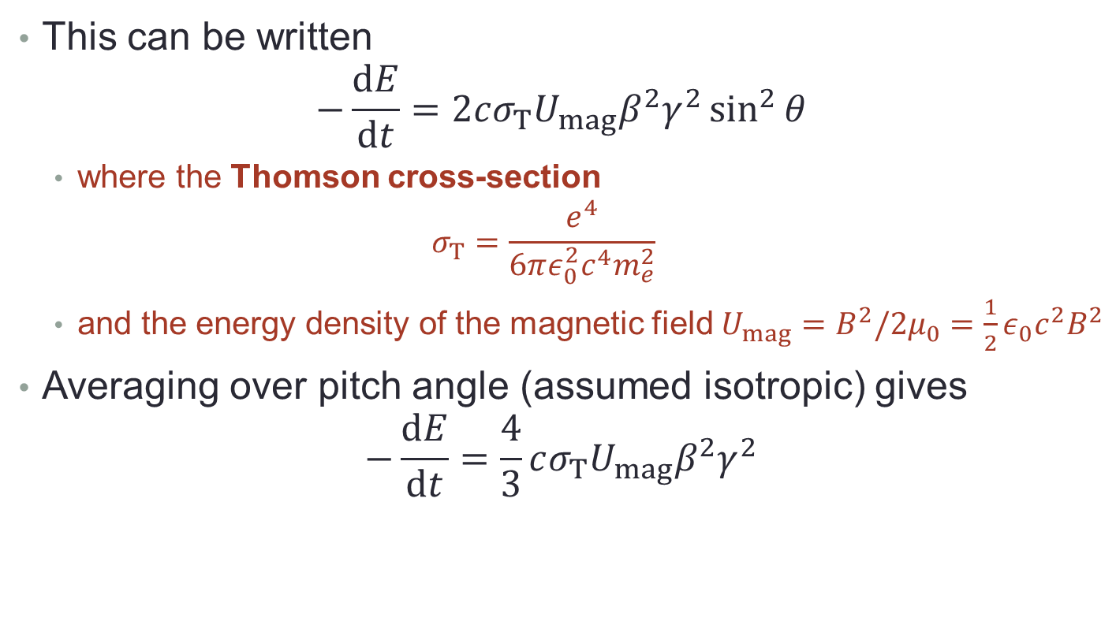
Synchrotron radiation
This can be written
$−\frac{dE}{dt}=2cσ_{T}U_{mag}β^{2}γ^{2}\sin^{2}{θ}$
  where the Thomson cross-section
  $σ_{T}=\frac{e^{4}}{6πε_{0}^{2}c^{4}m_{e}^{2}}$
  and the energy density of the magnetic field $U_{mag}=B^{2}/2μ_{0}=\frac{1}{2}ε_{0}c^{2}B^{2}$
Averaging over pitch angle (assumed isotropic) gives
$−\frac{dE}{dt}=\frac{4}{3}cσ_{T}U_{mag}β^{2}γ^{2}$

Slide 16
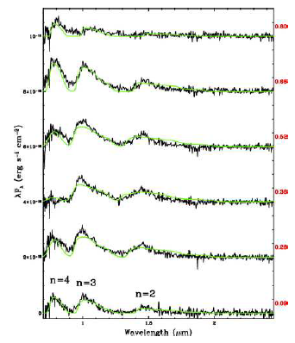
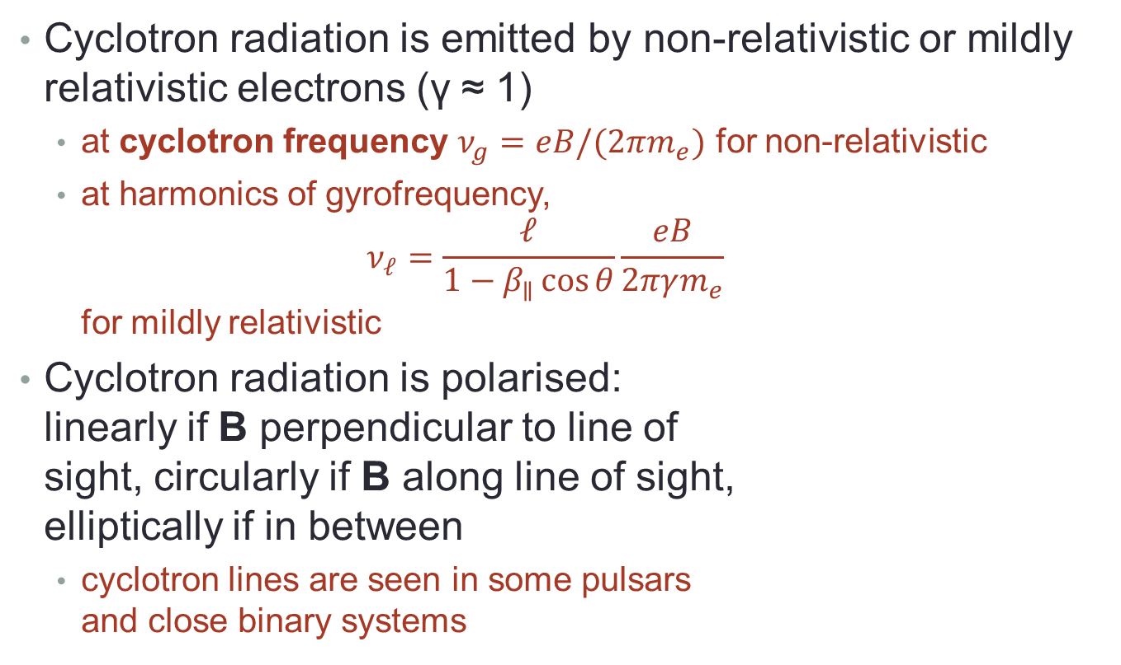
Cyclotron radiation
Cyclotron radiation is emitted by non-relativistic or mildly relativistic electrons (γ ≈ 1)
  at cyclotron frequency $ν_{g}=eB/(2πm_{e})$ for non-relativistic
  at harmonics of gyrofrequency,
  $ν_{ℓ}=\frac{ℓ}{1−β_{∥}\cos{θ}}\frac{eB}{2πγm_{e}}$
  for mildly relativistic
Cyclotron radiation is polarised:
linearly if B perpendicular to line of
sight, circularly if B along line of sight,
elliptically if in between
  cyclotron lines are seen in some pulsars
  and close binary systems

Slide 17

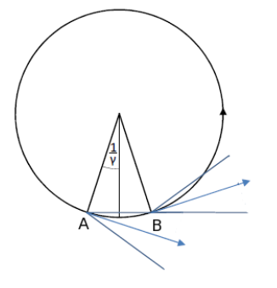
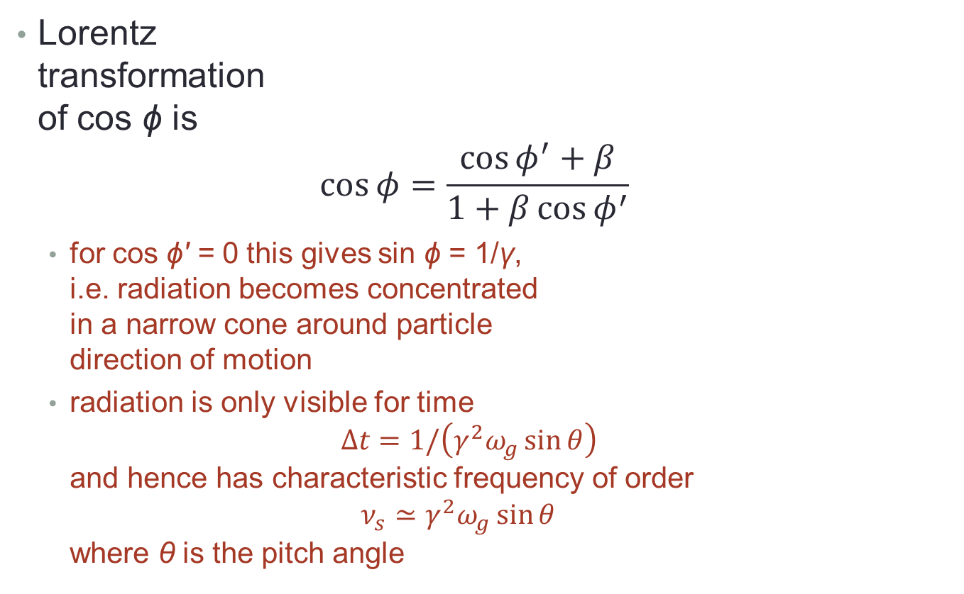
Synchrotron radiation and beaming
Lorentz
transformation
of cos ϕ is
$\cos{φ}=\frac{\cos{φ^{′}}+β}{1+β\cos{φ^{′}}}$
  for cos ϕ' = 0 this gives sin ϕ = 1/γ,
  i.e. radiation becomes concentrated
  in a narrow cone around particle
  direction of motion
  radiation is only visible for time
  $Δt=1/\left(γ^{2}ω_{g}\sin{θ}\right)$
  and hence has characteristic frequency of order
  $ν_{s}≃γ^{2}ω_{g}\sin{θ}$
  where θ is the pitch angle

Slide 18
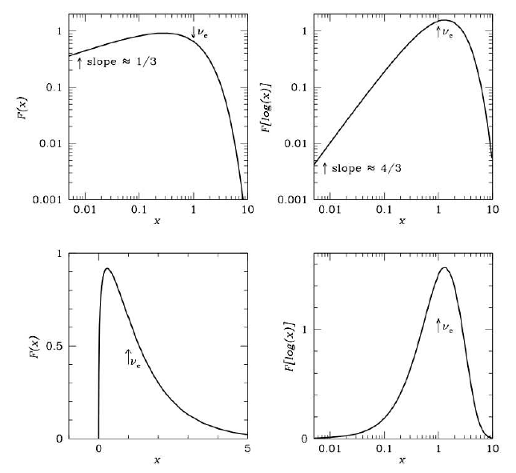
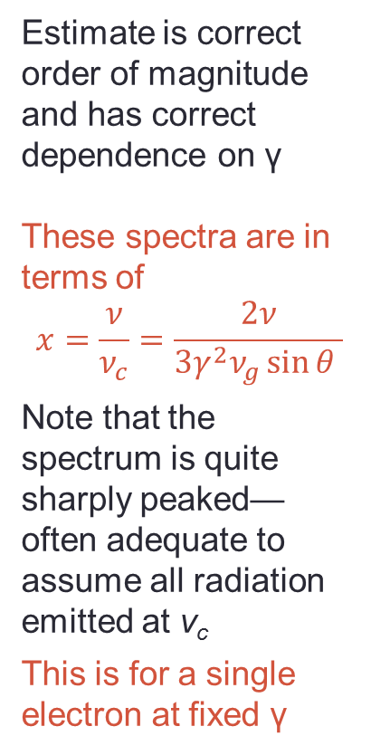
Synchrotron radiation: full spectrum
Estimate is correct order of magnitude and has correct dependence on γ
These spectra are in terms of
$$x=\frac{ν}{ν_{c}}=\frac{2ν}{3γ^{2}ν_{g}\sin{θ }}$$
Note that the spectrum is quite sharply peaked—often adequate to assume all radiation emitted at ν_{c}
This is for a single electron at fixed γ

Slide 19
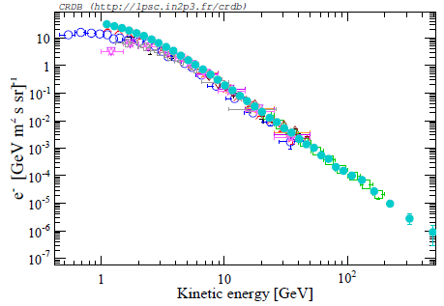
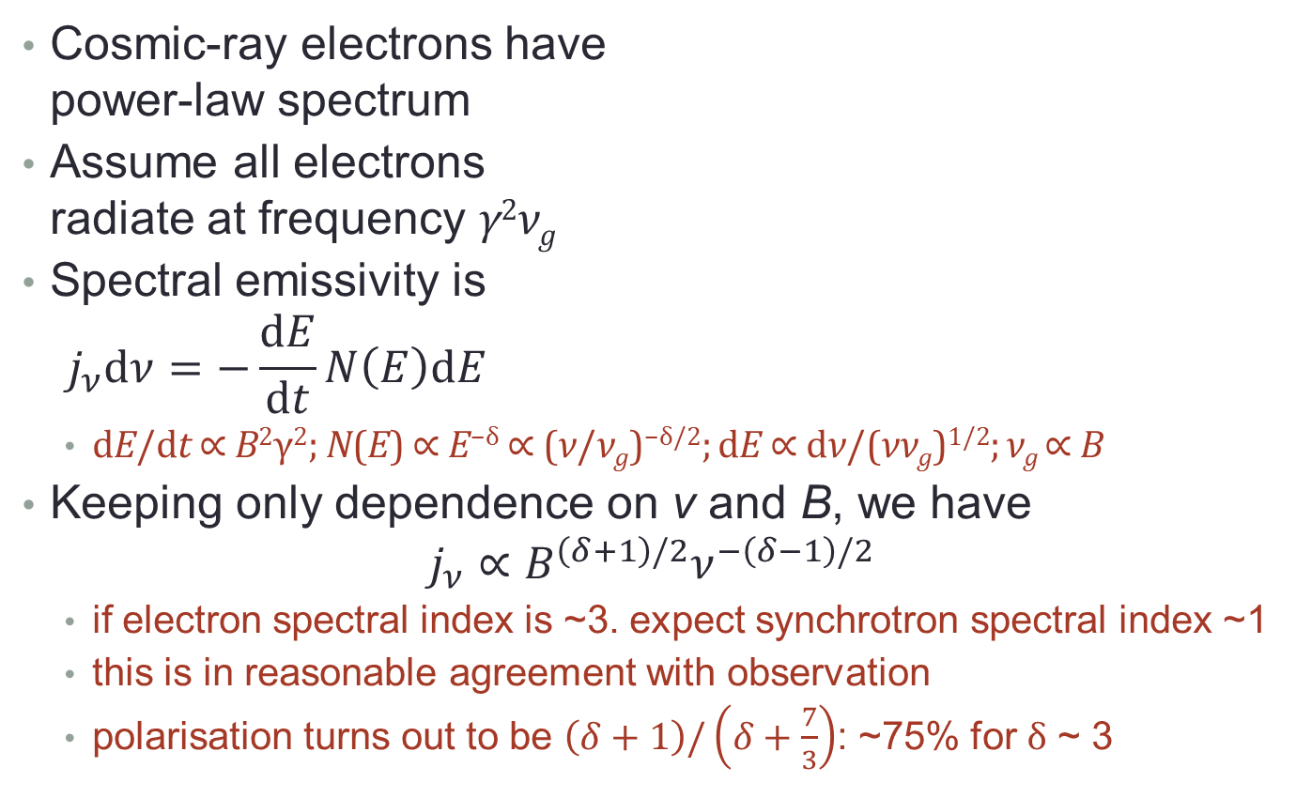
Synchrotron radiation: power law
Cosmic-ray electrons have
power-law spectrum
Assume all electrons
radiate at frequency γ²ν_{g}
Spectral emissivity is
$j_{ν}dν=−\frac{dE}{dt}N\left(E\right)dE$
  dE/dt ∝ B²γ²; N(E) ∝ E^{−δ} ∝ (ν/ν_{g})^{−δ/2}; dE ∝ dν/(νν_{g})^{1/2}; ν_{g} ∝ B
Keeping only dependence on ν and B, we have
$j_{ν}∝B^{\left(δ+1\right)/2}ν^{−\left(δ−1\right)/2}$
  if electron spectral index is ~3. expect synchrotron spectral index ~1
  this is in reasonable agreement with observation
  polarisation turns out to be $\left(δ+1\right)/\left(δ+\frac{7}{3}\right)$: ~75% for δ ~ 3

Slide 20
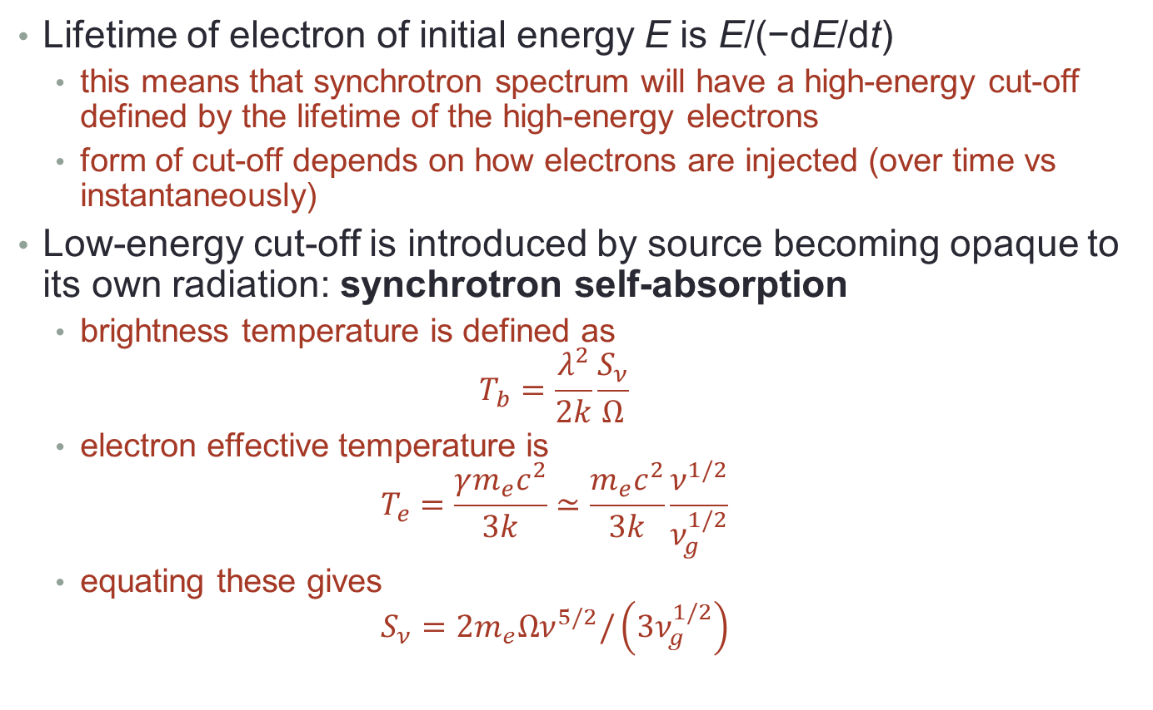
Synchrotron spectrum cut-offs
Lifetime of electron of initial energy E is E/(−dE/dt)
  this means that synchrotron spectrum will have a high-energy cut-off defined by the lifetime of the high-energy electrons
  form of cut-off depends on how electrons are injected (over time vs instantaneously)
Low-energy cut-off is introduced by source becoming opaque to its own radiation: synchrotron self-absorption
  brightness temperature is defined as
  $T_{b}=\frac{λ^{2}}{2k}\frac{S_{ν}}{Ω}$
  electron effective temperature is
  $T_{e}=\frac{γm_{e}c^{2}}{3k}≃\frac{m_{e}c^{2}}{3k}\frac{ν^{1/2}}{ν_{g}^{1/2}}$
  equating these gives
  $S_{ν}=2m_{e}Ων^{5/2}/\left(3ν_{g}^{1/2}\right)$
flux
source solid angle

Slide 21
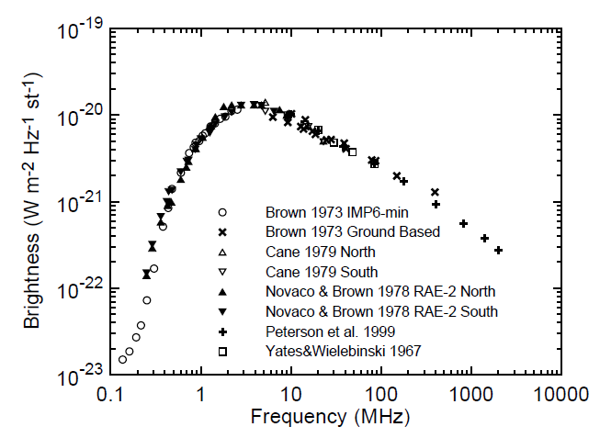
Synchrotron spectrum of Milky Way
slope 5/2
slope −0.7

Slide 22
Summary
The atmosphere is transparent to radio emission (1 mm < λ < 10 m)
There are many sources of radio emission, including thermal emission from dust and the CMB, line emission, and emission from accelerated charges
  bremsstrahlung produces a flat spectrum with a ν² rise at low frequencies (self-absorption) and an exponential fall-off at high frequencies
  synchrotron radiation produces a power law with spectral index ~1, with a ν^{5/2} rise at low frequencies and a cut-off at high frequencies from the electron energy
Synchrotron radiation is diagnostic of the presence of relativistic electrons
You should read section 2.3 of the notes.
You should know about
  radio emission mechanisms
  radiation from an accelerated charge
  bremsstrahlung
  synchrotron radiation

Slide 23
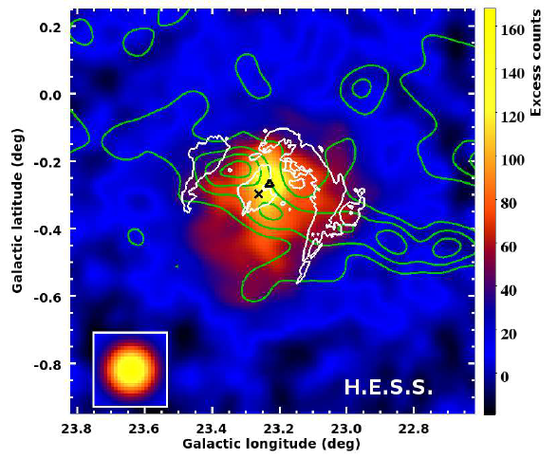
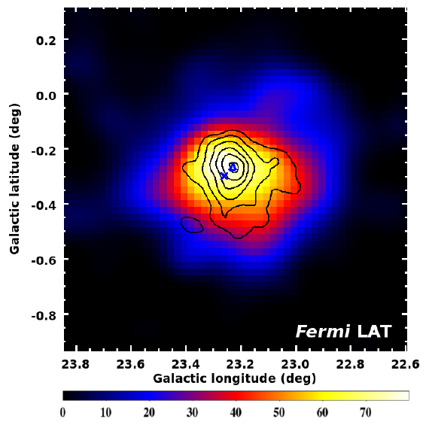
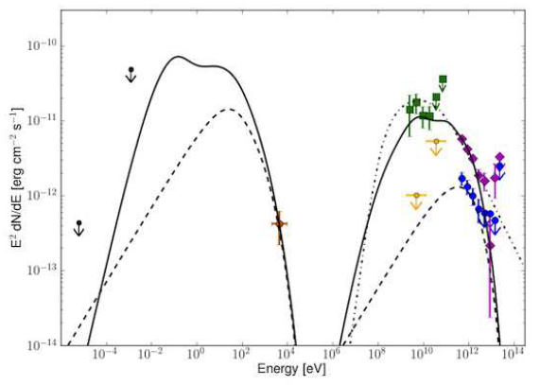
Next: high-energy photon emission
X-rays
γ-rays
Notes section 2.4

