Slide 1
PHY418 Particle Astrophysics
Cosmic Rays

Slide 2
Cosmic Rays
Discovery

Slide 3
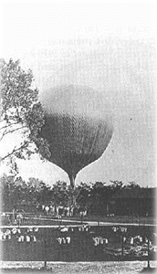
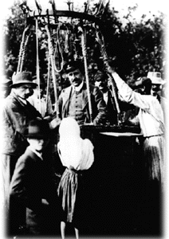
Discovery of cosmic rays
Cosmic rays were discovered in 1912 by Hess
he showed that the intensity of penetrating radiation increased with altitude
therefore not due to natural radioactivity in rocks
Shown to be charged particles by Compton in 1932
flux observed to vary with latitude as expected for charged particles deflected by Earth’s magnetic field
East-west asymmetry observed in 1933
showed particles were mainly positively charged (protons & ions)

Slide 4
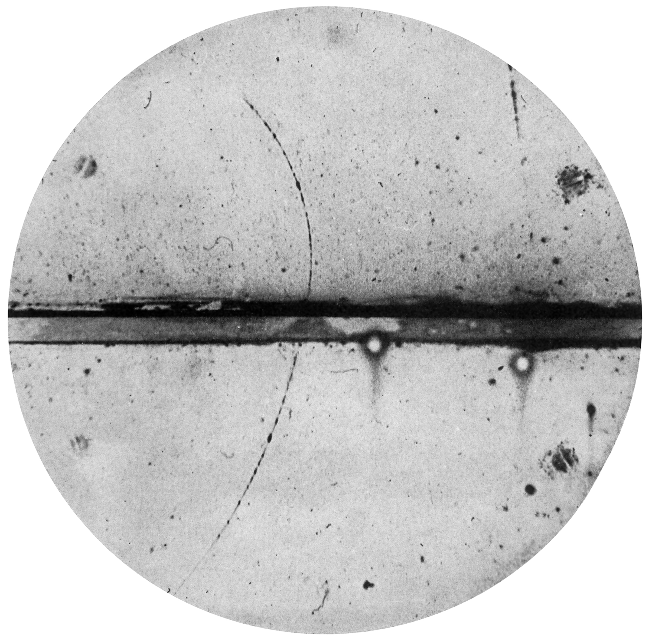
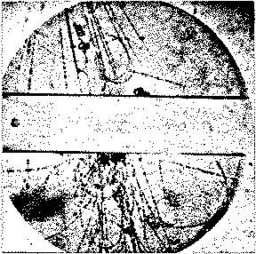
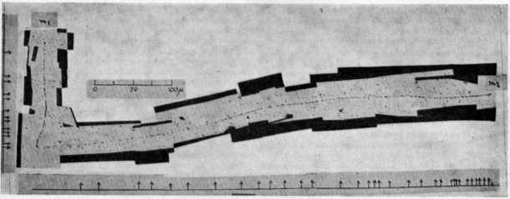
Early significance of cosmic rays
Initial significance of cosmic rays mostly related to particle physics
e⁺, μ, π and strange particles all discovered in cosmic rays
later superseded by accelerators

Slide 5
Cosmic Rays
Detection

Slide 6
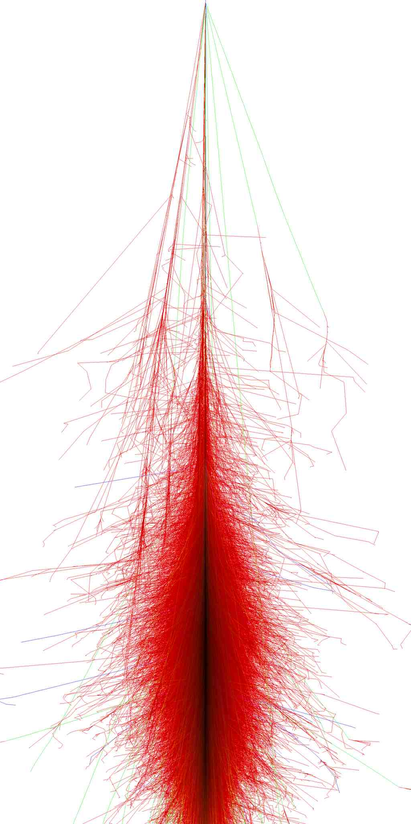
Detection of cosmic rays
Cosmic rays are strongly interacting
primary cosmic rays shower high in the atmosphere
Therefore, two approaches to detection:
detect primary particle at high altitude
requires balloon-borne or space-based experiment
detect shower products
can be ground-based, but loses information
Typically, ground-based detection used for higher-energy cosmic rays
flux is too low for effective detection by experiments small enough to launch to high altitude

Slide 7
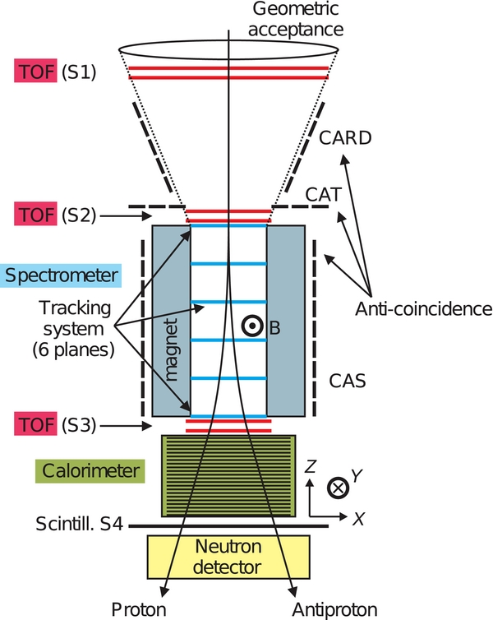
Detection of cosmic rays: primaries
Ideally, would like to know energy (or momentum), direction and identity of particle
energy can be measured by calorimetry
momentum by a magnetic spectrometer
direction requires tracking information
spark chambers, wire chambers, silicon strip detectors, CCDs, …
various techniques for particle identification
time of flight, dE/dx, threshold or ring-imaging Cherenkov
measure mass, but generally only for low-ish energies
charge measurement
measures Z, cannot separate isotopes
PAMELA

Slide 8
Energy/momentum and direction
Magnetic spectrometers measure momentum (actually, rigidity) from deflection of particle by magnetic field
this has the advantage that it measures charge sign, and thus distinguishes particles from antiparticles
Calorimeters measure energy by causing particle to shower and then detecting deposited energy
this is usually more accurate than momentum above a certain threshold (depends on magnetic field) and measures photons (and other neutrals) as well as charged particles
Other techniques include transition radiation (measures γ; convert to E by determining m)
calorimetry and transition radiation can both be used by non-magnetic detectors

Slide 9
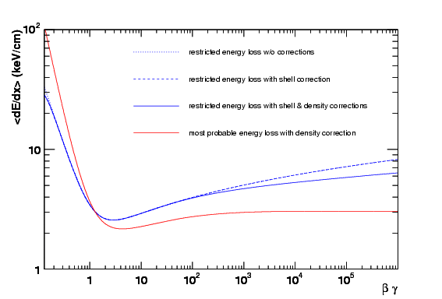
Particle identification
dE/dx depends on βγ and therefore, for a known momentum, on the mass of the particle
the dependence is fairly complicated, and measurements do not generally use ⟨dE/dx⟩ itself but a truncated mean—therefore need to adjust formula
TOF depends on β, hence on m if p known
Cherenkov methods depend on β via cos θ = 1/nβ
All these methods lose discrimination when particles become ultra-relativistic, so that m is negligible
Determining particle charge via ionisation produced works up to higher momenta, but does not give isotopic info
ZEUS

Slide 10
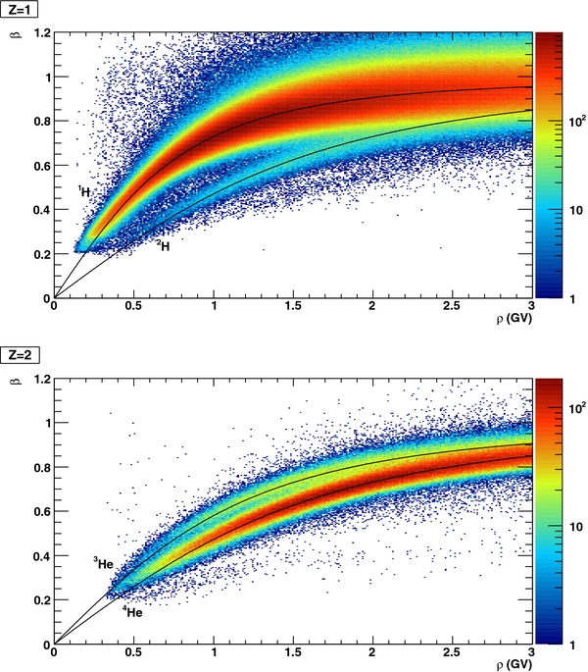
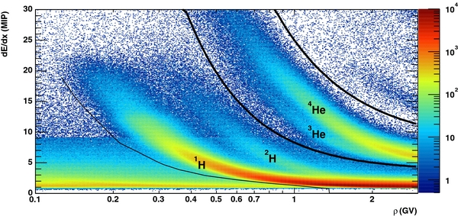
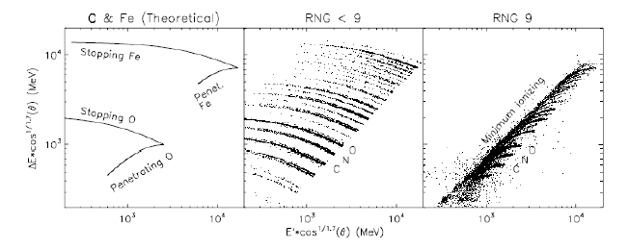
Particle identification
PAMELA dE/dx
Note: rigidity R (or ρ) = cp/Ze is often used instead of momentum; it defines response of particle to magnetic field
PAMELA time of flight
CRIS charge deposited

Slide 11
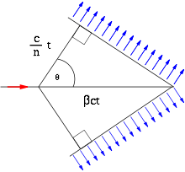
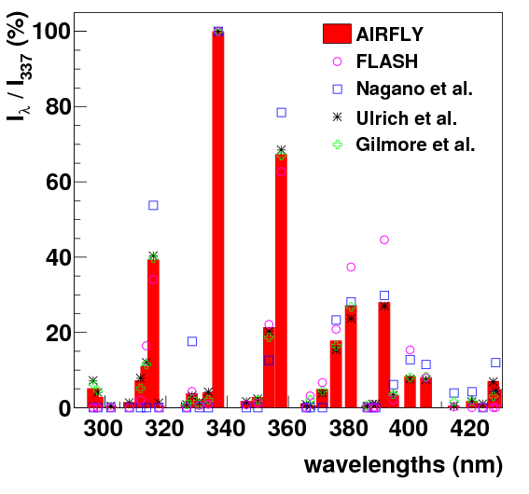
Detection of cosmic rays: showers
Two possibilities: detect the shower in the air, or detect shower particles that reach the ground
Detection in air: either Cherenkov radiation or nitrogen fluorescence
Cherenkov radiation: detect particles travelling at speeds > c/n (~25 MeV for electrons in air)
very forward peaked: cos θ = 1/nβ ~ 1° in air
blue light
Nitrogen fluorescence: detect near-UV radiation from excited nitrogen molecules
also mostly sensitive to electrons, but isotropic
Light is very faint in both cases: require clear skies and very dark nights
poor duty cycle, but large effective area

Slide 12
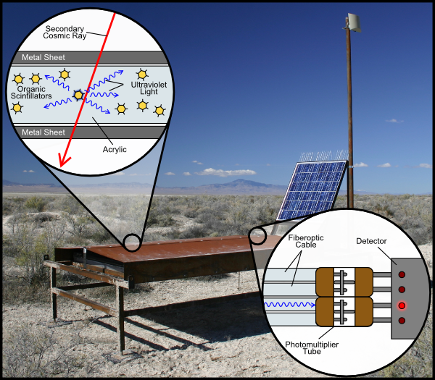
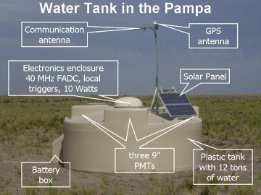
Detection of cosmic rays: showers
Two possibilities: detect the shower in the air, or detect shower particles that reach the ground
Ground arrays: need large area coverage, so cheap, fairly autonomous array elements
technologies of choice: water Cherenkov or plastic scintillator
some arrays also have muon detectors (shielded from other particles)

Slide 13
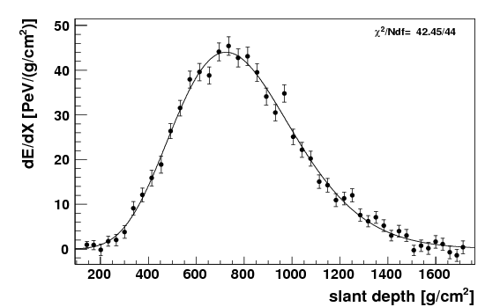
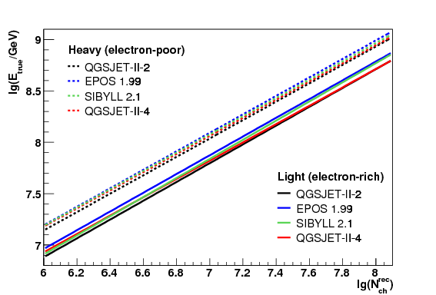
Energy measurement
Fluorescence detectors measure light yield and longitudinal shower profile
a fit to this can be used to deduce energy of primary
Ground arrays measure transverse shower profile at ground level
charged particle multiplicity or charged particle density at specified distance from shower axis can be used to deduce energy
Auger
KASCADE

Slide 14
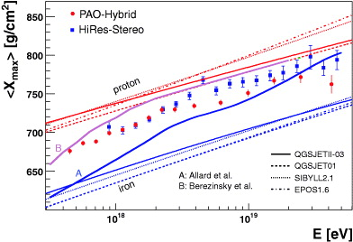
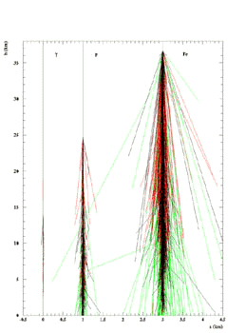
Particle identification
Ground arrays cannot provide specific primary identification
“Heavy” and “light” primaries can be distinguished by the depth in the atmosphere at which they shower (X_{max})
Showers initiated by electrons/photons are narrower and contain only e± and γ
At the highest energies there is some model dependence in this—no way to test models at these energies—and some disagreement between experiments
this is actually quite important as particle ID at highest energies has a bearing on possible sources

Slide 15
Cosmic Rays
Properties

Slide 16
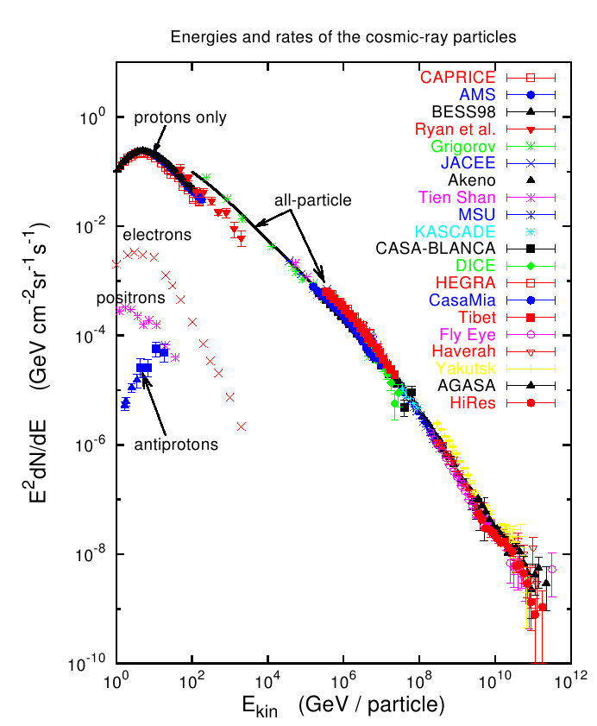
Properties of cosmic rays
Energy spectrum is close to a power law with spectral index ~2.7
turn-over at low energies is due to solar magnetic field
two noticeable slope changes: “knee” at ~10⁶ GeV and “ankle” at ~10⁹ GeV
possibly due to changeover of sources
knee
ankle

Slide 17
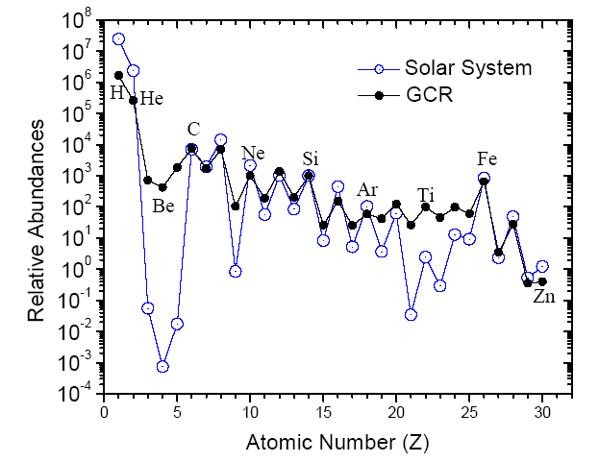
Composition
fixed
Relative deficit of H and He (more easily deflected)
Large excess of Li/Be/B and elements just below iron peak
these nuclei are produced in CRs by spallation
also accounts for smaller odd/even modulation
Note that detailed composition information is only available for fairly low-energy CRs
170 MeV/nucleon

Slide 18
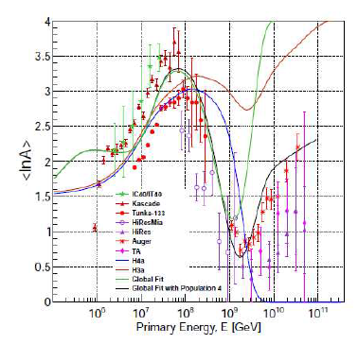
High energy composition
Rigidity R = cp/Ze
particles of same rigidity behave in same way in Galactic magnetic field and in source magnetic field
if source can only confine particles up to rigidity R_{max}, then maximum particle energy ∝ Z: composition will skew towards heavier species at cut-off
Evidence for source change above knee, and perhaps also above ankle
latter is driven mainly by data from Auger—not much evidence of heavier composition from TA or HiRes

Slide 19
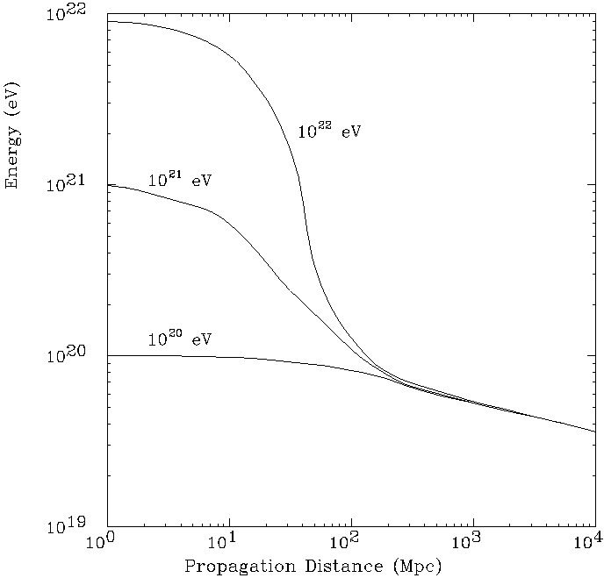
High energy composition: GZK
An unavoidable cut-off at high energies arises from the interaction $p+γ→Δ^{+}→p+π^{0}(n+π^{+})$
at energies above ~5×10¹⁹ eV this reaction can take place with a CMB photon
this is unavoidable as these photons are everywhere
result is to reduce proton energy by ~3% owing to the production of the pion mass
repeated until proton energy drops below threshold
limits range of protons with E > 5×10¹⁹ eV to ~100 Mpc (~Coma cluster)
It is not clear if observed cut-off at about this energy is GZK or not
if associated with shift to heavy nuclei, could be source cut-off instead

Slide 20
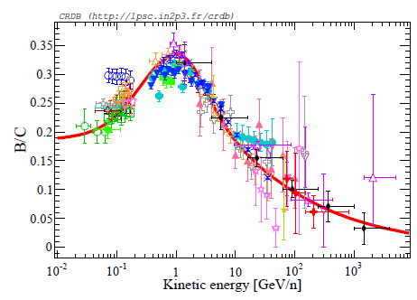
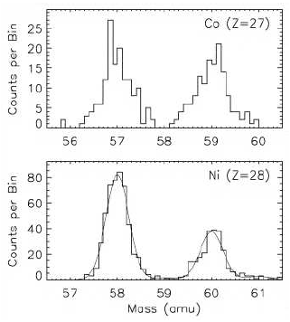
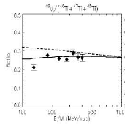
Isotopic composition
Key issues:
ratio of secondary (spallation-produced) to primary nuclei
provides information about propagation of CRs in Galaxy
nuclei which are stable to β⁺ decay (X → X’ + e⁺ + ν_{e}) but unstable to electron capture (X + e⁻ → X’ + ν_{e})
as long as such nuclei are fully ionised they are completely stable
absence of such isotopes among primary nuclei suggests that material that is accelerated is initially cold
(these isotopes are observed among secondary nuclei)

Slide 21
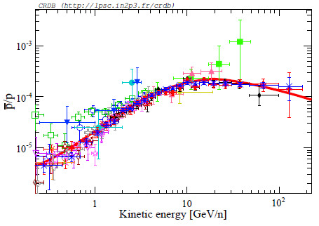
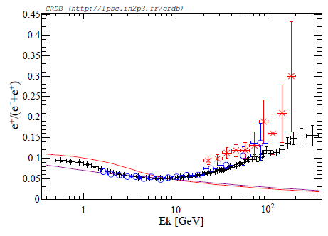
Antiparticles
Antiprotons and—especially—positrons can be produced as secondaries by energetic interactions
also possibly by dark-matter annihilation
Antinuclei would imply existence of antistars
“Positron excess”—probably astrophysical (pulsars or pulsar wind nebulae?)

Slide 22
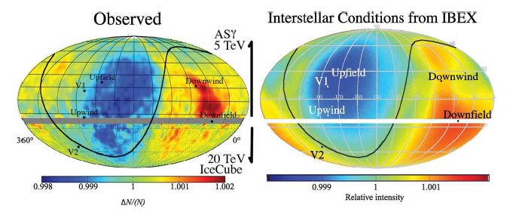
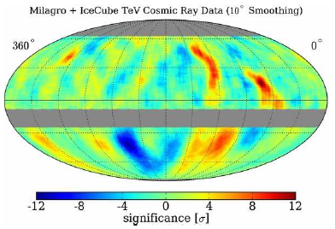
Directional information
Cosmic ray directions are scrambled by Galactic magnetic field
small-amplitude large-scale anisotropies are well accounted for by local magnetic fields
smaller-scale anisotropies may be due to source distribution or magnetic field variations
in fact, level of anisotropy is much lower than theoretically expected

Slide 23
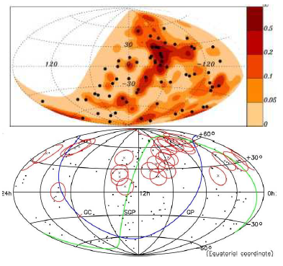
Directional information: high energies
At very high energies directions should not be so severely affected—might find correlations with sources
results so far not very impressive
Auger see weak correlation with nearby AGN, but more data have weakened, not strengthened, result
Auger also see slight increase in flux in direction of Cen A; both these are 2σ
TA sees “hot spot” near 6^{h} RA, 60° Dec (3.6σ)—but this is broad and not obviously correlated with a potential source
if high-energy CRs are heavy ions as suggested by Auger data, this is easier to understand, as they are deflected more for same p

Slide 24
Summary
Cosmic rays consist mostly of protons and heavy ions
primary cosmic rays are detected by balloon-borne and space-based platforms
products of air showers are detected by ground-based experiments
Detectors aim to measure energy, direction and particle ID
energy by magnetic spectrometers, calorimeters, transition radiation (primaries) or by shower profile, light yield and particle counting (showers)
Observed properties:
energy spectrum is a power law with spectral index ~2.7
elemental composition shows evidence for spallation
isotopic composition implies accelerated material is initially cool
directions are broadly isotropic, no direct evidence for particular sources
You should read section 2.2 of the notes.
You should know about
the discovery of cosmic rays
detection techniques
basic properties (energy spectrum, composition, anisotropies)

Slide 25
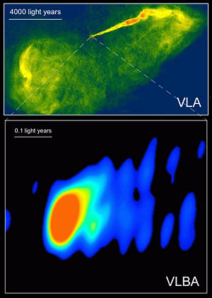
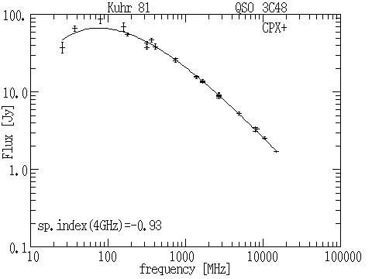
Next: radio emission
radiation from an accelerated charge
bremsstrahlung
synchrotron radiation
Notes section 2.3

