Slide 1
PHY418 Particle Astrophysics
Introduction: What is particle astrophysics?

Slide 2
What is particle astrophysics?
Particle astrophysics is the use of particle physics techniques (experimental or theoretical) to address astrophysical questions.
Topics included:
early-universe cosmology
inflation (and alternatives), baryogenesis, dark energy
cosmic rays
γ-ray astronomy
high-energy neutrino astronomy
low-energy neutrino astronomy
dark matter (see PHY326/426)
I will focus on high-energy particle astrophysics
These form a coherent field with a lot of common factors—“high-energy particle astrophysics”

Slide 3
PHY418 Syllabus
Introduction
brief outline of those topics I am not going to cover in detail
High-energy particle astrophysics: the observations
cosmic rays
radio emission
high-energy photon emission (X-rays and γ-rays)
neutrinos
Acceleration mechanisms
Fermi second-order
diffusive shock acceleration
magnetic reconnection
Sources
case studies of the principal source types

Slide 4
PHY418 Resources
There isn’t an ideal course text—so I have basically written one
too long to photocopy for you but you can download the pdf from the website (or from the MOLE reading list)
www.hep.shef.ac.uk/cartwright/phy418
this also contains copies of slides
The nearest thing to a “proper” course text is Malcolm Longair, High Energy Astrophysics 3rd edition, CUP
several copies in IC
different organisation and emphasis compared to course
rather more detail in the mathematics
it is in SI units—note that a lot of texts at this level are in cgs

Slide 5
PHY418 Assessment
End-of-semester exam (85%)
One compulsory question (30 marks)
Any two from four optional questions (20 marks each)
A practice exam will be provided since this is a new module
Also short class tests (15%)
designed to test your ability to apply the taught material to problems
similar to exam questions (but without bookwork)
3 (two during Observations, and one after Acceleration Mechanisms)
open notes format

Slide 6
Introduction to Particle Astrophysics
Early-universe cosmology

Slide 7
Early-universe cosmology
In the early universe, energies are extremely high
appropriate physics is very high-energy particle physics
GUTs, string theory??
consequences in early universe
inflation (breakdown of GUT?)
baryogenesis (matter-antimatter asymmetry)
consequences in later universe
dark energy (vacuum energy? scalar field?)
dark matter (lightest supersymmetric particle? axion?)
Particle physics of early universe is very difficult to test
energies are much too high for feasible accelerators

Slide 8
Inflation
notes section 1.2.1
Observational evidence shows that the universe is
geometrically flat (k = 0 in Robertson-Walker metric)
extremely uniform at early times (ΔT/T ~ 10⁻⁵ in CMB)
not precisely uniform (with nearly scale invariant fluctuations)
These properties are unexpected in the classical Big Bang model
no reason in GR why overall geometry should be flat
and if it is not flat originally it evolves rapidly in the direction of increased curvature
no expectation that the CMB temperature should be uniform
horizon distance expands faster than universe, so causally connected regions at ~400000 years correspond to only ~2° on sky now
if initial conditions force it to be uniform, no explanation for the fact that it is not quite uniform

Slide 9
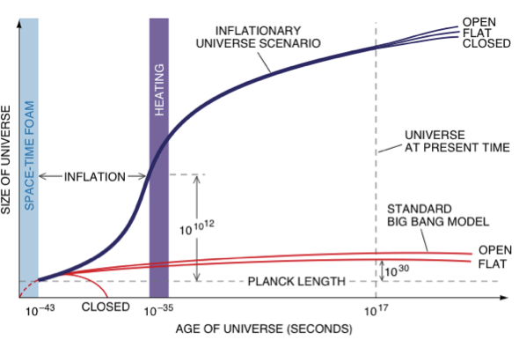
Inflation
Observational features can be accounted for by inflation
period of very fast (~exponential) expansion in very early universe
expansion $\dot{a}∝e^{Ht}$ or $\dot{a}∝a^{n}$, n > 1, will force geometry towards flatness and ensure that visible universe is causally connected
quantum fluctuations provide the anisotropies
with the right spectrum

Slide 10
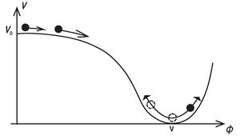
Inflation and the inflaton
Exponential expansion requires equation of state P = −Ɛ (vacuum energy)
this can be approximated by a scalar field (the inflaton) ϕ: $ℰ_{φ}=\frac{1}{2ℏc^{3}}{\dot{φ}}^{2}+V\left(φ\right);$ $P_{φ}=\frac{1}{2ℏc^{3}}{\dot{φ}}^{2}−V\left(φ\right);$
if the kinetic term is small this is almost a vacuum energy
this is very similar to the Higgs field (but expected mass of inflaton ≫ Higgs mass)
most extensions to Standard Model (e.g. supersymmetry) predict more Higgs fields
various models of inflationary cosmology exist
testable using CMB polarisation, cf. BICEP2

Slide 11
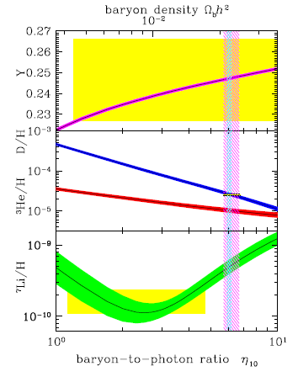
Baryogenesis
notes section 1.2.2
The universe contains matter, but not antimatter
evidence: no annihilation signatures
The amount of (baryonic) matter is small
ratio of baryons to photons ~6×10⁻¹⁰
At some point in the very early universe, non-zero baryon number must be generated
Sakharov conditions:
B must be violated
reactions must take place out of thermodynamic equilibrium
C and CP must be violated

Slide 12
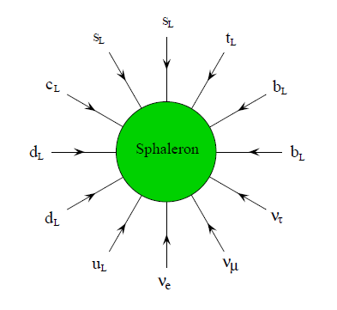
Baryogenesis
B violation occurs in Standard Model
via transitions called sphalerons which conserve B – L but violate B and L separately (by 3 units)
these are quantum tunnelling transitions which are suppressed to non-existence in the present universe but would have occurred easily at sufficiently high energies
Out-of-equilibrium conditions are natural
in a rapidly expanding and cooling early universe
C and CP violation are observed in weak interactions
level of CP violation insufficient for observed asymmetry
CP violation may also occur in neutrino sector

Slide 13
Baryogenesis models
GUT baryogenesis
takes place via heavy gauge bosons X and Y
problem—may allow production of heavy GUT relics such as magnetic monopoles
Electroweak baryogenesis
takes place at electroweak phase transition (~100 GeV)
problem: requires first-order phase transition to satisfy out-of-equilibrium condition, and this requires a light Higgs (<75 GeV/c², cf. 126 GeV/c²)

Slide 14
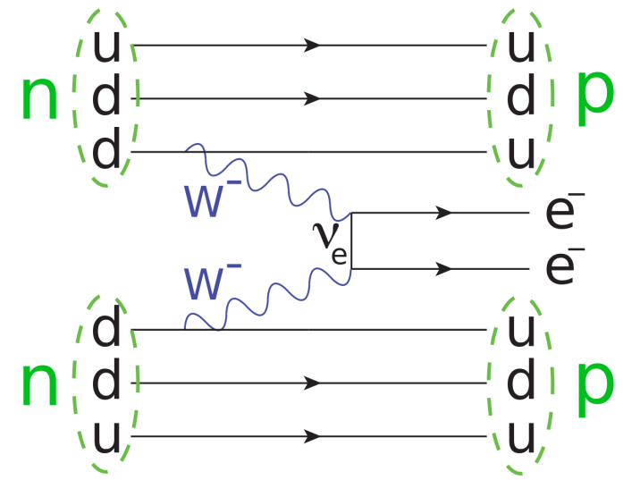
Leptogenesis models
Generate non-zero lepton number, convert to B via sphaleron transitions
lepton number violation is testable at low energies via double β decay
occurs if neutrinos are Majorana particles (neutrino and antineutrino are the same particle with different “handedness”)
expected in “seesaw models” which use massive right-handed neutrino to explain why (left-handed) neutrino mass so small compared to other fermions
possible link to axion dark matter
lightest of the “heavy” neutrino states could be linked to axion symmetry-breaking scale f (see later)

Slide 15
Introduction to Particle Astrophysics
Dark Energy and Dark Matter

Slide 16
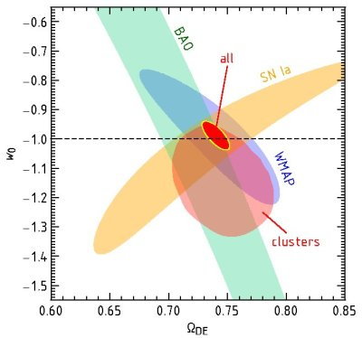
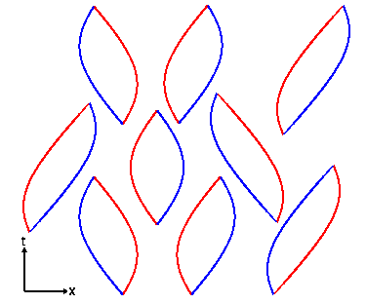
Dark energy
notes section 1.3
There is a great deal of observational evidence from astrophysics and cosmology that the expansion of the universe is currently accelerating
requires a component with equation of state P = wƐ where w < −1/3 (w = −1 is a vacuum energy or cosmological constant, Λ)
Vacuum energy is “natural” because of spontaneous pair creation (uncertainty principle)
but “natural” value of Λ is ~10¹²⁰ times too large!

Slide 17
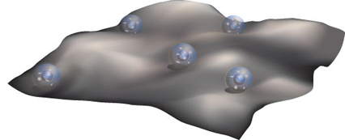
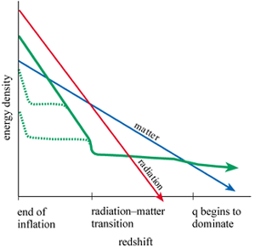
Models of dark energy
Vacuum energy plus weak anthropic principle
if Λ had its “natural” value, we would not exist, therefore Λ must be “unnaturally” small
works best in multiverse models such as chaotic inflation (there are then many other universes with “natural” Λ and no life)
Scalar field (as in inflation)
in this case the effective value of Λ will evolve over time
in some “tracker” models it is constrained to stay close to the density of radiation or matter
Modified gravity
especially in models with extra dimensions

Slide 18
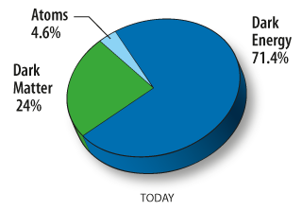
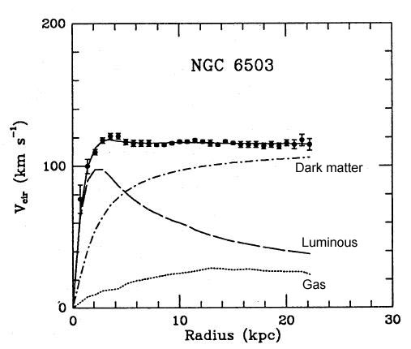
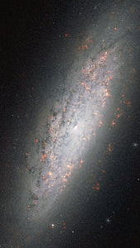
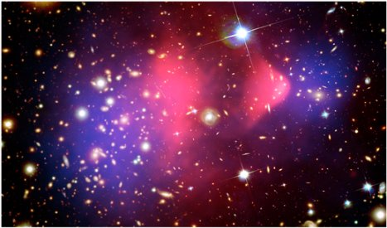
Dark matter
notes section 1.6
Much observational evidence that most matter in the universe is (a) non-luminous and (b) non-baryonic
non-luminous:
rotation curves of galaxies
gravitational potential of galaxy clusters
weak lensing maps
non-baryonic
comparison of light-isotope abundances with gravitational mass
comparison of X-ray luminosity of clusters with gravitational potential
power spectrum of CMB anisotropies

Slide 19
Dark matter properties
From observations, dark matter must
not absorb or emit light (and hence, not interact electromagnetically)
because it is not seen, in emission or absorption, at any wavelength, and from CMB power spectrum which implies it does not interact with photons
not be hadronic (i.e. strongly interacting)
from discrepancy between light-element abundances and gravitational mass measurements
be non-relativistic at z ~ 3000
so that it can be bound in galaxy-sized potential wells when structures form
be stable or very nearly so
because mass measurements in local universe agree with CMB
No Standard Model particle satisfies this list
neutrinos are closest, but are relativistic at z ~ 3000 (“hot”)

Slide 20
Dark matter candidates
GHP = Gauge Hierarchy Problem; NPFP = New Physics Flavour Problem
√ = possible signal; √√ = expected signal
Jonathan Feng, ARAA 48 (2010) 495 (highly recommended)

Slide 21
WIMPs
Weakly Interacting Massive Particles
predicted by various extensions of the Standard Model, the most popular and widely studied being supersymmetry (SUSY)
in most variants of SUSY the lightest supersymmetric particle is absolutely stable
it is a “neutralino”, ${\tilde{χ}}_{1}^{0}$ (a mix of the SUSY partners of the h, H, γ and Z)
These can be detected by identifying the recoil of an atomic nucleus struck by the WIMP
SUSY neutralinos can also be detected indirectly by identifying their annihilation products from regions of high WIMP density, e.g. the centre of the Sun
it is also possible that WIMPs could be produced at the LHC and identified as missing energy/momentum (they would not interact in the detectors)

Slide 22
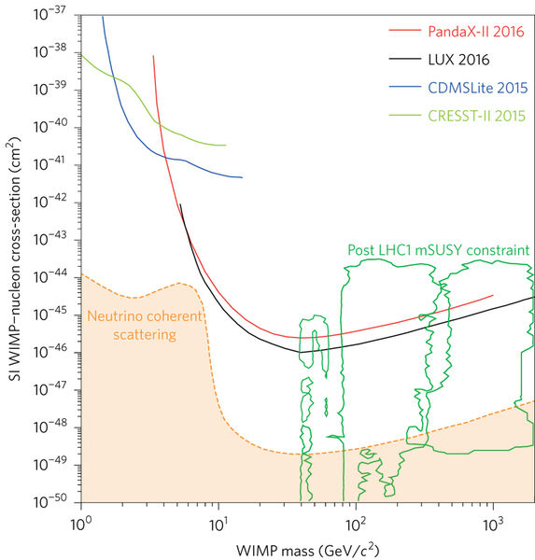
WIMP limits
There are some claimed signals at low WIMP masses (not shown), but they are inconsistent with each other and with limits from other experiments.
Their interpretation is still unclear.
Liu, Chen and Ji, Nature Physics 13, 212–216 (2017)

Slide 23
Axions
The axion is a hypothetical particle arising from attempts to understand why the strong interaction conserves CP
in the Standard Model there is no reason why it should do so
Axions are expected to be extremely light (μeV−meV), but are “cold” because they are not produced thermally
they arise from a phase transition in the very early universe
Unlike WIMPs, axions do couple—extremely weakly—to photons and can be detected by the Primakoff effect
resonant conversion of axion to photon in highly tuned magnetic field
this coupling is the basis of the ADMX experiment (ask Ed Daw…)

Slide 24
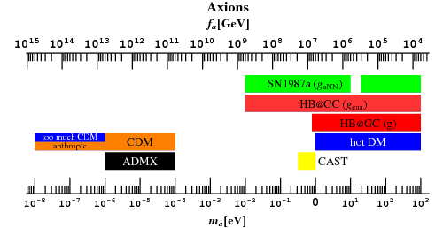
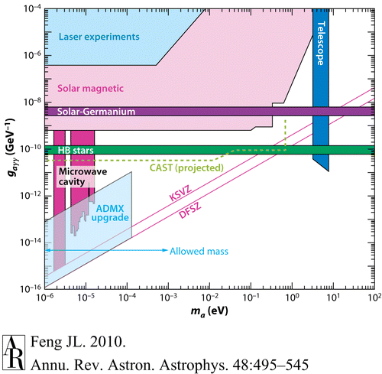
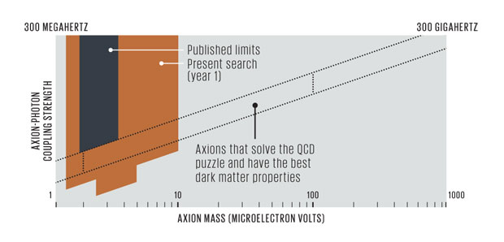
Axion limits

Slide 25
Introduction to Particle Astrophysics
Low energy neutrino astrophysics

Slide 26
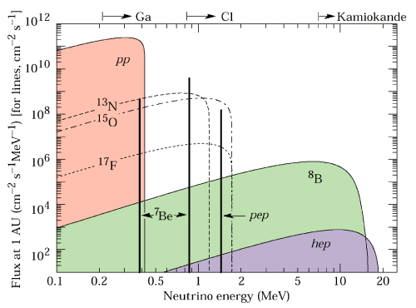
Solar neutrinos
Hydrogen fusion must involve neutrino emission: 4 ¹H → ⁴He + 2e⁺ + 2ν_{e}
two protons get converted to two neutrons—must emit 2e⁺ to conserve charge, then require 2ν_{e} for lepton number
must be electron neutrinos as insufficient energy to produce μ⁺ or τ⁺
Many routes to the final result
Q-values, and hence neutrino energies, vary

Slide 27
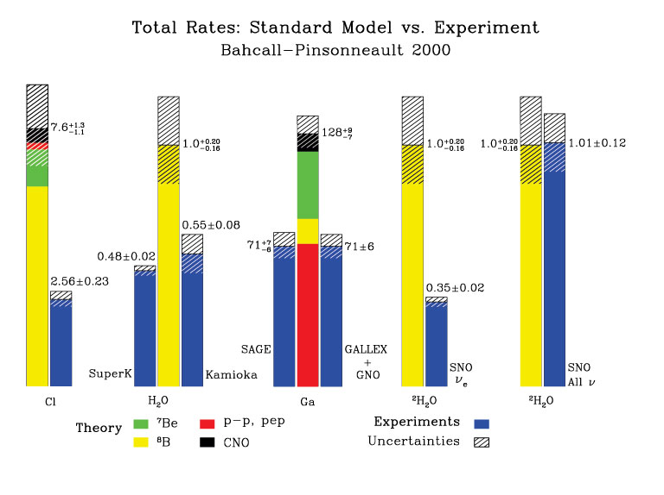
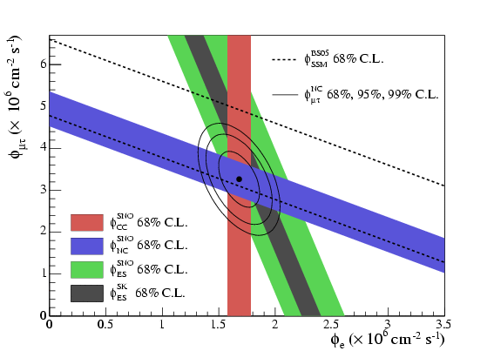
Solar neutrinos
Detection techniques
inverse β decay, e.g. ³⁷Cl + ν_{e} → ³⁷Ar + e⁻
low energy threshold, especially on ⁷¹Ga, but no directional or energy information
electron elastic scattering, ν + e⁻ → ν + e⁻
sensitive to all neutrino types, but mostly ν_{e}
capture on deuterium CC: ν_{e} + d → p + p + e⁻ NC: ν + d → p + n + ν
sensitive to all neutrino types
Deuterium measurement established that solar neutrinos change flavour before detection (neutrino oscillation)
SNO

Slide 28
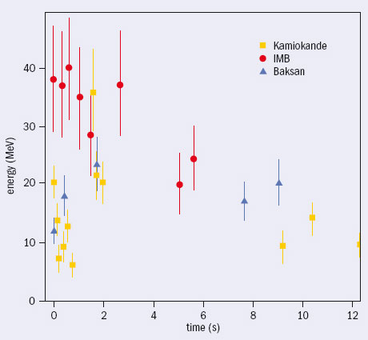
Supernova neutrinos
99% of the energy of a core-collapse supernova comes out as neutrinos
neutronisation pulse, p + e⁻ → n + ν_{e}
thermal pair production
Verified when neutrinos detected from SN 1987A
only 24, but enough to confirm energy scale
Potential for a great deal of interesting physics in the event of a Galactic CCSN
thousands of neutrinos would be detected

Slide 29
Summary
Particle astrophysics covers a very wide range of topics
early-universe cosmology
dark energy
dark matter
low-energy neutrino astrophysics
high-energy astrophysics
cosmic rays
radio emission from high-energy particles
high-energy photons
high-energy neutrinos
This section has summarised the first four of these
rest of course will focus on last topic
You should read sections 1.2, 1.3, 1.5.2, 1.5.3 and 1.6 of the notes
You should know about
inflation
baryogenesis
dark energy
dark matter
solar neutrinos
supernova neutrinos

Slide 30
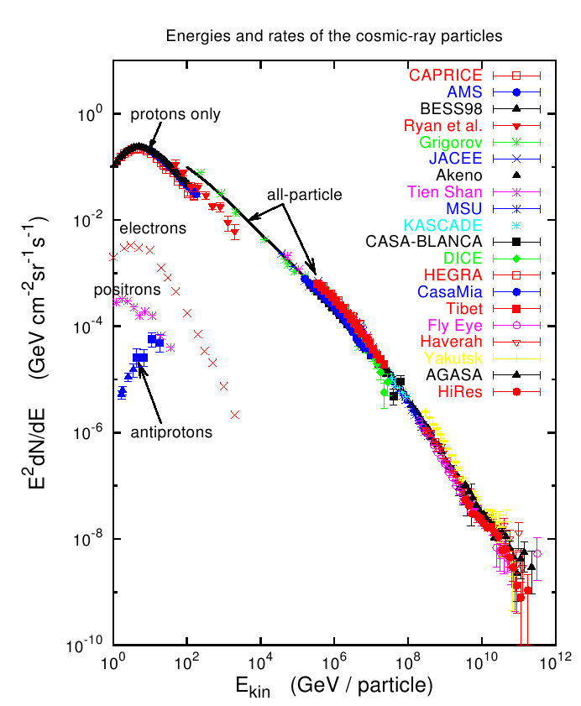
Next: cosmic rays
history
detection techniques
observed properties
Notes section 2.2

