Slide 1
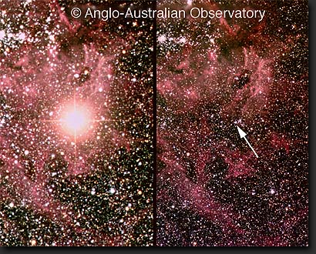
The Deaths of Stars
What happens to stars when the helium runs out?
  do they simply fade into oblivion?
  NO!
    stellar deaths produce
    some of the most
    spectacular phenomena
    in the universe
    and also play a vital role
    in enriching with heavy
    elements the material
    of which new stars are
    made

Slide 2
Stellar lifetimes
Our binary star data suggest that the lifetimes of stars with mass < 0.9 Msun are longer than 15 billion years (the age of the universe)
But massive stars have lifetimes of only a few million years

Slide 3
Stellar statistics
A census of nearby stars:
  most stars are low mass
  red dwarfs
  a few percent are 1–2 x
  the Sun’s mass
  very massive stars are
  very rare (only 3 B and
  no O class blue stars in
  the 3800 stars within 75
  light years of the Sun)
Stellar deaths are rare
  (but crucial to our existence!)

Slide 4
The deaths of Sun-like stars
Giant stars are very unstable
  especially those which are fusing helium
Outer layers of star easily lost
  mass loss seen in spectra of these stars
  rate increases towards end of helium fusion

Slide 5
Mass loss in Sun-like stars
Star of 1.7 solar masses

Slide 6
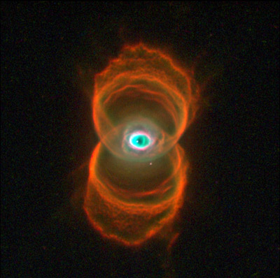
Death of a star
At end of helium fusion star has lost all its outer layers
  central, very hot, carbon core surrounded by expelled gas
  ultraviolet radiation from hot core causes gas to produce emission lines
  planetary nebula
    nothing to do with planet, just looks like one!

Slide 7
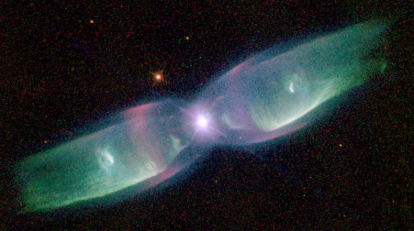
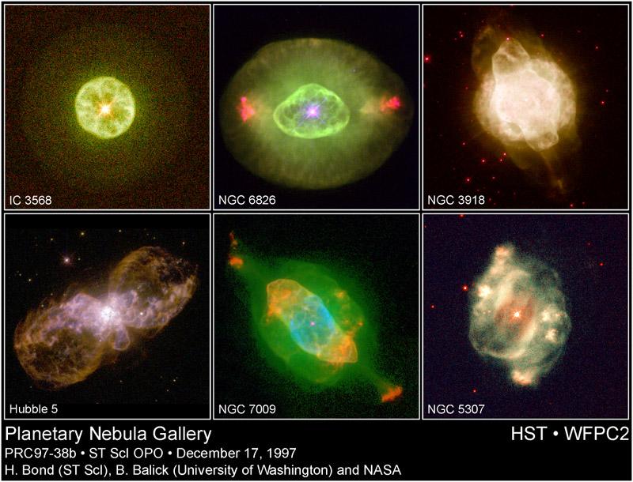
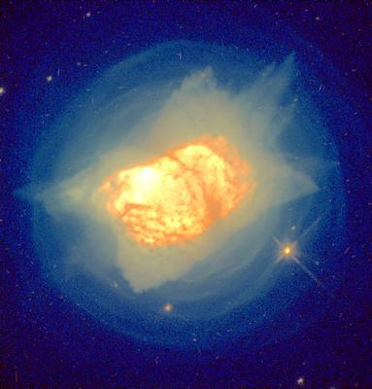
Planetary nebulae

Slide 8
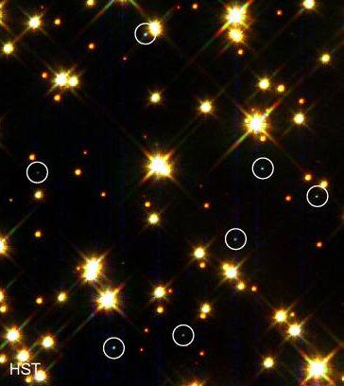
The legacy of Sun-like stars
Giant stars have convective outer layers
  elements formed in core are transported to surface
  thus ejected in planetary nebula
Planetary nebulae thus enrich the interstellar gas with many elements
  nitrogen, barium, zirconium, etc.
Stellar core is eventually revealed as small, hot white dwarf star

Slide 9
Fusing heavy elements
Massive stars have much hotter cores
  successfully fuse elements up to iron
But this is a very temporary respite:
  for a star of 20 solar masses,
    hydrogen fusion lasts around 15 million years
    helium fusion lasts around one million years
    carbon fusion lasts 300 years
    oxygen fusion lasts for 7 months
    silicon fusion lasts for two days and produces an iron core
not to scale!

Slide 10

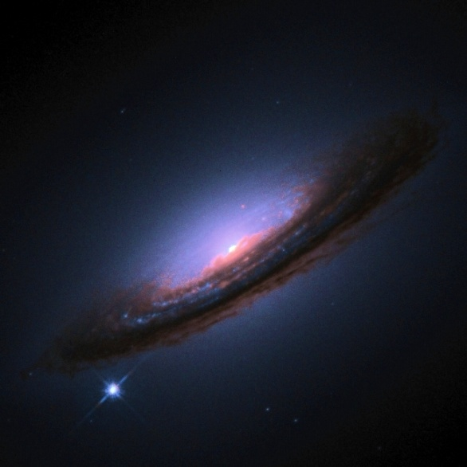
The fate of massive stars
Fusing iron requires (does not generate) energy
  iron core cannot support itself against gravity
  collapses to form neutron star
    neutron star is about 50% more massive than Sun, but is only 20 km across
    basically a gigantic atomic nucleus: protons and electrons have combined to form neutrons
    in extreme cases even this may not be stable, and a black hole is formed instead
  outer layers expelled in massive explosion: a supernova
    for a few weeks star is nearly as bright as a whole galaxy
SN1994D: HST

Slide 11
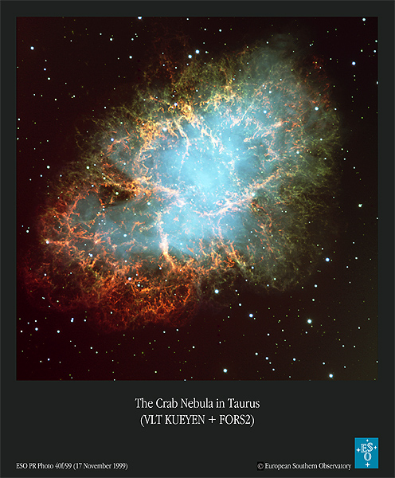
The legacy of massive stars
Supernova remnants
  expanding gas cloud, formerly star’s outer layers
Pulsars
  rapidly rotating neutron stars
    observed by their “lighthouse beam” of radio emission (sometimes also optical) emitted from magnetic poles of star
Heavy elements
  formed in the core of the star as it implodes

Slide 12
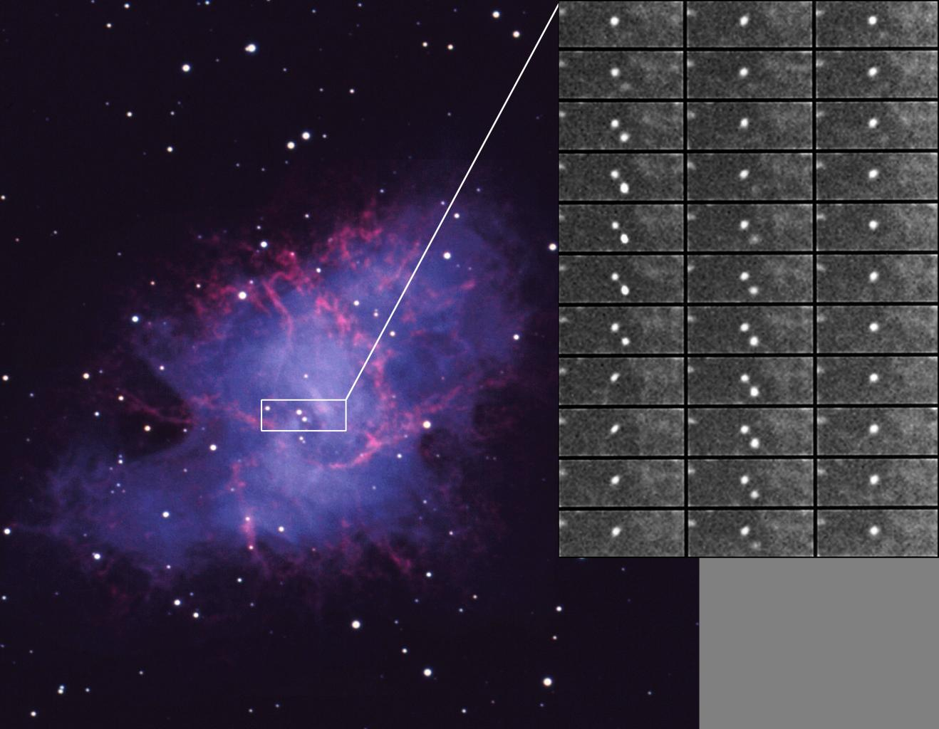
The Crab pulsar
Spin axis and magnetic axis misaligned: see pulse
In Crab see 2 pulses/cycle: angle must be ~90°

Slide 13
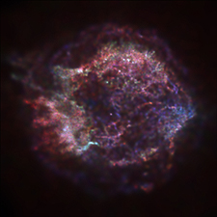
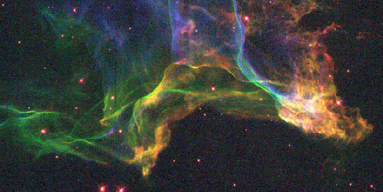
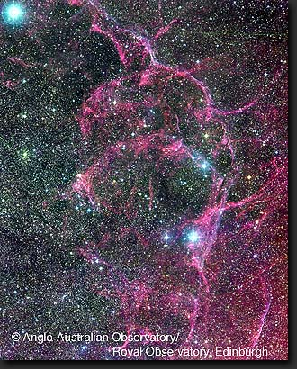
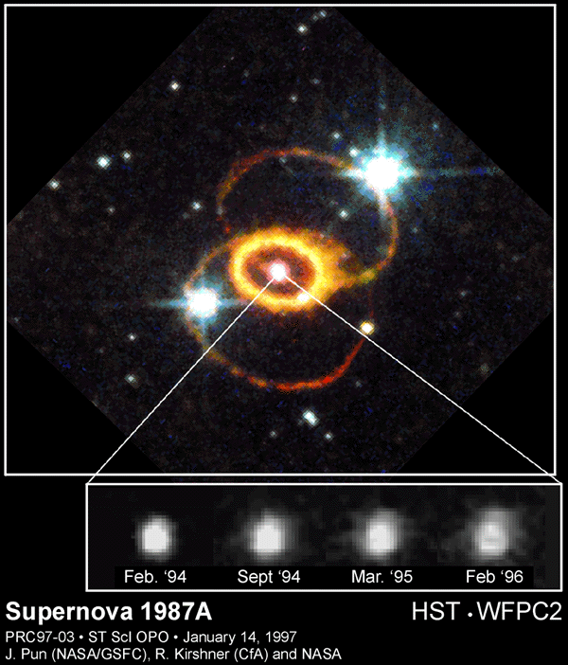
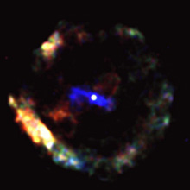
Supernova remnants
Cas A in x-rays (Chandra)
Cygnus Loop (HST): green=H, red=S⁺, blue=O⁺⁺
Vela
Remnant of SN386, with central pulsar (Chandra)
SN1998bu

Slide 14
Building the elements
Routes to building elements:
Start with | Add | In | Making
carbon | protons | H-fusing stars | nitrogen
carbon | helium nuclei (α-process) | He-fusing stars | oxygen-16, neon-20, etc.
carbon-13, neon-22 | helium nuclei | He-fusing stars | free neutrons
silicon, sulphur | silicon, sulphur | pre-supernova stars | iron
iron, neon | neutrons, slowly (s-process) | He-fusing stars | most stable isotopes up to Bi
iron | neutrons, rapidly (r-process) | supernovae | neutron-rich isotopes
iron | add photon, lose neutron? (p-pr) | supernovae | rare neutron-poor isotopes

Slide 15
Adding neutrons— why does the speed matter?
Slow addition of neutrons (s-process) cannot make isotopes that are “shielded” by unstable isotopes (e.g. ¹¹⁶Cd)
Rapid addition of neutrons (r-process) cannot make those shielded by stable nuclei (e.g. ¹¹⁶Sn)
Some isotopes (p-process) cannot be made by either method (e.g. ¹¹²Sn)

Slide 16
Summary: the abundance of the chemical elements
CNO
The iron peak:
made in the last
stages of fusion
Heavy elements:
made by adding
neutrons to iron
not made
in stars
p-process isotopes

