Slide 1
Star Birth
Most of the bright stars we see have lifetimes much less than the age of the Solar System
  star formation is an ongoing process
  how does it
  happen?
  are stars born
  now different
  from older
  stars?
  what about
  planetary
  systems?

Slide 2
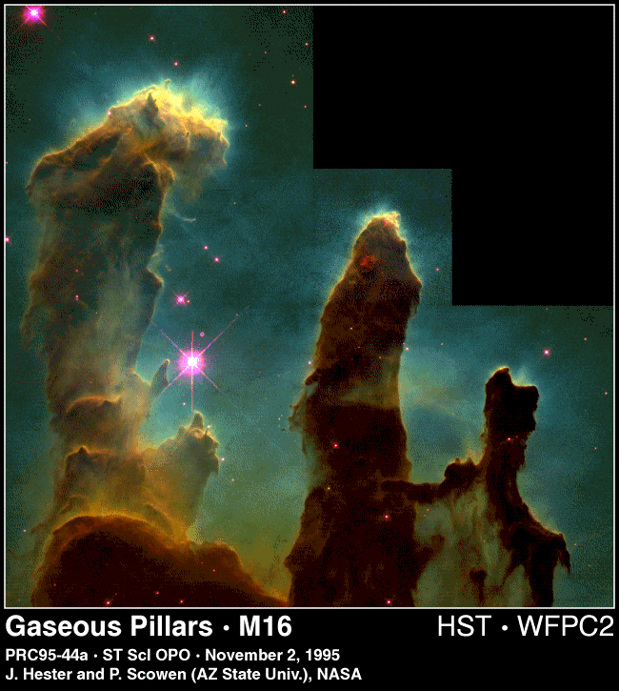
How are stars born?
Space is not empty, but filled with very rarefied gas
Gas pressure depends on temperature: cool, dense gas may not have high enough pressure to balance inward gravitational force
Cool, dense molecular gas can collapse to form stars

Slide 3
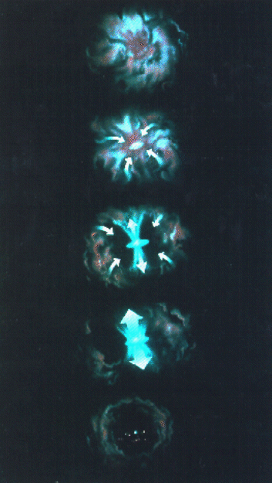
Stages in star birth
As gas cloud collapses
  its rotation causes the formation of a disc around the young star
  the gas forming the young star heats up as the star contracts
  the increased pressure causes jets of gas to be emitted from the poles of the young star
  conversion of gravitational energy to radiation (electromagnetic energy) causes young star to shine, even though fusion has not started
  eventually fusion reactions turn on in the centre of the young star: it has now reached the main sequence

Slide 4
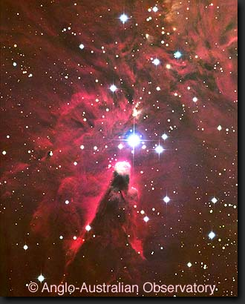
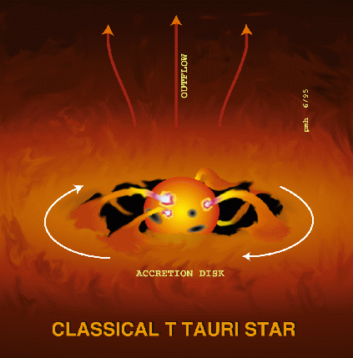
Recognising young stars
They will be surrounded by warm gas and dust, which gives off infra-red radiation
They may emit jets of material (bipolar outflows)
They are unstable, and hence
may have variable light output
They are located above and to
the right
of the main
sequence
(they are
large and
cool)

Slide 5
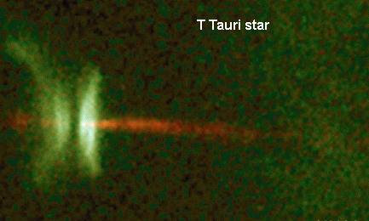
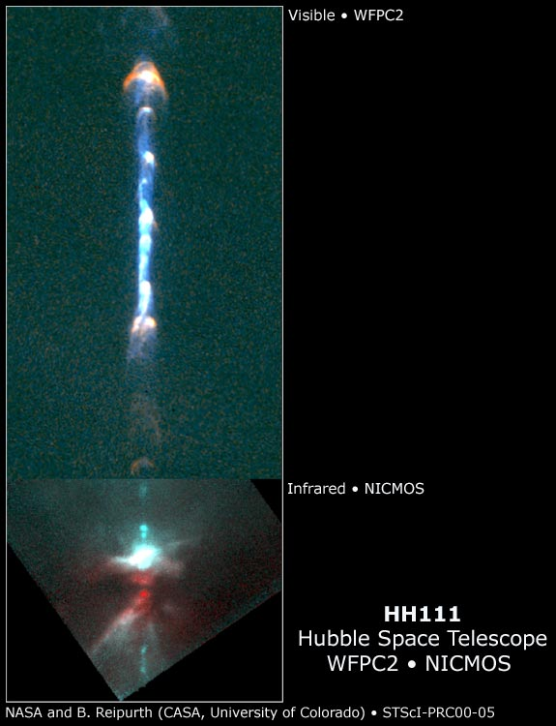
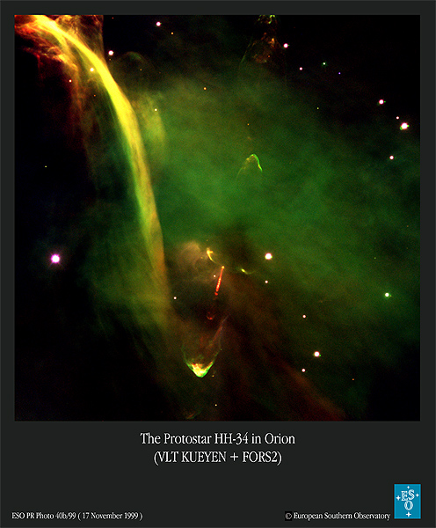
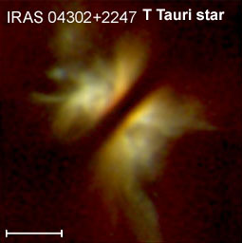
Young stars and jets

Slide 6
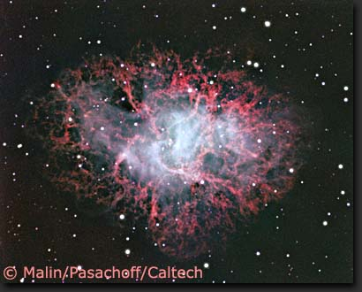
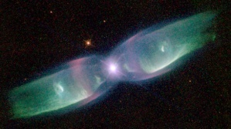
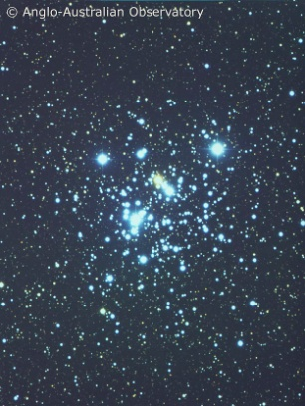
Galactic recycling
Supernovae and planetary nebulae replenish interstellar gas
  enriched with heavy elements from fusion
Very low mass stars are landfill!
  lifetime >> age of universe

Slide 7
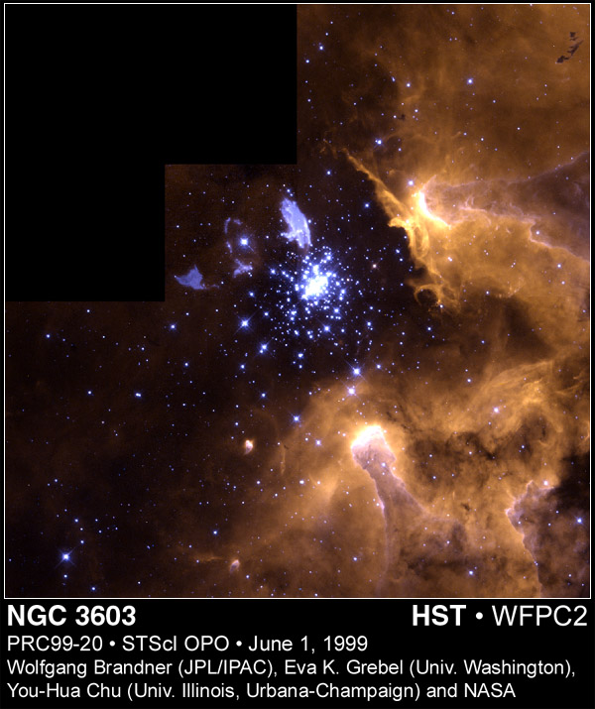
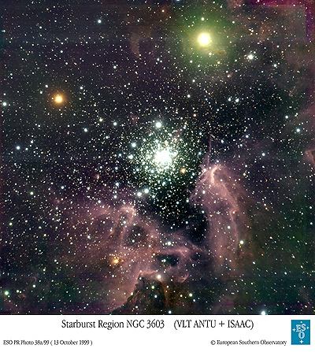
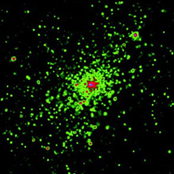
A star formation region
infra-red
X-ray (Chandra)
visible

Slide 8

Star formation in action: NGC3603
IR reveals a second, younger
cluster
Dark, opaque Bok globules of cold dense gas
Gas pillars caused by the presence of a dense clump of gas at the tip
A massive protoplanetary disc around a newly formed massive star
A young cluster of massive blue stars
An evolved blue supergiant, probably about to explode as a supernova

Slide 9
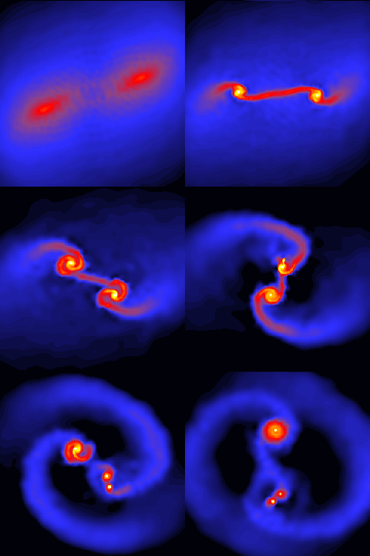
Binary systems
Most stars are members of binary or multiple systems
  of 30 nearest stars, 12 are in binary systems and 6 in triples
How does this happen?
  clouds spin faster as they collapse
    above critical speed cloud will break up into smaller clumps
    these clumps form individual stars, still gravitationally bound together (since clump was)
  picture shows simulation which produced triple system
Matthew Bate, U. of Exeter

Slide 10
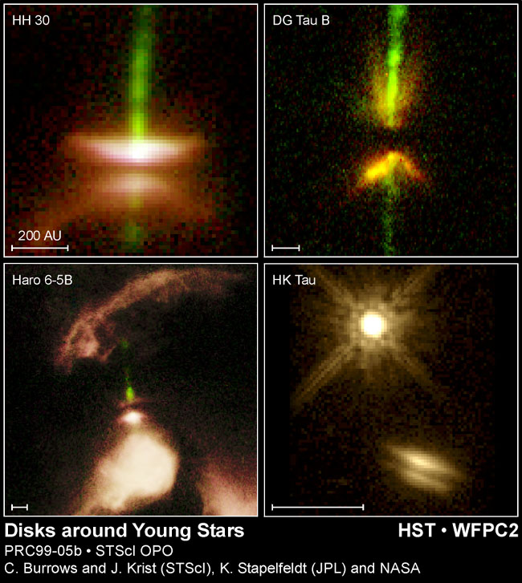
Planetary systems
Many young stars are seen to be surrounded by dusty discs (“protoplanetary discs” or “proplyds”)
  the Solar System is believed to have developed from such a disc
  dust grains clump together to form larger objects, eventually planets
Planetary systems common?

Slide 11
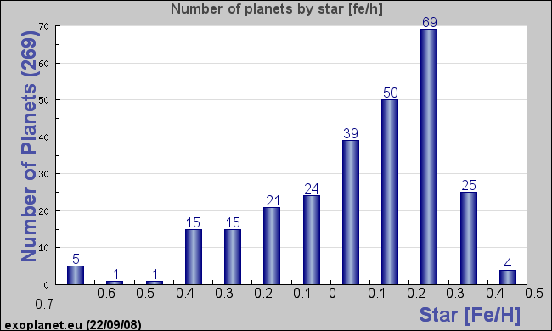
Recycling and planets
Many extrasolar planets have now been discovered (see later)
Heavy element content of stars with planets systematically higher than typical sample, though some low-heavy-element stars do have planets
  not surprising if planets
  form from build-up of dust
  grains into rocky bodies
  implies planets commoner
  around second-generation
  stars formed from enriched
  material
  indeed, no planets seen in
  transit search in globular
  cluster 47 Tucanae
average for nearby stars
heavy element content relative to Sun

Slide 12
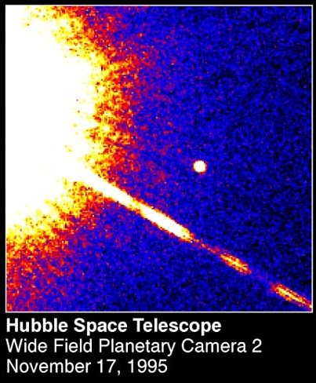
Brown dwarfs
Stars must have masses at least 8% of the Sun’s
  otherwise fusion never starts (not hot enough)
Jupiter is only 0.1% of Sun’s mass
Between the two are sub-stellar brown dwarfs
  in theory brown dwarfs form “like stars”, not “like planets”
  observationally hard to define boundary!
first brown dwarf seen: Gliese 229B

Slide 13
What have we learned?
Star formation is an ongoing process
  many of the bright stars we see are much younger than the Sun
Stars form when a clump of dense, cool gas collapses under gravity
  rapidly rotating clouds may fragment to produce binary systems
  heavy-element-rich clouds yield stars with planets
Supernovae and planetary nebulae recycle material to the interstellar gas
  this is enriched in heavy elements
  shocks from supernovae may also encourage stars to form
Where is all this happening?
  only in certain regions of our Galaxy
  …next lecture!

