Slide 1
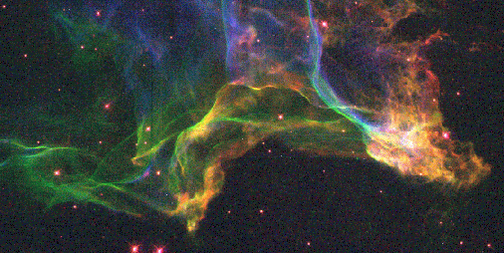
A planet-building universe
production
dissemination
The top ten elements:
Note that the most common elements in your body all occur in the top ten, formed by a variety of mechanisms (most obvious absentees are calcium and phosphorus)

Slide 2
A planet-building universe
Massive stars produce heavy elements
and disseminate them into interstellar medium via planetary nebulae and supernovae
Heavy elements in cool gas tend to clump together to form small dust grains
reason for opacity of gas clouds in Milky Way
Theory and observation (cratering record) suggest planets of solar system formed by accretion
dust grains collide and stick to form successively larger bodies
probably fairly easy process if stars form from dust-rich material

Slide 3
Detection of extrasolar planets
Over 850 planets have now been observed around other stars
how are they detected?
what do they look like?
what do they tell us?
How do planets form?
Are planets common?
Is our system typical?
Are Earth-like planets common?

Slide 4
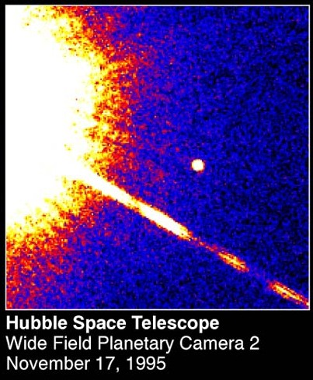
First, find your planet...
Can we observe planets directly?
hardly ever with current technology (but...)
planets too faint compared with their star
this brown dwarf is just visible - and its star is a red dwarf
this suspected planet is orbiting a brown dwarf
planets shine by reflected light
the brighter the planet, the closer it must be to its star

Slide 5
Finding invisible planets
Gravitational force is mutual: planet pulls on star as much as star on planet
star must move around system centre of mass
it changes position on the sky
it moves along line of sight
problem: star is much more massive than planet
so won’t move much, or very quickly
Example: Sun and Jupiter
Sun weighs 1000x Jupiter
Radius of Jupiter’s orbit around centre of mass: 5.2 AU
Radius of Sun’s orbit: 0.0052 AU
Radius of Sun: 0.0047 AU
From nearest star, Sun’s motion like 1p piece seen from 600 km away!
Orbital velocity of Jupiter: 13 km/s
Orbital velocity of Sun: 13 m/s
wavelength shift of 1 in 20 million!

Slide 6
Method 1: astrometry
Look for star moving across sky
used to detect presence of Sirius B (white dwarf)
need nearby star
to detect motion
need massive planet far from star
maximise size of star’s orbit
long period: need long series of observations
Only one or two detections

Slide 7
Method 2: Doppler shift
Look for periodic shift in star’s spectrum
does not depend on distance of star
need massive planet near star
the closer the planet, the faster the orbital speed (of both planet and star)
need very good spectrum
measure Doppler shifts of <1 in 1000000
Most confirmed detections use this method
and it is used to confirm transit candidates

Slide 8
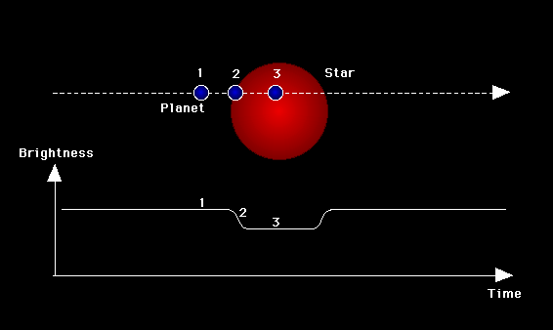
Problems….
Doppler shift only detects velocity along line of sight
can’t distinguish massive planet (or brown dwarf!) in tilted orbit from less massive planet in edge-on orbit
usually nothing to be done about this
might see planet move across face of star (transit)
can try astrometry

Slide 9
Method 3: transit
Observe small drop in light from star as planet passes across it
amount of drop indicates size (not mass) of planet
interval between transits gives period
needs confirmation by radial velocity measurements
otherwise could be grazing eclipse by stellar companion
Increasingly important technique

Slide 10
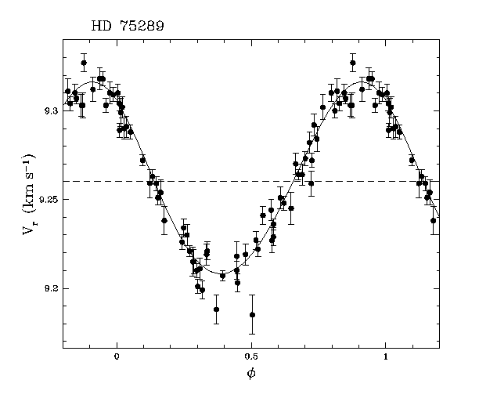
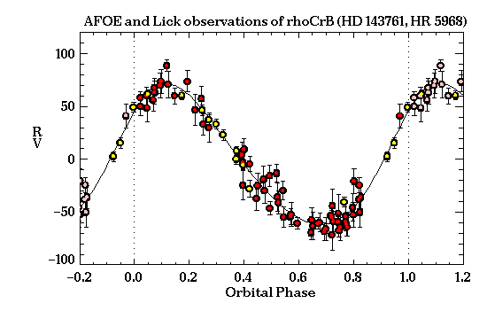
Some data….
Geneva Obs.
Transit of HD209458 (H-J Deeg)
Transit observations show that this planet has a radius about 1.5x Jupiter and a mass of 0.69x Jupiter.

Slide 11
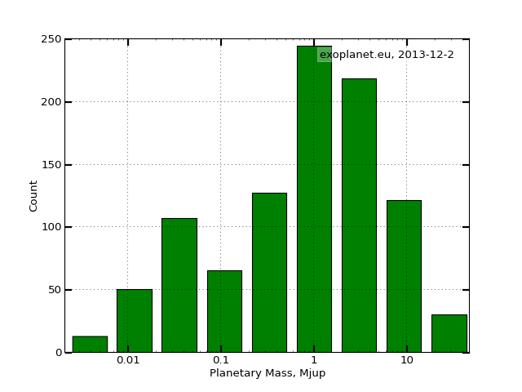
Known extrasolar planets
Massive (2 Earth - 30 Jupiter) and close to star (many <1 AU)
this is a selection effect (caused by detection method)
but does show that such planets exist!
most masses are minimum values
but 424 planets transit
25 found by gravitational lensing
44 directly imaged
some presumably brown dwarfs (>13 M_{J})
but surely not all (random orientation)

Slide 12
Known extrasolar planets
super-Earths
hot Jupiters

Slide 13
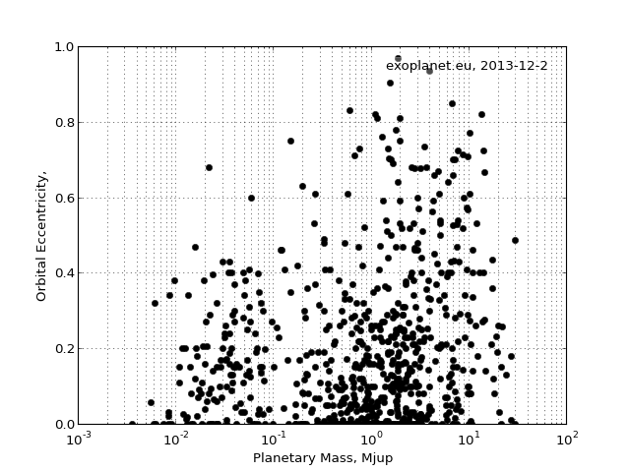
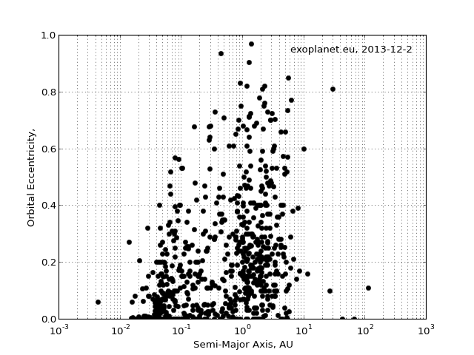
Orbits
Solar system planets in near-circular orbits
Binary stars (and brown dwarfs?) often in eccentric orbits
Many of these objects are in eccentric orbits
but no clear correlation with mass
no evidence for two distinct types of body

Slide 14
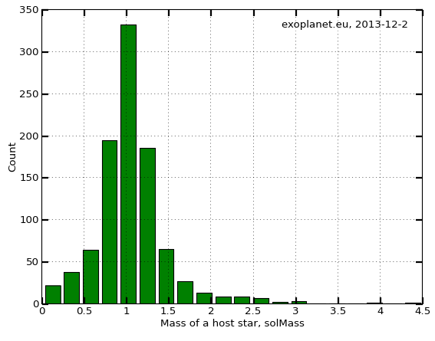
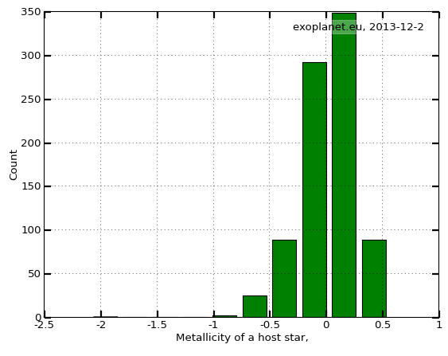
Parent stars
High in heavy elements (usually >Sun)
reasonable: planets form from dust
Roughly solar type (F7 - K2)
probably some selection bias: there are a few low mass stars
ultra-accurate spectroscopy difficult in cool stars because of complex spectra
Gaussian fit to nearby F and G class stars

Slide 15
What are these planets?
Solar system has small rocky planets close to star, large gas giants further away
no experience of large planets close to star
generally assume these are gas giants, but direct evidence only for transiting planets
Mars by HST
Voyager

Slide 16
How are they formed?
Our theory for solar system:
stellar wind from young Sun blows volatiles outwards
“snowstorm” at 5 AU where water-ice solidifies
fast accretion of large icy planet (~10 M_{Earth}) which then collects H/He atmosphere
gas giants Jupiter, Saturn just outside “snow line”
small rocky planets inside
slowly accreting icy planets in outer system (Uranus, Neptune)
Extrasolar “hot Jupiters”:
do they form in situ?
looks impossible: too hot for ices, too little material for rock
do they form outside snow line and migrate?
planet forms in gas/dust disc around star
drag from remaining gas/dust causes it to spiral inwards
why does it stop?
why didn’t Jupiter do this?
current theory—it did, but moved back out owing to interaction with Saturn
see PHY106

Slide 17
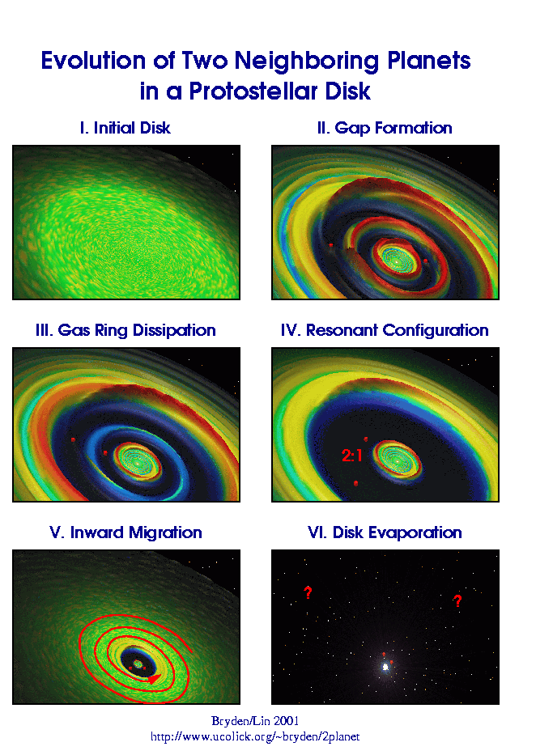
Formation of “hot Jupiters”
Movie by Willy Kley

Slide 18
What have we learned?
Using Doppler shift measurements we have detected planets round ~800 nearby stars
relatively massive planets close to stars, often in eccentric orbits
not what was expected
may arise when Jupiter-like planets migrate inwards after formation
mainly single planets
174 multi-planet systems containing up to 7 detected planets
solar system has only 1-2 detectable giant planets
What does this imply?
does not imply that such systems are typical
detection method is biased
does imply that they are possible!
does not imply that systems like ours are uncommon
Jupiter is barely detectable
but does not provide evidence that they are common!
No evidence yet for “other Earths”
...speculation next lecture!

