Slide 1
Why is the Night Sky Dark?
‘Cosmology’
  Studies of the universe as a whole…
Today…
  Brief history of ideas
  (Early Greeks → Big Bang)
  The expanding universe
  (Hubble, Relativity, density & destiny)
  An alternative theory:
  The ‘Steady State’ model

Slide 2
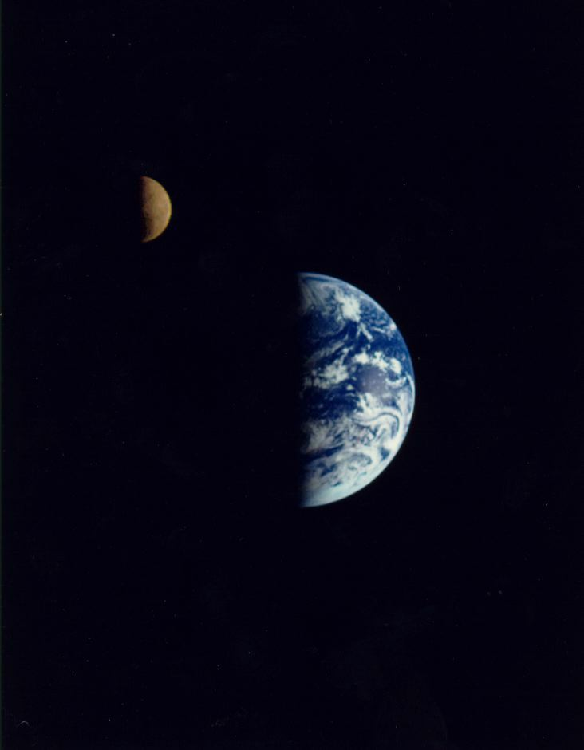
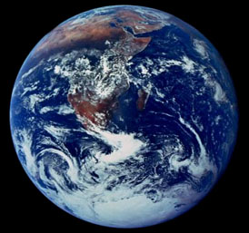
A brief history of Ideas…
Are we in a special place?
Early Greeks (BC)
  ‘Geocentric’ - Earth centred
Copernicus (1543 AD)
  ‘Heliocentric’ - Sun centred
Newton (1600s AD)
  Governed by law of gravity
Geocentric
Heliocentric
From Newton on (1600s → now)
  We’re NOT in a special place.
  The universe looks the same from everywhere and in all directions (‘Cosmological Principle’).
The Cosmological Principle

Slide 3

A brief history of Ideas…
Why is the night sky dark?
Olbers’ Paradox
Pre-1930’s the universe was widely thought to be infinite, eternal and static…
But if so…
‘Why is the night sky dark?’
  (Heinrich Olbers ~ 1800’s AD)
Expect:
  Sky as bright as surface of average star!
  Overall temperature of sky > 3000K!
Something is WRONG!

Slide 4
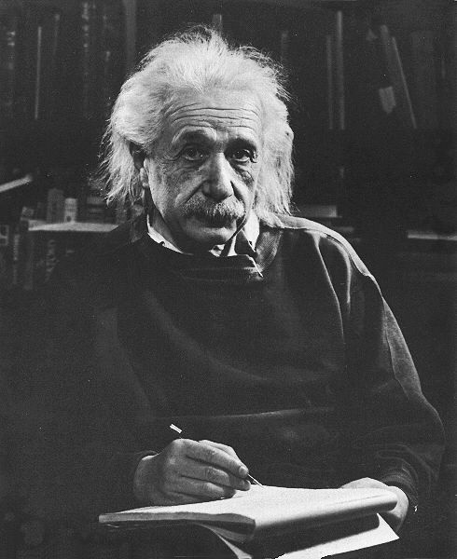
A brief history of Ideas…
Einstein’s Universe
Special & General Relativity
(Early 1900s)
  Revolutionary new descriptions of space, time, gravity and the universe.
Einstein’s model of the Universe assumed:
  The Cosmological Principle
  The universe is STATIC
He invented the cosmological constant (Λ) to allow static universe in General Relativity
  Note that he could have predicted expansion!
Λ

Slide 5
A brief history of Ideas…
Hubble’s Expanding Universe!
1929 -Edwin Hubble’s analysis of light spectra of distant galaxies revealed the universe is expanding…
  Doppler effect shows: Redshift ∝ Velocity
  Hubble’s Law:
  Velocity ∝ Distance
H + K
300 Mpc
Virgo
15,000 km/sec
430 Mpc
Ursa Major
22,000 km/sec
Einstein concedes: The universe IS expanding.
  The introduction of Λ was his “greatest blunder”!
Velocity (km/sec)
Hubble’s 1929 data
Distance (Mpc)

Slide 6
A brief history of Ideas…
Current Thinking: The Big Bang
The universe is expanding &
cooling after an initial ‘explosion’
~14 billion years ago.
T = 0
Now
Very hot
~ 3K
‘Inflation’
  Particle/photon Soup
  ‘Nucleosynthesis’
  Galaxy formation
  ‘Recombination’
Next lecture - ‘The 1st 400,000 years’

Slide 7

How does the Big Bang theory solve Olbers’ paradox?
Olbers’ paradox assumes the Universe is Infinite, Eternal and Static.
The Observable Universe
The Observable Universe
1. The Big Bang universe is NOT eternal.
  So the observable universe is not infinite.
2. The Big Bang universe is NOT static.
  Light from distant objects cools as the universe expands

Slide 8
The Expanding Universe
Hubble’s findings revisited.
Modern measurements of distant galaxies confirm Hubble’s findings
  Hubble’s Law: V = H₀×D
  H₀ = Hubble’s Constant
  Recent estimates: H₀ ~ 70 km.s⁻¹.Mpc⁻¹
1996 type 1 SNe
Does Hubble’s law go against the cosmological principle?
  No - the appearance of everything receding from US would be the same anywhere..

Slide 9
The expanding universe…
The age of the universe
Hubble’s law can be used to calculate the age of the universe:
  If expansion (V) is constant:
  Age = D₀/V
  = 1/H₀
  If H₀ ~70 km.s⁻¹.Mpc⁻¹
  Age ~ 14 billion years
D₀
V=H₀D₀
Separation of galaxies (D)
Age is less if expansion is slowed by gravity
  With Λ=0, would expect
  age ~ 9 billion years
  (With Λ>0, age goes back to
  ~ 14 billion years – see later)
Expansion
slowed by gravity
now
age
age
Time (t)

Slide 10
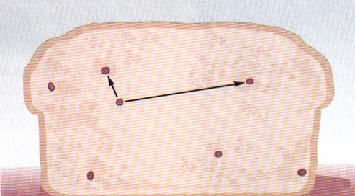
The expanding universe…
What does the expansion look like?
Raisins in bread
analogy
Not like a normal explosion
Not IN a particular place AT a particular time.
  Big bang thought to be the beginning of time itself.
  Expansion OF space not WITHIN space.
Hard (very hard) to visualise.
Surface of balloon analogy

Slide 11
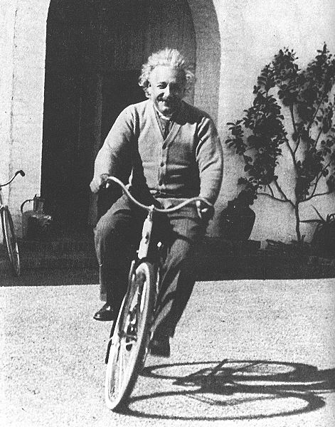
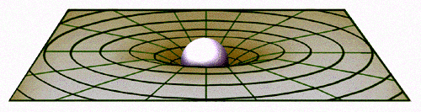
The expanding universe…
Einstein’s Relativity
Concerns motion, space, time & the speed of light.
Special Relativity (1905)…
  The speed of light (c) is always constant (3×10⁸ m s⁻¹)
  Nothing can go faster than c.
  Space & time are not independent.
  Mass & energy are related: E = mc²
SPACE-TIME
General Relativity (1915)…
Concerns motion, space-time,
gravity and mass.
  Mass WARPS Space-time.
  Warping perceived as gravity

Slide 12
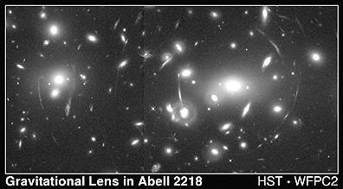
The expanding universe…
Evidence for General Relativity
General Relativity predicts light is bent by massive objects
‘Gravitational Lensing’

Slide 13
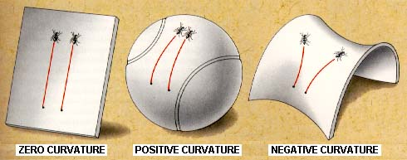
The expanding universe…
Curvature of the Universe
General relativity says:
  Space-time in the universe is CURVED!
  Curvature depends on mass density (ρ).
If
ρ = ρ_{c}
ρ > ρ_{c}
ρ < ρ_{c}
‘Critical
Density’
ρ_{c} =
‘Flat’ ‘Closed’ ‘Open’
Size of the Universe
Infinite Finite Infinite

Slide 14
The expanding universe…
What about the future?
But...
BEWARE OF THE COSMOLOGICAL CONSTANT!
(See later!)
Fate of the universe is dependent on density (ρ) & critical density (ρ_{c})
Density is Destiny!
In simple models (Λ=0):
  If ρ < ρ_{c}: (Open Universe)
  Universe will expand forever
ρ=0
ρ < ρ_{c}
ρ = ρ_{c}
  If ρ = ρ_{c}: (Flat universe)
  Expansion decelerates towards zero
Separation of galaxies (D)
  If ρ > ρ_{c}: (Closed Universe)
  Universe will eventually
  collapse (the Big Crunch!)
ρ > ρ_{c}
Time (t)
  Which is it? 3rd lecture - ‘Vital Statistics of the Universe’

Slide 15
Summary so far…
Brief history of ideas..
  The Cosmological Principle: The universe looks the same in all directions and in any location.
  Olbers’ Paradox: If the universe is infinite, eternal and static - ‘Why is the night sky dark?’
  Now believe the universe is in a state of expansion and cooling after an initial ‘Big Bang’ ~14 billion years ago.

Slide 16
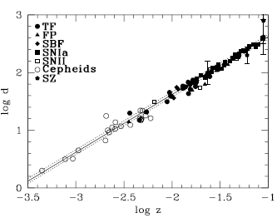
Summary so far…
The expanding universe:
  Distant objects are receding
  according to Hubble’s law (V=H₀D).
  The Big Bang is not like a normal explosion.
    Expansion OF (not WITHIN) space
    Big bang = beginning of time
  Einstein’s Relativity describes
  gravity, space, time and the structure of the universe.
  The Age and Fate of the universe dependant on density (ρ)

Slide 17
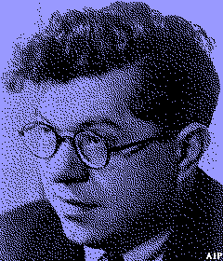

An alternative model?
The Steady State Model
So far we know…
  Distant objects receding according to Hubble’s Law
  Structure of universe described by General Relativity.
Is the Big Bang the only Model that fits?
Fred Hoyle (1915-2001)
The Steady State Model…
  There was no big bang
  The universe has always looked same as it does now.
  It is infinite but expanding
  Mass is created as space expands
new mass

Slide 18

An alternative model?
The Steady State Model
Does the Steady State model also solve Olbers’ Paradox?
  Yes… Light is cooled by expansion
Big Bang or Steady State?
  Any evidence for change over time?
  Any evidence for hot beginnings?
3rd lecture - ‘Vital statistics of the Universe’

