Slide 1

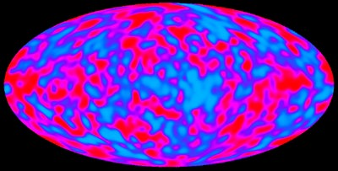
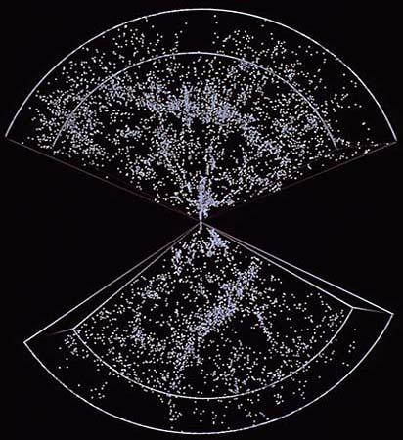
Vital Statistics of the Universe
  Today…
  Observational evidence for the Big Bang
  Vital statistics of the Universe
    Hubble’s Constant (H₀)
    Curvature (k)
    Density (Ω)
  How will it all end?
  (Expand forever - or collapse?)
Ho
Λ
Ω
K

Slide 2
The Big Bang so far…
The universe is expanding & cooling after an initial ‘explosion’ ~14 billion years ago.
T = 0
380,000 years
Now
The CMB…
Very hot
~ 3K
‘Inflation’
  Matter
  ‘Freeze-out’
  ‘Recombination’
  Structure
  formation
  Particle/photon Soup
  ‘Nucleosynthesis’

Slide 3
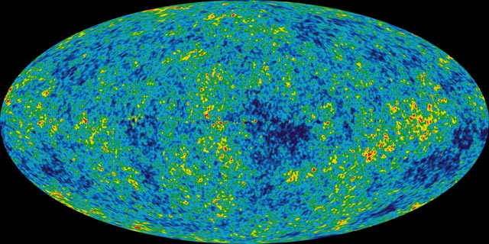
Evidence for the Big Bang
1996 type 1 SNe
Hubble’s Law
  V = H₀×D (H₀=Hubble’s Constant)
  Evidence for expanding universe
  (not specifically for Big Bang)
The Cosmic Microwave Background
  Photons from ‘recombination’ at T= 380,000 yrs
  Evidence for a HOT beginning

Slide 4
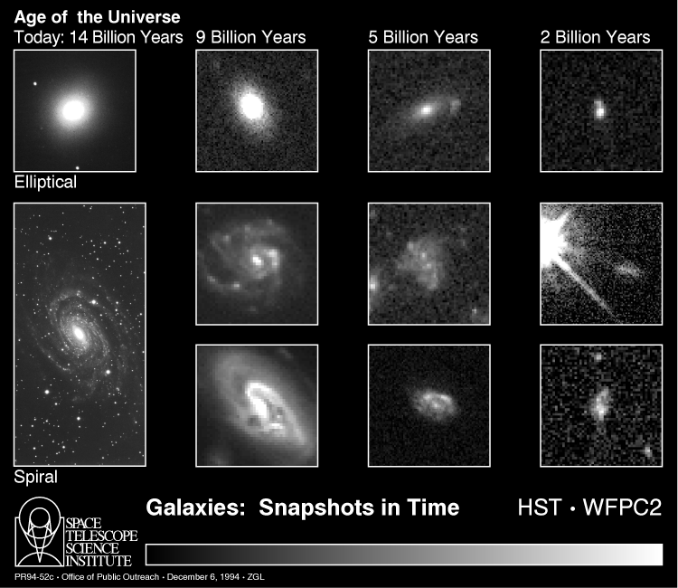
Evidence for the Big Bang
The evolution of galaxies
  Distant (older) galaxies look different from those nearby.
    Older galaxies generally smaller, more irregular & more interacting
    More active galaxies
  Evidence for changing, non-eternal universe.
Earlier lecture ‘Evolution of Galaxies’

Slide 5
Evidence for the Big Bang…
The abundance of elements
Big Bang Nucleosynthesis predicts:
  Mostly Hydrogen & ⁴Helium formed - with much smaller quantities of heavier elements.
p
n
²H
p
³He
  Relative abundance of ⁴Helium to Hydrogen predicted to be 25% (by mass) of total.
    Dependent on ratio of proton to neutrons at the time of nucleosynthesis (~7:1)
  Levels of ²H, ³He and ⁷Li also predicted.
n
⁴He
+³He
(Rare)
⁹Be
⁶Li
⁷Li
  Theory makes clear predictions based on ‘well understood physics
⁴He
²H
³He
¹H
A=8
A=5

Slide 6
Evidence for the Big Bang…
The abundance of elements
Observations…
Observed value
Predicted values
  (Current abundances dependent on density of ordinary matter at nucleosynthesis - & therefore density now).
1
He
~25%
‘Allowed’
density
10⁻³
  Observations agree VERY WELL with predictions
  More STRONG evidence for Hot Big Bang
D
Element Abundance (Relative to Hydrogen)
10⁻⁶
Li
  (Allowed ‘baryon’ density also of great interest for later studies of ‘Dark Matter’)
10⁻⁹
0.005
0.01
0.02
Baryon (normal matter) density (% of ρ_{c})

Slide 7
Evidence for the Big Bang…
Summary…
  Overall…
  Plenty of evidence FOR the Big Bang…
  Nothing directly AGAINST.

Slide 8
Vital statistics of the universe
Parameters needed to describe the state (& predict the fate) of the Universe :
The fate of the universe…
Big Yawn
Ω=<1, k=-ve
  Hubble’s constant (H₀)
Ω=1, k=0
Size of observable universe
?
  Density (ρ or Ω)
  • Ω = density/critical density = ρ/ρ_{c}
  Curvature (k)
  • (For ‘flat’ universe k = 0).
Ho
Big Crunch
Now…
Ω>1, k=+ve
Time (t)
Cosmological
Constant
Einstein’s General Relativity says how it all fits together.
…
Hubble’s
Constant
Density term
Curvature term

Slide 9
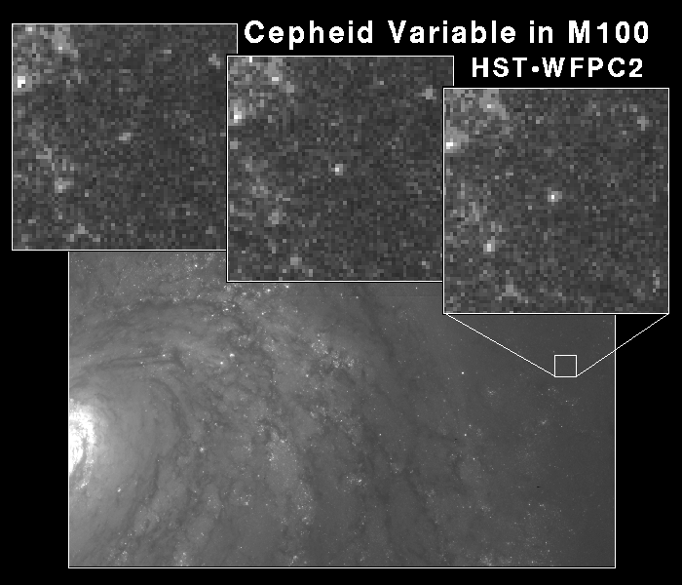
Vital statistics of the universe…
Measurement of Hubble’s constant
Many ways to do this
  redshift easy: distance challenging
  need long distances
  (>300 Mlyr or so)
Recent results:
  73±2±4 km s⁻¹ Mpc⁻¹
  (compilation, 2010)
  69.8±1.5 km s⁻¹ Mpc⁻¹
  (WMAP + galaxy surveys)
Type 1
Supernovae
Study
HST Cepheid
Variable study

Slide 10
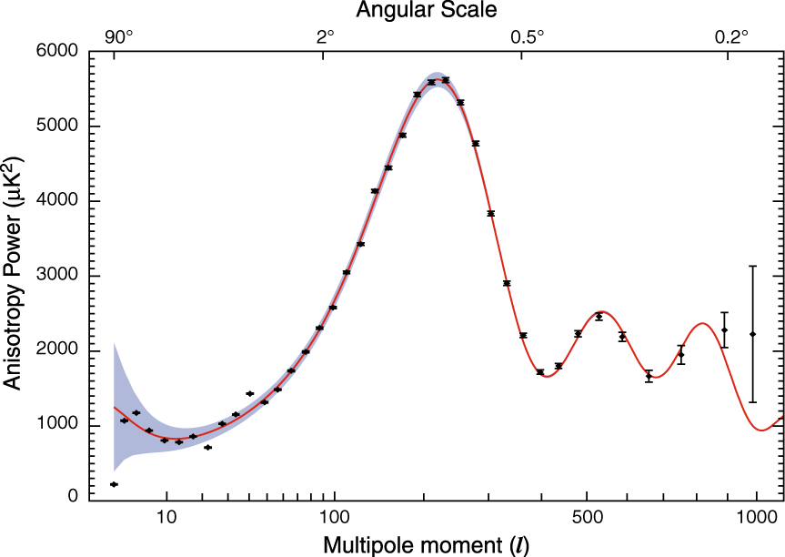
Vital statistics of the universe…
Measurements of curvature
  Curvature (k)
  Is dependent on total density Ω.
  Inflation predicts universe is FLAT! (i.e. k = 0).
  Curvature can be determined
  through analysis of the ripples
  in the CMB
Position gives:
k = 0 (Flat!)
(Also H = 70±2 km/s/Mpc)

Slide 11
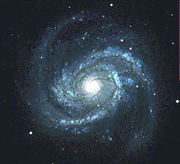
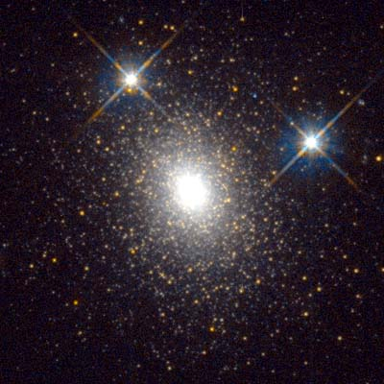
Vital statistics of the universe…
Measurements of density (1)
  1) Contribution of stars
  Add up the masses of all stars…
  Density (Ω)
  Ω = density/critical density
  = ρ/ρ_{c}
  ρ_{c} ~ 10⁻²⁶ kg.m⁻³
  ~ 6 H atoms per m³!
There are many different ways of determining the density of the universe…
Ω_{stars} ~ 0.005
~0.5% of what is needed to make a flat universe!

Slide 12
Vital statistics of the universe…
Measurements of density (2)
  2) Contribution of galaxies
  Over 90% of the total mass of galaxies is in the form of a ‘Dark Matter’ Halo
Dark Matter
Luminous matter
Luminous matter
R
NGC6503
Halo
Ω_{galaxies} ~ 0.1
  ‘Rotation curves’ tell us about distribution & amount of mass in galaxies
Disc
< 10% of what is needed to make a flat universe!
Gas

Slide 13
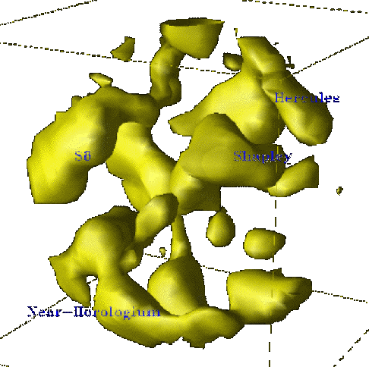
Vital statistics of the universe…
Measurements of density (3)
  3) Contribution of clusters
  B) ‘Bulk flow’ study…
  Using redshift to look at motion of large scale structures…
  A) Gravitational lensing study…
Images of galaxies warped by central mass
‘PSCz’ Infrared Experiment
Ω_{clusters} ~ 0.25
Ω_{bulkflow} ≥ 0.25
Velocity survey
At largest scales we see ~25% of what is needed to make a flat universe.
More dark matter!
Mass distribution implied by warping
Large scale structures

Slide 14
Vital statistics of the universe…
Ω - how it all adds up…
Results so far…
  Results so far…
  Inflation theory and CMB observations indicate:
    The universe is FLAT
    (ie. Ω_{total} = 1)
  ~25% of the mass needed is seen in observations of largest structures
Prediction of Inflation
Flat universe
1
CMB ripples
Bulk
Flow
Galaxy Clusters
0.1
Ω
Galaxy: All Mass
Dark Matter
  BUT - the majority (>90%) of the mass in the universe is some form(s) of non-luminous and unknown DARK MATTER…
0.01
Galaxy: Stars
0.001
  Is this enough to
  understand the fate of
  the universe?
0.0001
0.01
1
100
10000
Scale (Mpc)

Slide 15
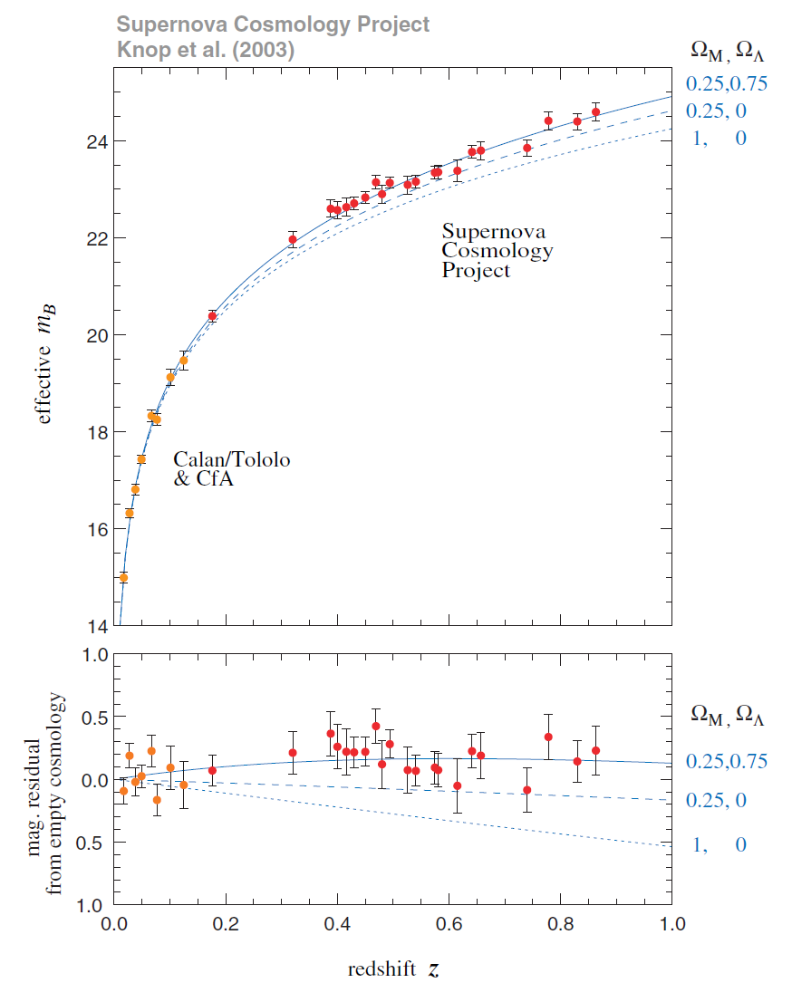
Vital statistics of the universe…
A new twist?
1999 - Type 1a supernovae studies of Hubble’s law at large distances…
  Expected: The expansion rate to have decreased due to pull of gravity.
= 0
= 1
= 2
  Found: The expansion rate has increased!
  The expansion of the Universe is accelerating!

Slide 16
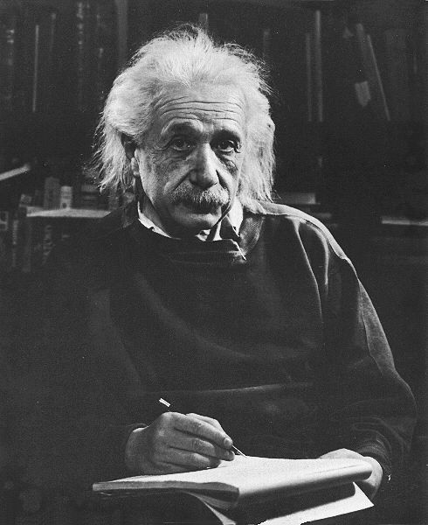
Vital statistics of the universe…
A new twist?
What is causing this accelerating expansion?
  Some kind of ‘Vacuum energy’
  that OPPOSES pull of gravity?
The Cosmological
Constant is back!
Λ
Λ
Also known as:
  ‘DARK ENERGY’
1
Prediction of Inflation
Ω_{Λ}
  Because it is energy it also
  contributes to the universe’s
  total mass (or density)
All Matter
0.1
Galaxies
Ω
Dark Matter
0.01
  Ω_{total} = Ω _{matter} + Ω_{Λ}
Stars
0.001
  1 0.3 0.7
Scale (Mpc)

Slide 17
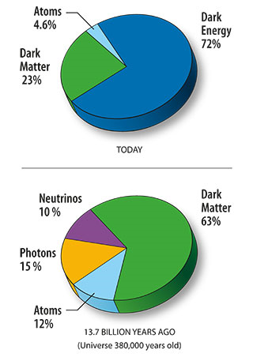
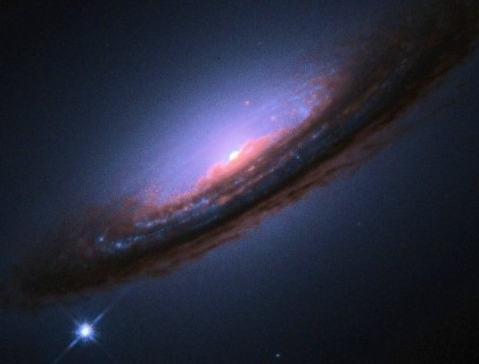
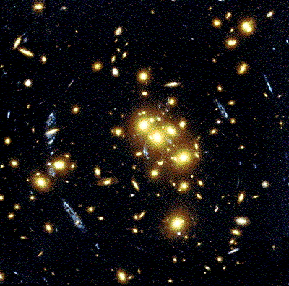
Recipe for the Universe
of which only 1/10 stars!
From WMAP data + galaxy
clusters, supernovae etc.

Slide 18
How will it all end?
The fate of the universe…
How does Λ affect the fate of the universe?
= 1
(Flat)
With Λ
  Even though universe is nearly flat - it will continue to EXPAND FOREVER…
  …at an EVER-INCREASING rate
Separation of galaxies (D)
Without Λ
Time (t)
What is
DARK ENERGY (Λ)?
What is
DARK MATTER?
But…
And…

Slide 19
Summary
Evidence for the Big Bang (as against alternative models) includes:
  The Cosmic Microwave Background.
  The evolution of galaxies.
  The abundance of elements.
Recent evidence indicates:
  A positive cosmological constant (Λ) is causing the expansion of the universe to increase.
  The fate of the universe is to continue to expand and cool forever……
Vital statistics of the universe:
  Ho = 73±5 km.s⁻¹Mpc⁻¹
  Curvature = 0 (FLAT)
  Matter Density = 0.3 × ρ_{c}
  ~98% of the mass of the universe is dark
  ~85% is exotic ‘Dark Matter’

