Slide 1
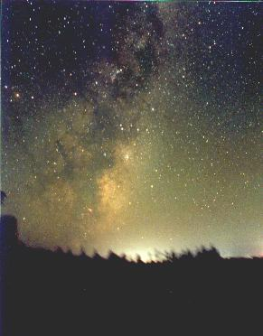
The Milky Way
From a dark site the Milky Way can be seen as a broad band across the sky
  What is it?
    telescopes resolve it into many faint (i.e. distant) stars
  What does it tell us?
    that we live in a spiral galaxy
  How does it relate to the Solar System?
Milky Way from New Zealand
Photo by Chris Picking

Slide 2
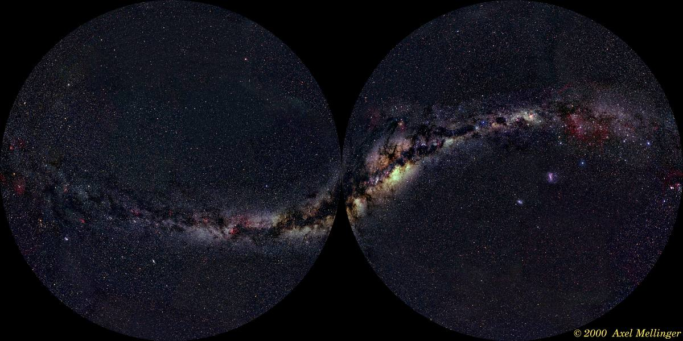
A band or a disc?
If the Milky
Way forms a
band around
the night sky
  plausible
  explanation
  is that we
  are inside
  a disc-shaped collection of stars
  see many more stars looking in plane of disc
see few stars
see many stars

Slide 3
Where are we?
The Milky Way band cuts the sky in half
  the Sun is very near the mid-plane of the disc
The system of globular clusters centres about 25000 l.y. from the Sun
  distances determined from HR diagram
  this is the centre of the Milky Way
  we are a long way from
  the centre (but nowhere
  near the edge)

Slide 4
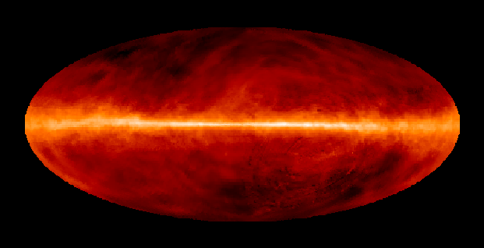
The disc and the halo
Open clusters are found close to the Milky Way on the sky
  they belong to the disc
Globular clusters aren’t
  they form a spherical “halo” around the disc
Hydrogen gas is very concentrated in the mid-plane of the disc
  new star formation confined to disc
The disc contains younger stars than the halo

Slide 5
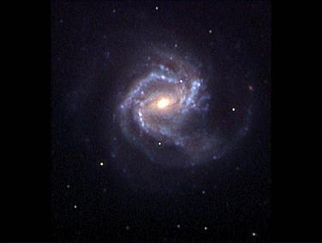
The dynamic Milky Way
The Sun orbits the Galactic centre at about 200 km/s
Other disc stars near the Sun are moving at only ~20 km/s relative to the Sun
The whole disc must be rotating
  although stars further out take longer to complete each circuit
Globular clusters move fast relative to the Sun
  they orbit in random directions
M61: photo by Jack Newton

Slide 6
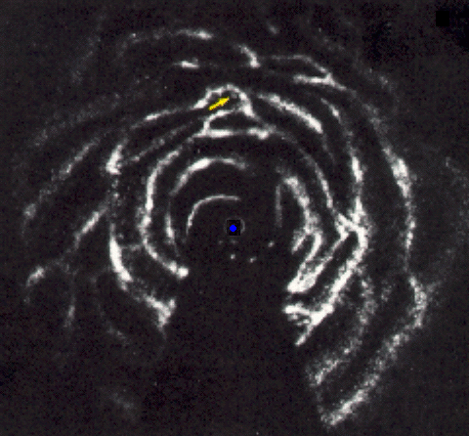
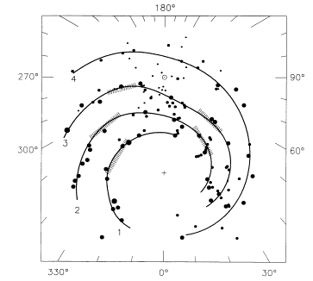
Mapping the Milky Way
We can use the rotation of the disc to map the Milky Way in hydrogen gas
  neutral hydrogen emits a radio spectral line at 21 cm
  orbital motion produces Doppler shift
  use geometry to work out location of cloud
The Milky Way appears to be a rather untidy spiral
  similar results from mapping the ionised hydrogen associated with hot (massive, young) stars
region
not observable

Slide 7
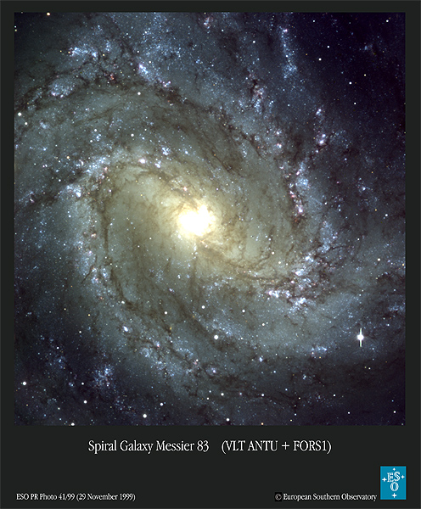
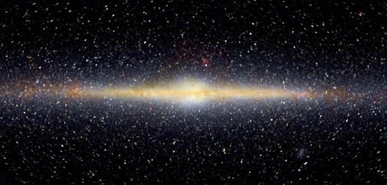
Stellar populations
The Milky Way thus has at least four distinct populations of stars:
  the spiral arms
    young objects, including massive blue stars
    rotating system, second generation (high in heavy elements)
  the rest of the disc
    including the Sun; wide age range
    rotating, high in heavy elements
  the halo
    including the globular clusters
    non-rotating, low in heavy elements, old
  the central bulge
    of old stars, seen in infra-red light
    which penetrates the dust
    slowly rotating, high in heavy elements
    (with wide spread)

Slide 8
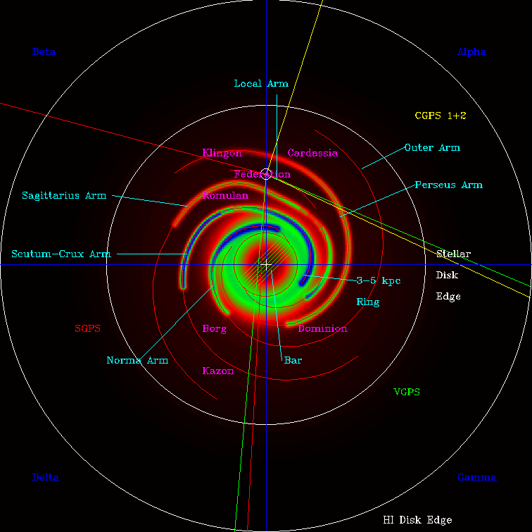
At home in the Milky Way
We saw that planetary systems prefer stars with high heavy element content
  planetary systems are only likely to be common in the disc and spiral arms
    possibly the bulge too
  we are more or less where we might expect to be!
    however, the Sun has higher than usual heavy element content for its age
    could planets as old as ours be rare?

Slide 9
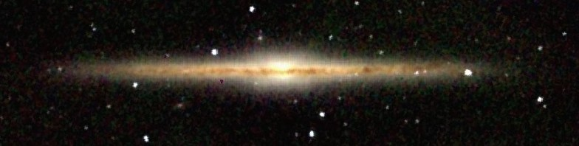
Our Galaxy and others
By looking in the infra-red
we can see through the dust
  the Milky Way looks
  remarkably like NGC891
By looking in radio we have
mapped out spiral arms
  the Milky Way resembles
  galaxies such as M61
The Milky Way is a typical large spiral galaxy
  (like the Sun, larger than most, but not a champion!)
our Galaxy in infra-red by COBE
NGC891 in infra-red by 2MASS
M61 by Jack Newton

Slide 10
What you see isn’t all you get: the dark side of the Milky Way
We can use Newton’s laws to analyse the Milky Way’s rotation
  it’s too fast!
    the gravitational force is more than we can account for by the masses of stars
  we need to assume that
  most of the Milky Way’s
  mass is dark matter
    as yet we do not know
    exactly what this is
    see seminar later
dark matter
bulge
disc

Slide 11
What do we know about the Milky Way?
It is disc shaped
  from its appearance in the night sky
It has a bulge of older stars, and is surrounded by a halo of globular clusters and other very old stars
  bulge from infra-red observations, globular clusters from visual
We are about 25000 l.y. from the centre
  from studying globular clusters
The disc rotates
  from Doppler shift studies of velocities of nearby stars and gas clouds
Gas is confined to the disc
  from radio studies
  therefore only old stars in bulge and halo
There are spiral arms
  from maps of neutral hydrogen and young stars
Most of the mass is dark
  from analysis of rotation curve

Slide 12
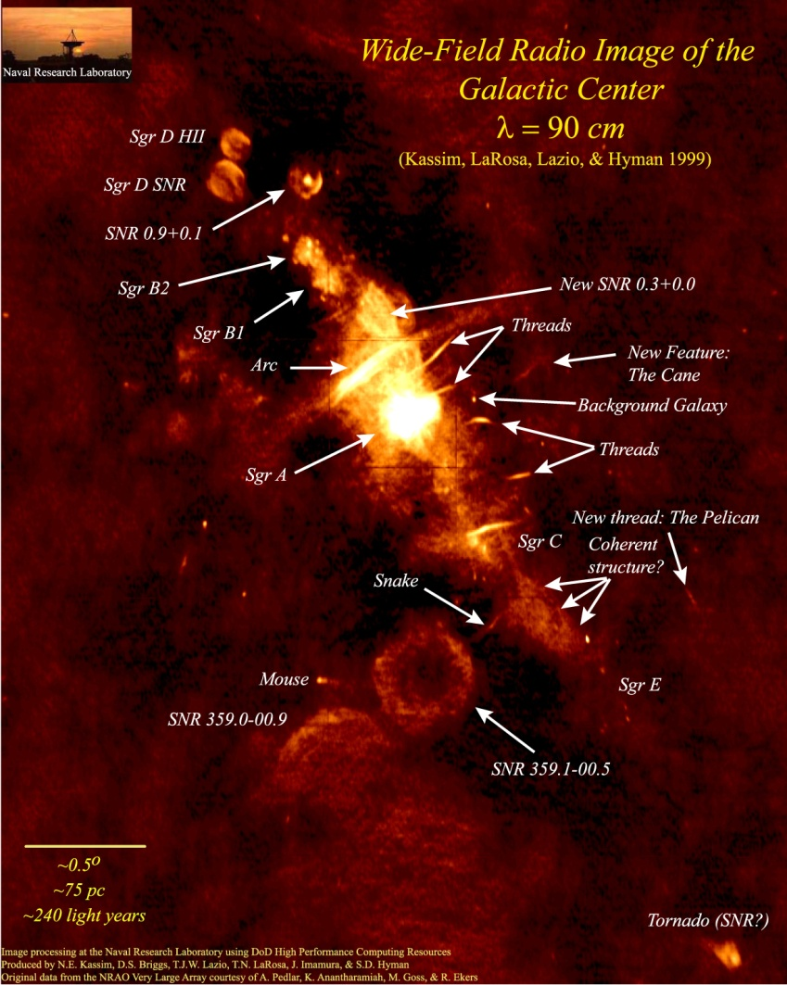
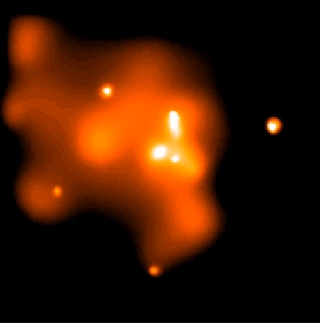
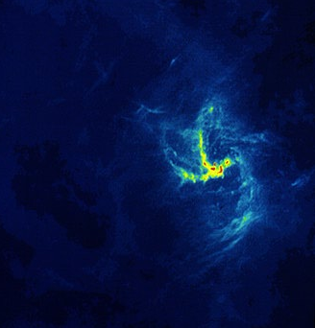
And finally… the Galactic centre
The centre of the Milky Way is not like the rest of the bulge
  it contains lots of gas
  it is a site of new star forma-tion and recent supernovae
  it is a strong radio source and an X-ray source

Slide 13
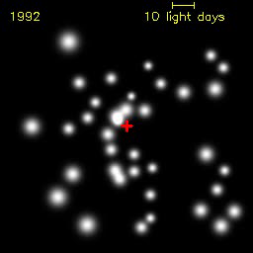
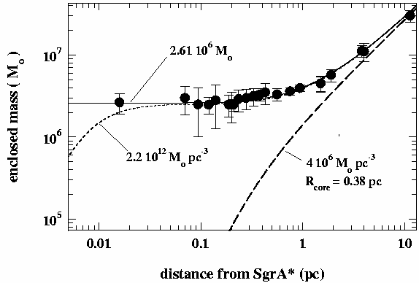
Heart of darkness?
Using infra-red we can observe stars within 1 l.y. of the centre of the Galaxy
  they move, visibly
  applying Newton’s laws we find that there must be a central mass of 3 million solar masses
movie from MPE Garching
  this is associated with the central radio source
  …almost certainly a
  massive black hole

