Slide 1

Planets and life
Successful detections of extrasolar giant planets suggests that planetary systems may be fairly common
  could we detect Earth-
  like planets?
  is it likely that such
  planets would have life?
  how would we know?

Slide 2
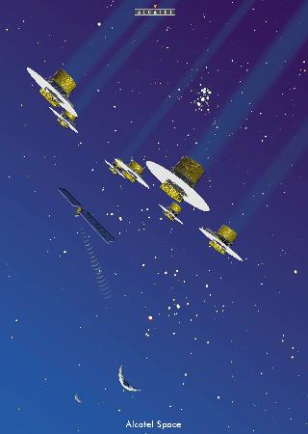

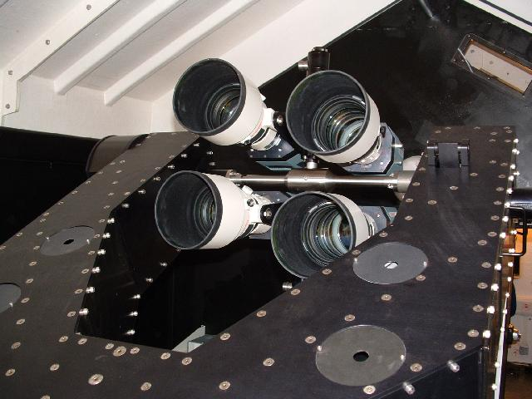
Detection of Earth-like planets
Doppler shift technique will not work
Two possible strategies
  transit detection
    WASP ground-based (now)
    CoRoT space-based (now)
    Kepler (NASA) within 5 years?
  direct imaging
    requires space-based interferometer
      multiple telescopes acting as one
    Darwin, TPF
    >10 years
One system of Earth-mass
planets has been found
  around a pulsar!
    not well understood, but
    clearly not really “Earth-like”

Slide 3
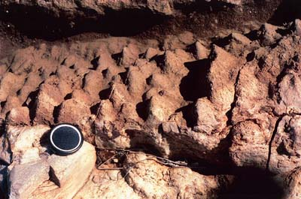
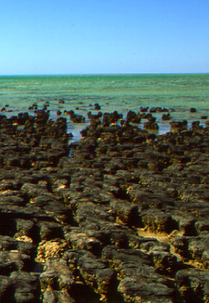
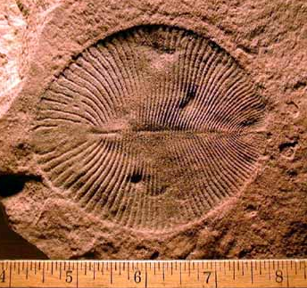
Life on Earth: the fossil record
Oldest rocks ~3.8 Gyr old
Oldest fossils ~3.5 Gyr
  bacteria
Oldest eukaryotes (nucleated cells) ~2 Gyr
  coincide with rise of atmospheric oxygen
Oldest multicellular organisms ~550 Myr
Early hominids ~5 Myr
Fossil stromatolites, W. Australia
Shark Bay
Dickinsonia, Vendian fossil

Slide 4

Life on Earth: implications
Life appears very quickly
  “easy” process?
but >80% of history of life consists of single-celled organisms
  becoming multicellular is “hard”?
  on the other hand, it evolved several times...
and intelligence appears only in last 0.001% of life’s timeline
  intelligence is “hard”?
Main elements used by life are very abundant
“Organic” (carbon-based) compounds form easily in “early-Earth” conditions
Route from there to DNA+protein organisms not well understood
  “RNA world” first?
Liquid water looks essential
Arguing from a single example is intrinsically unsafe — and there is clear selection bias (we exist!)

Slide 5
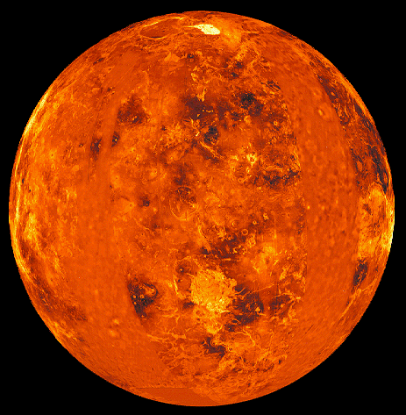
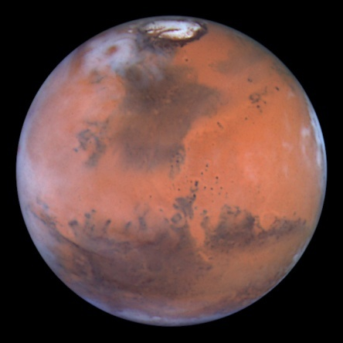
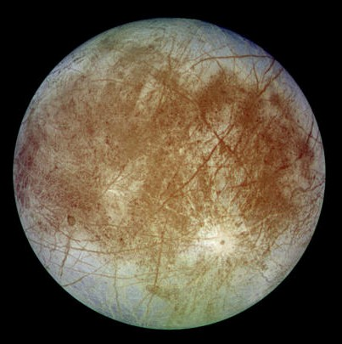
Life elsewhere: the solar system
L
Venus looks superficially very similar to Earth
  but runaway greenhouse effect
  leads to surface temperature
  of 745 K (472°C)
Mars is too small to keep its
atmosphere
  evidence for running water
  early in its history
  life might have evolved, but
  not complex life
    finding bacterial fossils would be major step: confirm that originating life is “easy”
Europa is heated by tidal forces
  icy crust probably overlies liquid water ocean
Magellan
HST
Galileo

Slide 6
Life elsewhere: other stars
Criteria for candidate stars:
  long enough lifetime
    life unlikely to evolve in 10-million-year lifetime of 10-solar-mass star
    star of 1.7 M_{sun} has 2 Gyr main sequence llfetime
      classes FGKM are OK
  high heavy element content
    evidence suggests this is required for planet formation
      not stars in halo
  stable star, stable orbits
      not close binary?
      not very low mass stars (often unstable flare stars)?
Many stars satisfy these criteria

Slide 7
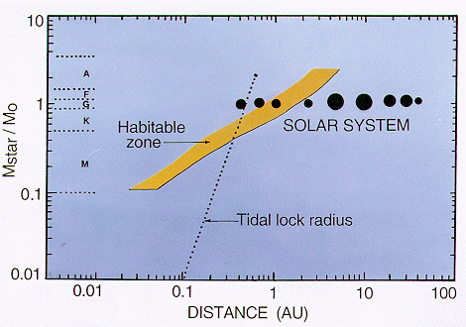
Habitable zones
Liquid water probably essential for life
  candidate planets must be in appropriate temperature range
  temperature basically determined by distance from star
  habitable zone
    should allow for
    stellar evolution
    continuously
    habitable zone
    also affected by
    size of planet
  problem for low mass
  stars: tidal locking
    planets face star
    extremes of
    temperature
J.F. Kasting et al.

Slide 8
Planets in habitable zones
Some observed extrasolar planets are in habitable zone
  remember these are (probably gas) giants
  remember detection method biased in favour of planets near stars
    certainly no
    evidence against
    habitable planets
    also possibility of
    rocky satellites of
    gas giants
    (Ganymede,
    Callisto and Titan
    are Mercury-sized)
Extrasolar planets
J.F. Kasting et al.

Slide 9
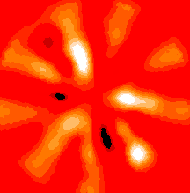
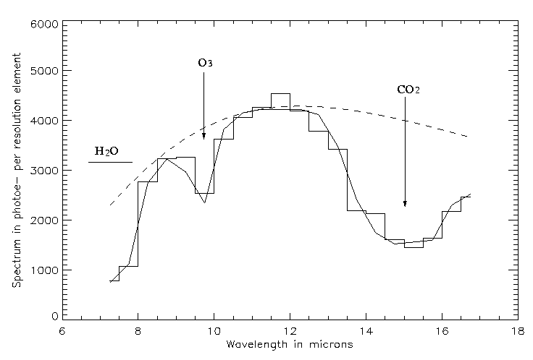
Signs of life
Oxygen is highly reactive
  not stable in atmosphere: maintained by plants
  earliest fossils already photosynthesising
    oxygen in atmosphere good indicator of life even in early stages
  spectroscopic detection
  possible
    in infra-red to reduce
    background from star
    good for 3-atom molecules
    detect CO₂ (atmosphere),
    H₂O (oceans), O₃ (life)
Simulated image and spectrum from DARWIN homepage

Slide 10


Life like us?
How probable is evolution of intelligent organisms with technological civilisation?
  Drake equation (Frank Drake, SETI pioneer)
    Number of communicating civilisations
    = rate of formation of suitable stars ☑
    x fraction of these stars with planets ☑
    x number of Earth-like planets per system ☑
    x fraction of such planets which develop life ☑
    x fraction of life-bearing planets evolving intelligence
    x fraction of intelligent species developing technology
    x average lifetime of such a civilisation
  information obtainable on factors marked ☑
    last three very difficult to estimate
    rough guess: assume 10 stars/year and all fractions = 0.1; then number of civilisations = average lifetime/10000
known
high?
?
high?
controversial
?
????

Slide 11
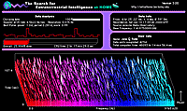
Search for Extra-Terrestrial Intelligence
Drake equation suggests other civilisations may exist
  only way to confirm this is direct detection
  obvious method of communication is radio
    galaxy fairly transparent to appropriate wavelengths
    travels at speed of light
    fairly easy to send and detect
  “radio” covers a wide wavelength range!
    need to guess appropriate wavelength
      21 cm? (hydrogen)
      microwaves? (cosmic background)
  would we recognise a signal?
    probably: information-carrying signal
    very different from natural sources
  would we be able to decode it?
    much more problematic
SETI@home: Berkeley programme using Arecibo telescope at 21 cm

Slide 12
What if….
Conversations with alien intelligence requires patience!
  disc of Milky Way is ~40000 light years in radius
    optimistically suppose 1000 civilisations
    nearest one, on average, 2000 light years away
      wait 4000 years for answer: not very practical…
      so, don’t converse, just send Encyclopaedia Britannica and assume they will too
      advantage: will also take 4000 years for their invasion fleet to get here…..
They’re not there because they’re not here?
  unmanned (unaliened?) probes could in principle colonise Galaxy
    fact that this has not happened suggests no advanced civilisations?
      advanced civilisations are all eco-warriors, robot probes environmentally unfriendly?

Slide 13
Conclusions
Evidence from history of life on Earth is that origin of life may be easy
  evidence of past existence of life on Mars would be strong confirmation of this
Basic criteria for stars “suitable” for life are not too difficult to satisfy
  detection of Earth-like planets around nearby stars possible on 10-20 year timescale
    spectroscopy could provide evidence for life on these planets
Other technological civilisations might exist
  probability depends on hard-to-estimate factors
  radio searches so far found nothing, but you never know…
    even if they do exist, United Federation of Planets probably precluded by large distances (at least on basis of current physics)

