Slide 1
Introduction: The Night Sky
What do we see in the night sky?
  the Moon
  moving planets
  occasional comets and meteors
  against a background of randomly scattered “fixed” stars and the band of the Milky Way
What do we see here on Earth?
  a rocky planet with oceans and an atmosphere
  life that has evolved for more than 3 billion years
What has this to do with the stars and the Milky Way?

Slide 2
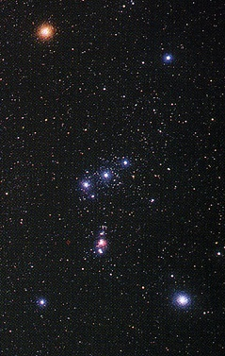
The Stars
What do we see?
  Stars have
  different
  brightnesses
  Stars have
  different
  colours
What would we like to
know?
  What are the stars made of?
  How far away are they?
  How do they live and die?
  How has this influenced life on Earth?
  How can we learn all this just from what we see in the night sky?
Betelgeuse
Rigel

Slide 3


How far away are the stars?
Earth moves (around Sun)
  see some stars move (against background)
  parallax
  distance of nearest stars
  = few light years
  (1 l.y. ≈ 10¹⁶ m)
    first measured: 61 Cygni (Bessel, 1838), 11 l.y.
    closest: α Centauri, 4 l.y.

Slide 4
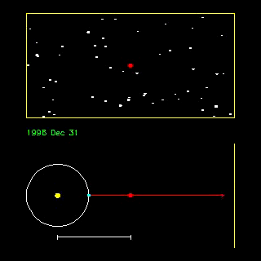

Measuring parallax
Nearby star seen against background of fainter stars
  motion reflects Earth’s orbit
  the closer the star, the greater the motion
  geometry gives distance
R. Pogge, Ohio State

Slide 5
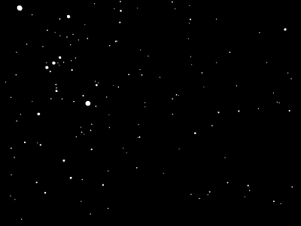
A parallax demo
Parallax was not observed until 1838 because the stars are so far away that the effect is small
But what if the stars
were much closer (or
Earth’s orbit much
larger)?
Animation shows
effect multiplied by
one million

Slide 6
How bright are the stars?
Are they all the same?
  No!
    the white stars Fomalhaut and Deneb appear almost equally bright, but Deneb
    is 1500 l.y. away whereas Fomalhaut is only 20 l.y. distant
Are they like the Sun?
  Sort of…
    almost all the familiar stars are much brighter
    almost all nearby (within 15 l.y.) stars are much fainter
×100

Slide 7
The magnitude scale
Astronomers measure brightness in magnitudes:
  larger magnitude = fainter star
  a difference of one magnitude corresponds to a factor of 2.5 in brightness
  absolute magnitude measures the intrinsic brightness of the star (Sun = 4.8); apparent magnitude measures the brightness of the star seen from Earth (Sun = -27)
Luminosity (Sun = 1)
Absolute visual magnitude (Sun = 4.83)

Slide 8
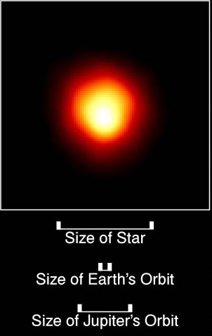
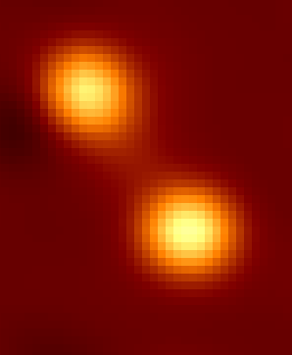
How big are the stars?
Very few stars can be imaged as more than just points (even with HST)
Size usually inferred from brightness
Vary enormously,
from size of
small city to
beyond orbit
of Earth
Betelgeuse imaged by HST
Capella
imaged by COAST

Slide 9
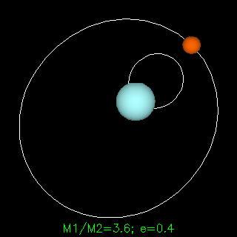
Weighing stars
Important for our under-standing of underlying physics
  measure mass on Earth using gravity: scales and springs
  measure mass of stars using gravity: bound pairs of binary stars (fortunately common)
Are they like the Sun?
  Yes…
    familiar bright stars are a few times more massive
    nearby stars are typically less massive
R. Pogge, Ohio State

Slide 10
What have we learned?
From the motion of stars in the sky we can find:
  their distances
  (if they are close)
  their masses
  (if they are binaries)
And from studying their images we get:
  their luminosities
  (if we know distance)
  their sizes
  (if they are large and close)
How does the Sun compare?
  the stars we see in the sky are much brighter and somewhat more massive
  typical stars near us are much fainter and somewhat less massive
  the Sun is much better than average, but not a champion!

Slide 11
What have we still to find out?
“…never, by any means, will we be able to study [the stars’] chemical composition … I am of the opinion that every notion of the true mean temperature of the stars will necessarily always be concealed from us.”
Auguste Comte, French philosopher, 1835
He was proved wrong only 25 years later by the development of spectroscopy…
…next lecture!

