Slide 1
Galaxy evolution
Why do galaxies come in such a wide variety of shapes and sizes?
How are they formed?
How do they evolve?

Slide 2
From gas cloud to galaxy
Gas cloud (or several small clouds) collapses under gravity
Globular clusters form from infalling gas
Result: disc galaxy with halo of old globular clusters
Cloud is rotating. Friction causes gas to settle into disc

Slide 3
What do we expect?
From this scenario
globular clusters should contain the oldest stars
the disc should rotate and should contain all the remaining gas
dark halo probably spherical, not disc-shaped (no friction)
Looks reasonable for spiral galaxies — but what about ellipticals?

Slide 4
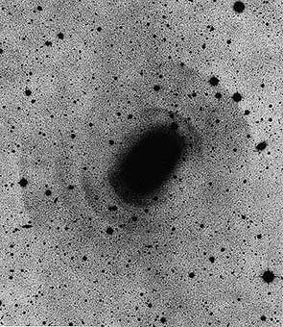
Making elliptical galaxies
Elliptical galaxies have little gas
used up? lost somehow?
The stars have much less ordered motion
original disc disrupted?
They are much more common in galaxy-rich environments
nearby galaxies needed?
They often show faint “shells” of increased star numbers
produced by interactions with other galaxies?
Are elliptical galaxies the result of galaxy collisions?
NGC3923/AAO

Slide 5
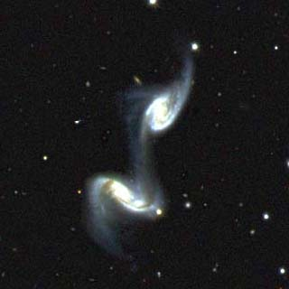
Colliding galaxies
Pairs of colliding galaxies can be seen in the night sky
the collision sets off a burst of star formation
and produces “tidal tails” of gas and stars
Discs and spiral arms are clearly disrupted
resulting merged galaxy will not be a spiral
Antennae: B. Whitmore/ NASA
Arp 240: SDSS

Slide 6
Simulation of galaxy collision
Physics of galaxy collisions is simple (gravity)
very large numbers of objects (stars, dark matter, gas, etc.)
use supercomputers to simulate
Simulations reproduce observed phenomena well
support idea that large ellipticals form from mergers
Hernquist, Dubinski, Mihos
Chris Mihos

Slide 7
Galaxy clusters
Rich clusters such as Coma usually have a supergiant elliptical galaxy at the centre
simulations show how such galaxies form by consuming smaller members of the cluster
these interactions may also explain why so few spirals survive in cluster centres
John Dubinski, CITA/Toronto

Slide 8
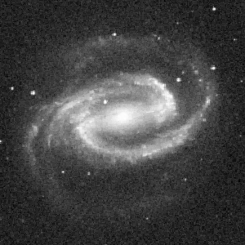
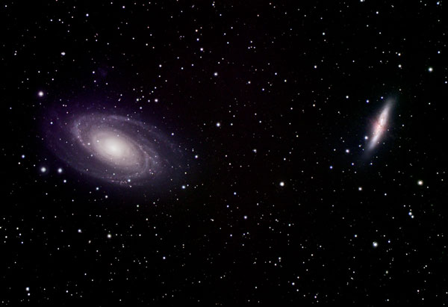
Discs and spirals
What makes and maintains spiral structure?
it’s not always the same stars
spiral arms are seen in short-lived massive stars
spiral arms would wind up
probably a “density wave” of increased gas density (like sound wave)
induces star formation
perturbs orbits of existing stars
what generates this wave?
bar
satellite
close encounter
NGC 1300
M51
M81
R. Gendler

Slide 9
Theory and observation
Summary so far:
disc galaxies form from collapse
elliptical galaxies are produced by mergers
spiral structure is maintained by a density wave triggered by bar, companion or close passage
How can we test these ideas?
need to look at galaxies in the process of formation

Slide 10
Looking back in time
Light from a distant galaxy takes time to get here
M31 is 2 million light years away
we see it as it appeared 2 million years ago
2 million years is a short time
but looking at very distant galaxies we see them as they were billions of years ago

Slide 11
Results from “deep fields”
Images of very distant galaxies contain
large numbers of interacting galaxies (up to 25% — now 1%)
more disrupted and irregular galaxies rather than “modern” spirals
some apparently normal elliptical galaxies
results of early collisions?
many small, blue objects
which will merge to form larger modern galaxies?

Slide 12
Baby galaxies

Slide 13
Wild youth: active galaxies
The light from some galaxies isn’t just stars
enormous amounts of “extra” luminosity in radio, X-rays, etc.
sometimes associated with huge “jets” extending over millions of light years
much more common in distant objects, i.e. when galaxies were young
galaxies responsible often disrupted ellipticals
activity associated with galaxy interactions?
Bill Keel
Jodrell Bank/MERLIN

Slide 14
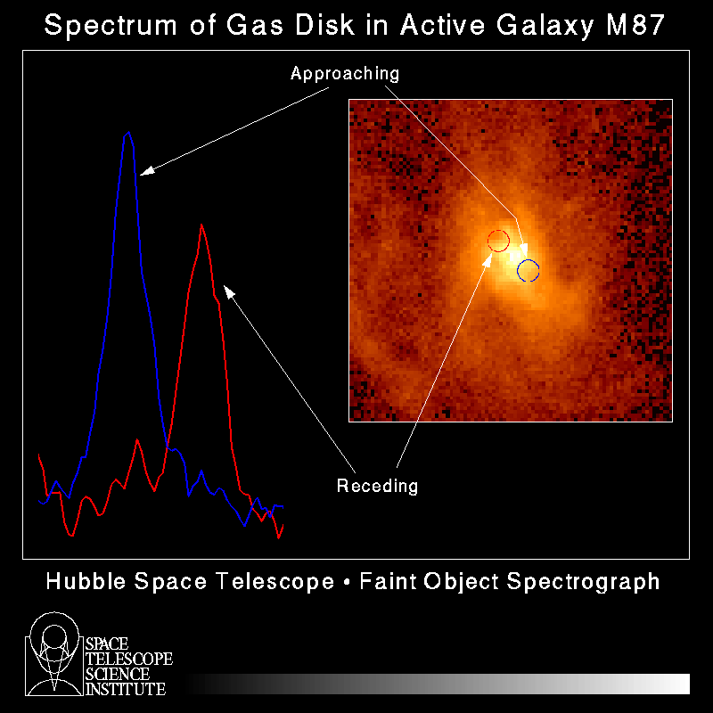
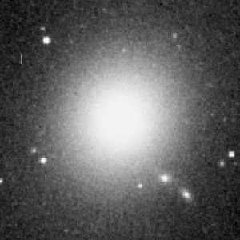
Active galaxies & black holes
Huge luminosities of active galaxies powered by very small object in centre
probably supermassive black hole
energy generated by gas heated up by friction as it falls into black hole
eventually black hole runs out of accessible gas, becomes quiet (like ours)
many modern galaxies should contain black holes

Slide 15
Black holes in galaxy centres
Most large galaxies do seem to contain black holes
detected by applying Newton’s laws to motion of stars and gas in central region of galaxy
The more massive the galaxy’s central bulge, the larger the black hole
cause or effect? or bias??
John Kormendy
bulge brightness and orbital speeds of bulge stars are both measures of the mass of the bulge

Slide 16
What have we learned?
Pre-galactic gas clouds are quite small
could form dwarf galaxies or merge to form galaxies like the Milky Way
spirals could form when most merging occurs early
they take time to settle down: early galaxies are more irregular
ellipticals may result from collisions between fully-fledged galaxies
simulations support this
Spiral structure may be due to a density wave
started by bar, companion or close encounter
causes star formation
Many galaxies contain central black holes
when the galaxy is young these can power nuclear activity
To go beyond galaxies we need to consider the whole universe … next lecture!

