Slide 1
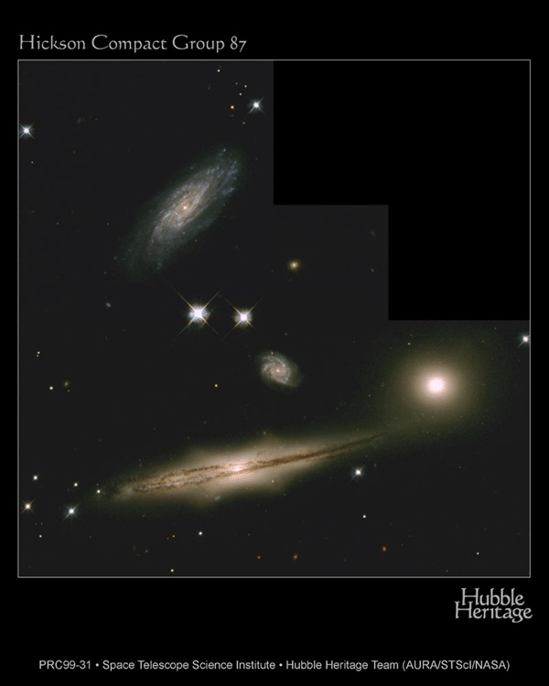
Other galaxies
Telescopic images of the night sky reveal many other galaxies
  What do they look like?
    are they all like the Milky Way?
  Where are they?
    spread randomly through space, or grouped?
  What can we learn about the Universe?

Slide 2
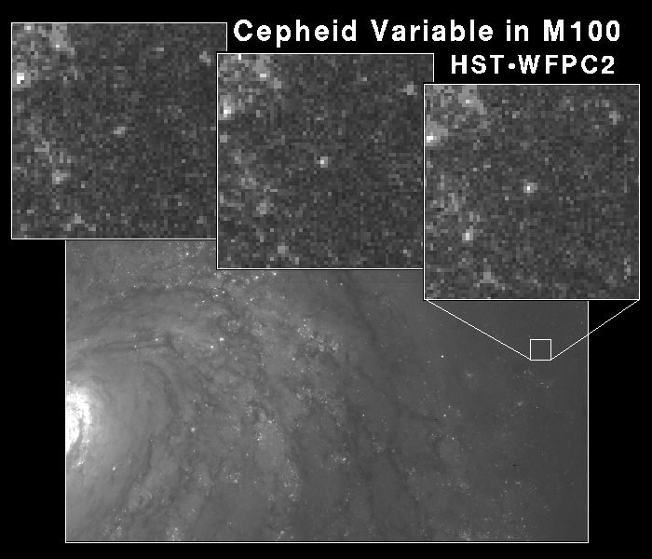
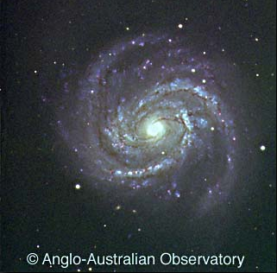
A long time ago in a galaxy far, far away...
How do we know these fuzzy blobs are distant galaxies?
  some types of star (especially variable stars) have well-known intrinsic brightness
  by measuring how bright
  they appear to be we can
  infer their distance
  “standard candles”

Slide 3
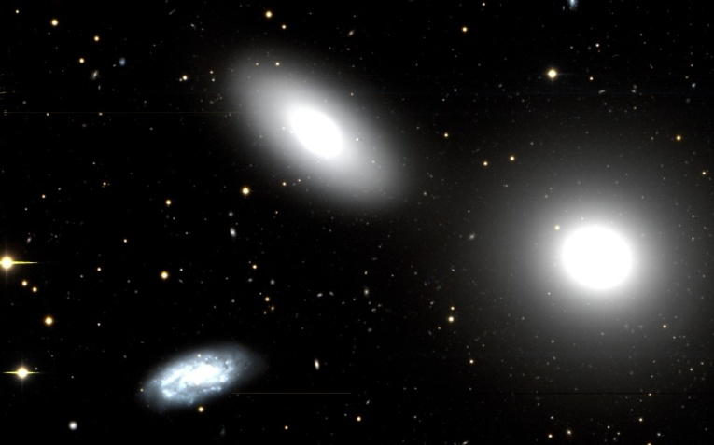
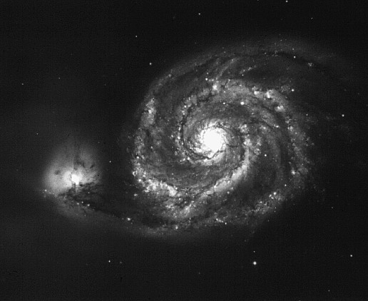
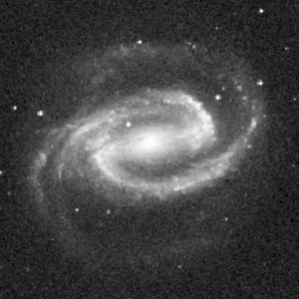
Types of galaxies
Galaxies seem to come in two basic types
  smooth, featureless elliptical galaxies
    circular or elongated
    made of old, reddish stars
  spiral galaxies like the
  Milky Way
    some with round bulges,
    some with bars

Slide 4
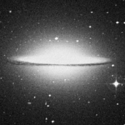
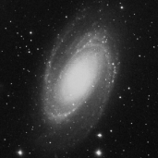
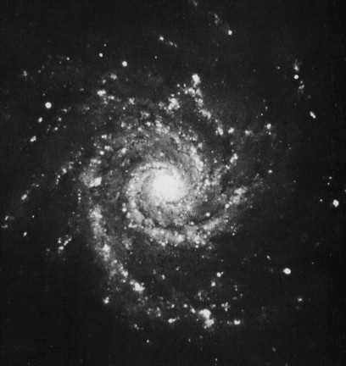
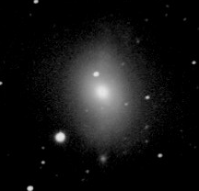
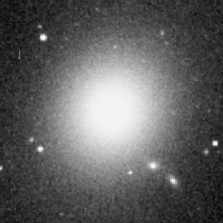
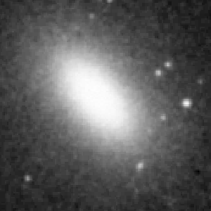
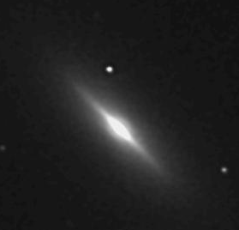
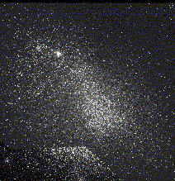
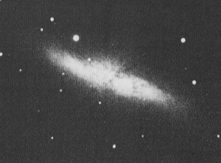
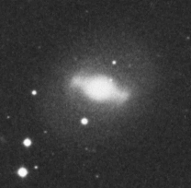
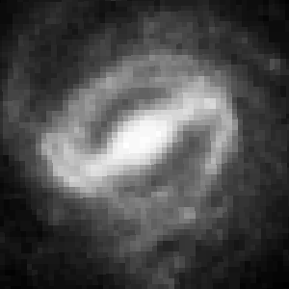

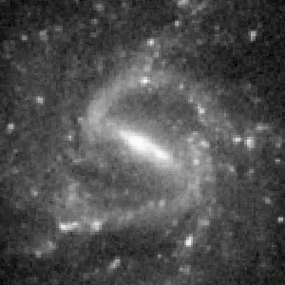
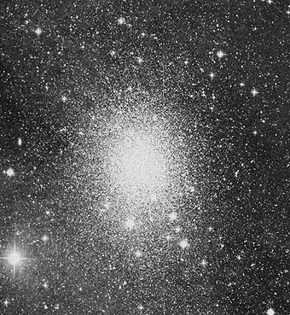
Hubble’s tuning fork
no spiral arms
Sa Sb Sc
old stars; no recent star formation
lots of young stars
E0 ••• E6
S0
SB0
Irregular
looser spiral arms —> smaller bulge —>
more elongated —>
amorphous or disrupted
old stars
dwarf elliptical (dE/dSph)
SBa SBb SBc
old stars in bulge; younger in disc;
youngest in spiral arms

Slide 5
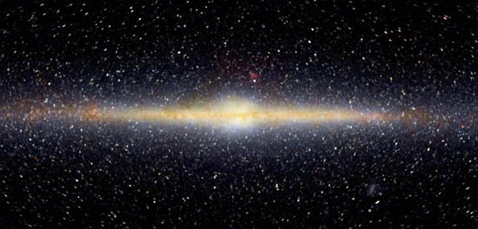
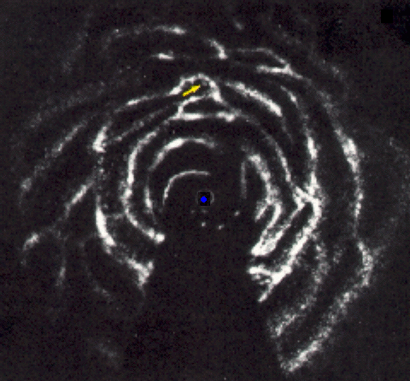
Where do we fit in?
The Milky Way is clearly not
an elliptical galaxy
  it has a disc, and contains
  young stars
It has spiral arms
  so, not S0
  size of bulge and arm pattern suggest Sbc
    between Sb and Sc
There is evidence for a small bar
  SBbc, or SABbc
    SAB means intermediate between barred and unbarred

Slide 6
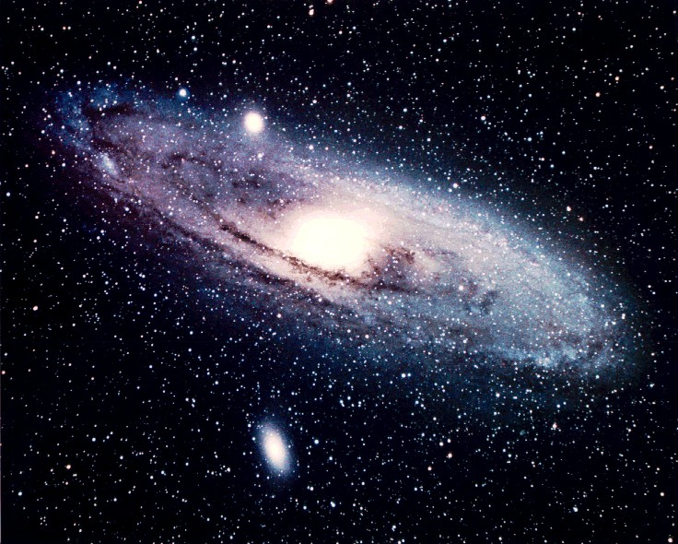
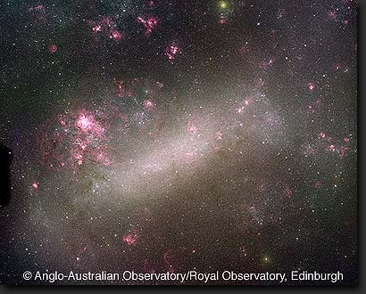
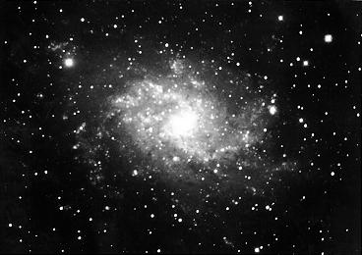
The Local Group
The Milky Way is not alone: it is part of a small group containing
  M31 (the Andromeda galaxy)
    a large Sb spiral, bigger than us
  M33
    a small Sc spiral
  the Large Magellanic Cloud
    an irregular satellite of the Milky Way
  at least 30 dwarf
  irregular and dwarf
  elliptical galaxies
  but no large elliptical
  galaxies

Slide 7
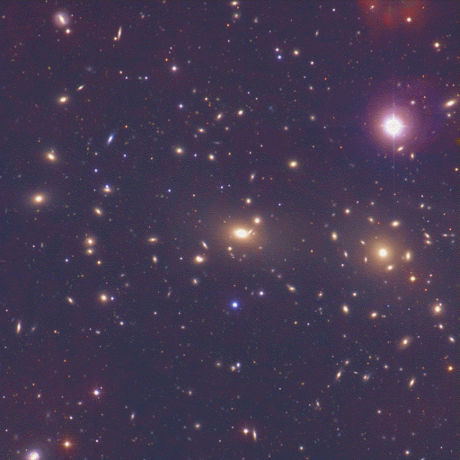
Galaxy groups and clusters
The Local Group is small: some rich clusters contain thousands of large galaxies
  elliptical and S0/SB0 galaxies are much more common in rich clusters
  spiral and irregular galaxies are much more common in small groups and the outskirts of clusters

Slide 8
Galaxy properties
Elliptical galaxies
  contain old stars
  have little net rotation
    star orbits are randomly directed, as in our halo
  have little internal structure
  are much more common in galaxy-rich environments
  include the most massive galaxies (but also some with very low mass)
Spiral galaxies
  show recent star formation (in disc)
  have rotating discs
    stars all orbit in same direction
  have complex internal structure
  are more common in low-density environments
  have a smaller range of masses
Lenticular (S0/SB0) galaxies are like spiral galaxies with no gas
Irregular galaxies are mostly like spirals too small to become organised

Slide 9
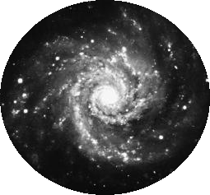
Galaxy problems
What makes some galaxies elliptical and others spiral?
  their mass?
  their age?
  their rotation?
  their history?
How do spiral galaxies avoid “winding
up” their spiral arms?
How does the evolution of galaxies
relate to the presence of central
supermassive black holes?
  the Milky Way’s is, if anything, less
  massive than most!
…next lecture!

Slide 10
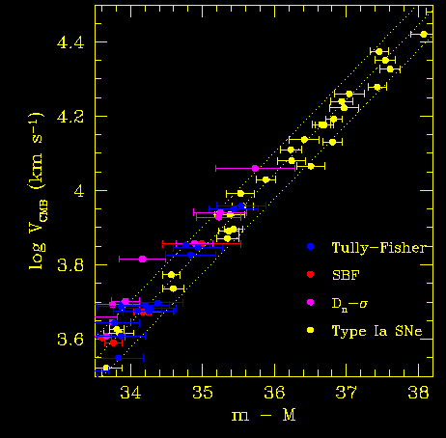
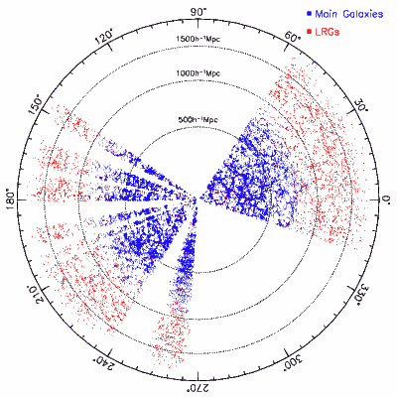
Galaxies and cosmology
Almost all galaxies are moving away from us
  and the greater their distance, the faster they recede (Hubble’s law)
Clusters of galaxies group to form huge superclusters, separated by vast voids
  how does this large scale structure develop?
What is the dark matter?
…next section!

