Slide 1
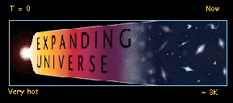
The first 400,000 years…
All about the Big Bang…
Temperature
Chronology of the Big Bang
The Cosmic Microwave
Background (CMB)
The VERY early universe
Big
Bang

Slide 2
Temperature and the Big Bang
The universe cools & becomes less dense as it expands.
Redshifted photons have less energy – radiation less important
Temperature plays a VERY important role in the evolution of the universe…
neutral universe
  Different physical processes occur at different times & temperatures.
  To understand physics in early universe we need to understand physics at high temperatures (or energies)
ionised universe

Slide 3
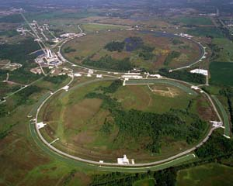
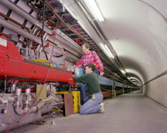
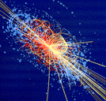
Temperature & the Big Bang…
How far back can we look?
Depends on accelerator & particle physics technology…
  Colliding particles mimic early universe.
  Higher energy -> Higher temp
  -> Earlier universe
Beam Equivalent Time after
Date Accelerator Energy Temperature Big Bang
1930 1st Cyclotron 80 KeV 10⁹K 200 secs (Berkely)
1952 Cosmotron 3 GeV 10¹²K 10⁻⁸ secs (Brookhaven)
1987 Tevatron 1000 GeV 10¹⁶K 10⁻¹³ secs (Fermilab)
2009 LHC >7000 GeV 10¹⁸K 10⁻¹⁴ secs (CERN)
‘High
Energy
Physics’

Slide 4
Temperature & the Big Bang…
What have colliders told us so far?
  The ‘Standard Model’
  of Particle physics.
Particles
Matter
‘Hadrons’
(made of Quarks)
Protons (p)
Neutrons (n)
(etc)…
‘Leptons’
Electrons (e-)
Neutrinos (ν)
(etc)…
Anti-matter
‘Hadrons’
(made of antiquarks)
anti Protons (p)
anti Neutrons (n)
(etc)…
‘Leptons’
Positrons (e+)
anti Neutrinos (ν)
(etc)…
Forces
Gravity (mass)
Electromagnetic
(charge)
Strong
Weak
Nuclear
forces
Photons (γ) and other force particles

Slide 5
Quick chronology of the Big Bang…
The universe is expanding &
cooling after an initial ‘explosion’
~14 billion years ago.
<10⁻⁴s
T = 0
Now
Very hot
~ 3K
‘Inflation’
  Matter
  ‘Freeze-out’
  ‘Recombination’
  Structure
  formation
  Particle/photon Soup
  ‘Nucleosynthesis’

Slide 6
Quick chronology of the Big Bang
  Hot particle & photon soup…
  Time < 10⁻⁴s
  Temp > 10¹²K
The universe a dense soup of rapidly interacting photons & elementary particles (matter & anti-matter).
2 reactions governed the balance of particles and photons :
  Matter and antimatter produced by ‘pair production’
  Photons produced by matter & antimatter annihilation
Pair production
Photon (γ)
Proton (p)
Anti-Proton (p)
Proton (p)
Annihilation
Particle production is reliant on high temperature (by E = mc²)
Photon (γ)
Anti-Proton (p)

Slide 7
Quick chronology of the Big Bang
  Matter ‘Freeze-out’…
  Time ~ 10⁻⁴s
  Temp ~ 10¹²K
Universe becomes too cool for pair production.
  Photon energy becomes < particle/anti-particle mass energy (E < mc²)
  MOST existing particles & anti-particles annihilate leaving small amount of matter
Before
Why is there any matter at all!?
  Because of a TINY imbalance of matter over antimatter in particle photon soup.
After

Slide 8
Quick chronology of the Big Bang
  Nucleosynthesis
  Time ~ 2 mins
  Temp ~ 10⁹K
Protons and neutrons combine to form atomic nuclei
  Protons and neutrons combine to form deuterium (²H)
p
n
²H
  1 proton and 1 neutron combine with deuterium to form Helium (³He and ⁴He).
p
³He
n
⁴He
Production of nuclei in the early universe stops at Helium
  There are no stable elements with mass 5 or 8 - which stops synthesis of heavier elements.
+³He
(Rare)
⁹Be
⁶Li
⁷Li
³He
⁴He
¹H
²H
A=5
A=8

Slide 9
Quick chronology of the Big Bang
  Recombination…
  Time ~ 380,000 yrs
  Temp ~ 3000K
Electrons combine with nuclei forming atoms.
  Before now the temperature is too high for electrons and nuclei to bind
The universe becomes
  Photons readily interact with free electrons - so early universe is OPAQUE
  Photons interact with bound electrons much less - so the universe becomes TRANSPARENT
Transparent
Before
After

Slide 10


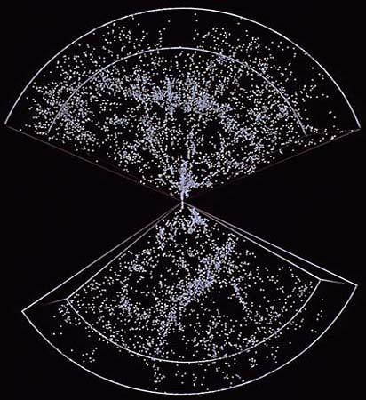
Quick chronology of the Big Bang
  Structure formation
  380,000 yrs → Now
  3000K → 3K
Under the pull of gravity - all the matter in the universe condenses to form the structures we see today.
  Gravitation attraction results in gas clouds, stars, galaxies, clusters and super-clusters
  Heavier elements formed by nuclear fusion in stars
Later on….
  The Earth formed ~ 4.6 billion yrs ago
  Humans appeared ~ 2-4 million yrs ago

Slide 11

Do we know everything?
Fred Hoyle (1915-2001)
No!...
Still some long-standing questions about the Big Bang…
  How/why did the Big Bang start in the first place?
  Why was there a matter/antimatter imbalance?
  What happened in the VERY early universe?
I prefer the
Steady State Theory

Slide 12
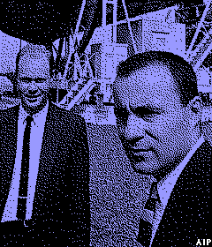
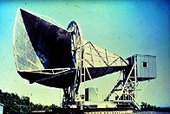
The Cosmic Microwave Background (CMB)
1965 - Penzias & Wilson discover background ‘noise’ in new radio antenna.
1964 - Princeton group predicted radiation left over from big bang:
  Black body distributed
  In microwave region: (λ ~mm)
  T < 50 K
Actually predicted earlier (1950) – but prediction forgotten!
1968 results

Slide 13
The Cosmic Microwave Background (CMB)
Background radiation found to be almost perfect blackbody spectrum.
T = 2.735 K
+/- 0.06
’Proof’ of the Hot Big Bang
* Nobel Prize 1978 *
Penzias & Wilson
COBE Results (1990s)

Slide 14
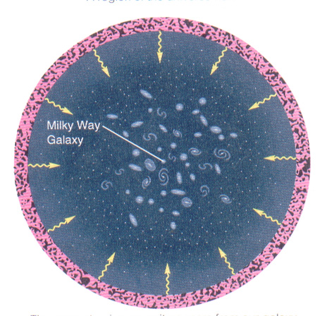
The Cosmic Microwave Background
What is the CMB?
  Radiation left-over from the ‘recombination’ period of the hot Big Bang.
Horizon picture
  Emitted with hot black body spectrum ~300,000 years after Big Bang.
  Photons stretched & cooled by the expansion of the universe (×1000).
  Then: λ~10⁻⁶m T~3000 K
  Now: λ~10⁻³m T~3 K

Slide 15
The Cosmic Microwave Background
What is the CMB?
The universe is expanding & cooling after an initial ‘explosion’ ~14 billion years ago.
Opaque
Transparent
T = 0
300,000 years
Now
The CMB…
Very hot
~ 3K
‘Inflation’
  Matter
  ‘Freeze-out’
  ‘Recombination’
  Structure
  formation
  Particle/photon Soup
  ‘Nucleosynthesis’

Slide 16
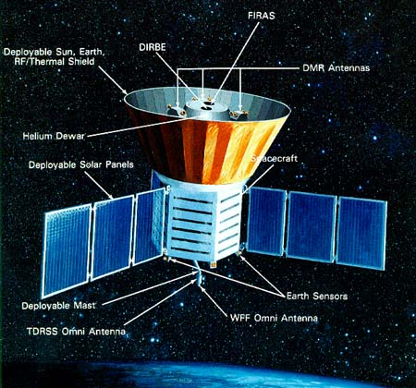

The Cosmic Microwave Background
Mapping the CMB sky
Cosmic Background Explorer satellite (COBE) launched 1989
All sky ‘temperature’ map
Raw data
  CMB is mostly VERY UNIFORM
  (smoother than 1 in 100,000)
  T = 2.728 Kelvin
T = 2.728 K

Slide 17
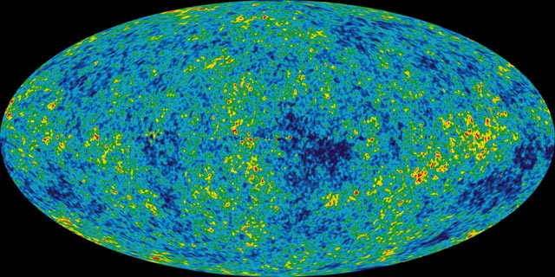
The Cosmic Microwave Background
Mapping the CMB sky
Cosmic Background Explorer satellite (COBE) launched 1989
All sky ‘temperature’ map
Expanded temp
scale
  TINY temperature & density fluctuations.
  ‘Seeds’ for
  today’s structure
ΔT = 18 μK

Slide 18
The Cosmic Microwave Background
CMB Summary
The origins of the CMB…
  Primordial blackbody radiation released after recombination 380,000 years after the big bang.
  Cooled from 3000K to 3K by the expansion of the universe
  Strong Evidence in favour of the Hot Big Bang.
The CMB sky…
  CMB is mostly VERY UNIFORM
  (smoother than 1 in 100,000)
  Ripples show temperature & density fluctuations of the early universe.
  Fluctuations = seeds of later structure formation

Slide 19
What happened in the VERY early universe?
  Clue 1…
  The ‘Horizon Problem’
  ‘Why is the Cosmic Microwave
  Background so UNIFORM?’
  Distant points too far apart to have reached thermal equilibrium before recombination.
limit of influence < 2˚
CMB
Raw data
T = 2.728 K
  Clue 2…
  The ‘Flatness Problem’
  ‘Why is the curvature of the Universe so SMALL?’
  If ρ ≠ ρ_{c}, difference should grow quickly over time
  Universe should either recollapse almost immediately or rapidly expand into nothingness.

Slide 20
The VERY early universe
The era of INFLATION (10⁻³⁵s)
The theory of ‘Inflation’ (1980) predicts a period of RAPID expansion.
  Begins at 10⁻³⁵ seconds after the Big Bang
  Size of universe increases by 10³⁰ - 10⁵⁰!
Normal Expansion
10⁻⁶⁰ 10⁻⁴⁰ 10⁻²⁰ 1 10 ²⁰ 10 ⁴⁰
Size of observable universe (m)
Solves Horizon problem
  Limits of influence massively increased.
Inflation Period
Now
and Flatness problem
  Huge expansion factor makes our small part of Universe look very flat.
10⁻⁴⁰ 10⁻³⁰ 10⁻²⁰ 10⁻¹⁰ 1 10¹⁰
Time (Seconds)

Slide 21
The VERY early universe
The era of INFLATION (10⁻³⁵s)
What caused inflation??
Not sure but…
Theoreticians think….
  At high temperatures the forces of nature combine.
  Inflation occurred when the strong and weak nuclear forces separated.
GUT
Inflation
Electro-Weak force
Age of the universe (sec)
LHC – soon!
Temperature (K)
Tevatron - now
Efforts continue to look further and further back.
Gravity
Electro-magnetic
Weak force
Strong force

Slide 22
Summary
The universe is expanding & cooling after an initial ‘explosion’ ~14 billion years ago.
Opaque
Transparent
T = 0
300,000 years
Now
The CMB…
Very hot
~ 3K
‘Inflation’
  Matter
  ‘Freeze-out’
  ‘Recombination’
  Structure
  formation
  Particle/photon Soup
  ‘Nucleosynthesis’

