Slide 1
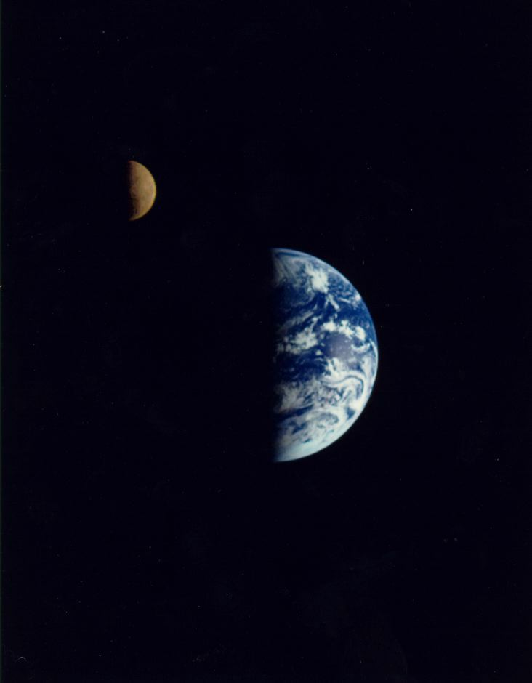
Atoms and Starlight
Why do the stars shine?
  planets shine by reflected sunlight—but what generates the Sun’s light?
What does starlight tell us about the stars?
  their temperature
  their chemical composition
  their motion towards or away from us
  sometimes, their age

Slide 2
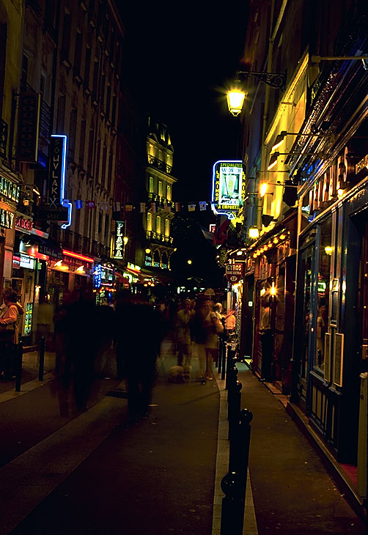
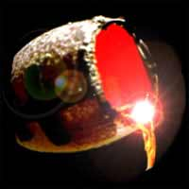
Generating light
What everyday objects emit light?
  hot solid objects (molten metal, electric bar fire, tungsten filament lamp)
  electrical
  discharge
  in gas
  (neon
  lights,
  aurora,
  lightning)

Slide 3
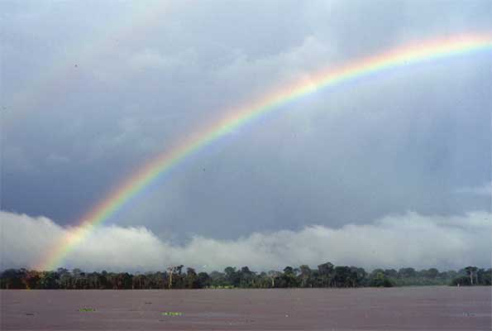
Measuring light
Two issues:
  intensity
    how bright is the source?
  wavelength
    what colour is the light?
Use prism or grating to spread light into a spectrum
our basic information: intensity as function of wavelength

Slide 4
Light and atoms
Light is an electromagnetic wave
  wavelengths range from fm (gamma rays) to m (radio)
    atmosphere transparent only to optical, some infra-red, and radio
    depend on satellites to observe x-rays, UV, sub-millimetre
Light is made of particles
  called photons
    each carries energy hc/λ, where h is Planck’s constant, c is speed of light, λ is wavelength
    this picture of light is vital in understanding how light and atoms interact

Slide 5
Atoms and light
Electrons in atoms occupy certain fixed energy levels (orbitals)
  basis of chemistry
  moving electron to higher level requires energy; moving to lower level releases energy
  absorption or emission of photons of light of specific wavelength (energy)
these patterns of emission
or absorption provide a
“fingerprint” for any
element

Slide 6
Blackbody radiation
Light from hot solid objects is not made up of emission lines
  collisions between atoms and photons of light change photon energies
  result is continuous spectrum
  if object has no intrinsic colour (blackbody) spectrum depends only on its temperature
  hotter = bluer and brighter

Slide 7
The Sun’s spectrum
Basically continuous, but with dark absorption lines
  is the Sun solid?
    no, because we know its rotation period varies with latitude
    the Sun is a dense gas (about 1.3 times as dense as water)
  does the Sun have an atmosphere?
    yes, of cooler gas, to create absorption lines
Colour of Sun tells us its temperature
  so do absorption lines, because strength of lines for given element depends on temperature (though position does not)
Lines tell us about chemical composition
  as well as temperature and density

Slide 8
How hot is the Sun?
Compare its spectrum with blackbody
  similar shape
  temperature ~5800 K (same overall area, i.e. same total power output) — ~6000 K (most similar shape)
  note that this is only its surface temperature

Slide 9
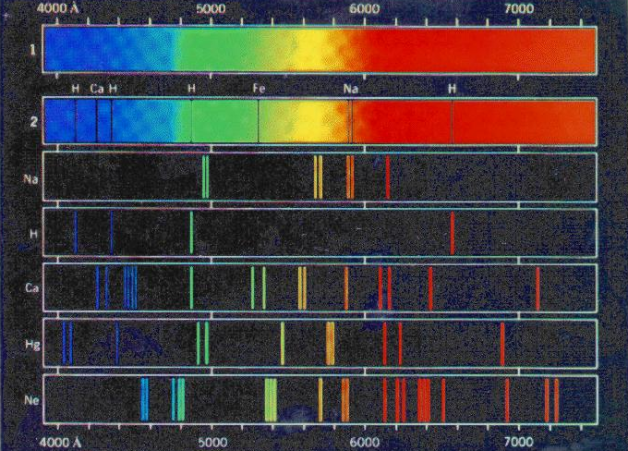
What is the Sun made of?
Most of the lines are metals (Ca, Fe, Mg, etc.)
  is the Sun’s composition similar to the Earth?
  No!
    hydrogen and helium
    form strong lines only
    at very high temperature
    the Sun is in fact
    73% H, 25% He, 2%
    everything else
    (Cecilia Payne, 1924)

Slide 10
Other stars
Different colours suggest different temperatures
  line strengths agree
  classification system based on line patterns
    hottest stars have strong helium lines
    hot stars have hydrogen
    sun-like stars have ionised metals
    cooler stars have neutral metals
    very cool stars have molecules
Is Sun’s composition typical?
  all stars have similar amounts of hydrogen and helium
  amount of “heavy” elements varies from much less (down to <0.01%) to a little more
  remember this is surface composition

Slide 11
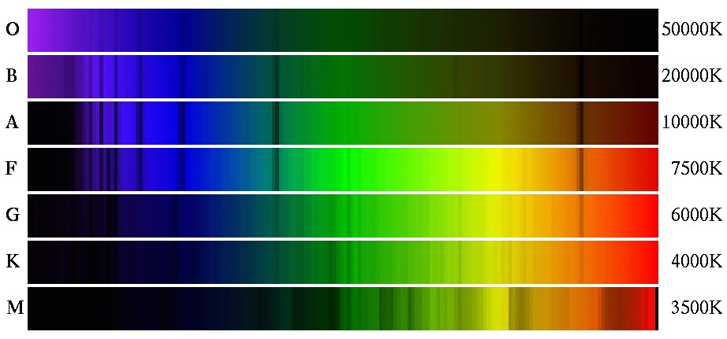
The spectral sequence
Oh, Be A Fine Guy/Girl, Kiss Me

Slide 12
The Doppler shift
If a light source moves
  away from us:
    peaks of light wave arrive
    further apart
    light is redshifted
  towards us:
    peaks of wave arrive
    closer together
    light is blueshifted
This is the Doppler shift
  same effect with sound
    e.g. ambulance siren
  in astronomy observe change in position of spectral lines

Slide 13
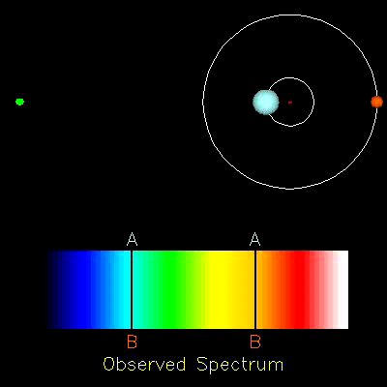
Moving stars
Doppler shift can help us measure the motion of stars
  in binary systems
  in their orbits around the Galactic centre
  in other galaxies
It can also provide evidence for planets around other stars
and tell us about the history and fate of the universe
R. Pogge, Ohio State

Slide 14
What have we learned?
The colour of a star tells us its temperature
  blue stars are hot
  (>10000 K)
  red stars are cool
  (~3000 K)
The spectral lines confirm its temperature and tell us about its composition
  all stars are mainly hydrogen and helium
  everything else typically ~1-2% or less
The positions of spectral lines tell us about motion
  redder than expected: moving away from us
  bluer than expected: moving towards us
If we know colour (i.e. temperature) and luminosity, we can deduce size
  from form of blackbody radiation

Slide 15
What do we now know about relatively nearby stars?
distance (parallax)
brightness (from measured brightness and distance)
surface temperature
(from spectrum)
size (from spectrum and brightness)
composition
(from spectrum)
mass (if suitable binary)
So we can now look at
  what kinds of stars exist
  how stars are born, live, and die
  what this has to do with our existence on Earth
...starting next lecture!

