Slide 1
Exam Technique
READ THE QUESTION!!
  make sure you understand what you are being asked to do
  make sure you do everything you are asked to do
  make sure you do as much (or as little) as you are asked to do [implicitly, by the number of marks]
Answer the question, the whole question, and nothing but the question

Slide 2
Exam Technique
Read the whole paper through before you start
  if you have a choice, choose carefully
  whether or not you have a choice, do the easiest bits first
    this makes sure you pick up all the “easy” marks
PHY111
  do all of section A (20 questions, 40%)
  do 3 from 5 in section B (3 questions, 30%)
  do 1 from 3 in section C (1 question, 30%)

Slide 3
Last Year’s Exam, Section B
Answer any 3 of 5 short questions
5 marks each
  exam is out of 50
    i.e. 120/50=2.4 minutes per mark
  hence each question should take ~12 minutes to answer
    do not let yourself get bogged down, but
    do not write 2 sentences for 5 marks!

Slide 4
Question B1
Explain how we can determine:
  the Sun’s surface temperature; [1]
  either by its colour (because stars are approximately blackbodies)
  or by the strengths of spectral lines (e.g. ratio of ionised to neutral metal lines)
  the Sun’s surface chemical composition; [1]
  by looking at strengths of spectral lines after correcting for surface temperature
  (e.g. expect hydrogen lines to be weak at T ~ 6000 K)

Slide 5
Question B1
Explain how we can determine:
  the Sun’s luminosity; [1]
  by combining the flux(energy received per second per square metre) with the distance (which is known)
  that the Sun is powered by hydrogen fusion. [2]
  [need two points here, because there are two marks]
  directly
  by detecting neutrinos from the various fusion processes occurring in the Sun’s core; these occur in the correct numbers, and with about the right energies
  indirectly
  by looking at the Sun’s interior structure via helioseismology;
  because it’s the only process that will keep going long enough;
  because simulations agree with the Sun’s observed size and brightness

Slide 6
Question B2
Explain the similarities and differences between:
  a white dwarf and a brown dwarf; [2½]
  both are small, faint and not powered by fusion [1]
  white dwarf is more massive (~0.6 solar masses, cf. <0.1 solar), is mostly carbon and oxygen (brown dwarf mostly hydrogen), and is remnant of a star which was fusion powered (brown dwarf never fusion powered except briefly by deuterium) [1½]
  a planetary nebula and a supernova remnant. [2½]
  both are expanding gas clouds expelled from evolved stars and enriched in heavy elements [1]
  both are associated with compact objects (white dwarf and neutron star respectively) [½]
  SNR is more massive, more enriched in different elements, and created by explosion rather than gradually in wind [1]

Slide 7
Question B3
Explain how the heavy elements are produced in stars and disseminated into the interstellar gas. Your account should include the following terms: fusion; s-process;
r-process; β-decay; planetary nebula; supernova. [5]
  All stars start by fusing hydrogen to helium;
    in stars more massive than Sun this results in build-up of nitrogen through CNO cycle
  all except M-dwarfs then fuse helium to carbon via triple-alpha process
    further addition of helium nuclei creates alpha-process elements such as ¹⁶O, ²⁰Ne, ²⁴Mg, but this gets harder as electric charge increases
  helium fusion also produces free neutrons via
  ⁴He + ¹³C → ¹⁶O + n

Slide 8
Question B3
Explain how the heavy elements are produced in stars and disseminated into the interstellar gas. Your account should include the following terms: fusion; s-process;
r-process; β-decay; planetary nebula; supernova. [5]
  free neutrons added to nuclei slowly during He fusion
  (s-process) produce stable isotopes as any unstable ones decay before next neutron added
  but during supernova explosion there are lots of neutrons – add neutrons quickly (r-process) to produce neutron-rich unstable isotopes which then β-decay to stable nuclei
  stars which supernova also produce heavy elements through fusion (e.g. Si, S, Fe) and by high-temperature reactions during the explosion (very heavy nuclei)

Slide 9
Question B3
Explain how the heavy elements are produced in stars and disseminated into the interstellar gas. Your account should include the following terms: fusion; s-process;
r-process; β-decay; planetary nebula; supernova. [5]
  convection currents in helium-burning stars carry heavy elements up from core to outer layers
    where they are ejected as planetary nebula and thus dispersed in interstellar medium
  in high-mass stars, dispersion is done through supernova explosion

Slide 10
Question B4
In the context of modern cosmology, what is meant by inflation? [1]
  brief period of very rapid (exponential expansion very early in history of Universe (10⁻³⁵ s after Big Bang)
Briefly explain why we believe that there was an era of inflation in the very early universe. [2]
  horizon problem – microwave background is extremely uniform, although we would not expect it to have been in thermal equilibrium over angles of more than 2° on night sky; this is OK in inflation because pre-inflation visible universe was small enough to be in thermal equilibrium
  flatness problem – universe is very close to flat, though there is no reason to expect this in standard theory; OK in inflation because exponential expansion makes any initial geometry flat

Slide 11
Question B4
Proponents of the Big Bang model originally thought that all the elements were created in the first few minutes after the Big Bang. What is the observational evidence showing that this cannot be so? [1]
  surface heavy-element content of stars depends on their ages – older stars have less – whereas if everything made in Big Bang there is no reason for this to happen
  or unstable elements (Tc) seen in red giant spectra
What elements or isotopes are produced in the first few minutes after the Big Bang? [1]
  isotopes: ²H, ³He, ⁴He, ⁷Li
  elements: helium, lithium

Slide 12
Question B5
Compare and contrast the astrometric and spectroscopic methods of detecting planets around other stars. Which one has been more successful? [2½]
  Both work by detecting motion of star (planet is not detected directly) [½]
  Both are most sensitive to massive planets [½]
  Astrometry prefers planet far from star, spectroscopy close to star [½]
  Astrometry prefers face-on orbit, spectroscopy edge-on [½]
  or Astrometry works only for nearby systems, spectroscopy much less bothered [½]
  Spectroscopy much more successful than astrometry [½]

Slide 13
Question B5
Briefly describe the properties of the extrasolar planets discovered so far. You should mention mass, distance from star, and shape of orbit. Comment on whether these properties are biased by the detection methods used. [2½]
  All fairly massive (from ~5 Earth masses up to ~10 Jupiters) [½]
  This is definitely biased – massive planets easier to see [½]
  Most rather close to parent star (up to ~3 AU) [½]
  This is also biased – most detections spectroscopic [½]
  Many have quite eccentric orbits, unlike our solar system planets which all have rather circular orbits (this probably isn’t biased) [½]

Slide 14
Last Year’s Exam, Section C
Answer any 1 of 3 long questions
15 marks each, ~36 minutes’ work
Question C3 is on the seminars:
  Write short essays on any three of the following
    binary stars
    black holes
    the search for dark matter
    prospects for alien intelligence
  Note that you know this is coming, so more detail expected in answers!

Slide 15
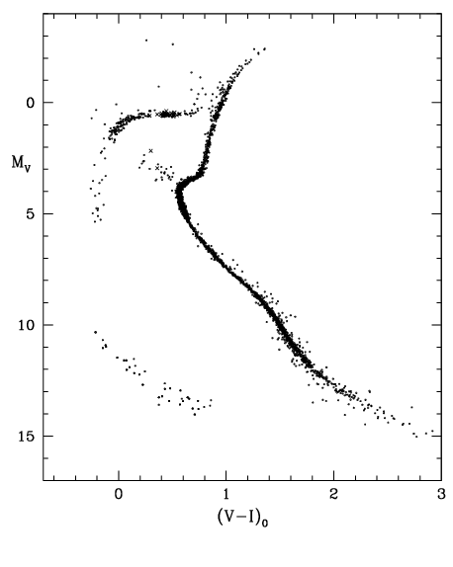
Question C1
The picture shows a detailed Hertzsprung-Russell (HR) diagram of a globular cluster.
B
A
C
D

Slide 16
Question C1
Explain which features of the HR diagram show that this cluster is (i) old and (ii) low in heavy elements. [2]
  Old: lack of upper main sequence, presence of strong red giant branch
  Low in heavy elements: long horizontal branch extending to blue
Name the branches of the HR diagram labelled A, B, C and D in the figure. [6]
  In each case, state which element, if any, is being fused to generate energy, and where in the star this fusion is occurring.
  A: red giant branch, hydrogen to helium in shell outside He core
  B: horizontal branch, helium to carbon in core
  C: main sequence, hydrogen to helium in core
  D: white dwarfs, no fusion

Slide 17
Question C1
Describe the life cycle of a typical solar-mass star from its formation to its eventual demise. Relate your account to the features of the HR diagram shown. [6]
  Starts from cool, dense gas cloud which collapses under its own gravity, forming a protostar probably surrounded by disc of gas and dust. Protostar shines by conversion of gravitational potential energy (above & right of main sequence in HRD) [1]
  Eventually gets hot enough to fuse hydrogen in core – has reached main sequence. [½]
  When core hydrogen exhausted, star shrinks slightly until region just outside core hot enough to fuse. Ignition of fusion greatly increases temperature and pressure in this shell – outer layers of star expand and cool along subgiant branch and up red giant branch. [1½]

Slide 18
Question C1
Describe the life cycle of a typical solar-mass star from its formation to its eventual demise. Relate your account to the features of the HR diagram shown. [6]
  Mass and temperature of He core steadily increasing. At tip of RGB, He fusion ignites in core – star moves quickly to horizontal branch on HRD (where depends on heavy element content) [1]
  When He exhausted in core, He fusion starts in shell, and star reascends red giant branch. At this stage it is very unstable and loses mass through stellar wind. Eventually all outer layers will be lost, forming a planetary nebula, and He fusion will stop; central carbon core will survive to radiate its stored heat as a white dwarf (bottom left of HRD) [2]
Would you expect to find planets orbiting the stars in this cluster? Briefly justify your answer. [1]
  No, because too low in heavy elements to form much dust.

Slide 19
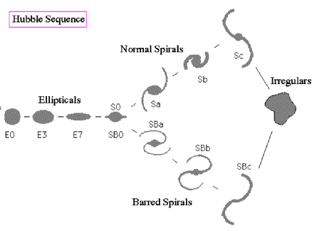
Question C2(a)
Describe, with appropriate diagrams, the Hubble tuning fork system for the classification of galaxies. [5]
En where increasing n indicates increasing ellipticity.
S0: disc galaxies without spiral structure.
S/SB: unbarred/barred
Sa/b/c: bulge size/ brightness decreases, so does tightness with which arms are wound.
Irr: amorphous or disrupted.

Slide 20
Question C2(b)
Describe the structure of our own Milky Way Galaxy, carefully explaining how the features that you mention can be deduced from observational data. [6]
  It is a disc galaxy, consisting of a bulge, disc, halo and spiral arms
    disc is seen in sky as Milky Way
    bulge can be seen in infra-red, e.g. COBE, 2MASS
    spiral arms seen in 21 cm (H gas) and in young stars
    halo seen as globular clusters and old, low-mass stars [2]
  Disc and spiral arms consist of youngish and very young objects, high in heavy elements (spectroscopy) describing nearly circular orbits around Galactic centre (low relative motions) [1]
  Bulge consists of old, moderate heavy-element-content stars, orbiting in organised but not very circular orbits [1]
  Halo consists of very old, low-heavy-element stars in non-circular, randomly oriented orbits [1]
  From orbital velocities we also know that Galaxy’s mass is dominated by a spread-out halo of dark matter [1]

Slide 21
Question C2(c)
Explain how the Milky Way might have formed from the gravitational collapse of a very large, slowly rotating gas cloud. Relate your account to the observational features of the Milky Way that you described in part (b). [4]
  During initial collapse, densest parts of cloud initiate star formation, making the globular clusters on infalling, elongated orbits (this accounts for halo kinematics) [1]
  Collapse causes rotation to speed up, and cloud flattens into disc around central condensation (this is the bulge and disc) [1]
  All the gas flattens into the disc, so star formation stops in bulge and halo (explains why bulge and halo are old stars) [1]
  Finally, spiral arms probably formed by wave of enhanced density (like sound wave) propagating round disc – possibly started by tidal interaction with satellite galaxy (Large Magellanic Cloud?) – this explains why Galaxy still has spiral structure, and why spiral arms are made of the youngest stars (higher density encourages gas clouds to collapse) [1]

