Slide 1
Nucleosynthesis
Elements are made in four distinct ways (plus another we didn’t go into)
  Big Bang Nucleosynthesis
    takes place when the universe is a few minutes old
    makes ²H, ³He, ⁴He and ⁷Li
  Fusion in stars
    in stars like the Sun, makes ⁴He and C, N, O
    in massive stars, makes elements up to iron-56
  Fusion in supernova explosions
    primarily makes elements around iron
  Neutron capture in He-fusing stars and supernovae
    makes elements heavier than iron

Slide 2
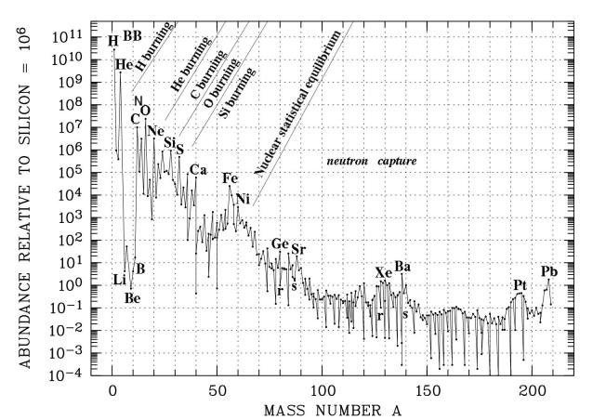
Abundance of elements

Slide 3
Neutron capture processes
Three basic types
  s-process (slow)
    occurs in helium-fusing stars where small quantities of free neutrons are made by processes like ¹³C + ⁴He → ¹⁶O + n
    adds neutrons very slowly, so any unstable nucleus that forms has time to decay
    therefore makes only nuclei which can be reached (directly or via decay) from a stable isotope
      anything surrounded by unstable isotopes cannot be produced

Slide 4
Neutron capture processes
Three basic types
  r-process (rapid)
    occurs in very neutron-rich environment—we think during supernovae
    adds neutrons rapidly, so many neutrons are added before the nucleus has time to decay
    therefore initially makes highly unstable, very neutron-rich nuclei which subsequently decay to stable isotopes via β decay
      each β decay converts one neutron to a proton
      therefore cannot make any nucleus which has a stable isobar with the same mass number but smaller atomic number

Slide 5
Neutron capture processes
Three basic types
  p-process
    probably occurs in supernovae
    creates rare neutron-poor isotopes, either by adding protons or by knocking out neutrons
    responsible for making isotopes which are to the left of the s-process path, therefore not accessible by either the s-process itself or the r-process

Slide 6
The s-process path
stable isotope?
stable isotope
add neutron
no
yes
decay
(probably β decay, maybe electron capture)
Repeat until ²⁰⁹Bi, where it ends because ²¹⁰Po α-decays, forming a loop back to ²⁰⁶Pb

Slide 7
The r-process path
add many neutrons
stable isotope?
stable isotope
no
β decay
The initial neutron influx only happens once, followed by many β-decays
stable isotope
yes

Slide 8
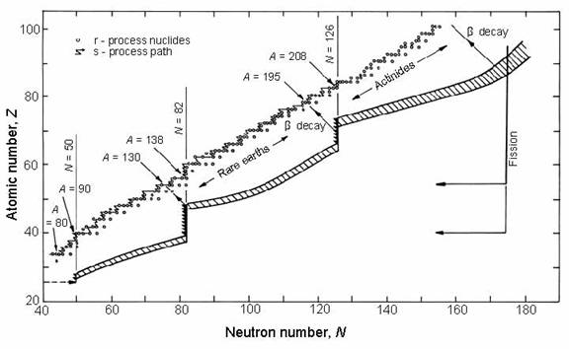
The s- and r-process paths
r-process makes very unstable nuclei

Slide 9
Example
 | 39 | 40 | 41 | 42 | 43 | 44 | 45 | 46 | 47 | 48 | 49 | 50 | 51 | 52
₃₇Rb |  |  |  |  |  |  | ε | ε | ε | 72.2 | β | 27.8 | β | β
₃₆Kr | ε | ε | ε | 0.4 | ε | 2.3 | ε | 11.6 | 11.5 | 57.0 | β | 17.3 | β | β
₃₅Br |  |  | ε | ε | ε | 50.7 | β | 49.3 | β | β | β | β
₃₄Se | ε | 0.9 | ε | 9.0 | 7.6 | 23.5 | β | 49.8 | β | 9.2 | β | β
₃₃As | ε | ε | ε | 100 | β | β | β | β
s and r process
s process only
r process only
p process only
A, Z+1
β decay converts neutron to proton
A, Z
e capture converts proton to neutron
A, Z−1

Slide 10
Summary
Big Bang nucleosynthesis makes only isotopes with atomic masses 2, 3, 4 and 7
  because masses 5 and 8 are not stable
Stellar fusion makes helium, and elements from carbon to iron
Supernova fusion makes the “iron peak”
Neutron capture makes elements heavier than iron
  s-process: isotopes from Fe to Bi adjacent to other stable isotopes
  r-process: isotopes accessible via repeated β decays
  p-process: isotopes to the left of the s-process path

