Slide 1
Stellar evolution and star clusters
Key variable is mass of star
directly measured only for binary stars, but it determines position on main sequence

Slide 2
Cluster ages
Main-sequence luminosity increases much faster than mass
therefore massive stars use up their fuel much faster
therefore their lifetimes on main sequence are much shorter
therefore age of cluster can be found from the location of the top of its main sequence
confirm this with the length and strength of the red giant branch: the longer the RGB and the further down it goes, the older the cluster
any HR diagram showing both a clear upper main sequence and a long red giant branch is not a single-age population
but in real HR diagrams don’t be fooled by scattered bad measurements/foreground stars

Slide 3
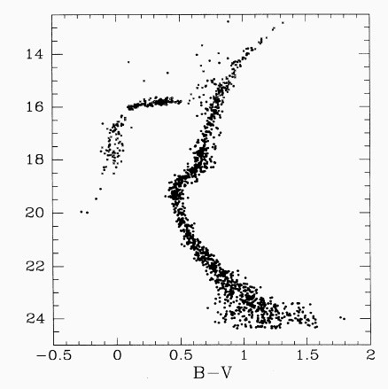
Examples
a few very bright RGs
horizontal branch
turn-off point near B0
lots of RGs
K & M stars not on MS yet
turn-off point near F/G
Very young cluster h & χ Persei Globular cluster M15

Slide 4
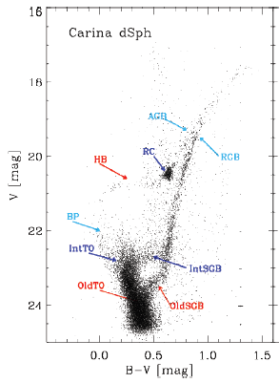
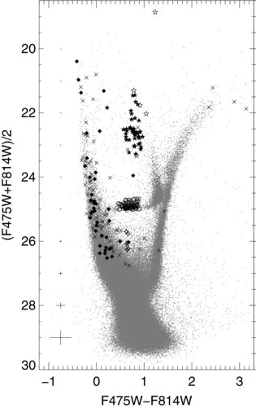
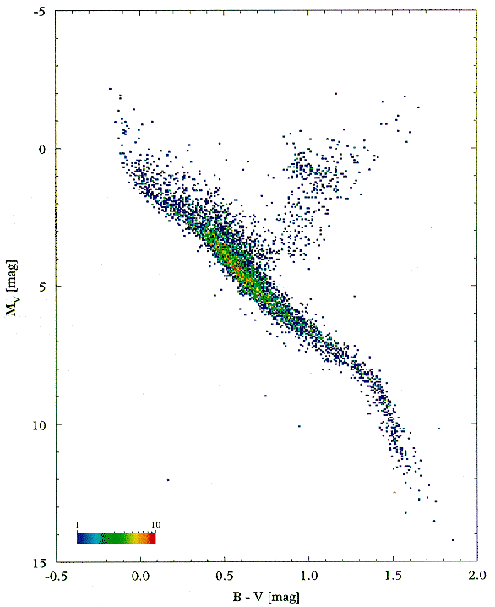
Examples
nearby stars
IC 1613

Slide 5
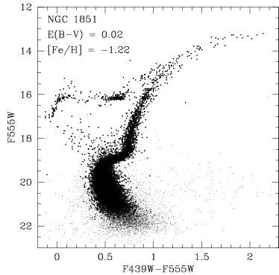
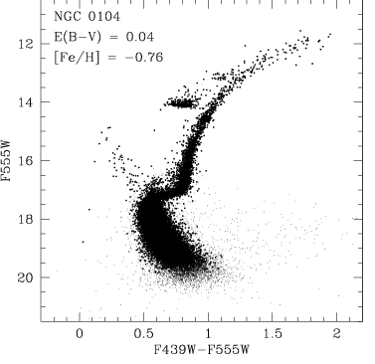
Effect of heavy element content
Horizontal branch extends further to the left for lower (initial) heavy element content

Slide 6
Stellar evolution
Step 0: pre main sequence
gas cloud collapses under gravity
this will make it spin faster and form a disc (later planets)
lost gravitational potential energy is partly converted to internal heat and partly radiated away
star is large, cool and quite luminous
eventually core gets hot enough to fuse hydrogen
star has reached main sequence

Slide 7
Stellar evolution
Step 1: main sequence
fusing hydrogen to helium in core
star will spend ~90% of its lifetime here
luminosity and colour (surface temperature) depend on mass
more massive star will be hotter and much brighter (L ∝ M^{3.5} or so)
surface temperature and chemical composition can be determined from spectrum
eventually core hydrogen will run out

Slide 8
Stellar evolution
Step 2: subgiant and red giant
fusing hydrogen to helium in shell around helium core
this is not a stable situation
H fusing shell gets hotter, generates more energy and pressure
star expands, cools and gets brighter
moves along subgiant branch and up red giant branch
eventually core helium gets hot enough to fuse
note star does not run out of H!

Slide 9
Stellar evolution
Step 3: horizontal branch
fusing helium to carbon in core
position depends on (initial) heavy element content
lower-metallicity stars hotter
stable, but lasts <10% as long as main sequence because helium fusion is only 10% as efficient (and star is brighter now)
eventually core helium will run out

Slide 10
Stellar evolution
Step 4: second red giant branch (asymptotic GB)
fusing helium to carbon in shell around carbon core
very unstable indeed
later, hydrogen fusion turns on again in second shell
very severe mass loss in stellar wind
eventually all outer layers are blown off, causing fusion to stop and leaving very hot carbon core

Slide 11
Stellar evolution
Step 5: planetary nebula and white dwarf
carbon core will ionise and excite surrounding gas, making it glow
planetary nebula
gas will eventually dissipate, leaving behind small, hot white dwarf
which will just cool off as it gets older

Slide 12
Massive stars
Differences from lower-mass (<8 solar masses)
much shorter lifetime
luminosity does not change much as they evolve (though colour does)
after He fusion, will repeat process with steadily heavier elements until iron core forms
iron fusion does not generate energy, so collapse of iron core is catastrophic
core produces neutron star or black hole, rest of star bounces off core to produce supernova explosion

Slide 13
