Slide 1
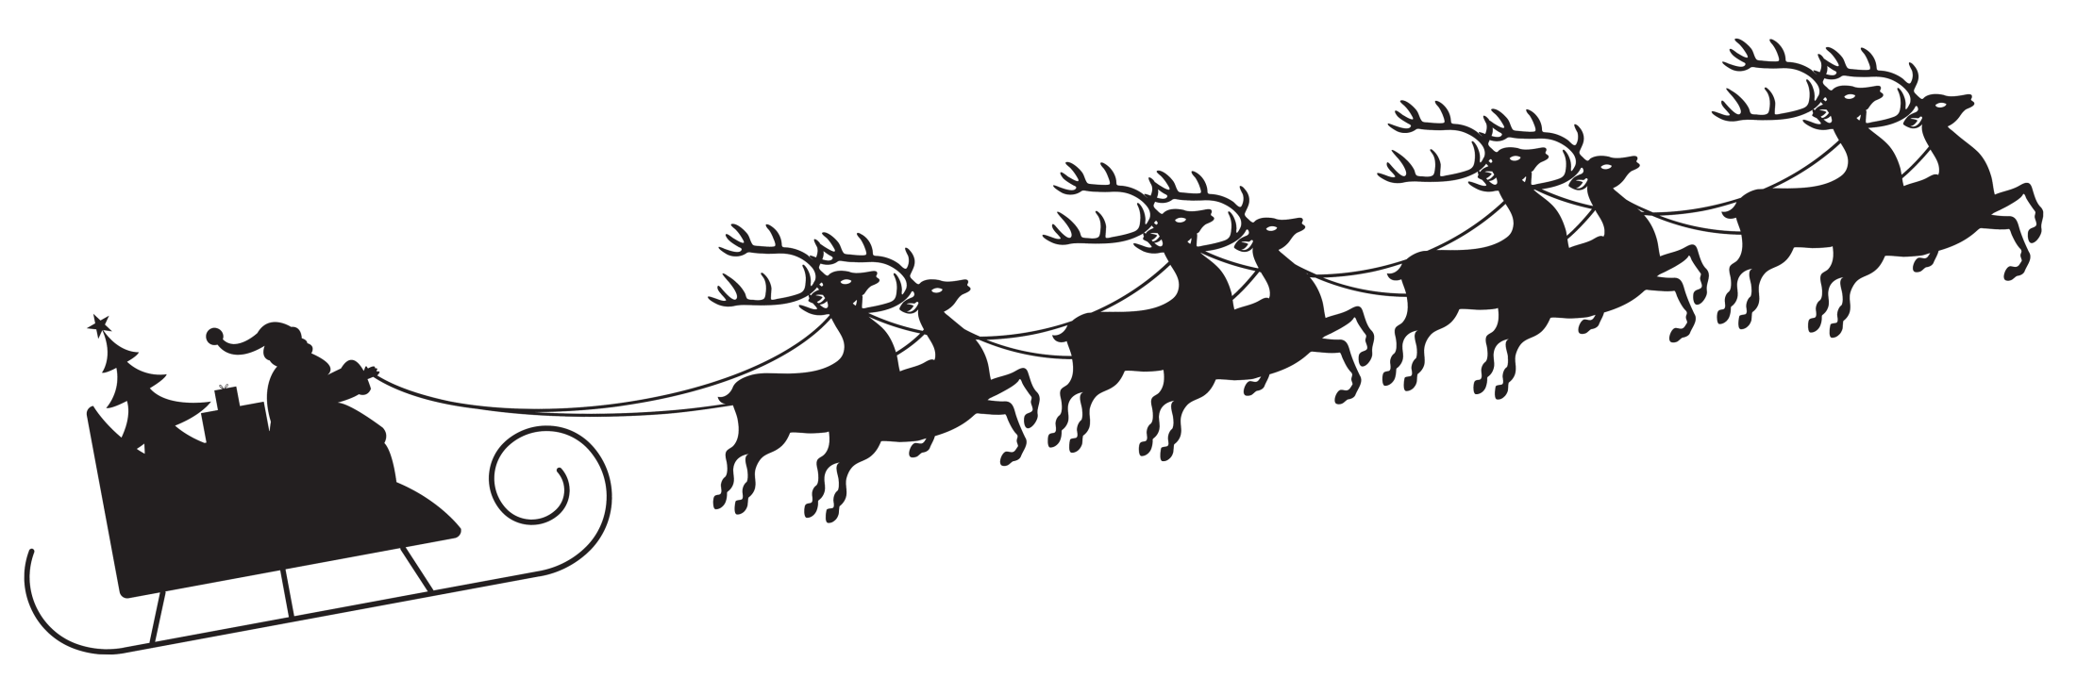
The Physics of Santa
Susan Cartwright

Slide 2
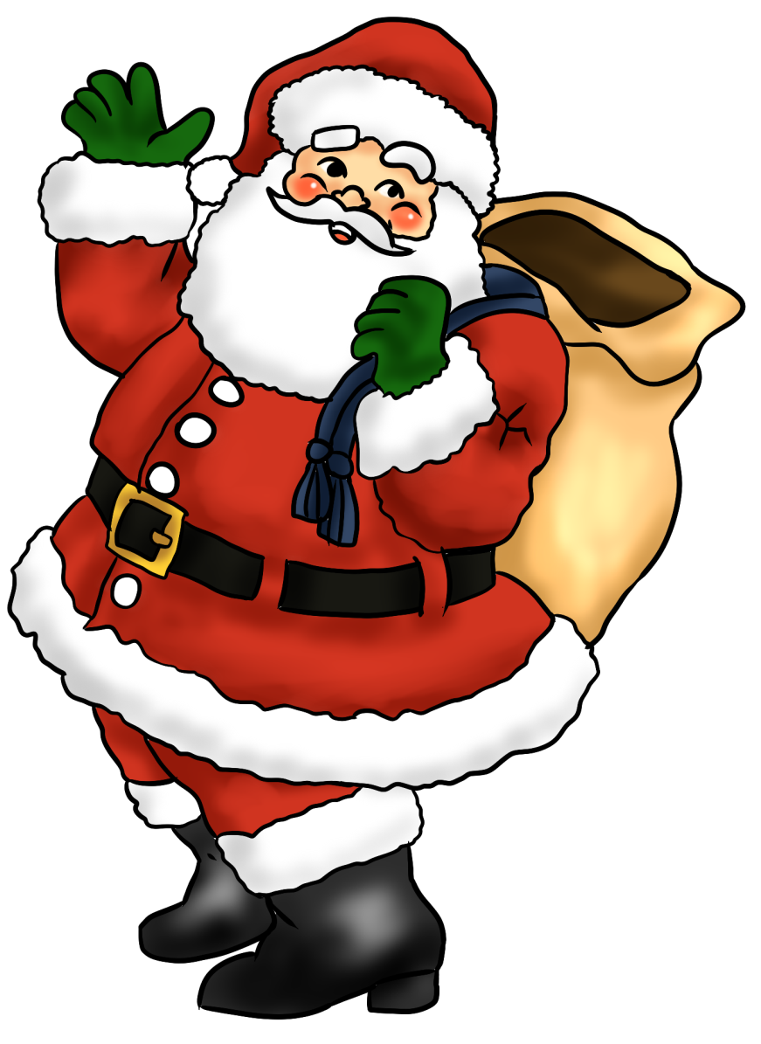
Santa: the job description
Deliver toys to children on Christmas night
Associated with Christian deity, so delivery only required in Christian countries and to Christian households in non-Christian communities
Access to households should be gained via chimney, and deliveries left under Christmas tree unless instructions to contrary
Post-holder is entitled to consume any mince pies or similar left out near delivery location

Slide 3
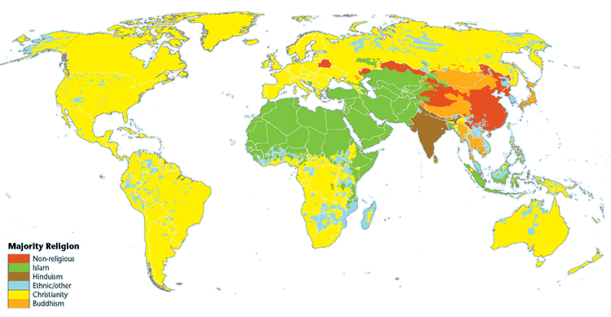
The Big Problem
About a third of the world population is Christian
We expect Santa to deliver to around 500 million households, spread over the whole world, in one night
This gives him 0.17 ms per house, including travel time
This presents Santa with a fearsome logistical challenge

Slide 4
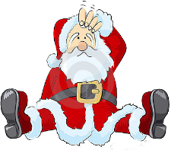
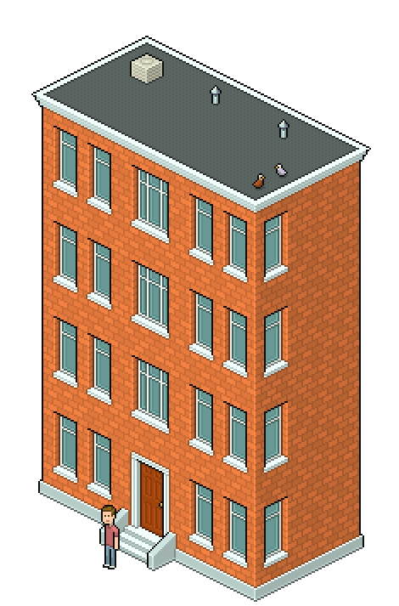
The smaller problem
The chimney is an endangered species
Santa has a bit of an access problem…
…and that’s not even thinking about flats and apartments
Clearly Santa needs some assistance from physics!

Slide 5
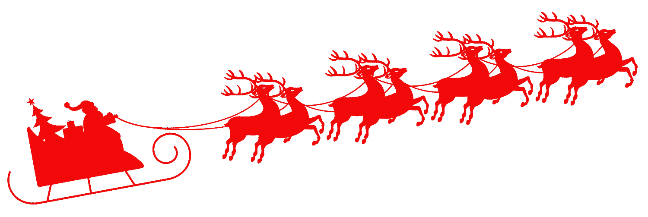
Plan A: Relativity (or, Rudolph the redshifted reindeer)
We know that travelling close to the speed of light alters the apparent clock speed
Can Santa use this effect to give himself more time to complete his round?

Slide 6
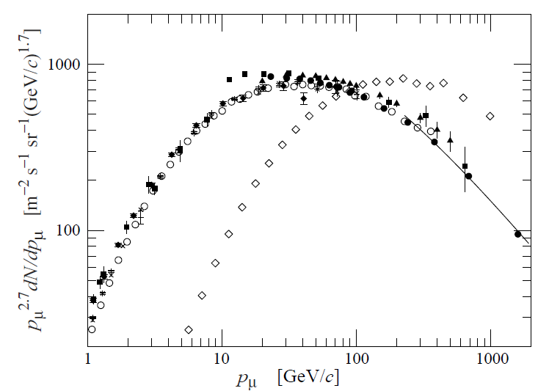
Relativistic time dilation
Example: cosmic ray muons
muons live for 2.2 μs on average and are produced ~10 km up in the atmosphere
at the speed of light they should travel ~660 m
but in fact many reach sea level
From Santa’s point of view this is the wrong way round
We see a longer time than the muons do
θ = 0°
θ = 75°

Slide 7
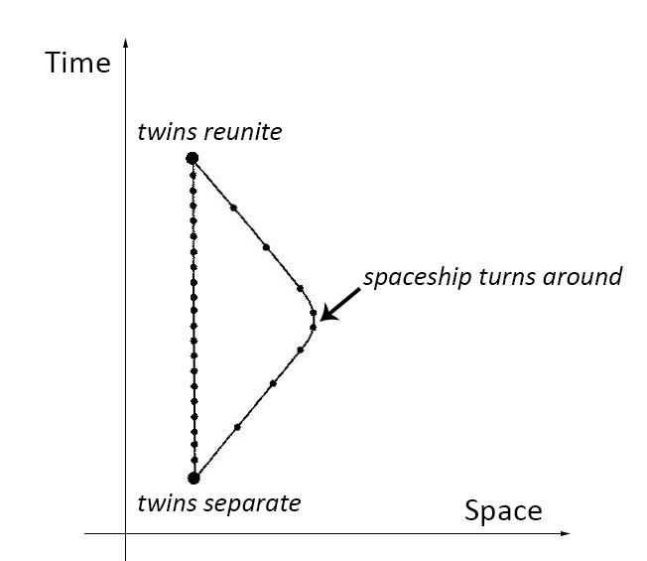
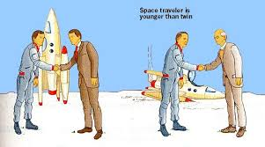
The Twin Paradox
In relativity there is no absolute state of rest
If two people are moving relative to each other, each sees the other’s clock run more slowly
So why is it clear that Santa will experience less time than we do?
The two cases are not symmetrical
Santa has to return to the North Pole, which means that he must change direction
This is the Twin Paradox of relativity

Slide 8
Conclusion
Plan A doesn’t work.
Travelling at close to the speed of light won’t help.
(And dropping off the presents at close to the speed of light probably voids the warranty.)

Slide 9
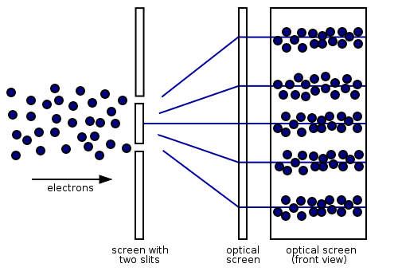
Plan B: Quantum Mechanics (or, Schrödinger’s Claus)
Maybe Santa is a quantum object
This would mean that he can be treated as either a particle or a wave, so his location is not well determined
Example: electron diffraction
If we fire a beam of electrons at a double slit, we get an interference pattern (as with waves)
How does this help Santa?
(We do not, after all, have a beam of Santas.)

Slide 10
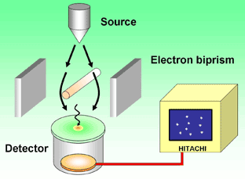
The single-electron double-slit experiment
We only send one electron at a time, yet we get an interference pattern.
The one electron must take both paths!
http://www.hitachi.com/rd/portal/highlight/quantum/movie/index.html

Slide 11
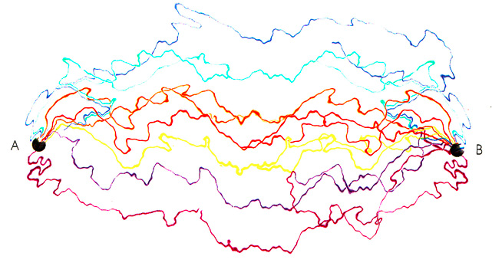
The sum over histories
In Richard Feynman’s formulation of quantum mechanics, the particle takes every possible path from A to B
Clearly this is a potential winner…if Santa takes every possible path from the North Pole, he has the opportunity to deliver to every household individually

Slide 12
Tunnelling
Another useful aspect of quantum particles is that they can tunnel through barriers
Example: hydrogen fusion in stars
Two protons feel a repulsive force because they are both positive
This should prevent them from ever getting close enough to fuse (at the temperature of the Sun’s core)
But in fact they do get through: their wavelike properties allow them to “tunnel” through the barrier
Is this a solution to our chimney issue?

Slide 13
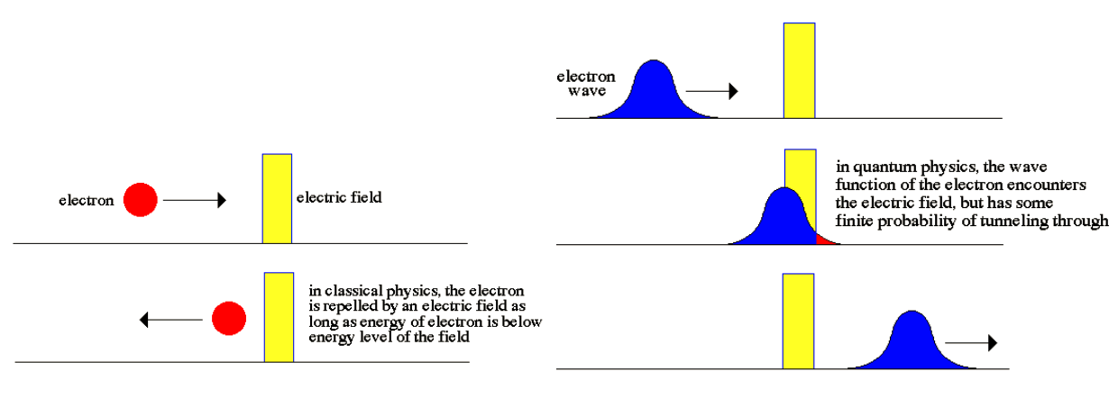
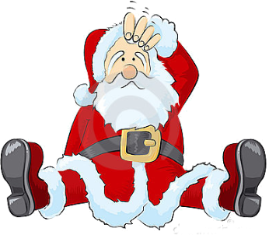
Tunnelling

Slide 14
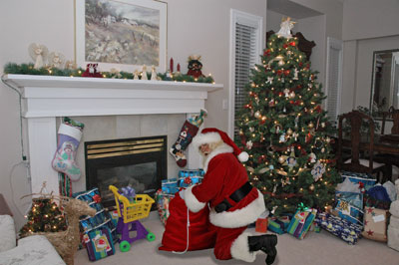
The snag: wavefunction collapse
If we observe the electron as it passes through one slit or the other, we do not get an interference pattern
By making an observation, we “collapse the wavefunction” and define the position of the electron
Therefore, actually seeing Santa deliver presents is a disaster!

Slide 15
Conclusion
Quantum mechanics can solve Santa’s problems, provided that he is allowed to behave like a single particle…
…and provided nobody sneaks a peek!

Slide 16
Merry Christmas, and may Quanta Claus be good to you!

