Slide 1
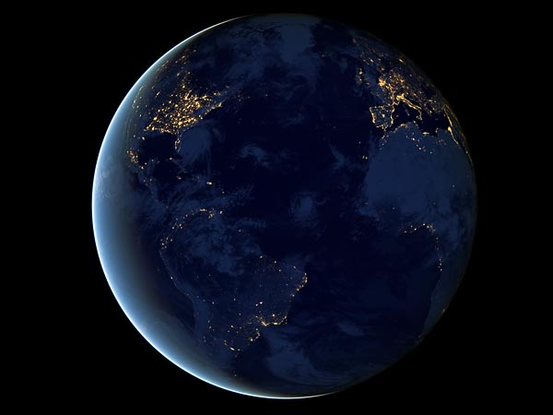
The only intelligent planet?
Susan Cartwright
University of Sheffield

Slide 2
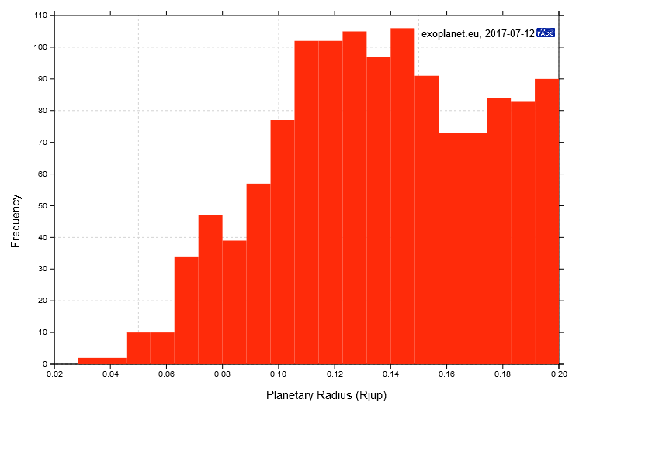
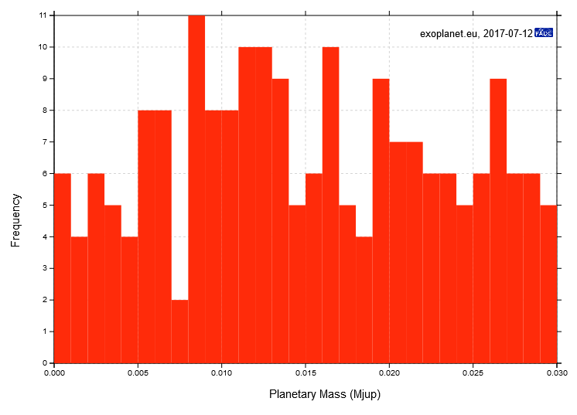
Are we alone?
We have now discovered over 3600 planets in ~2700 systems
  planets are common
  Earth-sized planets
  probably aren’t rare
1284 planets
<2.2 Earth radii
10
8
6
4
2
0
201 planets <10 Earth masses
0 2.5 5 7.5 10

Slide 3
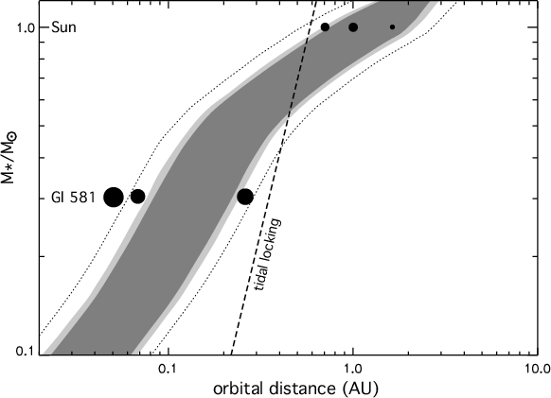
Are we alone?
Several planets have been discovered in or near their star’s habitable zone
  the distance at
  which liquid water
  could exist on an
  Earth-like planet
  note that
  subsurface
  oceans can
  exist further
  out, e.g.
  Europa

Slide 4
Are we alone?
Conclusions
  Earth-sized planets probably are not uncommon
    small current numbers reflect difficulty of detection, not non-existence
  Earth-sized planets, and maybe large moons of giant planets, do exist at appropriate distance from star
    therefore, if life develops easily given appropriate conditions, it should be widespread in Galaxy

Slide 5
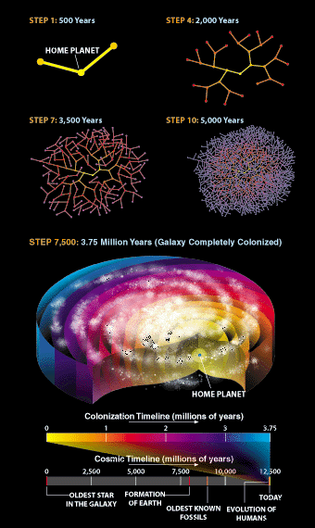
The Fermi Paradox
Why aren’t aliens obvious?
  A civilisation not much more advanced than us could build self-replicating robot probes
  These can visit every star in the Galaxy in < 10 Myr
    with quite modest assumptions about performance
  Therefore aliens should already be here!

Slide 6
Resolutions to the Fermi Paradox
They do not exist.
They exist, but do not colonise or communicate.
They exist and colonise, but we are looking in the wrong places.
We do not exist!

Slide 7
They do not exist.
Life is rare.
  Life occurred early on Earth, but maybe it occurs early or not at all?
  Life elsewhere in Solar System (Mars? Europa?) would disprove this.
Complex life is rare.
  Rare Earth hypothesis:
    maybe evolution of complex life requires special conditions or unlikely events
    if only one planet ever evolves complex life, we have to be living on it!

Slide 8

They do not exist.
Intelligence and/or technology is improbable.
  Tool use and language appear
  obviously advantageous, but are
  very rare and unique, respectively
    Are they difficult to develop by
    natural selection?
  Technology requires suitable
  environment
    Dolphins aren’t going to develop
    metal-working any time soon...

Slide 9

They exist, but do not colonise.
Technological civilisations have limited lifespan.
  Naturally limited by extinction-level events
    Asteroid impacts, ice ages...
  Artificially limited by incompetence
    Nuclear war, global warming...

Slide 10
They exist, but do not colonise.
Lack of curiosity/resources
  Nobody cares enough to invest the time and effort
Galactic Zoo hypothesis
  Star Trek “Prime Directive”
    thou shalt not mess with primitive civilisations
  But why wouldn’t Earth have been colonised earlier—hominids have existed for <10 Myr?
Explanations of this form have the disadvantage that you only need one exception

Slide 11
We are looking in the wrong place.
The “Singularity” hypothesis:
  computers improve at exponential rate
  next phase of evolution might be conversion from biological to software-based “life”
    artificial intelligence and/or uploaded biological intelligence
  silicon-based life would not appreciate terrestrial conditions
    oxygen and water nasty stuff if you’re a computer

Slide 12
We do not exist.
If humanity is destined to develop into a post-biological computer-based culture
  they might well wish to study their ancestors
  they might choose to do this through computer simulation
  with near-unlimited computing power, their simulated personalities would be conscious
There is only one real past, and presumably many simulations, so...

Slide 13
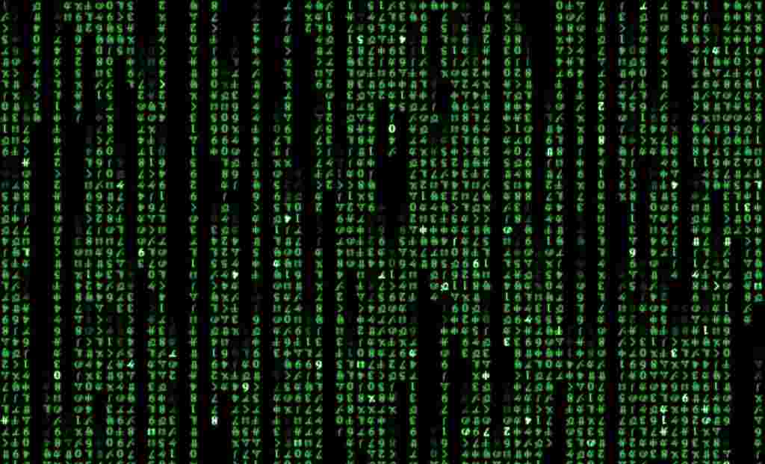
We do not exist.

