Slide 1
What’s the matter with antimatter?
Susan Cartwright

Slide 2
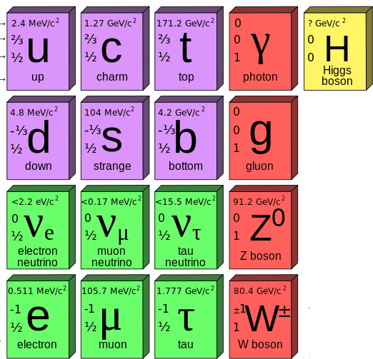
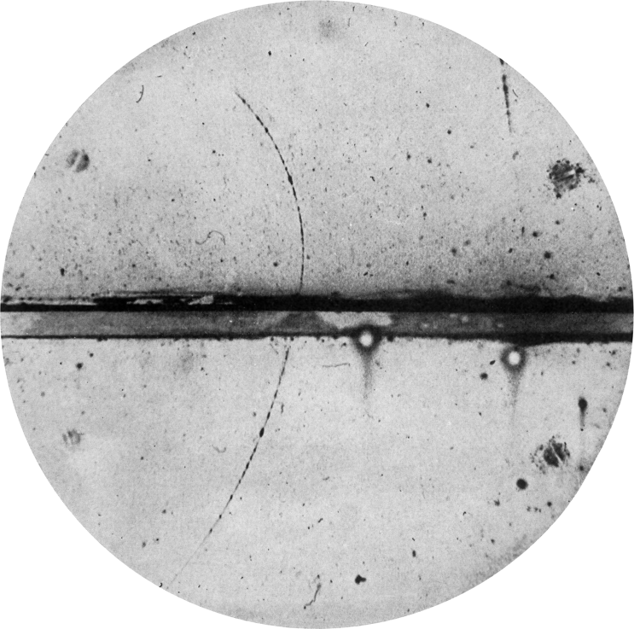
What is antimatter?
The Standard Model of particle physics contains 12 fundamental particles
9 of these have electric charge
It turns out that each of these particles has a corresponding antiparticle
with the same mass and interactions, but opposite charge
The first antiparticle discovered was the positron (1932—predicted 1928)
a positively-charged electron

Slide 3
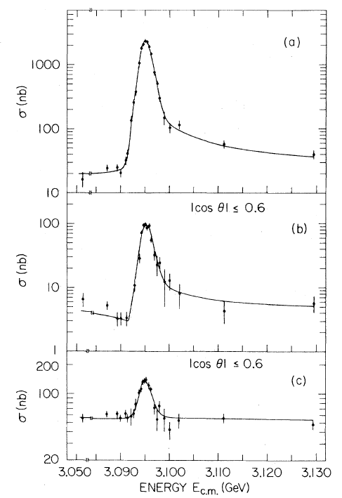
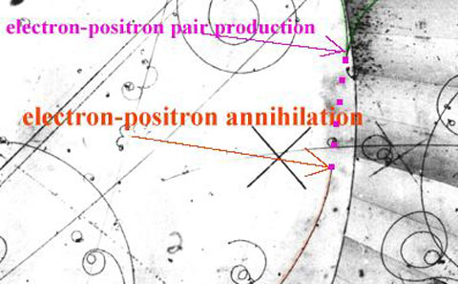
Matter and antimatter
Because they have opposite quantum numbers, particles and antiparticles can annihilate each other
e.g. e⁺e⁻ → γγ
Also, when particles are created by accelerators, they normally come as particle-antiparticle pairs
e.g. e⁺e⁻ → γ → cc̄

Slide 4
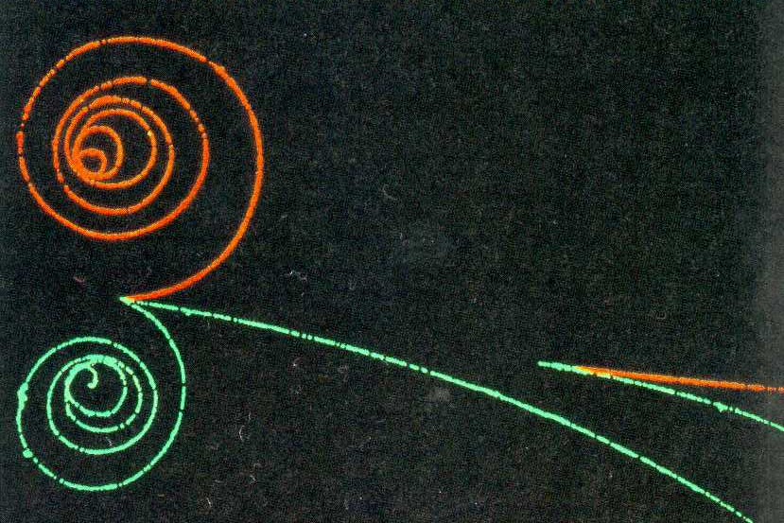
So what’s the problem?
When we make particles in the lab, we make particle-antiparticle pairs
either a particle and its exact antiparticle, or related particles (e.g. containing a quark and its antiquark)
there are various conserved quantum numbers which mandate this
So, when particles were made just after the Big Bang, we would expect them to be made as particle-antiparticle pairs
So the Universe should be a 50:50 mixture of matter and antimatter
But it isn’t: there is essentially no antimatter
So the question is: where did all the antimatter go, and why?

Slide 5
How do we know?
What is the evidence that the universe does not contain equal quantities of matter and antimatter?
This is a fair question: antistars made of antihydrogen would shine just like stars, so from a safe distance there would be no obvious difference
The key point here is that space is not empty
there is the solar wind in the solar system, the interstellar medium within the Galaxy, and the intracluster medium in clusters of galaxies
If gas were to collide with antigas, we would see the results of particle-antiparticle annihilation

Slide 6
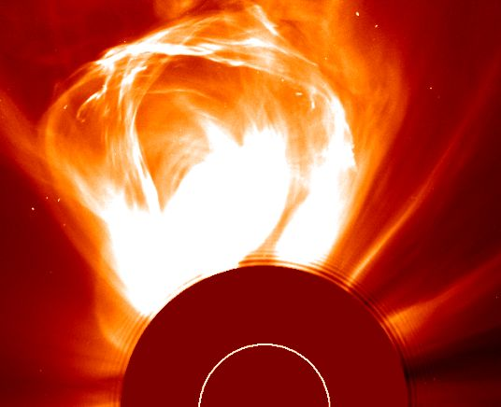
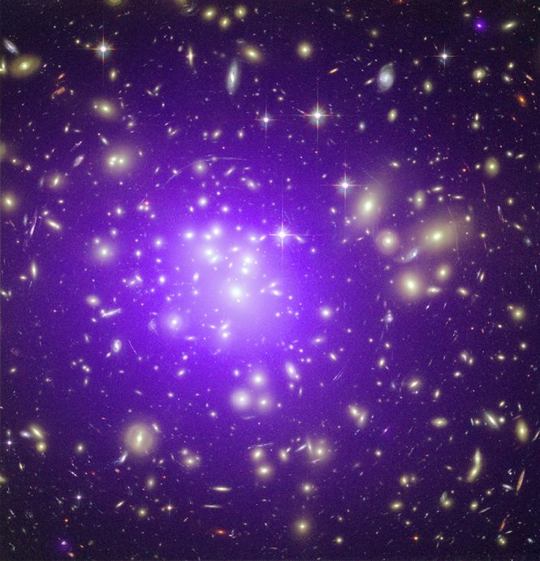
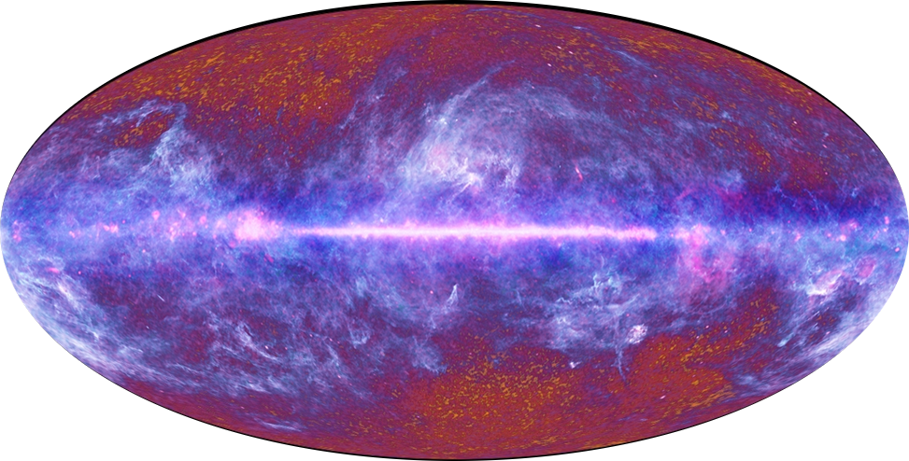

Slide 7
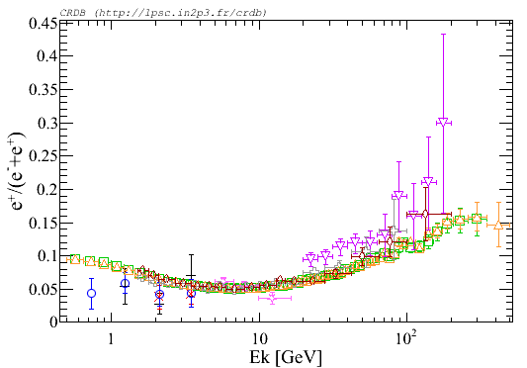
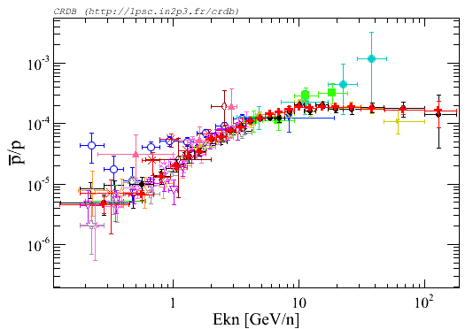
Antimatter in cosmic rays
We do see low levels of positrons and antiprotons
these can be made by reactions like p+p → p+p+p+p̄ and γγ → e⁺e⁻
We do not see anything requiring large-scale antimatter, e.g. antihelium or anticarbon
e⁺/(e⁺+e⁻)
unexpected but understandable
p̄/p
consistent with expectations

Slide 8
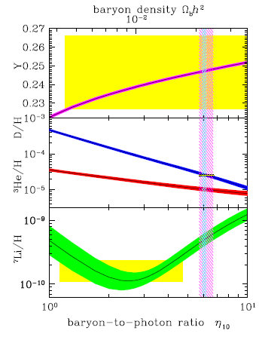
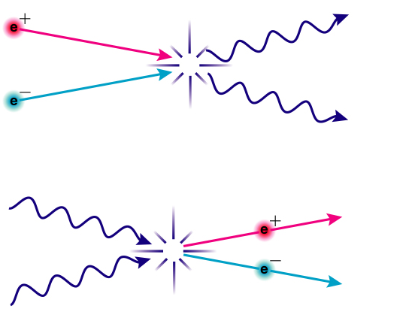
Fossil antimatter
Was there never any antimatter?
Abundance of the lightest isotopes (²H, ⁴He, ⁷Li) suggests otherwise
In particle physics experiments we tend to make approximately equal numbers of charged particles and photons
In the Universe there are about 6 protons for every 10 billion photons!
This suggests that there was originally a lot more matter
Most of it annihilated, but we are looking at (and made up of) a bit that got left over
How could this happen?

Slide 9
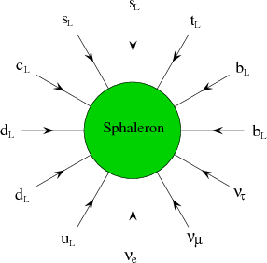
Matter vs Antimatter
Why can’t we make matter or antimatter alone?
Particle reactions conserve baryon number (basically, total number of quarks – antiquarks) and lepton number
Reactions that cannot happen: p → e⁺π⁰, μ → eγ
This is a good thing: proton decay would be bad news!
Surprisingly, such processes are not forbidden in the Standard Model
but the mechanism that allows them operates only at extraordinarily high energies
i.e. a fraction of a second after the Big Bang
Why doesn’t this solve all our problems?

Slide 10
Matter vs Antimatter: the sequel
Remaining problem: most reactions can go in either direction
Having a matter-creating reaction is not helpful if it is balanced by a matter-destroying reverse reaction
Therefore:
the reaction must not be in thermal equilibrium
i.e. it must not have reached a stable steady state in which forward and reverse reactions go at the same rate
there must not be a matching antireaction involving antiparticles
in particle physics jargon, C must be violated
this is OK: C is conserved in strong and electromagnetic interactions, but it is violated in weak interactions
there must not be a reflected antireaction involving antiparticles
CP must also be violated

Slide 11
C and CP
In the weak interaction, C and P are not conserved separately—these decays do not match reality.
The CP reversed decay does match reality
P
C
CP
B
⁶⁰Co
⁶⁰Co
electrons
positrons

Slide 12
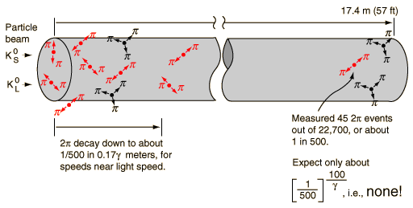
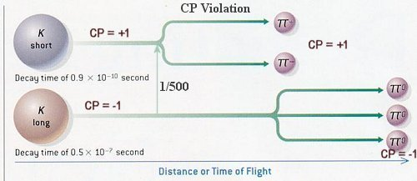
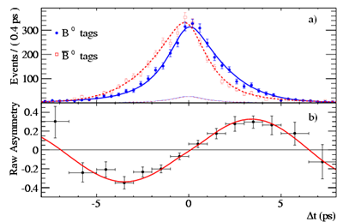
CP violation
It turns out that the weak interaction does violate CP
Discovered in 1964 by Cronin and Fitch in decay of neutral K meson
This exists as two states, a “CP even” one which decays to 2 pions (K_{S}) and a “CP odd” one which decays to 3 pions (K_{L})
Cronin & Fitch found that occasionally the K_{L} decays to 2 pions
very rare, but should not happen at all if CP conserved
Equivalent effects since observed in decays of B mesons
Problem solved?

Slide 13
Baryogenesis
The Universe has a baryon-to-photon ratio of about 0.6 ppb
With no CP violation we would expect about one billionth of this!
The level of CP violation observed in the quark sector is nowhere near large enough to solve this problem
it is at least a factor of 1000 too small
Grand Unified Theories (GUTs) can produce matter-antimatter asymmetries at very high energies
but in an inflationary universe this is diluted away by the inflation
leaving one extra baryon per observable universe…not helpful…
We need some new physics!

Slide 14
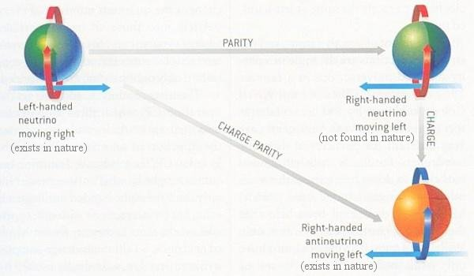
Neutrinos and CP violation
Another possible source of CP violation is neutrino interactions
The neutrino sector involves weak interaction CP violation just like the quark sector
We think that the known neutrinos—which are almost massless—have very heavy partner particles which would be important in the early universe
CP violation in the heavy neutrino sector can produce matter-antimatter asymmetry via leptogenesis

Slide 15
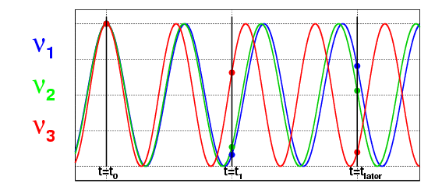
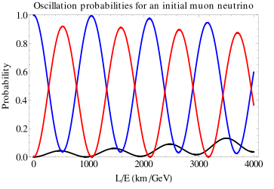
Do neutrinos violate CP symmetry?
We can study this through neutrino oscillation
There are three types of neutrino
There are three neutrino masses
But the divisions do not align
Each neutrino type is a mixture of different masses, and each neutrino mass is a mixture of different types
A neutrino can be produced as ν_{μ}, travel some distance, and interact as ν_{e}
The different mass states travel at different speeds, so get “out of step”
This behaviour is affected by CP violation

Slide 16
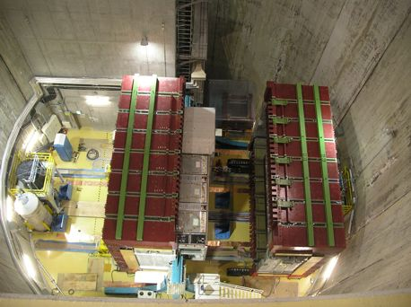
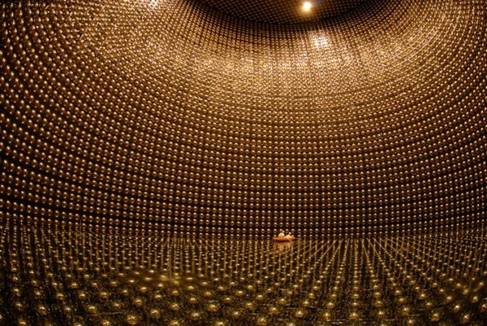
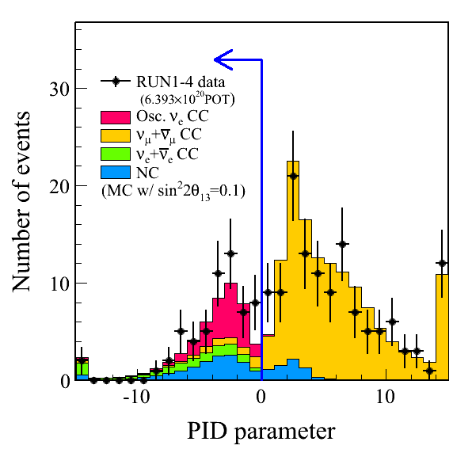
Neutrino oscillations: T2K
Produce ν_{μ}—detect ν_{e}

Slide 17
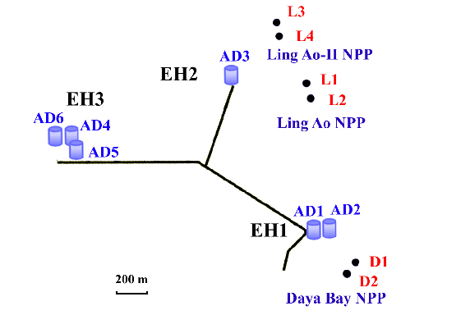
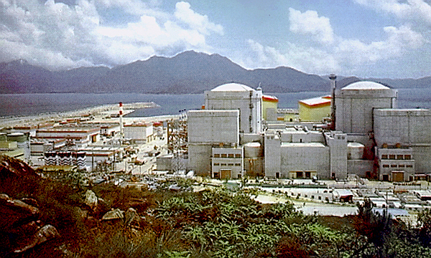
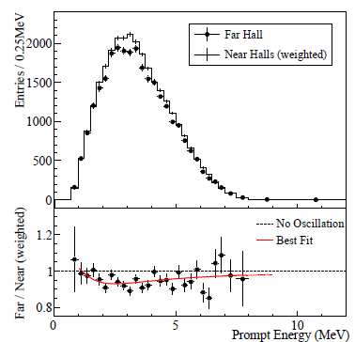
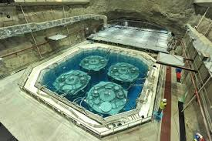
Neutrino oscillations: Daya Bay
Produce ν̄_{e} Detect ν̄_{̄μ}

Slide 18
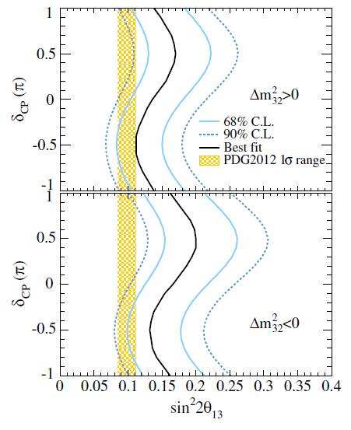
Neutrino oscillations and CP
T2K results depend on CP violation parameter δ
Reactor results don’t
Combining the two gives insight into value of δ
The current results suggest a non-zero value
Statistics not yet high enough to be certain
New NOνA experiment in the USA will provide more information

Slide 19
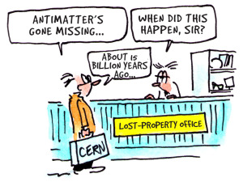
Summary
Our Universe contains matter and not antimatter
This is essential—if matter and antimatter all annihilated in the early universe, we would not exist!—but difficult to explain
So far, we do not have a good explanation
The key may lie in neutrino physics—or it may be something entirely new

