Slide 1
The Dark Universe
Susan Cartwright

Slide 2
The Dark Universe
Darkness Visible
Dark atoms
Dark matter
Dark energy

Slide 3
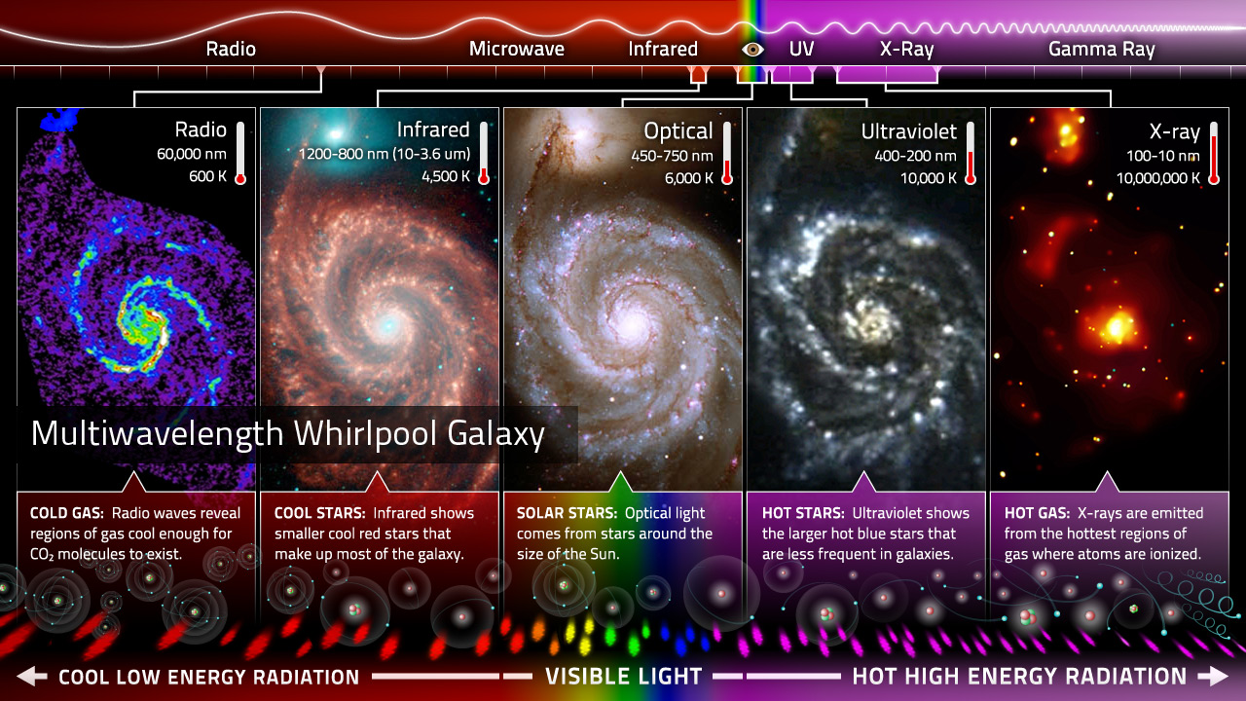
Darkness visible
We observe the Universe throughout the electromagnetic spectrum
http://ecuip.lib.uchicago.edu/multiwavelength-astronomy/astrophysics/05.html

Slide 4
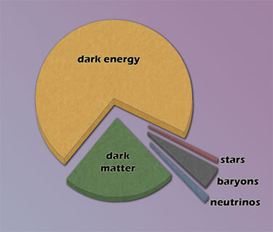
Darkness visible
However, what we see is only a small fraction of the energy content of the Universe
How do we know this?
What makes up the dark universe?
We have two major probes:
Gravity
Cosmology

Slide 5
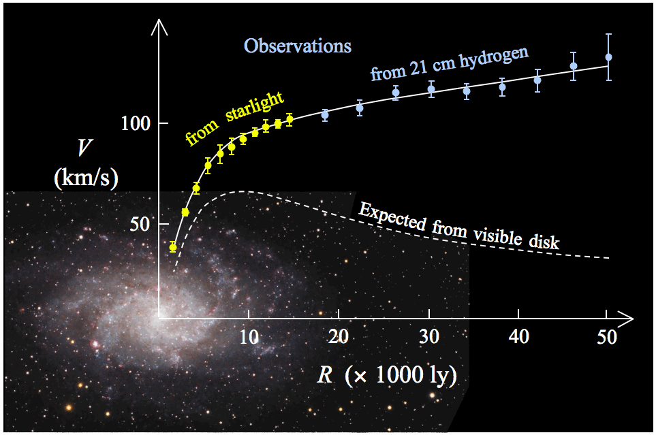
Gravity: galaxy rotation curves
Galaxies rotate much faster than we would expect from their stellar content

Slide 6
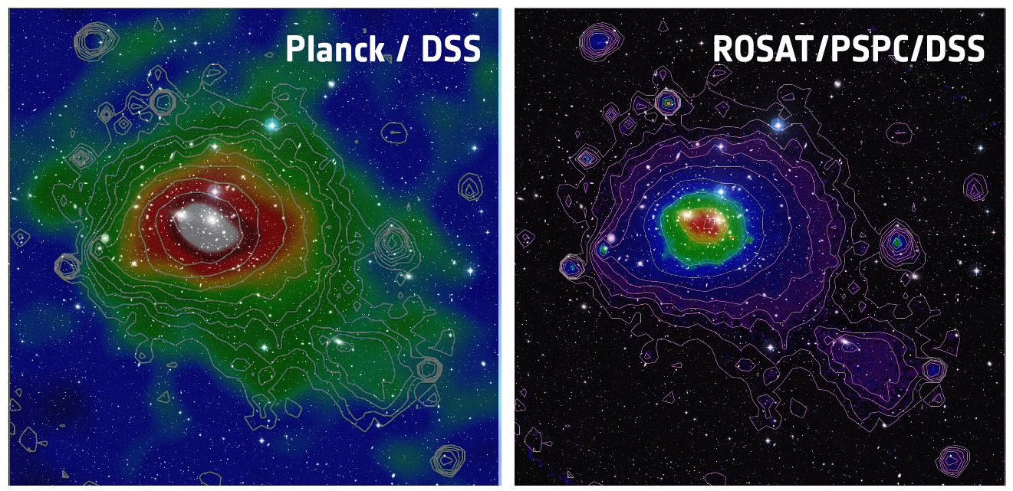
Gravity: X-ray gas
Intergalactic gas in the Coma cluster of galaxies, seen in X-rays (R) and by its scattering of the cosmic microwave background (L)

Slide 7
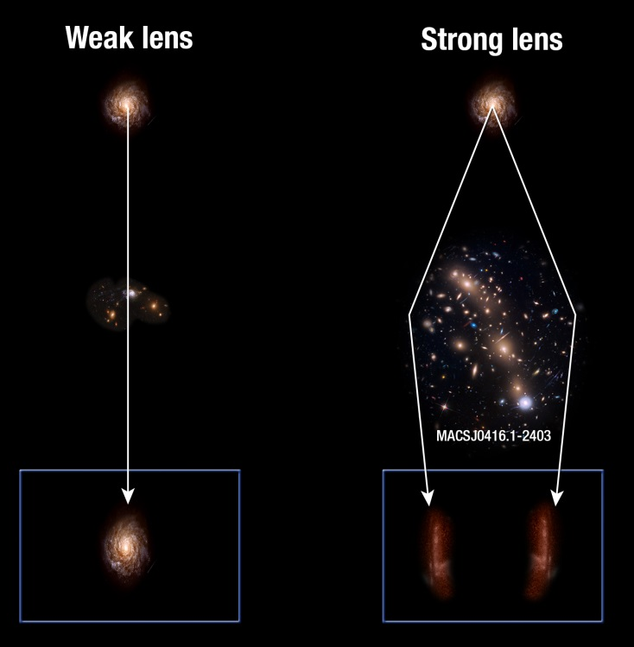
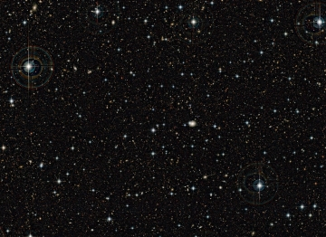
Gravity: gravitational lensing
Intervening matter can act as a lens and distort the images of distant galaxies.
The shape changes caused by weak lensing can be used to map the distribution of matter between us and the background object.

Slide 8
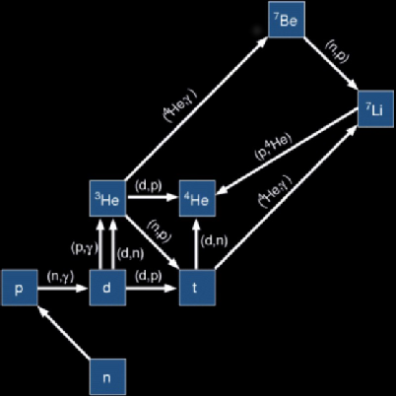
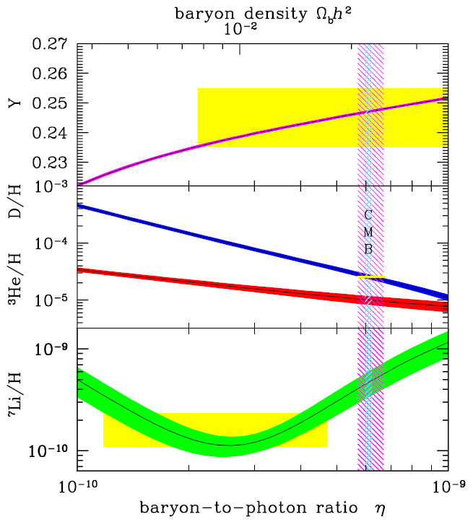
Cosmology: making the light elements
This measurement is sensitive to the density of baryons in the universe
Deuterium (²H), ³He, most ⁴He and most ⁷Li are made a few minutes after the Big Bang.

Slide 9
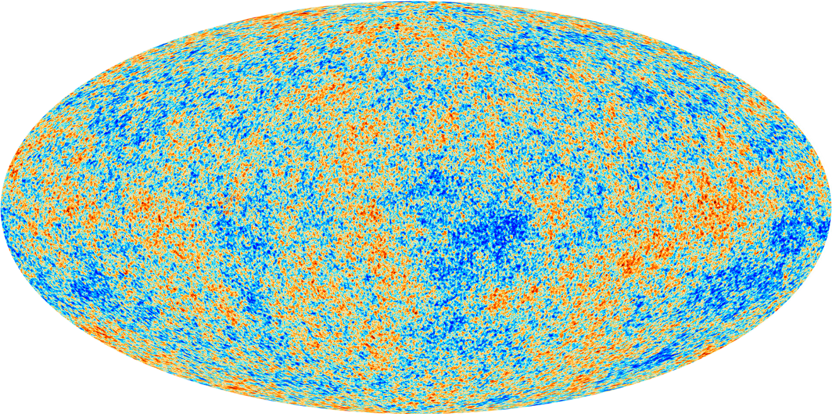
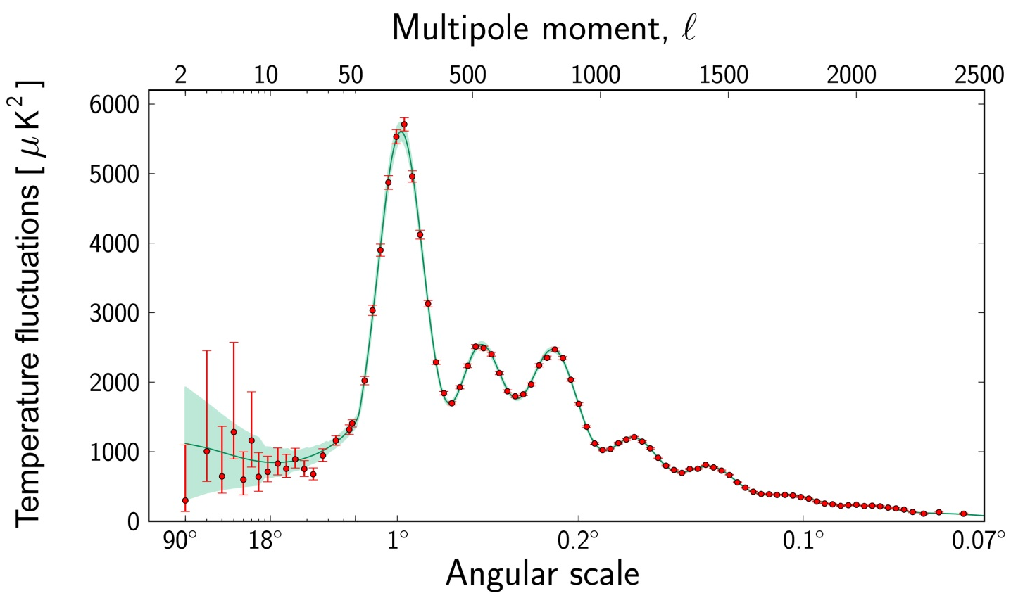
Cosmology: the Cosmic Microwave Background
Emitted about 400000 years after the Big Bang
The characteristic sizes of hot and cold spots tell us a great deal about the early universe and its matter/energy content

Slide 10
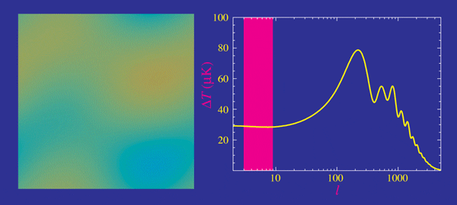
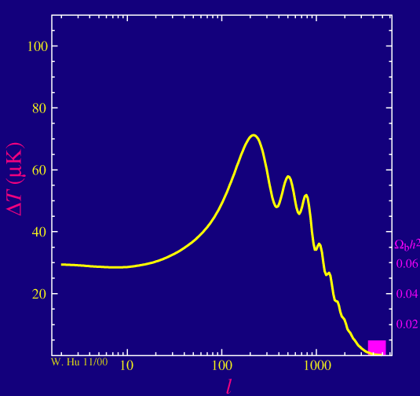
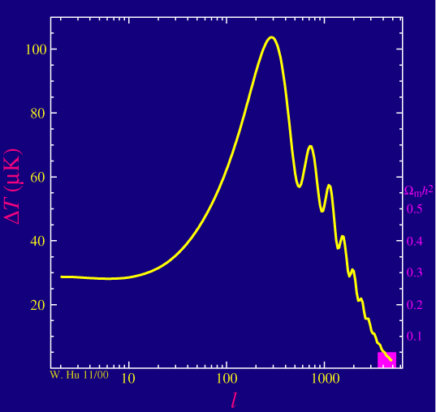
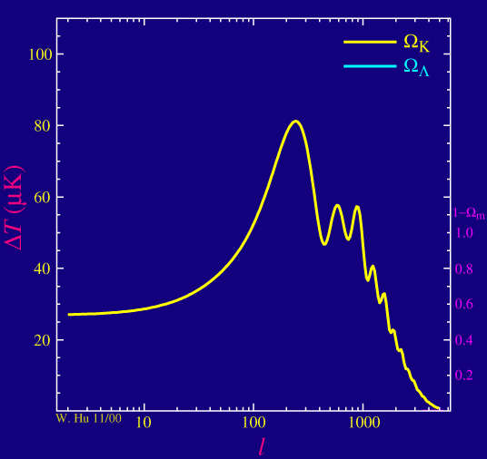
Cosmology: the Cosmic Microwave Background
Baryons
Dark matter
Dark energy
http://background.uchicago.edu/~whu/metaanim.html
The heights of peaks change with changing properties of the universe

Slide 11
The Dark Universe
What makes up the dark universe?
Dark atoms
Dark matter
Dark energy

Slide 12
Dark atoms
Only about 10% of atomic matter is contained in stars.
The rest is mostly in gas, which may be invisible to our eyes but can be seen in other wavelengths—in this case, X-rays.
Anything made of atoms will interact with photons, and can therefore be “seen” at some wavelength or other. It also leaves a footprint in the CMB.

Slide 13
Dark matter
Most of the dark stuff is not atoms
from light element abundances
from CMB
from comparison of X-ray gas and gravitational lensing
There is nothing in the Standard Model of particle physics that has the properties needed for dark matter. It must be new physics.

Slide 14
Dark matter
There are many theoretical candidates for the dark matter particle, but as yet no experimental evidence for any of them:
WIMPs—heavy neutral particles: could be detected at the LHC or observed by direct detection experiments here on Earth
axions—very light particles proposed to explain why nature is nearly mirror-symmetric: could be detected by dedicated experiments on Earth
sterile neutrinos—much more massive than ordinary neutrinos, and not sensitive to the weak interaction: very difficult to detect at the masses relevant to dark matter
many more exotic suggestions!

Slide 15
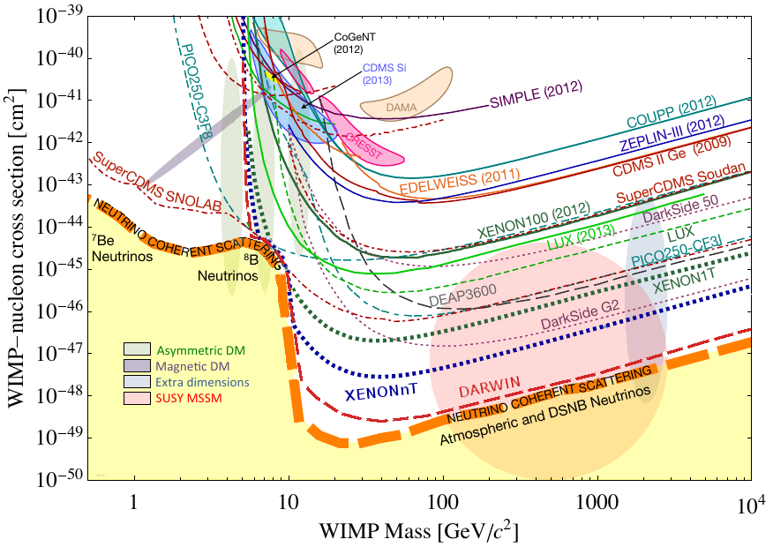
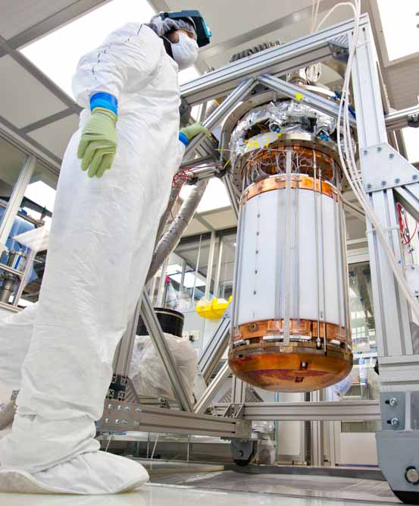
Dark matter
Direct detection experiments look for the signal created when a WIMP collides with a nucleus and the nucleus recoils—we see the recoil, not the WIMP.
Future experiments, under construction, will increase our sensitivity.
LUX experiment

Slide 16
Dark energy
SN 2014J in M82
Gerrit Burggraaf
The expansion of the Universe is accelerating!
A universe composed of atoms and dark matter would have decelerating expansion because of gravity.
The accelerating expansion was first discovered using supernovae—exploding stars whose light can be seen at very large distances.

Slide 17
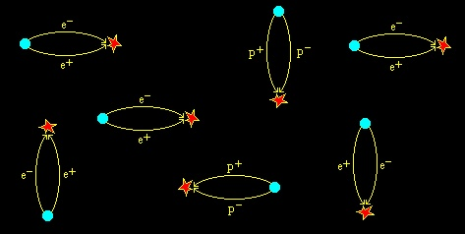
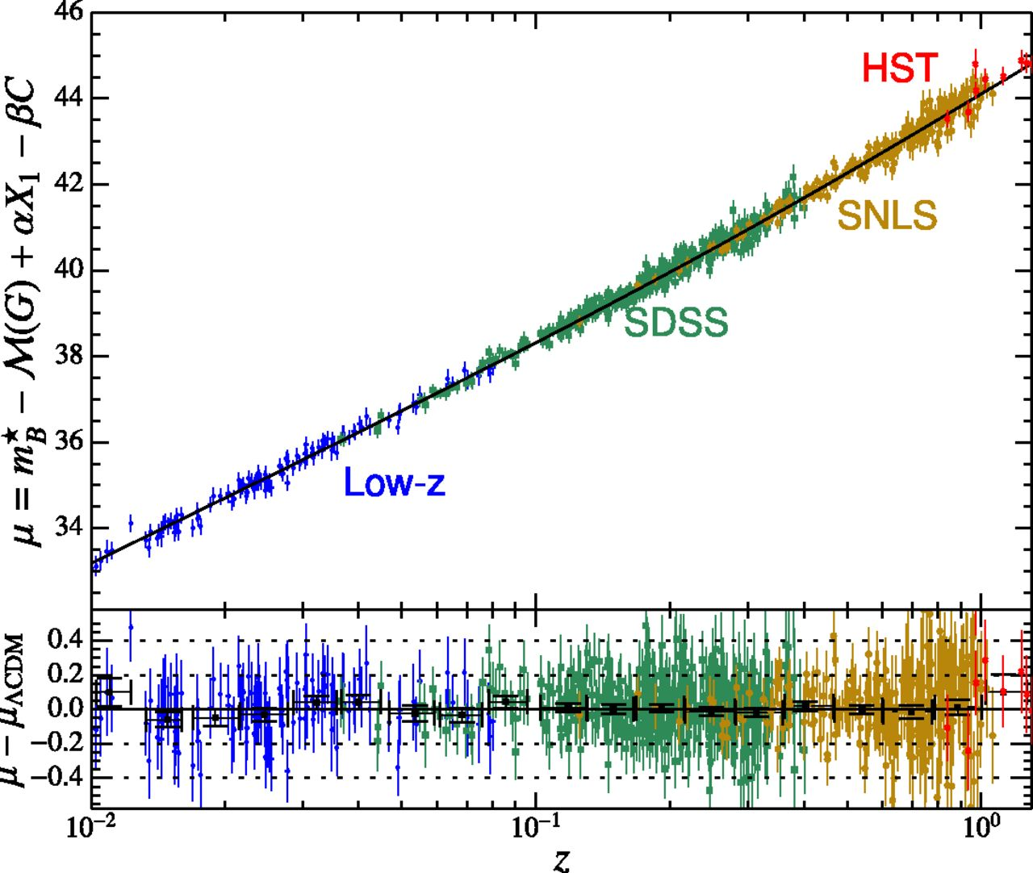
Dark energy
The Uncertainty Principle suggests empty space should contain particle-antiparticle pairs—the vacuum has energy
Dark energy appears in General Relativity as the “cosmological constant” Λ—which Einstein originally introduced to produce a universe which did not expand!
There is no theoretical explanation of why we see a small, but non-zero, Λ—it should be either zero or huge.
The slight upward curve in this plot is a consequence of dark energy

Slide 18
The Dark Universe
We have several converging lines of evidence that indicate that the energy density of the Universe is ~70% dark energy, ~26% dark matter, only 4% atoms, and only 0.4% stars
We think we know where the dark atoms are, and what they are (mostly H and He)
We know where the dark matter is, but we don’t know what it is
We know very little about dark energy
Many discoveries still to be made!

