Slide 1
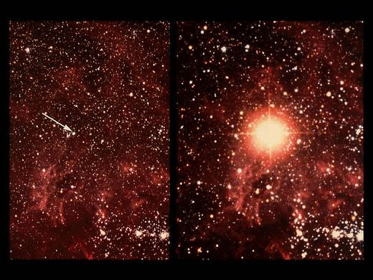
Supernovae
Susan Cartwright
University of Sheffield

Slide 2
What is a supernova?
Stellar explosions
Types of supernova
The importance of supernovae
Supernova remnants

Slide 3
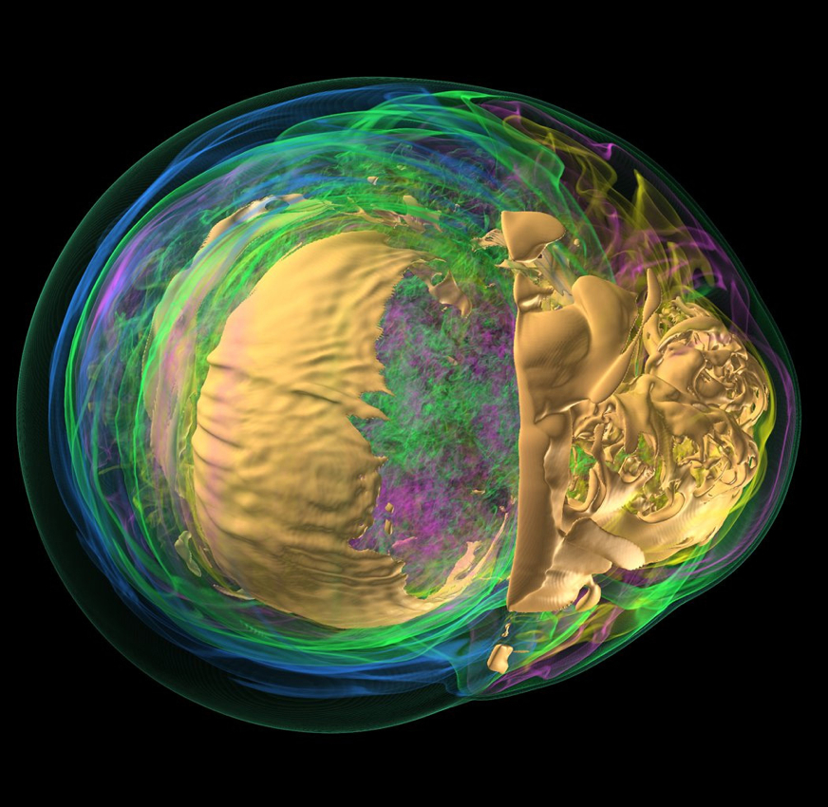
Stellar explosions
Most stars are a balancing act between gravity and pressure
At the end of a star’s life, this balance is lost
fusion processes stop, nothing to provide pressure
In most stars, quantum mechanics takes over
producing a white dwarf
In a few, this does not work
explosion!

Slide 4
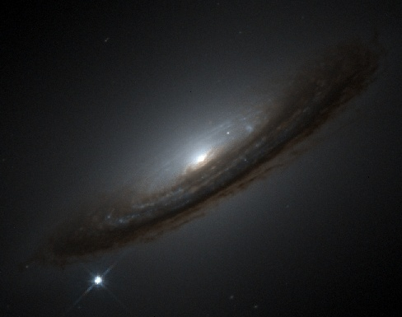
Types of supernova
Most supernovae occur when an inert, superdense stellar core collapses under gravity
core-collapse supernovae—collapse of the iron core of a massive star (>8 solar masses at the beginning of its life)
thermonuclear supernovae—collapse of a white dwarf in a binary system
unclear whether two white dwarfs collide, or a single white dwarf accretes material from a companion
Thermonuclear (Type Ia) SNe are brighter than most CCSNe

Slide 5
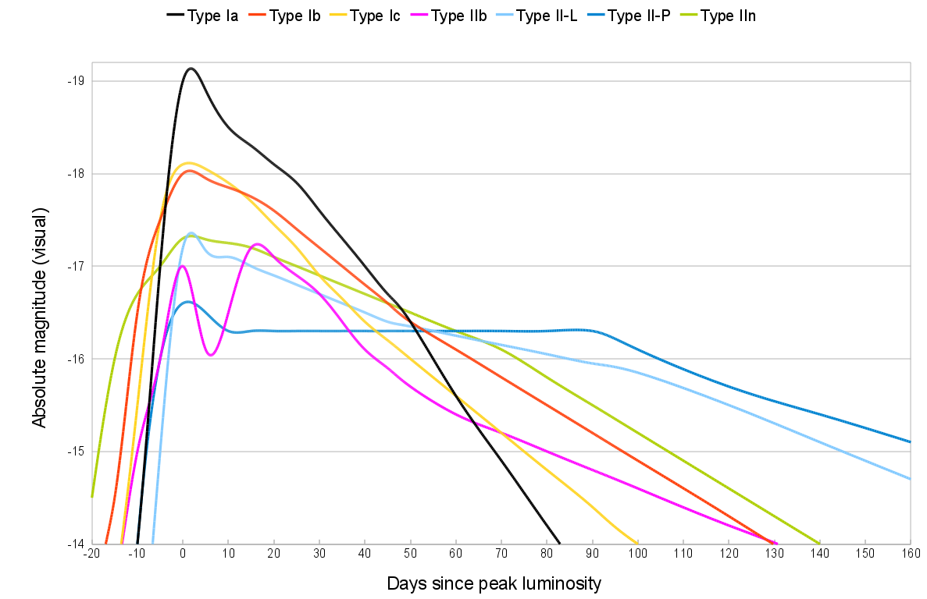
Types of supernovae
early H
no H
H
Different types of supernova are distinguished by their light curves and their spectra
Type Ia are all very similar (one collapsing white dwarf is very like another), but CCSNe vary (many different types of massive star)

Slide 6
The importance of supernovae
Supernovae are responsible for a great deal of heavy element production (including important elements like oxygen [CCSNe] and iron [SNe Ia])
Life on Earth would never have evolved if massive stars did not explode
In astronomy, Type Ia supernovae serve as a long-distance “standard candle”
responsible for the discovery of accelerated expansion (dark energy) in 1998

Slide 7
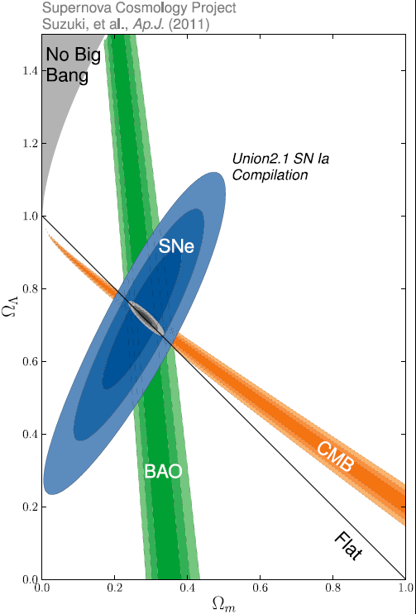
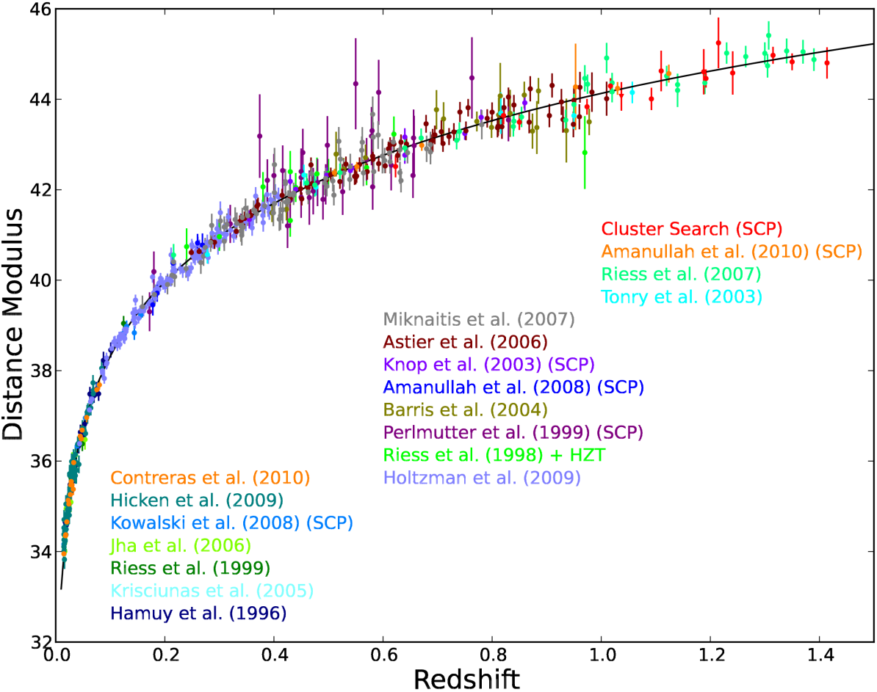
The importance of supernovae
Concerted efforts over the last 20 years or so have produced a very large dataset of SNe Ia for cosmological studies

Slide 8
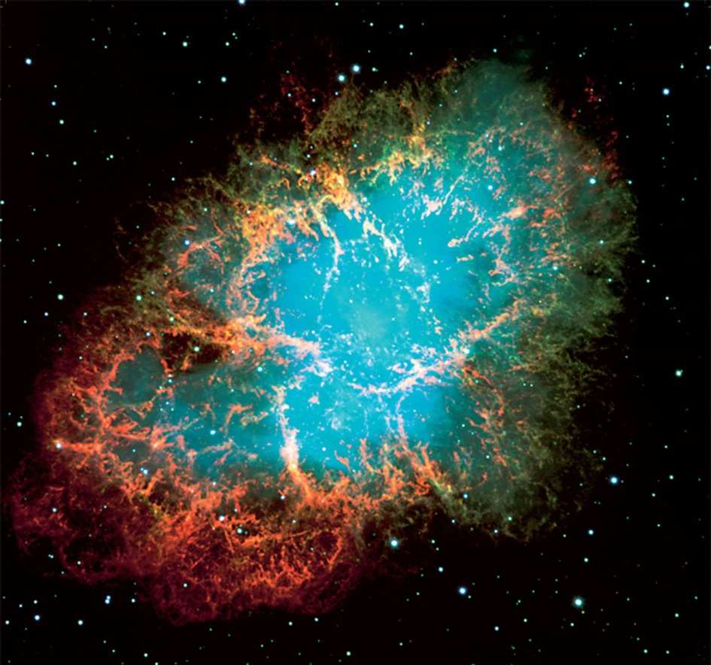
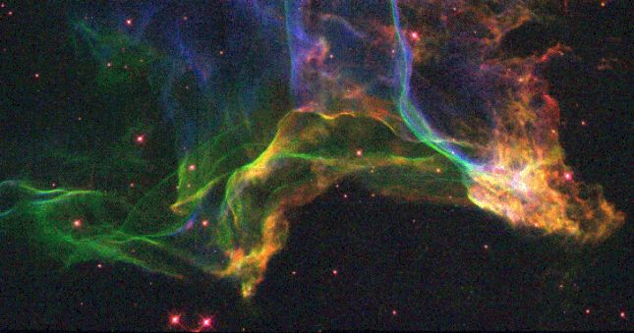
Supernova remnants
Supernova explosions are visible for months, but the expanding gas cloud they leave behind is seen for thousands of years
they seed the interstellar gas with heavy elements
1000 years old
20000 years old

Slide 9
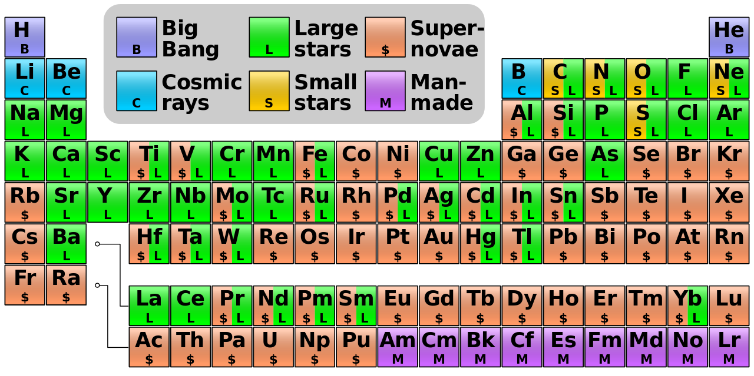
Supernova remnants
Many of the heavy elements are probably made mostly in supernovae; even some that aren’t made in supernovae are distributed via supernova explosions.

Slide 10
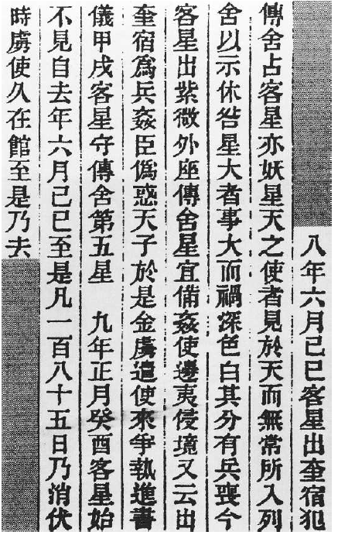
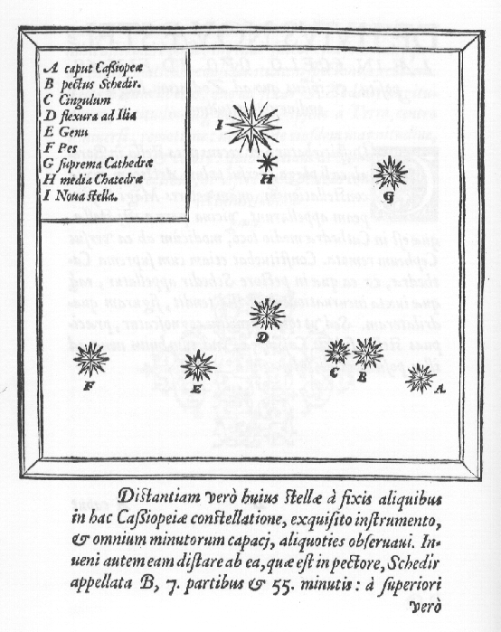
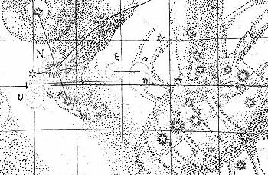
Supernovae in the Milky Way
Historical records of supernovae

Slide 11
Historical supernovae
Supernovae are rare events—the last one observed in our Galaxy was in 1604
there are historical records that are interpreted as Galactic supernovae—mostly from China, Japan and Korea
until Tycho Brahe, European astronomers don’t seem to have paid much attention, probably because Aristotle claimed that the heavens were eternal and unchanging—anything that did change must belong to the Earth
(hence the connection between the words meteor and meteorology)

Slide 12
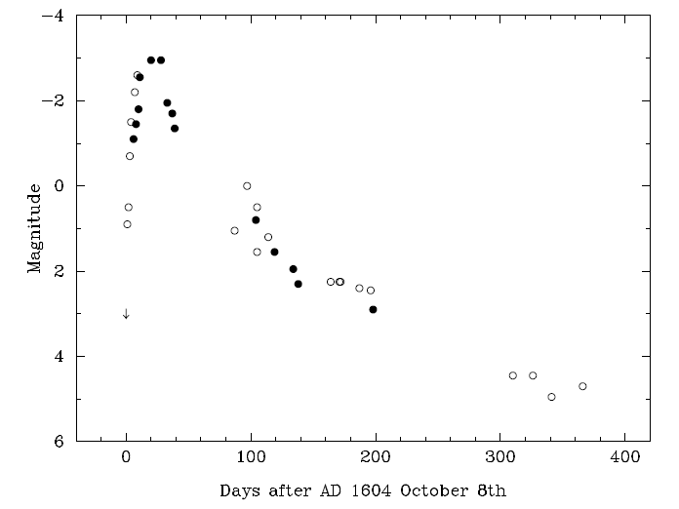
Definite supernovae
1604: Kepler’s
Well-observed Type Ia in Ophiuchus
Good-quality light curve compiled from naked-eye observations by European and Korean observers

Slide 13
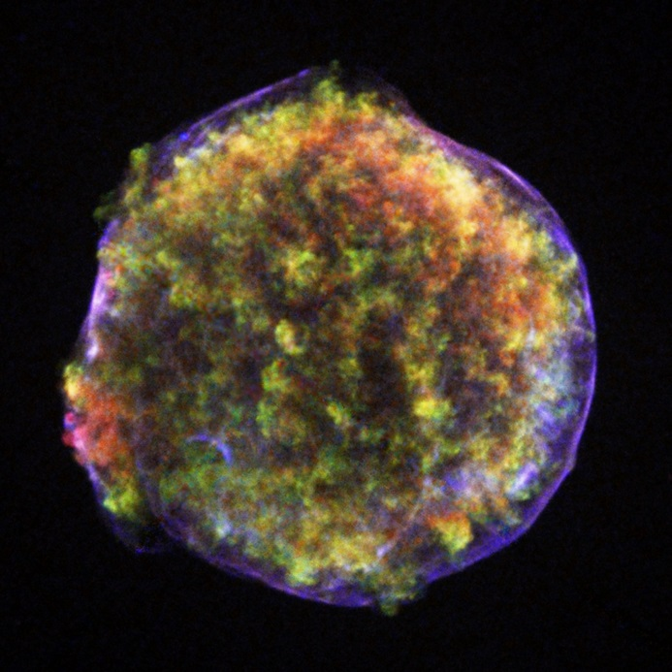
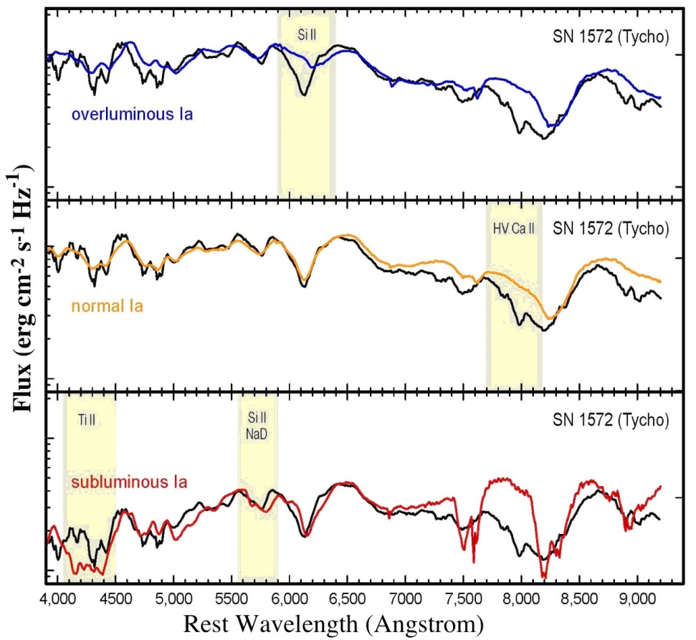
Definite supernovae
1572: Tycho’s
Type Ia in Cassiopeia
Brahe showed that SN 1572 had no diurnal parallax and was more distant than the Moon
Spectrum of SN 1572 recently observed using light reflected from a gas cloud behind the supernova
Typical of a Type Ia SN

Slide 14
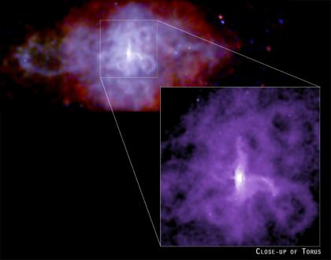
Definite supernovae
1181: China and Japan
Type II (?) in Cassiopeia
Probably identifiable with SNR 3C 58
This remnant contains a pulsar, which indicates a CCSN
The connection between SN 1181 and 3C 58 has been disputed, but there is no other candidate for its remnant.
A recent study suggests SN 1181 many have been a low-luminosity event similar to SN 1987A

Slide 15
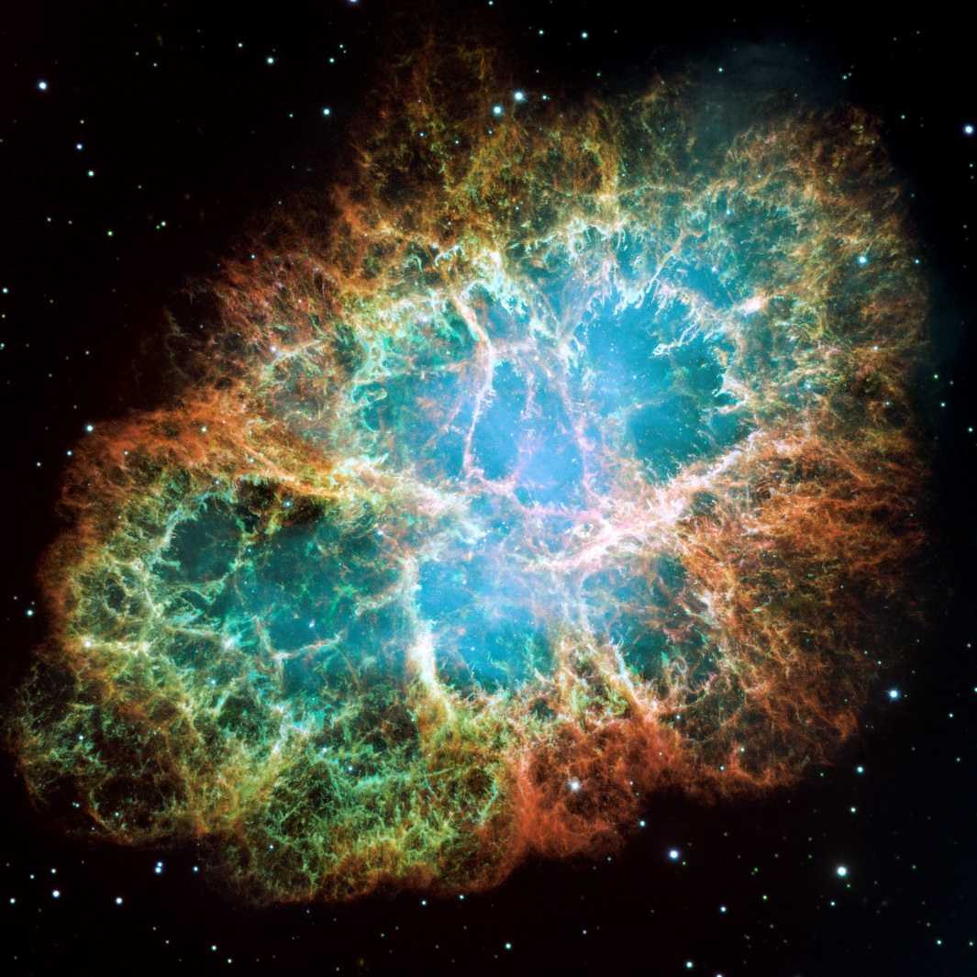
Definite supernovae
1054: China and Japan
Type II in Taurus
The event that gave rise to the Crab Nebula
The Crab contains a young pulsar and its expansion age is consistent with 1054

Slide 16
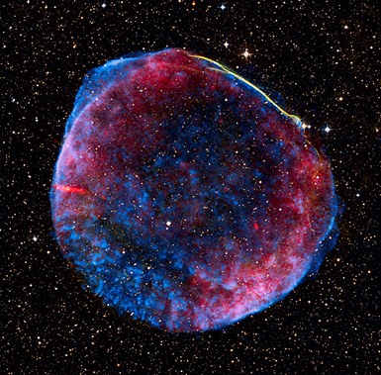
Definite supernovae
1006: everywhere
Type Ia in Lupus
The brightest naked-eye supernova in recorded history
Visible in daylight; cast shadows at night
Ten times brighter than Venus at its peak, and remained visible to the naked eye for 3 years

Slide 17
Earlier probable supernovae
Chinese records from AD 393, 386, 369 and 185 describe “guest stars” visible for several months and therefore SN candidates
the event of 369 is poorly recorded and may not have been a supernova
the event of 185 has been interpreted as a comet instead of a supernova, but this interpretation has been rejected by other Chinese astronomers
393, 386 and 185 all have plausible but not definite associations with supernova remnants

Slide 18
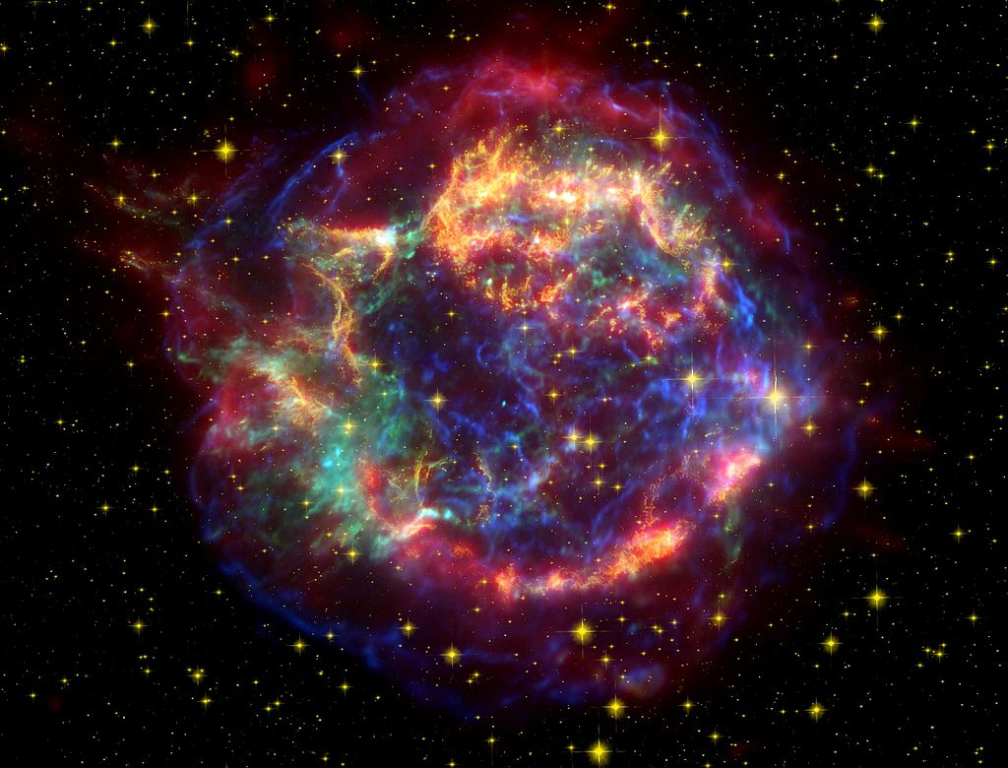
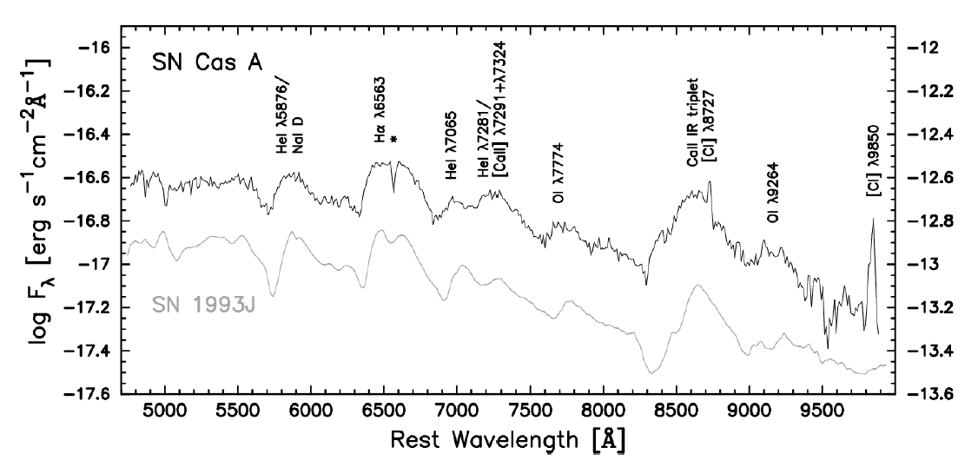
Later unobserved supernovae
~1680
Type IIb in Cassiopeia
The remnant is a bright radio source with an expansion age of around 300 years
Spectrum obtained from light echo indicates Type IIb (explosion of “stripped” massive star)
Probably not observed because its own ejected material obscured it from view

Slide 19
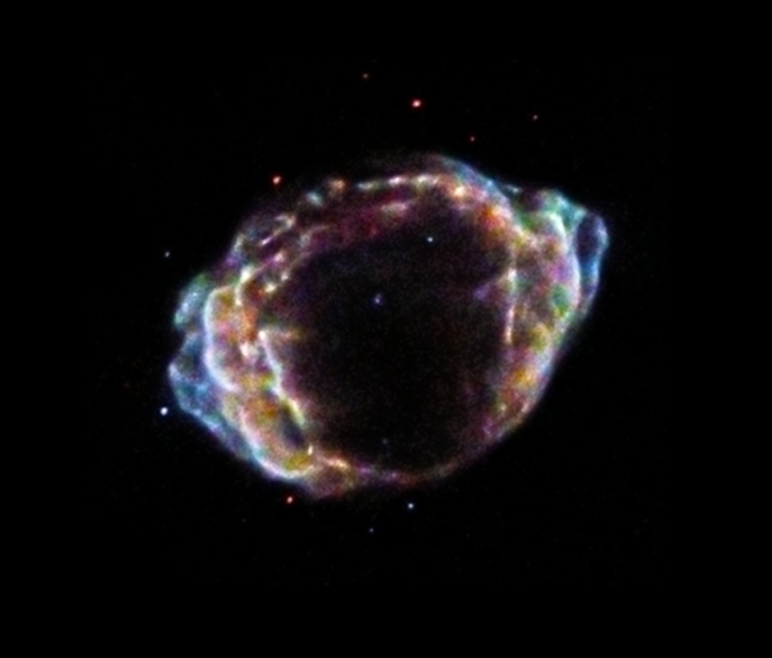
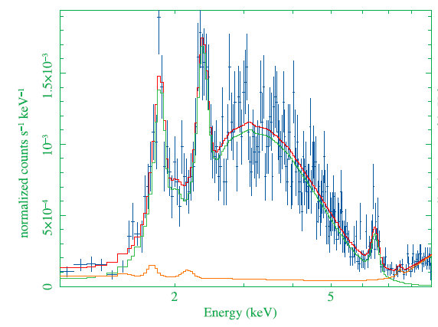
Later unobserved supernovae
~1870
Type Ia in Sagittarius
Discovered as a radio source; also seen in X-rays
Very small and expanding rapidly—not more than 150 years old when discovered in 2008
Remnant spectrum looks like Type Ia
Not observed because it is close to the Galactic centre and heavily obscured

Slide 20
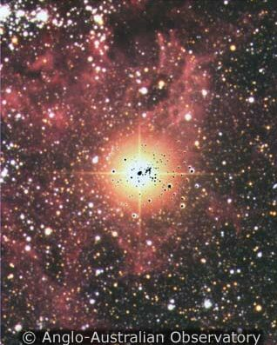
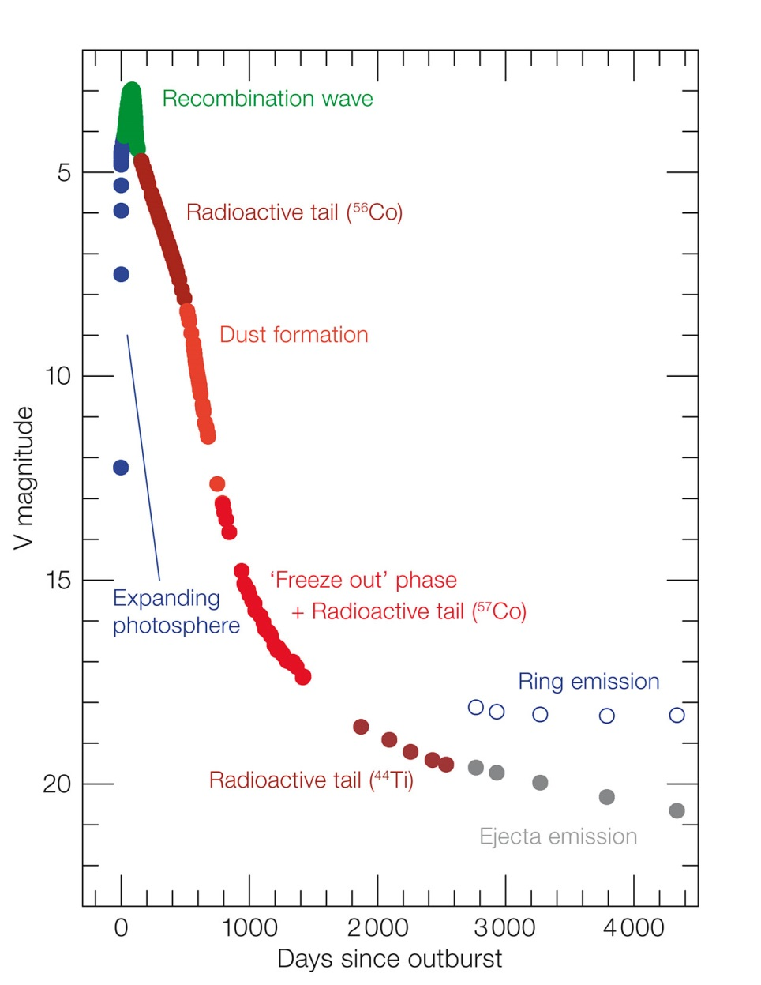
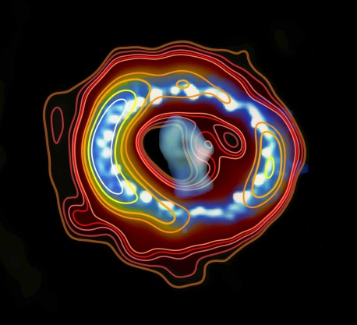
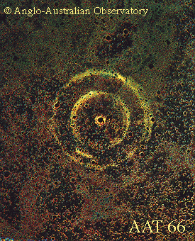
Not quite the Milky Way: SN 1987A
Unusual Type II in the Large Magellanic Cloud

Slide 21
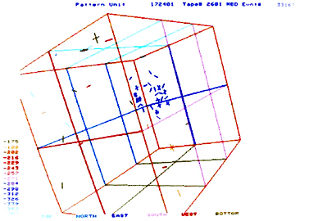
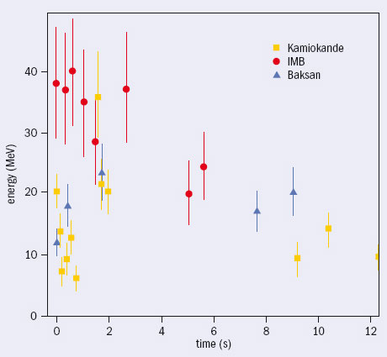
Not quite the Milky Way: SN 1987A
SN1987A:
the first naked-eye SN since 1604
the first whose progenitor was known prior to the explosion
Sk -69 202, blue supergiant
the only identified astrophysical neutrino source other than the Sun
99% of the energy of a CCSn comes out in neutrinos
A galactic supernova observed in a modern neutrino telescope would yield thousands of neutrinos

Slide 22
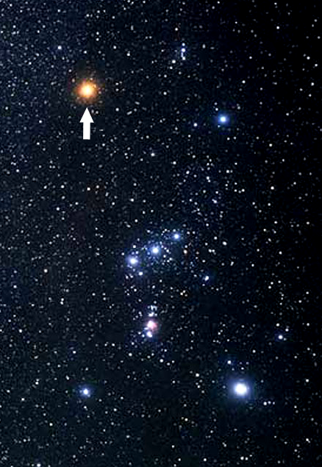
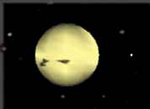
Future supernovae
Several well-known (and not so well-known) stars are likely “near”-future supernovae
η Car (unstable very massive star)
Betelgeuse (red supergiant)
IK Pegasi (binary with massive white dwarf)

Slide 23
Conclusions
Supernovae are rare but spectacular events
probably only ~2 per large galaxy per century
We have been remarkably unlucky to see no Galactic supernovae in the era of modern astronomy
but candidates do exist—we could quite possibly see one in the future
Watch this space!

