Slide 1
Sun, Earth and Moon
Susan Cartwright

Slide 2
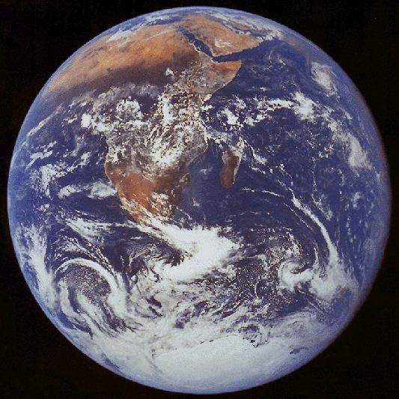
The Shape of the Earth
The Earth is round like a ball
How do we know?
Nowadays, we have photographs from space
But the ancient Greeks knew this more than 2000 years ago
How did they know?
The Earth, viewed by Apollo 17

Slide 3
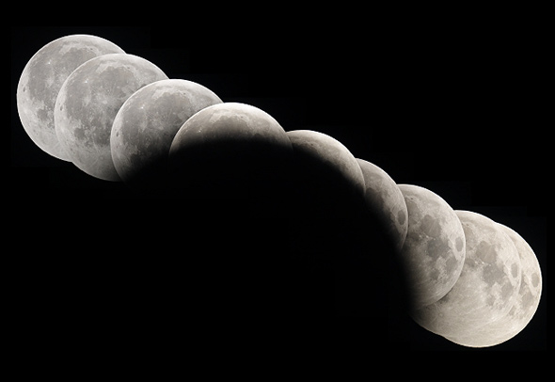
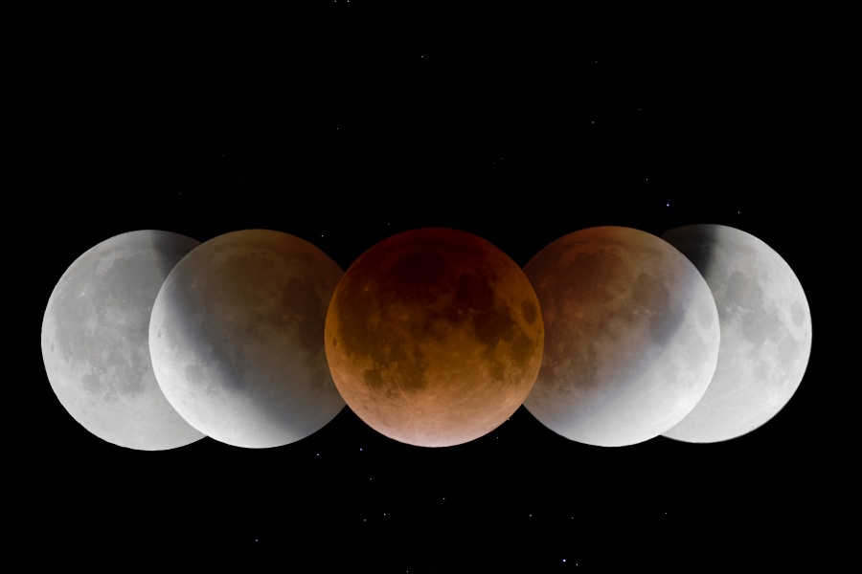
The Shape of the Earth
The Earth’s shadow on the Moon is round
Anthony Ayiomamitis
Only a ball casts a round shadow in all directions
Wang Letian

Slide 4
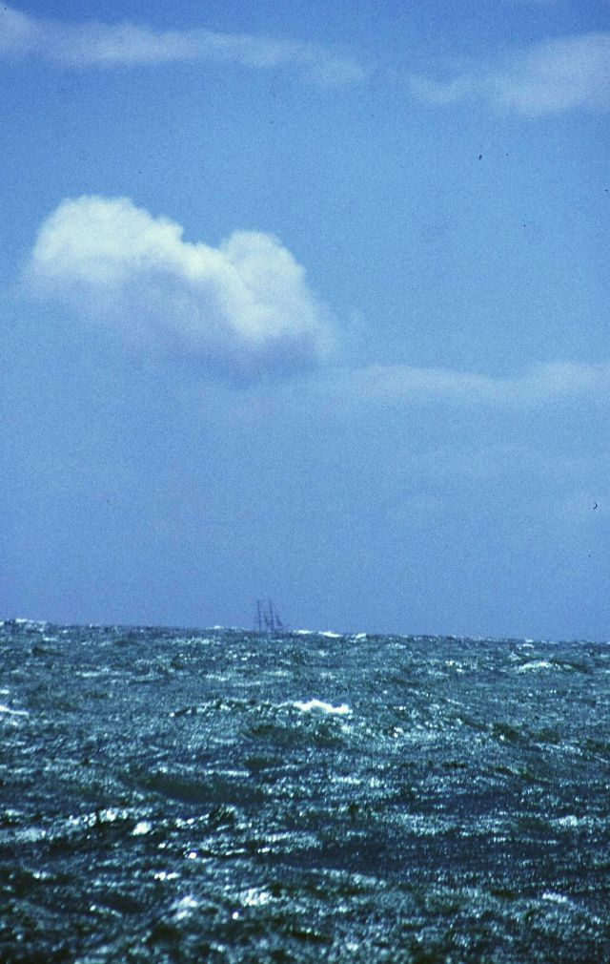
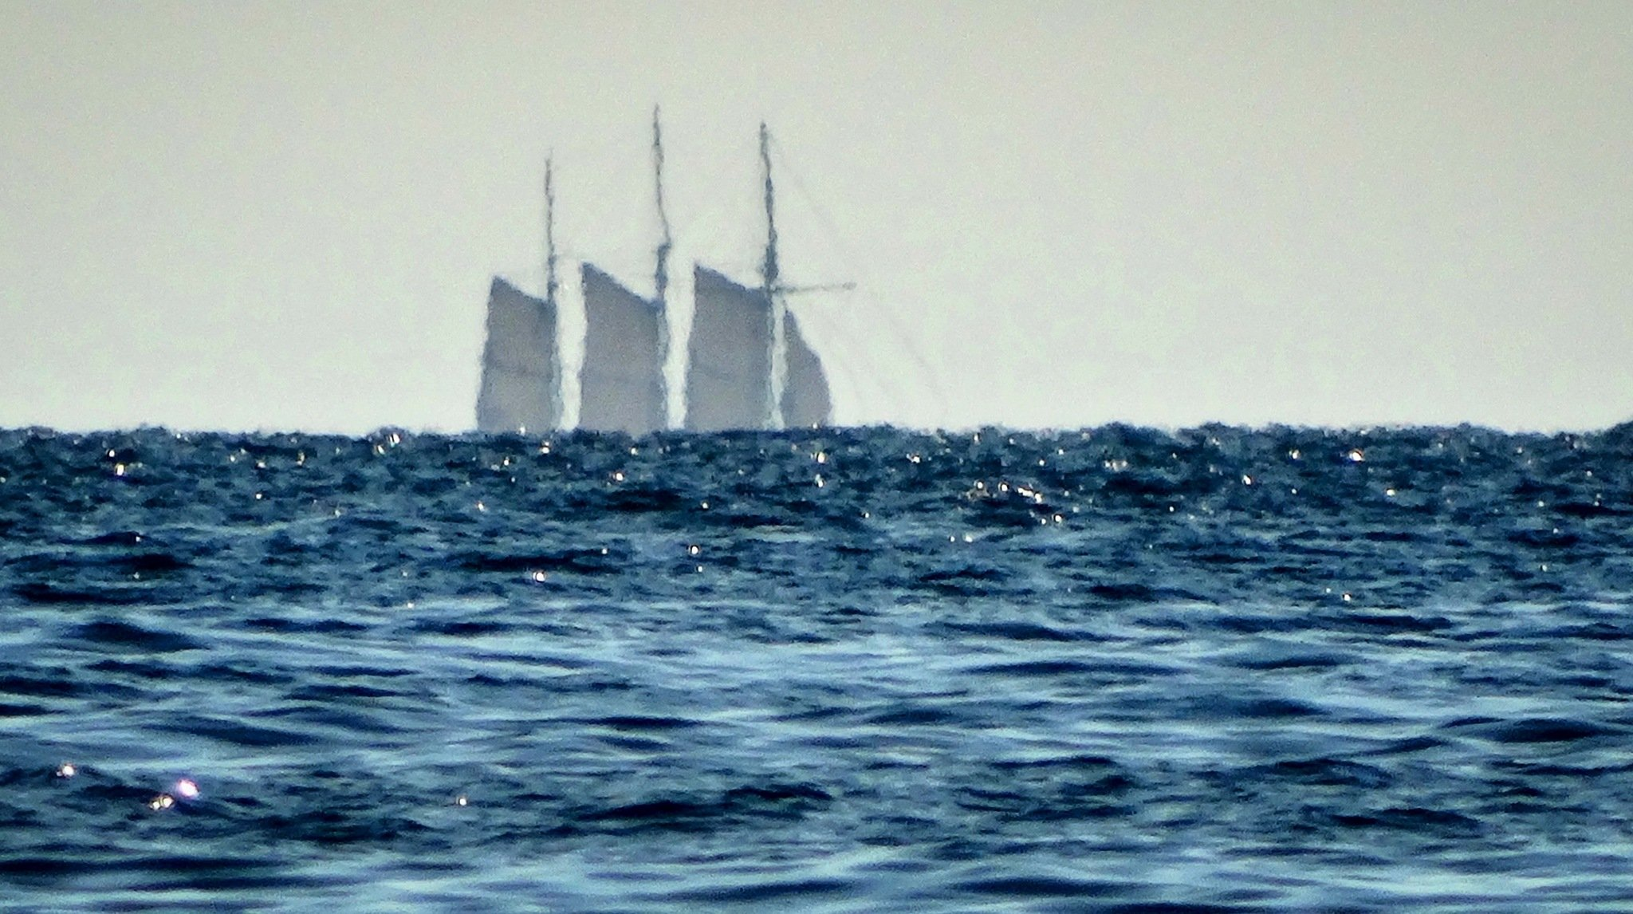
The Shape of the Earth
Ships on the horizon disappear hull first
This shows that the surface is curved
https://hallnjean.wordpress.com/
Denis Sullivan

Slide 5
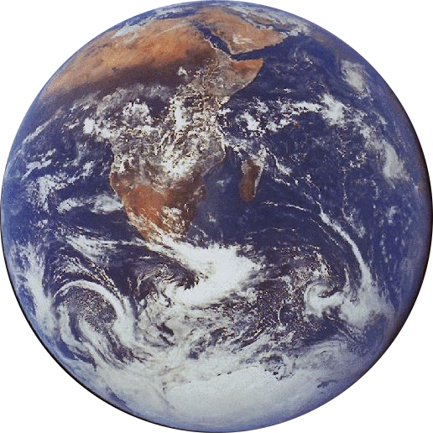
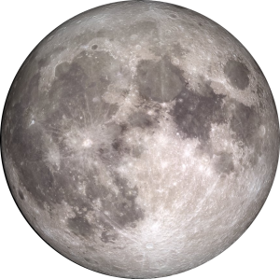
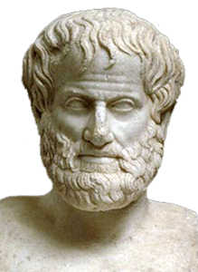
The Earth and the Moon
The Moon is roughly ¼ as large as the Earth
The Greeks knew this too!
The Moon is about 30 Earth-diameters from the Earth

Slide 6
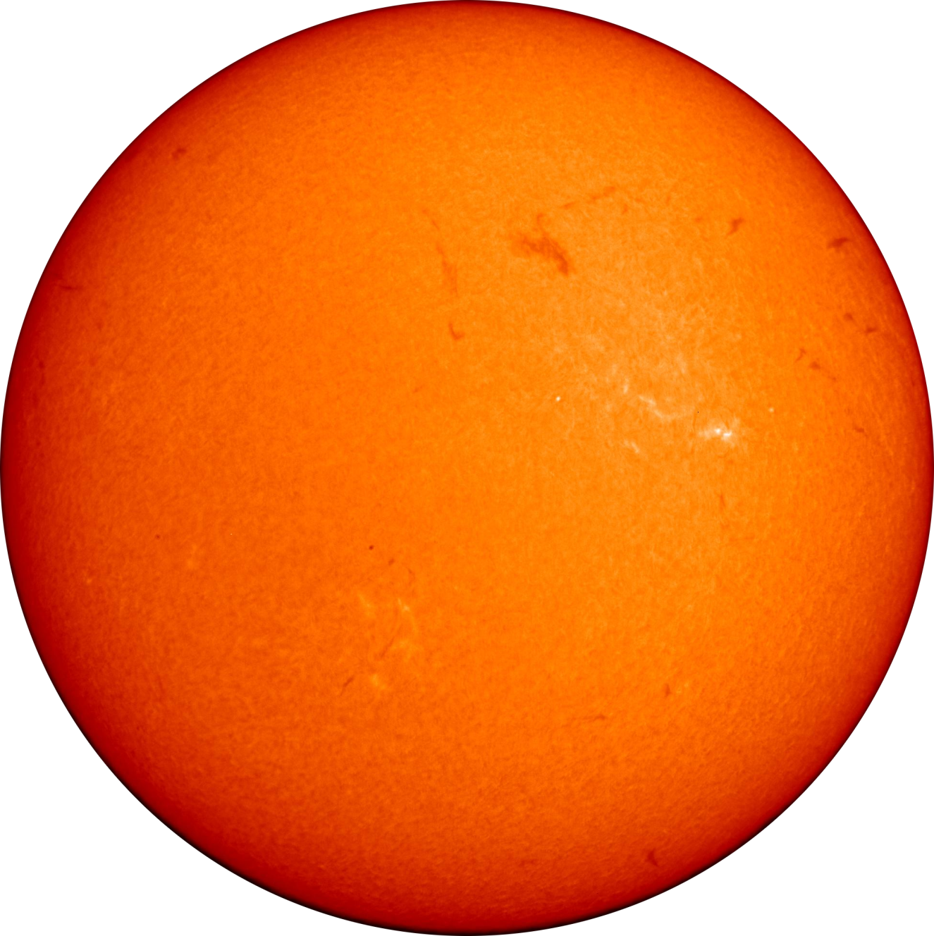
The Earth and the Sun
The Earth is more than 100 times smaller than the Sun
The Earth is about 100 solar diameters from the Sun
You could pile over one million Earths inside the Sun!

Slide 7
Sun, Earth and Moon
The Earth and the Moon reflect sunlight
they do not shine by themselves
So we only see the part of the Moon that is lit
to the Sun
Fred Espenak

Slide 8
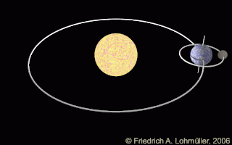
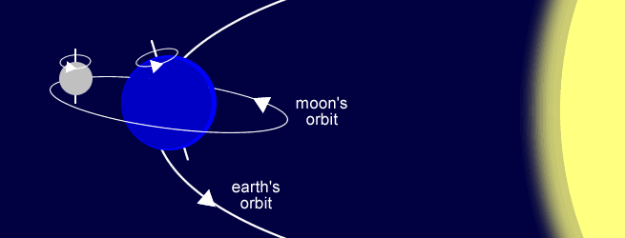
Sun, Earth and Moon
NOT TO SCALE!!
To scale!
The size of the Moon’s orbit is the thickness of the line.
The Sun is nearly twice the thickness of the line.
The Earth would be 1/60 of the thickness of the line.
The Moon would be about 1/220 of the thickness of the line.

Slide 9
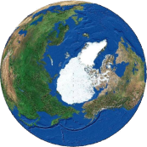
Why do we always see the same side of the Moon?
The Moon spins round once for each time it goes round the Earth.
This means that we always see the same side.
NOT TO SCALE!!

Slide 10
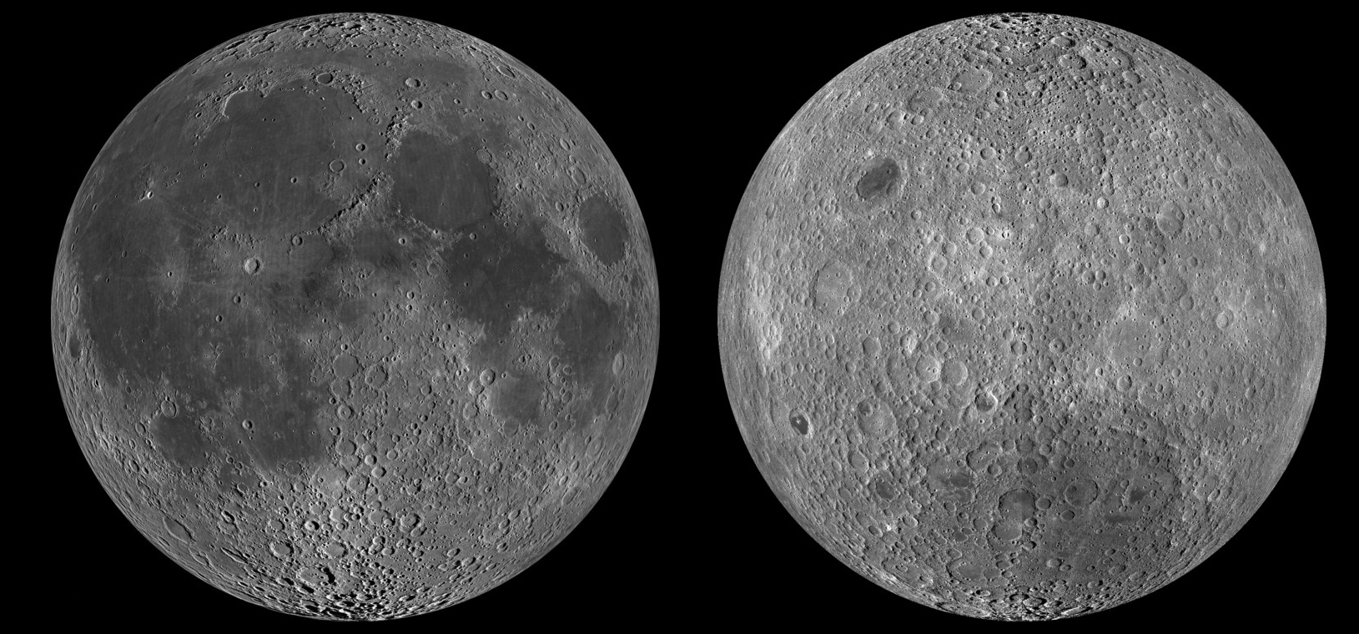
What does the other side look like?
Side we see
Side we don’t see

Slide 11
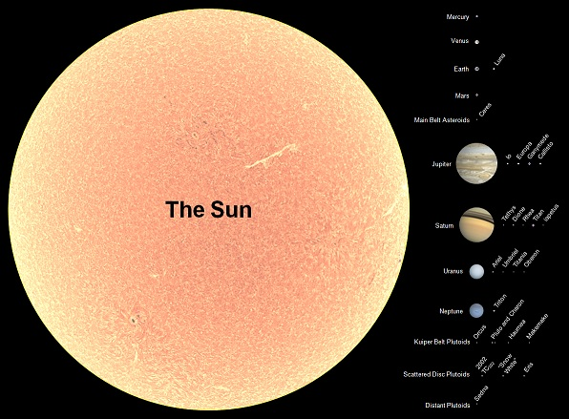
Sun and planets: sizes
Barry and Helen Setterfield
Jupiter is by far the most massive planet.
It weighs 318 times as much as the Earth—2½ times as much as all the other planets put together.

Slide 12
Sun and planets: distances
Mercury Venus Earth Mars
Jupiter
On this scale:
the size of the Sun is about 1/10 of the width of the thick lines the nearest star is about 9000 times further than the longest line
Saturn
Uranus
It takes light:
8 min 19 s to get from the Sun to the Earth
43 min 17 s to reach Jupiter
4 hr 9 min 54 s to reach Neptune
4 years 89 days to reach the nearest star
Neptune

Slide 13
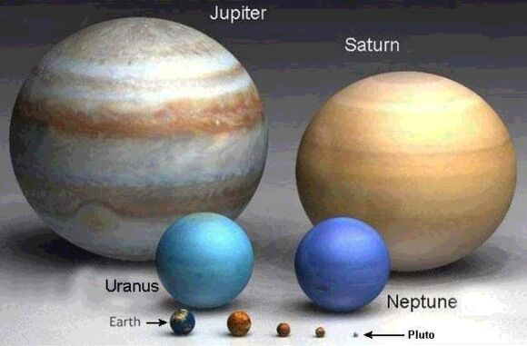
Did you know…
you could fit all the other planets inside Jupiter?
Saturn would float on water?
we have discovered 3540 planets around other stars?
if you put the star Betelgeuse where the Sun is, it would reach out to Jupiter?

Slide 14
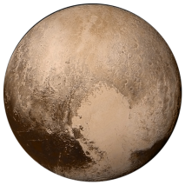
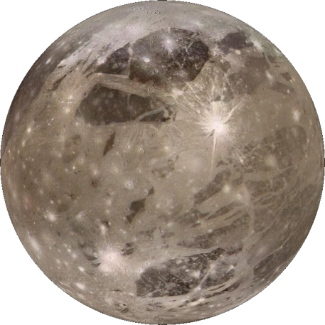
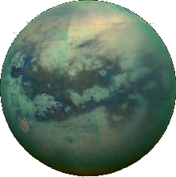
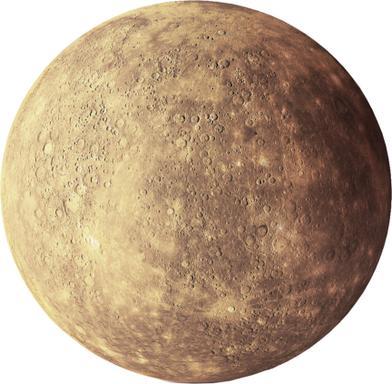
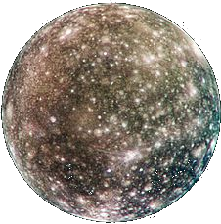
Did you know…
the Moon is bigger than Pluto?
one moon of Jupiter and one moon of Saturn are larger than the planet Mercury?
Saturn’s moon Titan has an atmosphere, and lakes and rivers (though not of water—it is much too cold)?
Ganymede and Titan are bigger than Mercury. Callisto is almost exactly the same size as Mercury.

