Slide 1
PHY111
Stellar Evolution and Nucleosynthesis
Evolution on to the main sequence
The main sequence
Evolution off the main sequence
Nucleosynthesis

Slide 2
Evolution on to the Main Sequence
Basics
On the Hertzsprung-Russell Diagram
Observations

Slide 3
Basics
Stars are formed when a cloud of cool, dense gas collapses under its own gravity
As the collapse progresses, the star will
  spin faster (conservation of angular momentum)
    and hence either fragment into a binary system or develop a protoplanetary disc
  get denser
    and hence less transparent
  heat up (conversion of gravitational potential energy)
    once the material is dense enough to trap radiation
  eventually start to fuse hydrogen
    this marks the start of its main sequence life

Slide 4
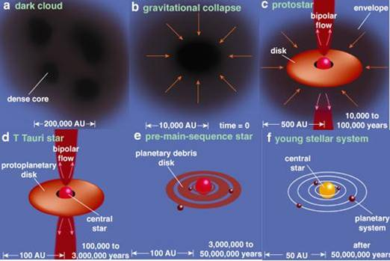
Basics

Slide 5
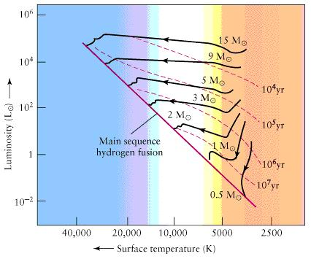
On the HR Diagram
massive stars evolve horizontally
Massive stars take a much shorter time to reach the main sequence
low mass stars evolve vertically downwards

Slide 6

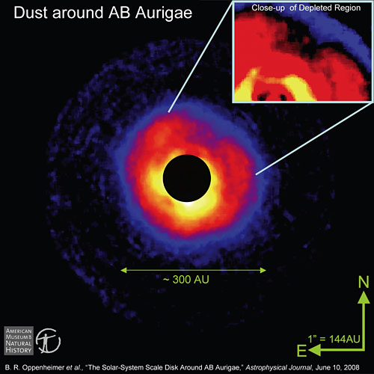
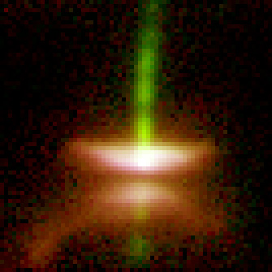
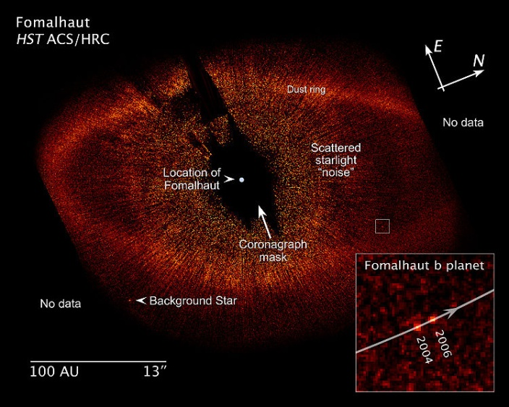
Observations
bipolar outflow

Slide 7
On the Main Sequence
Structure of the Star
Mass, luminosity and Lifetime
On the HR Diagram
The Effect of Age

Slide 8
Structure of the Star
A main-sequence star is fusing hydrogen to helium in its core
  outward pressure balances gravity
  star is stable and fairly compact
Stars of the Sun’s mass and
lower use the pp chain
  p + p → ²H + e⁺ + ν_{e}
  ²H + p → ³He
  ³He + ³He → ⁴He + p + p
Stars more massive than the
Sun use the CNO cycle
  add protons successively to ¹²C
  eventually emit ⁴He nucleus and
  get original ¹²C back
P = G
H → He

Slide 9
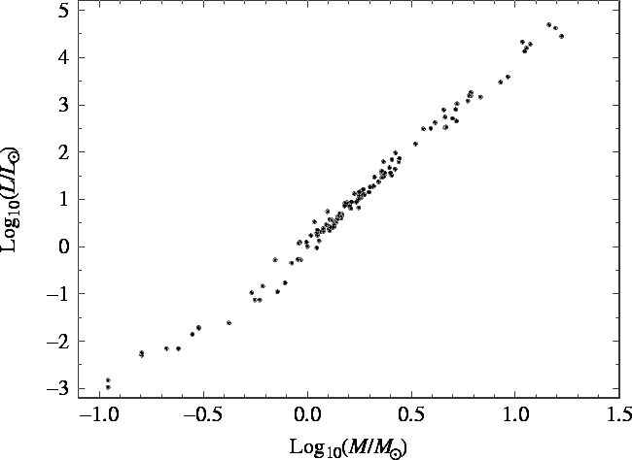
Mass, Luminosity and Lifetime
Data from binary stars
star 10× Sun’s mass is about 6000× more luminous
Massive stars have much shorter lifetimes.
This does not mean that all low-mass stars are very old!
star 1/3 of Sun’s mass is about 60× less luminous

Slide 10
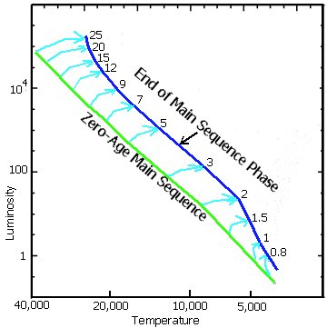
On the HR Diagram
Stars don’t evolve up or down main sequence
They do evolve across main sequence
  this is not a very large effect
Note that during this phase the star gets cooler but more luminous
  this implies it must be larger at the end of its main sequence life than at the beginning

Slide 11
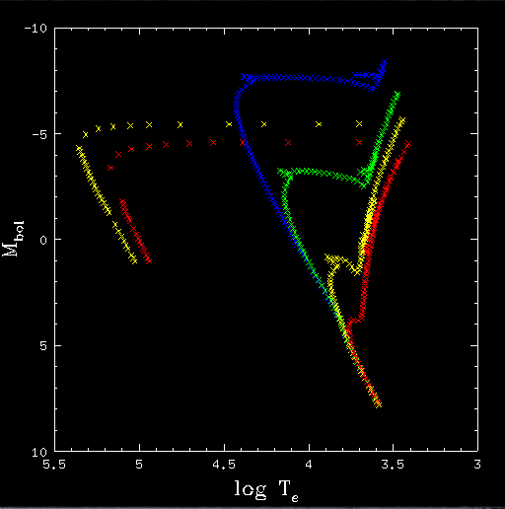
Effect of age
Older cluster will have shorter main sequence and longer red giant branch
Note that bottom of red giant branch is more-or-less level with top of surviving main sequence
10 million years
100 million years
1 billion years
10 billion years

Slide 12

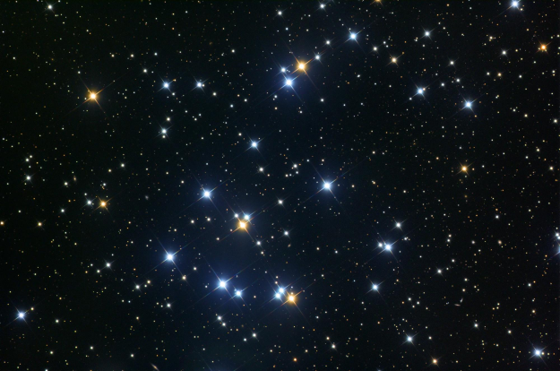
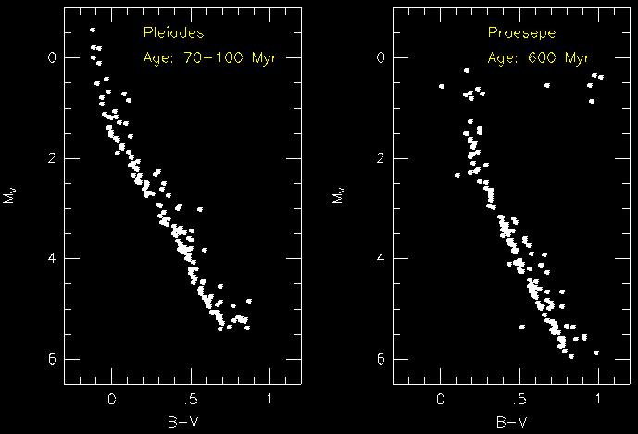
Effect of age: examples
no red giants
a few bright red giants

Slide 13
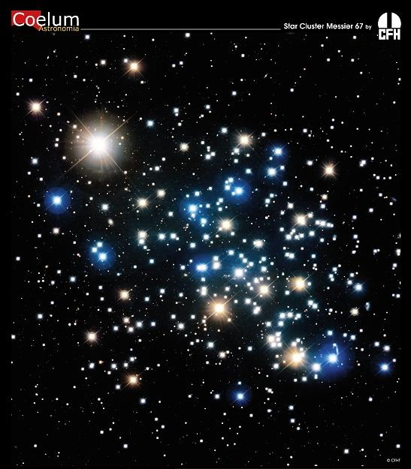
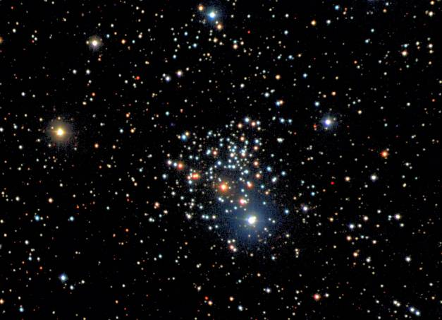
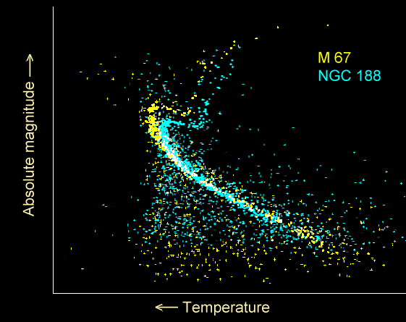
Effect of age: examples
0
+2
+4
+6
+8
~4 Gyr
~6 Gyr
lots of red giants
&
a subgiant branch
0.0 0.5 1.0 1.5 2.0

Slide 14
After the Main Sequence
Basics
On Hertzsprung-Russell diagram
Death of low mass stars
death of high mass stars

Slide 15
Basics
After the main sequence a star has two possible structures:
  fusion in a shell around an inert core
    the shell is typically very hot →
    pressure exceeds gravity →
    outer envelope is pushed outward
    star becomes a very large, cool
    red giant
  core fusion (of a heavier element)
    more stable configuration, so
    easier to balance pressure and
    gravity
    star is typically smaller and hotter,
    but less luminous
possible secondary shell source
P > G

Slide 16
Typical sequence of evolution
Fusion processes require a certain threshold temperature to ignite
  this increases for heavier elements because of greater Coulomb repulsion
  note that the material just outside a fusing core is only just not hot enough
After core exhaustion gravity overcomes pressure
  star shrinks → temperature increases owing to conversion of gravitational potential energy
  shell of material just outside core exceeds threshold and ignites
Continuing fusion in shell will increase mass and temperature of inert core
  eventually (if it gets hot enough) a new fusion process will ignite in core

Slide 17
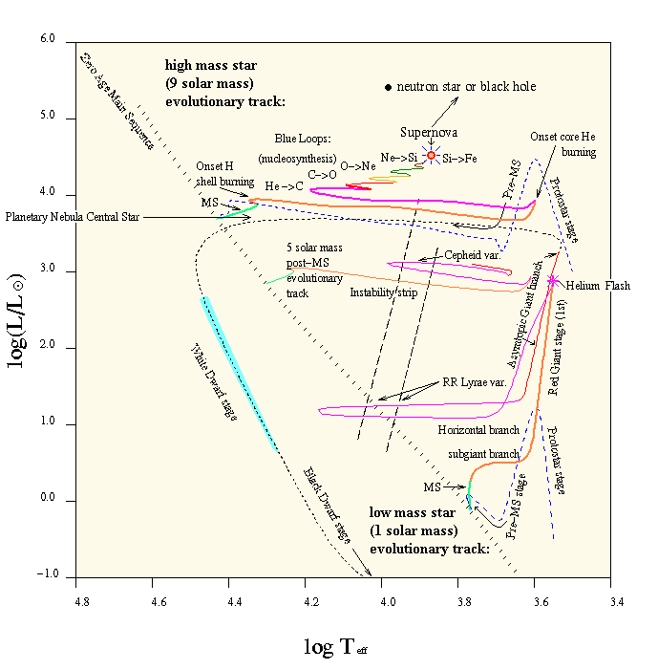
On HR Diagram
Lowest mass stars won’t even fuse helium
  but their main-sequence lifetimes are trillions of years
Stars up to 5 solar masses or so will fuse helium, but nothing heavier
  they expel their outer layers, producing planetary nebula, and end as white dwarf
Stars above ~8 solar masses fuse up to iron
  they explode as supernovae

Slide 18
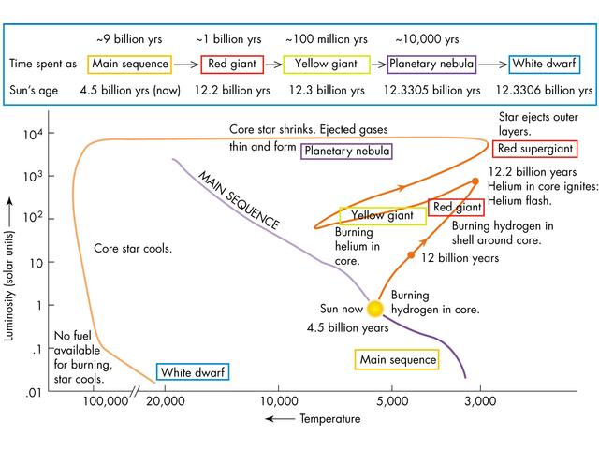
Example: evolution of the Sun
probably the Sun doesn’t really get this yellow in core He fusion

Slide 19
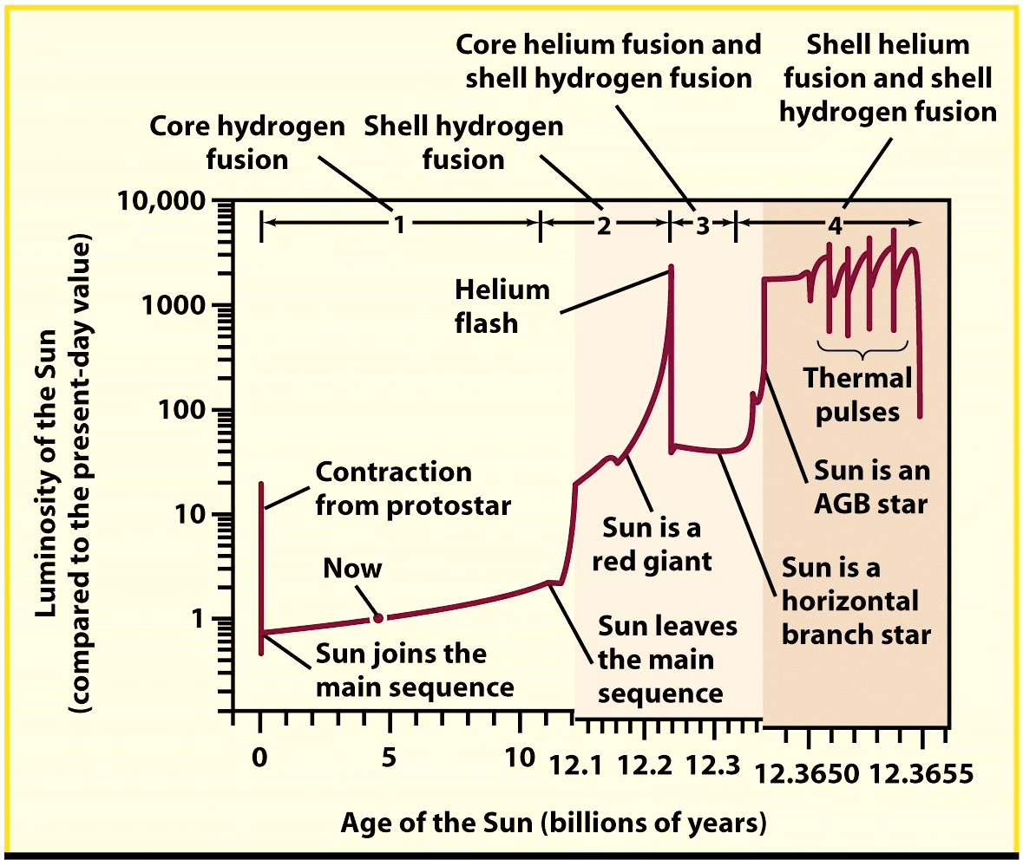
outer envelope lost in this stage

Slide 20
Some notes
Massive stars (supergiants) don’t change dramatically in luminosity as they evolve, but do change in colour (so they must change in size)
  most massive stars explode as red supergiants, but some (e.g. SN 1987A) explode as blue supergiants
Sun-like stars increase greatly in size and luminosity when they become giants
  therefore a comparatively bright red giant could have a wide range of possible masses (and hence ages)
    but a faint red giant must be fairly old
  this is a consequence of the H-fusing shell being hotter than the core was on the main sequence → higher rate of fusion → brighter
Mass loss to form planetary nebula occurs at the end of the helium shell fusion (AGB) stage in a star < 8 M_{Sun}

Slide 21
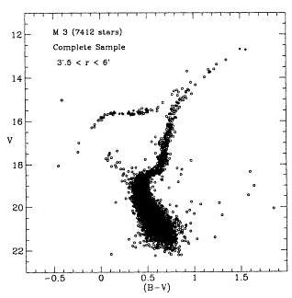
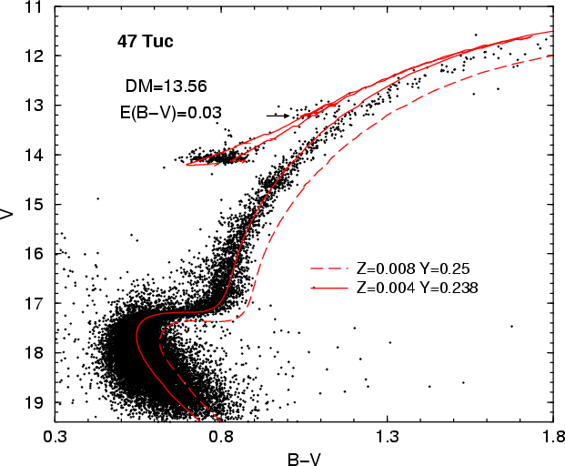
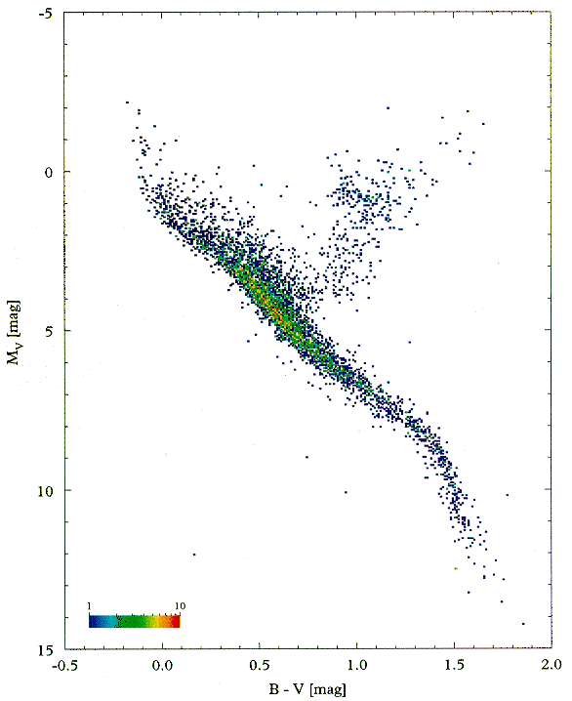
Effect of heavy element content
Note: bright main seq. plus faint red giants → range of ages
Arrows show horizontal branch (He core fusion)
Globular cluster M3
About 3% of Sun’s heavy element content (Z = 0.06%)
Globular cluster 47 Tuc
About 20% of Sun’s heavy element content (Z = 0.4%)
Solar neighbourhood
Roughly solar heavy element content
(Z = 2%)
Note that “heavy element content” refers to initial composition

Slide 22
Nucleosynthesis
Fusion in stars
fusion in supernovae
s-process
r-process
p-process

Slide 23
Fusion in stars
Hydrogen fusion via the pp chain creates only ⁴He
Hydrogen fusion via the CNO cycle creates ⁴He and also increases the abundance of ¹³C and ¹⁴N
  these nuclei are produced by the cycle faster than they are destroyed
  most ¹⁴N comes from here
Helium fusion creates ¹²C and higher α-process isotopes: ¹⁶O, ²⁰Ne, ²⁴Mg, etc.
  ¹²C dominates because it is resonant
  secondary helium fusion reactions produce free neutrons via ¹³C + ⁴He → ¹⁶O + n and ²²Ne + ⁴He → ²⁵Mg + n

Slide 24
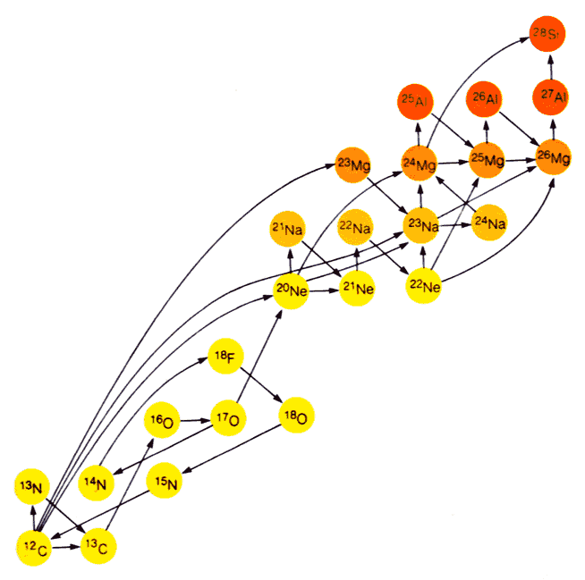
Fusion in stars
Massive stars can fuse elements from carbon up to silicon
These processes generate less energy and hence
last for less time
Silicon fusion lasts
a few days and
creates iron
Iron has the most tightly bound nucleus: fusing iron does not generate energy

Slide 25
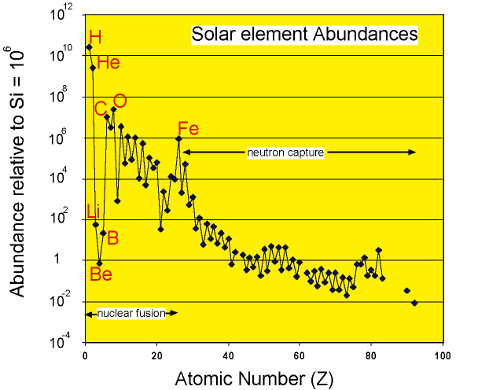
Fusion in supernovae
Fusion in super-novae takes place at very high temperatures
abundances determined by thermodynamic equilibrium
  the most tightly bound isotopes are preferentially made
  generates abundance peak around iron

Slide 26
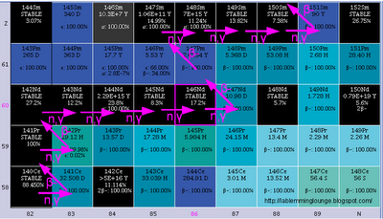
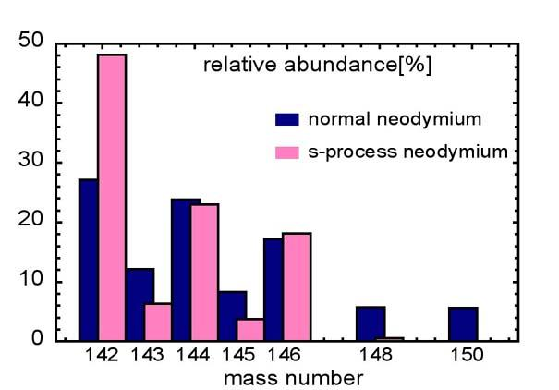
Neutron capture: the s-process
plots from http://lablemminglounge.blogspot.com/2010_11_01_archive.html
Elements beyond iron are made by successive capture of free neutrons
In He-fusing stars neutrons are rare
  captures are infrequent
  any unstable isotope will decay first
  produces isotopes near line of maximum stability
not s-process
Neodymium in SiC grains believed to be produced in carbon-rich He-fusing stars, compared to ordinary neodymium

Slide 27
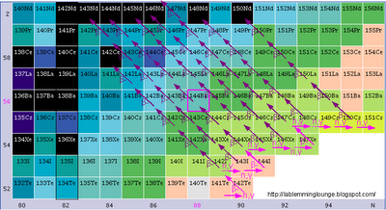
Neutron capture: the r-process
In supernovae
neutrons are
very abundant
  captures occur
  very frequently,
  making highly
  unstable nuclei
  with far too many
  neutrons
  these then β-decay to stable nuclei
  will not make isotopes that are “shielded” by stable isotopes with same atomic mass but more neutrons—e.g. can’t make ¹⁴²Nd because of ¹⁴²Ce
  only way to make elements beyond bismuth—s-process stops at ²⁰⁹Bi
not r-process
colour coded by lifetime

Slide 28
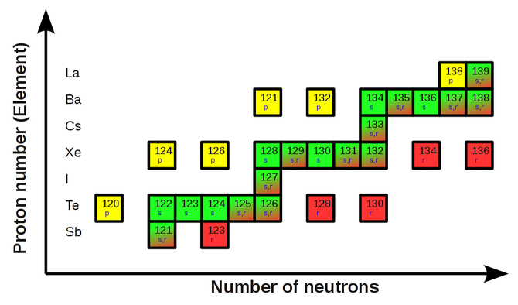
Rare isotopes: the p-process
A few nuclei, usually neutron-poor, cannot be made by either s- or r-process
  these are rare isotopes, so whatever process makes them is unusual or difficult
  a number of different processes are thought to contribute,
  mainly
  γ + ^{A}X → ^{A−1}X + n
  in supernovae, but also
  p + ^{A}X →^{A+1}X' + γ
  in very proton-rich
  environments
p
s
s,r
r

Slide 29
Rare isotopes: spallation
Very light isotopes aren’t made in stars
  they are weakly bound and easily fused to heavier elements
Isotopes above mass 4 are not made in Big Bang
  apart from a bit of ⁷Li
But ⁶Li, ⁹Be, ¹⁰Be & ¹¹B
do exist—albeit rare
We think they are made
when cosmic rays knock
bits off heavier nuclei
α-process nuclei
⁷Li
¹¹B
⁶Li
¹⁰Be
⁹Be

Slide 30
Summary
Stellar Evolution
Nucleosynthesis

Slide 31
Summary: stellar evolution
Timescales in the evolution of stars are determined by the star’s mass—therefore it is easily possible for a star cluster to contain main-sequence stars, red giants, horizontal branch stars and white dwarfs despite all its stars’ being the same age.
  However, note that lifetime does not equal age: the lower-main-sequence stars in the Pleiades are much younger than the Sun, even though their lifetimes are much longer.
The evolutionary path goes H core fusion → H shell fusion → He core fusion → He shell fusion [→ heavy element fusion]
  step in [] only for stars of >8 solar masses
  star is a red giant during shell fusion stages
In a star cluster, main-sequence turn-off point gives age

Slide 32
Summary: nucleosynthesis
¹H, ²H, ³He, ⁴He and ⁷Li are made in the early universe
  some ⁴He also in stars, some ⁷Li also by spallation
⁶Li, ⁹Be, ¹⁰Be and ¹¹B are made by cosmic ray spallation
Elements between carbon and the iron peak are made mostly by fusion (in stars or in supernovae)
Elements above iron are made mostly by neutron capture
  by slow addition of neutrons in He-fusing stars (s-process)
    unstable nuclei decay before next capture, so this makes nuclei close to line of maximum stability, and generally next to other stable nuclei
  by rapid addition of neutrons in supernovae (r-process)
    makes very unstable neutron-rich nuclei which produce stable nuclei by β-decay, so can’t make nuclei where the β-decay path is blocked
  a few isotopes are made by knocking out neutrons (p-process)

