Slide 1
Parallel Universes
Parallel
Parallel
Dr Susan Cartwright
Dept of Physics and Astronomy
University of Sheffield

Slide 2
Parallel Universes
Are you unique?
Could there be another “you” differing only in what you had for breakfast this morning?
Could there be another Europe in which Germany won the second world war?
Could there be another Earth which wasn’t hit by a comet 65 million years ago, and on which dinosaurs are still the dominant group?
Could there be another Universe, in which not just history but all of physics is different?
All of these questions come under the heading of “parallel universes”

Slide 3
Parallel Universes
Consequences of an infinite universe
that which is not forbidden is compulsory
Consequences of cosmology
Chaotic inflation
Braneworlds
Consequences of quantum mechanics
Many Worlds
Consequences of mathematics
Mathematics as reality

Slide 4
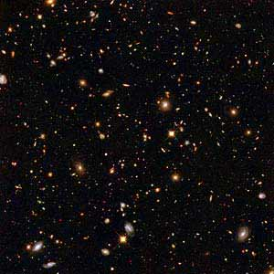
An infinite universe
a very, very long way!
Our Hubble volume
An exactly identical Hubble volume
Same physical laws, different initial conditions

Slide 5
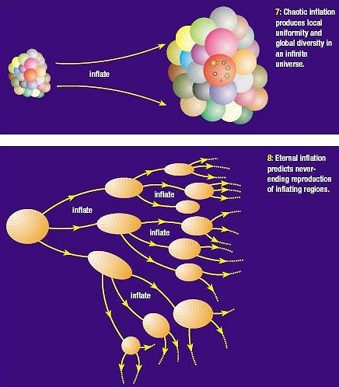
Cosmology: inflation
Same “fundamental” (high energy) physical laws, different effective laws
Some cosmologists see this as a good way of explaining “unexpectedly helpful” values of physical constants

Slide 6
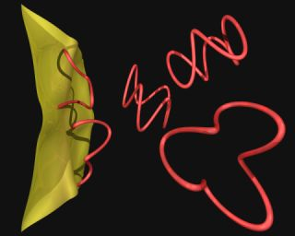
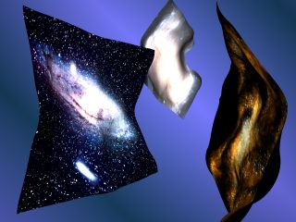
Cosmology: braneworlds
Same “fundamental” (high energy) physical laws, different effective laws
May communicate with our universe via gravity

Slide 7
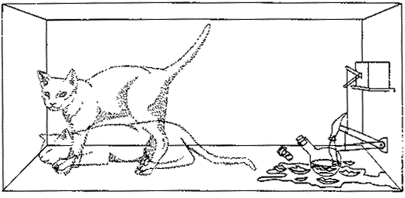
The “Many Worlds” of Quantum Mechanics
Every possible outcome of a quantum event happens.
Same fundamental physical laws, possibly different effective laws.

Slide 8
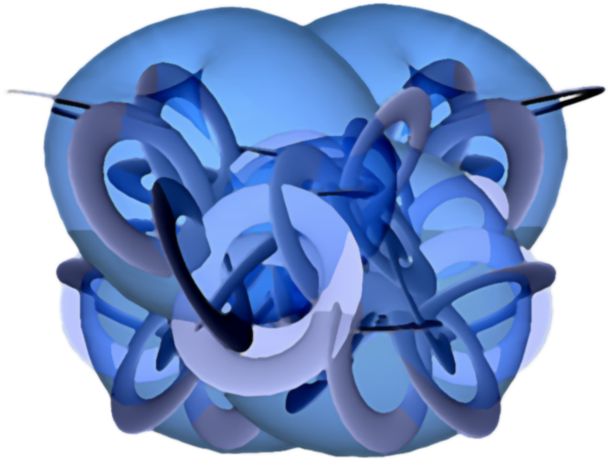
“The unreasonable effectiveness of mathematics” [Eugene Wigner, 1960]
Mathematical structures do an unexpectedly good job of describing the universe
Is the universe a mathematical structure?
Are all sufficiently complicated mathematical structures universes?

Slide 9
Summary
If the universe is infinite (our best current guess) then “parallel Earths” are inevitable because they are possible
but they’re a VERY long way away
If chaotic inflation and/or braneworlds are right, then there are entire other universes
probably with quite different local physics
If the “many worlds” interpretation of quantum mechanics is right, multiple “parallel universes” must coexist right here
but we only perceive one
If some abstract mathematicians are right, any sufficiently complex mathematical structure could be experienced as a universe
very difficult to visualise or test!

