Slide 1
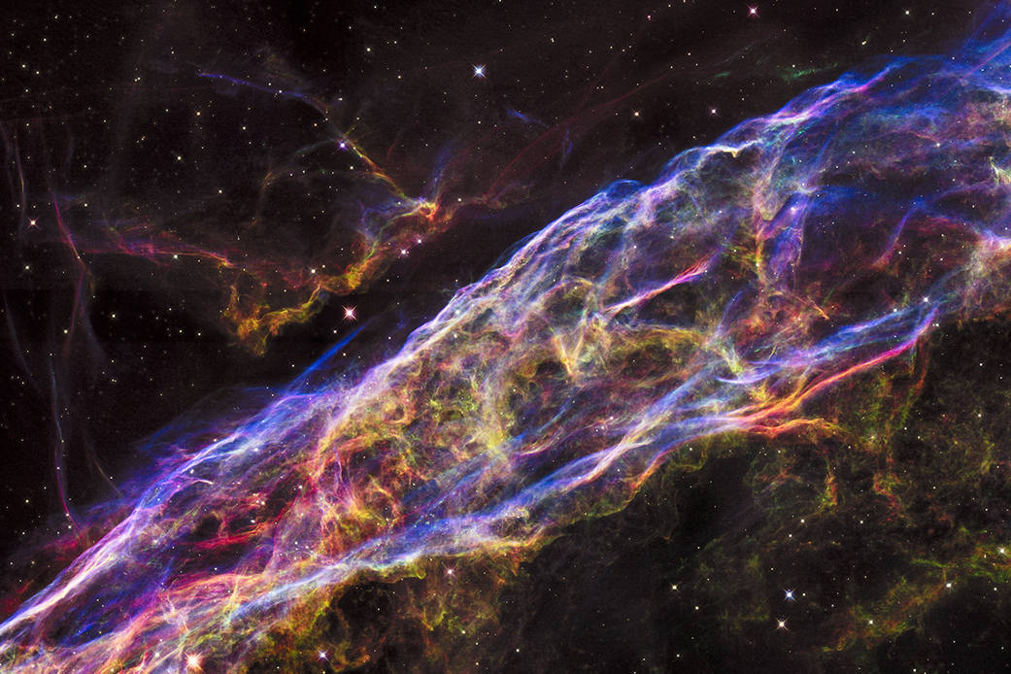
Galaxies to atoms
Veil supernova remnant NASA/ESA/Hubble Heritage Team
Susan Cartwright

Slide 2
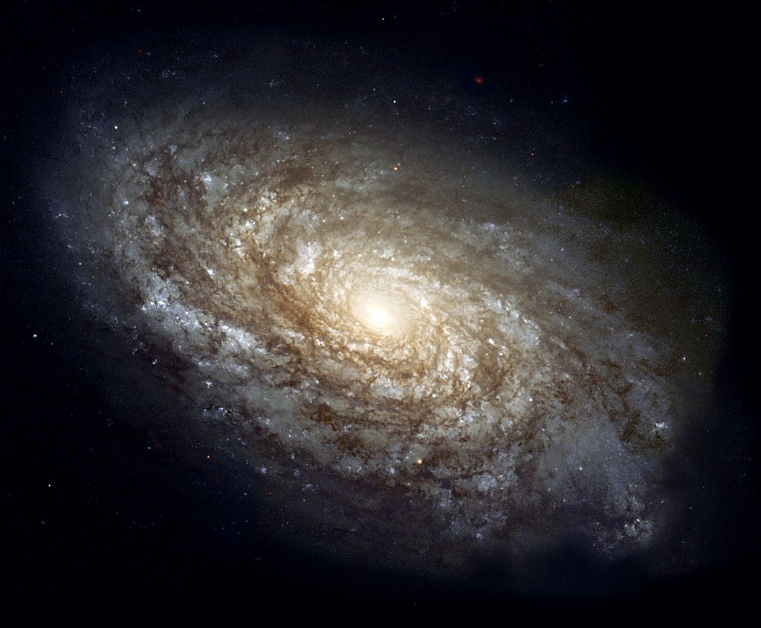
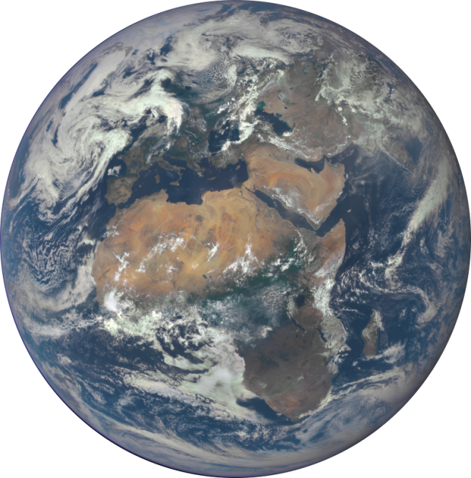
It takes a village to raise a child…
It takes a galaxy to raise a world

Slide 3
The chemical elements: The building blocks of worlds

Slide 4
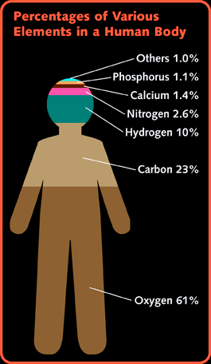
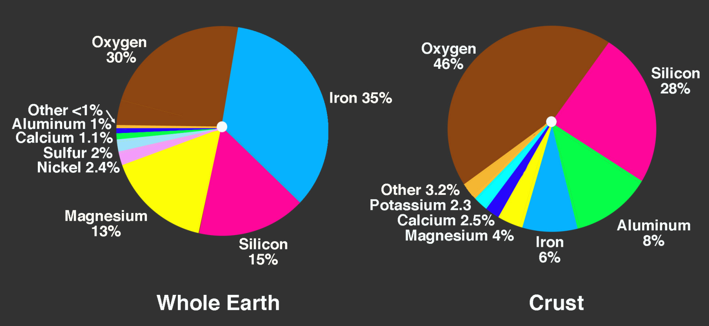
by number of atoms
hydrogen… helium…metals

Slide 5
Where do the chemical elements come from?
Only hydrogen and helium (plus very small amounts of Li, Be and B) are made in the Big Bang
All the other elements are made in stars
therefore, in order for the gas cloud from which the Sun formed to contain all the elements needed to form planets (and living organisms), the Sun had to form in a galaxy that had already produced several generations of stars
The Sun is much younger than the Galaxy. This is not an accident.

Slide 6
How do stars make the chemical elements?
In the fusion processes that generate their energy
For example, our Sun is currently converting hydrogen into helium (releasing 0.7% of the mass as energy via E = mc²)
By adding neutrons to pre-existing nuclei
Neutrons are uncharged and therefore easily captured by nuclei
Radioactive decays can then convert this “neutron-rich” nucleus into a new element (e.g. ¹⁴C → ¹⁴N + e⁻ + ν̅)
During a supernova explosion

Slide 7
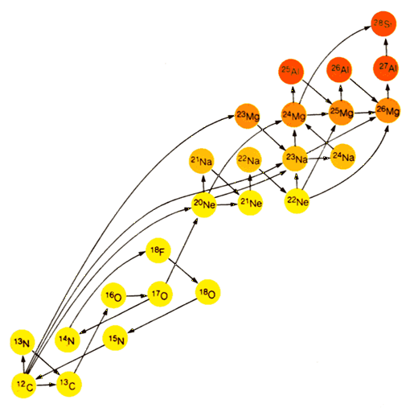
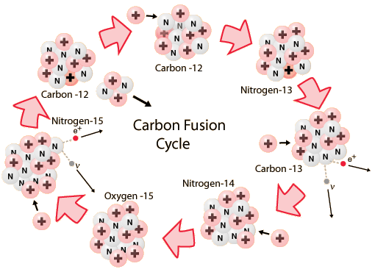
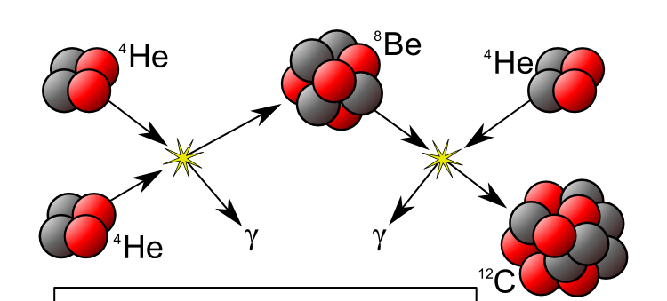
Fusion Processes in massive stars
Stars like the Sun do this in a simpler way (with same end result)
Hydrogen fusion
Fusion of heavier elements
⁴He
⁸Be
⁴He
Stars of less than about 8 solar masses don’t get past helium fusion
γ
γ
⁴He
¹²C
Helium fusion

Slide 8
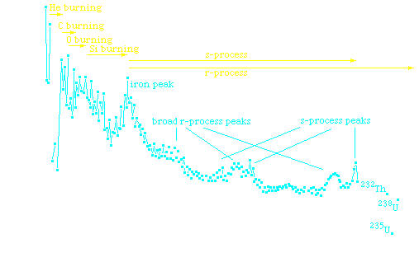
Feeling the Heat: element production in Supernovae
The iron peak: a higher abundance of the most stable nuclei

Slide 9
Feeling the Heat: Element production in supernovae
The core of an exploding star is much hotter even than a normal stellar core. Elements are broken into protons and neutrons, and reassembled so that only the most stable nuclei—the ones around iron—survive.
Further out, accelerated fusion reactions produce lighter elements such as oxygen
Supernova simulation by Max Planck Institute Garching, see http://wwwmpa.mpa-garching.mpg.de/ccsnarchive/movies/

Slide 10
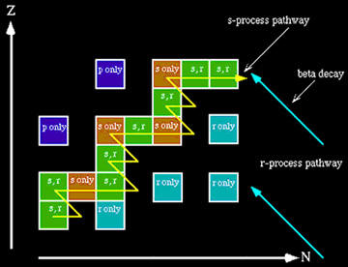
Making the Rest of the Elements
Elements heavier than iron can be made by adding neutrons, slowly in helium-burning stars (s-process) or quickly in a hot neutron-rich environment (r-process)
Site of r-process may be merging neutron stars

Slide 11
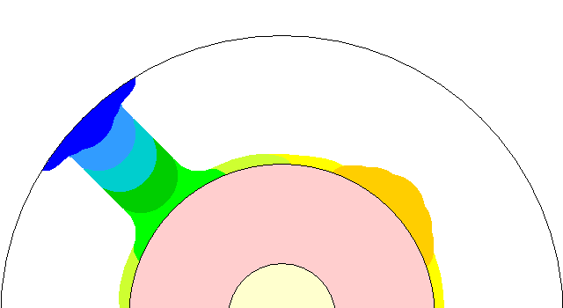
How do the newly made elements escape?
The new elements are made in the hearts of stars. How do they get out into space?
In stars like the Sun, but older, convection currents dredge up material from the centre of the star to the outer layers
The star then loses these layers in a planetary nebula
Stars more than 8−11 times the Sun’s mass explode at the ends of their lives
Steven Dutch, Natural and Applied Sciences, University of Wisconsin - Green Bay

Slide 12
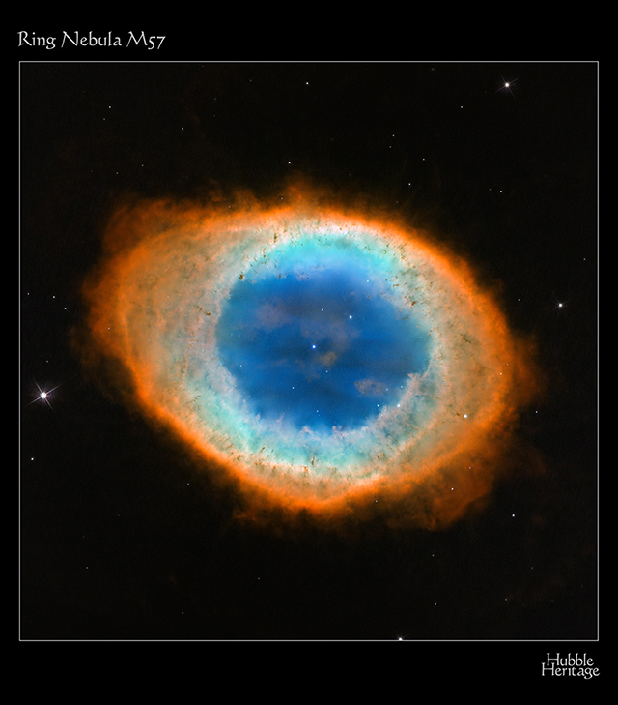
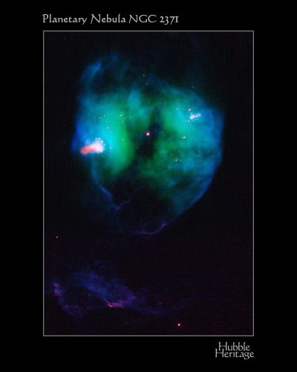
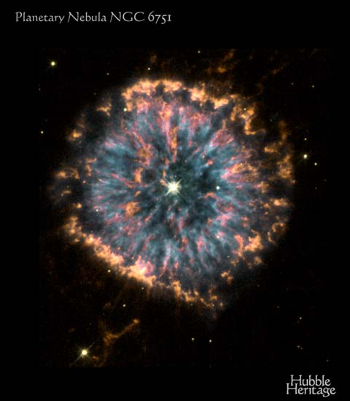
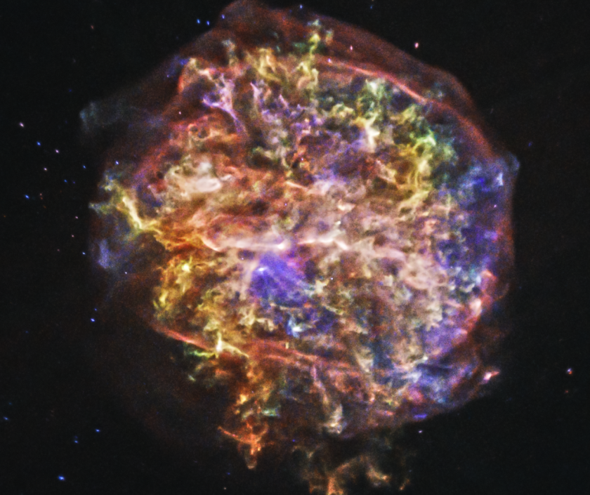
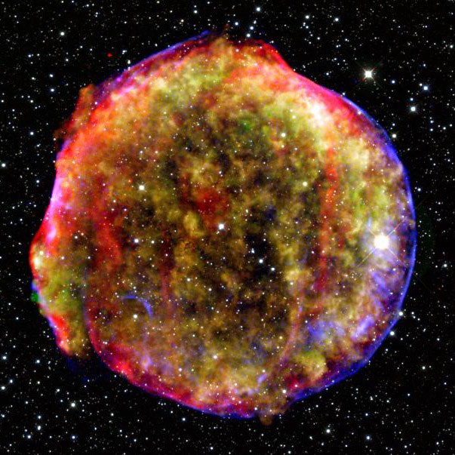
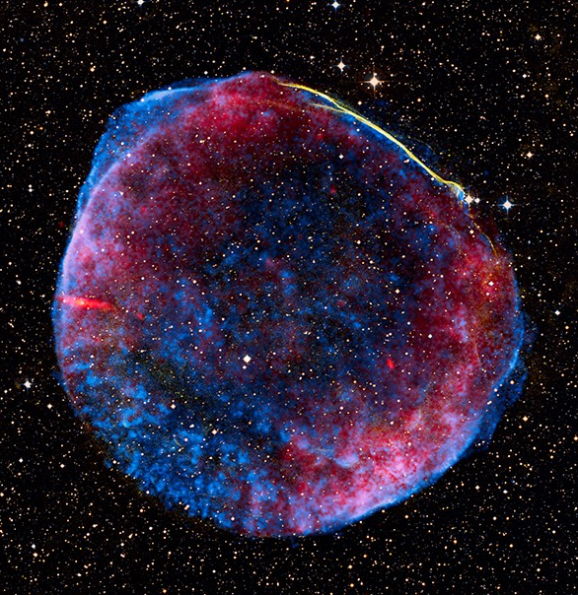

Slide 13
Timescales
age of Universe
age of solar system
Massive stars have very short lifetimes—but for some elements we need less massive stars to die
extinction of dinosaurs
stars explode

Slide 14
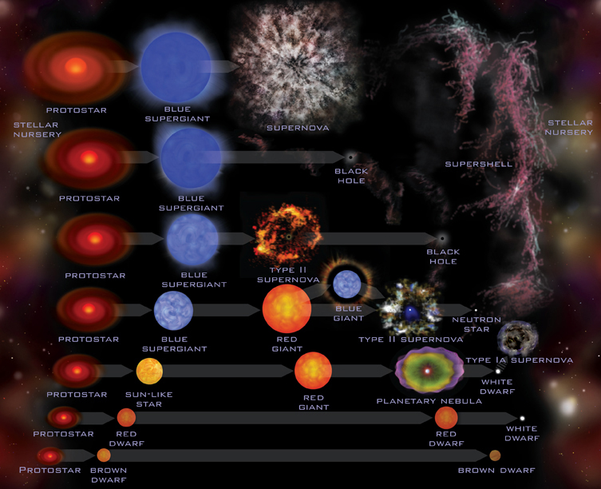
A summary of stellar life-cycles

Slide 15
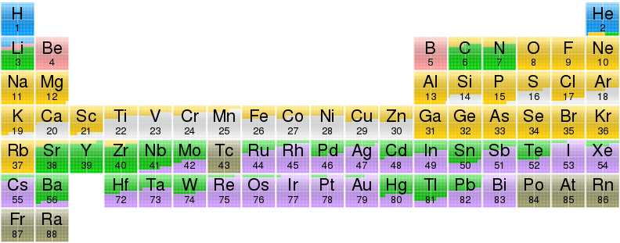
It takes a Galaxy to build a world…
Image from Wikipedia, based on data by Jennifer Johnson at Ohio State University

