Slide 1
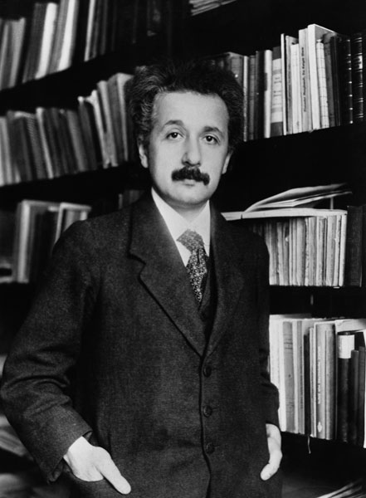
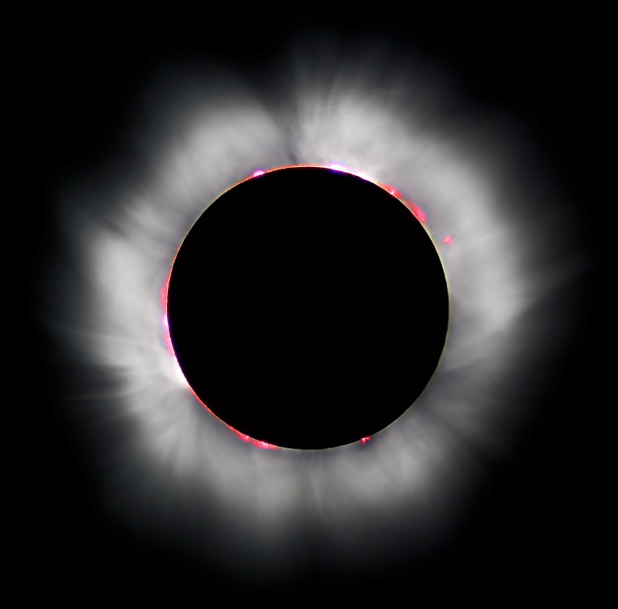
100 years of General Relativity
Luc Viatour
Susan Cartwright

Slide 2
Ideas of General Relativity
The Special Theory of Relativity (1905) argued that all observers at rest or in uniform motion observe the same laws of physics
including in particular the same speed of light
The General Theory (1915) postulates that this also applies to observers falling freely in a gravitational field
this is the Principle of Equivalence
The key ingredient here is that all objects experience the same acceleration in a gravitational field
this is reminiscent of the “fictitious forces” introduced to describe motion in accelerated reference frames, e.g. “centrifugal force”

Slide 3
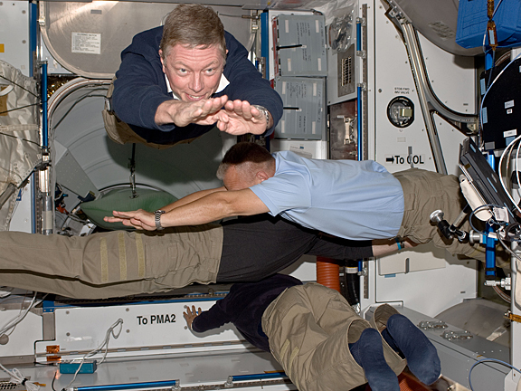
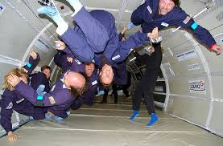
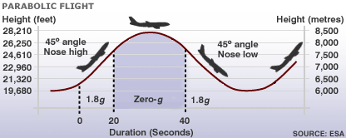
The Principle of Equivalence
Examples of the Equivalence Principle at work
astronauts in the ISS
altitude of ISS = 400 km
radius of Earth = 6370 km
g at ISS = 88.5% of surface g
NASA’s “Vomit Comet”
aeroplane on a ballistic trajectory

Slide 4
Consequences
Light must lose energy when it escapes from a gravity well
inertial frame
free fall
Light must bend in a gravitational field
time
observer moving away from source hence redshift
this must not be seen, so light must be blueshifted

Slide 5
Classical tests of General Relativity
The perihelion of Mercury
The bending of starlight
Gravitational redshift

Slide 6
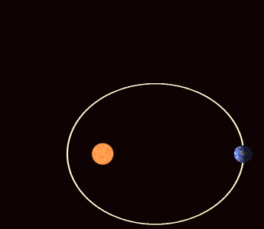
The perihelion of Mercury
The orbit of Mercury is not a perfect ellipse
it precesses, i.e. the orientation of its long axis changes slowly with time
The amount of precession is 574.10±0.65 arcsec/century
531.63±0.69 arcsec/century is accounted for by the gravitational effects of the other planets
this left about 42.5 arcsec/century unaccounted for
General relativity predicts an additional 42.98±0.04 arcsec/century
in excellent agreement with the observations

Slide 7
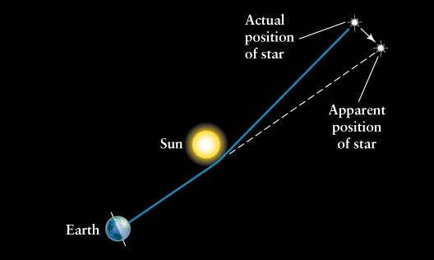
The bending of starlight
GR predicts that the path of a light beam will be deflected by gravity
The effect is small: α = 4GM/c²R
e.g. for light grazing the limb of Jupiter we expect a deflection of 0.017 arcsec (about 4.6 millionths of a degree)
Clearly the Sun is the only sensible target in the solar system
GR predicts a deflection of 1.75 arcsec
Newtonian gravity, based on E = mc² to give a “mass” for the photon, would predict half this, 0.87 arcsec
classical wave theory would predict no deflection
Problem: Sun’s glare drowns out starlight!

Slide 8
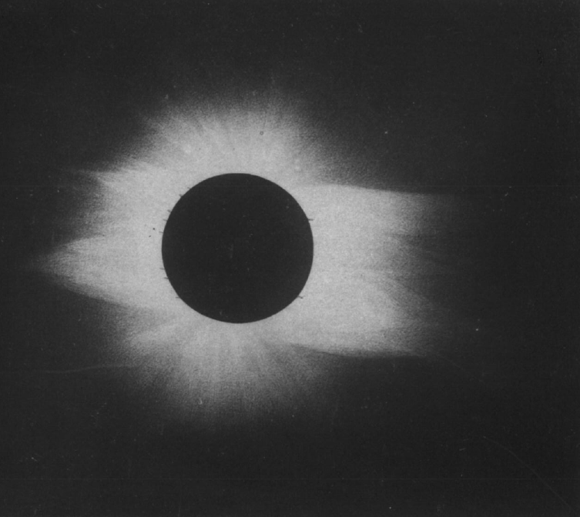
Solution: a solar eclipse
During a total solar eclipse it is possible to observe stars
Therefore, if we compare a photo taken during an eclipse to a photo of the same star field without the Sun, we could be in business
The 1919 May 29 eclipse was particularly suitable
Sun was in a rich star field
1889 eclipse photo by Washington University

Slide 9
The 1919 eclipse expeditions
By November 1917 the Joint Permanent Eclipse Committee of the Royal Society had “decided, if possible, to send expeditions to Sobral in North Brazil, and to the island of Principe” [off the west coast of Africa]
to be organised by Sir Frank Dyson (Astronomer Royal), Prof. Arthur Eddington, Prof. Alfred Fowler and Prof. Herbert Turner
this is a fairly impressive decision considering that the First World War was still raging at the time
Sobral expedition (Crommelin and Davidson) arrived in Sobral on 1919 April 30 and set up on “the race-course of the Jockey Club, which was provided with a covered grand stand”
Principe expedition (Eddington and Cottingham) arrived April 23 and set up in a walled garden belonging to Sr Carneiro, owner of a cocoa plantation, who “had postponed a visit to Europe in order to entertain us”

Slide 10
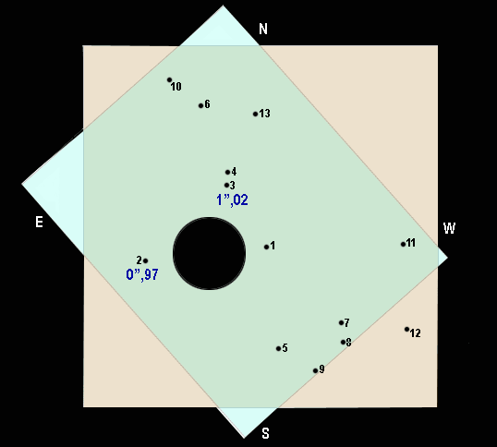
The 1919 solar eclipse
Stars mapped on to photographic plates
Coordinates (in units of 50’) and magnitudes of stars in field, from paper by Dyson, Eddington and Davidson

Slide 11
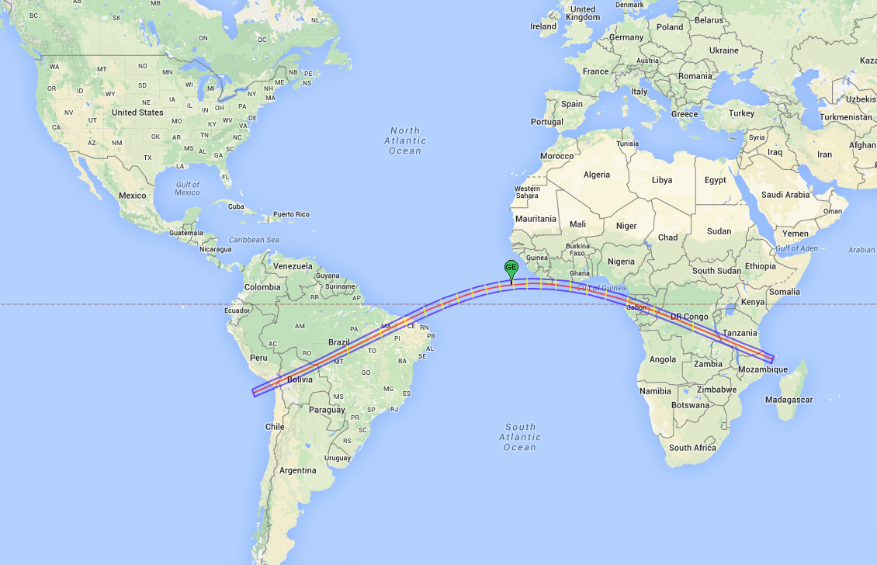
The 1919 total solar eclipse

Slide 12
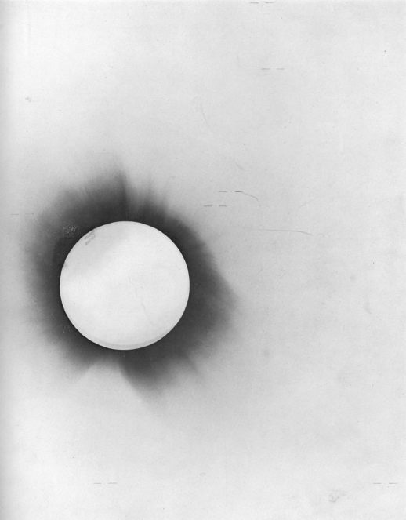
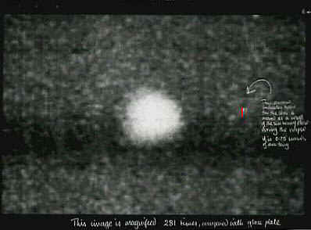
Results
Measurement and reduction of plate data is quite difficult: shifts are small, typically ≪ size of star image
Various “check plates” used to calibrate techniques

Slide 13
Results
The Sobral team took 8 plates with a 4-inch objective and 19 with a 13-inch astrograph stopped down to 8 in
unfortunately the plates from the astrograph turned out to be “very disappointing. The images were diffused and apparently out of focus”
they suspected that this was due to distortion of the optics as a consequence of use in the heat of the Sun rather than at night
The Principe team took 16 plates using a similar astrograph, also stopped to 8 in
though the first 9 show no star images owing to poor weather
the remaining 7 show between 4 and 6 stars (the Sobral 4-in plates show seven), but only two were satisfactory as star 5 is needed for accurate alignment of plates

Slide 14
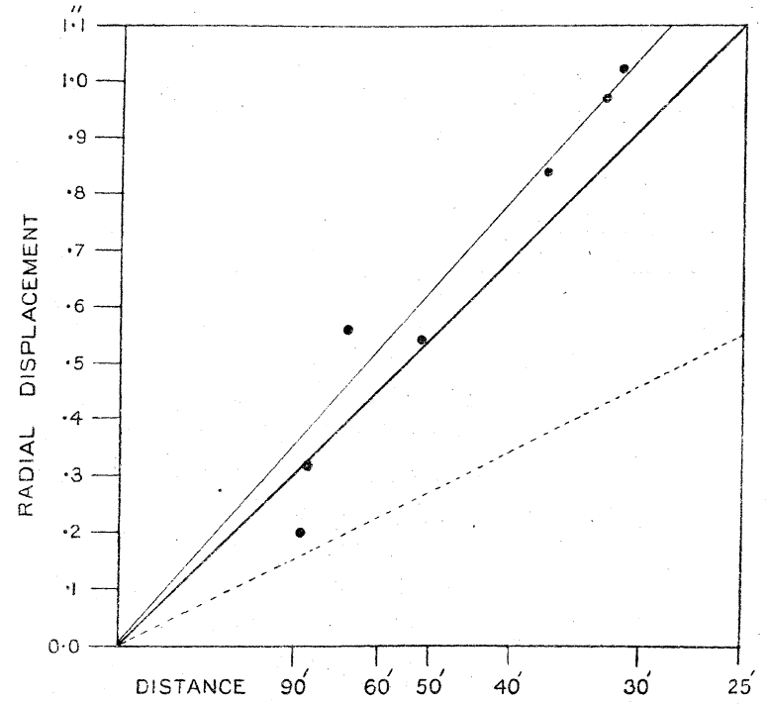
Results
Comparison plates for Principe were taken at Oxford before the expedition
Results from four sets of measurements (the two Principe plates, each compared with two different reference plates) gave 1.61±0.30 arcsec
Comparison plates for Sobral were taken at Sobral in July
the 4-inch gave 1.98±0.12
the astrograph gave 0.93”, but recall poor quality plates
later reanalysis gave 1.52”
Measurements from the 4-in at Sobral

Slide 15
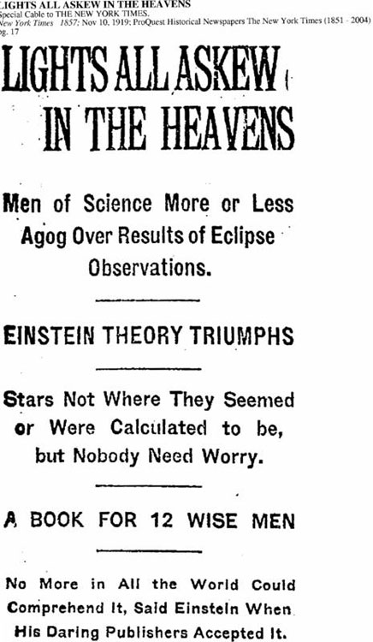
Response
New York Times, 1919 Nov 10
The Times, 1919 Nov 7
A report of the results in November 1919 made (rather exaggerated) headlines, and established Einstein as a media figure.
Scientific response was more muted, which is fair considering quality of data.

Slide 16
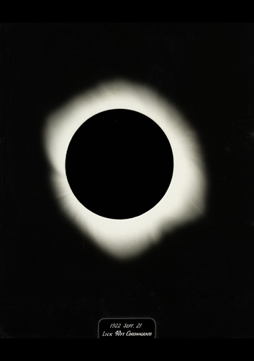
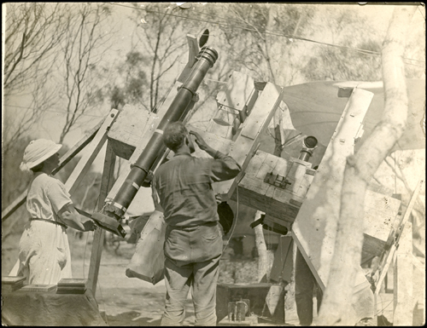
Later confirmation
Lick Observatory mounted expedition to Australia to observe 1922 solar eclipse
results: 15 ft camera 1.72±0.11” 5 ft camera 1.82±0.15” weighted mean 1.75±0.09”
This measurement included 24 stars and established the correctness of the 1919 results.

Slide 17
Gravitational redshift
The predicted gravitational redshift is another small effect—the fractional shift in the wavelength is approximately GM/c²R where M is the mass of the body and R is the distance between the centre of mass and the point at which the light is emitted
The obvious test of this is extremely dense astrophysical compact objects
white dwarfs: mass ~0.5 – 1.0 solar masses, radius ~10000 km
neutron stars: mass ~1.5 solar masses, radius ~10 km
Problem: to test Einstein’s prediction, need to know both mass and radius
for most astrophysical objects this is a serious challenge

Slide 18
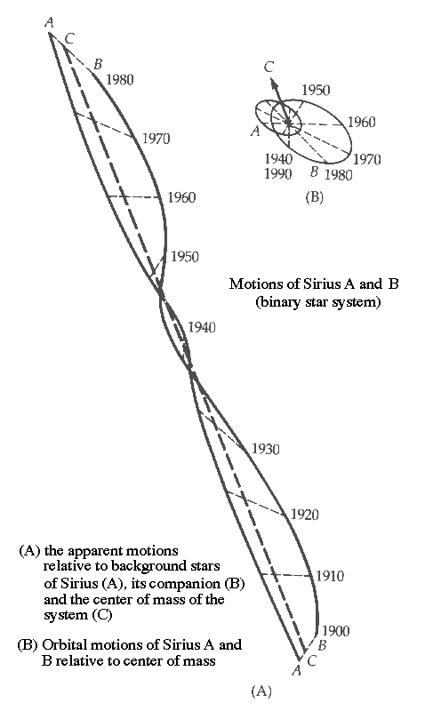
Gravitational redshift
First observed in the spectrum of Sirius B by Walter Adams in 1925
mass of this white dwarf well established from orbital parameters of the Sirius binary system
spectral line shift of 0.032 nm, consistent with a radius of order 20000 km for the white dwarf
This measurement is difficult (because of contamination of Sirius B’s spectrum from much brighter Sirius A) and was not regarded as definitive

Slide 19
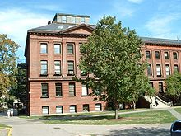
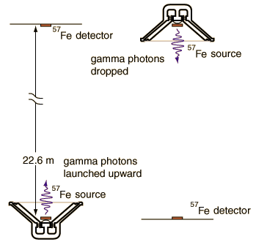
Gravitational redshift
Definitive evidence was provided by laboratory measurements by RV Pound and GA Rebka in 1960
unfortunately published on April 1…
Measured wavelength shift from top to bottom of 22.5 m high “tower” of Jefferson Physical Lab in Harvard
result: net fractional shift (difference between “source at top” and “source at bottom” of −(5.13±0.51)×10⁻¹⁵
one part in 200 trillion!
relativity prediction: −4.92×10⁻¹⁵

Slide 20
Modern tests of General Relativity
Laboratory tests
Gravitational lensing
Gravity Probe B
Binary pulsars
Gravitational waves

Slide 21
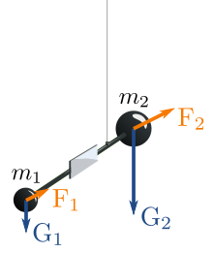
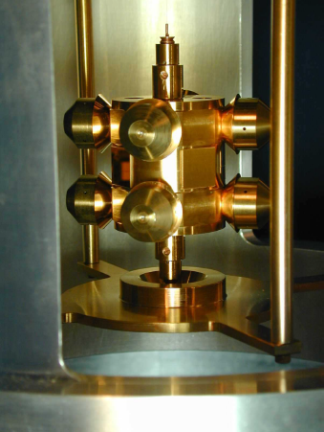
Laboratory tests
Tests of the equivalence principle
looking for differences between M_{inertial} (as in F = Ma) and M_{gravity} (as in F = GMm/r²)
standard experiment: torsion balance measuring ratio of gravitational force to string tension
No differences in acceleration found, at the 10⁻¹⁵ (1 in a quadrillion) level
tests the Equivalence Principle and sets limits on the existence of new ultraweak forces

Slide 22
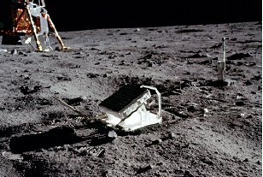
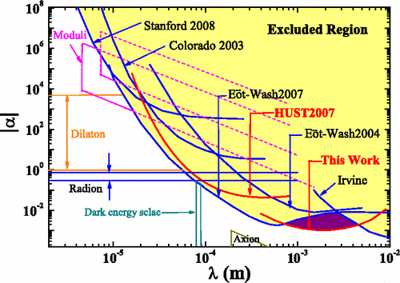
Laboratory tests
Tests of the inverse square law
potentially sensitive to the existence of extra space dimensions
Short range tests
typically torsion balance experiments, see previous slide
Long range tests
lunar laser ranging (monitors distance of Moon with mm precision)
tests inverse square law and equivalence principle
No deviations from expectations seen

Slide 23
Gravitational lensing
Early measurements of gravitational bending of starlight were heroic attempts to measure tiny effects
These days, gravitational lensing is a powerful tool for cosmology
measuring the mass distribution in galaxy clusters
a tool for studying dark matter
determining the Hubble constant
constructing mass maps of the universe
investigating the structure of the Galactic bulge and looking for dark objects in the Galactic halo
detecting extrasolar planets

Slide 24
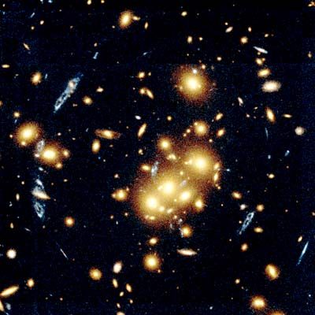
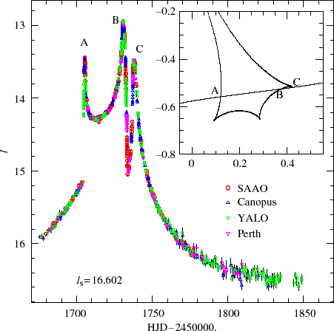
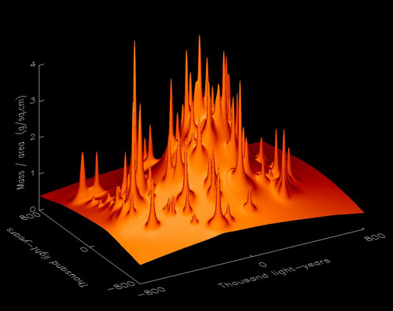

Slide 25
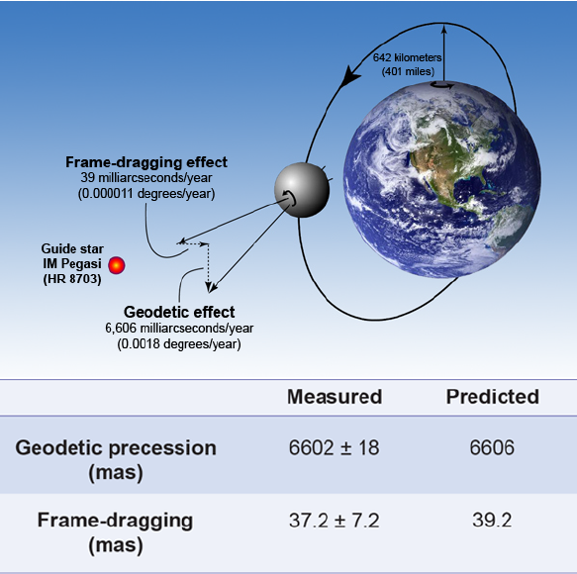
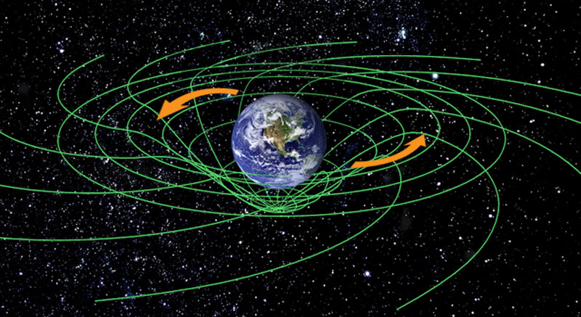
Gravity Probe B
Test of space curvature and “frame dragging” in Earth orbit
satellite in polar orbit containing four precision gyroscopes
measure precession of gyro axis

Slide 26
Binary pulsars
The ideal test of General Relativity is an accurate clock in a strong gravitational field
Precisely this is provided by pulsars in close binary systems with other compact objects (other neutron stars, white dwarfs, potentially—but not yet observed—black holes)
First example: Hulse-Taylor pulsar, PSR B1913+16
system consists of a pulsar and another neutron star (not observed as a pulsar)
Most spectacular example: PSR J0737−3039
a double neutron star system in which both neutron stars are seen as pulsars

Slide 27
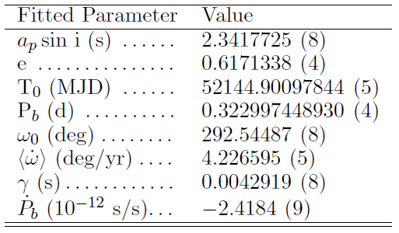
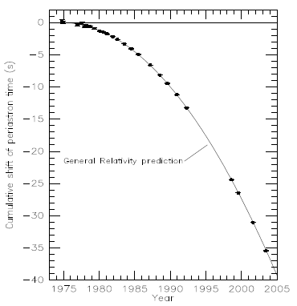
PSR B1913+16
Discovered by Hulse and Taylor in 1974; earned them the Nobel Prize in 1993
Located about 7 kpc from Earth
Mass of pulsar: 1.4414±0.0002 solar masses
Companion: 1.3867±0.0002 solar masses
System is losing energy at a rate consistent with gravitational wave production as predicted by GR
Orbital decay with GR prediction (not fit!)

Slide 28
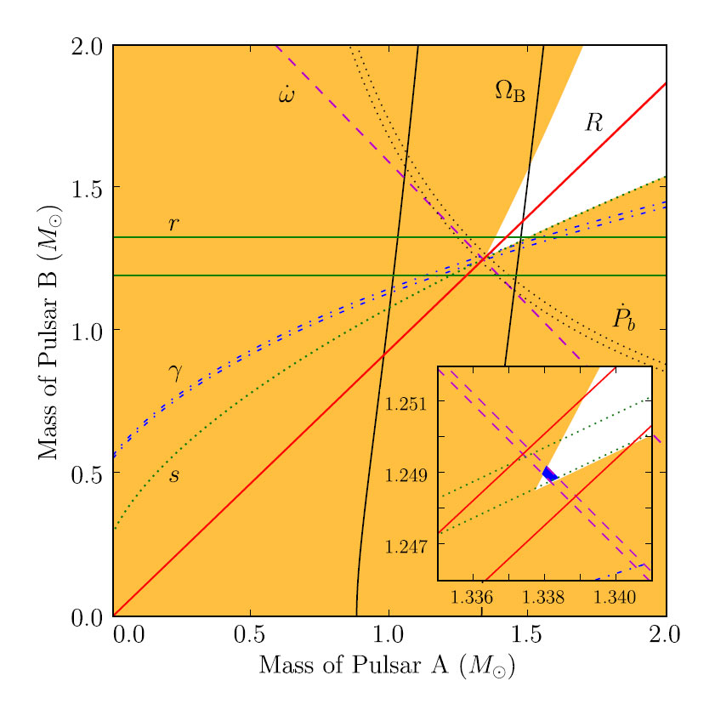
PSR J0737−3039
Much closer to Earth (~1 kpc) and a tighter binary
Therefore gives more stringent tests of GR
Pulsar A: 1.3381±0.0007 solar masses; 22 ms
Pulsar B: 1.2489±0.0007 solar masses; 2.8 s
Many different tests performed; results all consistent with GR

Slide 29
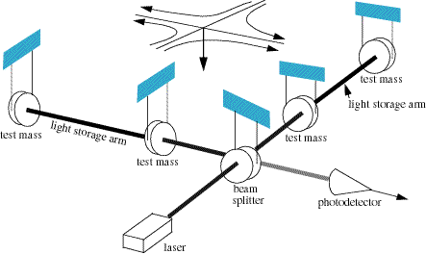
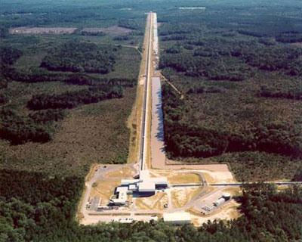
Gravitational waves
GR predicts gravitational waves: travelling ripples in spacetime
indirect evidence for these is provided by binary pulsars
Laser interferometers aim to provide direct evidence
by measuring the tiny shift in the relative lengths of the two arms caused by a passing wave
this shift is ~10⁻²¹—i.e., about the diameter of a proton over a baseline of 1 km!

Slide 30
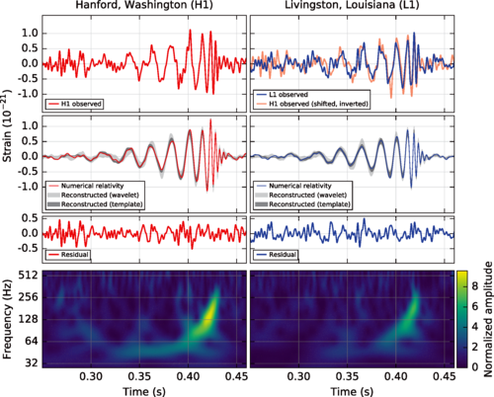
GW150914
Announced February 11, 2016, but observed September 14, 2015
signal in both advanced LIGO detectors corresponding to the merger of two black holes of 36 and 29 M at a distance of 400 Mpc (1.3 billion light years)
Form of signal exactly as predicted by GR

Slide 31
General Relativity and You

Slide 32
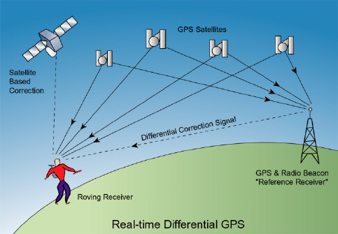
Everyday General Relativity
GR has the reputation of being an abstruse theory with no real relevance to you and me
This is no longer true!
(at least, not if you ever use a satnav)
Basic idea of GPS
your receiver compares its time with the time signals from (at least) 4 GPS satellites
from time lag, calculate distance to satellite
hence solve for your position

Slide 33
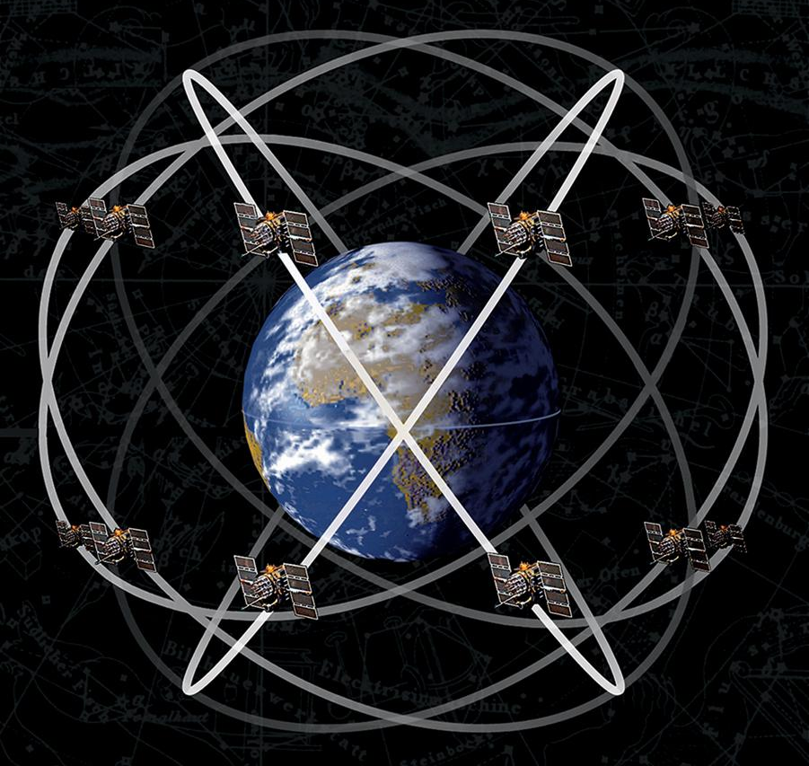
GPS and GR
Your GPS satellite is
moving at about 14000 km/h in an orbit with a 12 h period
this means that its clock runs slow relative to yours by about 7 µs per day
in a lower gravitational potential than you are, on account of being at an altitude of about 20000 km
this means that your clock runs slow relative to its by about 45 µs per day
this is a net shift of 38 µs per day (about 11 km!)
To compensate for this, the atomic clocks on GPS satellites are deliberately set to run slow

Slide 34
Summary
Over the last half century or so, General Relativity has become an extremely well-verified theory
owing to a combination of very high precision local measurements and measurements of extreme astrophysical systems
Further advances in experimental General Relativity are likely in the near future
increasing numbers of binary pulsars
further observations of gravitational waves
Happy 100th birthday, GR!

