Slide 1
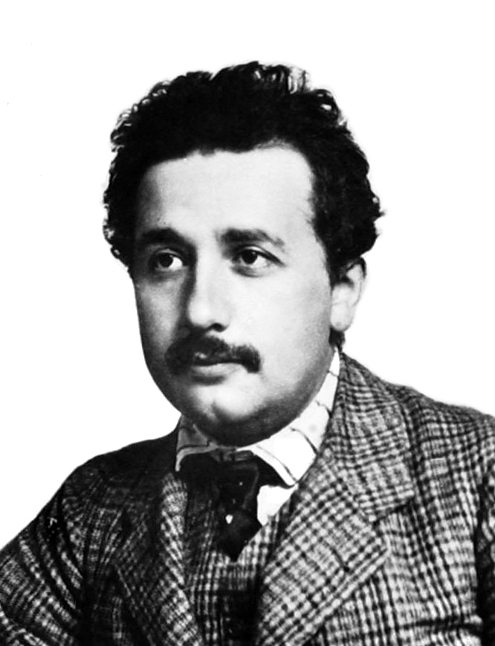
Einstein and the Photon
Susan Cartwright

Slide 2
Einstein’s 1905 papers
In 1905 Einstein wrote four ground-breaking papers:
On a Heuristic Viewpoint Concerning the Production and Transformation of Light
On the Motion of Small Particles Suspended in a Stationary Liquid, as Required by the Molecular Kinetic Theory of Heat
On the Electrodynamics of Moving Bodies
Does the Inertia of a Body Depend Upon Its Energy Content?
Although the last two (relativity and E = mc²) are by far the most famous, his 1921 Nobel Prize actually specified the first one.
Einstein’s Nobel Prize is for the photon, not relativity.

Slide 3
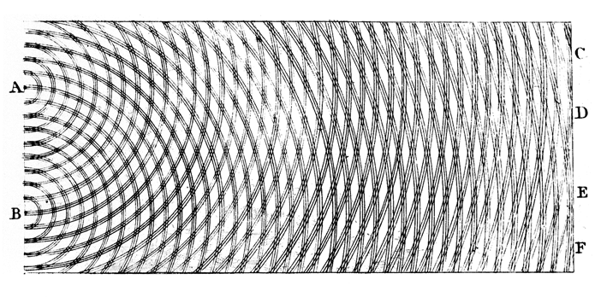
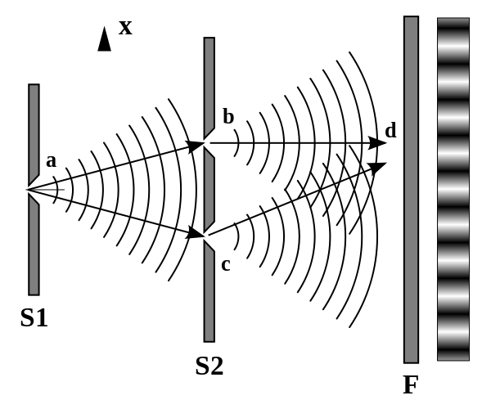
Before Einstein: light in the 19th century
Early theories of light included both “corpuscular” or particle models (e.g. Newton) and wave models
In 1801 Thomas Young demonstrated his two-slit experiment, which shows that light behaves like a wave
In 1818 Fresnel offered a wave theory of light in a competition run by the French Académie des sciences
In an attempt to disprove this theory Poisson showed that it implied a bright spot in the shadow of a circular object cast by a point source (which seemed ridiculous)
The committee chair, Arago, tested this prediction and showed that the spot did exist!

Slide 4
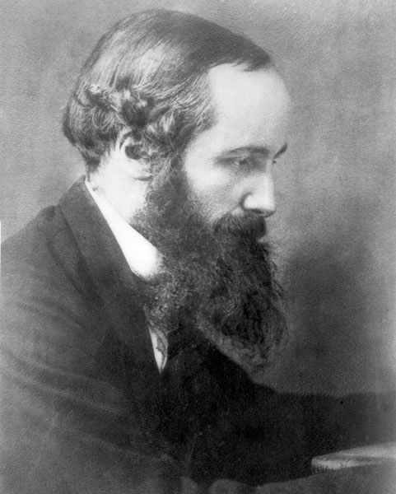
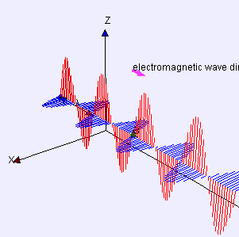
Light in the 19th century: Maxwell
In the 1860s James Clerk Maxwell formulated the modern theory of electricity and magnetism
His equations predicted electromagnetic waves travelling at a speed very like the measured speed of light
Heinrich Hertz experimentally demonstrated that Maxwell’s prediction worked—discovering radio waves
Light is an electromagnetic wave

Slide 5
Problems with light: the blackbody spectrum
If you heat an object, it will emit electromagnetic radiation
initially infra-red, but subsequently visible if it gets hot enough
The spectrum of this radiation depends only on the temperature of the object
it is called “blackbody radiation”
Using classical physics, it is impossible to derive a good formula for this spectrum
this was one of the very few acknowledged failures of classical physics at the end of the 19th century

Slide 6
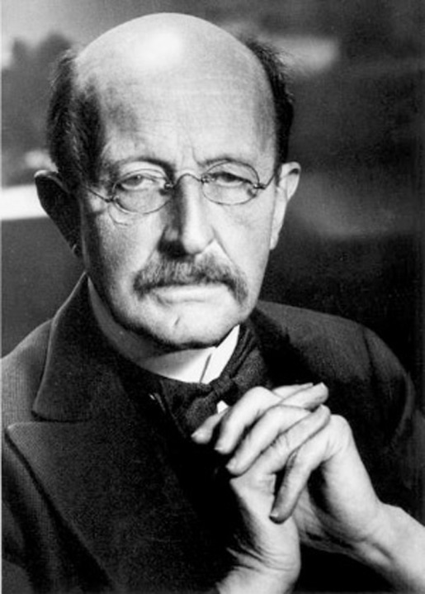
Max Planck and his constant
Wilhelm Wien derived an expression for blackbody radiation from thermodynamics*
this approach had worked for particles in a gas, and gave a good description at high frequencies, but failed at low frequencies
In 1901 Max Planck showed that the correct description could be obtained by assuming that light energy was quantised in units of hν where h is a constant
* another James Clerk Maxwell production…

Slide 7
Problems with light: the photoelectric effect
The photoelectric effect is the observation that shining a light on the surface of a metal will cause an electron to be emitted
energy is transferred from the light to the electron, allowing it to escape from the metal
In the wave theory, the energy carried by a wave is proportional to the square of its amplitude, so one might expect that brighter light would produce more energetic electrons
it doesn’t: it produces more electrons, but the electron energy is not changed
in fact the electron energy depends on the frequency of the light, not its intensity

Slide 8
Einstein and the photon
Einstein suggested that all light (not just blackbody radiation) was quantised in units of hν
if an electron can only absorb photons one at a time, this explains the features of the photoelectric effect
say an electron needs to gain energy E₀ to escape:
if hν > E₀, the electron will escape with energy E = hν – E₀
if hν < E₀, the electron will not escape
more intense light means more photons and hence more electrons, but not more energetic electrons
there is a threshold frequency ν_{o} below which you never get any electrons at all
This was a novel idea: Planck had not thought of his quantised energy as a general property of light

Slide 9
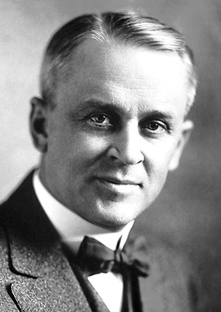
Millikan and the photon
In 1916 Robert Millikan set out to test this idea
He was initially sceptical:
“It was in 19o5 that Einstein made the first coupling of photo effects and with any form of quantum theory by bringing forward the bold, not to say the reckless, hypothesis of an electro-magnetic light corpuscle of energy hν, which energy was transferred upon absorption to an electron. This hypothesis may well be called reckless first because an electromagnetic disturbance which remains localized in space seems a violation of the very conception of an electromagnetic disturbance, and second because it flies in the face of the thoroughly established facts of interference.”
However, he accepted that the theory
“furnished a ready explanation of one of the most remarkable facts brought to light by recent investigations, viz. that the energy with which an electron is thrown out of a metal…is independent of the intensity of the light while it depends on its frequency.”

Slide 10
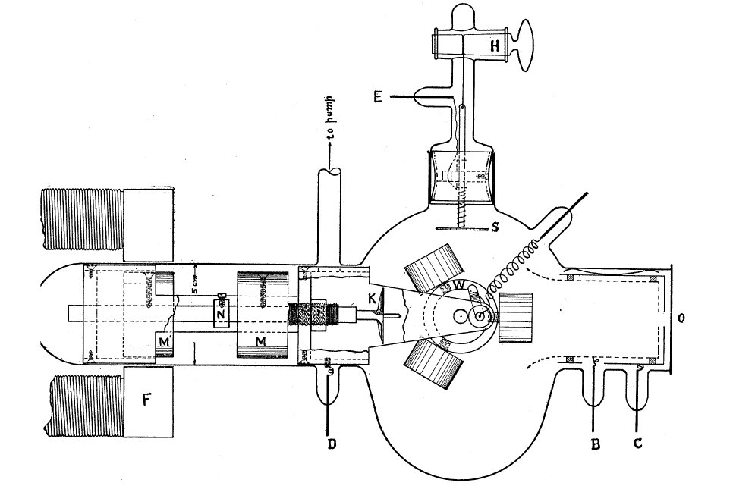
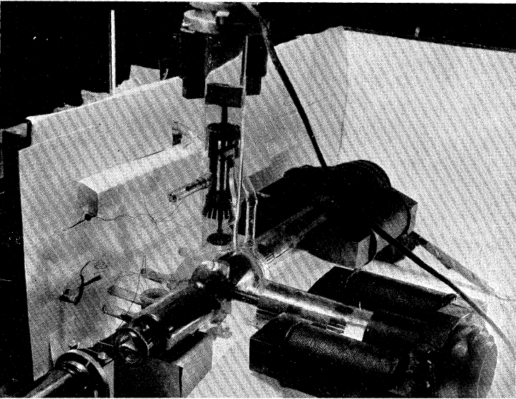
Millikan and the photon
“…it has become not inappropriate to describe
the present experimental arrangement as a machine shop in vacuo.”

Slide 11
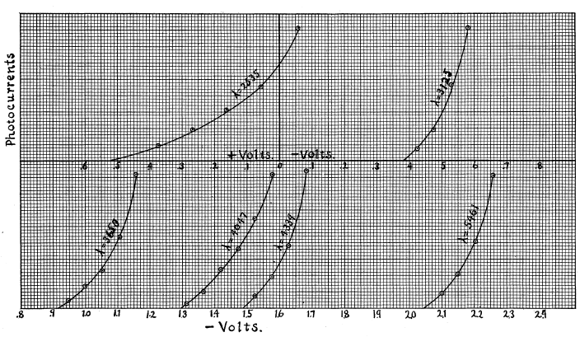
Millikan and the photon
Millikan measured the energy of his emitted electrons by applying a voltage and measuring the resulting current. Note that longer wavelengths (lower frequen-cies) require higher voltage.

Slide 12
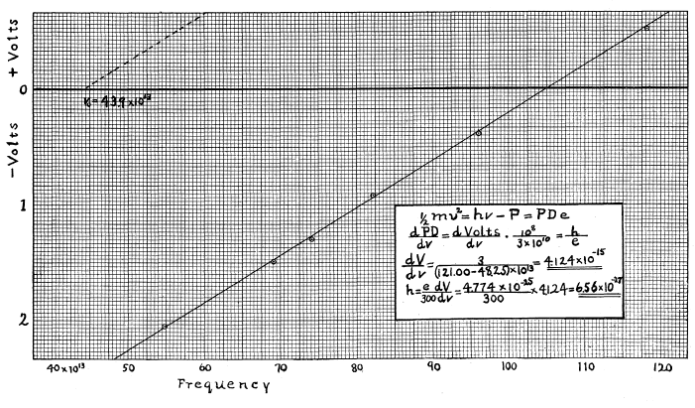
Millikan and the photon
Einstein predicts that the plot of electron energy (represented by the minimum voltage) against frequency is a straight line of slope h.
This is a straight line, and the value of h is very close to our modern value (about 5% high).

Slide 13
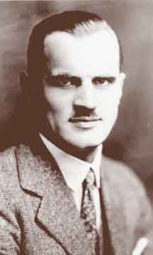
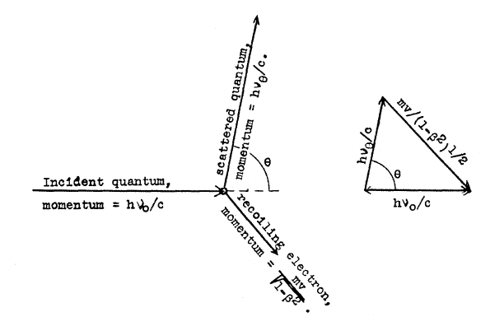
Compton and the photon
When X-rays are scattered by matter, the outgoing X-ray has lower frequency than the incoming one
In 1923 Arthur Compton explained this by treating the scattering as a collision between a photon of energy hν and momentum hν/c and an initially stationary electron
this theory requires the photon to behave like a real (albeit massless) particle

Slide 14
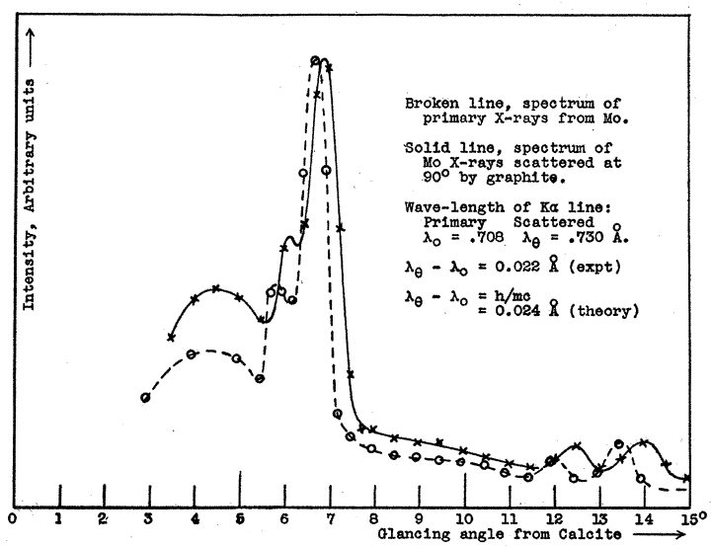
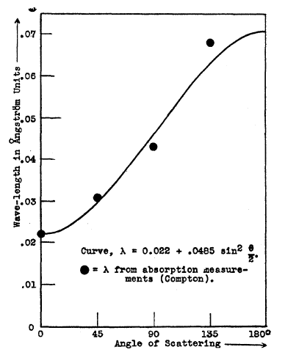
Compton and the photon
This theory successfully described X-ray scat-tering, which previous theories had not. The process is still called Compton scattering.

Slide 15
Einstein and the photon
It is often claimed that Einstein disapproved of quantum mechanics
However, in 1905 he was one of the first scientists to take the idea of quantisation seriously
By combining Planck’s idea of the quantisation of light energy with a fairly obscure and little-understood phenomenon, he was able to provide the first evidence for wave-particle duality: light, while clearly a wave, also behaves as a particle of energy hν
Although other great scientists, before and after, also contributed, Einstein was the pioneer of our modern picture of the nature of light

