Slide 1
Discovering Neutrinos
Dr Susan Cartwright Department of Physics and Astronomy

Slide 2
Discovering neutrinos
Routes to scientific discovery:
Accident!
You find something unexpected in your data
For example, gamma-ray bursts (discovered by satellites designed to look for clandestine nuclear tests)
Prediction
There is a clear-cut theoretical prediction that your experiment is designed to test
For example, discovery of the W, Z and Higgs at CERN
Anomaly
Something in the data does not agree with theoretical expectations

Slide 3
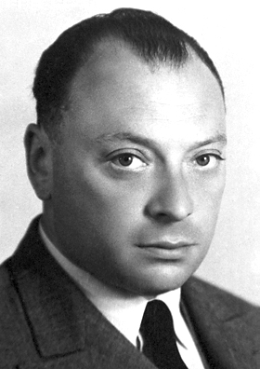
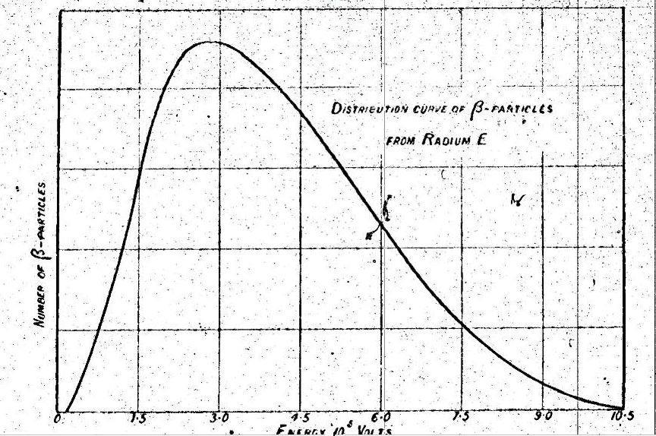
The idea of neutrinos
Neutrinos have
no charge
very little mass
very weak interactions with everything else
Why would anyone suspect their existence?
radioactive β decay X → X' + e⁻
Wolfgang Pauli suggested emission of an additional particle (1930)
+ ν̄_{e}
should have E = Δmc²
obviously doesn’t!
Ellis & Wooster, 1927

Slide 4
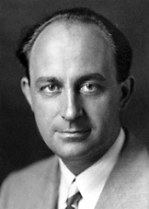
Neutrinos in theory
Fermi’s theory of weak force (1933) assumed the existence of the neutrino, but nobody had detected one directly
Pauli worried that he might have postulated a particle which was literally impossible to detect
Neutrinos interact so weakly that they are very hard to see
you need a very intense source to make up for the extremely small chance of any given neutrino interacting

Slide 5
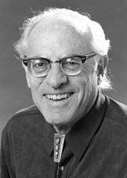
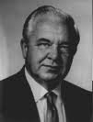
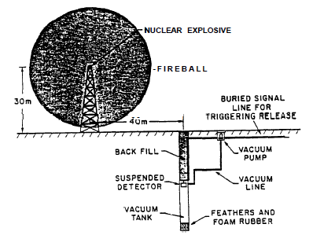
Discovering neutrinos
Enter Fred Reines and Clyde Cowan (1950s)
Plan A: use a bomb!
lots of neutrinos from fission fragments
detect via ν͞_{e} + p → e⁺ + n
problem—need your detector to survive the blast...
detect γ rays produced when it annihilates with e⁻
late γ rays emitted when it is captured by a nucleus

Slide 6
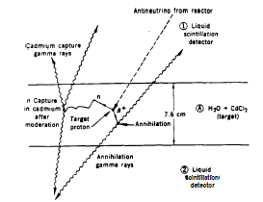
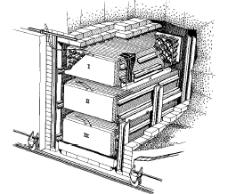
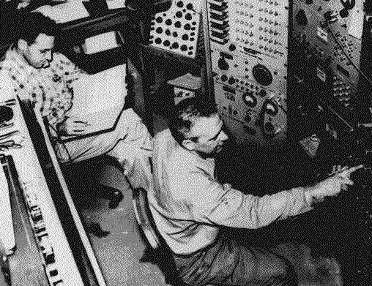
Discovering neutrinos
Enter Fred Reines and Clyde Cowan (1950s)
Plan B: use a nuclear reactor
lots of neutrinos from fission fragments
detect via ν͞_{e} + p → e⁺ + n
detector survives... can repeat experiment
detect γ rays produced when it annihilates with e⁻
late γ rays emitted when it is captured by a nucleus

Slide 7
The results
They observed a signal of 2.88±0.22 counts per hour
Is this real?
It agrees with the expectations of Fermi’s theory to within a factor of 2
The first signal consists of two γ-rays arriving at the same time (from e⁺e⁻ → γγ)
The second signal went away when the cadmium was removed (i.e. it is from a neutron)
The rate is halved when H₂O is partially replaced by D₂O (reducing the number of free protons)

Slide 8
Conclusion
It took 25 years to convert the neutrino from a theoretical postulate to a detectable particle
This is because neutrinos interact extremely weakly, not because they are rare—the flux of solar neutrinos at the Earth is 65 billion per square cm per second!
The discovery required ground-breaking experimental techniques
This detector was enormous by the standards of the 1950s
The team made many cross-checks before announcing their result
“Extraordinary claims require extraordinary evidence”

Slide 9
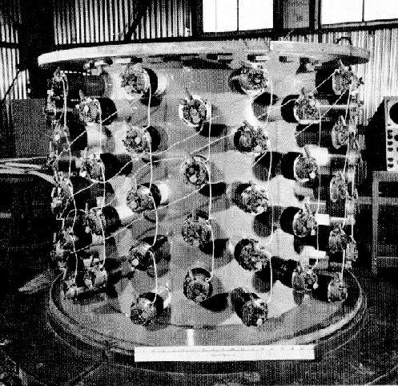
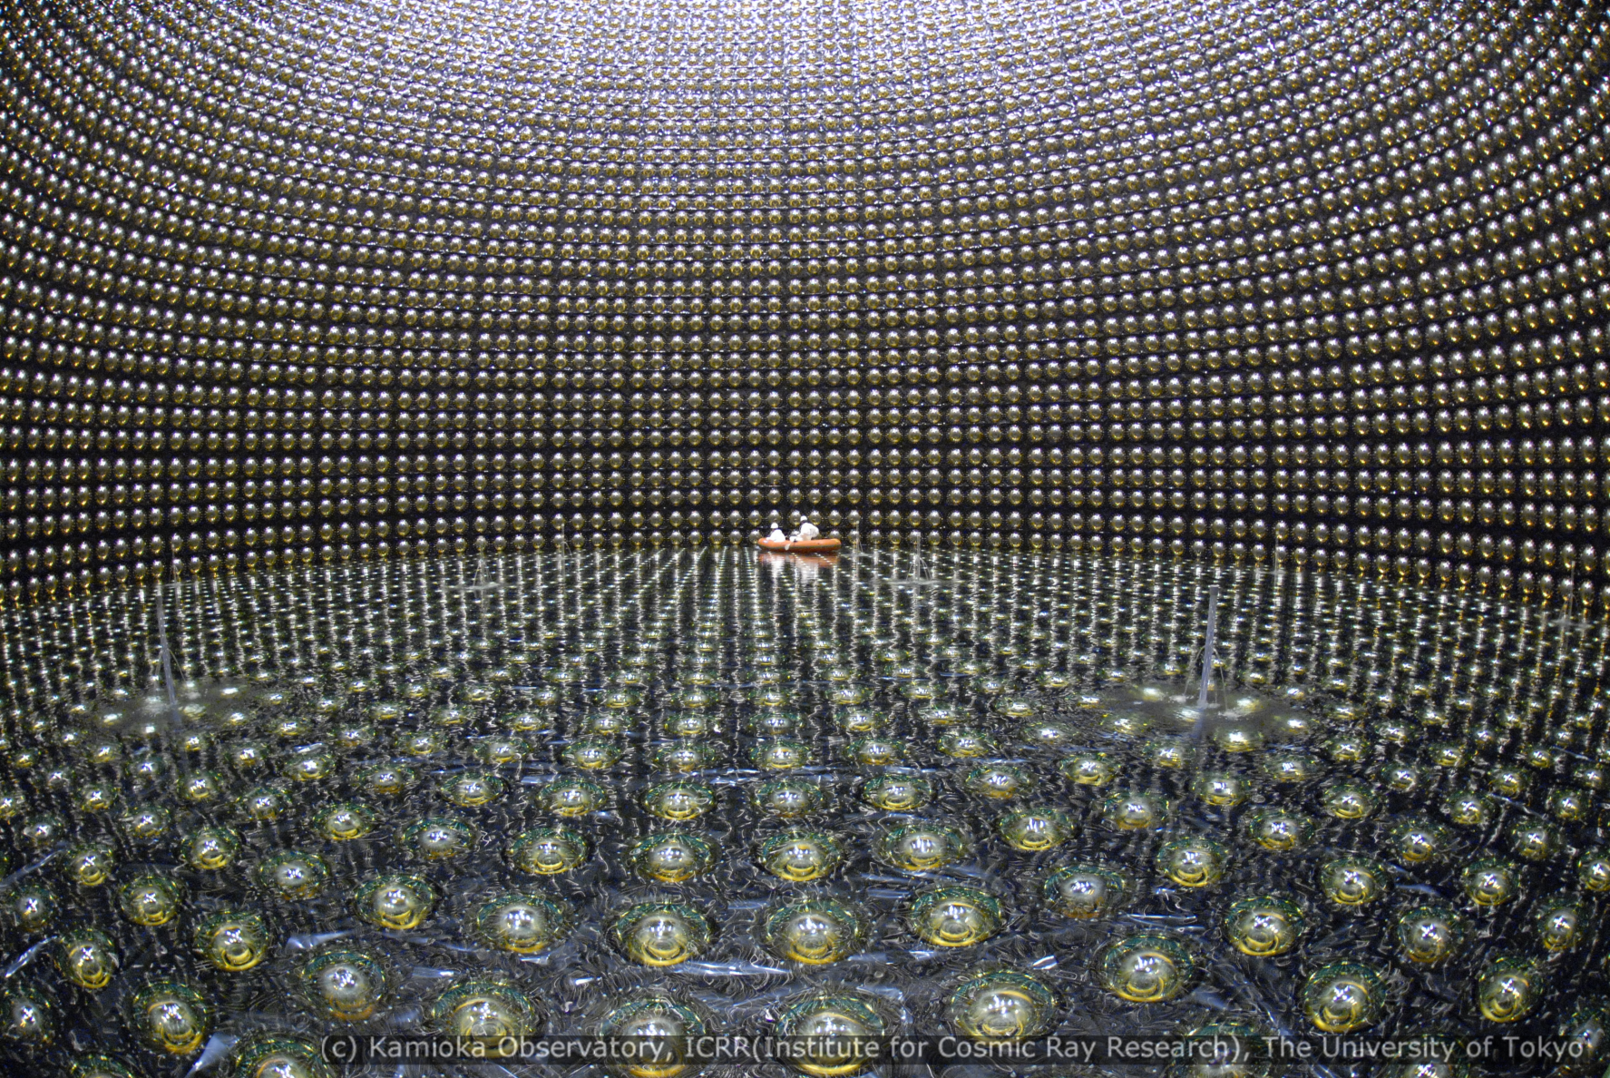
Neutrino experiments still measure the interaction that Reines and Cowan used—but they’ve got a bit bigger since 1953…

