Slide 1
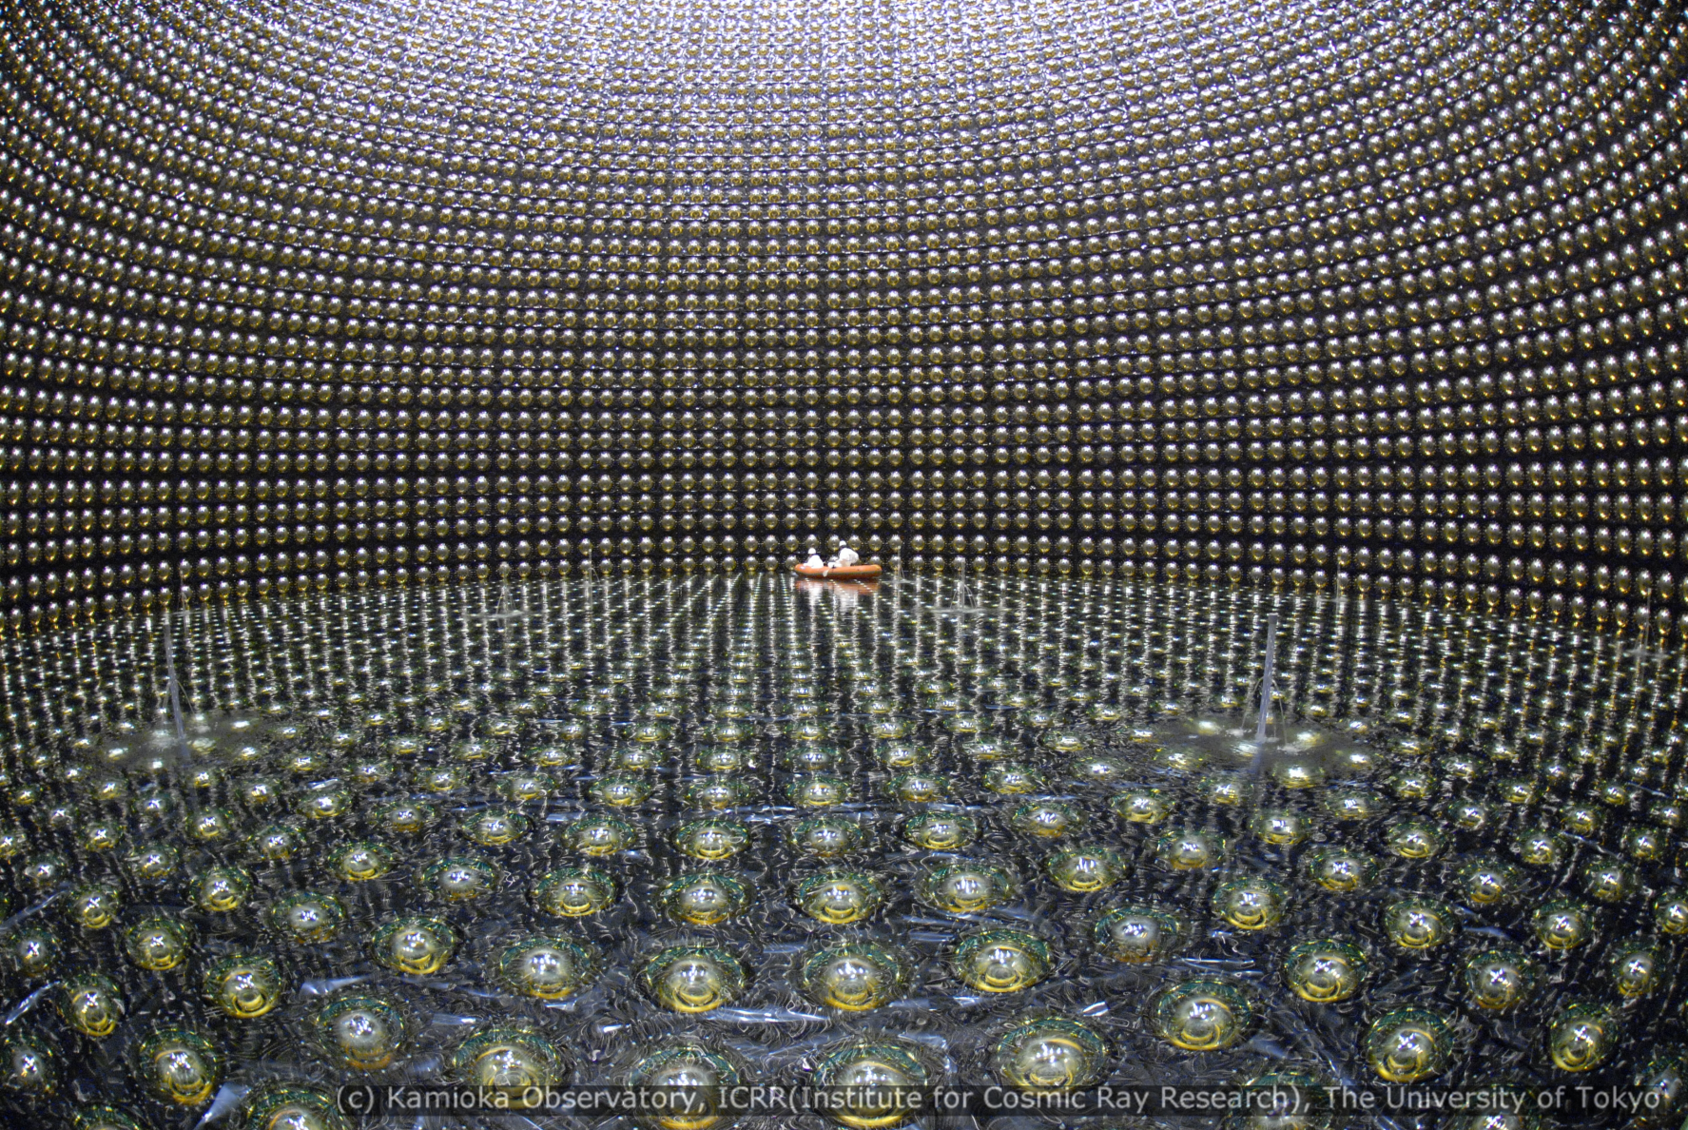
Astroparticle Physics
Susan Cartwright
University of Sheffield

Slide 2
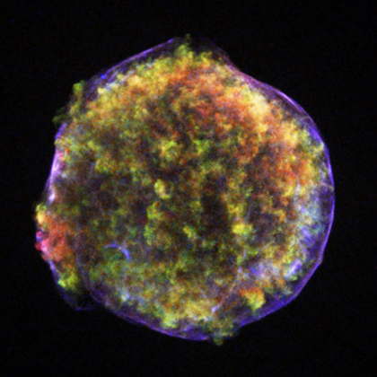
What is Astroparticle Physics? Astrophysical Accelerators

Slide 3
What is Astroparticle Physics?
Various definitions! Mine is the use of particle physics technology to study astrophysical phenomena
Included:
neutrino astrophysics
gamma-ray astronomy
cosmic rays
dark matter
early-universe cosmology
Sometimes also included:
cosmic microwave background
gravitational waves
neutrino masses (especially 0νββ)
coherent field with a lot of common factors
High Energy Astroparticle Physics
someone else’s problem!
not very particulate
not very astrophysical

Slide 4
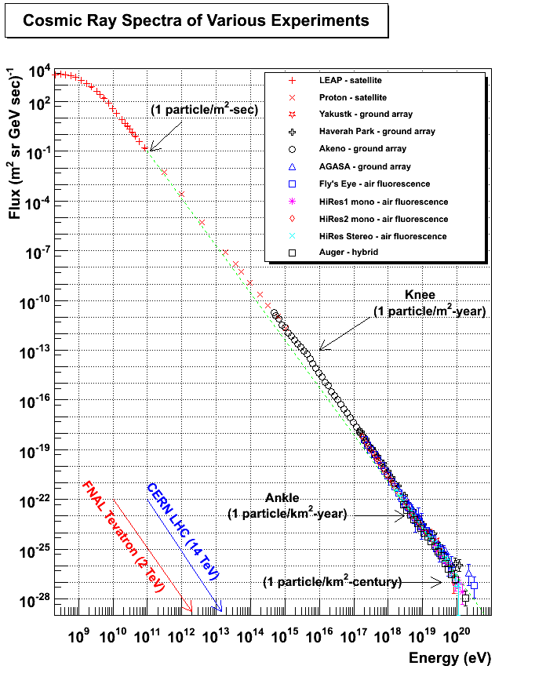
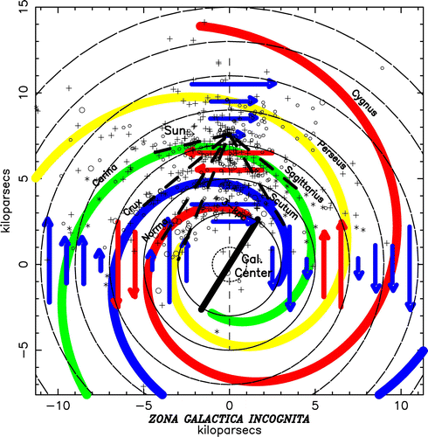
Astrophysical Accelerators
Cosmic rays are observed up to very high energies (>> LHC)
therefore something must accelerate them
unfortunately their directions are scrambled by Galaxy’s magnetic field

Slide 5
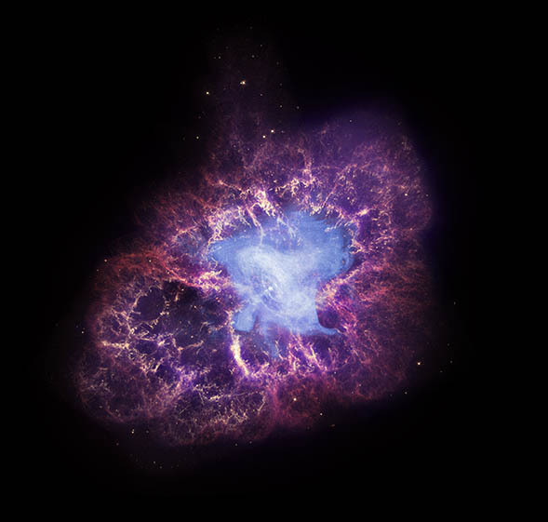
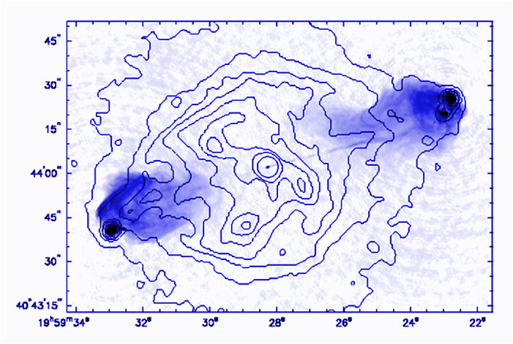
Protons and Electrons
How does the cosmos accelerate charged particles?
probably through combination of shock waves and magnetic fields
Candidate locations: supernova remnants, active galaxies

Slide 6
Photons and Neutrinos
These are secondary particles produced from the high-energy protons and electrons
photons: inverse Compton effect (scattering off fast electrons)
neutrinos and photons: pion production
π⁰ → γγ
π± → ℓν

Slide 7
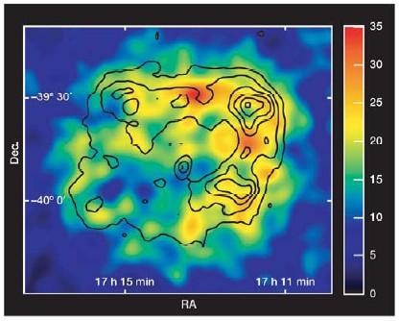
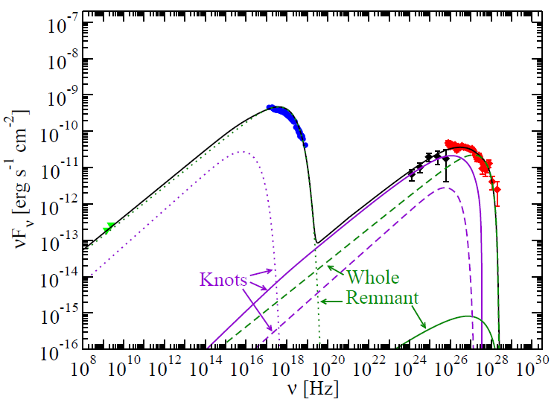
Supernova Remnant RXJ 1713.7−3946
ROSAT + HESS
Suzaku
Fermi LAT
HESS
ATCA
Spectrum is consistent with high-energy electrons only: synchrotron radiation (radio → x-ray) plus inverse Compton effect (γ-rays)
Expect this SNR not to produce high-energy neutrinos

Slide 8
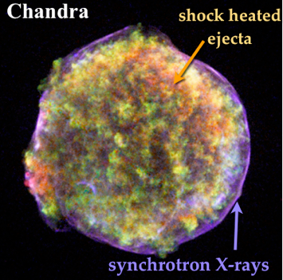
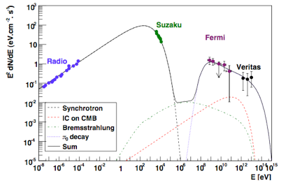
SN 1572 (Tycho)
Spectrum seems to prefer π⁰ decay—shape wrong for IC
This SNR should produce high-energy neutrinos

Slide 9
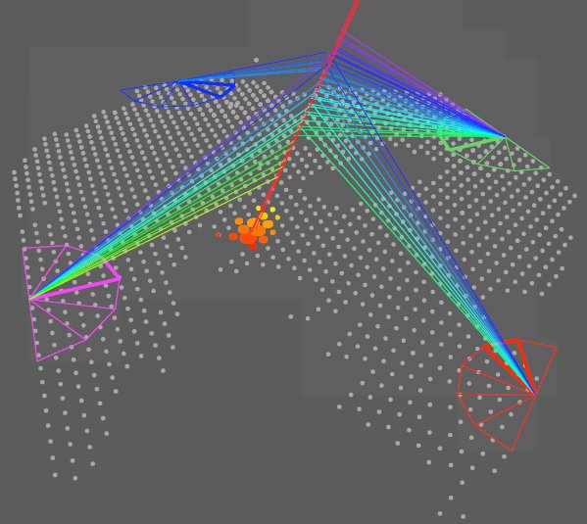
Detecting High-Energy Astroparticles

Slide 10
Detecting high-energy Astroparticles
Moderate-energy γ-rays detected by satellites
e.g. Beppo-SAX, CGRO, SWIFT, Fermi
this is generally regarded as a branch of astronomy
For high-energy γ-rays and cosmic rays space is not practical
rare events, need very large effective areas
therefore use ground-based instruments
primary particles don’t survive, but they create air showers that do
Neutrinos also require very large detector volumes
very small interaction probabilities
detectors situated underground or underwater to reduce cosmic-ray background

Slide 11
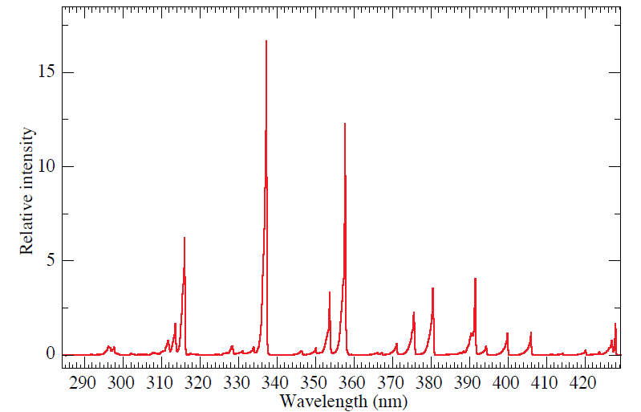
Detection Methods
3 MeV electrons in dry air
Basic principles
Cosmic rays and high-energy γs shower in the atmosphere
detect light emitted or induced by the shower
Cherenkov radiation
fluorescence
detect shower particles that reach the ground
much more likely for hadron-induced showers
Neutrinos in general don’t shower
detect products of charged-current interactions (e, μ, τ)

Slide 12
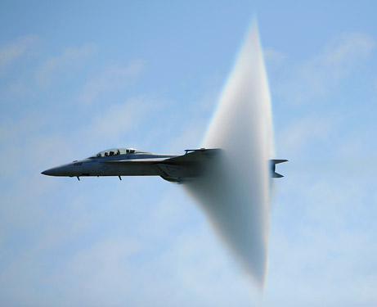
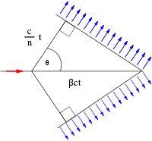
Cherenkov Radiation
Radiation emitted by charged particle travelling faster than speed of light in a medium
wavefronts constructively interfere to produce cone of radiation
angle of cone given by cos θ = 1/βn
for astroparticle applications usually β ≈ 1
hence in air θ ≈ 1.3° (depends on temperature); in water θ ≈ 41° (40° for ice)

Slide 13
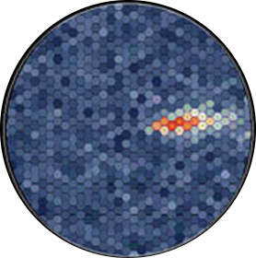
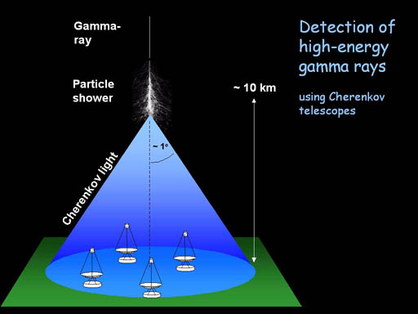
TeV Gamma-Ray Astronomy: Imaging Atmospheric Cherenkov Telescopes
Principles (from H.E.S.S. website)

Slide 14
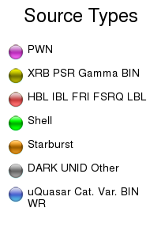
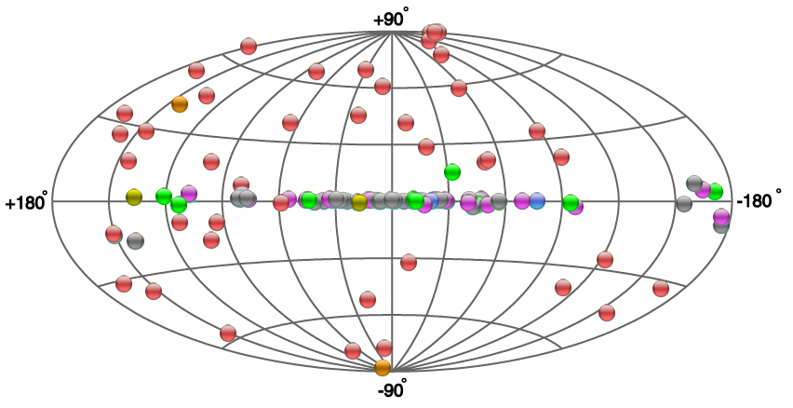
TeV γ Sources

Slide 15
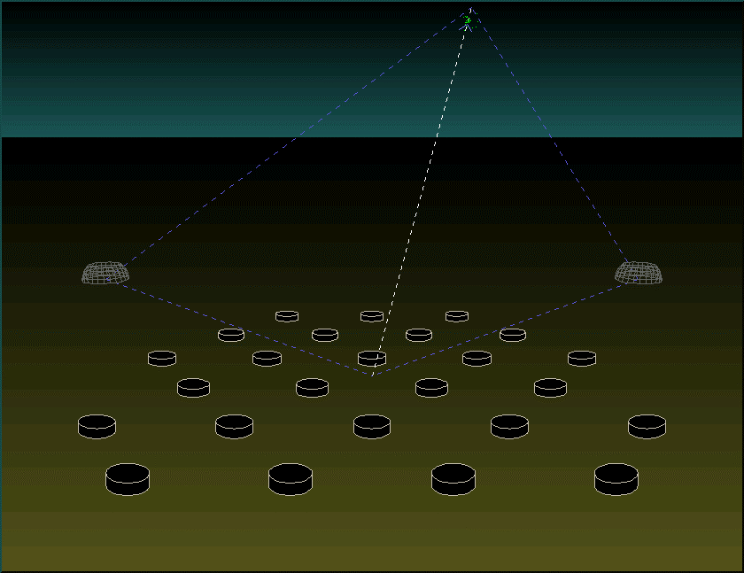
Cosmic Ray Astronomy: Auger Hybrid Detector
fluorescence telescope
water Cherenkov detects shower particles

Slide 16
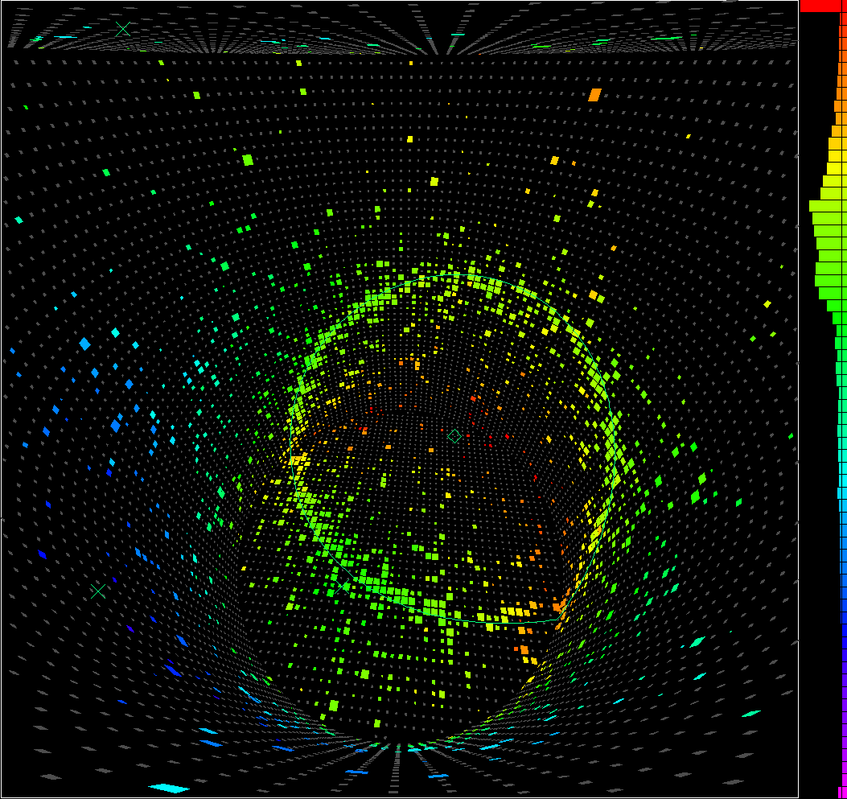
Neutrino Astronomy

Slide 17
Astrophysical Neutrino Sources
Solar neutrinos
by-product of fusion: 4 ¹H → ⁴He + 2e⁺ + 2ν_{e}
relatively low energies: 0.1 – 10 MeV roughly
Supernova neutrinos (SN1987A)
produced in core-collapse supernovae
some from neutron star formation: p + e⁻ → n + ν_{e}
most thermally, e.g. e⁺ e⁻ → ν ν̄
few 10s of MeV
High-energy neutrinos
produced from pions created by high-energy proton interactions
Neutrinos from dark-matter annihilation
if dark matter is neutralinos (supersymmetric particles)
☑
☑
☒
☒

Slide 18
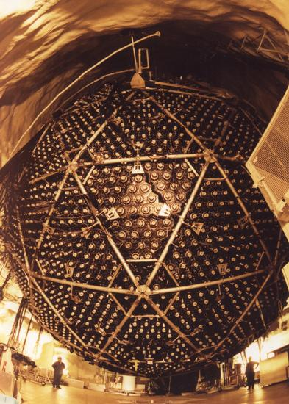
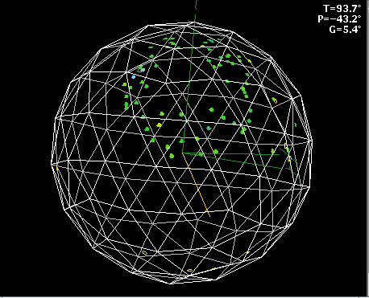
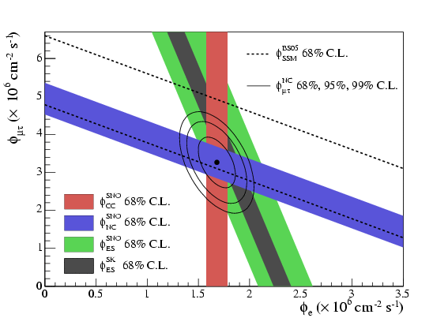
Solar Neutrinos
Detected by water Cherenkov detectors or radiochemical methods
used to be a problem—too few neutrinos for known reaction rate in Sun
no longer an issue: SNO experiment showed that neutrinos weren’t missing, merely transformed
ν_{e} + d → p + p + e⁻
ν + d → p + n + ν
ν + e⁻ → ν + e⁻

Slide 19
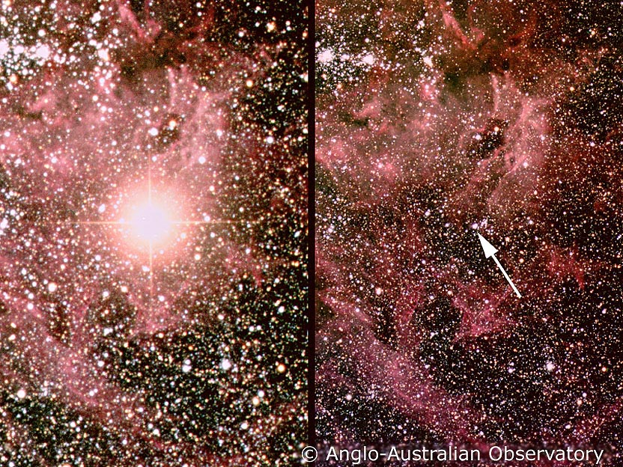
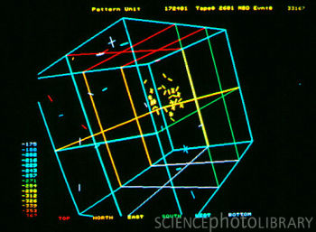
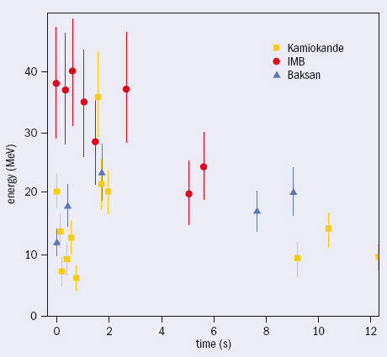
Supernova Neutrinos
SN1987A in the Large Magellanic Cloud was the first naked-eye SN for nearly 400 years
distance about 160000 ly
About 20 neutrinos were detected by the water Cherenkov experiments Kamiokande and IMB
both of which had actually been designed to search for proton decay
Confirmed that about 99% of the energy of a core-collapse SN is in neutrinos not light

Slide 20
High-Energy Neutrinos
Neutrino water Cherenkovs are getting bigger!
but for high-energy neutrinos need a still larger detector, owing to low rate
Building big enough underground tank not really practical
we need about 1 km³
therefore use natural water instead
lake, ocean, ice-cap

Slide 21
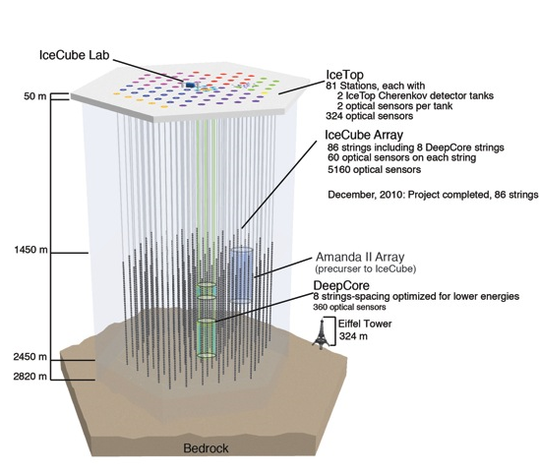
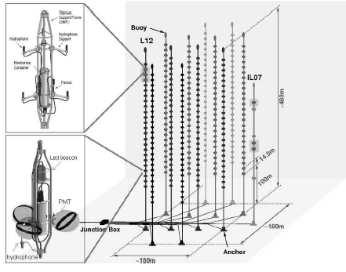
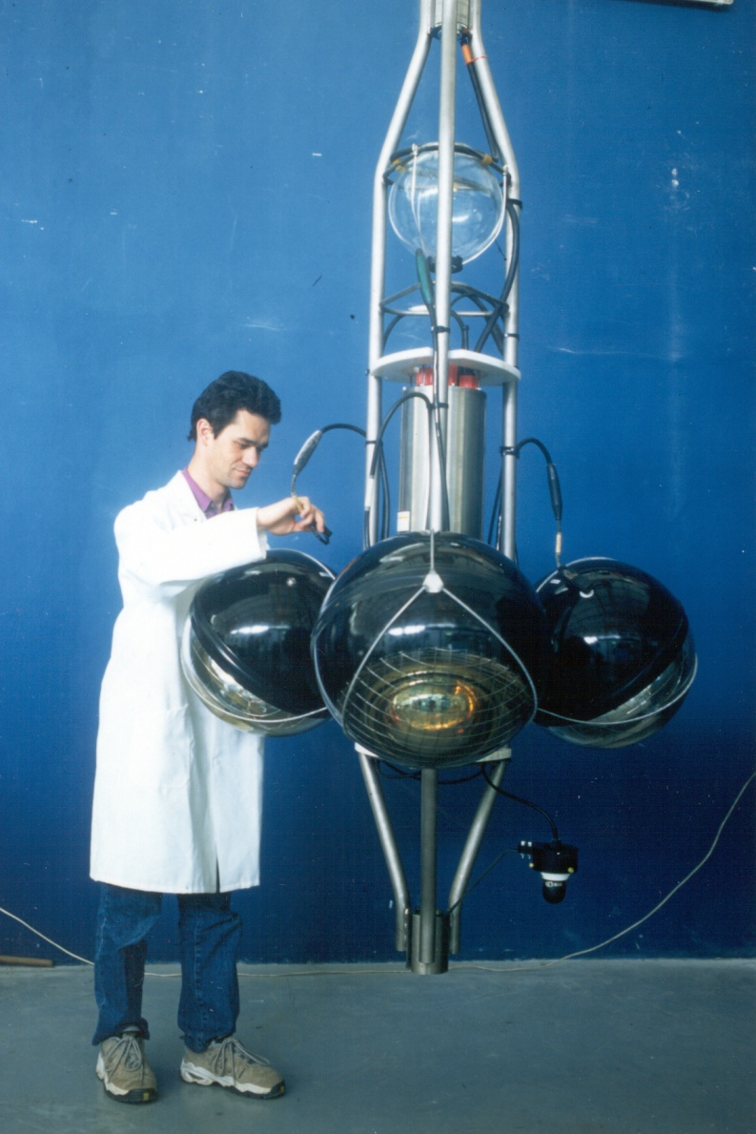
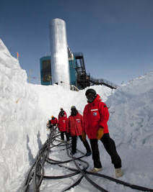
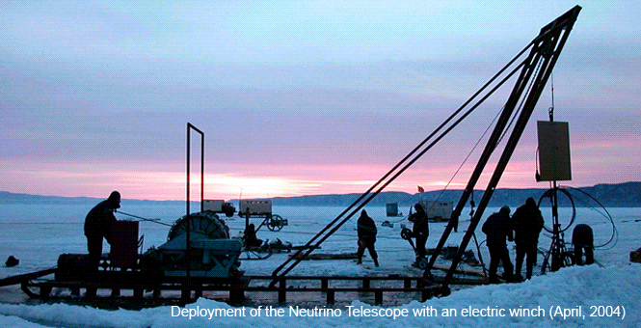
High-Energy Neutrino Detectors

Slide 22
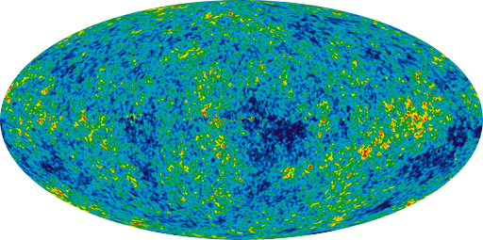
Dark Matter

Slide 23
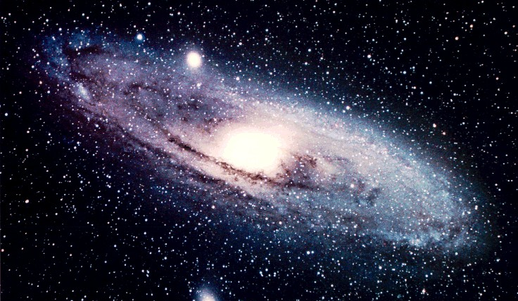
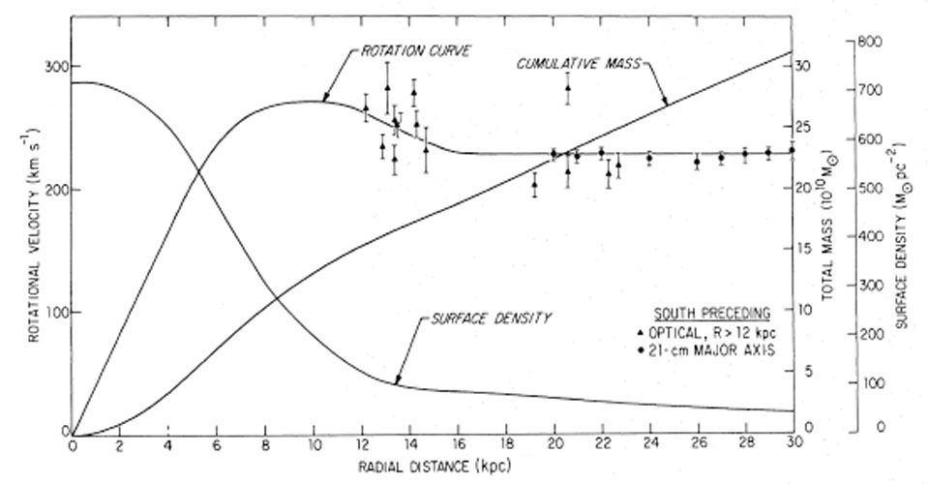
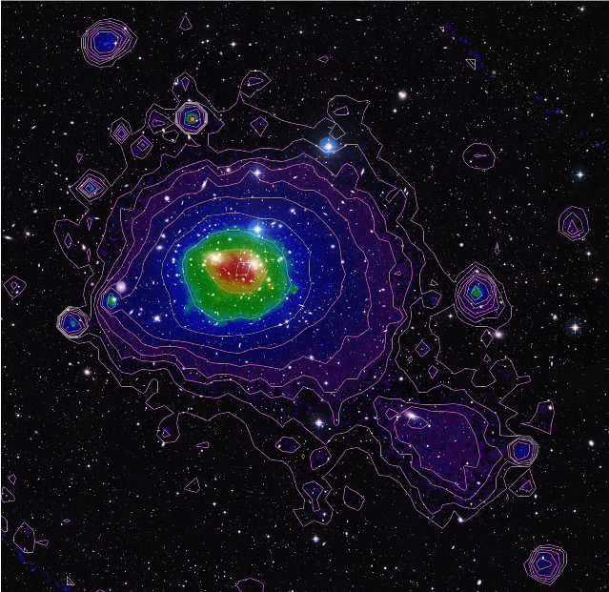
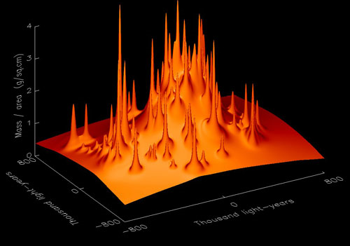
Dark Matter: The Astrophysical Evidence
Spiral galaxy rotation
too fast, too constant
Clusters of galaxies
galaxies move too fast
masses calculated from x-ray emitting gas (intracluster medium) are too high
gravitational lensing maps

Slide 24
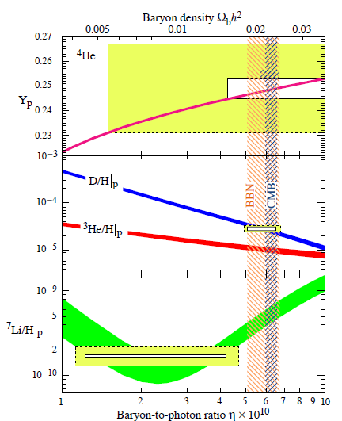
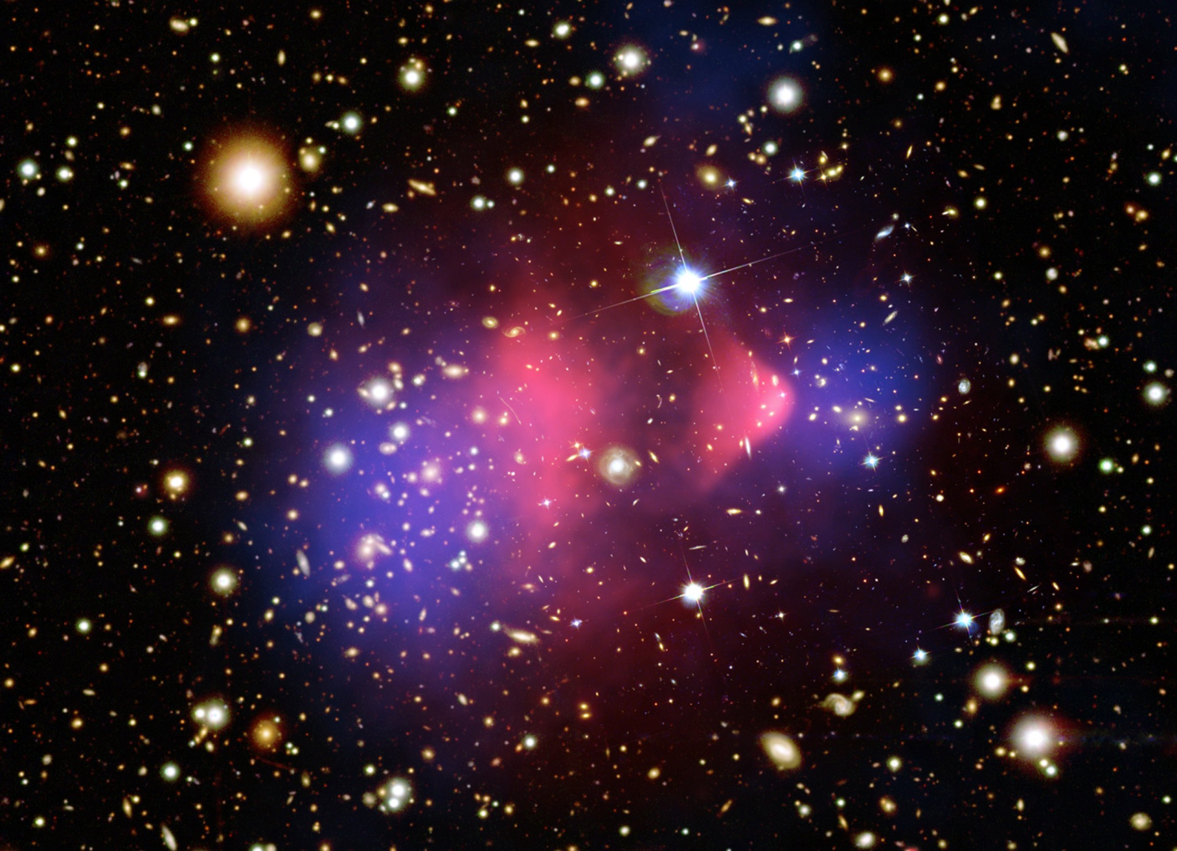
Dark Matter: The Cosmological Evidence
Abundance of ²H and ⁴He indicates that normal atomic matter accounts for about 4% of critical density
Galaxy cluster measurements require that gravitating mass amount to about 25% of critical density
Dynamics of dark matter suggest that it is weakly interacting (collisionless)

Slide 25
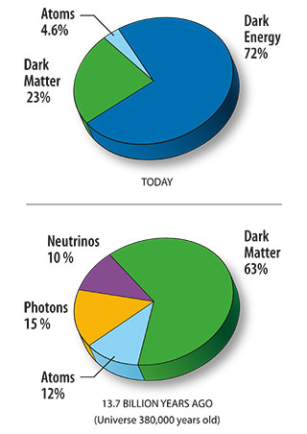
Dark Matter: The Cosmological Evidence
Cosmic microwave background and large-scale distribution of galaxies favour nonbaryonic cold dark matter
nonbaryonic—not ordinary atoms
cold—not rapidly moving when galaxies form
Therefore require a candidate which is
stable (universe is 13.7 Gyr old)
uncharged (must not interact with light)
nonrelativistic in the early universe (either relatively massive, or produced in some unusual way)
No such candidate in Standard Model particle physics

Slide 26
Dark Matter Candidates
Jonathan Feng, ARAA 48 (2010) 495
Actually quite a number of suitable candidates motivated by pre-existing theoretical problems in particle physics
this is not an “ad hoc” patch-up
Most popular candidates are WIMPs and axions

Slide 27
WIMPs and Axions
WIMPs
Axions
Weakly Interacting Massive Particles
usually assumed to result from supersymmetry
popular extension to Standard Model
discoverable at LHC
fairly massive (10s to 100s of proton masses)
detected by nuclear recoil
Result from attempts to explain why strong interaction is mirror-symmetric
extremely light (μeV to meV)
detected by resonant conversion to photon in magnetic field
not discoverable at LHC

Slide 28
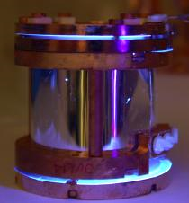
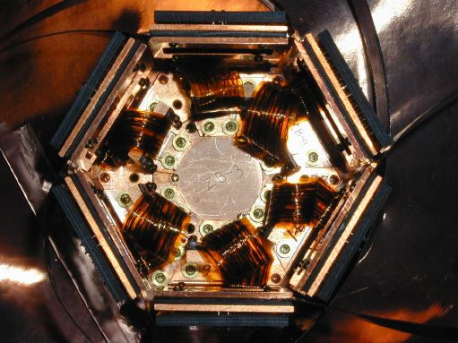
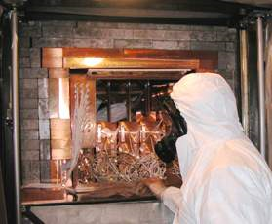
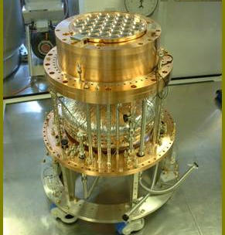
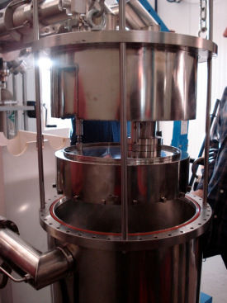
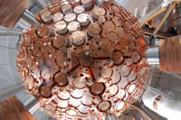
Direct Detection of WIMPS
Basic principle: WIMP scatters elastically from nucleus; experiment detects nuclear recoil
HEAT
CRESST-II
EDELWEISS
CDMS
DAMA/LIBRA
SCINTILLATION IONISATION
DRIFT
XMASS
ZEPLIN III XENON-100

Slide 29
Non-Direct Detection of WIMPs
Supersymmetric WIMPs are their own antiparticles—they can annihilate into particle-antiparticle pairs
W⁺W⁻, ZZ, tt̄, bb̄ can all decay to produce neutrinos
these neutrinos can be detected in neutrino telescopes
This will only happen if the WIMPs are very concentrated
best bet probably centre of Sun
Supersymmetric WIMPs should also be produced at LHC
not detected directly, but observed as “missing energy”
discovery of supersymmetry is a principal physics goal of LHC
Detection of WIMPs at LHC would complement direct detection experiments
basically tell them what to look for!

Slide 30
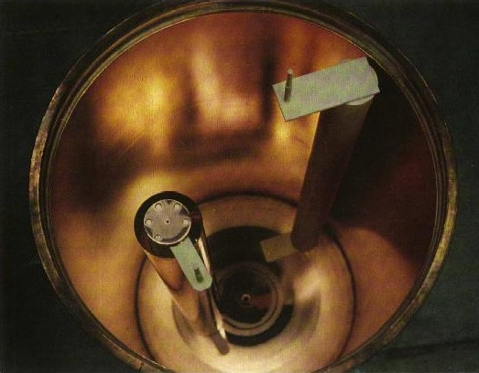
Detection of Axions
γ
a
Axions do interact with photons, albeit at an extremely low rate
detect by “resonant conversion” of axion into photon
need photons of precisely the right energy
high magnetic field in precisely tuned resonant cavity
signal is excess power in cavity
scanning experiment—very slow and tedious
ADMX experiment has been going for a decade but has only covered a small part of allowed mass range
minority pursuit—great patience required!

Slide 31
Conclusions
• Astroparticle physics is a diverse and exciting field
• potential for major discoveries, e.g. nature of dark matter, workings of central engines of quasars
• but experiments are difficult and results can be hard to interpret
• Interdisciplinary area—lots of different expertise required
• astrophysics, particle physics, nuclear physics, electronics, engineering, chemistry...
• Also very rich theoretical field (which I didn’t have time even to glance at)
• Particle physics isn’t confined to the LHC!

